Slide 1
Advanced Himawari Imager Spectral Bands

Slide 2
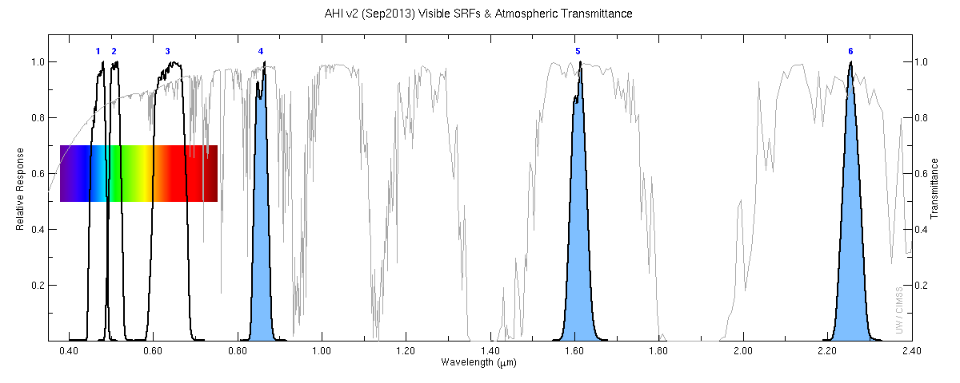
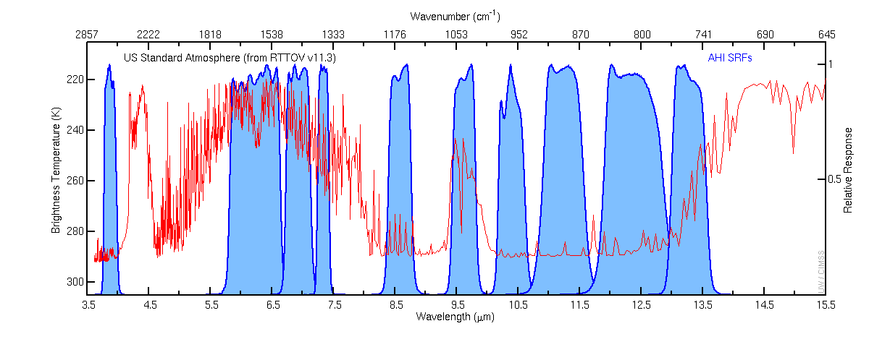
AHI

Slide 3
Advanced Baseline Imager Spectral Bands
AHI Band | AHI Approximate Central Wavelength (μm) | ABI Approximate Central Wavelength (μm) | ABI Band | Type | Nickname
1 | 0.47 | 0.47 | 1 | Visible | Blue
2 | 0.51 |  |  | Visible | Green
3 | 0.64 | 0.64 | 2 | Visible | Red
4 | 0.86 | 0.86 | 3 | Near-Infrared | Veggie
 |  | 1.4 | 4 | Near-Infrared | Cirrus
5 | 1.6 | 1.6 | 5 | Near-Infrared | Snow/Ice
6 | 2.3 | 2.2 | 6 | Near-Infrared | Cloud Particle Size
7 | 3.9 | 3.9 | 7 | Infrared | Shortwave Window
8 | 6.2 | 6.2 | 8 | Infrared | Upper-level Water Vapor
9 | 6.9 | 6.9 | 9 | Infrared | Mid-level Water Vapor
10 | 7.3 | 7.3 | 10 | Infrared | Lower-level Water Vapor
11 | 8.6 | 8.4 | 11 | Infrared | Cloud-Top Phase
12 | 9.6 | 9.6 | 12 | Infrared | Ozone
13 | 10.4 | 10.3 | 13 | Infrared | “Clean” Longwave Window
14 | 11.2 | 11.2 | 14 | Infrared | Longwave Window
15 | 12.4 | 12.3 | 15 | Infrared | “Dirty” Longwave Window
16 | 13.3 | 13.3 | 16 | Infrared | CO₂ Longwave

Slide 4
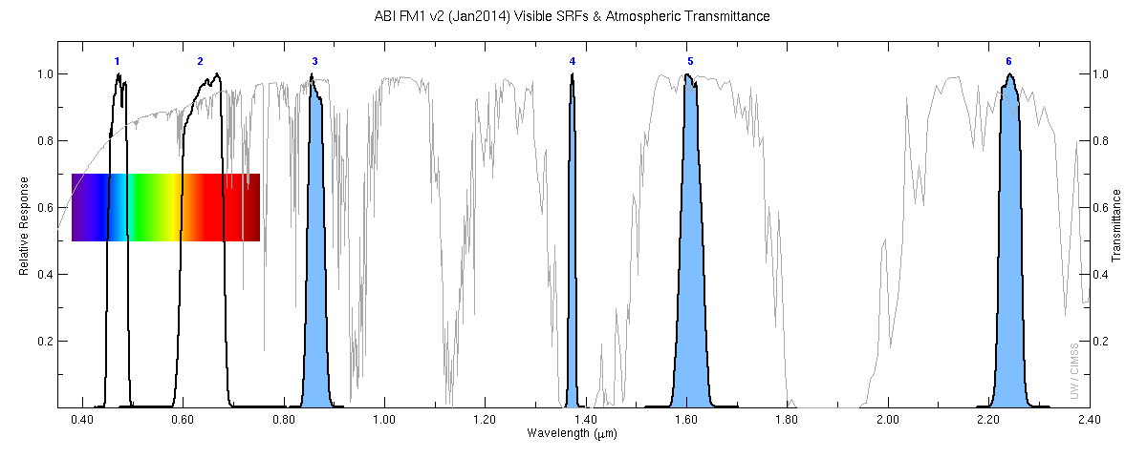
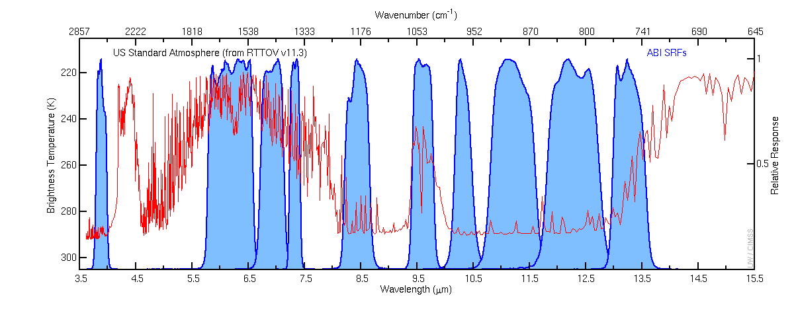
ABI

