Slide 1
a. FY12-13 GIMPAP Project Proposal Title Page Final version 28 October 2011
Title: GOES Imager Sky Cover Analysis Product
Status: New
Duration: 2 years
Project Leads:
Jordan Gerth / CIMSS / jordan.gerth@ssec.wisc.edu
Other Participants:
Jeffrey Craven / NWS Milwaukee (MKX)
Andrew Heidinger / STAR ASPB
James Nelson / CIMSS
Anthony Schreiner / CIMSS
Notes:
Schreiner, A. J., D. A. Unger, W P. Menzel, G. P. Ellrod, K. I. Strabala and J . L. Pellet, 1993: A comparison of ground
and satellite observations of cloud cover. Bull. Amer. Meteor. Soc., 74, 1851-1861.
____ , T. J. Schmit and W P. Menzel, 2001: Observations and trends of clouds based on GOES
sounder data. J. Geophys. Res.-Atmospheres, 106, 20,349-20,363.

Slide 2
b. Project Summary
The goal of this project is to increase the frequency of Cloud Mask, Effective Cloud Amount, and Cloud Top Pressure products from the current GOES, and eventually GOES-R, Imager to produce an average sky cover grid, nationwide, once per hour using multiple scans. Other methods and inputs will eventually be required to complete the grid where ECA and CTP are not valid indicators of sky cover as defined by the National Weather Service’s operational requirements.
Numerous NWS forecasters have directly requested such a product to verify an operationally required forecast sky grid because (1) purely numerical weather prediction methods do not account for radiative transparency of clouds and (2) current satellite-based techniques and algorithms, used alone or in existing analysis tools, do not match the forecasters’ interpretation of the NWS-established definition.

Slide 3
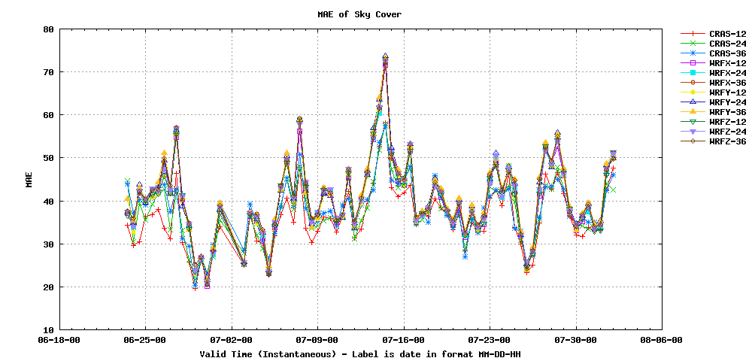
c. Motivation / Justification
Numerical weather prediction forecasts of total sky cover are exceptionally poor. Algorithms need revision and unification if intended for sky grid. Currently, no suitable formulation exists.
Notes:
CRAS — 36-hour Forecast based on NWS MKX WRF domain; Assimilates GOES Sounder water vapor and clouds on GFS background
WRFX GFS — 36-hour Forecast based on NWS MKX WRF domain; Initial conditions and boundary conditions from previous (6/18Z) GFS run
WRFY CRAS — 36-hour Forecast based on NWS MKX WRF domain; Initial conditions and boundary conditions from initial hour CRAS run
WRFZ CIGB — 36-hour Forecast based on NWS MKX WRF domain; Initial conditions from CRAS and boundary conditions from GFS run

Slide 4
c. Motivation / Justification
Sky cover composites from the National Digital Forecast Database (NDFD) lack sufficient integrity due to weak office-to-office consistency, and are relatively smooth in definition within individual forecast areas.
Since sky conditions alone are never hazardous to the general public, and NDFD text output translates a percent into categorical terms, forecasters generally place more attention on the other forecast elements (weather, precipitation, temperature, etc.).
Existing operational numerical weather prediction models do not provide a sufficient first-guess for sky cover, relying heavily on relative humidity in the lower and middle levels of the atmosphere. In addition, convective parameterizations can produce extremes in the forecast cloud field which do not accurately represent a fair weather cumulus scene.

Slide 5
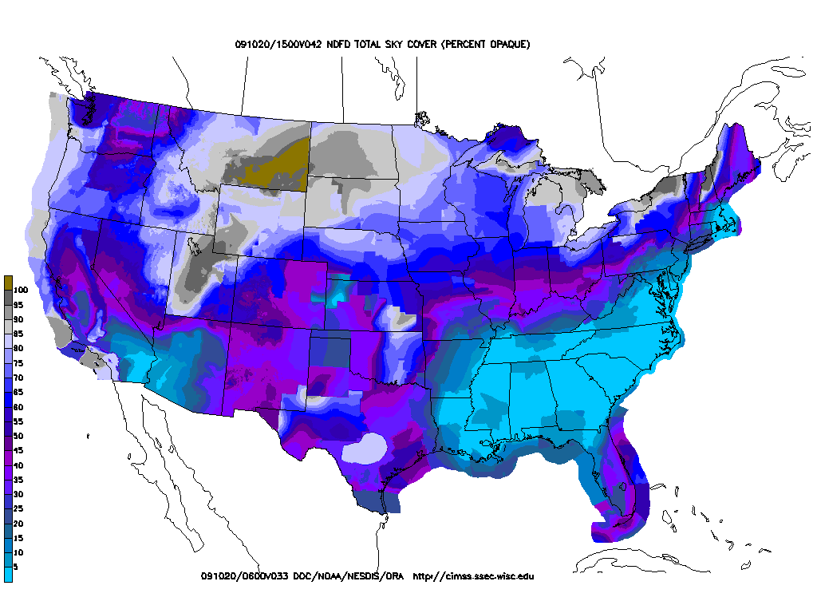
c. Motivation / Justification
Example NDFD operational output

Slide 6
c. Motivation / Justification
“[W]e continue to have a strong need for decent hourly sky cover (observations) for verification.”
Jeff Craven, Science Operations Officer NWS WFO Milwaukee/Sullivan, WI
“[T]he sky grid is one of the most difficult to produce in our NDFD database and any way of improving them would be very beneficial to our forecast staff and customers.”
Chris Collins, Senior Forecaster NWS WFO Newport/Morehead City, NC
“What is wrong with (the sky cover grid) and why is it so hard to get a good analysis? We have so many different channels on our GOES satellites yet it is a pain to create a decent looking grid. … [I]t is a grid that needs tackling and really a vision to it.”
Andy Just, Senior Forecaster (National Sky Cover Task Force Leader) NWS WFO La Crosse, WI

Slide 7
d. Methodology
The NWS/NOAA web site defines “sky cover” as “the expected amount of opaque clouds (in percent) covering the sky valid for the indicated hour.”
Requires validating analysis to account for movement of clouds over a one-hour interval. Currently, Effective Cloud Amount is only produced once hourly.
No probabilistic component.
No definition of “opaque cloud” or “cloud”.
Effective Cloud Amount is part of the solution, particularly for situations involving partially sunlight-passive clouds, such as cirrostratus.
The implication is cloud coverage of the celestial dome (all sky visible from a point observer).
Requires consideration of adjacent pixels up to 50 km from the source, weighted on the center and immediately adjacent pixels.

Slide 8
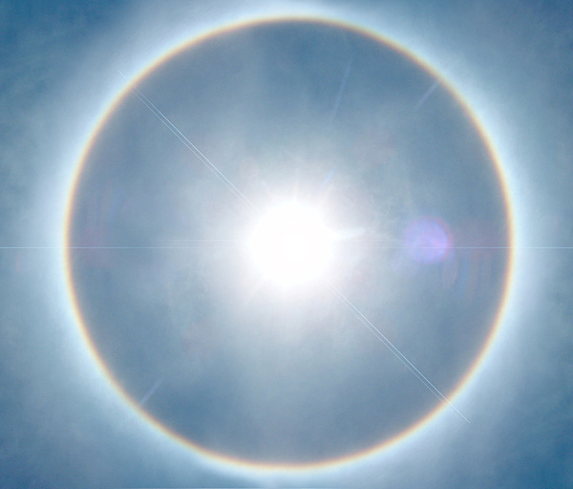
d. Methodology
Cirrostratus (Cs) covering the whole sky
http://www.srh.weather.gov/srh/jetstream/synoptic/h7.htm

Slide 9
d. Methodology
For each scan, compute the ECA and CTP from the GOES Imager. Currently, this is only produced once per hour. Depending on CTP and ABI Cloud Mask, apply the ECA directly, or a correction (very high clouds, boundary layer clouds).
(Year 2) Use simple spatial techniques for bands to discern spatial cloud distribution for sub-pixel cloudiness, as necessary. A numerical weather prediction data assimilation scheme and ad hoc methods may be required to fill gaps where sufficient cirrus clouds prevent observation of the entire cloud scene from satellite.
Build the celestial dome at each pixel, for each scan.
Average over the one-hour interval to produce the final product.
Verify against the 1-hour forecast of sky cover from the NDFD to compute cloud fraction coefficients for each cloud coverage bracket (mostly clear, clear, partly cloudy, mostly cloudy, cloudy).

Slide 10
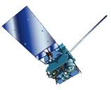
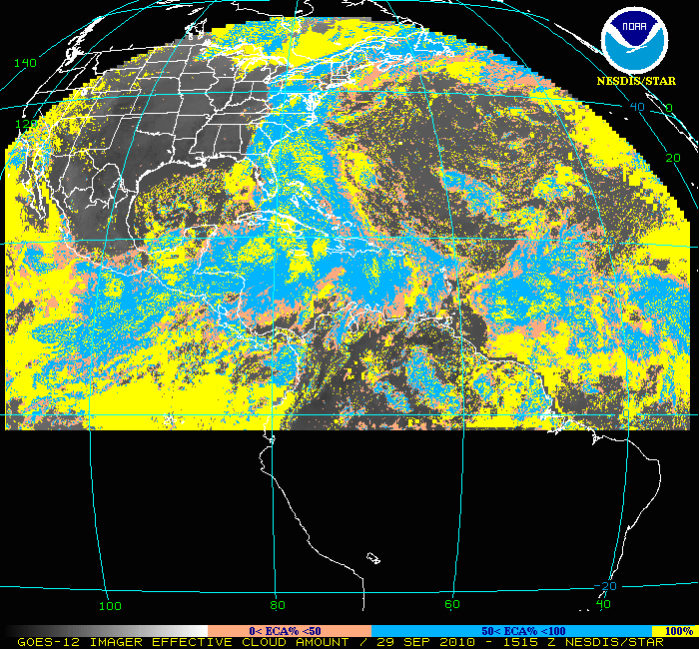
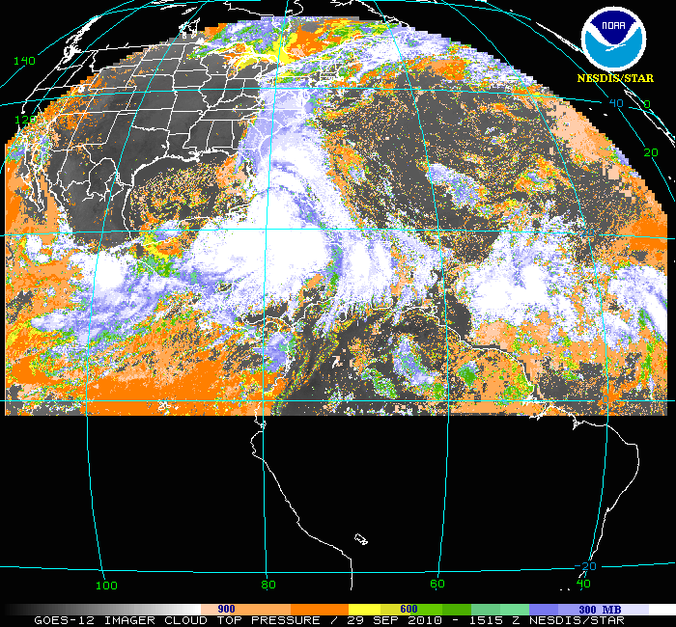
d. Methodology
For each scan within the hour,
compute
Compute
Based on adjacent
pixels
Effective Cloud Amount
for each pixel
Satellite scans by pixel; observer considers entire sky (can see high clouds at greater distance)
Celestial
Dome
GOES-R Algorithm Working Group (AWG) ECA is also produced at CIMSS with current GOES and could be used for this exercise as well.
Final
product
Average
all scans
then check
Cloud Top Pressure
and ABI Cloud Mask
Alternative techniques are required to compute cloud fraction for cloud heights lower than 700 hPa
(scattered cumulus or stratus, water cloud).
Notes:
ECA is defined as the product of the cloud amount and the emissivity or opacity of the cloud. This cloud product has been generated once per hour at the full spatial resolution of the GOES Imager, i.e. 4 km, at CIMSS for the past ten years.

Slide 11
e. Expected Outcomes
This project will, for the first time, create a scientific formulation for the sky cover grid based on the existing definitions and forecaster interpretations.
The initial product, the hour-averaged ECA, is the first step toward a better definition for the sky grid, which adds significant value to the existing GOES cloud products. To this end, the elements involved and steps necessary have been identified, and the procedure is considered low risk.
There are some situations where ECA is not a valid indicator of sky cover (e.g., a broken cumulus field; thick cirrus).
The final product will require additional input, perhaps from other observations and systems. Depending on feedback from the initial product, subsequent work will pursue identifying techniques which match the NWS requirement for the operational sky cover grid.

Slide 12
e. Possible Path to Operations
CIMSS has partnerships with dozens of NWS offices around the country, with a five-year history of making experimental satellite imagery and products available to the field in Advanced Weather Interactive Processing System (AWIPS) and Graphical Forecast Editor (GFE) readable formats to assist in operational decisions. This expertise is easily applied to this project.
Pre-operational, interim solutions for extensive field evaluation are employed by CIMSS as part of the GOES-R Proving Ground. Field input is a required component of developing a widely-accepted sky cover analysis grid, and we plan to leverage our NWS connections to assure the end product is consistent with field expectations.
The PSDI path to operations will be investigated for this project. Applying GOES-R AWG algorithms ensures a greater likelihood of a legacy for the resulting product.

Slide 13
e. Possible Path to Operations
ABI Cloud Mask in AWIPS (main pane)

Slide 14
f. Milestones
Year 1
Generate ECA and CTP for every scan from GOES-13 Imager.
Complete first-attempt final product based on aforementioned methodology.
Make available in real-time for dissemination to participating NWS offices (Milwaukee/Sullivan WFO and others as able).
Involve NWS forecasters in providing (1) subjective feedback and (2) quantitative “verification” against the NDFD.
Year 2
Generate ECA and CTP for every scan from new GOES-W Imager (GOES-15?) and make similar product.
Improve product based on feedback with other observational and numerical inputs.
Publish results.
Work under PSDI to transfer real-time product to operations.

Slide 15
g. Funding Request (K)
Funding Sources | Procurement Office | Purchase Items | FY12 | FY13
GIMPAP | StAR | Total Project Funding | $69 | $70
 | StAR | Grant to CI (CIMSS) | $66.5 | $64
 | StAR | Contracts | $0 | $0
 | StAR | Federal Travel | $0 | $3
 | StAR | Federal Publication | $0 | $0
 | StAR | Federal Equipment | $0 | $0
 | StAR | Transfers to other agencies (NWS MKX) | $2.5 | $3
Other Sources
Notes:
For the $2500 transfer to the National Weather Service Milwaukee/Sullivan (NWS MKX), the majority of the funds will go to travel.
GSA lodging and per diem for FY12 rates were used.
Annual Great Lakes Operational Meteorology Workshop, Chicago, IL March 2012
3 days travel using our GOV. Jeff Craven and Jerry Wiedenfeld would travel. $700 (hotel, M&I)
GOES R Proving Ground all hands meeting in Kansas City April 2012.
Jeff Craven would travel using GOV. 3 days $500 (hotel, M&I)
8th GUC Miami FL April 2013.
Jeff Craven would travel. 3 days $1000 (hotel, M&I, airfare)

Slide 16
g. Spending Plan FY12
FY12 $69,000 Total Project Budget
Grant to CI - $66,500
% FTE - $60,000, 50% FTE
Travel - $1,500
Equipment - $5,000
Publication charge -
Federal Travel –
Federal Publication Charges –
Federal Equipment –
Transfers to other agencies – $2,500 to NWS MKX
Other -
Notes:
Travel: Amount will cover one or two trips to a domestic conference, depending on the length of stay.
Equipment: We anticipate purchasing a new, mid-range rack-mount server to produce the components of the sky cover analysis product upon receipt of every scan, which is fundamental to the hour-averaged methodology. We currently have limited computing resources to do that. For example, we only produce ECA from the GOES Imager once per hour on our current equipment.
Transfers to other agencies: Explained previously.

Slide 17
g. Spending Plan FY13
FY13 $70,000 Total Project Budget
Grant to CI - $64,000
% FTE - $60,000, 50% FTE
Travel - $2,000
Equipment -
Publication charge - $2,000
Federal Travel – $3,000
Federal Publication Charges –
Federal Equipment –
Transfers to other agencies – $3,000 to NWS MKX
Other -

