Slide 1
VIIRS Sandwich Formulas
May 6, 2025
Dave Santek
Tommy Jasmin
Bob Carp

Slide 2
Background
The Sandwich RGB combines visible and infrared satellite imagery into one display. This RGB allows for visualizing cloud-top infrared temperatures with the texture and resolution of the underlying visible data.
The ability to create Sandwich RGB displays from VIIRS data is now available in the McIDAS-V nightly.

Slide 3
Step 1: Load Data Source
Valid data types:
Imagery EDR M/I Band
SDR M/I Band

Slide 4
Step 2: Select Formula
Individual formulas for Imagery EDR and SDRs. The SDR formula also removes bowtie deletion lines from the data.

Slide 5
Step 3: Enter IR Temperature Values
Enter the minimum and maximum IR temperature values to enhance in the final display. The SDR version of this window also includes an input field for the resolution of the data.

Slide 6
Step 4: Select the IR and VIS Data
Any IR or VIS band can be selected. IR data should be a temperature calibration and visible can be radiance or reflectance. With no subsetting in the Region tab the entire domain of the data will be displayed at the native resolution of the data for imagery EDRs and the resolution specified by the user for SDRs.

Slide 7
Results: Left=VIS; Center=IR; Right=Sandwich Severe storms over southeast on 03/15/2025

Slide 8
Results: Left=VIS; Center=IR; Right=Sandwich Severe storms over southeast on 03/15/2025

Slide 9
Results: Left=VIS; Center=IR; Right=Sandwich Severe storms over southeast on 03/15/2025

Slide 10
VIIRS Rayleigh Correction

Slide 11
Background
Several VIIRS bands (Visible and to a lesser extent Near Infrared) are impacted by Rayleigh Scattering. This scattering, caused by particles in the atmosphere, can make surface features difficult to see clearly and resultant displays are less hazy-looking.
A Rayleigh correction can be applied to many VIIRS bands (M1-M7 and I1-I2) utilizing solar and satellite angle variables contained in the data.
Many functions and formulas have been added to McIDAS-V to display Rayleigh corrected individual bands, RGBs, and indices.

Slide 12
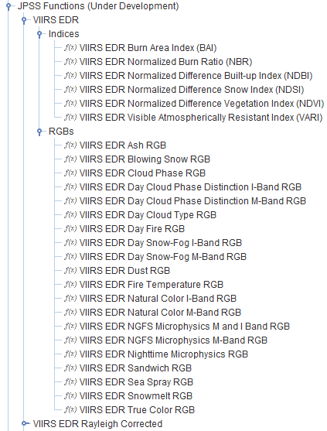
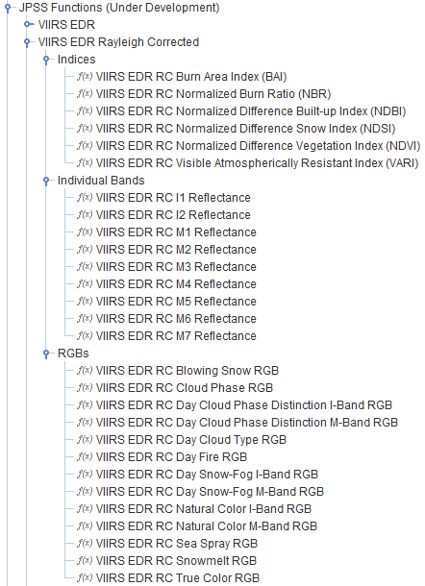
Formulas

Slide 13
True Color RGB - CONUS

Slide 14
True Color RGB - Himalayas

Slide 15
True Color RGB - Sahara

Slide 16
True Color RGB - Australia

Slide 17
True Color RGB – South America

