Slide 1
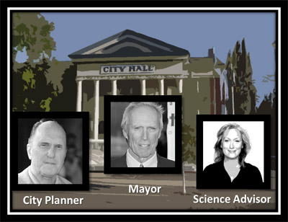
You're the new intern
You've just been hired as a part-time intern for the city of Munson, Wisconsin. You're working for Dr. Stephanie Acer, the city's science advisor. It's your first day on the job and she has an important project that draws on your meteorology background and your ability to interpret scientific data. After meeting Dr. Acer earlier this morning, she now invites you into her office to discuss the project.
Munson City Hall
Meet With Dr. Acer

Slide 2
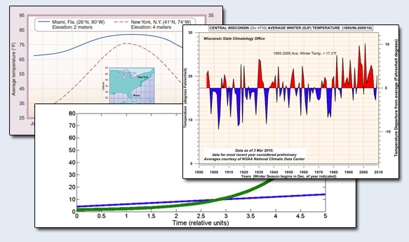
Your first challenge
Dr. Acer: I have an immediate project for you. It requires analyzing meteorological data.

Slide 3
Your first challenge
Dr. Acer: First, I need to be sure you can read scientific graphs and analyze data trends. Here's your chance to impress me.

Slide 4
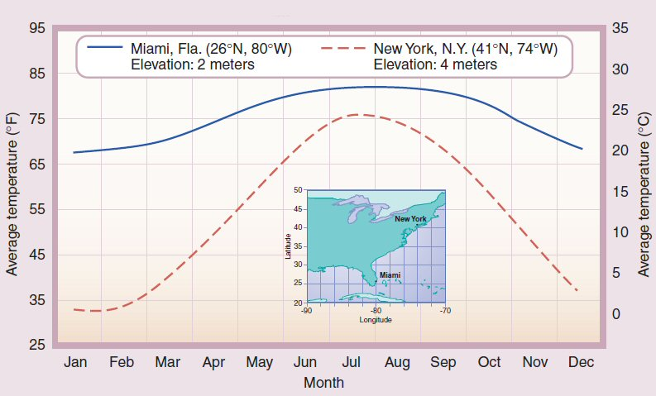
Your first challenge
Question 1:
Dr. Acer: I'll show you 3 graphs and ask a few questions.

Slide 5
Your first challenge
Question 1:
Dr. Acer: How do you answer this?
What is the approximate average July temperature of New York city?
78°F
78°C
25°C
74°F
Next Question
Notes:
78°F - No, that is the temperature of Miami in July.
78°C - No, that is a pretty warm temperature, something you might experience in a desert. The Celsius scale is on the left.
25°C - Correct, which is about 75 °F.
74°F - No, you are reading the figure wrong.

Slide 6
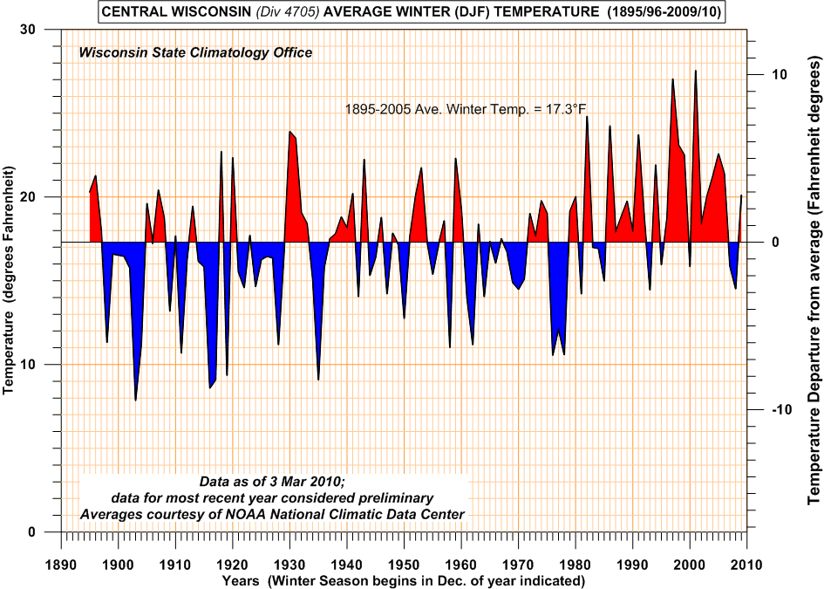
Question 2:
Dr. Acer: Okay, how about this?
This figure from the Wisconsin state climatology office is the average wintertime temperature for central Wisconsin. What can you conclude from this data about the winter time temperature of the last decade?
- It is more red than previous years.
- The temperature between 2000-2010 have been about normal.
- The temperatures between 2000-2010 are generally warmer than the previous 100 years.
Next Question
Notes:
- It is more red than previous years. ➔ Yes, but that doesn't tell me anything about the temperature.
The temperature between 2000-2010 have been about normal. ➔ What do you define as normal and how does that relate to previous years?
- The temperatures between 2000-2010 are generally warmer than the previous 100 years. ➔ Correct. The past decade has be warmer than usual. The four warmest winters have also occurred during this decade.

Slide 7
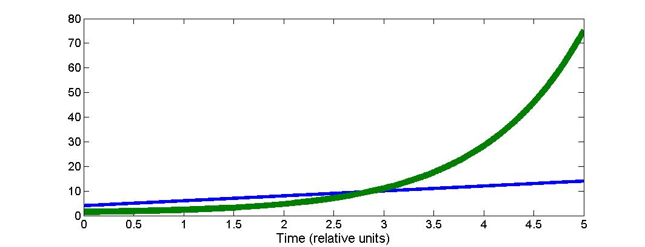
This figure plots two variables and how they relate to one another. Select all that are accurate.
The variable represented by the green line is larger than the the variable represented by the blue line.
Both variables are increasing with time.
Both variables are increasing linearly.
The green line increases exponentially with time
The differences between the green and blue line will get larger with time
The green line is increasing logrithmically
Dr. Acer: "Okay. How did you do?"
Continue
Notes:
All Correct ➔ Correct!
Some Correct ➔ Almost there, not all your answers are correct...
None Correct ➔ None of your answers are correct.

Slide 8
Design Note: Allow 2 attempts. If fail on second attempt learner is fired and remedial tutorial is recommended. Continue to next scene.
Board Room
I don't think you are ready for this job. Here's a tutorial for you to study. Until you're ready you can join the custodial team.
Try Again

Slide 9
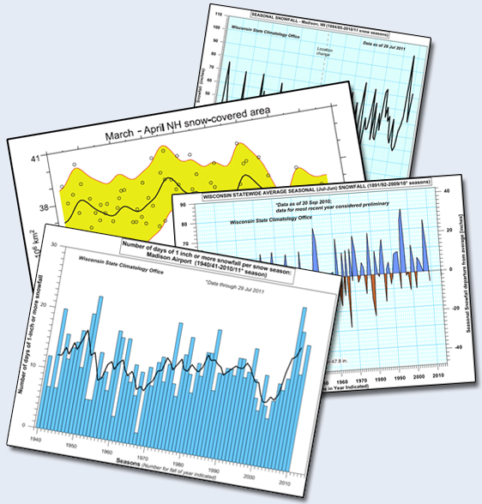
Dr. Acer: Good. Looks like you'll be able to handle the job. In 10 minutes we'll be meeting with the Mayor and the City Planner in the board room. I'll see you then.
Board Room

Slide 10
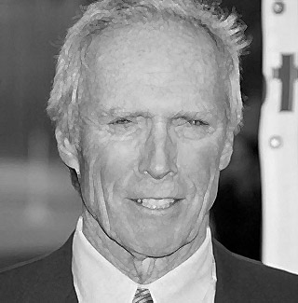
In the Board Room
Embarrassingly, you join the meeting a few minutes late. The human resources director nabbed you in the hallway to sign some new employee papers. As you enter the boardroom the mayor, the city planner and Dr. Acer are discussing budgets. The Mayor is speaking as you sit down.
Mayor: As I was saying yesterday...

Slide 11
In the Board Room
Embarrassingly, you join the meeting a few minutes late. The human resources director nabbed you in the hallway to sign some new employee papers. As you enter the boardroom the mayor, the city planner and Dr. Acer are discussing budgets. The Mayor is speaking as you sit down.
Mayor: The last item we need to finish for our strategic 10 year budget plan is snow removal costs. We need to cut costs but not at the expense of public safety.

Slide 12
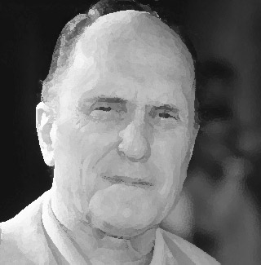
In the Board Room
Embarrassingly, you join the meeting a few minutes late. The human resources director nabbed you in the hallway to sign some new employee papers. As you enter the boardroom the mayor, the city planner and Dr. Acer are discussing budgets. The Mayor is speaking as you sit down.
City Planner: That depends on how much snow we get over the next decade. Who can predict this? Last year we got hardly any snow and the year before we got dumped on. We under budgeted for snow removal 2 years ago and overbudged last year. It seems like a crap shoot.

Slide 13
In the Board Room
Embarrassingly, you join the meeting a few minutes late. The human resources director nabbed you in the hallway to sign some new employee papers. As you enter the boardroom the mayor, the city planner and Dr. Acer are discussing budgets. The Mayor is speaking as you sit down.
Dr. Acer: I believe we have meteorological data that can help us predict trends in weather patterns for our region several decades ahead. Snow fall trends are definitely measurable.

Slide 14
In the Board Room
Embarrassingly, you join the meeting a few minutes late. The human resources director nabbed you in the hallway to sign some new employee papers. As you enter the boardroom the mayor, the city planner and Dr. Acer are discussing budgets. The Mayor is speaking as you sit down.
Mayor: Well, let's get the info as soon as possible. We need to finalize the budget plan by tomorow morning. This data might help us make better decsions.

Slide 15
In the Board Room
Embarrassingly, you join the meeting a few minutes late. The human resources director nabbed you in the hallway to sign some new employee papers. As you enter the boardroom the mayor, the city planner and Dr. Acer are discussing budgets. The Mayor is speaking as you sit down.
City Planner: Dr. Acer, do you mean you can tell us how much snow we're likely to get over the next decade?

Slide 16
In the Board Room
Embarrassingly, you join the meeting a few minutes late. The human resources director nabbed you in the hallway to sign some new employee papers. As you enter the boardroom the mayor, the city planner and Dr. Acer are discussing budgets. The Mayor is speaking as you sit down.
Dr. Acer: We can look at trends in meteorological data and our new intern here will help us analyze it to see how snow fall trends will likely play-out over time.

Slide 17
In the Board Room
Embarrassingly, you join the meeting a few minutes late. The human resources director nabbed you in the hallway to sign some new employee papers. As you enter the boardroom the mayor, the city planner and Dr. Acer are discussing budgets. The Mayor is speaking as you sit down.
Mayor: This is why we have scientists on our Mudson City staff. Budgetary decisions shouldn't be based on personal opinion and speculation. This is priority. Let me know what you find out. See you later.

Slide 18
Back in the Science Lab:
Science Lab
Dr. Acer: I have some data graphs from the climate office that I'd like you to analyze and interpret. We need to understand three things.

Slide 19
Back in the Science Lab:
Science Lab
Dr. Acer: First, what are the snow fall measurements over the last 30 years? You'll need to look at city, regional and hemispheric data to determine this. Keep in mind that snowfall measurements are difficult to make.

Slide 20
Back in the Science Lab:
Science Lab
Dr. Acer: I'll send you some data graphs along with questions to answer. I've asked my associate Dr. Helen Schmidt to corroborate your interpretations of the data before reporting back to me.

Slide 21
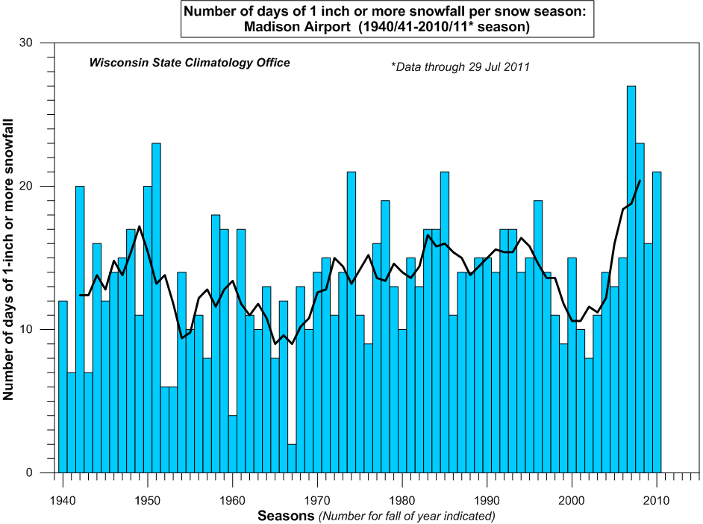
Dr. Acer's Email Message:
Here are the attached graphs. Validate your interpretations for each of them with Dr. Schmidt. When finished, report back to me.
Local City
State of WI
North Hemisphere
Other Hemishpere
< Click each graph on the left to view here.
Report to Dr. Acer

Slide 22
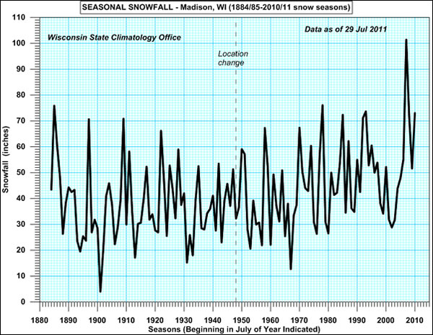
Dr. Acer's Email Message:
Local City Snowfall
Here are the attached graphs. Validate your interpretations for each of them with Dr. Schmidt. When finished, report back to me.
Local City
State of WI
North Hemisphere
Other Hemishpere
Questions: Do you see any trends in total season snow fall amount for this particular city dating back to 1880?
Do you see any trends since the observation site was moved in 1948?
What is the range of snowfall amount?
What can you say about the year to year variability in total annual snowfall?
Report to Dr. Acer
Explain to
Dr. Schmidt

Slide 23
Dr. Acer's Email Message:
Local City Snowfall
Here are the attached graphs. Validate your interpretations for each of them with Dr. Schmidt. When finished, report back to me.
Local City
State of WI
North Hemisphere
Other Hemishpere
Dr Schmidt: Okay, what did you come up with? (select all that apply)
The total snowfall remains about constant at 42 inches
The year-to-variability is very large
The range in snowfall amount is from a few of inches to over 100 inches
Total snowfall is definitely increasing in the last decade.
Total snowfall is definitely decreasing in the last decade.
The increased snowfall over the last decade is consistent with the observed colder temperatures.
Report to Dr. Acer
Explain to
Dr. Schmidt
Notes:
All Right ➔ I agree with your interpretation. Although there are some fluxuations the trend is definitely downward. - The year-to-year variablility is very large particularly for the decade 2001-2010. - The maximum snowfall amount occured in the 2007-2008 winter, and the minimum amount in the early 20th century, both of which surround snowfall measurements ranging from
Some Right ➔ I disagree with your interpretation. You may have overlooked: - The year-to-year variability between the decade 2001-2010 - The maximum snowfall amount occured in the 2007-2008 winter, and the minimum amount in the early 20th century. - The Fact that we have not yet analyzed temperature data for the city, or state, so we cannot conclude anything about the relationship between temperature and snowfall amount.
None Right ➔ How did you get this job? If you can't see the trends here I dont think you are experienced enough for this job. Let's go talk to Dr. Acer to see if we can get you assigned to another project.

Slide 24
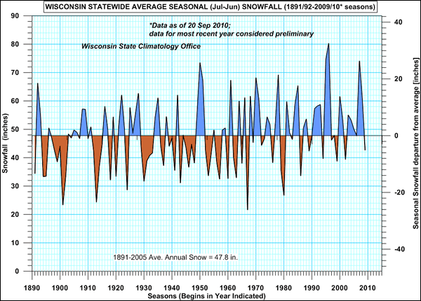
Dr. Acer's Email Message:
Local City Snowfall
Here are the attached graphs. Validate your interpretations for each of them with Dr. Schmidt. When finished, report back to me.
Local City
State of WI
North Hemisphere
Other Hemishpere
Questions: Do you observe any trends in total season snow fall amount for the state?
What is the range of snowfall amount?
What can you say about the year to year variability in total annual snowfall?
Report to Dr. Acer
Explain to
Dr. Schmidt

Slide 25
Dr. Acer's Email Message:
Local City Snowfall
Here are the attached graphs. Validate your interpretations for each of them with Dr. Schmidt. When finished, report back to me.
Local City
State of WI
North Hemisphere
Other Hemishpere
Dr Schmidt: Okay, what did you come up with? (select all that apply) Need some answers here
The range of snowfall over the last decade is less than 40 inches to more than 70 inches.
Since 1990, there have been fewer years where the snowfall amount has been above the long term mean.
In 1967-68 season the state wide snowfall amount was less than 20 inches.
The anonymously low snow fall amounts all occurred before 1990.
Report to Dr. Acer
Explain to
Dr. Schmidt
Notes:
All Right ➔ Right. I agree with your interpretation. - The range of snowfall over the last decade is less than 40 inches to more than 70 inches. - The anonymously low snow fall amounts all occurred before 1990.
Some Right ➔ Not exactly.... You maybe overlooked: - The color blue, and the scale on the right of the figure indicate that since 1990 there have been more years of above normal snowfall than below normal snowfall? - The left hand scale tells that in 1967-1968 the statewide snowfall was about 22 inches, and the righthand scale tells us this was about 26 inches below normal. - The top 10 years with least snowfall have all occurred before 1990.
None Right ➔ No way! If you can't see the trends here I dont think you are experienced enough for this job. Let's go talk to Dr. Acer to see if we can give you some remedial training.

Slide 26
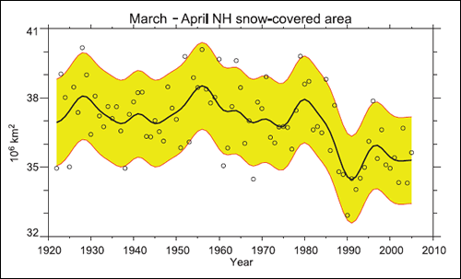
Dr. Acer's Email Message:
Local City Snowfall
Here are the attached graphs. Validate your interpretations for each of them with Dr. Schmidt. When finished, report back to me.
Local City
State of WI
North Hemisphere
Other Hemishpere
Questions: Do you observe any trends in total season snow fall amount for the state?
What can you say about the year to year variability in total annual snowfall?
Report to Dr. Acer
Explain to
Dr. Schmidt

Slide 27
Dr. Acer's Email Message:
Local City Snowfall
Here are the attached graphs. Validate your interpretations for each of them with Dr. Schmidt. When finished, report back to me.
Local City
State of WI
North Hemisphere
Other Hemishpere
Dr Schmidt: Okay, what did you come up with? (select all that apply)
Prior to 1970, the average area of the Northern Hemisphere covered by snow was consistent.
Since 1990, the total area of the Northern Hemisphere covered by snow has decreased.
The depth of snowfall was a minimum in 1990
Report to Dr. Acer
Explain to
Dr. Schmidt
Notes:
All Right ➔ Right! I agree with your interpretation. - While there is a large year-to-year variability, the average area coverage of snowfall prior to 1970 was about 37.5x10^6 square kilometers - The 15 year average between 1990-2005 is lower than previous years.
Some Right ➔ Not Exactly. Maybe you overlooked: - That while there is a large year-to-year variability, the average area coverage of snowfall prior to 1970 was about 37.5x10^6 square kilometers - That while there is a large year-to-year variability, the 15 year average between 1990-2005 is lower than previous years. - That this figure provides information on the area covered by snow, there is no information about the amount of snowfall that fell.
None Right ➔ No way! If you can't see the trends here I dont think you are experienced enough for this job. Let's go talk to Dr. Acer to see if we can get you some remedial training.

Slide 28
Dr. Acer's Email Message:
Local City Snowfall
Here are the attached graphs. Validate your interpretations for each of them with Dr. Schmidt. When finished, report back to me.
Local City
State of WI
North Hemisphere
Other Hemishpere
Questions: Do you observe any trends in the number of days with snowfall greater than 1 inches?
What can you say about the year to year variability?
Why would you be interested in the number of days withsnowfall greater than 1 inches (as compared to the number of days with snowfall greater than ¼ inch)?
Report to Dr. Acer
Explain to
Dr. Schmidt

Slide 29
Dr. Acer's Email Message:
Local City Snowfall
Here are the attached graphs. Validate your interpretations for each of them with Dr. Schmidt. When finished, report back to me.
Local City
State of WI
North Hemisphere
Other Hemishpere
Dr Schmidt: Okay, what did you come up with? (select all that apply)
The number of days with snowfall greater than 1 inches is increasing.
We have not had a year where there was a storm with more than 1 inches of snow fall.
Snowfall for the period 1975-1990 remained relatively constant.
Report to Dr. Acer
Explain to
Dr. Schmidt
Notes:
All Right ➔ Right. I agree with your interpretation. - We have not had a year where there was a storm whth more than 1 inches of snow fall, though in 1967 there were only 2 days when the snowfall was greater than 1 inch.
Some Right ➔ Not Exactly, Have you overlooked: - The number of days since 2000 does show an increasing trend, the year-to-year variation makes it difficult to make a strong conclusion like this, we need a few more years to see if the trend is a real one. - This figure provides information on the number of days when the snowfall amount was greater than 1 inch, it does not provide information on the total amount of snow. That was from another figure. - In 1967 there were only 2 days when the snowfall was greater than 1 inch.
None Right ➔ No way! If you can't see the trends here I dont think you are experienced enough for this job. Let's go talk to Dr. Acer to see if we can get you some remedial training.

Slide 30
Debrief with Dr. Acer
Design note:
Remedial links to be provided here:
Dr. Acer: "You did not do so well analyzing those graphs... Are you sure you are ready for this job? You need to study more. For now review this material."
Temporary Continue

Slide 31
Debrief with Dr. Acer
Dr. Acer: Good job interpreting the graphs! Dr. Schmidt is impressed with your ability to analyze data.
Continue

Slide 32
Debrief with Dr. Acer
Dr. Acer: As I expected, we can see that there are definitely some trends toward snowfall level reduction. I'll summarize them on the whiteboard.
Continue

Slide 33
Debrief with Dr. Acer
Dr. Acer: I'll set up a meeting with the Mayor so we can report these findings.
Meet with Mayor

Slide 34
Back In the Board Room
The Mayor convenes a meeting. Dr Acer. summarizes the data for the mayor and city planner.
Dr. Acer: "Mr. Mayor, our analysis of snowfall for the city and the state indicate that the year-to-year changes in snowfall amounts make it difficult to make a 10-year projection. In the last 10 years we have had mostly above normal snowfalls, including a record breaking snowfall."

Slide 35
Back In the Board Room
The Mayor convenes a meeting. Dr Acer. summarizes the data for the mayor and city planner.
Dr. Acer: " Based on the data we have analyzed, I don't think you can count on there being less snowfall in the coming years."

Slide 36
Back In the Board Room
The Mayor convenes a meeting. Dr Acer. summarizes the data for the mayor and city planner.
Mayor: "Do you know if the snowfall comes in one or two events or is the snow distributed over the entire season? That could make a difference in my political career. City residents can handle ¼ inches of snowfall, but 4 inches in one storm is a different matter."

Slide 37
Back In the Board Room
The Mayor convenes a meeting. Dr Acer. summarizes the data for the mayor and city planner.
Dr. Acer: "We have analyzed the number of days at least 1 inch of snowfall occurs during the season; and again, we see a lot of variability. But, if anything, the last 10 years indicates an increasing trend in the occurrence of 1 inch snowfall."

Slide 38
Back In the Board Room
The Mayor convenes a meeting. Dr Acer. summarizes the data for the mayor and city planner.
Mayor: "Well, political history has told me that if the major can't remove snowfall quickly enough, he or she will have a hard time being re-elected. So perhaps we should continue to budget for average snowfall amount."

Slide 39
Back In the Board Room
The Mayor convenes a meeting. Dr Acer. summarizes the data for the mayor and city planner.
Mayor: "I've promised this city my legacy will have a positive impact on our future environment. Since you can see these trends, let's broaden our horizon to 50 years!"

Slide 40
Back In the Board Room
The Mayor convenes a meeting. Dr Acer. summarizes the data for the mayor and city planner.
City Planner: "With all due respect Mr. Mayor, do we really need to look that far head? It seems that we may be getting more rain than snow in the next few years. That should be an immediate concern to us?"

Slide 41
Back In the Board Room
The Mayor convenes a meeting. Dr Acer. summarizes the data for the mayor and city planner.
Mayor: "That's a good point. It seems that the trend might be more snow and shorter winters. This could not only effect snow removal but the potential for flooding as well."

Slide 42
Back In the Board Room
The Mayor convenes a meeting. Dr Acer. summarizes the data for the mayor and city planner.
City Planner: "What will be the impact on other city services? If we get more precipitation then there will be a bigger load on our sewage systems, whicih are already in need of upgrades."

Slide 43
Back In the Board Room
The Mayor convenes a meeting. Dr Acer. summarizes the data for the mayor and city planner.
Mayor: "Yes, that's right. Looking 10 to 50 years out the impact of these temperature and climate shifts on our city services and economy could spell a crisis."

Slide 44
Back In the Board Room
The Mayor convenes a meeting. Dr Acer. summarizes the data for the mayor and city planner.
City Planner: "But I'm also wondering what's happening to our winters and the frequency of major snow storms. We need to be prepared for these too."

Slide 45
Back In the Board Room
The Mayor convenes a meeting. Dr Acer. summarizes the data for the mayor and city planner.
Dr. Acer: "Mr Mayor, there is a group of scientists studyng future trends in snowfall across the state, we could analyze their projects for you."

Slide 46
Back In the Board Room
The Mayor convenes a meeting. Dr Acer. summarizes the data for the mayor and city planner.
Mayor: "Yes, please do that. In planning for the next 50 years I'd be interested in how much snowfall occurs but also if the winter season is getting longer or shorter. This could impact how fast the snow melts and our sewage and potential for spring time flooding. Do we expect rainfall to increase in the next 50 years?"

Slide 47
Back In the Board Room
The Mayor convenes a meeting. Dr Acer. summarizes the data for the mayor and city planner.
Dr. Acer: "We'll get started on this analysis right away and get back to you later this afternoon."

Slide 48
To be continued
Stop
Back
Notes:
Use this section for more details about page

