Slide 1


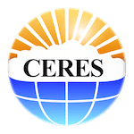
E. Eva Borbas, Elisabeth Weisz, W. Paul Menzel, Chris Moeller,
Geoff Cureton*, Greg Quinn*, and Bryan Baum**
Space Science and Engineering Center, University of Wisconsin-Madison
*NASA Atmosphere-SIPS
**Retired
The Version 2 VIIRS+CrIS Fusion Radiance
products
MODIS/VIIRS STM, May 2-4, 2023

Slide 2
Goal
The VIIRS+CrIS Fusion Radiance (FSNRAD) products have been created to provide a path for continuity of products based on the Terra, Aqua, SNPP, and NOAA-20 platforms.
Why is this work important? MODIS has three channels sensitive to CO₂ in the 4.5 µm CO₂ band, four channels in the broad 15 µm CO₂ band, 2 channels sensitive to H₂O near 6.7 µm, and an ozone channel near 9 µm. VIIRS has none of these IR absorption bands. The lack of the CO₂ and H₂O channels results in a degradation of the accuracy of the cloud mask especially at night in high latitudes, other cloud products (cloud top pressure/height and thermodynamic phase) and the moisture products (total precipitable water vapor, upper tropospheric humidity).
We addressed this restriction by constructing similar Aqua MODIS IR band radiances for VIIRS based on a fusion method that uses collocated VIIRS and CrIS data.

Slide 3
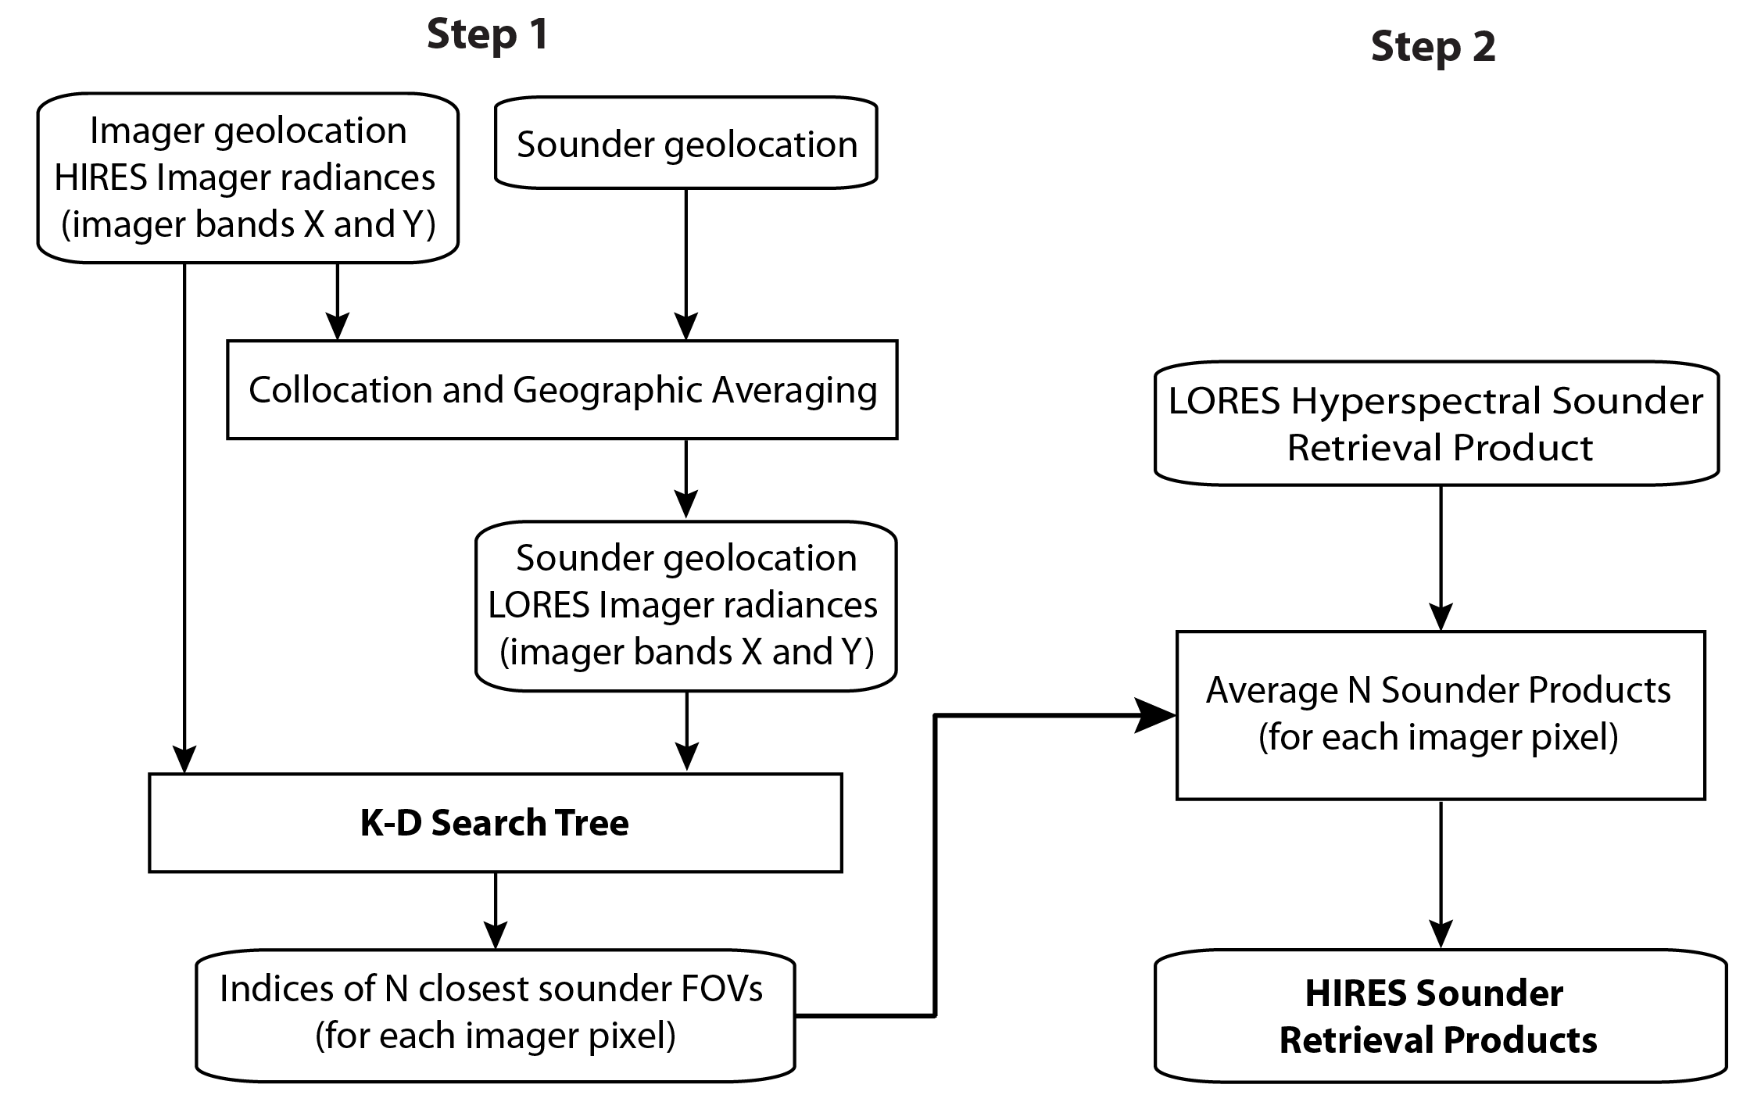
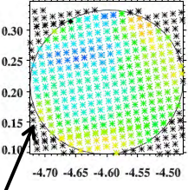
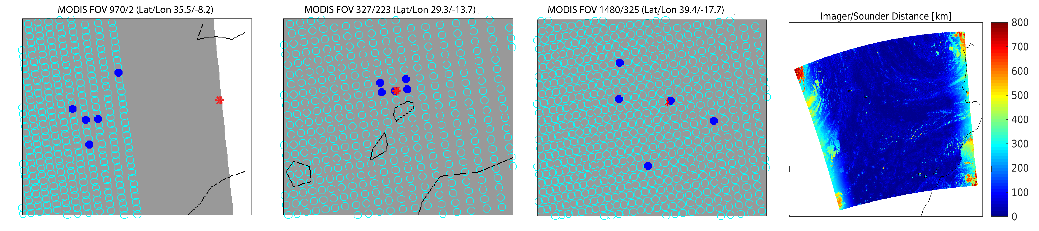
Imager+Sounder Spatial Fusion Schematics
Radiance Fusion
LORES Sounder Radiance
Convolved to Band Z
Average N Sounder FOVs
(for each imager pixel)
(Bentley, 1975)
N=5
HIRES Fusion Radiance
At Imager Band Z
LORES/HIRES … low/high spatial resolution
(Cross et al. 2013, Weisz et al. 2017)

Slide 4
Imager+Sounder Radiance Fusion Example
Convolved CrIS Rad
VIIRS/CrIS Fusion Rad
MODIS Rad
Imager+sounder radiance fusion applied to VIIRS+CrIS to construct missing VIIRS CO₂ and H₂O absorption bands (i.e., MODIS-like bands).
Can be applied to various instrument pairs (e.g., AVHRR+IASI, AVHRR+HIRS, VIIRS+TROPOMI, ABI+CrIS)
Band 25
4.52 𝜇m
Band 27
6.72 𝜇m
Band 35
13.94 𝜇m
(Weisz et al. 2017)

Slide 5
VIIRS+CrIS FSNRAD Product (on full VIIRS spatial resolution)
MODIS Infrared bands |  | VIIRS+CrIS Fusion Infrared bands |  | Primary Use
band | Central Wavelength [µm] | band | Central Wavelength [µm]
23 | 4.05 | M13 | 4.05 | Atmospheric temperature
24 | 4.47 | M24 Fusion | 4.47 | Atmospheric temperature
25 | 4.52 | M25 Fusion | 4.52 | Atmospheric temperature
27 | 6.72 | M27 Fusion* | 6.72 | Water vapor
28 | 7.33 | M28 Fusion | 7.33 | Water vapor
29 | 8.55 | M14 | 8.55 | Surface and cloud properties
30 | 9.73 | M30 Fusion | 9.73 | Ozone
31 | 11.03 | M15 M15 Fusion** | 10.76 | Surface and cloud properties
32 | 12.02 | M16 M16 Fusion** | 12.01 | Surface and cloud properties
33 | 13.34 | M33 Fusion* | 13.34 | Cloud properties
34 | 13.64 | M34 Fusion* | 13.64 | Cloud properties
35 | 13.94 | M35 Fusion* | 13.94 | Cloud properties
36 | 14.23 | M36 Fusion* | 14.23 | Cloud properties
*FSNRAD_SS subset for the CERES team
**BT diff for M15 and M16 are also provided for uncertainty estimate

Slide 6
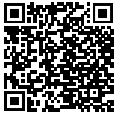
Status of the VIIRS+CrIS FSNRAD products
V1 released at NASA LAADS DAAC: Fall 2019
V2 released at NASA LAADS DAAC: March 8, 2022
    DOI: 10.5067/VIIRS/FSNRAD_L2_VIIRS_CRIS_SNPP.002
Subsetter products are available at A-SIPS:
    https://sips.ssec.wisc.edu/#/products/availability;id=14372
Note for SNPP: CrIS anomaly in LW data
  May 21 –July 12, 2021: fill value for Band 30-36 (anomaly of CrIS LW channels)
  July 14, 2021 - fill value for Band 27, 28, B30-36 restored (Side 1 -> Side 2)
Product Name | Description | Available at
FSNRAD_L2_VIIRS_CRIS_SNPP | S-NPP/VIIRS Fusion Radiances | LAADS DAAC
FSNRAD_L2_VIIRS_CRIS_NOAA20 | NOAA20/VIIRS Fusion Radiances | LAADS DAAC
FSNRAD_L2_VIIRS_CRIS_SS_SNPP | S-NPP/VIIRS Subsetted Fusion Radiances | Atmosphere-SIPS
FSNRAD_L2_VIIRS_CRIS_SS_NOAA20 | NOAA20/VIIRS Subsetted Fusion Radiances | Atmosphere-SIPS

Slide 7
V2 update: Decreasing surface effect in WV bands
V1
V2

Slide 8
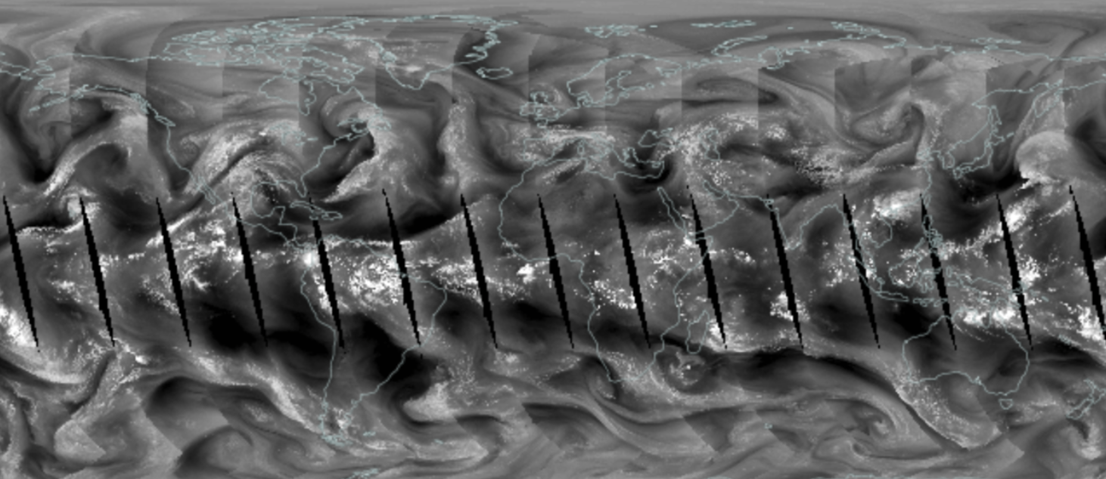

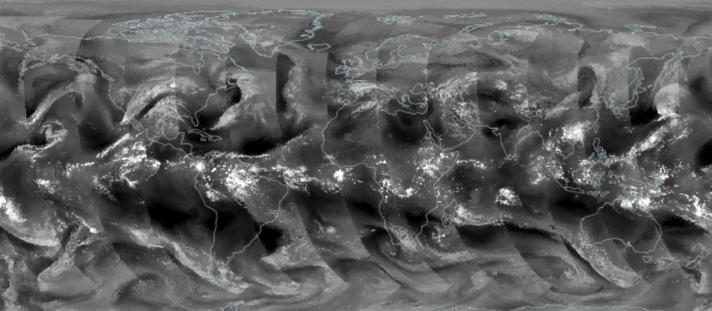
Aqua/MODIS B27
April 26, 2021
N20/FUS V1 B27

Slide 9
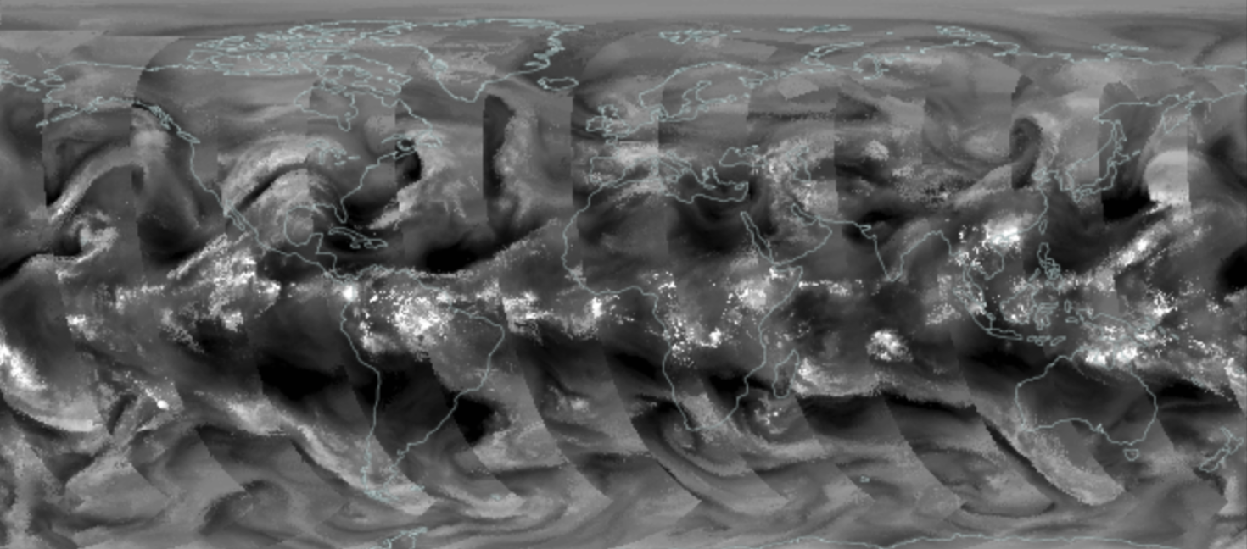
Aqua/MODIS B27
April 26, 2021
N20/FUS V2 B27

Slide 10
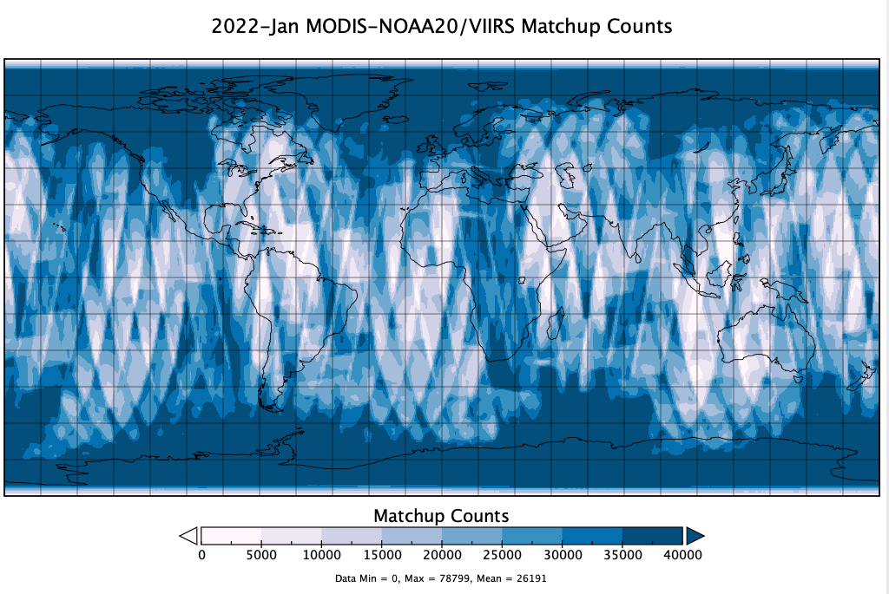
Assessment of Product Quality
SNPP and NOAA20 fusion radiance products are compared directly with Aqua/MODIS measured radiances operationally.

Slide 11
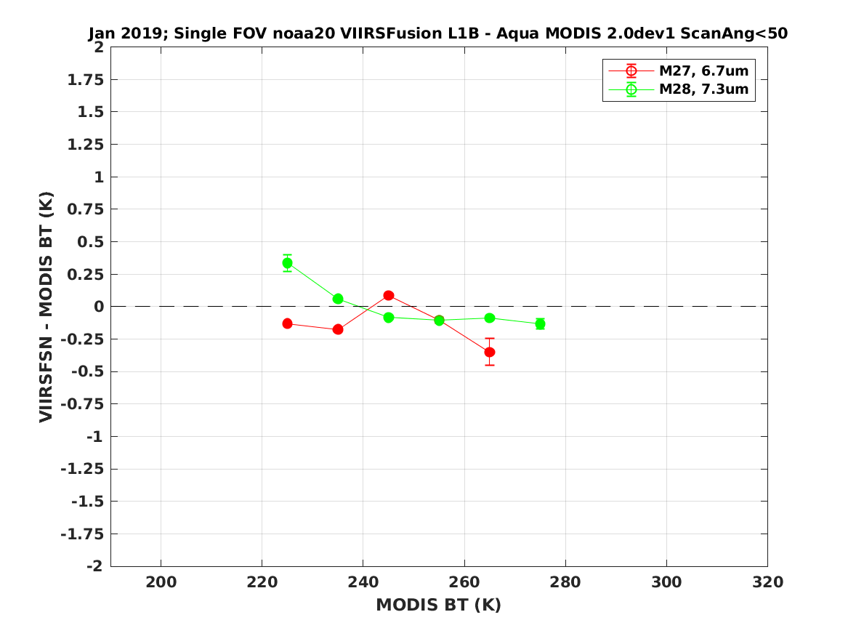
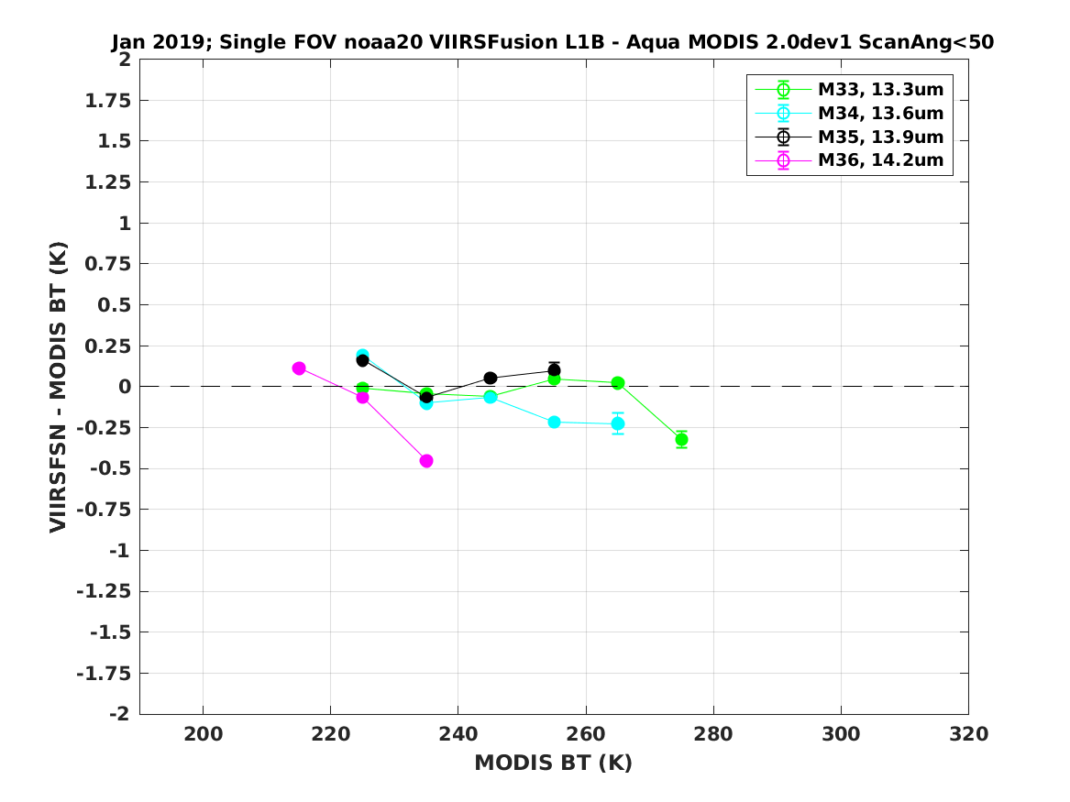
Assessment of Product Quality
January 2019
SNPP and NOAA20 fusion radiance products are compared directly with Aqua/MODIS measured radiances operationally.
January 2019

Slide 12
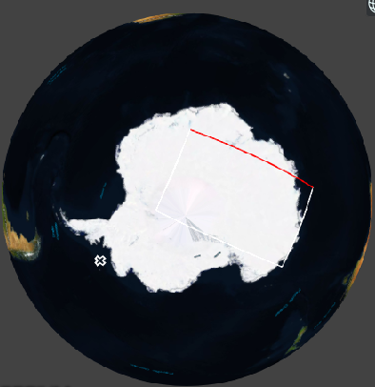
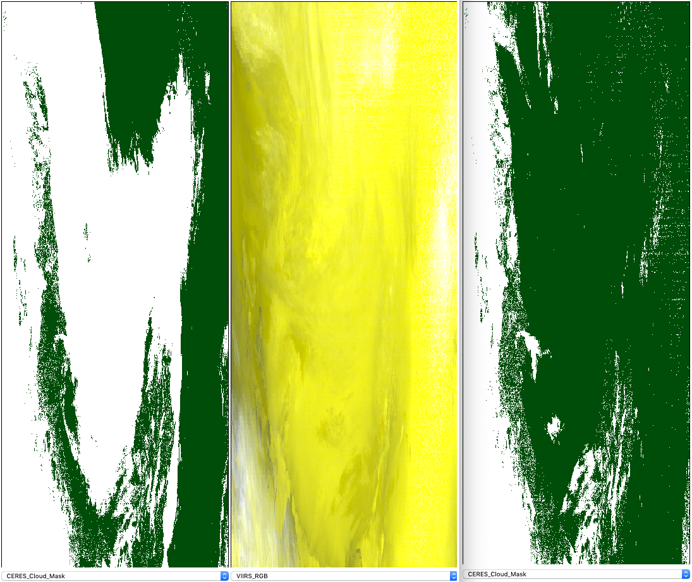
Application for the CERES team
Operational use in CERES-NOAA20 Ed1B Production
helps to pick up clouds over snow-ice covered surfaces at nighttime
consistency between CERES-Aqua Ed4 and CERES-NOAA20 Ed1B is improved
FSNRAD B27 &B33 are used in narrow-band to broad-band calculation for CERES-N20 production processing
Cloud Mask
VIIRS + FSNRAD
Nighttime RGB
Cloud Mask
VIIRS Alone
NPP 2019 07 15 09UTC

Slide 13
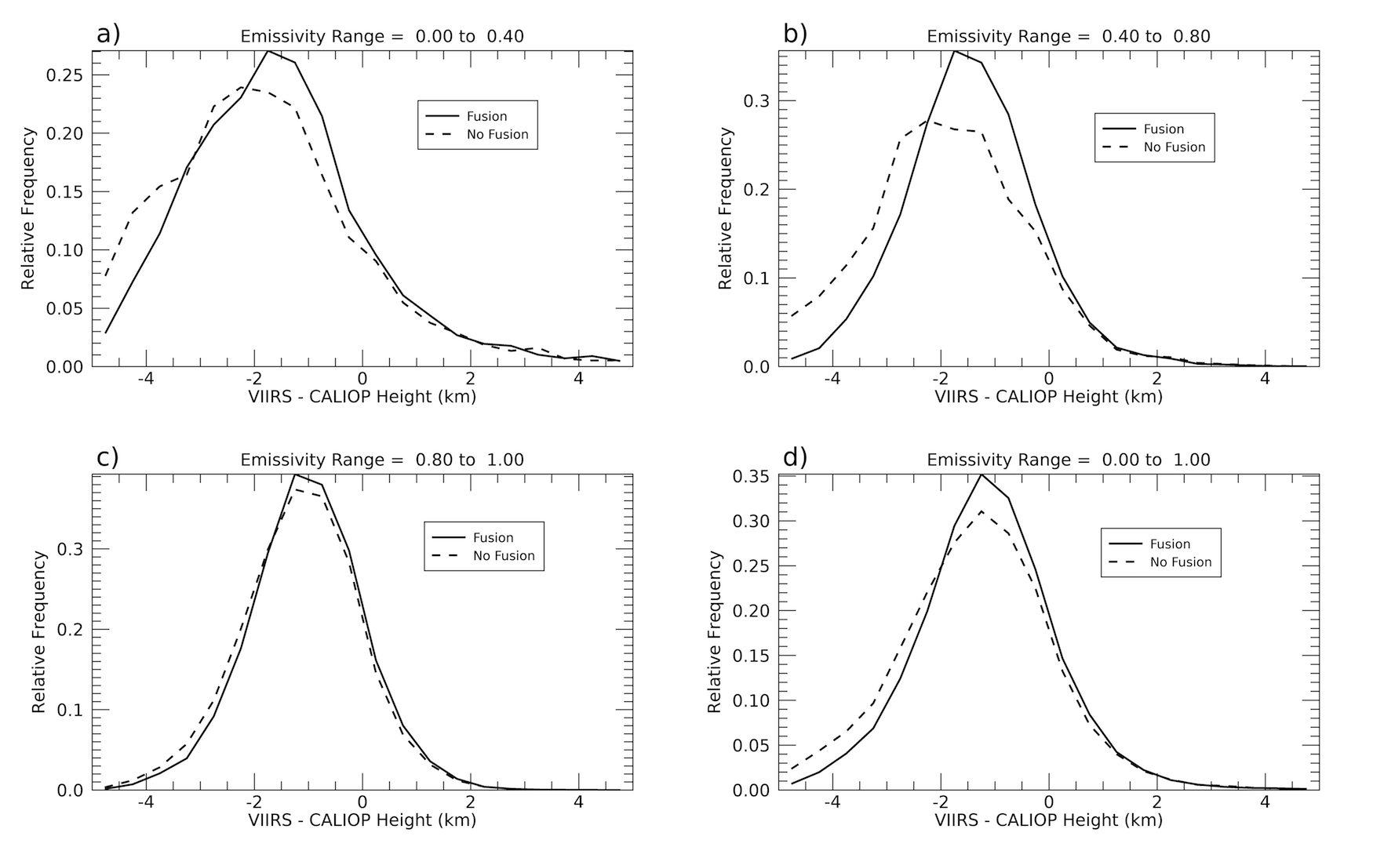
Cloud Application
(Li et al. 2020) used the 6.7 and 13.3 𝞵m CrIS+VIIRS fusion bands in CLAVR-X, the NOAA operational cloud processing package. They demonstrated that the fusion radiancies improved cloud parameters, like cloud mask (polar regions), type/phase, and cloud height for all latitudes.
Bias distribution of cloud top height of ice phase clouds between S-NPP VIIRS and CALIPSO/CALIOP for emissivity range a) 0 to 0.4; b) 0.4 to 0.8; c) 0.8 to 1.0; and d) 0 to 1.0. Solid and dashed lines indicate data with/without fusion channels.
Significant improvement is found for all ice cloud emissivities but especially for semi-transparent ice clouds, when the spectral information is used what the FUSION products provide.
(Li et al., 2020)

Slide 14
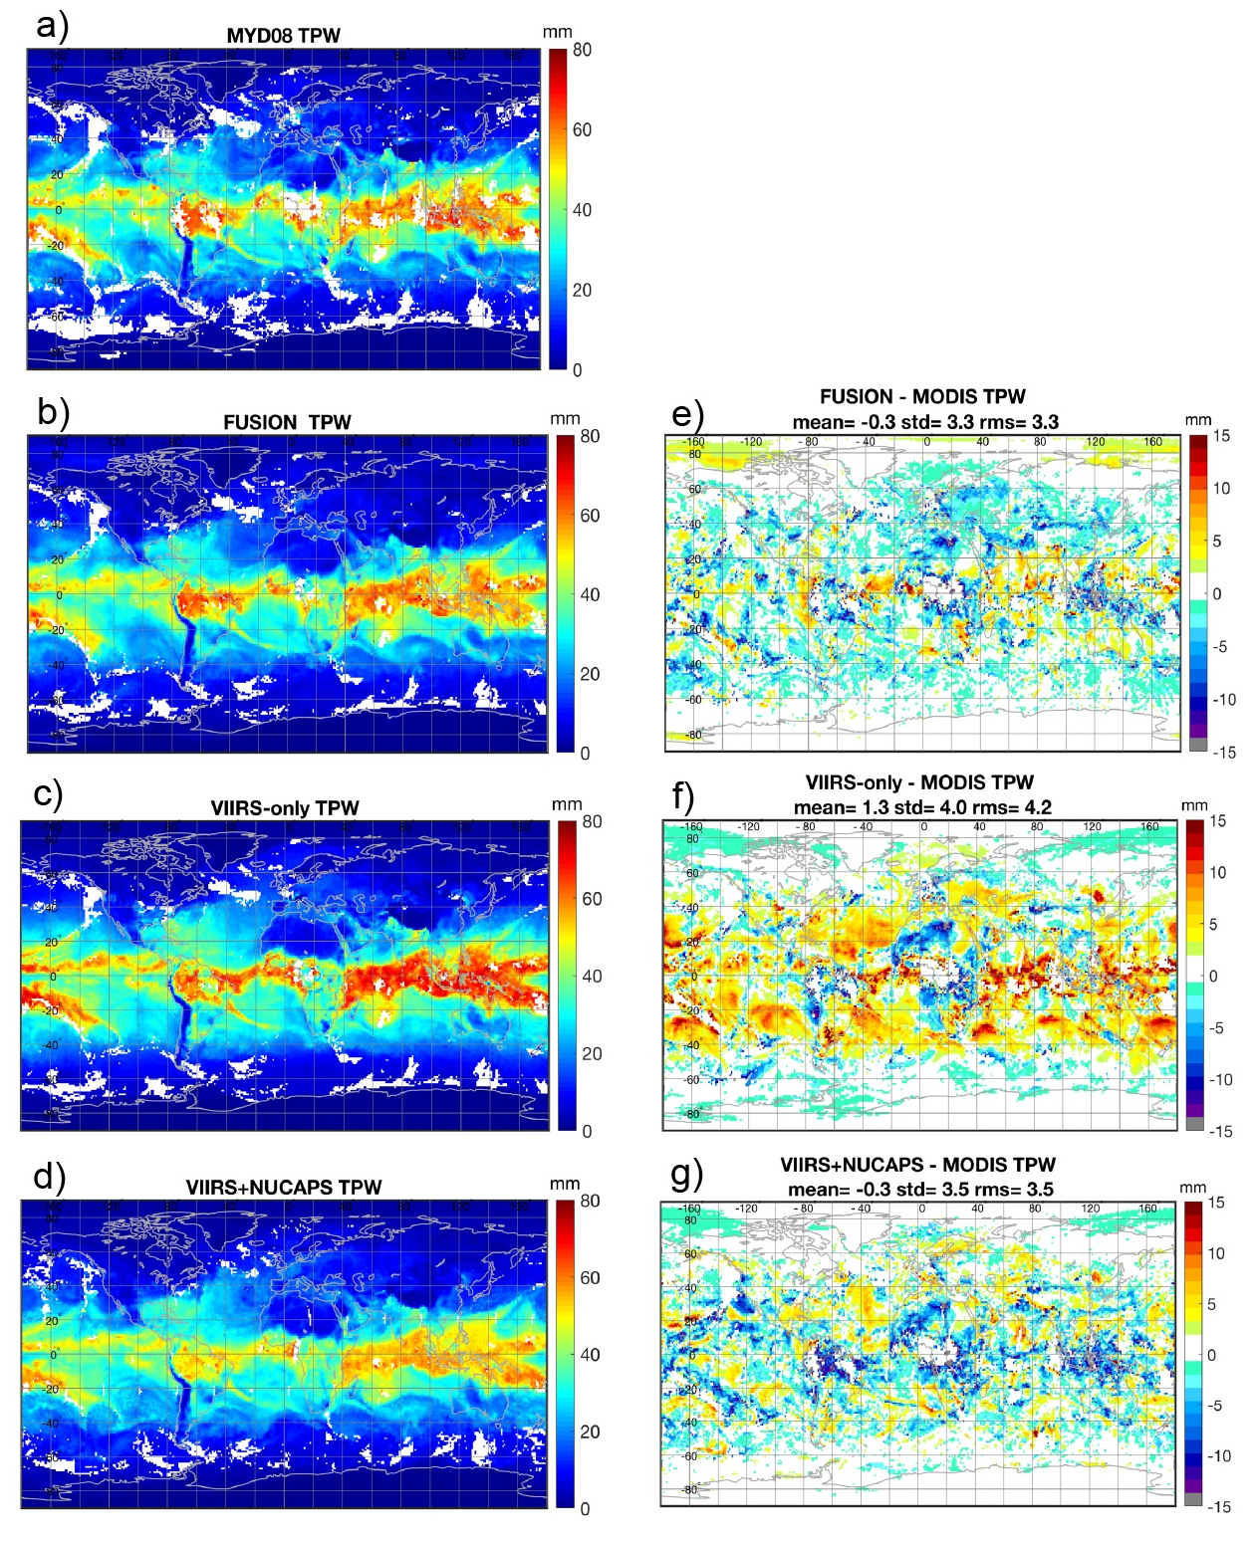
MOD07 TPW Application
TPW results and differences with MODIS
for April 9, 2018.
(Borbas et al., 2021)

Slide 15
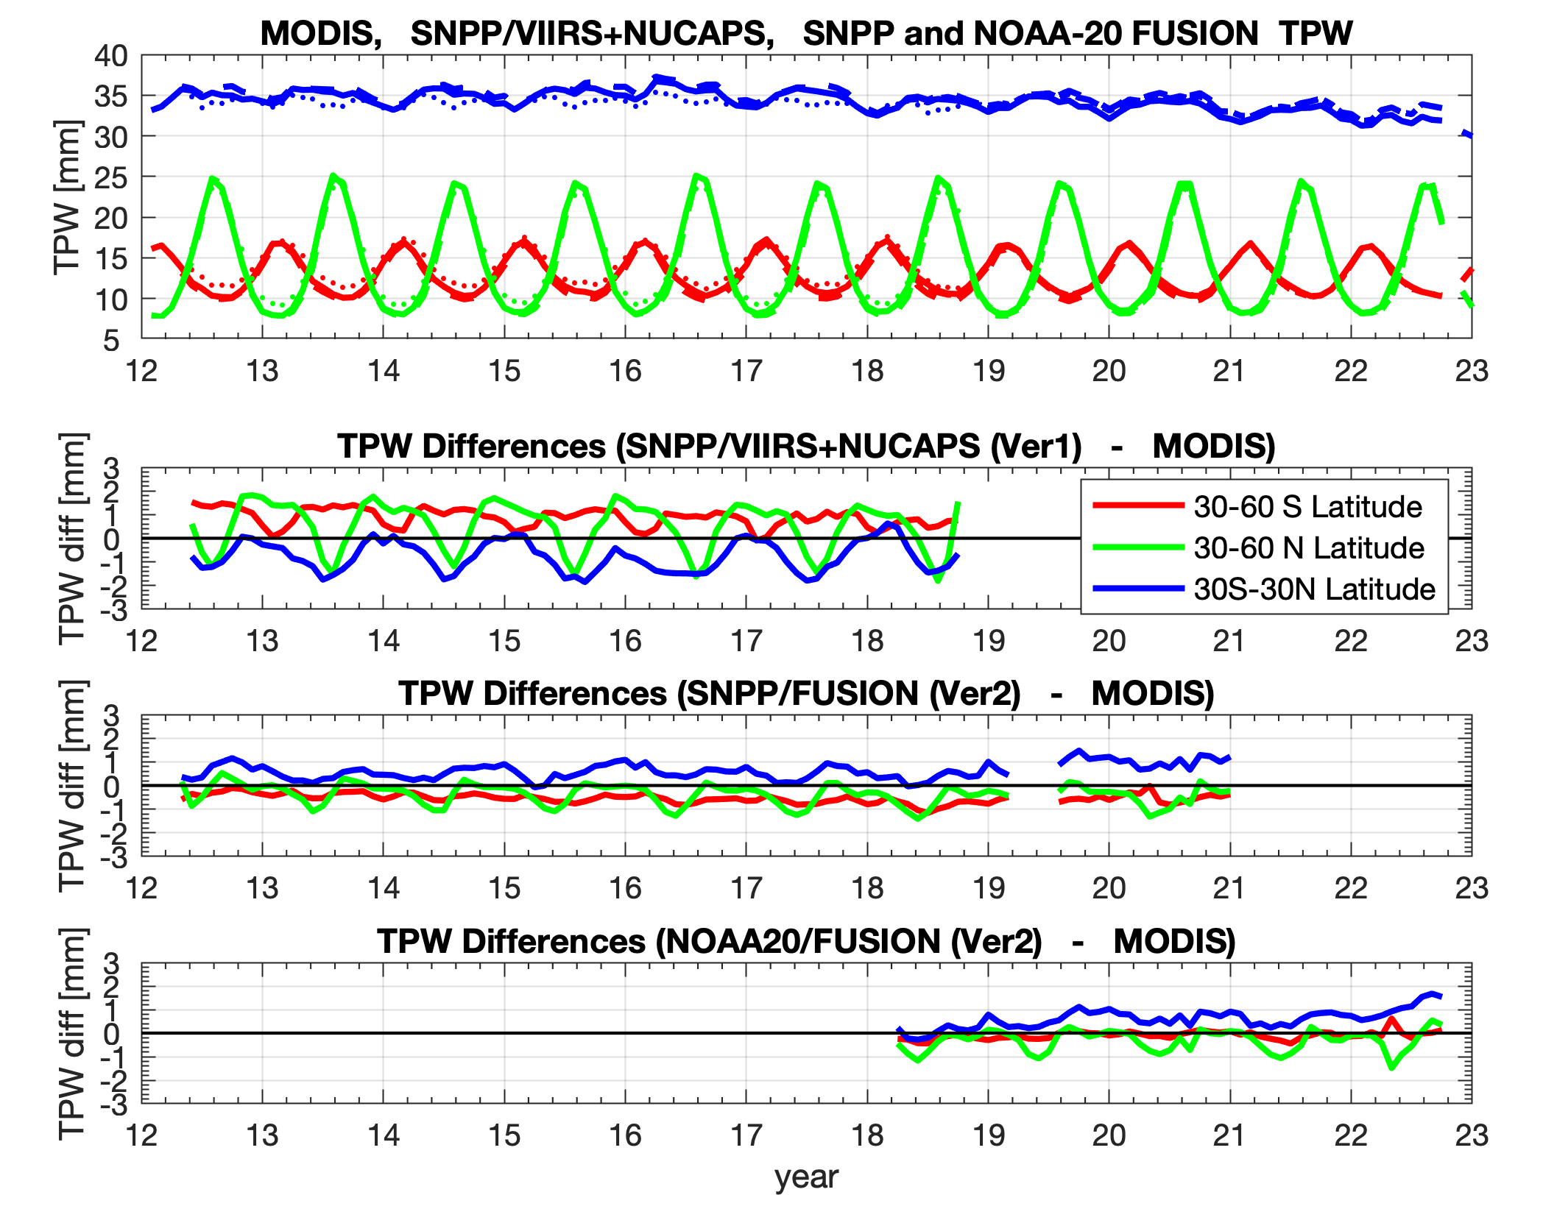
MOD07 TPW Application
TPW results and differences with MODIS
for April 9, 2018.
Aqua/MODIS: SNPP/VIIRS+NUCAPS: SNPP/FSNRAD: NOAA20/FSNRAD:
VIIRS+CrIS fusion TPW and MODIS TPW remain within 1mm for all three latitude bands (mid-latitudes north, tropics and mid-latitudes south).
(Borbas et al., 2021)

Slide 16
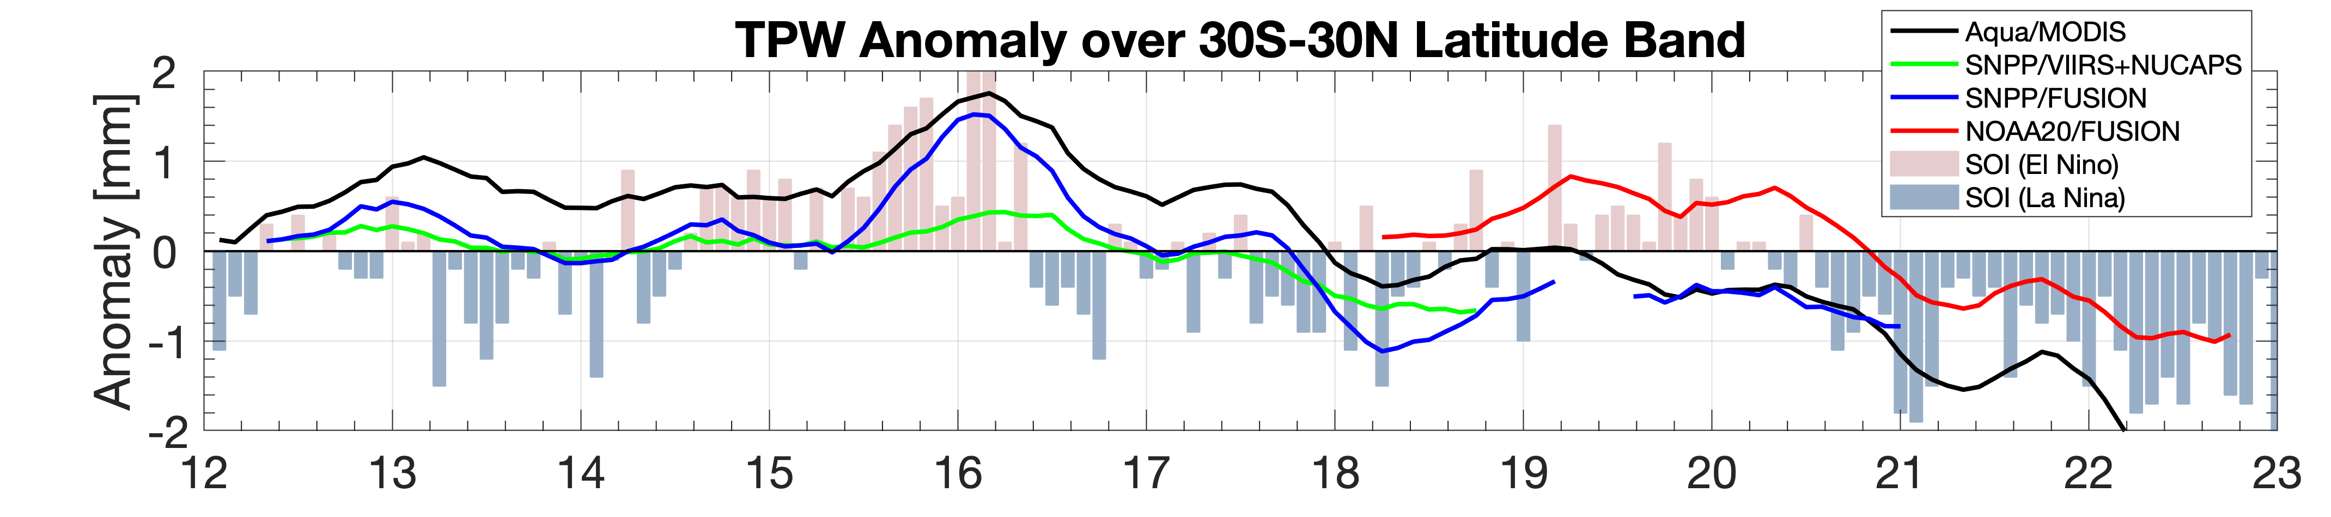
MOD07 TPW Application (cont.)
SOI
-2
-1
0
1
2
Borbas et al. (2021) show the advantage of using the VIIRS+CrIS fusion radiances for IR absorption bands at 4.5, 6.7, 7.3, 13.3, 13.6, 13.9, and 14.2 µm to determine TPW and demonstrate the potential for continuity of the Terra/Aqua MODIS infrared water vapor products. This study established the feasibility of extending the MODIS IR TPW and UTH into the future. The VIIRS+CrIS fusion TPW product, supplemented with the missing IR bands, was implemented using the same approach as the MODIS TPW product. Note that the fusion-based TPW product is in excellent agreement with MODIS.
(Borbas et al., 2021)

Slide 17
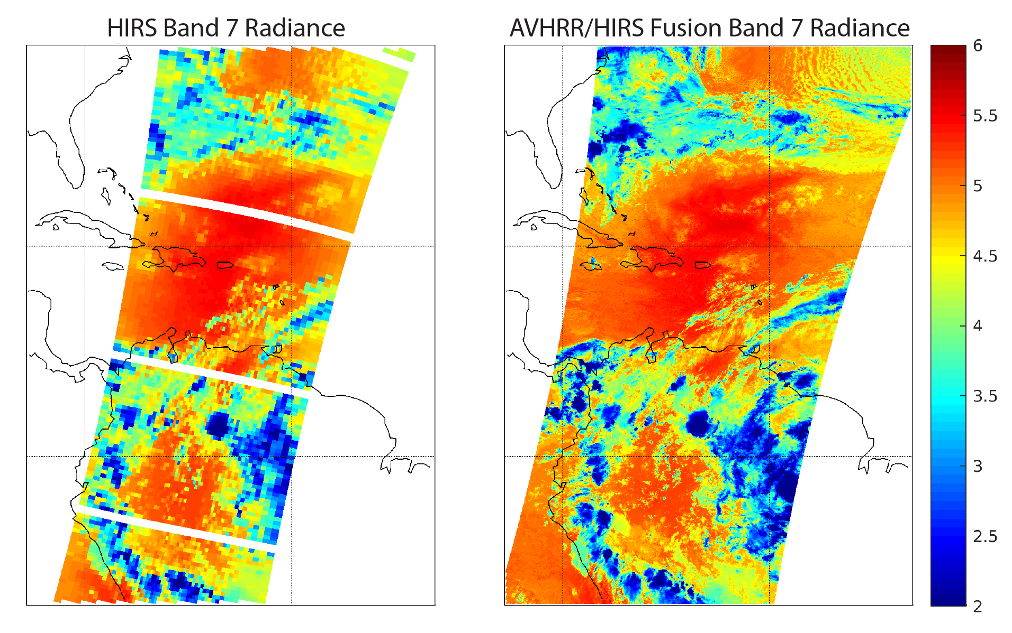
PATMOS-X Application
PATMOS-X V6 now includes the AVHRR+HIRS radiance fusion for the multidecadal NOAA POES and EUMETSAT METOP satellite record.
(13.3 𝞵m)
(Foster et al., 2023)

Slide 18
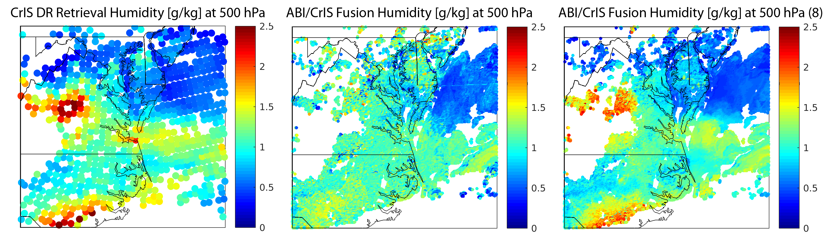
Other Applications
  GEO/LEO Application: spatial and temporal fusion (between imager radiances from subsequent time steps) - (Weisz et al., 2020) (Anheuser et al., 2020)
    ABI/CrIS fusion captures the rapidly evolving atmospheric changes during thunderstorm & tornado development (when CrIS overpass is timely) (Smith et al, 2020)
    Volcanic SO₂ detection at nighttime is demonstrated with ABI/CrIS fusion (Weisz and Menzel, 2022)
Product Fusion Example
“Product fusion” is used to transfer retrieval products at low spatial resolution (LORES) to high spatial resolution (HIRES)
  Imager / sounder product fusion has been demonstrated for VIIRS, ABI, AHI / CrIS, TROPOMI
CrIS SFOV RTV WV 500 hPa ABI/CrIS Fusion WV 500 hPa [g/kg]

Slide 19
References:
Foster, M. J., C. Phillips, A. K. Heidinger, E. E. Borbas, Y. Li, W. P. Menzel, A. Walther, and E. Weisz, 2023: PATMOS-x Version 6.0: 40 Years of Merged AVHRR and HIRS Global Cloud Data. J. Climate, 36, 1143–1160, https://doi.org/10.1175/JCLI-D-22-0147.1
Weisz, E. and W. P Menzel, 2022: Tracking atmospheric moisture changes in convective storm environments using GEO ABI and LEO CrIS data fusion. (Rem. Sens. Env. 14(21), 5327; https://doi.org/10.3390/rs14215327
Weisz, E. and W. P Menzel, 2022: Monitoring the 2021 Cumbre Vieja Volcanic Eruption Using Satellite Multi-Sensor Data Fusion. (Jour. of Geophys. Res. Atmos., 128, e2022JD037926. https://doi.org/10.1029/2022JD037926
Borbas, E. E., E. Weisz, C. Moeller, W. P. Menzel, and B. A. Baum, 2021: Improvement in tropospheric moisture retrievals from VIIRS through the use of infrared absorption bands constructed from VIIRS and CrIS data fusion, Atmospheric Measurement Techniques, 14, 1191–1203, https://doi.org/10.5194/amt-14-1191-2021
Smith Sr, William & Zhang, Qi & Shao, M. & Weisz, E.. (2020). Improved Severe Weather Forecasts Using LEO and GEO Satellite Soundings. Journal of Atmospheric and Oceanic Technology. 37. http://doi.org/10.1175/JTECH-D-19-0158.1
Weisz, E., and W. P. Menzel, 2020: An Approach to Enhance Trace Gas Determinations through Multi-Satellite Data Fusion, J. Appl. Remote Sens.,14(4), 044519, http://doi.org/10.1117/1.JRS.14.044519
Anheuser, J., E. Weisz, and W. P. Menzel, 2020: Low earth orbit sounder retrieval products at geostationary earth orbit spatial and temporal scales, J. Appl. Remote Sens. 14(4), 048502, http://doi.org/10.1117/1.JRS.14.048502
Li, Y., B. A. Baum, A. K. Heidinger, W. P. Menzel, and E. Weisz, 2020: Improvement in cloud retrievals from VIIRS through the use of infrared absorption channels constructed from VIIRS-CrIS data fusion, Atmospheric Measurement Techniques, 13, 4035–4049, https://doi.org/10.5194/amt-13-4035-2020
Weisz, E., and W. P. Menzel, 2020: An Approach to Enhance Trace Gas Determinations through Multi-Satellite Data Fusion, J. Appl. Remote Sens., 14(4), 044519 (2020), http://doi.org/10.1117/1.JRS.14.044519
Weisz, E., and W. P. Menzel, 2019: Imager and sounder data fusion to generate sounder retrieval products at an improved spatial and temporal resolution, J. Appl. Remote Sens. 13(3), 034506, http://doi.org/10.1117/1.JRS.13.034506
Weisz, E., B. A. Baum, and W. P. Menzel, 2017: Fusion of satellite-based imager and sounder data to construct supplementary high spatial resolution narrowband IR radiances. J. Appl. Remote Sens. 11(3), 036022, http://doi.org/10.1117/1.JRS.11.036022

Slide 20
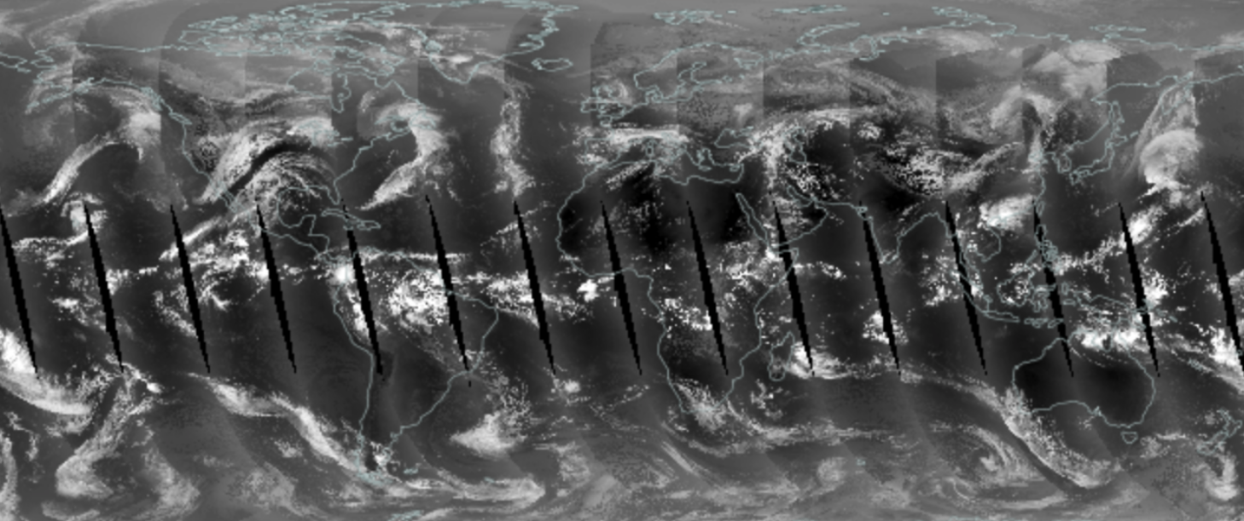

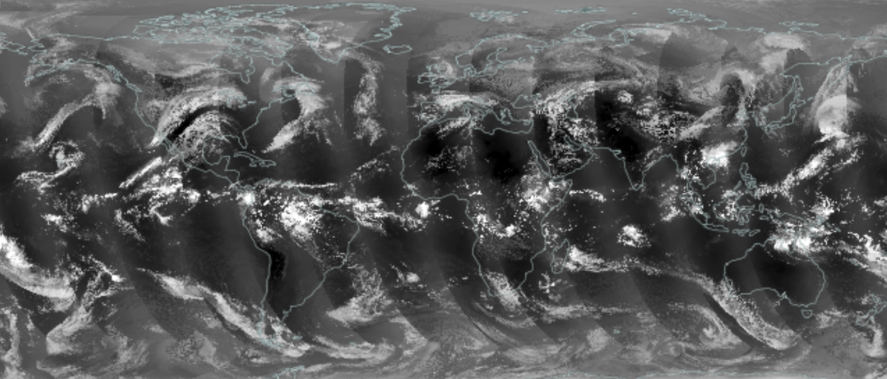
Aqua/MODIS B33
April 26, 2021
Thank you!
NOAA-20/FSNRAD V2 B33

