Slide 1
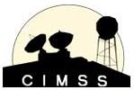
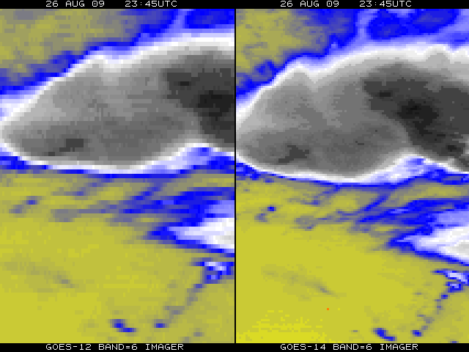
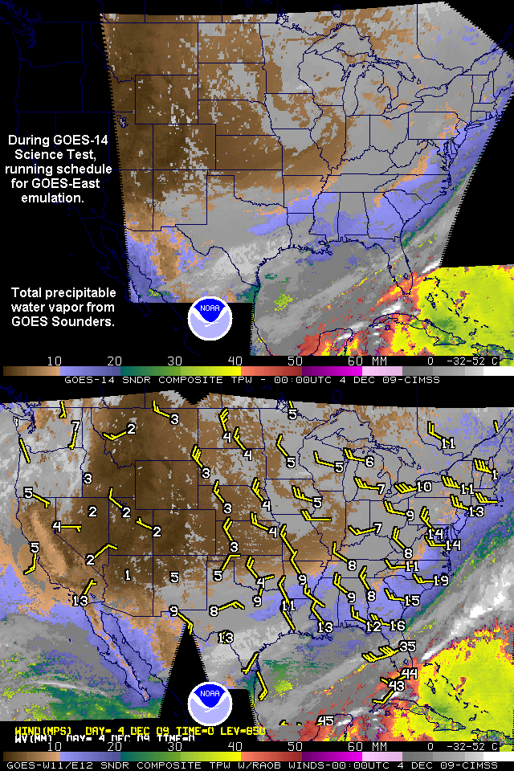
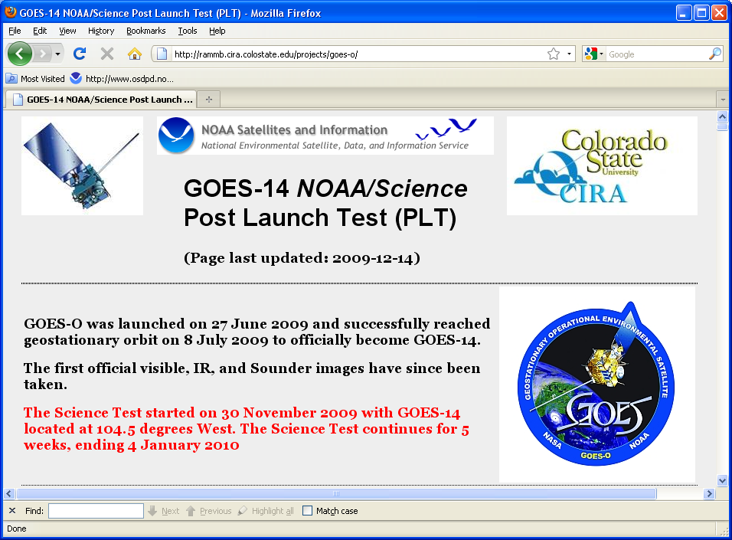
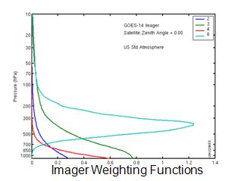
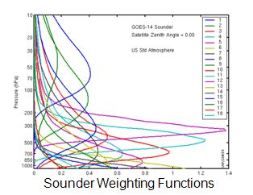
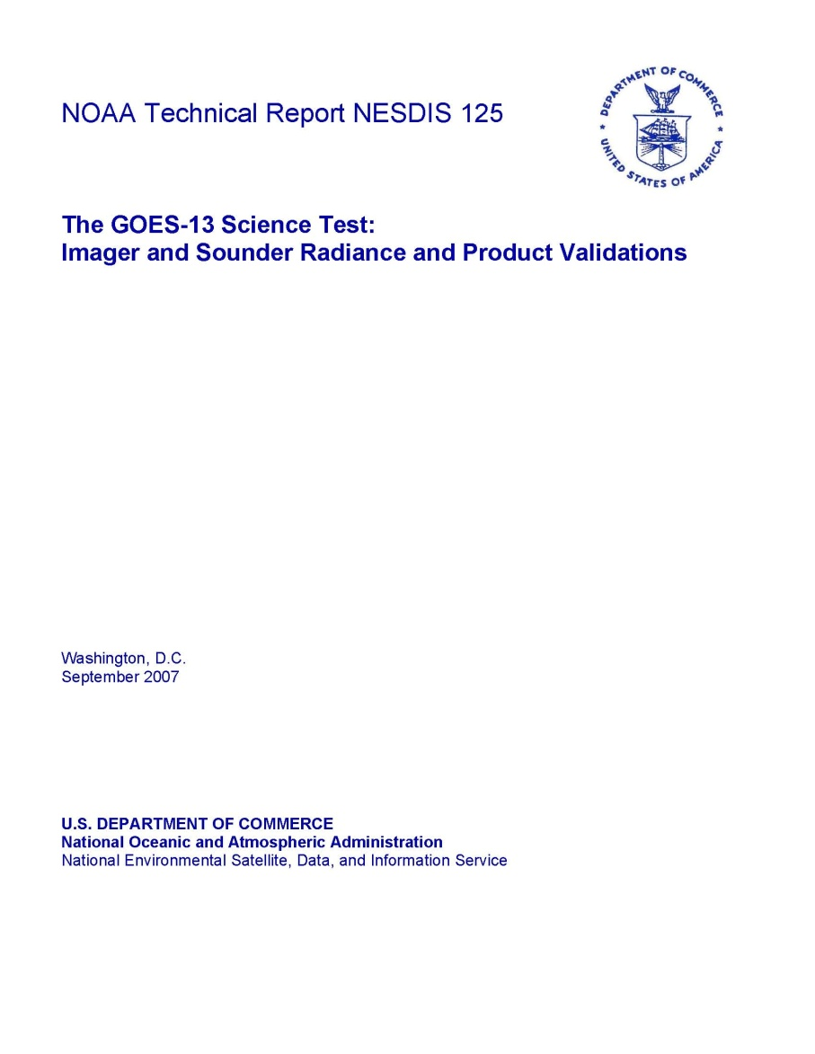
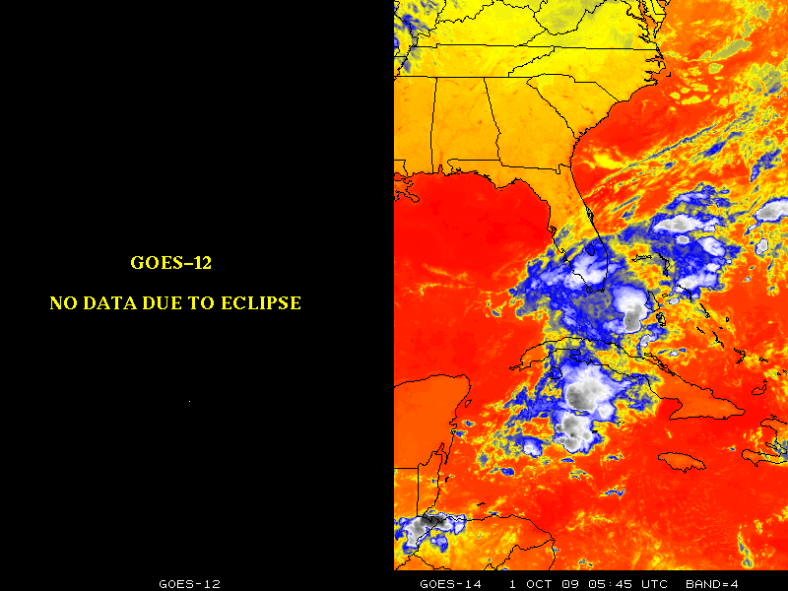
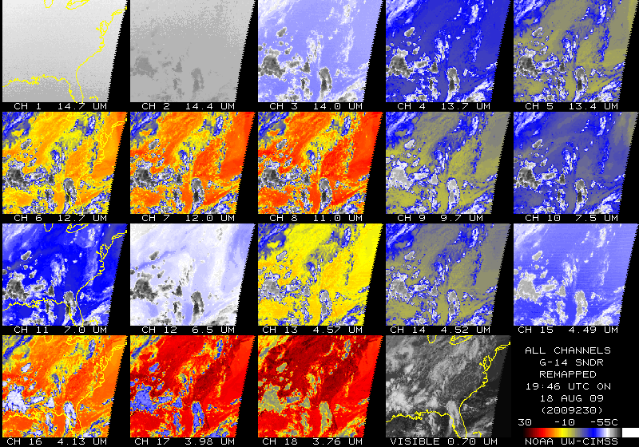
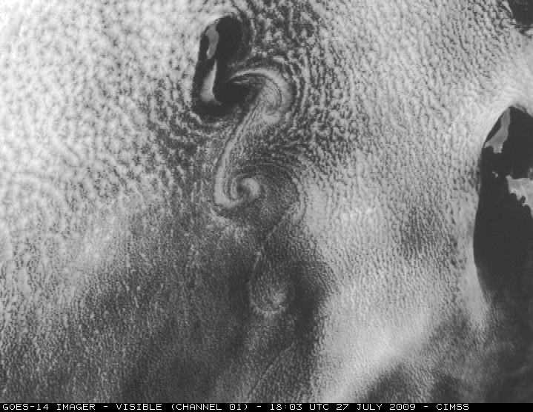
The GOES-14 Science Test – December 2009
Donald W. Hillger
NOAA/NESDIS, SaTellite Applications and Research (STAR)
Regional And Mesoscale Meteorology Branch (RAMMB)
Fort Collins CO 80523-1375
don.hillger@noaa.gov
Timothy J. Schmit
NOAA/NESDIS, SaTellite Applications and Research (STAR)
Advanced Satellite Products Branch (ASPB)
Madison WI 53706
tim.j.schmit@noaa.gov
Requirement: For all GOES check-outs, the goals of the Science Test include the following:
To assess the quality of the GOES radiance data. This is accomplished by comparison to other satellite measurements or by calculating the signal-to-noise ratio compared to specifications, as well as assess the striping in the imagery due to multiple detectors.
To generate products from the GOES data stream and compare to those produced from other satellites. These included several Imager and Sounder products currently used in operations.
Rapid-scan imagery of interesting weather cases are collected with temporal resolutions as fine as every 30 seconds, a capability of rapid-scan imagery from GOES-R that is not implemented operationally on current GOES.
Monitor any instrument changes. For example, the improved spatial resolution of the Geostationary Operational Environmental Satellites (GOES)-14 imager band 6 (centered at 13.3 um).
Science: Generate and validate products. Understand instrument characteristics. Balance the needs of the many groups during the data collection mode.
Benefit: Prepare for operational use and build unique datasets to prepare for future sensors.
http://rammb.cira.colostate.edu/projects/goes-o
Improved spatial resolution at 13.3 µm for GOES-14 (right) compared to GOES-12 (left)
GOES-14 Science Test
Preliminary intercalibration results with GOES-14 Imager using IASI
Derived product image (DPI) of total precipitable water (TPW) vapor derived from the GOES-14 Sounder (at 105W), nominally at 00 UTC on 04 Dec 2009 (top panel). DPI of TPW from GOES-11 (at 135 W) and GOES-12 (at 75W) at 00 UTC on 04 Dec 2009, with radiosonde values of TPW and 850 hPA winds overlaid. Good qualitative agreement is seen between GOES-14 and the operational GOES Sounders (lower panel).
(From Gary S. Wade and Jim Nelson, CIMSS.)
5 weeks, from Start: 30 November 2009 to 04 January 2010
8 pre-determined schedules
locations changed daily
Daily schedule changes (at 1630 UTC), determined by test coordinators, based on feedback from participating scientists and others
GOES-14 located at 105°W during the Science Test
Very important for operational readiness, worked closely with OSDPD
From M. Gunhor, of CIMSS
- Mean temperature differences with IASI (for 12 cases) are:
-0.4 K for the Shortwave Window band (5 night cases)
+0.8 K for the Water Vapor band
+0.1 K for the IR Window band
-0.6 K for the CO₂ Absorption band
- Using Spectral Response Function (SRF) Rev A release.
- Some of these results may include cases where navigation was not optimal.
- Similar results from Dr. Wu of STAR (not shown)
GOES-13 Science Test
GOES-13
Hillger, D.W., and T.J. Schmit, 2007: The GOES-13 Science Test, NOAA Tech. Rep., NESDIS 125, (September), 88 pp.
Hillger, D.W., and T.J. Schmit, 2009: The GOES-13 Science Test: A Synopsis. Bull. Amer. Meteor. Soc., 90(5), (May), 6-11.
Operation through Eclipse
GOES-14 Imager and Sounder weighting functions
(Figures courtesy of Mat Gunshor/CIMSS.)
GOES-14 Science Test Preliminary Results
First official GOES-14 images were collected from Imager (visible and IR) and Sounder
Improved (4 km) resolution of 13.3 µm band required changes to GVAR format. Several issues with implementing the new GVAR format were discovered, communicated, rectified, and verified.
Paired detectors on the higher-resolution 13.3 µm band were inadvertently swapped. Now fixed.
Image navigation issues have been resolved.
Imager and Sounder data collected for a host of schedules, including rapid scan imagery.
Identified GOES Sounder calibration issue with respect to averaging calibration slopes.
Initial IASI inter-calibrations with both the imager and sounders.
Various products generated (retrievals, winds, clouds, CSBT, SST, etc.)
Imagery posted on both the STAR and NESDIS home pages.
Cloud-top Pressure (GOES-14 Sounder)
Science Challenges: Validate instrument changes and products generated. Collect the right data at the right time.
Next Steps: Analysis to support a NOAA Technical Report. Work with OSPDP regarding operational readiness.
Transition Path: GOES-14 will become an operational satellite in 2 year, +/- 2 years.
First images from the GOES-14 Sounder
A series of von Karman vortices was seen streaming southward from Guadalupe Island off the west coast of Baja California.
(Figure courtesy of Scott Bachmeier and the CIMSS Satellite Blog)
http://cimss.ssec.wisc.edu/goes/blog/archives/category/goes-14
Cloud-top Pressure (GOES-14 Imager)
(Figures courtesy of Tony Schreiner of CIMSS)
Acknowledgements
The GOES Science Tests occur at the end of long Post Launch Test (PLT) periods for each satellite and are possible because of the cooperation of NASA and NOAA/OSD and OSO personnel, who in particular prepare the satellite schedules and enable the daily changes that are requested by the science team. Thanks as well to all who contribute to the analysis of the data collected during the Science Tests.
Center for Satellite Applications and Research (STAR) Review 09 – 11 March 2010

