Slide 1
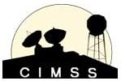
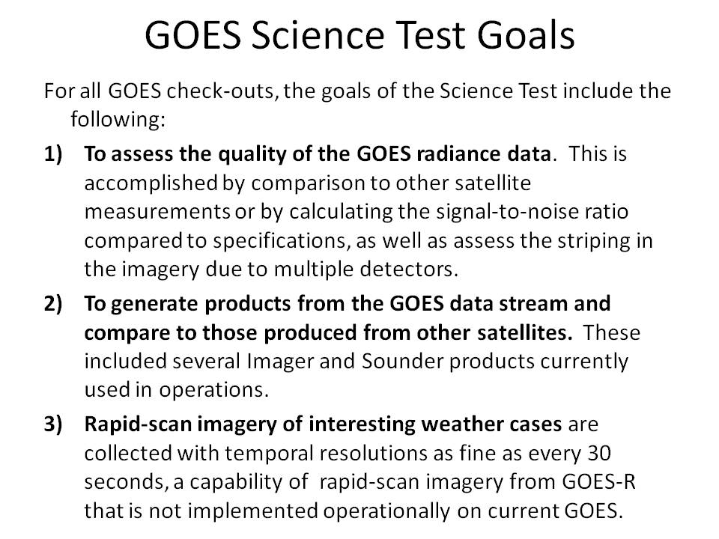
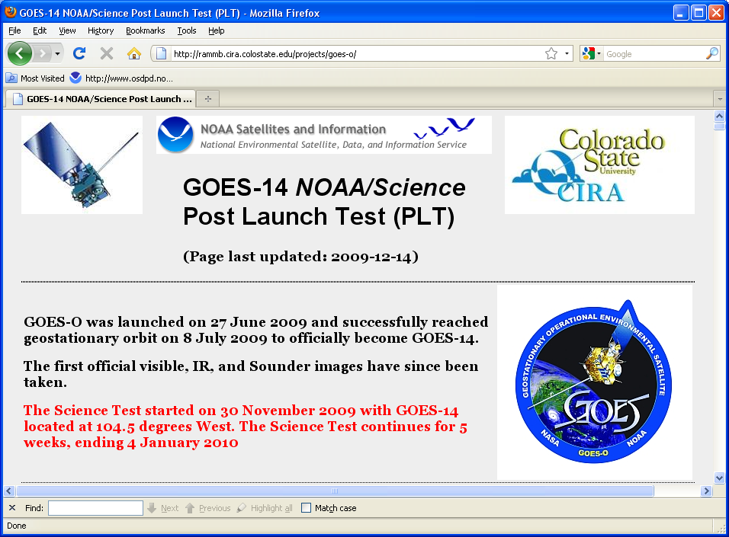
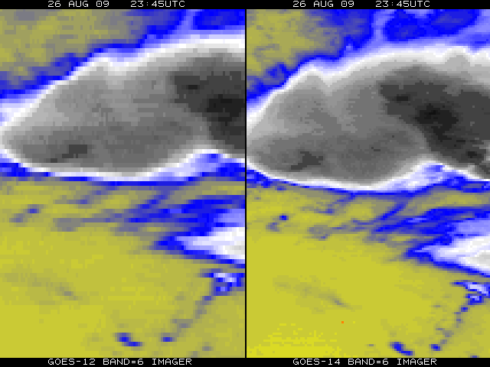
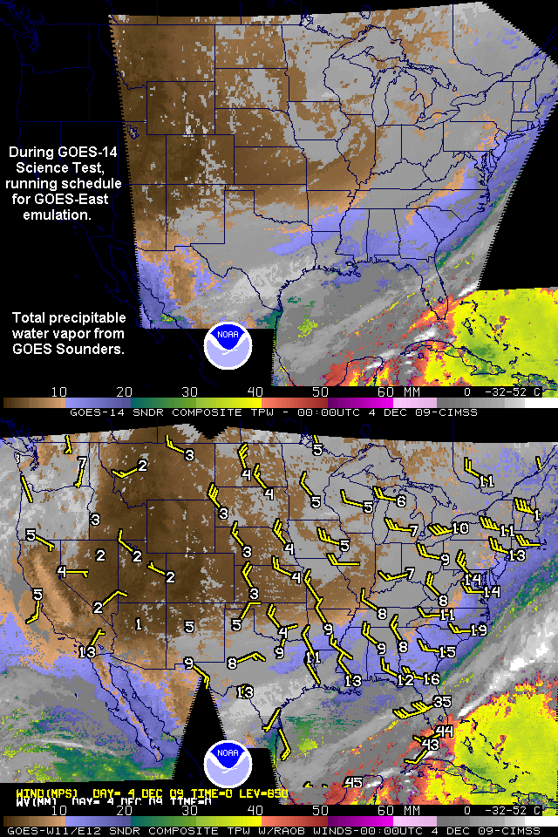
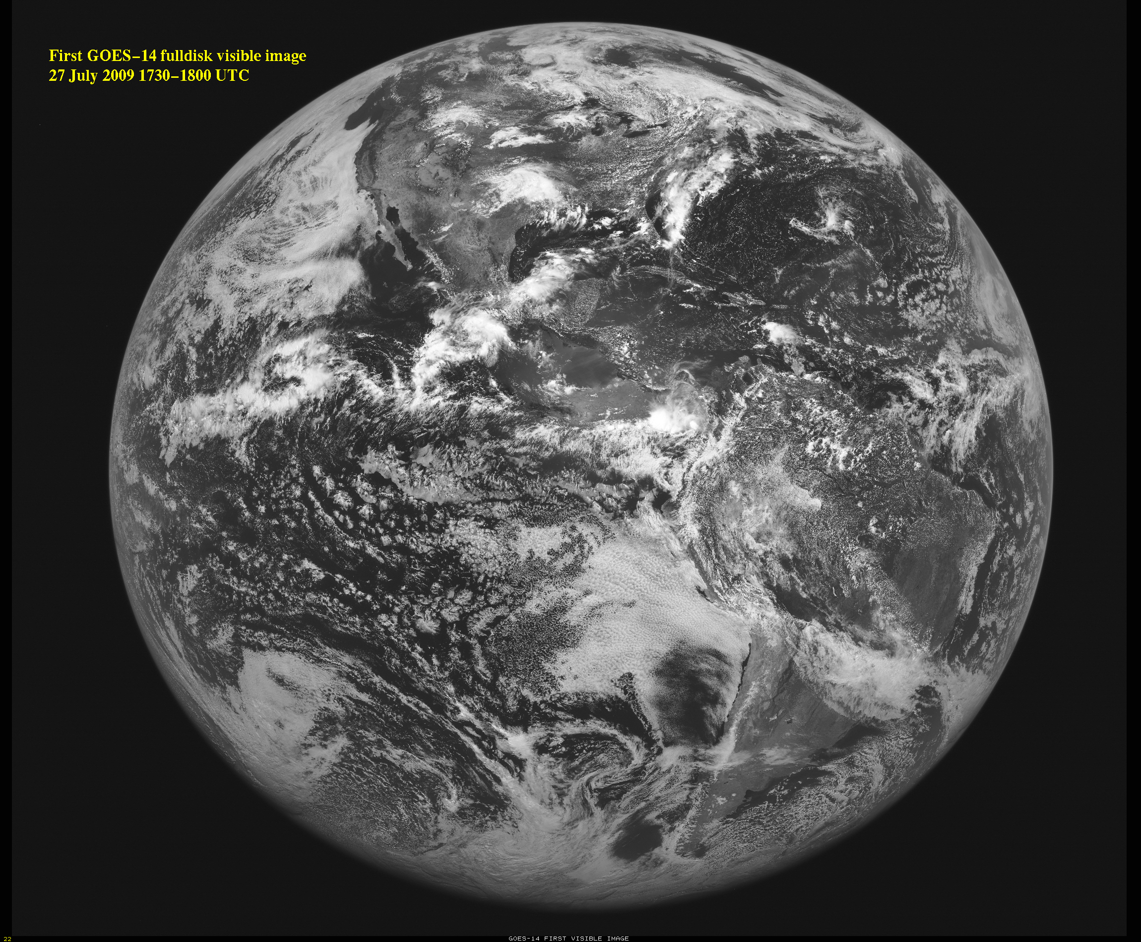
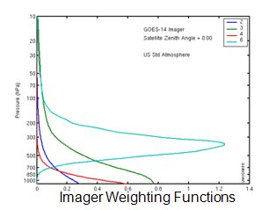
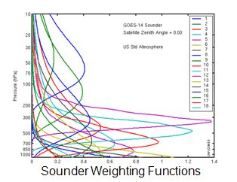
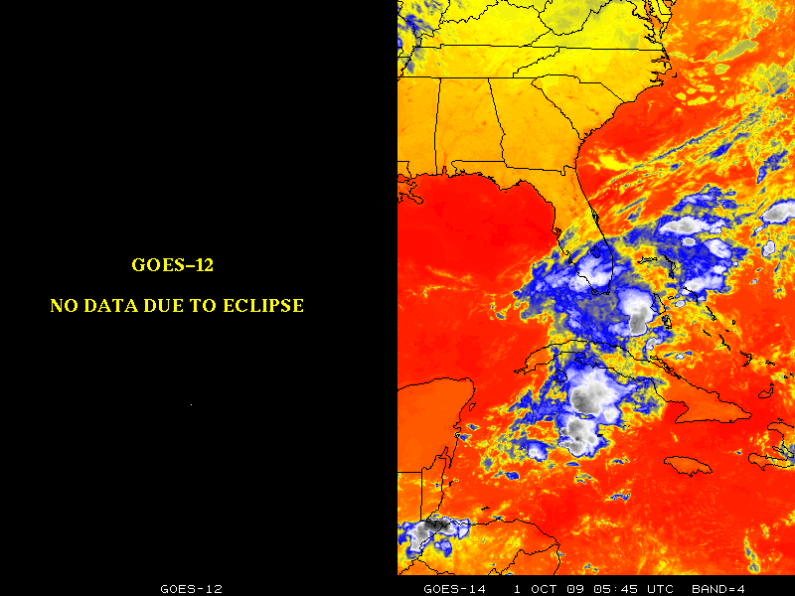
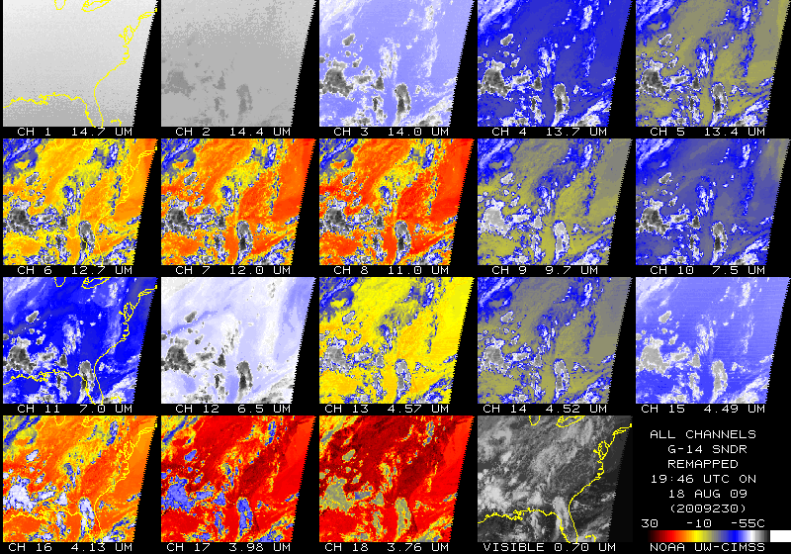
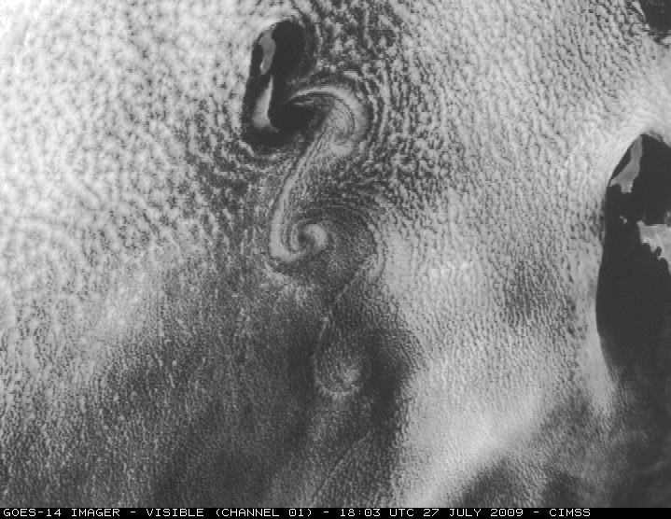
The GOES-14 Science Test – December 2009
Donald W. Hillger
NOAA/NESDIS, SaTellite Applications and Research (STAR)
Regional And Mesoscale Meteorology Branch (RAMMB)
Fort Collins CO 80523-1375
don.hillger@noaa.gov
Timothy J. Schmit
NOAA/NESDIS, SaTellite Applications and Research (STAR)
Advanced Satellite Products Branch (ASPB)
Madison WI 53706
tim.j.schmit@noaa.gov
GOES-14 Science Test
5 weeks, from Start: 30 November 2009 to 04 January 2010
8 pre-determined schedules: http://rammb.cira.colostate.edu/projects/goes-o/#schedules
Daily schedule changes (at 1630 UTC), determined by test coordinators, based on feedback from participating scientists and others
GOES-14 located at 105°W during the Science Test
Very important for operational readiness
Improved spatial resolution at 13.3 µm for GOES-14 (right) compared to GOES-12 (left)
Preliminary intercalibration results with GOES-14 Imager using IASI
From M. Gunhor, of CIMSS
- Mean temperature differences with IASI (for 12 cases) are:
-0.4 K for the Shortwave Window band (5 night cases)
+0.8 K for the Water Vapor band
+0.1 K for the IR Window band
-0.6 K for the CO₂ Absorption band
- Using Spectral Response Function (SRF) Rev A release.
- Some of these results may include cases where navigation was not optimal.
- Similar results from Dr. Wu of STAR (not shown)
Operation through Eclipse
GOES-14 Imager and Sounder weighting functions
(Figures courtesy of Mat Gunshor/CIMSS.)
Top: Derived product image (DPI) of total precipitable water (TPW) vapor derived from the GOES-14 Sounder (at 105W), nominally at 00 UTC on 04 Dec 2009. Bottom: DPI of TPW from GOES-11 (at 135 W) and GOES-12 (at 75W) at 00 UTC on 04 Dec 2009, with radiosonde values of TPW and 850 hPA winds overlaid. Good agreement is seen between GOES-14 and the operational GOES Sounders; the contrasting pattern of very moist air over the Caribbean and very dry air over the west and central US is clearly evident in both DPI. (Figure from Gary S. Wade and Jim Nelson.)
First images from the GOES-14 Imager
Previous GOES Science Tests
GOES-10
http://cimss.ssec.wisc.edu/goes/g10_report/
GOES-11
Daniels, J.M., T.J. Schmit, and D.W. Hillger, 2001: GOES-11 Imager and Sounder Radiance and Product Validations for the GOES-11 Science Test, NOAA Tech. Rep. NESDIS 103, (August), 49 pp.
GOES-12
Hillger, D.W., T.J. Schmit, and J.M. Daniels, 2003: Imager and Sounder Radiance and Product Validation for the GOES-12 Science Test. NOAA Tech. Rep., NESDIS 115, (September), 70 pp.
GOES-13
Hillger, D.W., and T.J. Schmit, 2007: The GOES-13 Science Test, NOAA Tech. Rep., NESDIS 125, (September), 88 pp.
Hillger, D.W., and T.J. Schmit, 2009: The GOES-13 Science Test: A Synopsis. Bull. Amer. Meteor. Soc., 90(5), (May), 6-11.
Cloud-top Pressure (GOES-14 Sounder)
First images from the GOES-14 Sounder
A nice series of von Karman vortices was seen streaming southward from Guadalupe Island off the west coast of Baja California.
(Figure courtesy of Scott Bachmeier and the CIMSS Satellite Blog)
Cloud-top Pressure (GOES-14 Imager)
Acknowledgements
The GOES Science Tests occur at the end of long Post Launch Test (PLT) periods for each satellite and are possible because of the cooperation of NASA and NOAA/OSD and OSO personnel, who in particular prepare the satellite schedules and enable the daily changes that are requested by the science team. Thanks as well to all who contribute to the analysis of the data collected during the Science Tests.

