Slide 1
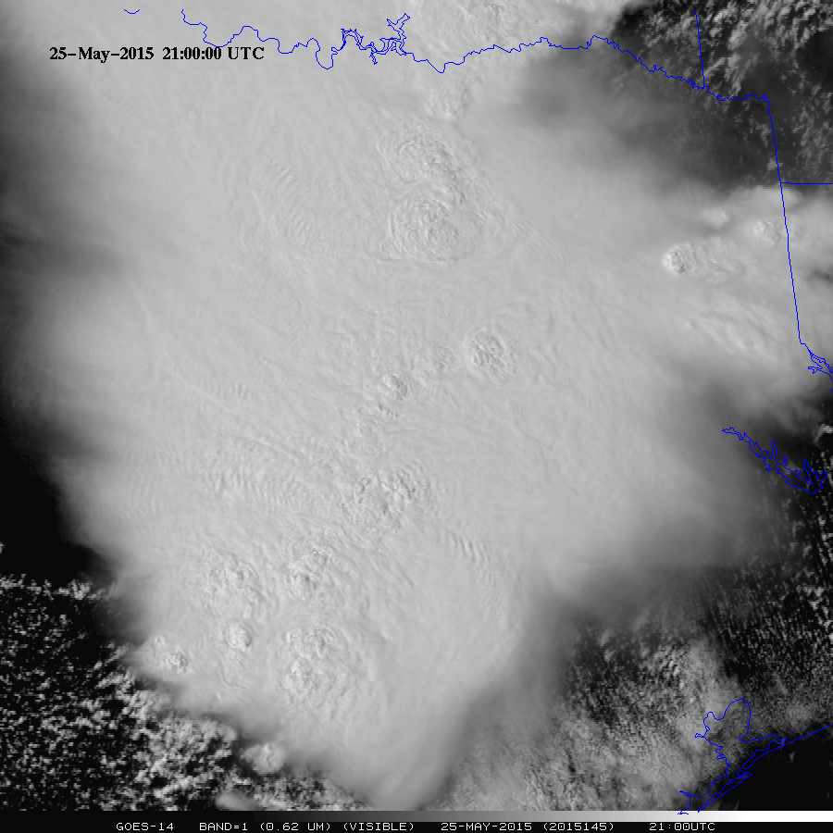

GOES-14: Special Rapid Scanning offers glimpse of the ABI
SRSOR (Super Rapid Scan Operations for GOES-R) from GOES-14 imager
GOES-14 currently on-orbit back-up
For 2015, two periods of data collection in may/June and mid-August.
http://cimss.ssec.wisc.edu/goes/srsor2015/GOES-14_SRSOR.html
Many phenomena were observed: convection, hurricanes, fires, smoke, etc.
Data to many operational groups
GOES-14 provided very unique information and offers a glimpse into the possibilities that will be provided by the ABI on GOES-R
Animation from GOES-14 Imager visible image at 1-min time resolution. Normally, only 1 image would have been available for this 30-min period. This case is over Texas during spring flooding.
(Schmit, Nelson, Bachmeier, Bellon, Gunshor, Velden, SSEC Data Center, …)
Notes:
Note that the image is only an image, the loop could be embedded, but make sure all the frames show. If not, just show ‘stand-alone’.
This loops is when the operational GOES takes just one (full disk) image.

