Slide 1
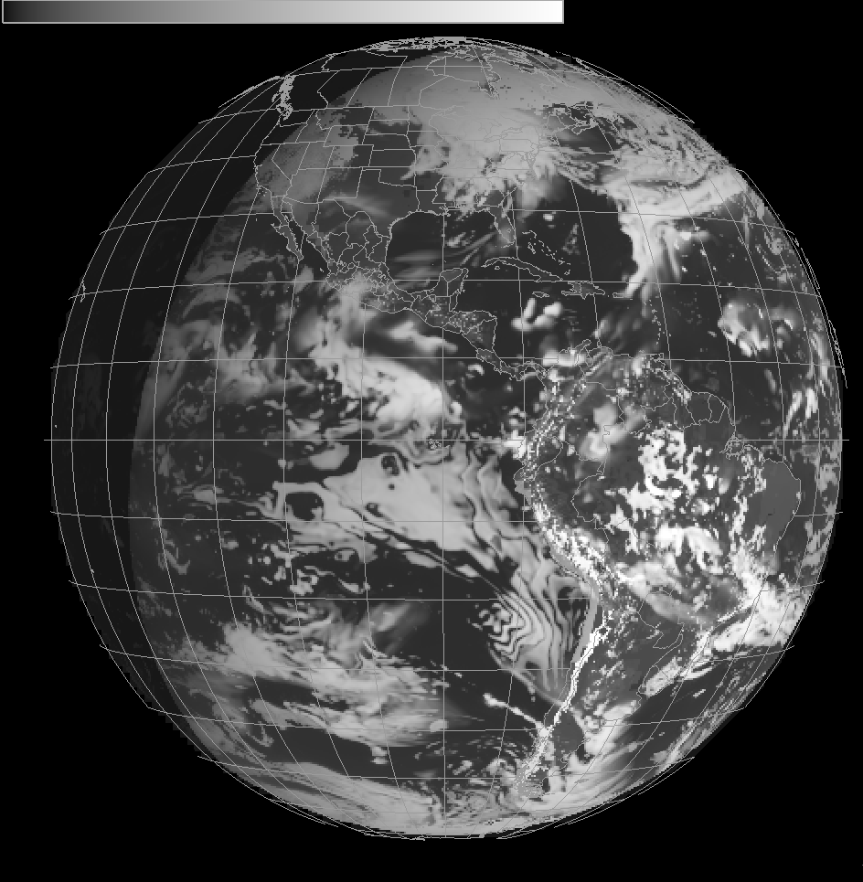
Cloud and Moisture Imagery and Level 2 products: Daily Real-time End-to-End Testing (from NWP to AWIPS-2)
Simulated ABI, on model grids
AWG / STAR / CIMSS
To NWS, remap, emulate ABI mode, released as PG blocks, sent over NOAA Port and into AWIPS-2, re-assembled.
Simulated ABI , in AWIPS-2
Pierce, Brad; Lenzen, Allen; Schaack, Todd; Gerth, Jordan; Gunshor, Mathew; Bah, Kaba; Schmit, Tim
Notes:
Datasets are used not just for KPP, but level 2 processing as well.

Slide 2
GOES-R ABI AWG Datasets
AWG@SSEC
GFS
Met+Ozone (Global)
RAQMS Aerosol (Global)
RAQMS Ozone (Global)
WRF-Chem
Met/Aerosol (CONUS)
NWP/Aerosol/Ozone Forecast –
Radiative
Transfer –
synthetic radiances
CRTM Full Disk
16 ABI bands
CRTM CONUS
16 ABI bands
NWS
Grid Remap
(GOES-R Full Disk GRB)
Grid Remap
(GOES-R CONUS/MESO GRB)
GOES West
GOES Test (Central)
GOES East
RaFTR software –
ABI in a box
Full Disk
Flex
NOAA Satellite Broadcast Network (SBN) distribution
Flowchart to emulate several operational situations (satellite locations and scan modes)
…including SSEC Data Center and CIMSS
AWIPS II

Slide 3
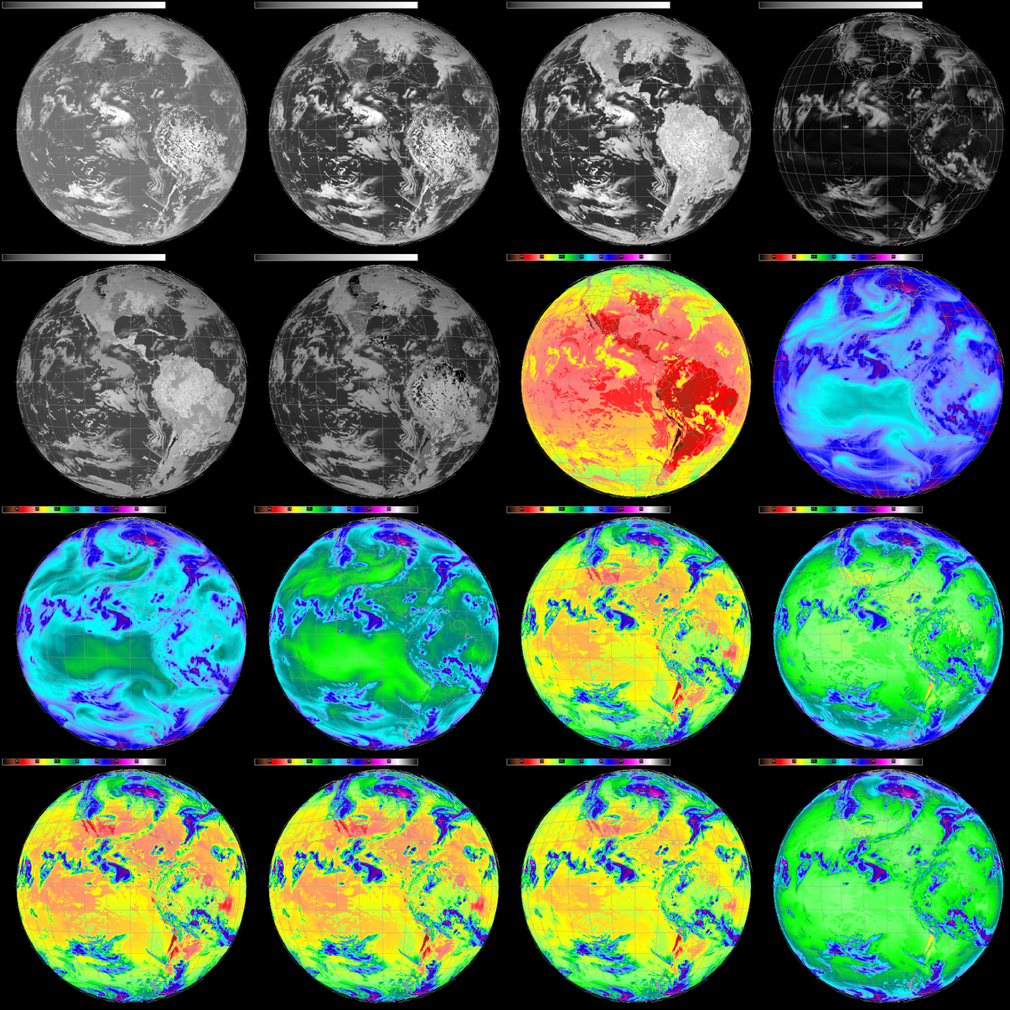
16 Simulated
ABI Bands
Visible (2)
Near IR (4)
IR (10)
AWIPS-2
Full Disk
Central location
(Test)
Realistic (simulated) imagery flowing for end-to-end system testing
Notes:
18 UTC. 28-Oct-2015. 11-bit enhancement

