Slide 1
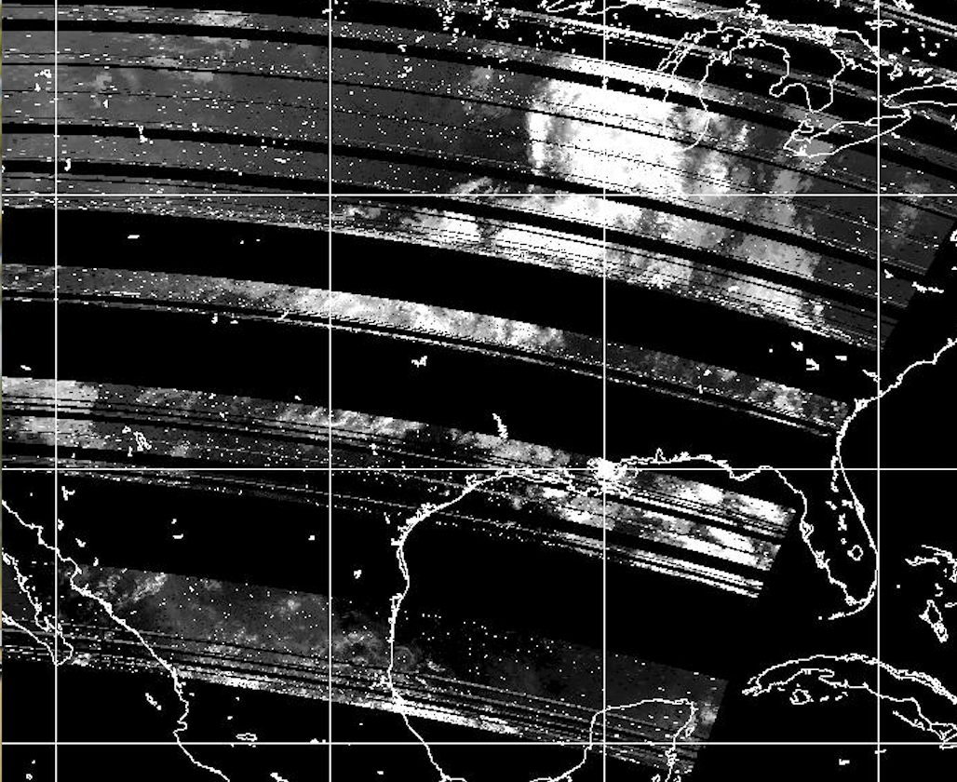
Federal MetSat Radio Spectrum Sharing Could Impact Sources of Broadcast & Internet Satellite Imagery
Some private sector weather enterprise providers of broadcast imagery products receive GOES / GOES-R data from direct broadcast satellite ground stations.
Such non-Federal stations could be subject to undesired radio frequency interference, making the products unusable or degraded.
Sharing is not dictated with commercial broadband transmitters in the adjacent frequency band.
Current GOES-R downlink spectrum (1675-1695 MHz) under consideration for sharing – interference to unprotected stations may be significant.
See for more information :http://blog.ametsoc.org/uncategorized/real-time-user-satellite-data-partly-to-mostly-available/
Sample 1-min GOES-14 SRSOR imagery
AVHRR Imagery Degraded by Frequency Interference

Slide 2
NOAA’s L-Band Environment
Legislative Recommendation for
Sharing by 2017
2003 Auction 46 Commercial Use
Under Evaluation for Sharing
Auctioned Jan 30 For Sharing
Today
POES/MetOp
2016 - 2030
MHZ
1670
1675
1680
1685
1690
1695
Radiosondes
1710
GOES-R Rebroadcast
Post-2030
DCPR
TLM HRIT
EMWIN
Commercial
1710 - 1755
Adjacent Bands
Radiosondes
POES & MetOp
Radiosondes

