Slide 1


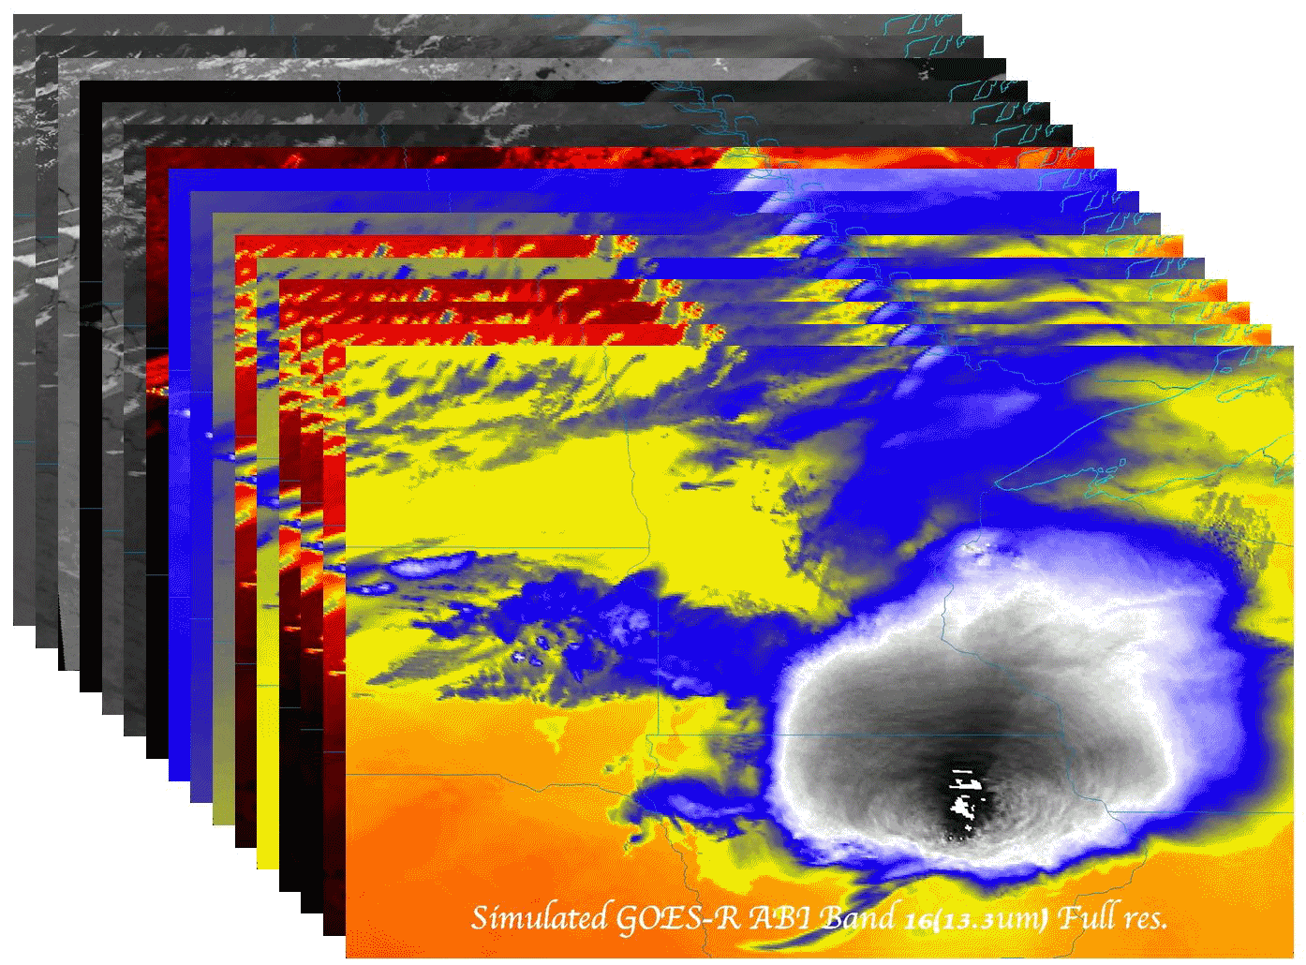

Possible ABI Scan Mode Options and Level-2 Product Options
  Timothy J. Schmit (tim.j.schmit@noaa.gov)
NOAA/NESDIS/StAR Advanced Satellite Products Branch (ASPB)
W. P. Menzel, CIMSS
Madison, WI
With help from many others (Mat Gunshor, Jordan Gerth…)
NOAA Science Week
26-February-2015
UW-Madison

Slide 2
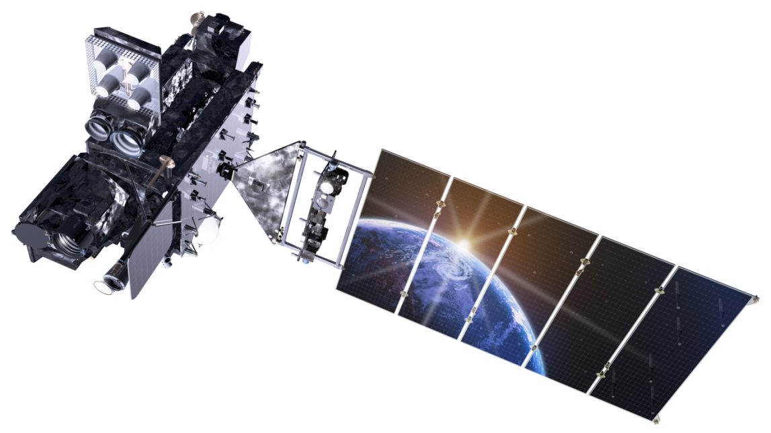
Outline
Geo Global Constellation
GOES-R ABI Rapid Scans
  Baseline and Exploratory scan strategies
ABI Level 2 Products
GOES SRSOR
  2015
Lockheed Martin

Slide 3
Next Generation Geo Imagers
(multispectral (>11), on the order of 1km resolution, ~10 min FD)
2002 – SEVIRI (MSG) Europe
2014 – AHI (Himawari-8) Japan
2016 – ABI (GOES-R) USA
2016 – AGRI (FY4) China
2017 – MSU-GS (Electro-L) Russia
201? – ARCTICA (Molniya) Russia
2018 – AMI (KOMPSAT-2A) Korea
2019 – FCI (MTG) Europe
202? – anticipated ‘geo-like’ PCW. Canada

Slide 4
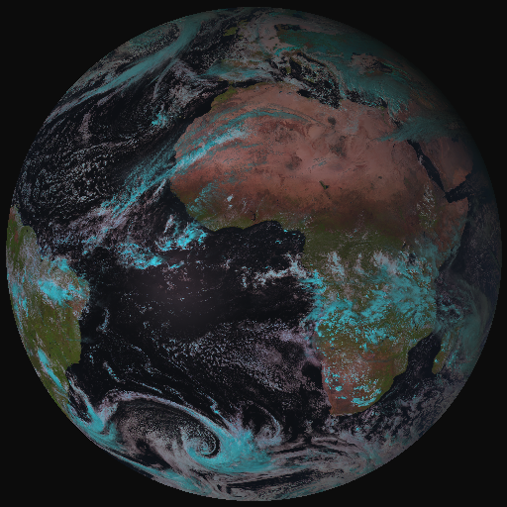
From MSG-SEVIRI to MTG-FCI
MTG FCI outbids MSG SEVIRI observations on cloud, aerosol, moisture and fire:
by adding new channels
by improving temporal-,
spatial-, and radiometric
resolution
High-Resolution Fast Imagery
a Full-Disk High-Spectral-resolution
Imagery (FDHSI)
Coverage Repeat cycle FDHSI mission 18ºx18º 10 min
HRFI mission 1/4 FD 2.5 min
Notes:
Flexible Combined Imager

Slide 5
MTG Provides a Total of Five Missions
FCI - Full Disk Scan Service (FCI-FDSS), global scales (Full Disk) RC = 10 min, with 16 channels at spatial resolution of 1 km (8 solar channels) and 2 km (8 thermal channels)
FCI - Rapid Scan Service (FCI-RSS), local scales (1/4th of Full Disk) RC = 2.5 min with 4 channels at high spatial resolution 0.5 km (2 solar channels @ 0.6 and 2.2 µm), and 1.0 km (2 thermal channels @ 3.8 and 10.5 µm)
    IRS => Repeat Cycle : 15 min per 1/4th of Full Disk; Spatial resolution : 4 km, spectral sampling at 0.625 cm⁻¹;
  Two bands: Long-Wave-IR 700 – 1210 cm⁻¹ ~ 820 spectral samples Mid-Wave-IR 1600 – 2175 cm⁻¹ ~ 920 spectral samples
LI, continuously observing 80% of Full Disk: Integration Time~1.5ms detection/mapping of Intra-Cloud and Cloud-Ground strokes at ~10km spatial resolution DE=90% (night) and DE=40% (overhead sun)
UVN Sounding, implemented as GMES Sentinel 4 Instruments provided by ESA

Slide 6
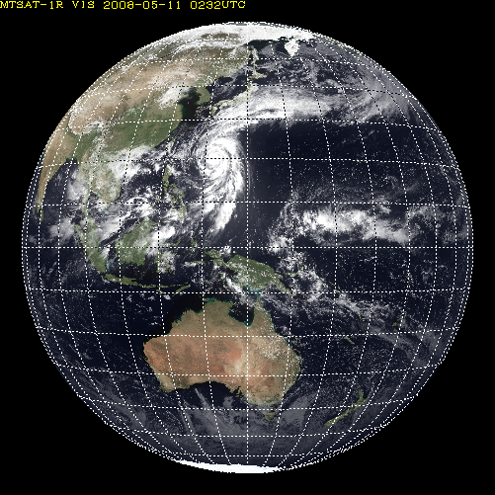
AHI Sectored Observations in 10 minutes
Full disk
Interval : 10 minutes (6 times per hour)
23 swath
Region 1 JAPAN (North-East)
Interval : 2.5 minutes (4 times in 10minutes)
Dimension : EW x NS: 2000 x 1000 km
2 swath
Region 1
N-E JAPAN
Region 2
S-W JAPAN
Region 3
Typhoon
Region 2 JAPAN (South-West)
Interval : 2.5 minutes (4 times in 10minutes)
Dimension : EW x NS: 2000 x 1000 km
2 swath
Region 3 Typhoon
Interval : 2.5 minutes (4 times in 10minutes)
Dimension : EW x NS: 1000 x 1000 km
2 swath
Region 5
Land mark
Region 4
Land mark
Region 4 Land mark
Interval : 0.5 minutes (20 times in 10minutes)
Dimension : EW x NS: 1000 x 500 km
1 swath
Region 5 Land mark
Interval : 0.5 minutes (20 times in 10minutes) Dimension : EW x NS: 1000 x 500 km
1 swath

Slide 7




































































4.3 COMS & GEO-KOMPSAT-2A
resolution 4times upgrade
channel 3times increase
products 3.5 times increase
COMS
Geo-KOMPSAT-2A
COMS
Geo-KOMPSAT-2A
COMS
VIS 1km
IR 4km
Geo-KOMPSAT-2A
VIS 0.5~1km
IR 2km
1
(Black and white)
4
(color image)
Cloud/pre. : 5
Cloud/pre. :19
VIS
Observation frequency 4 times
Aerosol : 5
Aerosol : 16
1hr
2
SW
IR
O
Full disk : 1
Full disk : 4
AMV : 3
AMV : 6
4
10
NH : 2
NH : 10
IR
Land sfc. : 3
Land sfc. : 11
…....
KP : every 15min
KP : every 2min
5 channel
16 channel
Total : 16
Total : 52

Slide 8
Outline
Geo Global Constellation
GOES-R ABI Rapid Scans
  Baseline and Exploratory scan strategies
ABI Level 2 Products
GOES SRSOR
  2015
Lockheed Martin

Slide 9
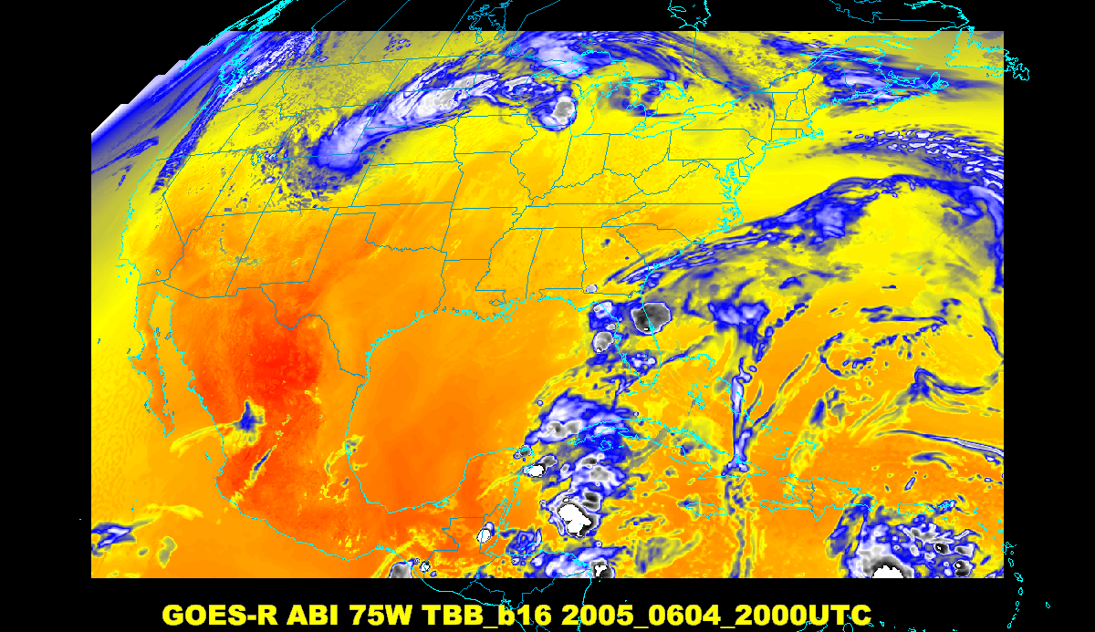
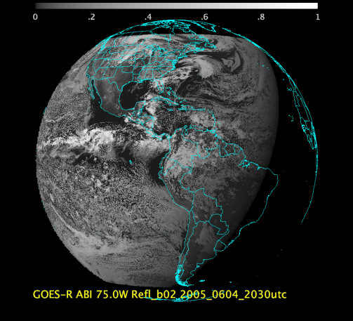
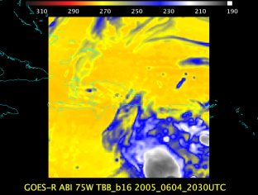
Baseline ABI Scan Modes
Scan mode (3) or ‘flex mode’ for the ABI:
- Full disk every 15 minutes + 5 min CONUS
+ 1-min mesoscales (2 locations).
[Scan mode (4) or ‘Continuous Full Disk’ (CFD) is a full disk every 5 min]
Notes:
CONUS image is the shifted center point.

Slide 10
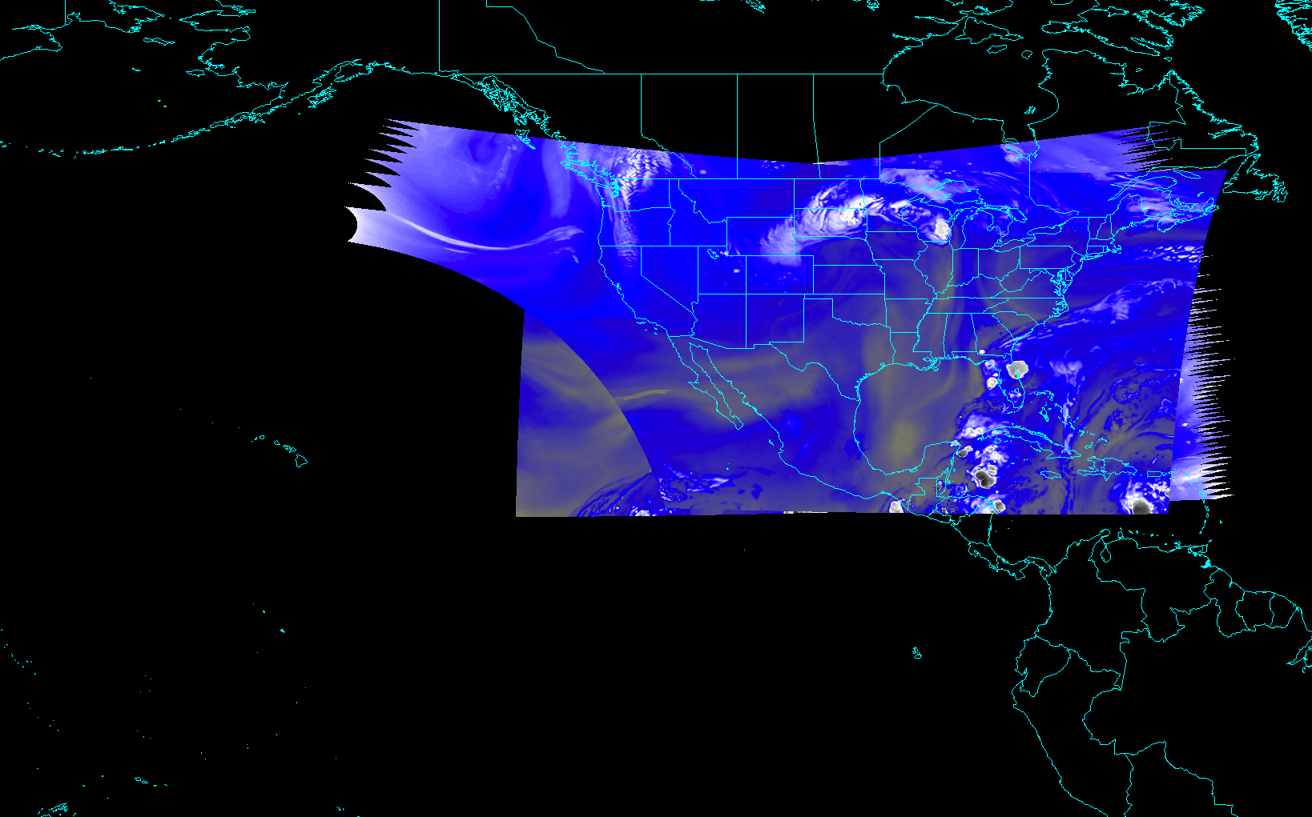
CONUS from East and West (PUG Volume 4 Version C)
Notes:
Different days simulated.

Slide 11
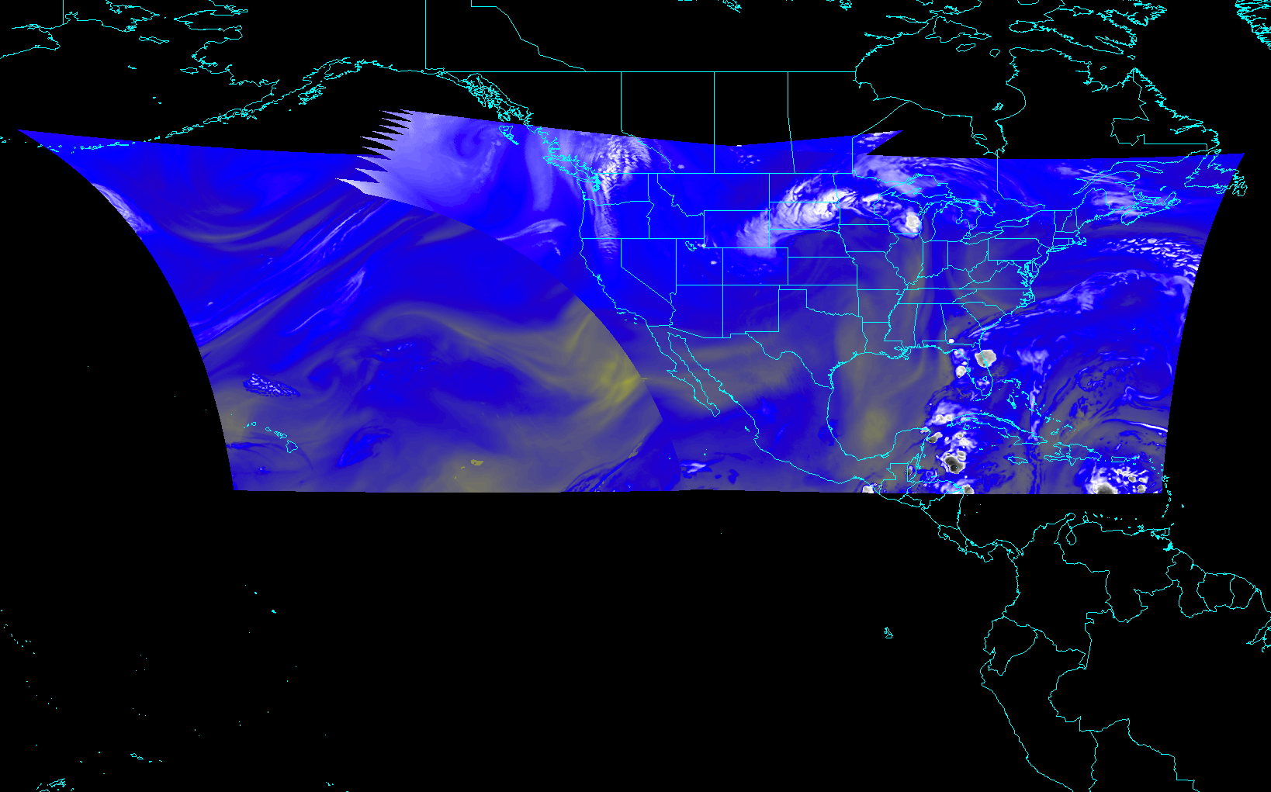
CONUS from East and West (NOAT/GORWG-approved)
Notes:
Different days simulated.

Slide 12
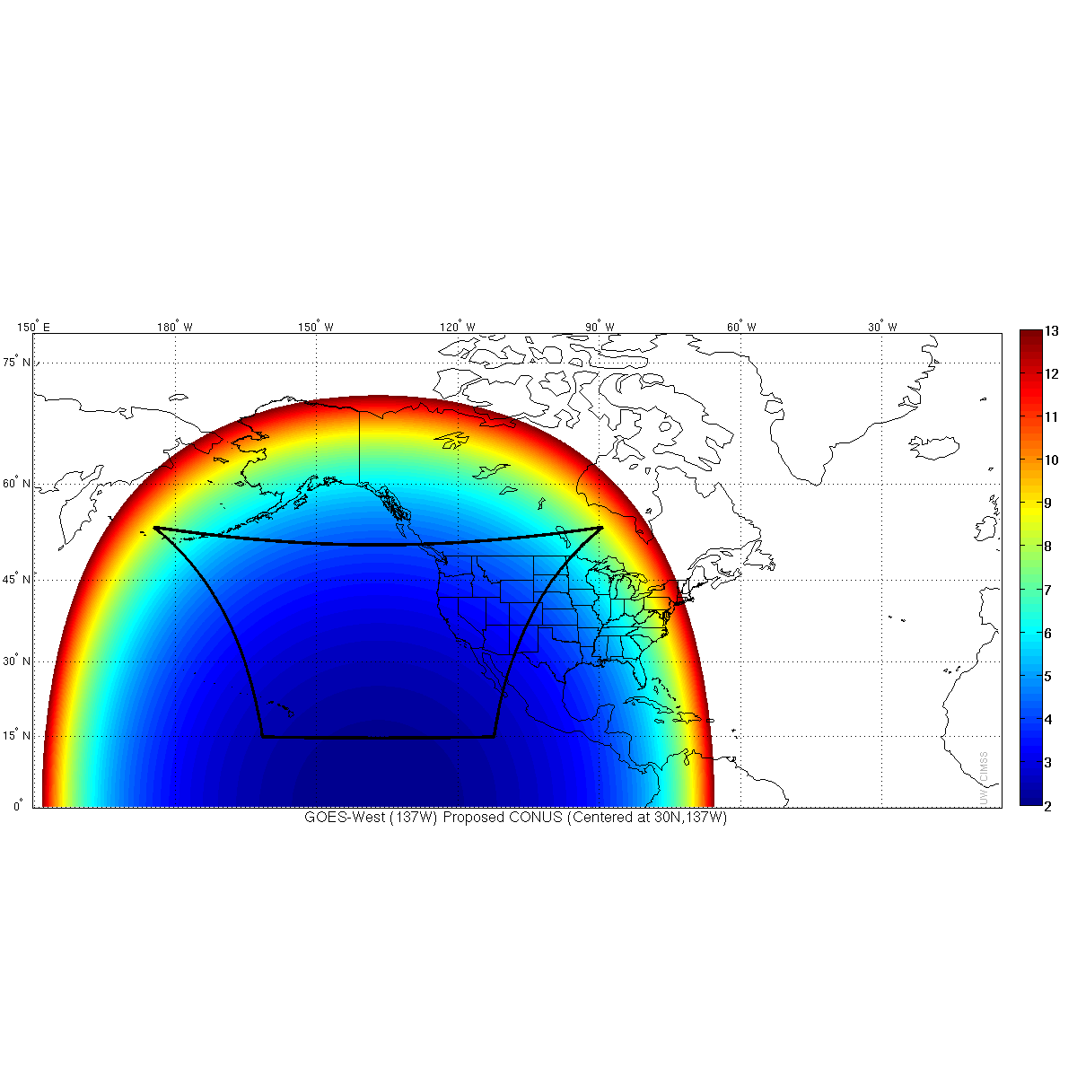
ABI CONUS: West
(with increasing pixel size)
Notes:
GORWG-approved

Slide 13
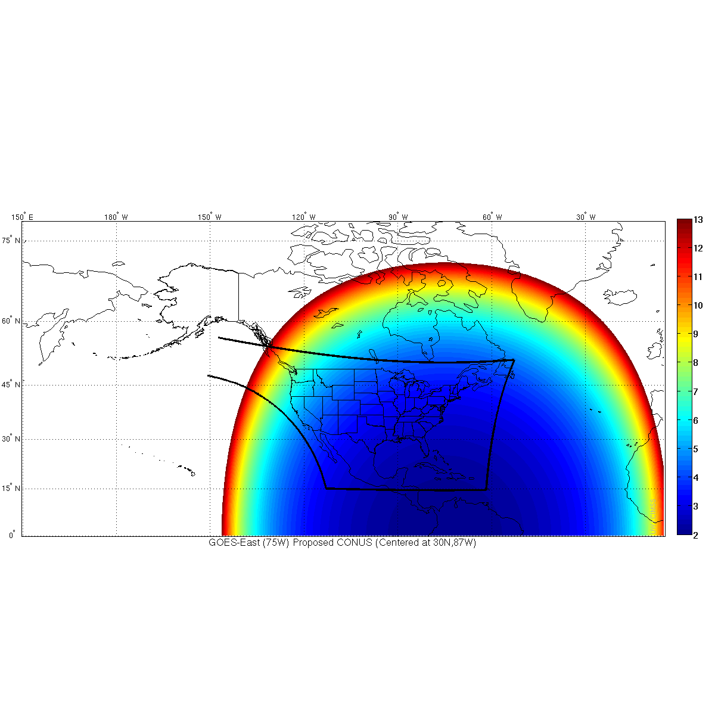
ABI CONUS: East
(with increasing pixel size)
Note the northwest corner of the scan sees into space
Notes:
GORWG-approved

Slide 14
Recent Mode 3 “Time-Time” chart
Note the ‘white’ space is instrument idle time.
DRAFT!!!!!
Notes:
Copy and pasted from excel. Pasted as a picture. Resized to 44% by 44% of original. Arrange -> Align -> Align Center & Align Middle

Slide 15
Baseline Time-Time Mode 4
This is the Continuous Full Disk (every 5 min) mode
This is the highest data rate.

Slide 16
Exploratory ABI Scan Mode (draft)
At some point, other ABI scan modes could be possible.
  requires an upgrade to the ground system.
  ABI instrument is capable of supporting other scan modes.
One option is to use the ‘white space’ of when the ABI instrument is not scanning in mode 3 (‘flex’). For example, increase to an ‘extended CONUS’ image.
There are other optimized scan options as well, such as investigating a FD scan every 10 min to sync with global constellation (EUMETSAT, AHI, AGRI, etc.).

Slide 17
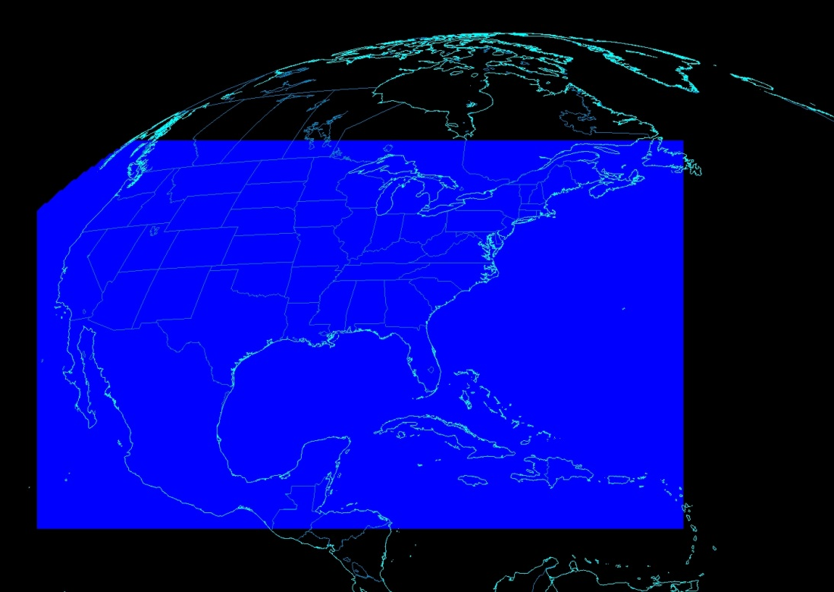
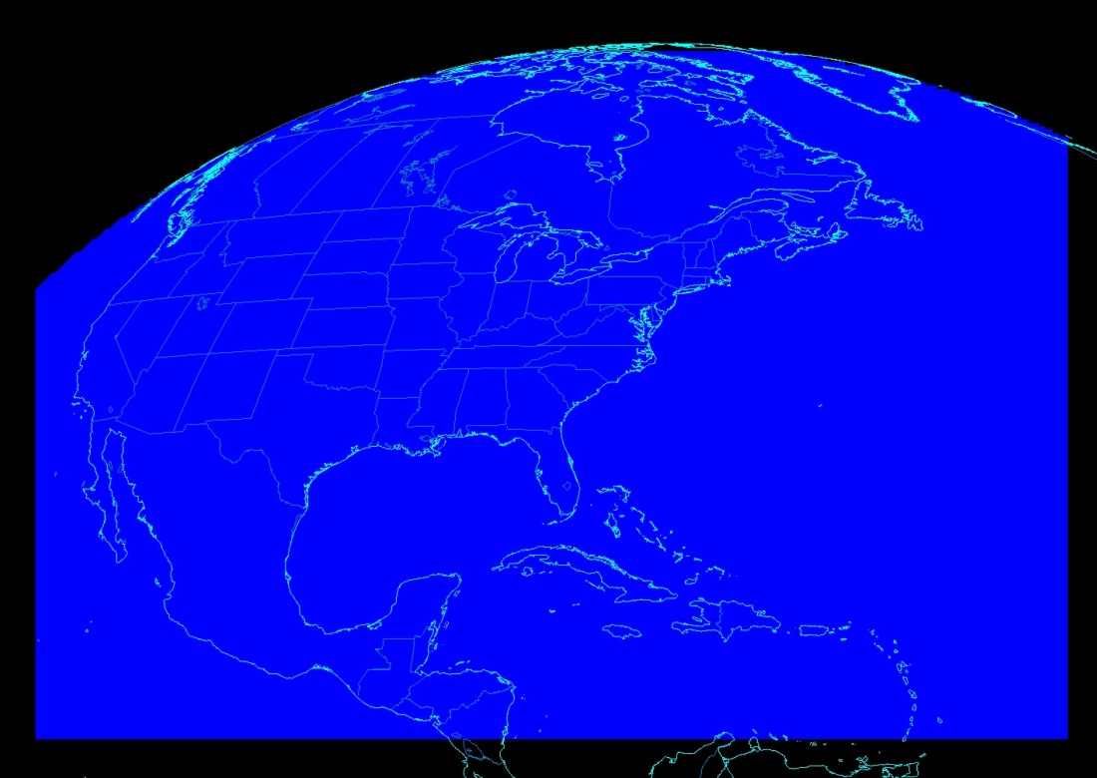
ABI CONUS Sector Size
Working on extending the ABI CONUS size to better address operational needs (and use time when the ABI instrument would be idle)
This would need a ground system upgrade
Other scan modes are being explored
Mode 3
Current CONUS Sector for ABI
Mode “3a”
Proposed CONUS Sector for ABI

Slide 18
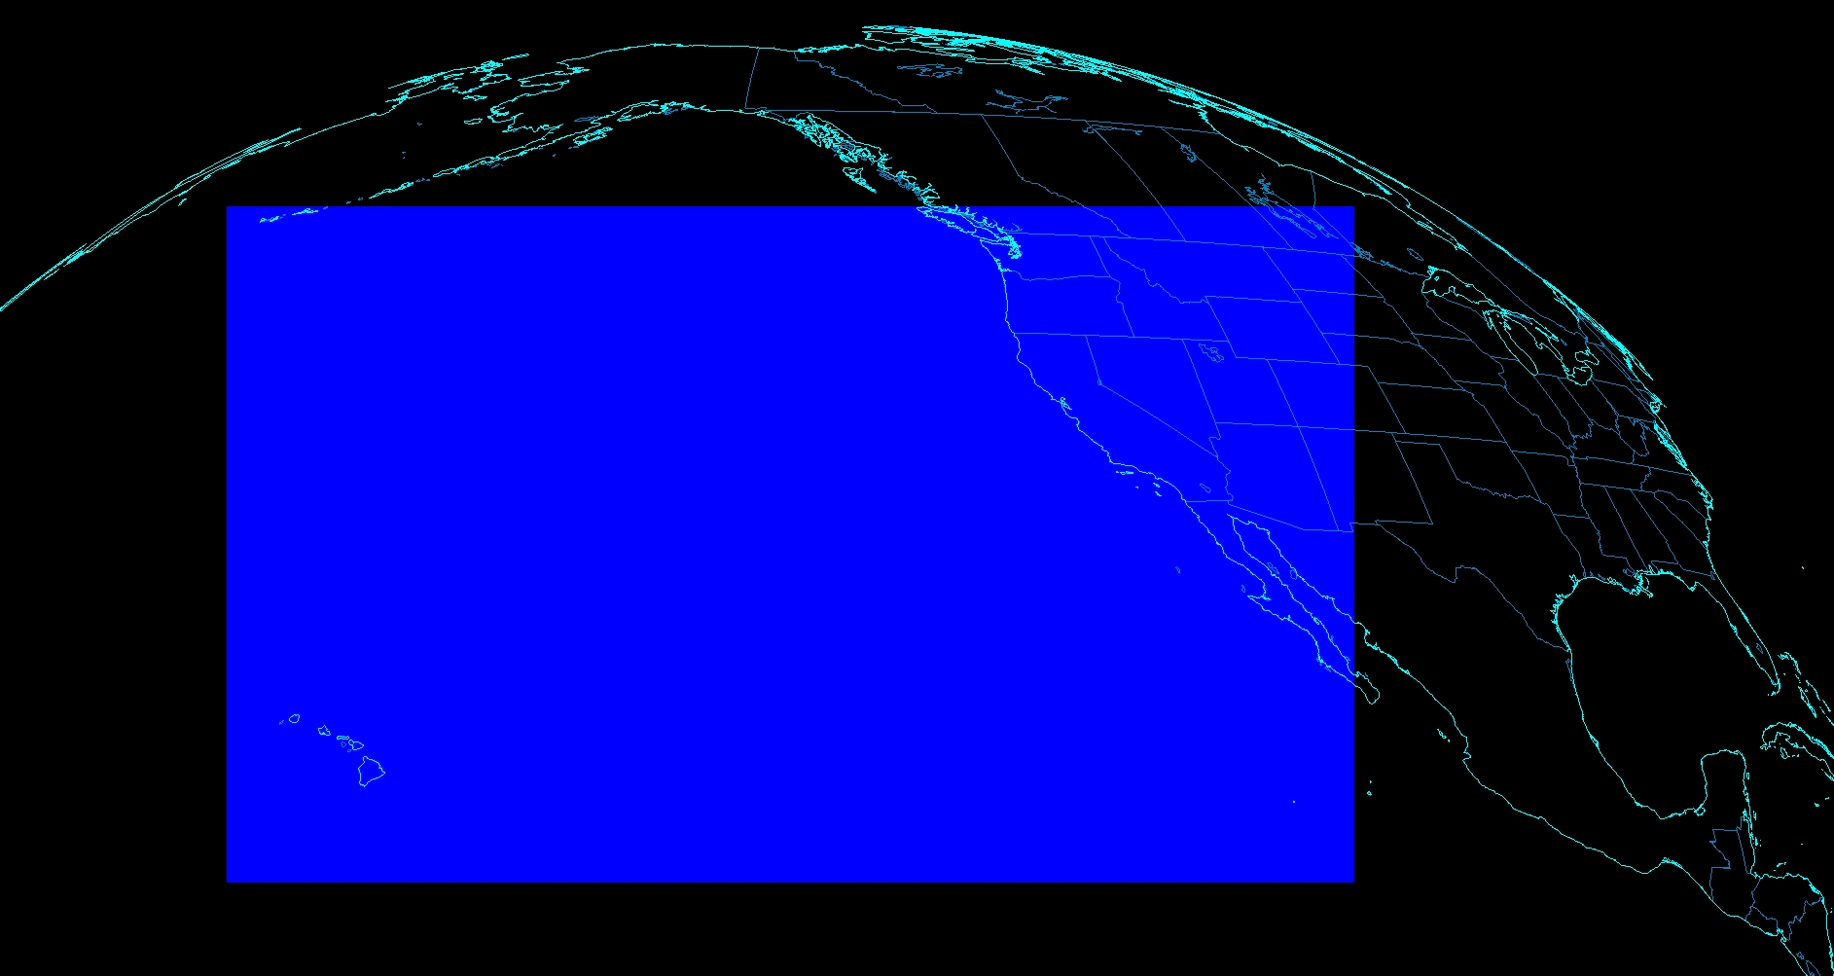
Extent of planned ABI CONUS image
CONUS from 137W

Slide 19
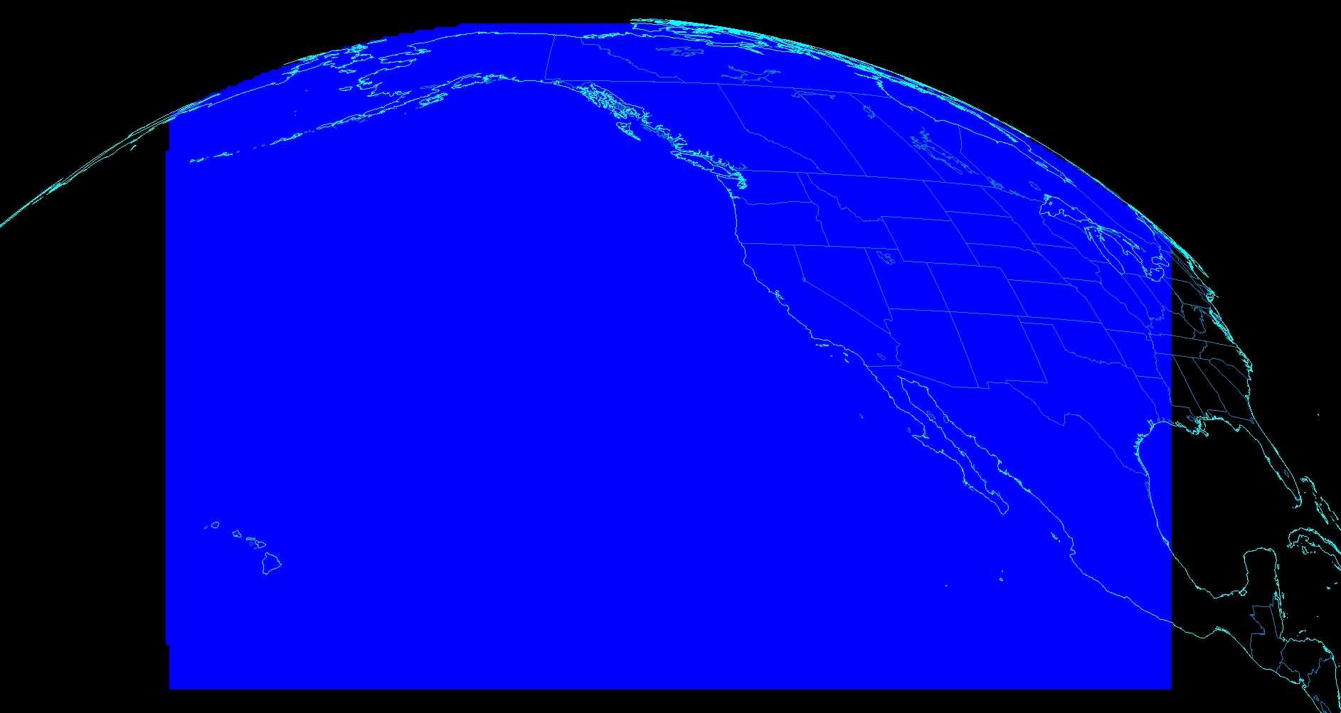
Alaska
Gulf of Alaska
Canada
Great
Plains
Volcanoes
Extent of planned ABI CONUS image
Proposed Extended ‘CONUS’ from 137W

Slide 20
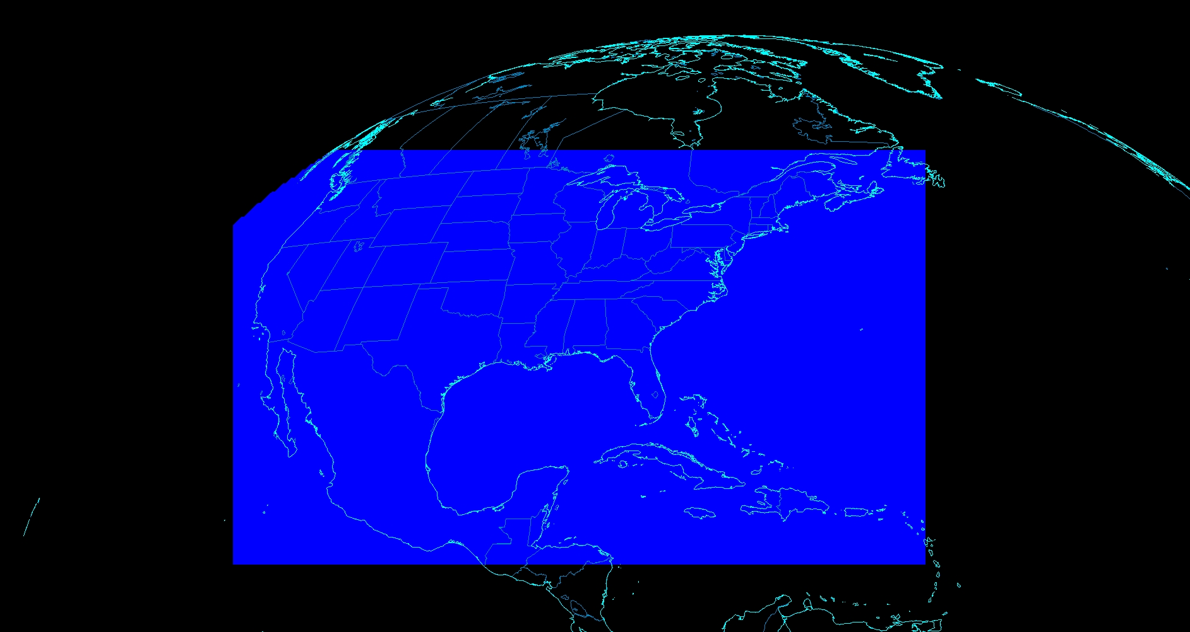
CONUS from 75W

Slide 21
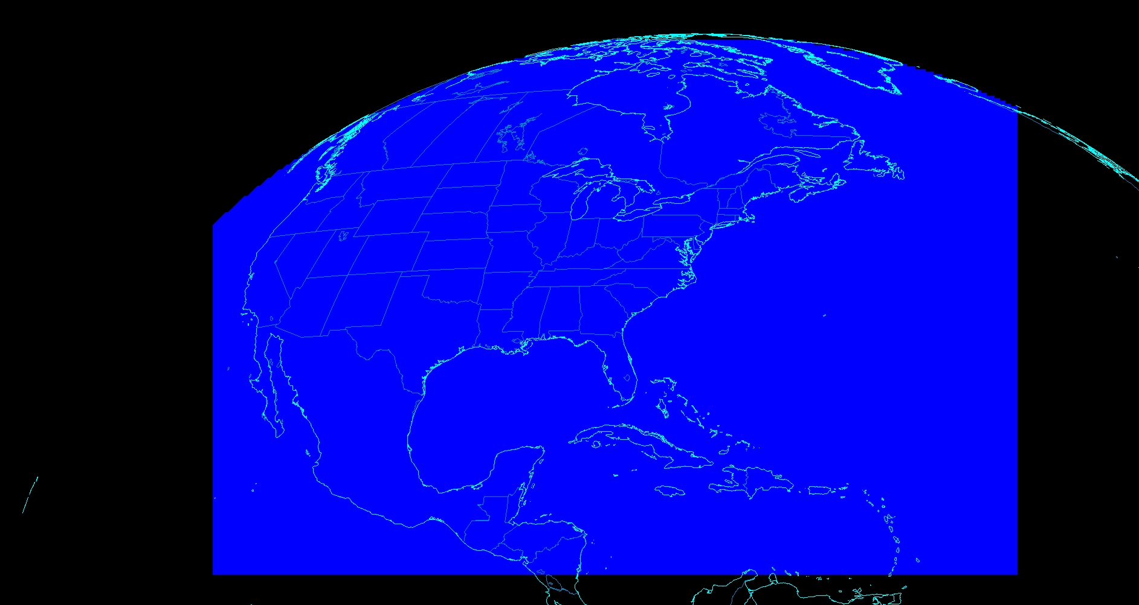
Canada
Atlantic
Atlantic
Volcanoes
Proposed Extended ‘CONUS’ from 75W

Slide 22
Draft Scan Mode ”6” with 10-min FD
In 10-min:
  1 Full Disk +
  2 CONUS +
  20 Meso-scale
The 10-min Full Disk would offer synergy with other geos and improved AMVs outside of CONUS, plus still allow for meso-scale observations.
This draft mode 6 ideally could be tested during PLPT (Post Launch Products Test).
This mode should be easier to implement at the Ground System, sense the scan sectors are the same size/locations as in mode 3.
DRAFT!
Notes:
Copy and pasted from excel. Pasted as a picture. Resized to 44% by 44% of original. Arrange -> Align -> Align Center & Align Middle

Slide 23
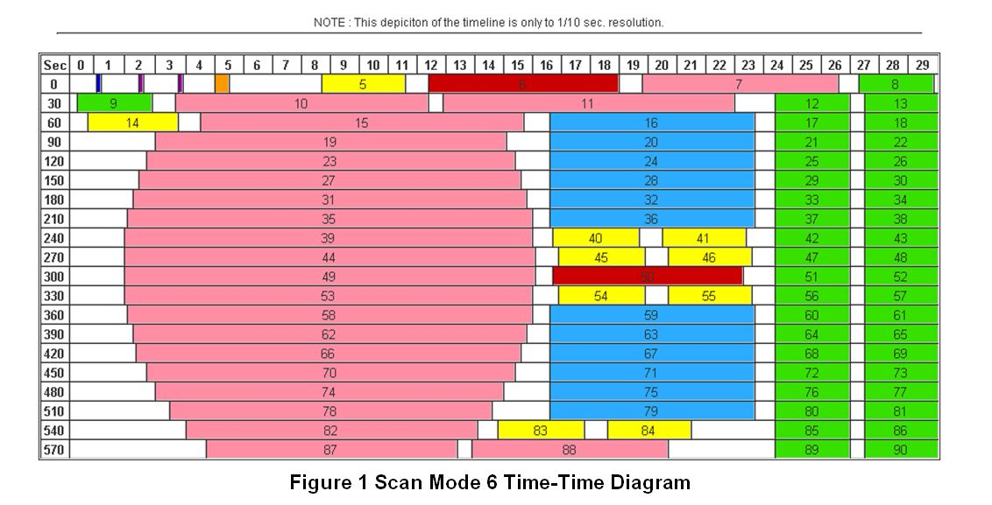
Draft Scan Mode ”6” with 10-min FD
Note less ‘white space’ than scan mode 3 (flex mode)
Time-time diagram from Exelis
Notes:
Copy and pasted from excel. Pasted as a picture. Resized to 44% by 44% of original. Arrange -> Align -> Align Center & Align Middle

Slide 24
Outline
Geo Global Constellation
GOES-R ABI Rapid Scans
  Baseline and Exploratory scan strategies
ABI Level 2 Products
GOES SRSOR
  2015
Lockheed Martin

Slide 25
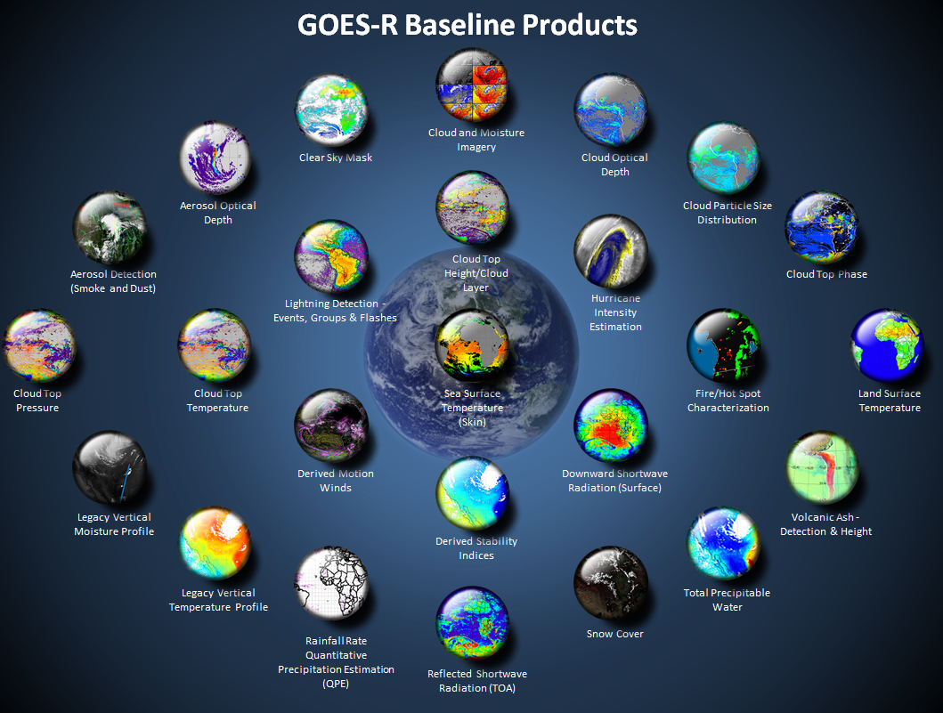
http://www.goes-r.gov

Slide 26
GOES-R ABI Products
Baseline Products
Future Capabilities
Advanced Baseline Imager (ABI)
Aerosol Detection (Including Smoke and Dust) Aerosol Optical Depth (AOD) Clear Sky Masks Cloud and Moisture Imagery Cloud Optical Depth Cloud Particle Size Distribution Cloud Top Height Cloud Top Phase Cloud Top Pressure Cloud Top Temperature Derived Motion Winds Derived Stability Indices Downward Shortwave Radiation: Surface Fire/Hot Spot Characterization Hurricane Intensity Estimation Land Surface Temperature (Skin) Legacy Vertical Moisture Profile Legacy Vertical Temperature Profile Radiances Rainfall Rate/QPE Reflected Shortwave Radiation: TOA Sea Surface Temperature (Skin) Snow Cover Total Precipitable Water Volcanic Ash: Detection and Height
Advanced Baseline Imager (ABI)
Absorbed Shortwave Radiation: Surface Aerosol Particle Size Aircraft Icing Threat Cloud Ice Water Path Cloud Layers/Heights Cloud Liquid Water Cloud Type Convective Initiation Currents Currents: Offshore Downward Longwave Radiation: Surface Enhanced “V”/Overshooting Top Detection Flood/Standing Water Ice Cover Low Cloud and Fog Ozone Total Probability of Rainfall Rainfall Potential Sea and Lake Ice: Age Sea and Lake Ice: Concentration Sea and Lake Ice: Motion Snow Depth (Over Plains) SO₂ Detection Surface Albedo Surface Emissivity Tropopause Folding Turbulence Prediction Upward Longwave Radiation: Surface Upward Longwave Radiation: TOA Vegetation Fraction: Green Vegetation Index Visibility

Slide 27
ABI Level 2 Product Generation (draft)
After the ground system has been accepted by the government, it might be a good time to consider optimizing product generation
Ideally, full spatial resolution, coupled with reasonable temporal resolution would be done for products for a given phenomena. For example, does it make since for some cloud products to be generated at a reduced resolution?
Some products could be produced less often, while some may need to be produced more often, to be consistent with other products.

Slide 28
ABI Level 2 Product Generation (draft)
Consider re-visiting product generation, working with key stakeholders. This would be based on bringing a consistency by type/phenomena to product generation.
For example,
5min CONUS aerosol optical depth, but15min aerosol detection?
Only 15min for volcanic ash?
Cloud top phase at 2km, but cloud top height at 10km (CONUS)?
No mesoscale fire detection?
60min land surface temperature from the mesoscale sector?
60min snow cover from the mesoscale sector? (which must be embedded in the 60min full disk)
etc.

Slide 29
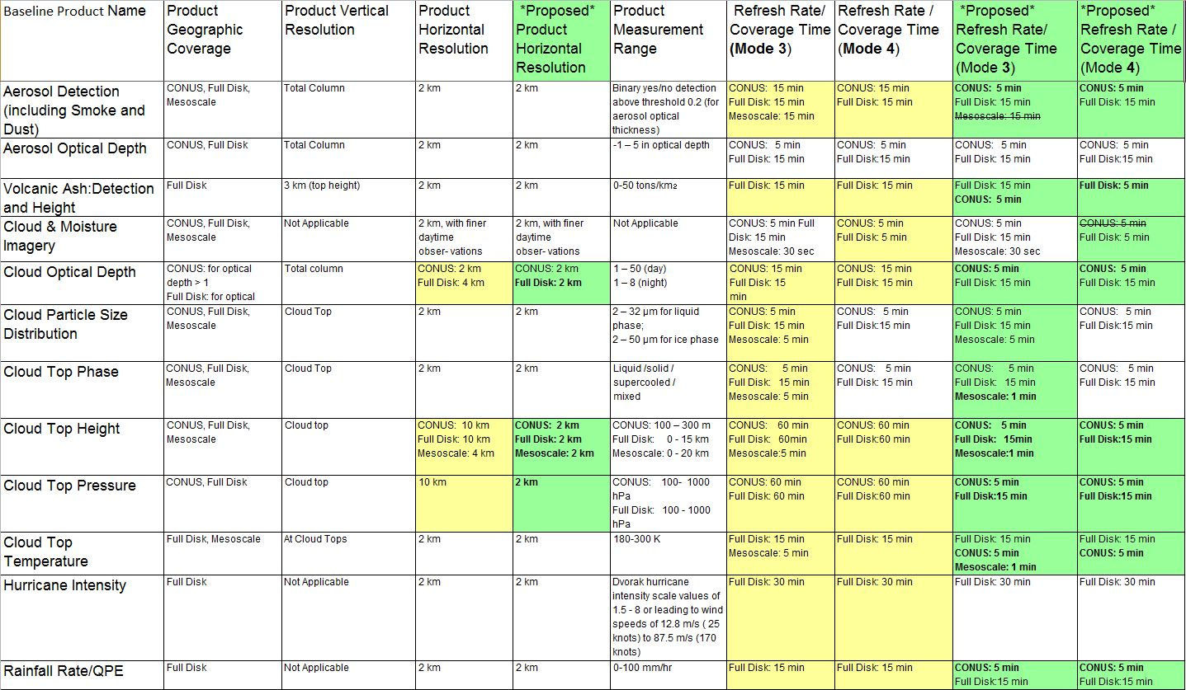
F&PS (Proposed only that!)

Slide 30
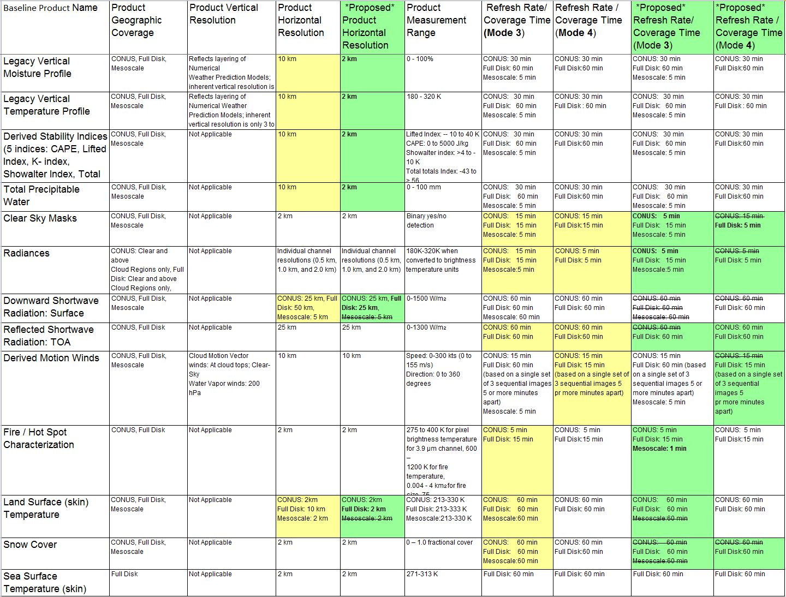

Slide 31
Outline
Geo Global Constellation
GOES-R ABI Rapid Scans
  Baseline and Exploratory scan strategies
ABI Level 2 Products
GOES SRSOR
  2015
Lockheed Martin

Slide 32
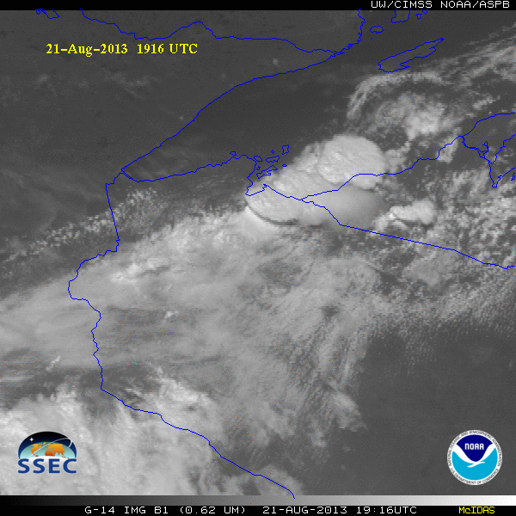
GOES-14 Super Rapid Scan Operations to Prepare for GOES-R (SRSOR)
SRSOR plans for 2015 include May 18-June 12, and August 10-22:
  http://cimss.ssec.wisc.edu/goes/srsor2015/GOES-14_SRSOR.html
  Data during parts of 2012 (Hurricane Sandy, convection), 2013 (CA Rim Fire, convection) and 2014 (Hurricane Marie, convection):
  http://cimss.ssec.wisc.edu/goes/srsor/GOES-14_SRSOR.html
  http://cimss.ssec.wisc.edu/goes/srsor2013/GOES-14_SRSOR.html
  http://cimss.ssec.wisc.edu/goes/srsor2014/GOES-14_SRSOR.html
GOES-14 provided very unique data and offered a glimpse into the possibilities that will be provided by the ABI on GOES-R in one minute mesoscale imagery
GOES-14 visible image showing rapid convective development

