Slide 1
ABI WRF-CHEM Proxy Decision Support
Brad Pierce, Todd Schaack, Marek Rogal, Kaba Bah, Tom Greenwald, Allen Lenzen, Jim Nelson, Jason Otkin, Jim Davies, Eva Borbas, Justin Sieglaff, Hung-Lung Huang, Tim Schmit, Andrew Heidinger
Presented at the CIMSS/Satellite Liaison Meeting, Madison WI, March 5-6, 2014

Slide 2
Background
GOES-R AWG real-time proxy system has been developed to:
Provide real-time proxy ABI data (including products) from WRF-Chem model forecasts over CONUS using the Community Radiative Transfer Model (CRTM) for all 16 ABI bands. Remap it to the ABI Fixed Grid Format, compatible with GOES-R Re-Broadcast Level 1b data
Provide a validation system for verification of model simulated ABI radiances and derived products
Community Impact:
System allows forecasters and other users to prepare for the new information that the ABI will provide on the atmosphere, clouds and the surface making use of the future GOES ReBroadcast (GRB) data and GOES-R ABI algorithms
These data can also be used for GOES-R pre-launch activities, such as testing GOES-R ground system throughput, and providing synthetic ABI imagery and products to AWIPS users
Realtime synthetic radiance imagery:
http://cimss.ssec.wisc.edu/goes_r/proving-ground/wrf_chem_abi/wrf_chem_abi.html
Realtime synthetic retrievals:
http://cimss.ssec.wisc.edu/goes_r/proving-ground/wrf_chem_abi/ABI-PRODUCTS/wrf_chem_abi_prod.html
Realtime synthetic GRB data:
ftp://ftp.ssec.wisc.edu/ABI/REALTIME_PROXY/

Slide 3
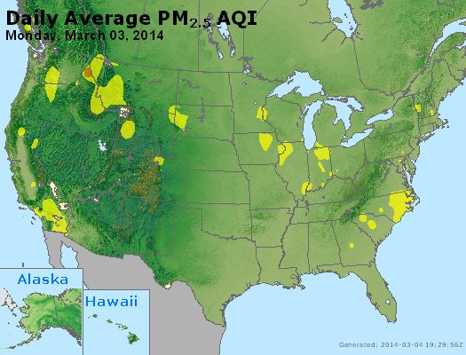
Surface Fine Particulate (<2.5 micron) PM2.5 Air Quality Index (AQI) March 03, 2014

Slide 4
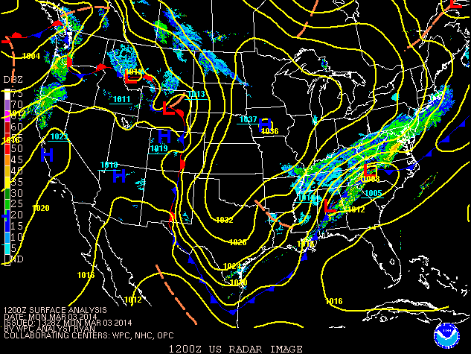
Radar reflectivity/Surface analysis: 12Z March 03, 2014

Slide 5
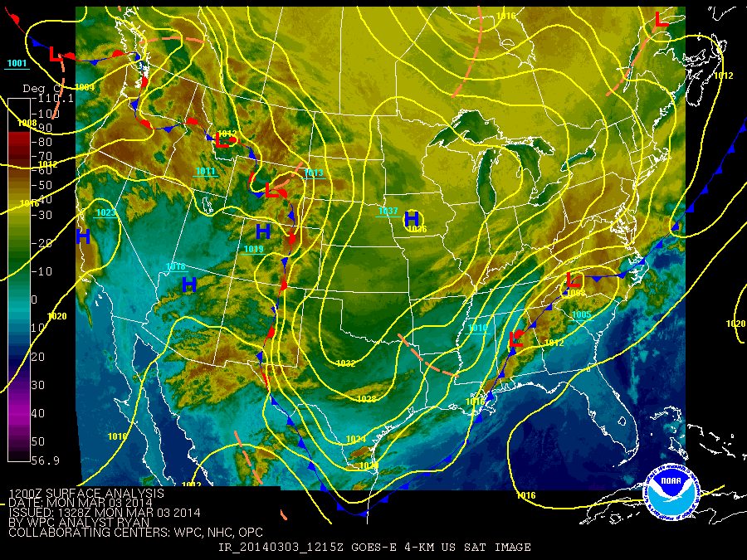
IR Satellite/Surface analysis: 12Z March 03, 2014

Slide 6
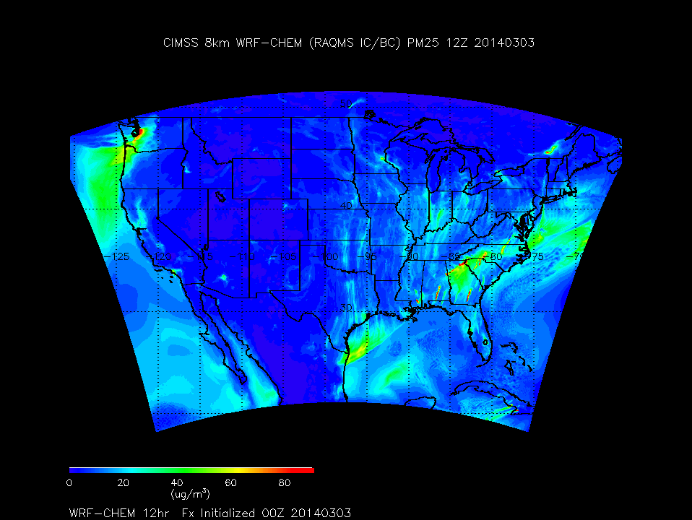
Forecasted Surface PM2.5: 12Z March 03 –12Z March 04, 2014

Slide 7
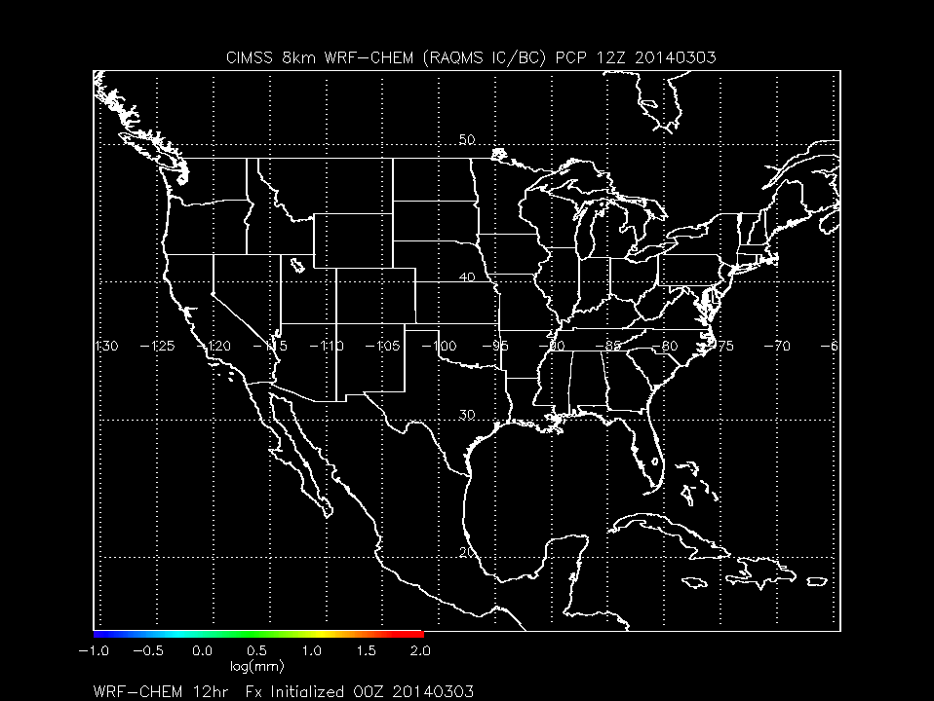
Forecasted Precipitation: 12Z March 03 –12Z March 04, 2014

Slide 8
GOES-R ABI CRTM Synthetic Radiances
0.5ºx0.5º
GFS
Meteorological Forecast
1ºx1º
RAQMS Aerosol Forecast
8x8km
WRF-Chem
Met/Aerosol Forecast (CONUS)
CRTM
Radiative Transfer
16 ABI bands
Synthetic Radiances

Slide 9
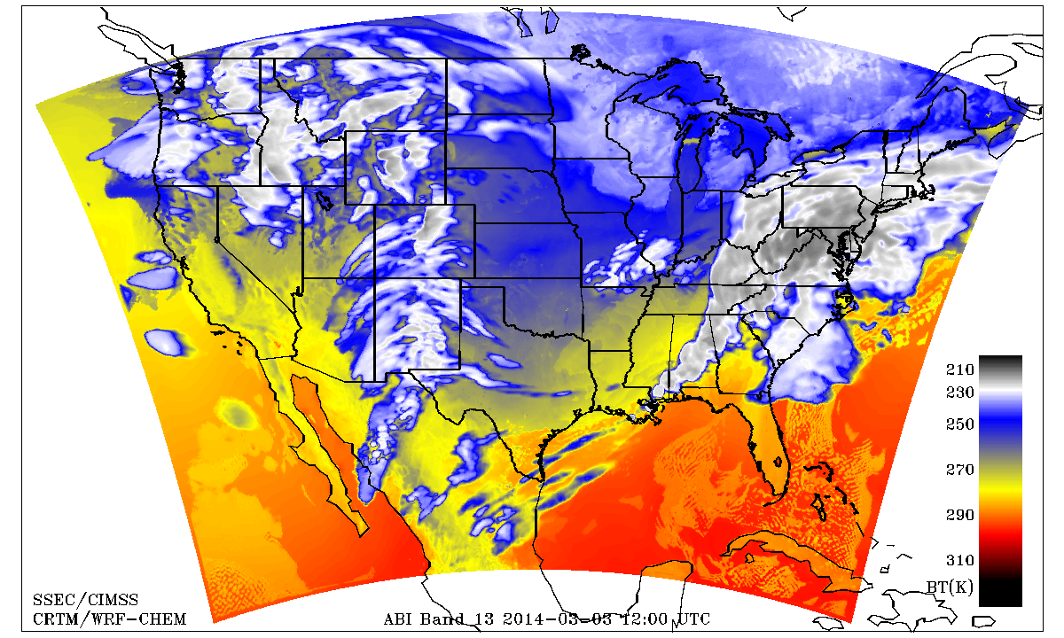
Synthetic ABI Band 13 (10.35micron) 12Z March 03 –12Z March 04, 2014
http://www.goes-r.gov/products/ATBDs/baseline/Imagery_v2.0_no_color.pdf

Slide 10
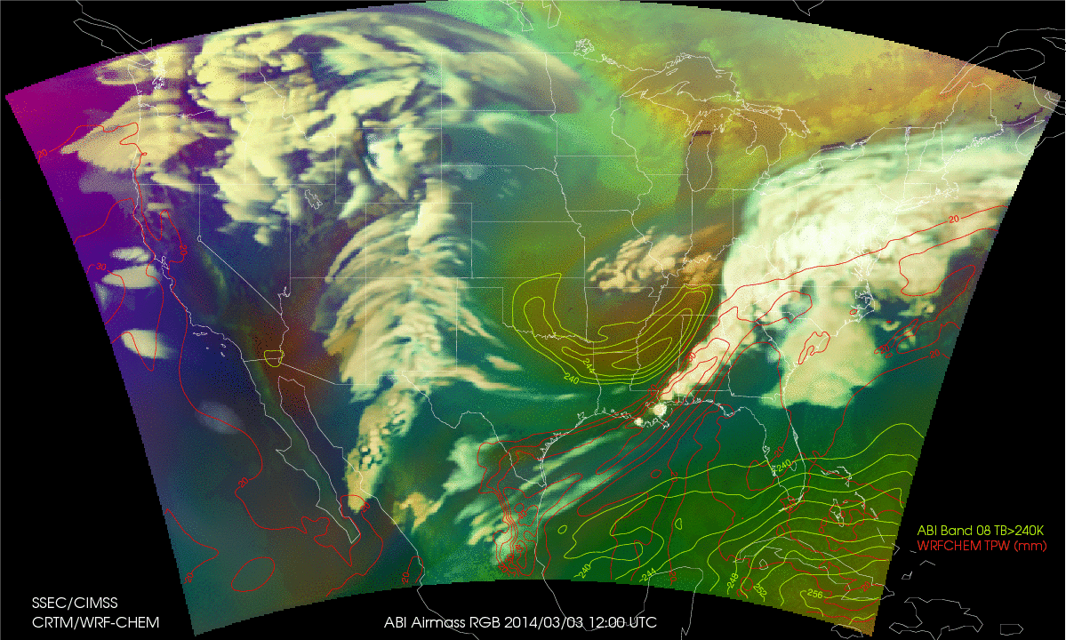
Synthetic ABI Airmass RGB 12Z March 03 – 12Z March 04, 2014
Color scheme:
Ozone-poor tropical air masses are green, ozone-rich polar air masses are blue
Dry air masses in the upper troposphere are red to orange
High-level clouds are white, Mid-level clouds are brown
Magenta (limb viewing, disregard)
http://www.goes-r.gov/users/comet/npoess/multispectral_topics/rgb/navmenu.php_tab_1_page_6.7.0.htm

Slide 11
GOES-R ABI Cloud Retrieval using Synthetic Radiances
0.5ºx0.5º
GFS
Meteorological Forecast
1ºx1º
RAQMS Aerosol Forecast
8x8km
WRF-Chem
Met/Aerosol Forecast (CONUS)
CRTM
Radiative Transfer
16 ABI bands
GEOCAT
GOES-R ABI
Cloud Retrieval
using Synthetic Radiances
2kmx2km Fixed Grid
Remap (GOES-R GRB)
Cloud Top Height
Synthetic Retrieval

Slide 12
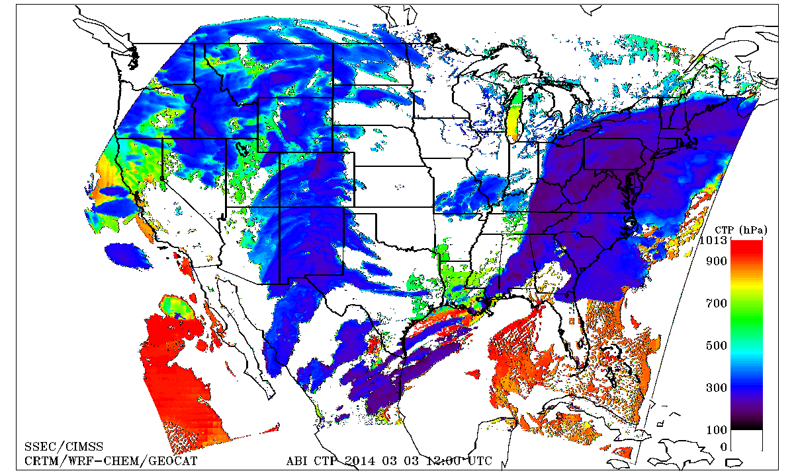
Synthetic ABI Cloud Top Pressure 12Z March 03 – 12Z March 04, 2014
http://www.goes-r.gov/products/ATBDs/baseline/Cloud_CldHeight_v2.0_no_color.pdf

Slide 13
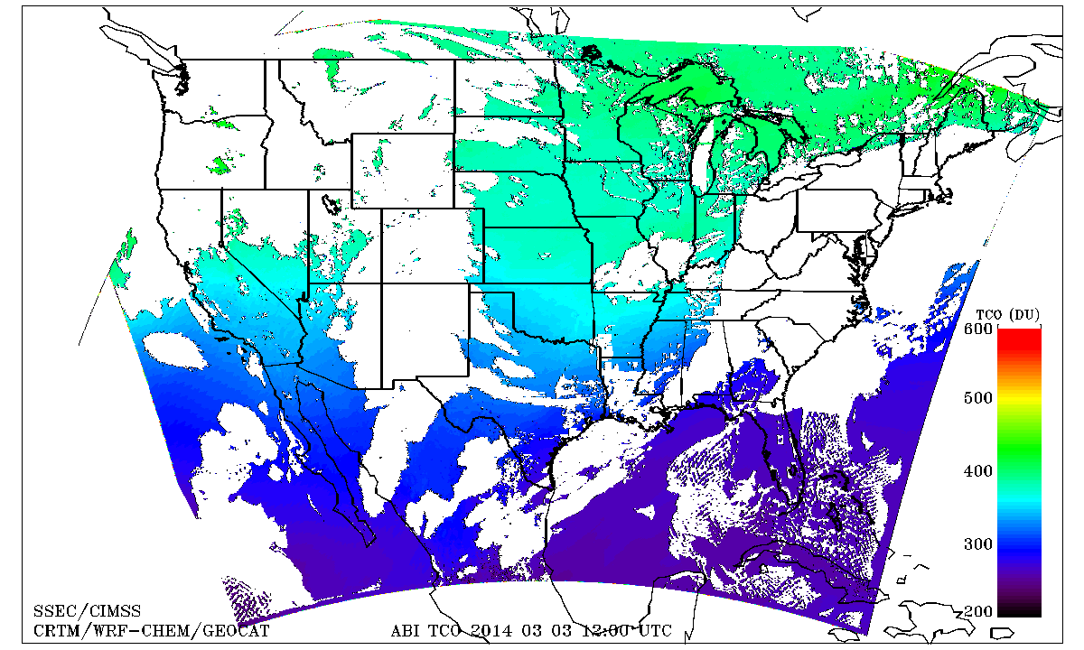
Synthetic ABI Total Column Ozone 12Z March 03 – 12Z March 04, 2014
http://www.goes-r.gov/products/ATBDs/option2/AAA_Ozone_V2.0_no_color.pdf

Slide 14
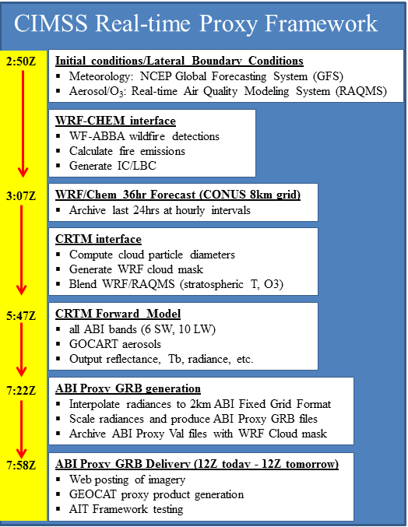
CRTM calculations use 16 day running mean MODIS BRDF retrievals for surface reflectivity
CRTM calculations use monthly mean climatological surface emissivity from the UW-Madison hyperspectral data base
Verification
GOES-13 Sounder data (collected at SSEC) are used to verify select IR and visible bands of the simulated ABI data.

Slide 15
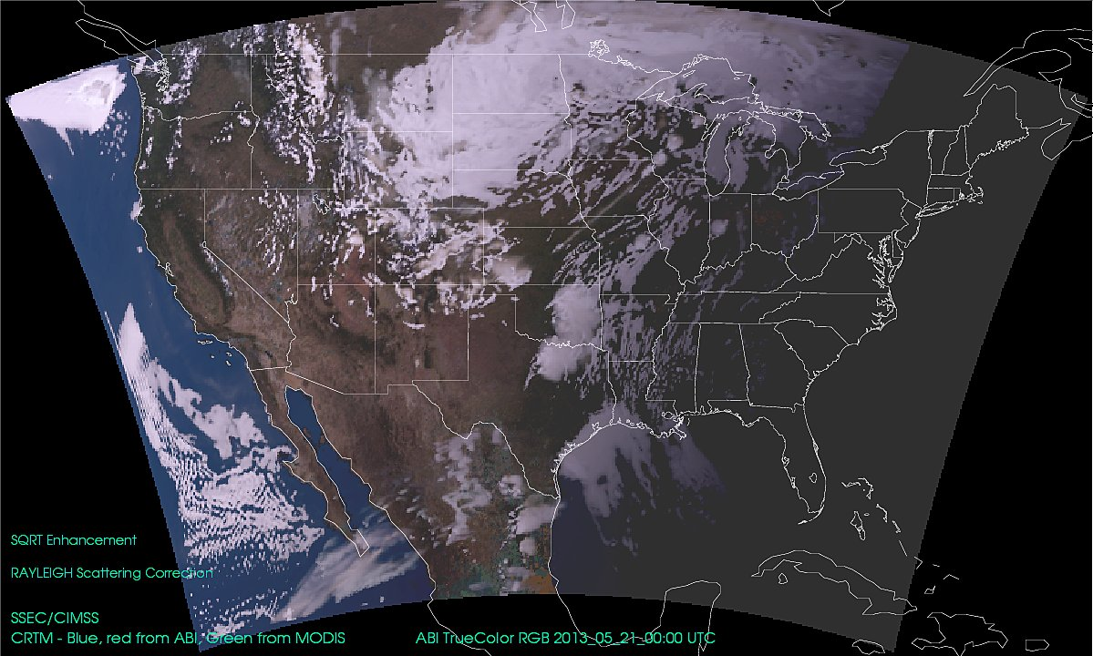
Moore OK Tornado Case Study
12Z May 20 to 12Z May 21, 2013

Slide 16
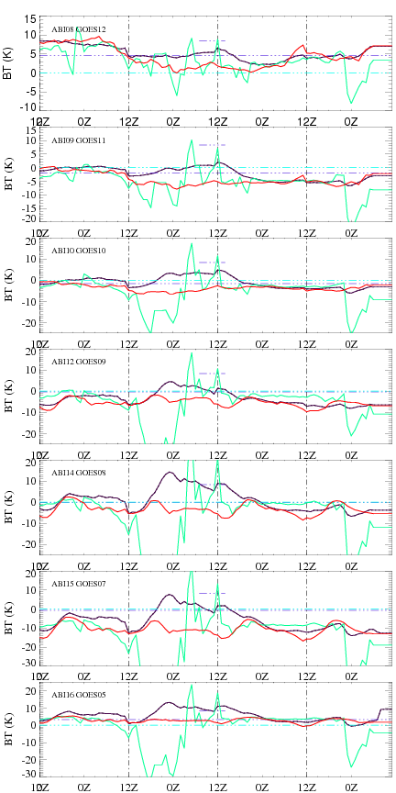
Comparison with GOES Sounder Channels
Synthetic ABI – GOES Timeseries
Red=All pixels
Black=Clear Pixels
Green=Cloudy pixels
Largest biases for cloudy pixels around 18Z May 18, and 00Z May 21st
ABI Band 08
18th
19th
20th
21st
ABI Band 09
ABI Band 10
ABI Band 12
ABI Band 14
ABI Band 15
ABI Band 16

Slide 17
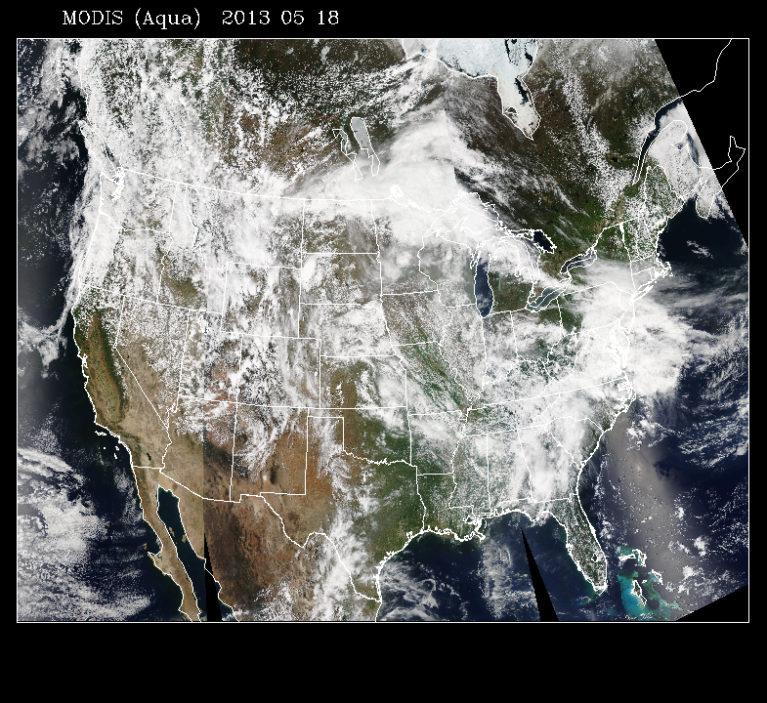
Comparison with GOES Sounder Channels
Synthetic ABI – GOES Timeseries
Red=All pixels
Black=Clear Pixels
Green=Cloudy pixels
Largest biases for cloudy pixels around 18Z May 18, and 00Z May 21st
ABI Band 08
18th
19th
20th
21st
ABI Band 09
ABI Band 10
ABI Band 12
ABI Band 14
ABI Band 15
ABI Band 16

Slide 18
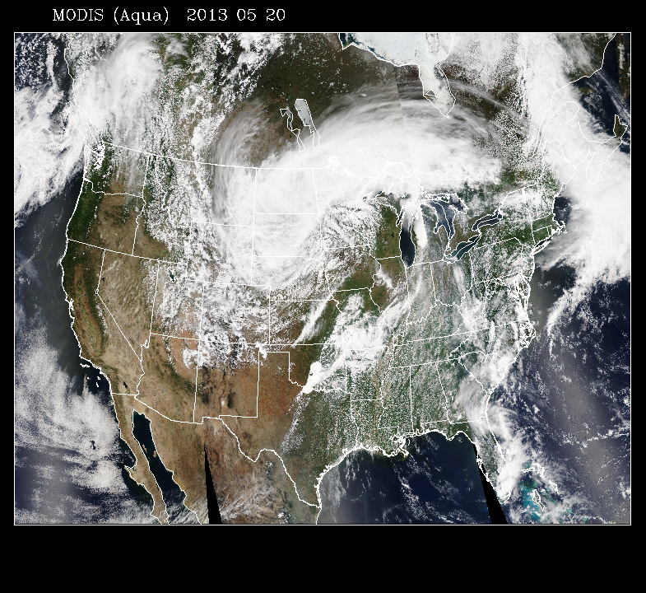
Comparison with GOES Sounder Channels
Synthetic ABI – GOES Timeseries
Red=All pixels
Black=Clear Pixels
Green=Cloudy pixels
Largest biases for cloudy pixels around 18Z May 18, and 00Z May 21st
ABI Band 08
18th
19th
20th
21st
ABI Band 09
ABI Band 10
ABI Band 12
ABI Band 14
ABI Band 15
ABI Band 16

Slide 19
Comparison with GOES Sounder Channels
Synthetic ABI – GOES Scatter Plot
(12Z May 17 – 12Z May 21, 2013)
ABI Band 08
ABI Band 09
ABI Band 10
ABI Band 12
ABI Band 14
ABI Band 15
ABI Band 16

Slide 20
Comparison with GOES Sounder Channels
Synthetic ABI – GOES Ranked Correlation
(12Z May 17 – 12Z May 21, 2013)

Slide 21
GOES-R ABI Profile Validation using Synthetic Retrievals
0.5ºx0.5º
GFS
Meteorological Forecast
1ºx1º
RAQMS Aerosol Forecast
1ºx1º
RAQMS Ozone Forecast
Truth
Total Column Ozone (TCO)
Truth
2x2km Fixed Grid
Remap (GOES-R GRB)
8x8km
WRF-Chem
Met/Aerosol Forecast (CONUS)
Total Precip Water (TPW)
Lifted Index (LI)
Validation:
WRF-Chem Truth
vs
ABI synthetic retrieval
CAPE
CRTM
Radiative Transfer
16 ABI bands
Total Column Ozone (TCO)
GEOCAT
GOES-R ABI
Legacy Profile Retrieval
using Synthetic Radiances
Total Precip Water (TPW)
2kmx2km Fixed Grid
Remap (GOES-R GRB)
Lifted Index (LI)
CAPE
Synthetic Retrieval

Slide 22
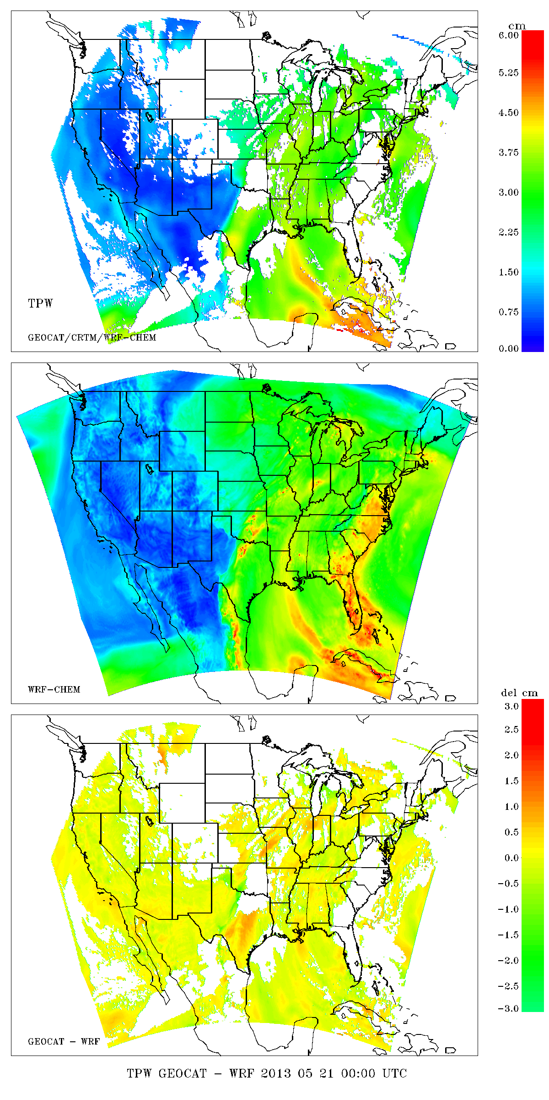
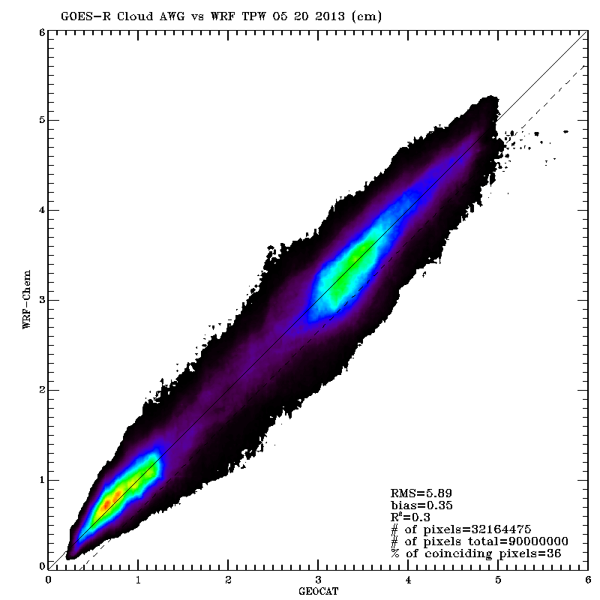
Synthetic Retrieval
Total Precip Water (TPW) Validation
Truth
Synthetic Retrieval - Truth

Slide 23
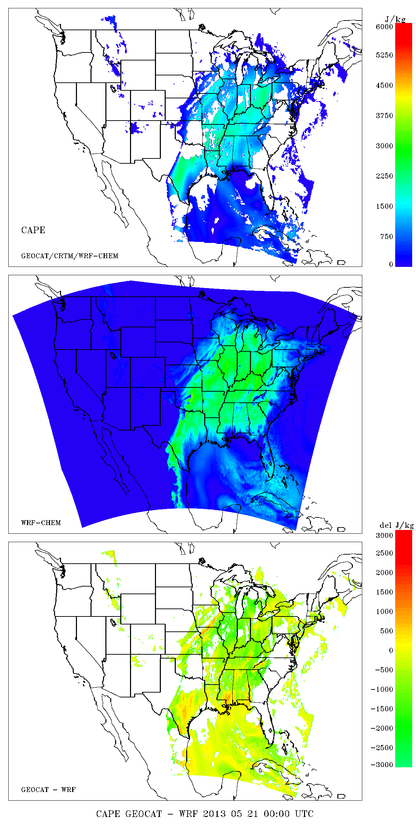
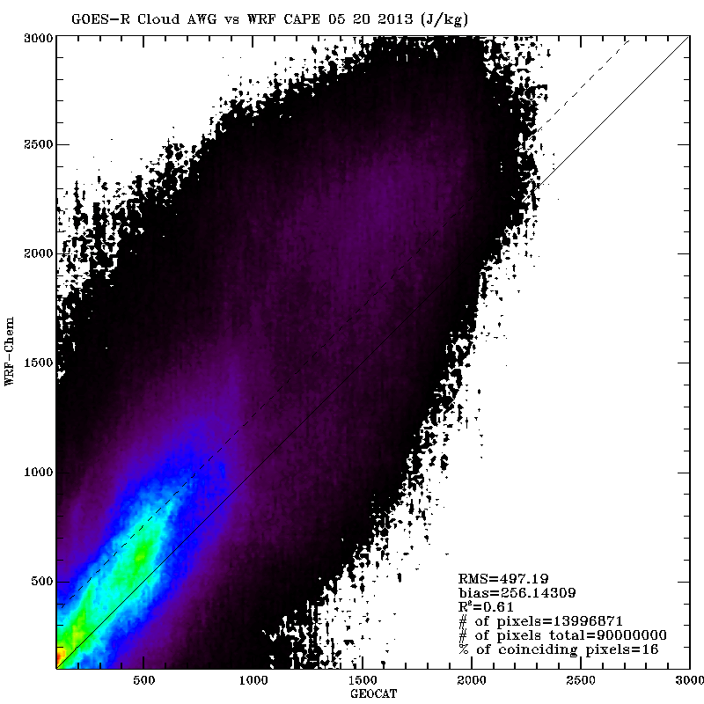
Synthetic Retrieval
CAPE Validation
Truth
Synthetic Retrieval - Truth

Slide 24
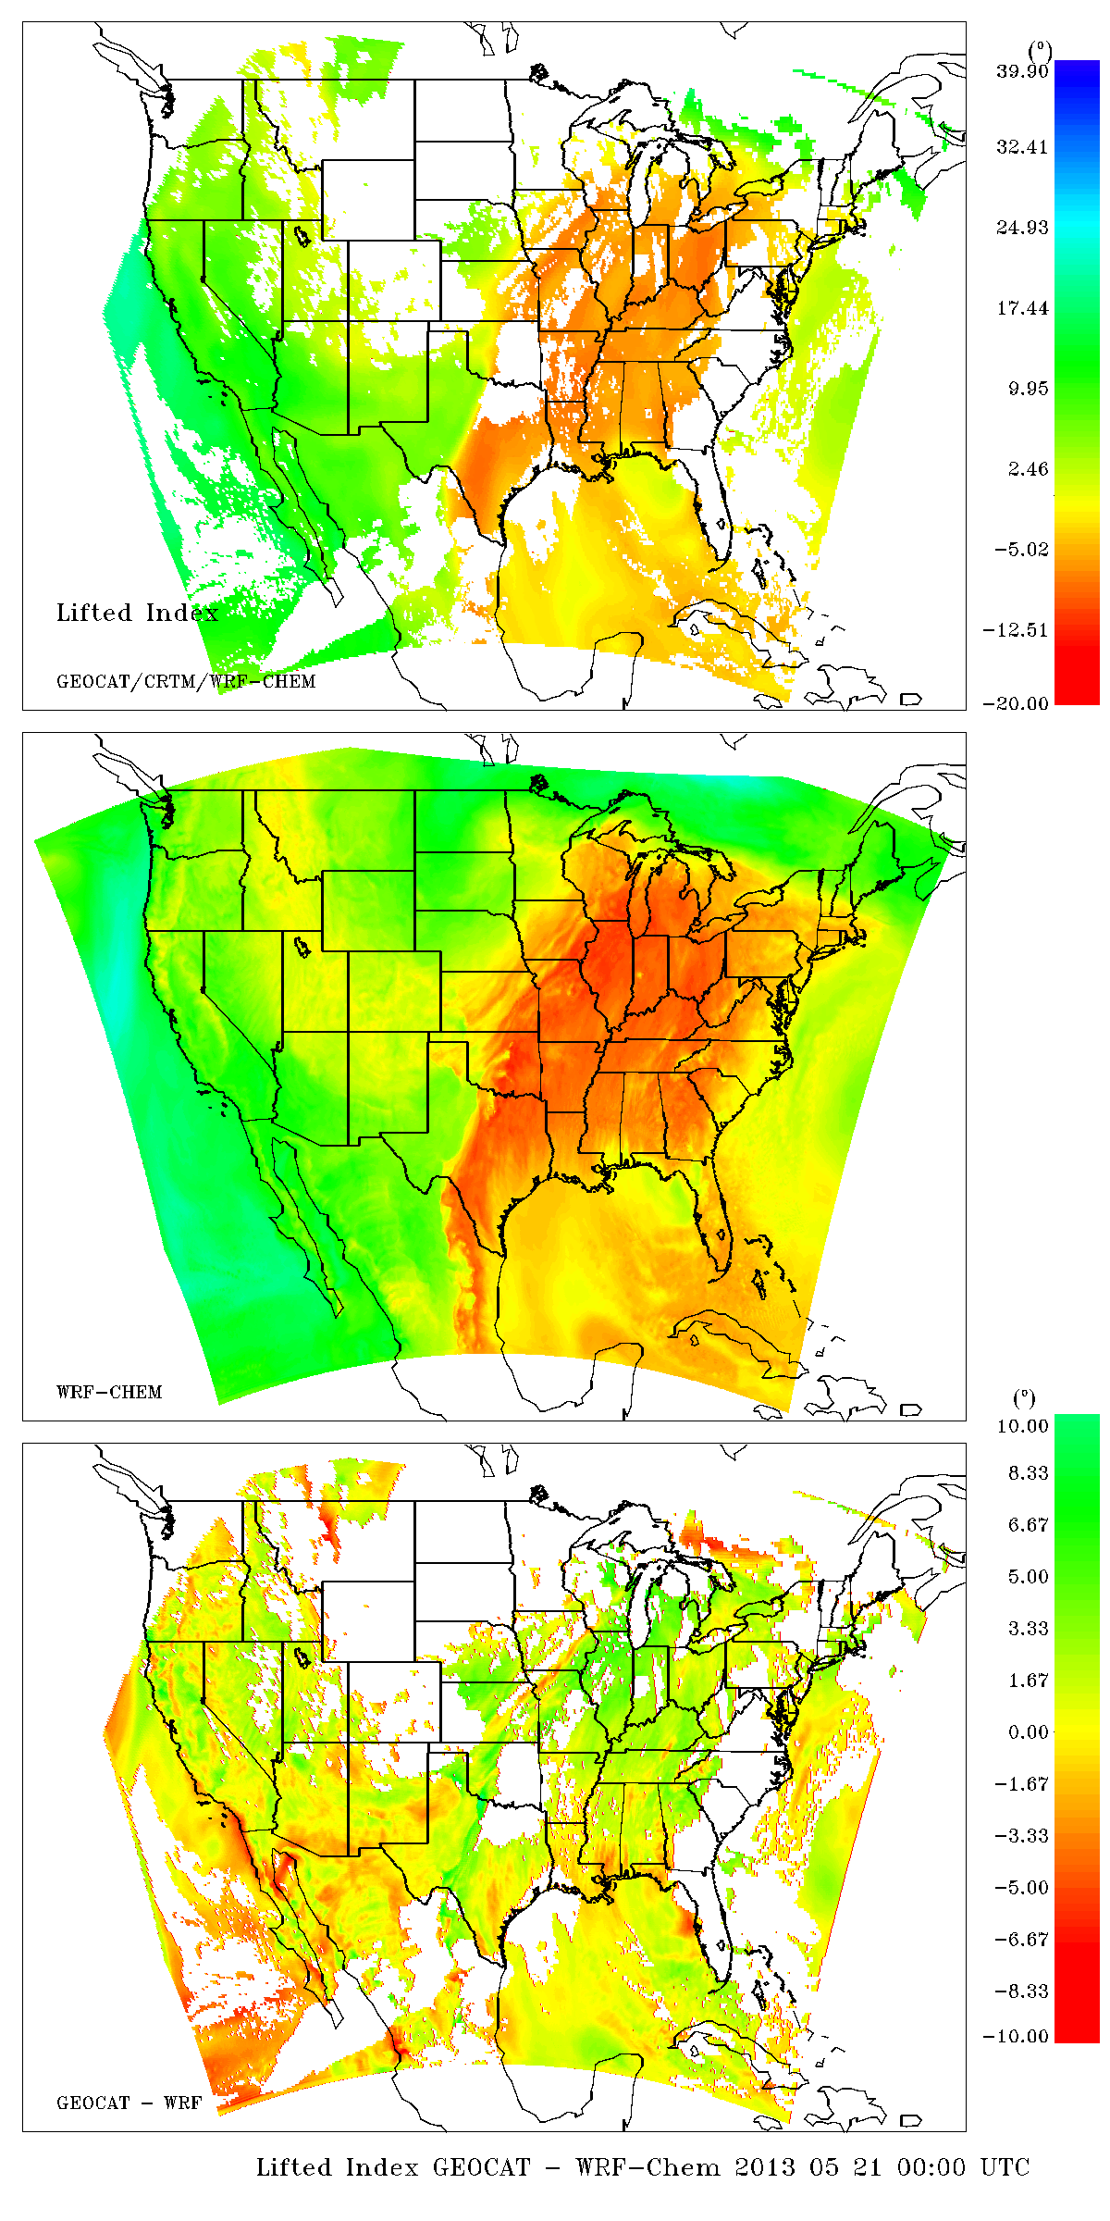
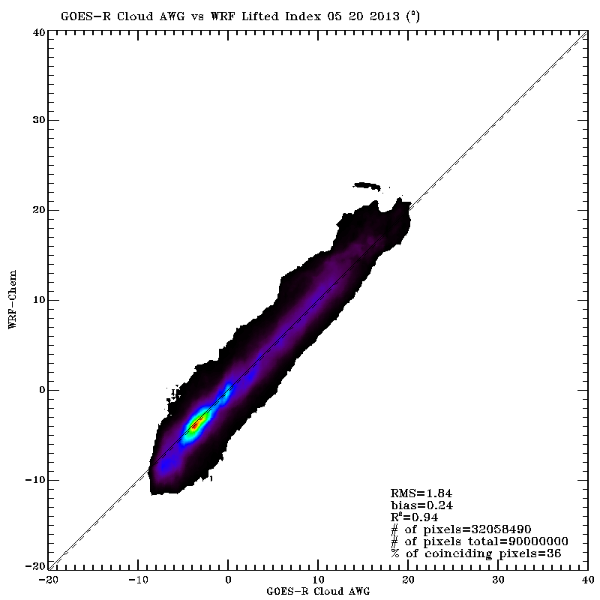
Synthetic Retrieval
Lifted Index (LI) Validation
Truth
Synthetic Retrieval - Truth

Slide 25
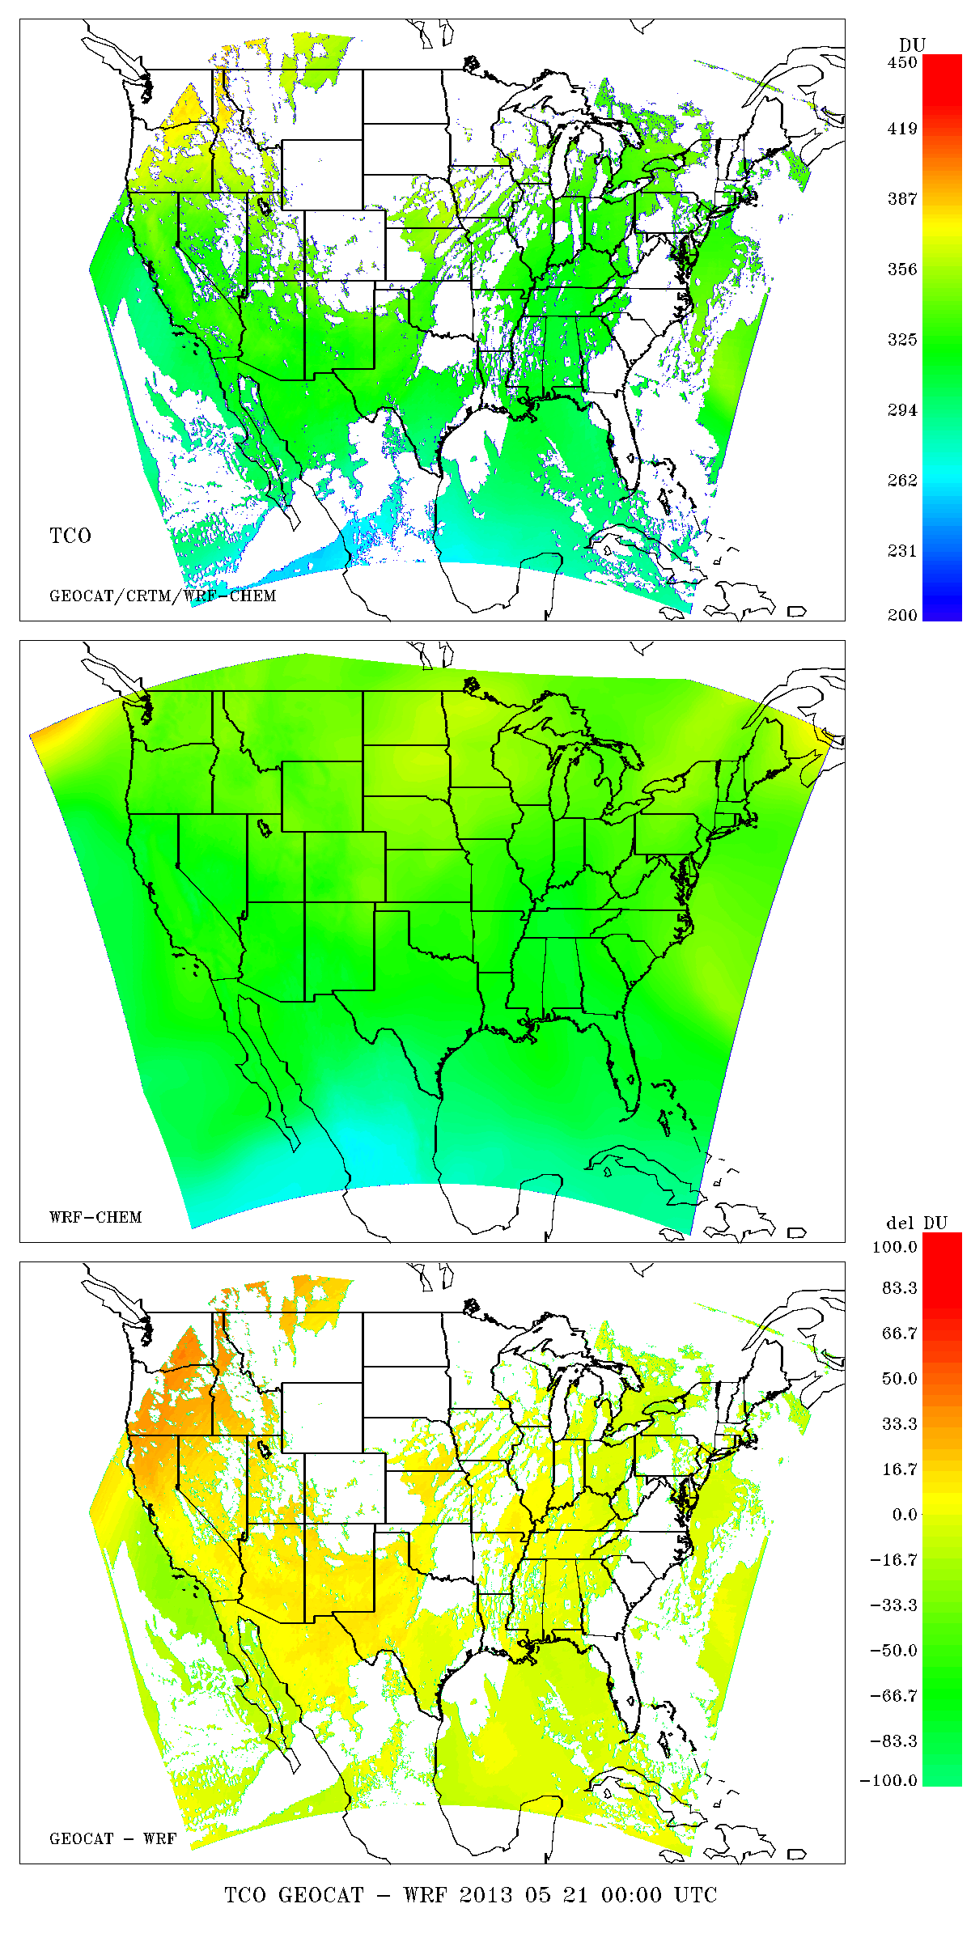
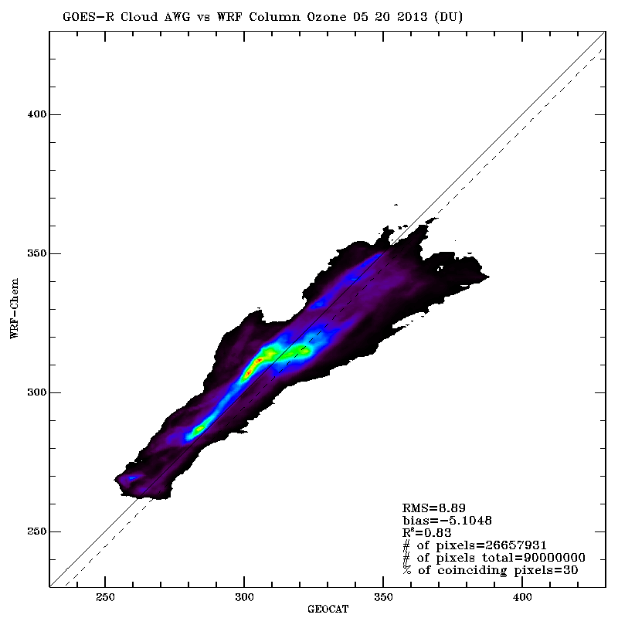
Synthetic Retrieval
Total Column Ozone (TCO) Validation
Truth
Synthetic Retrieval - Truth

Slide 26
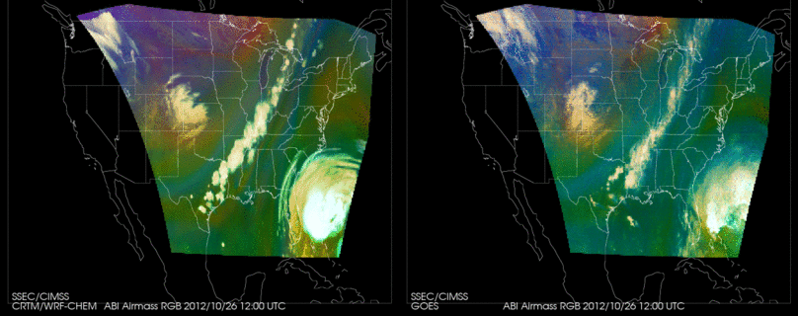
WRF-CHEM Proxy Hurricane Sandy simulation vs GOES Sounder Airmass RGB
October 26-31, 2012.
RGB Airmass shows entrainment of dry upper tropospheric air into Sandy during transition from tropical to extra-tropical storm
Calculation Observation
The Airmass RGB is designed for monitoring the evolution of cyclones, rapid cyclogenesis, jet streaks, and potential vorticity (PV) anomalies
Color scheme:
Ozone-poor tropical air masses are green, ozone-rich polar air masses are blue
Dry air masses in the upper troposphere are red to orange
High-level clouds are white, Mid-level clouds are brown
Magenta (limb viewing, disregard)
http://www.goes-r.gov/users/comet/npoess/multispectral_topics/rgb/navmenu.php_tab_1_page_6.7.0.htm

Slide 27
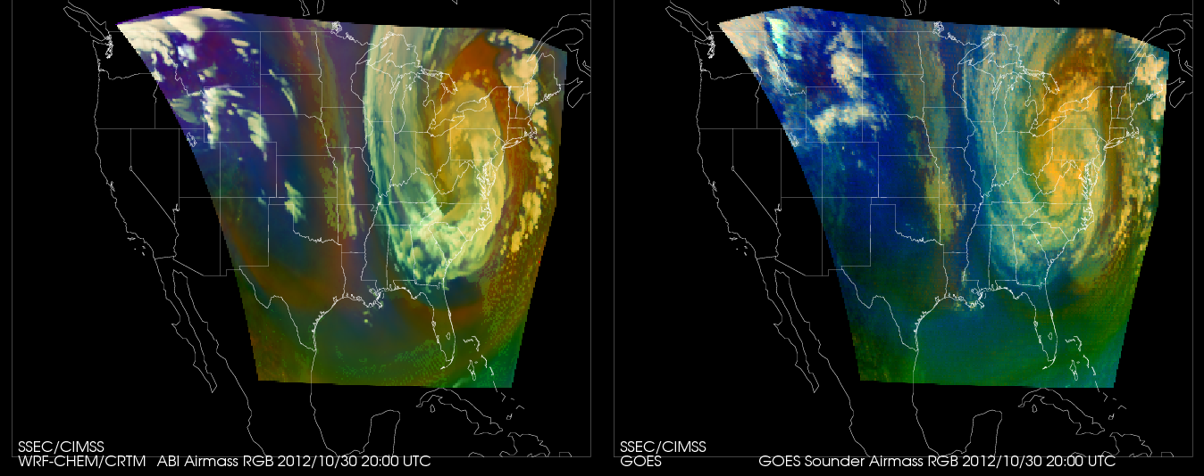
WRF-CHEM Proxy Hurricane Sandy simulation vs GOES Sounder Airmass RGB
October 26-31, 2012.
Validation with GOES Sounder RGB shows that biases are consistent with expected ABI and Sounder SRF differences (dashed)
Calculation Observation
Validation of proxy ABI RGB airmass vs GOES Sounder
Red
Green
Blue

Slide 28
GOES-R ABI Cloud Validation using Synthetic Retrievals
0.5ºx0.5º
GFS
Meteorological Forecast
1ºx1º
RAQMS Aerosol Forecast
8x8km
WRF-Chem
Met/Aerosol Forecast (CONUS)
Truth
Cloud Height
Cloud Optical Depths ranging from
0.1,0.3,0.5,1.0,2.0,4.0
2x2km Fixed Grid
Remap (GOES-R GRB)
Validation:
WRF-Chem Truth
vs
ABI synthetic retrieval
CRTM
Radiative Transfer
16 ABI bands
GEOCAT
GOES-R ABI
Cloud Retrieval
using Synthetic Radiances
2kmx2km Fixed Grid
Remap (GOES-R GRB)
Cloud Top Height
Synthetic Retrieval

Slide 29
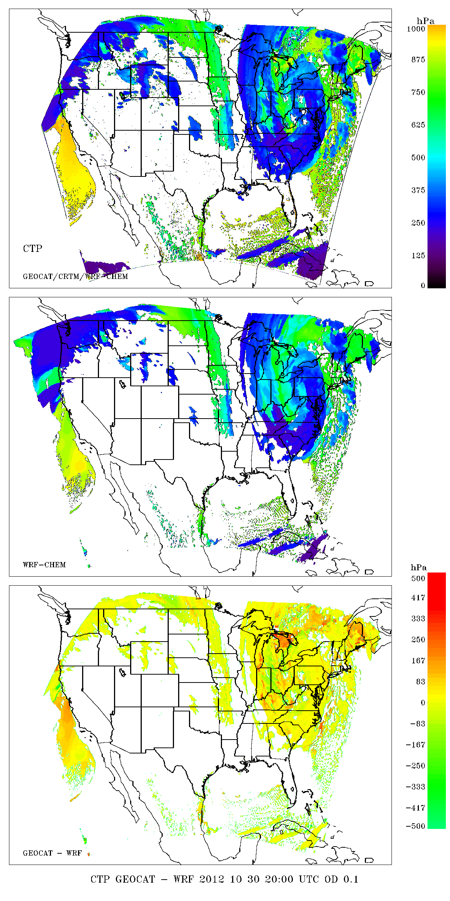
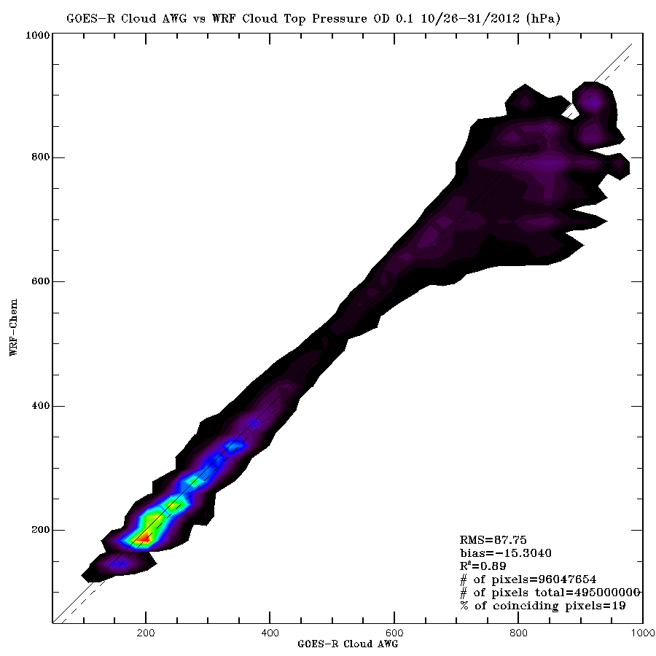
Synthetic Retrieval
Cloud Top Height (COT=0.1) Validation
Truth
Synthetic Retrieval - Truth

Slide 30
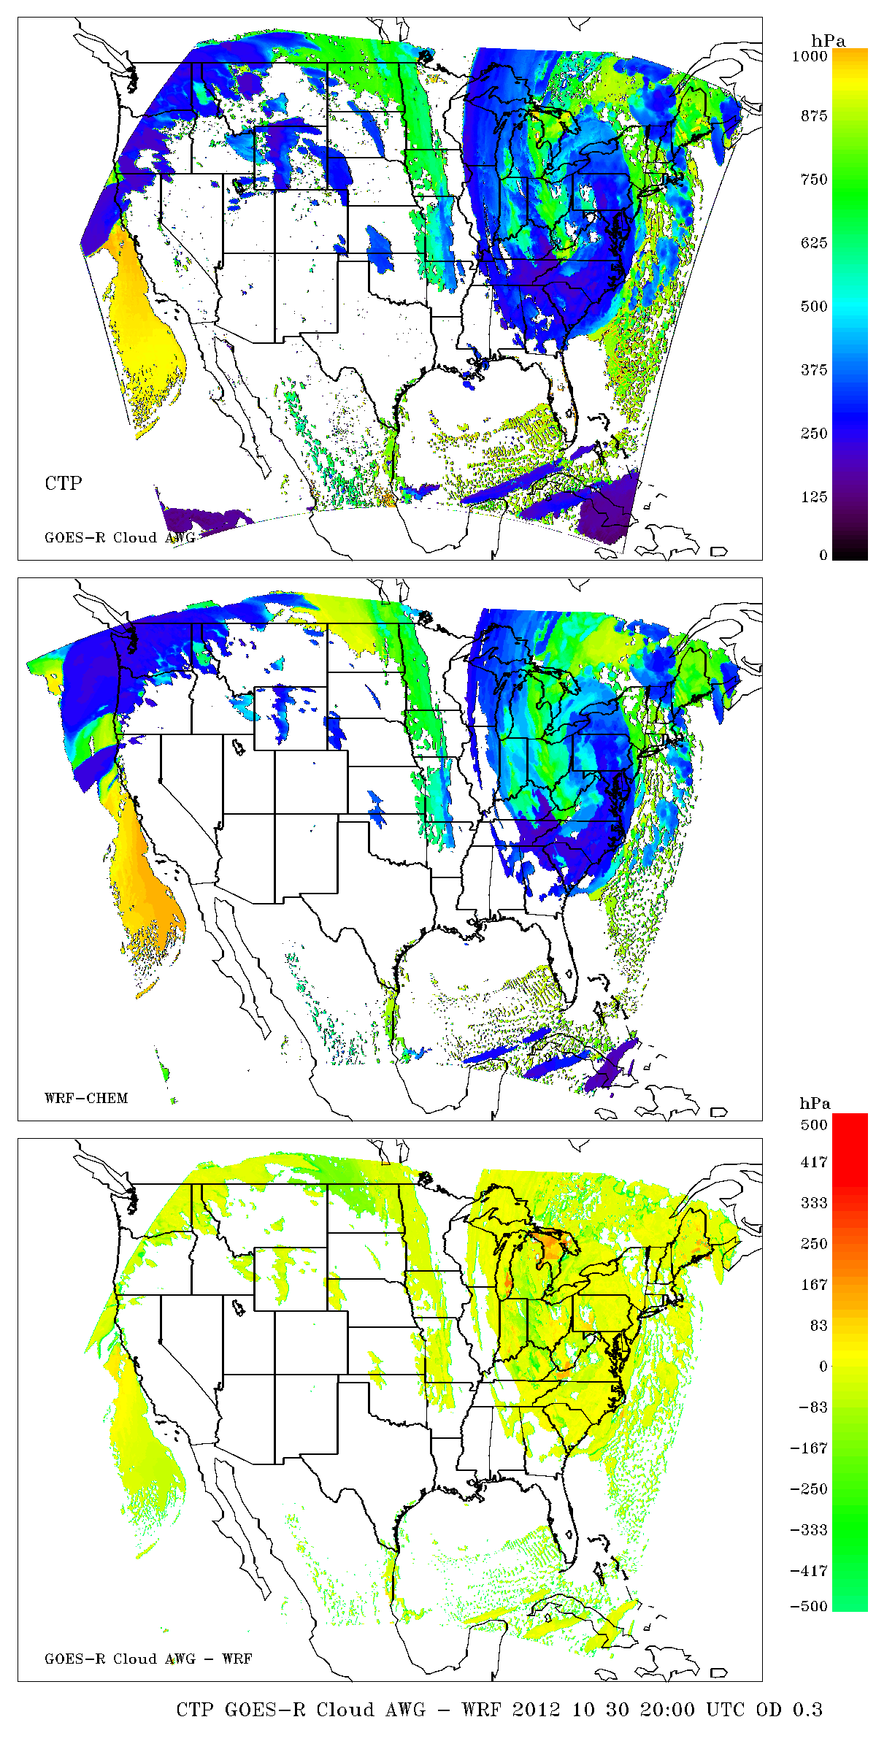
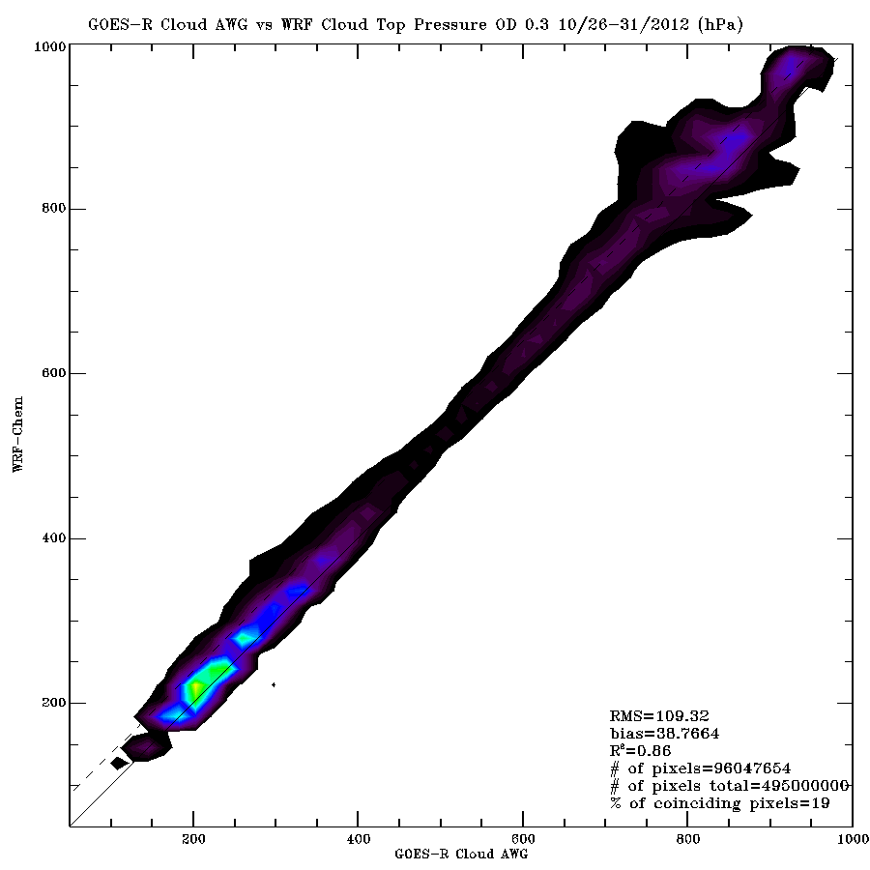
Synthetic Retrieval
Cloud Top Height (COT=0.3) Validation
Truth
Synthetic Retrieval - Truth

Slide 31
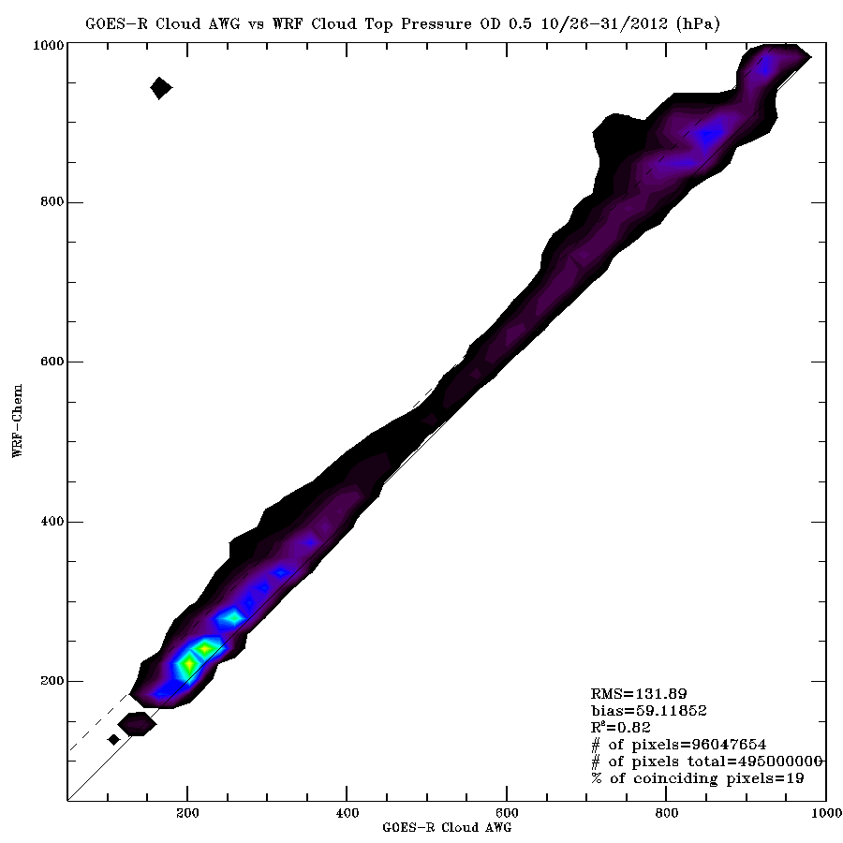
Synthetic Retrieval
Cloud Top Height (COT=0.5) Validation
Truth
Synthetic Retrieval - Truth

Slide 32
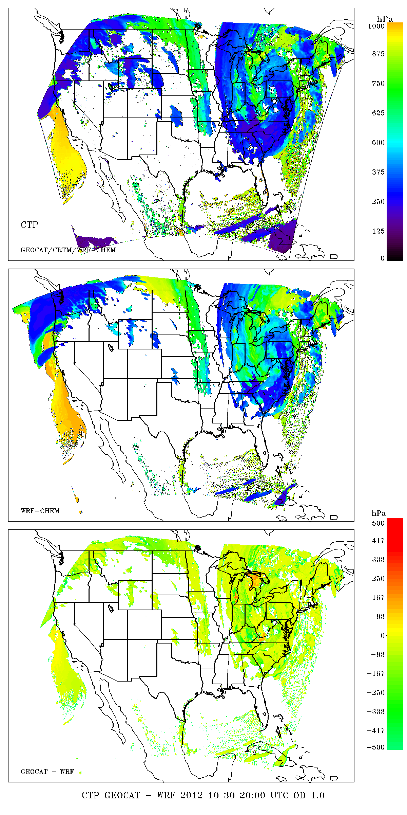
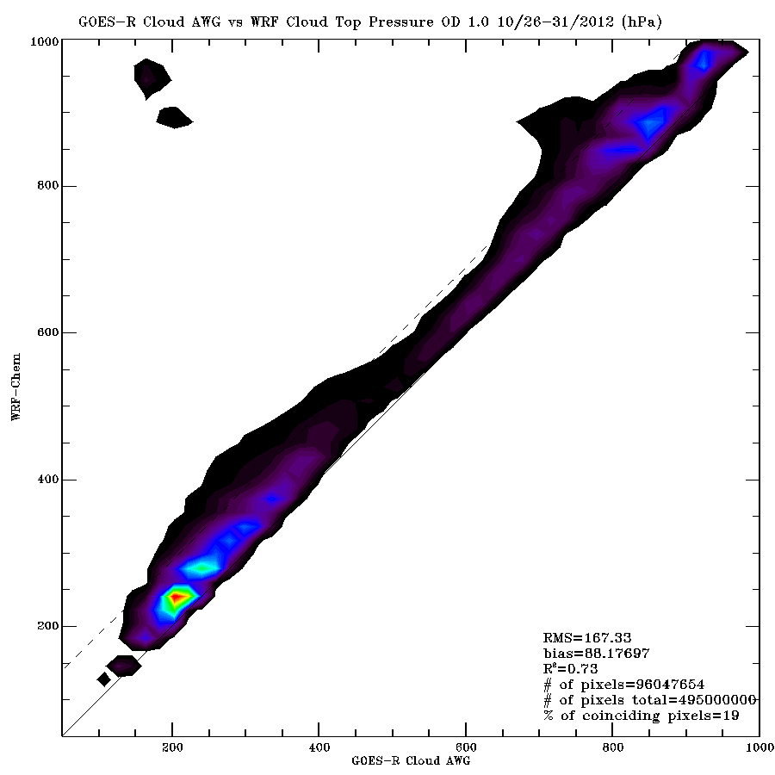
Synthetic Retrieval
Cloud Top Height (COT=1.0) Validation
Truth
Synthetic Retrieval - Truth

Slide 33
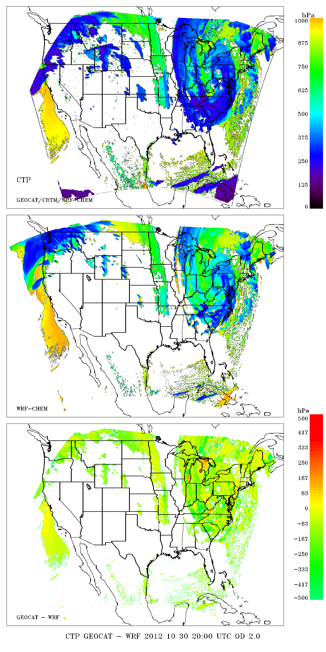
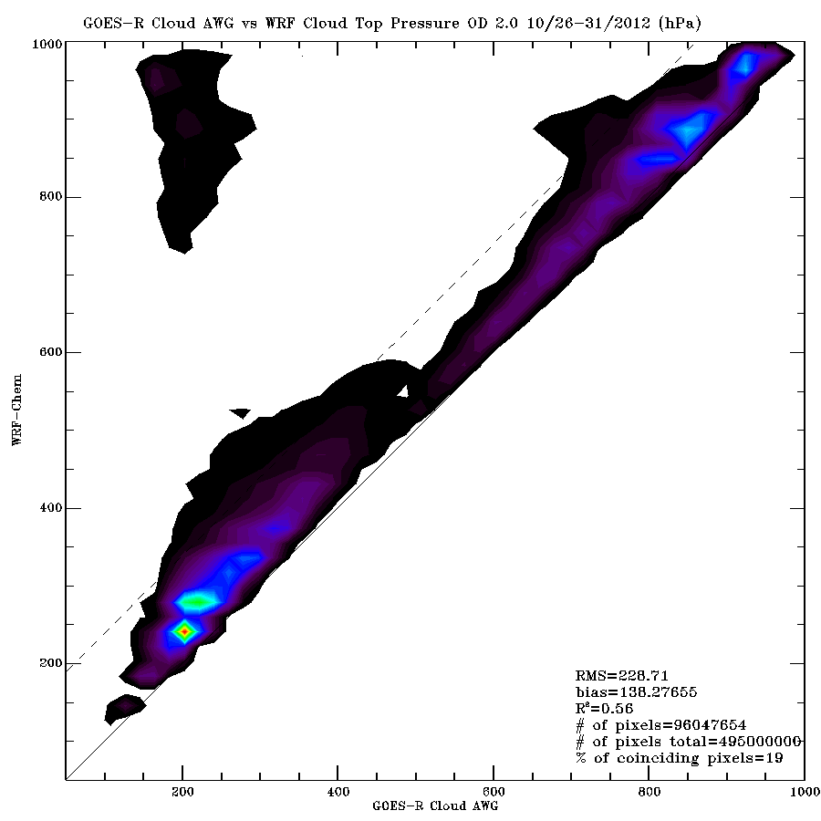
Synthetic Retrieval
Cloud Top Height (COT=2.0) Validation
Truth
Synthetic Retrieval - Truth

Slide 34
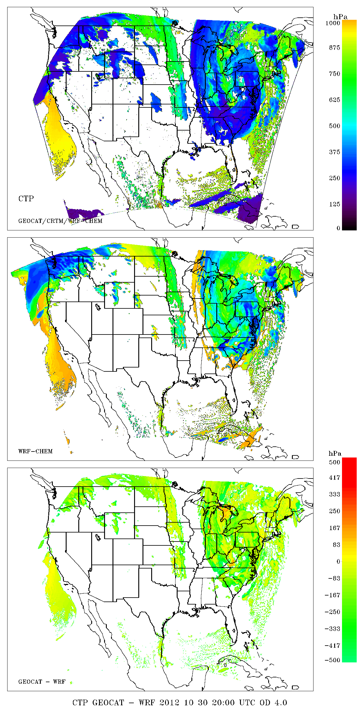
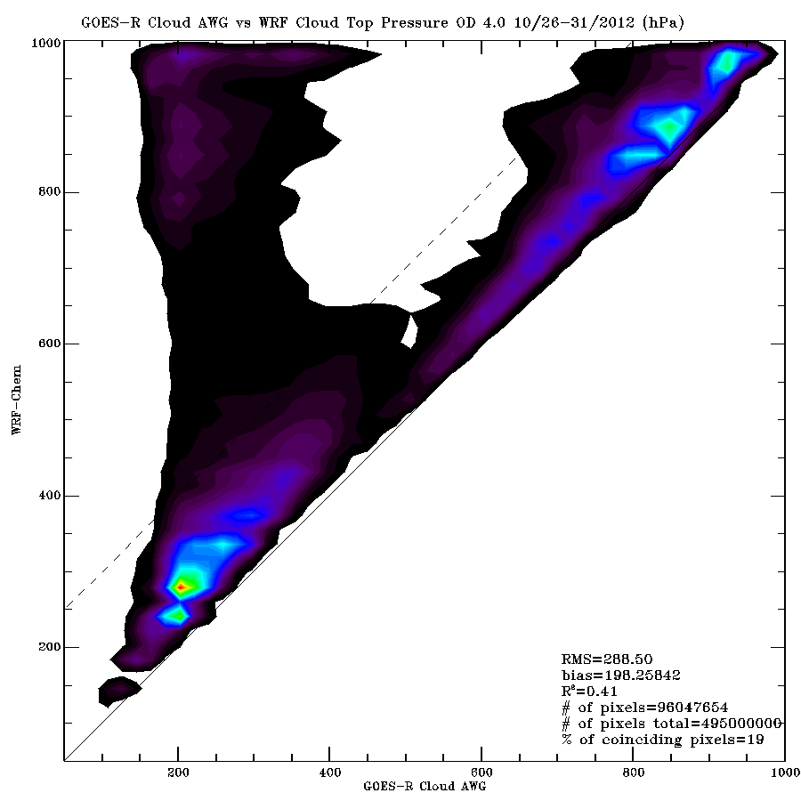
Synthetic Retrieval
Cloud Top Height (COT=4.0) Validation
Truth
Synthetic Retrieval - Truth

Slide 35
COT=0.1
COT=0.3
COT=0.5
COT=1.0
COT=2.0
COT=4.0
Tests using different Cloud Optical Thickness (COT) thresholds for determining Cloud Top Pressure (CTP) shows that the GOES-R ABI CTP retrieval is sensitive to clouds with minimum COT between 0.1 and 0.3

Slide 36
GFS/RAQMS/CRTM based Full Disk ABI proxy
1) GFS model meteorological (T,Q,P, Tsfc, cloud water, cloud ice) and RAQMS 1x1 degree aerosol/ozone forecasts interpolated onto GFS grid used as input to CRTM
2) Simulated FD datasets all bands provided on ABI fixed grid (as implemented in ground system) at time resolutions (achieved by linear time interpolation) indicated by expected ABI mode (3, 4).
3) Expertise developed under GRAFIIR will be adapted to develop a set of instrument level artifacts (such as noise or striping) to the automated generation of the simulated ABI data.
RAQMS – Realtime Air Quality Modeling System
http://raqms-ops.ssec.wisc.edu/

Slide 37
GOES-R ABI Full Disk Data Simulation
NWP/Aerosol/Ozone Forecast –
input profiles for RT
T574 (~28km) GFS
Meteorological Forecast (Global)
1ºx1º
RAQMS Aerosol Forecast (Global)
1ºx1º
RAQMS Ozone Forecast (Global)
8x8km
WRF-Chem
Met/Aerosol Forecast (CONUS)
CRTM Full Disk
Radiative Transfer
16 ABI bands
UW HSR IR land surface emissivity (Global/CONUS)
CRTM CONUS
Radiative Transfer
16 ABI bands
Radiative
Transfer –
synthetic radiances
MODIS land surface reflectivity (Global/CONUS)
FTP file transfer
RaFTR software –
ABI in a box
2kmx2km Full Disk Fixed Grid Remap (GOES-R GRB)
2kmx2km CONUS Fixed Grid Remap (GOES-R GRB)

Slide 38
Initial AWIPS II test data development (November/December 2013)
The primary AWIPS II application for data ingest, processing, and storage is the Environmental Data EXchange (EDEX) server.
The primary AWIPS II application for visualization/data manipulation is the Common AWIPS Visualization Environment (CAVE) client.
ABI Full disk simulation used for AWIPS II development/test of EDEX/CAVE capability wrt ABI imagery.
Working with Joe Zajic (AWIPS II coordinator for the Proving Ground efforts) to use WRF-CHEM and GFS-based ABI radiances to support GOES-R Data Operations Support Team (DOST) validation and preparation of operations of the GOES ground data and product system.

Slide 39
Initial AWIPS II test data development (November/December 2013)
Deliveries to date:
Full Disk GFS-based ABI radiances for 48 hour period August 20-22, 2013 (every 3 hours, on the forecast grid) - for East and West stations.
GFS global 27 km (T574) 64 level (model top at 0.2 hPa) forecast
2. CONUS RAQMS/WRF-Chem based ABI radiances for 48 hour period August 20-22, 2013 (hourly, on the forecast grid) – for East and West stations.
WRF-Chem 8km met/aerosol forecast with RAQMS stratosphere
3. The corresponding raw GOES-14 Super-Rapid-Scan data from that time period
August 21, 2013 Late Afternoon over Wisconsin
Currently working on real-time delivery of Full Disk East and West
GFS – NCEP Global Forecast System
WRF-Chem – Weather Research and Forecast model with Chemistry

Slide 40
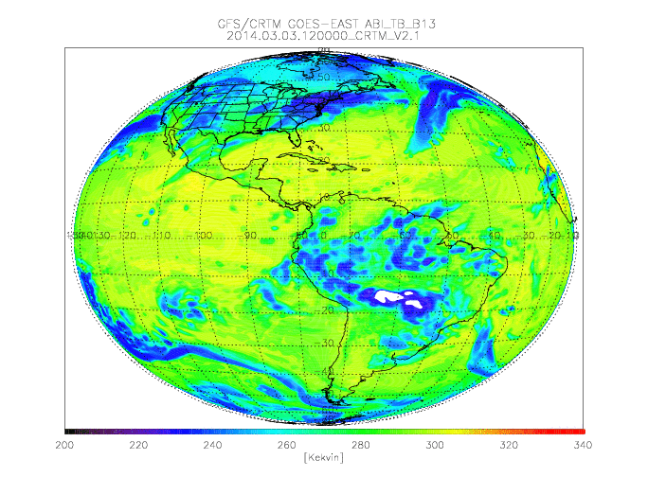
Synthetic ABI Band 13 (10.35 micron) 12Z March 03 –09Z March 06, 2014

Slide 41
The Infusing Satellite Data Into Environmental Applications - International (IDEA-I) Stratospheric Intrusion (SI) forecast is being developed under the Community Satellite Processing Package (CSPP)
CSPP supports the Direct Broadcast (DB) satellite community through the packaging and distribution of open source science software.
Funded by NOAA Joint Polar Satellite System (JPSS)
IDEA-I AIRS, CrIS, and IASI SI forecast capability is currently being beta tested at CIMSS using the UW-Madison Dual Regression retrieval
Extensive testing for June 6, 2012 Wyoming SI Exceptional Event Analysis
Testing for May 2013 SI events underway
http://cimss.ssec.wisc.edu/idea-i/USozone/

Slide 42
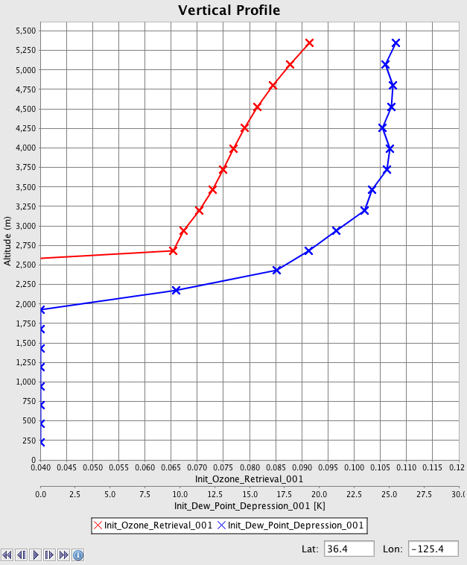
Dual-Regression Retrieval Parameters
atmospheric temperature [K] at 101 pressure levels
atmospheric humidity [g/kg] at 101 pressure levels
atmospheric ozone [ppmv] at 101 pressure levels
atmospheric relative humidity [%] at 101 pressure levels
atmospheric dew point temperature [K] at 101 pressure levels
surface skin temperature [K]
surface emissivity at instrument spectral resolution
total precipitable water (vertically integrated from 100 hPa to surface) [cm]
precipitable water 1, 2, 3 (vertically integrated from 900 hPa to surface, 700 to 900, 300 to 700 hPa) [cm]
total ozone amount (vertically integrated) [dobson units]
lifted index [ºC]
convective available potential energy [J/kg]
CO₂ concentration [ppmv]
cloud top pressure [hPa]
cloud top temperature [K]
cloud optical thickness
effective cloud emissivity
cloud mask (values: 0 clear, 1 cloud)
Output Format: hdf5
Used in SI
initialization
O3VMR (ppmv)
DPD (K)
http://cimss.ssec.wisc.edu/cspp/uwhsrtv_edr_v1.1.shtml

Slide 43
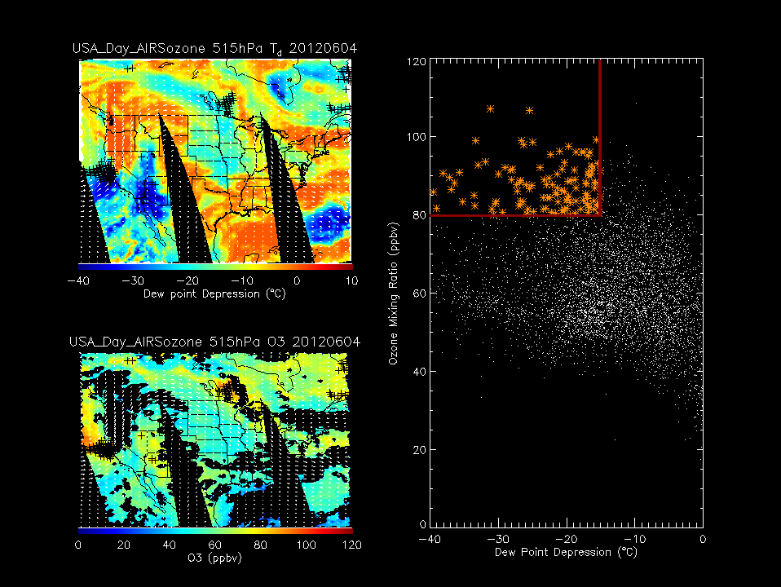
Basis for initialization point selection criteria
stratospheric air;
dry air with high ozone
Plevs threshold: >500mb
O3VMR threshold: >80ppbv
Dewpnt-Tair threshold: <-15K
4 June, 2012

Slide 44
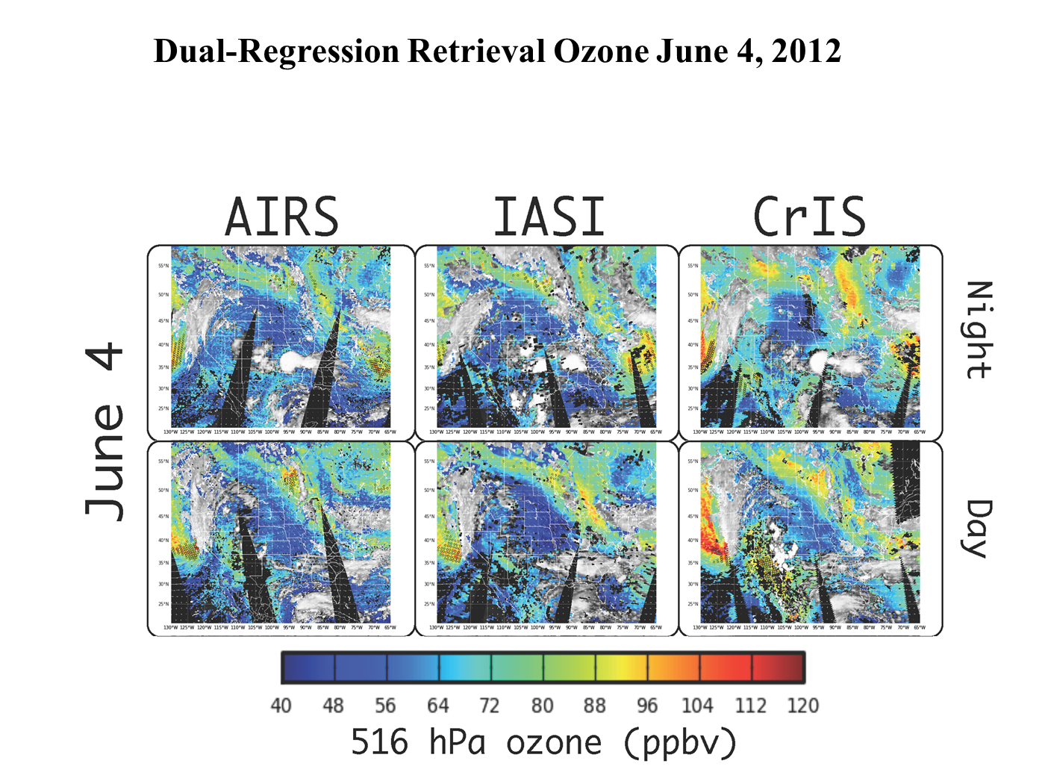
Two day’s prior to Wyoming SI exceptional Event
(6 initialization opportunities each day!)

