Slide 1


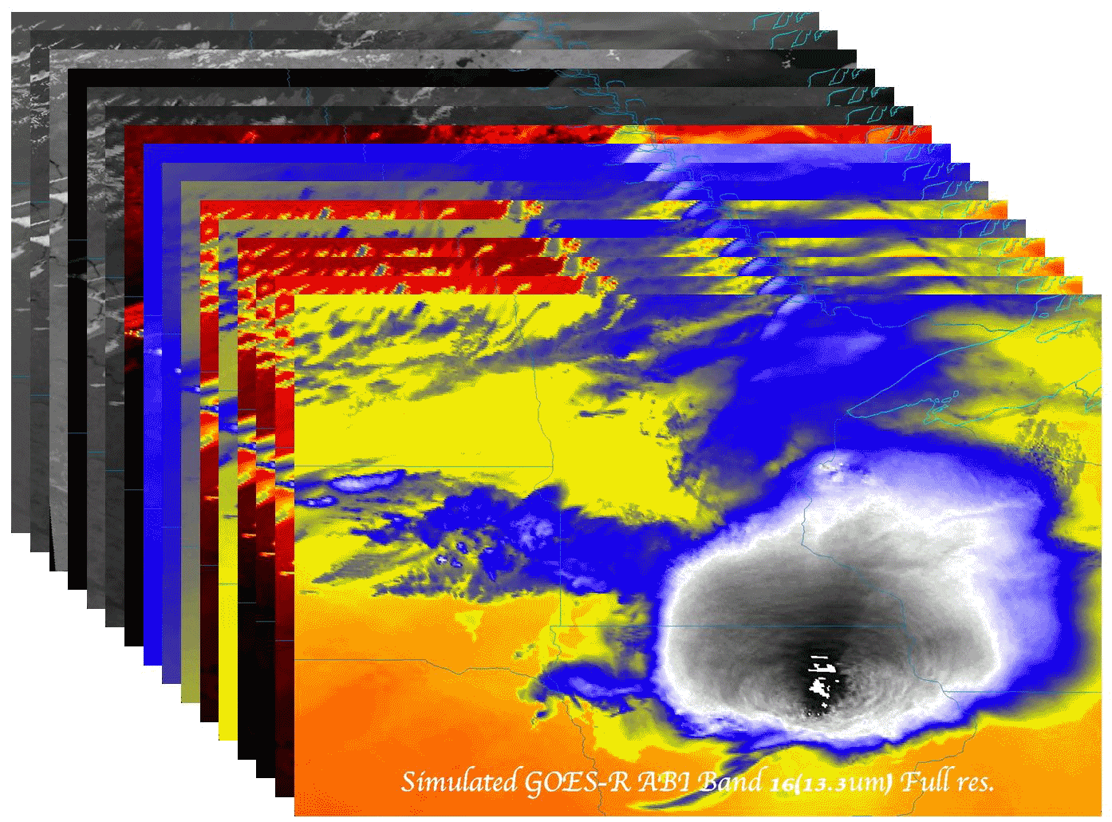

The History and Evolution of the GOES-R Advanced Baseline Imager
  Timothy J. Schmit (tim.j.schmit@noaa.gov)
NOAA/NESDIS/Satellite Applications and Research
Advanced Satellite Products Branch (ASPB)
Madison, WI
Former National Hurricane Center director Robert Sheets once said that if he had only one tool to do his forecasting job, it would be the geostationary weather satellite.
Invited presentation at the PMSR
Fort Wayne, Indiana
March 26, 2015
UW-Madison

Slide 2

Thanks to…
Paul Menzel, Steven J. Goodman, Daniel T. Lindsey, Robert M. Rabin, Kristopher M. Bedka, John L. Cintineo, Christopher S. Velden, A. Scott Bachmeier, Scott S. Lindstrom, Mat Gunshor, Chris Schmidt
Kaba Bah, Joleen Feltz, Tom Whittaker, Jordan Gerth, Margaret Mooney, Andy Heidinger, William Straka, Jun Li, Steve Ackerman, Bob Aune, Don Hillger, Tony Schreiner, Justin Sieglaff, Jim Jung, Elaine Prins, Brad Pierce, Wayne Feltz, Jean Phillips, Linda Hedges, Jim Nelson, Gary Wade, Don Hillger, Jinlong Li, Jing Zheng, Allen Huang, Bob Rabin, the SSEC data center, Mike Pavolonis, Jaime Daniels, ASPB, STAR, NESDIS, NSSL, MUG, Kevin Ludlum, GOES operators, GOES shift supervisors, Mark DeMaria, Dave Martin, Joe Schmit and many others!
GOES-R Program Office, Greg Mandt, NASA, Exelis Industries, Lockheed Martin, and other industry partners, etc.
You.

Slide 3
Conclusions
The ABI on the GOES-R series continues the critical continuity of geostationary imagers and will have huge positive societal impacts, given its improved temporal, spatial, spectral and radiometric attributes.
Impact areas include, but are not limited to: weather, Numerical Weather Prediction, severe weather, hazards (volcanic ash plumes), aviation, environmental (fires), health (smoke), oceanographic, cryosphere, land, etc.

Slide 4
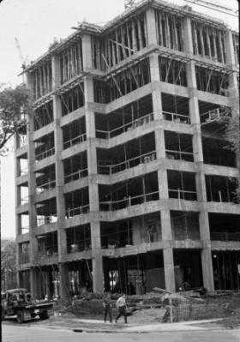
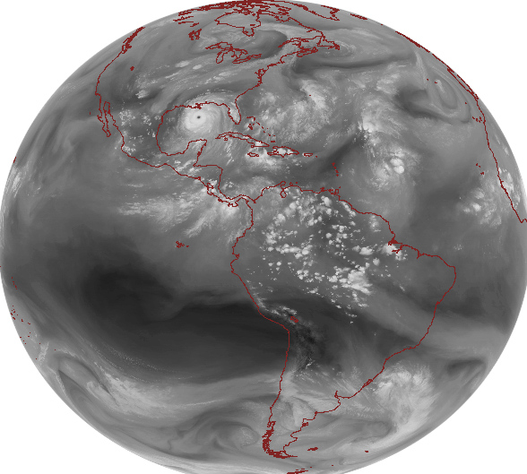
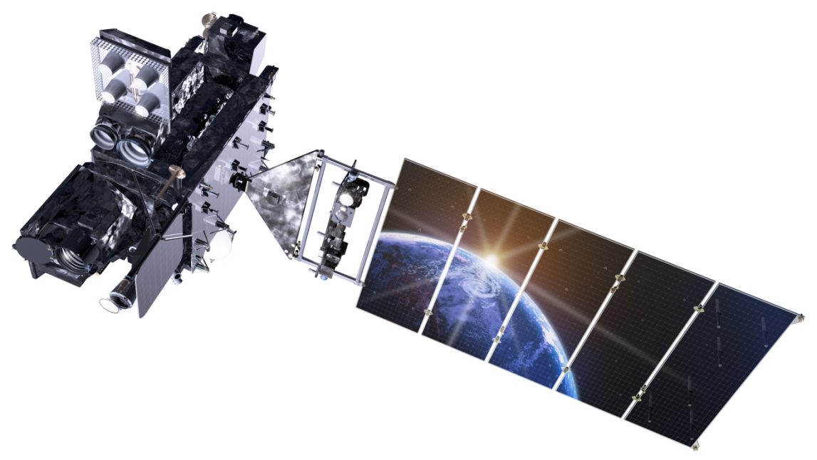
Outline
Pre-GOES and Early GOES
  First 3 Generations
Current GOES (13-15)
  Fourth Generation
GOES-R ABI
  Fifth Generation
Summary/Education
Lockheed Martin

Slide 5
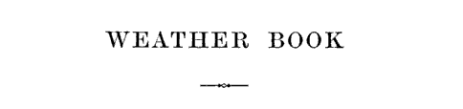
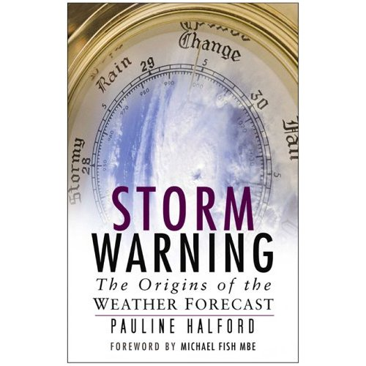
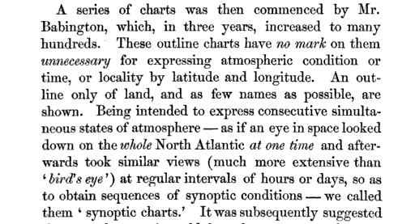
1863: Vice Admiral R. FitzRoy
‘…as if an eye in space looked down on the whole [North] Atlantic at one time and afterwards took similar views…at regular intervals….to obtain sequences….”
Vice-Admiral Robert FitzRoy
The weather book: a manual of practical meteorology
Storm Warning: The Origins of the Weather Forecast by Pauline Halford
Notes:
P. 103. 1854 -1863

Slide 6
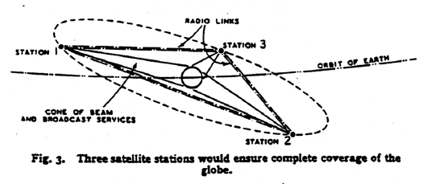
1945: Arthur C. Clarke
Extra-Terrestrial Relays — Can Rocket Stations Give Worldwide Radio Coverage?
Notes:
http://web.archive.org/web/20090318000548/http://www.clarkefoundation.org/docs/ClarkeWirelessWorldArticle.pdf

Slide 7
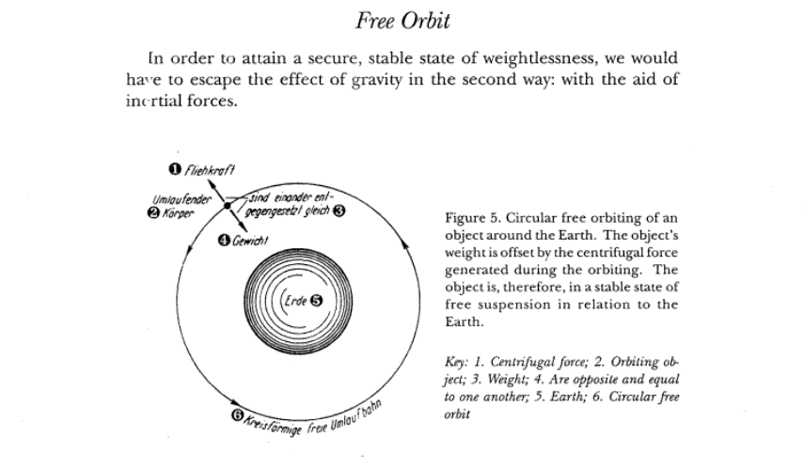
1928: Herman Potocnik
The Problem of Space Travel - The Rocket Motor -- using geostationary orbit for communications.
Notes:
http://en.wikipedia.org/wiki/Herman_Poto%C4%8Dnik

Slide 8
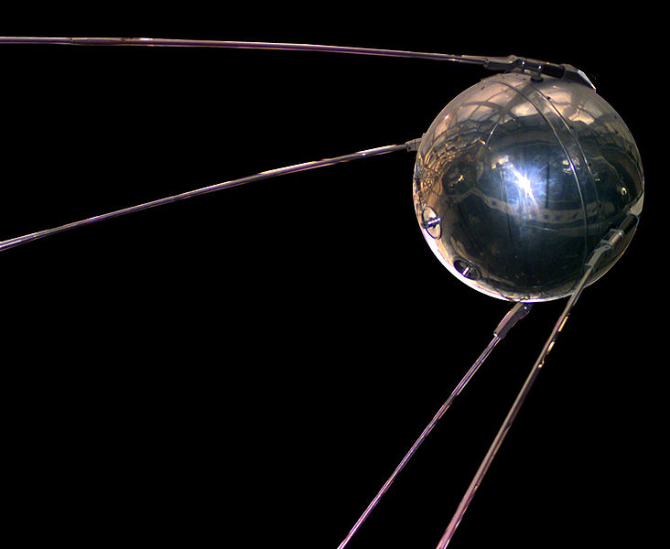
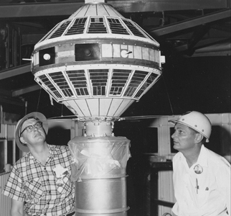
1957 Sputnik
The first artificial satellite
Followed by Explorer 7, in late 1959 with the thermal radiation experiment
Notes:
http://history.nasa.gov/sputnik/TOC.html

Slide 9
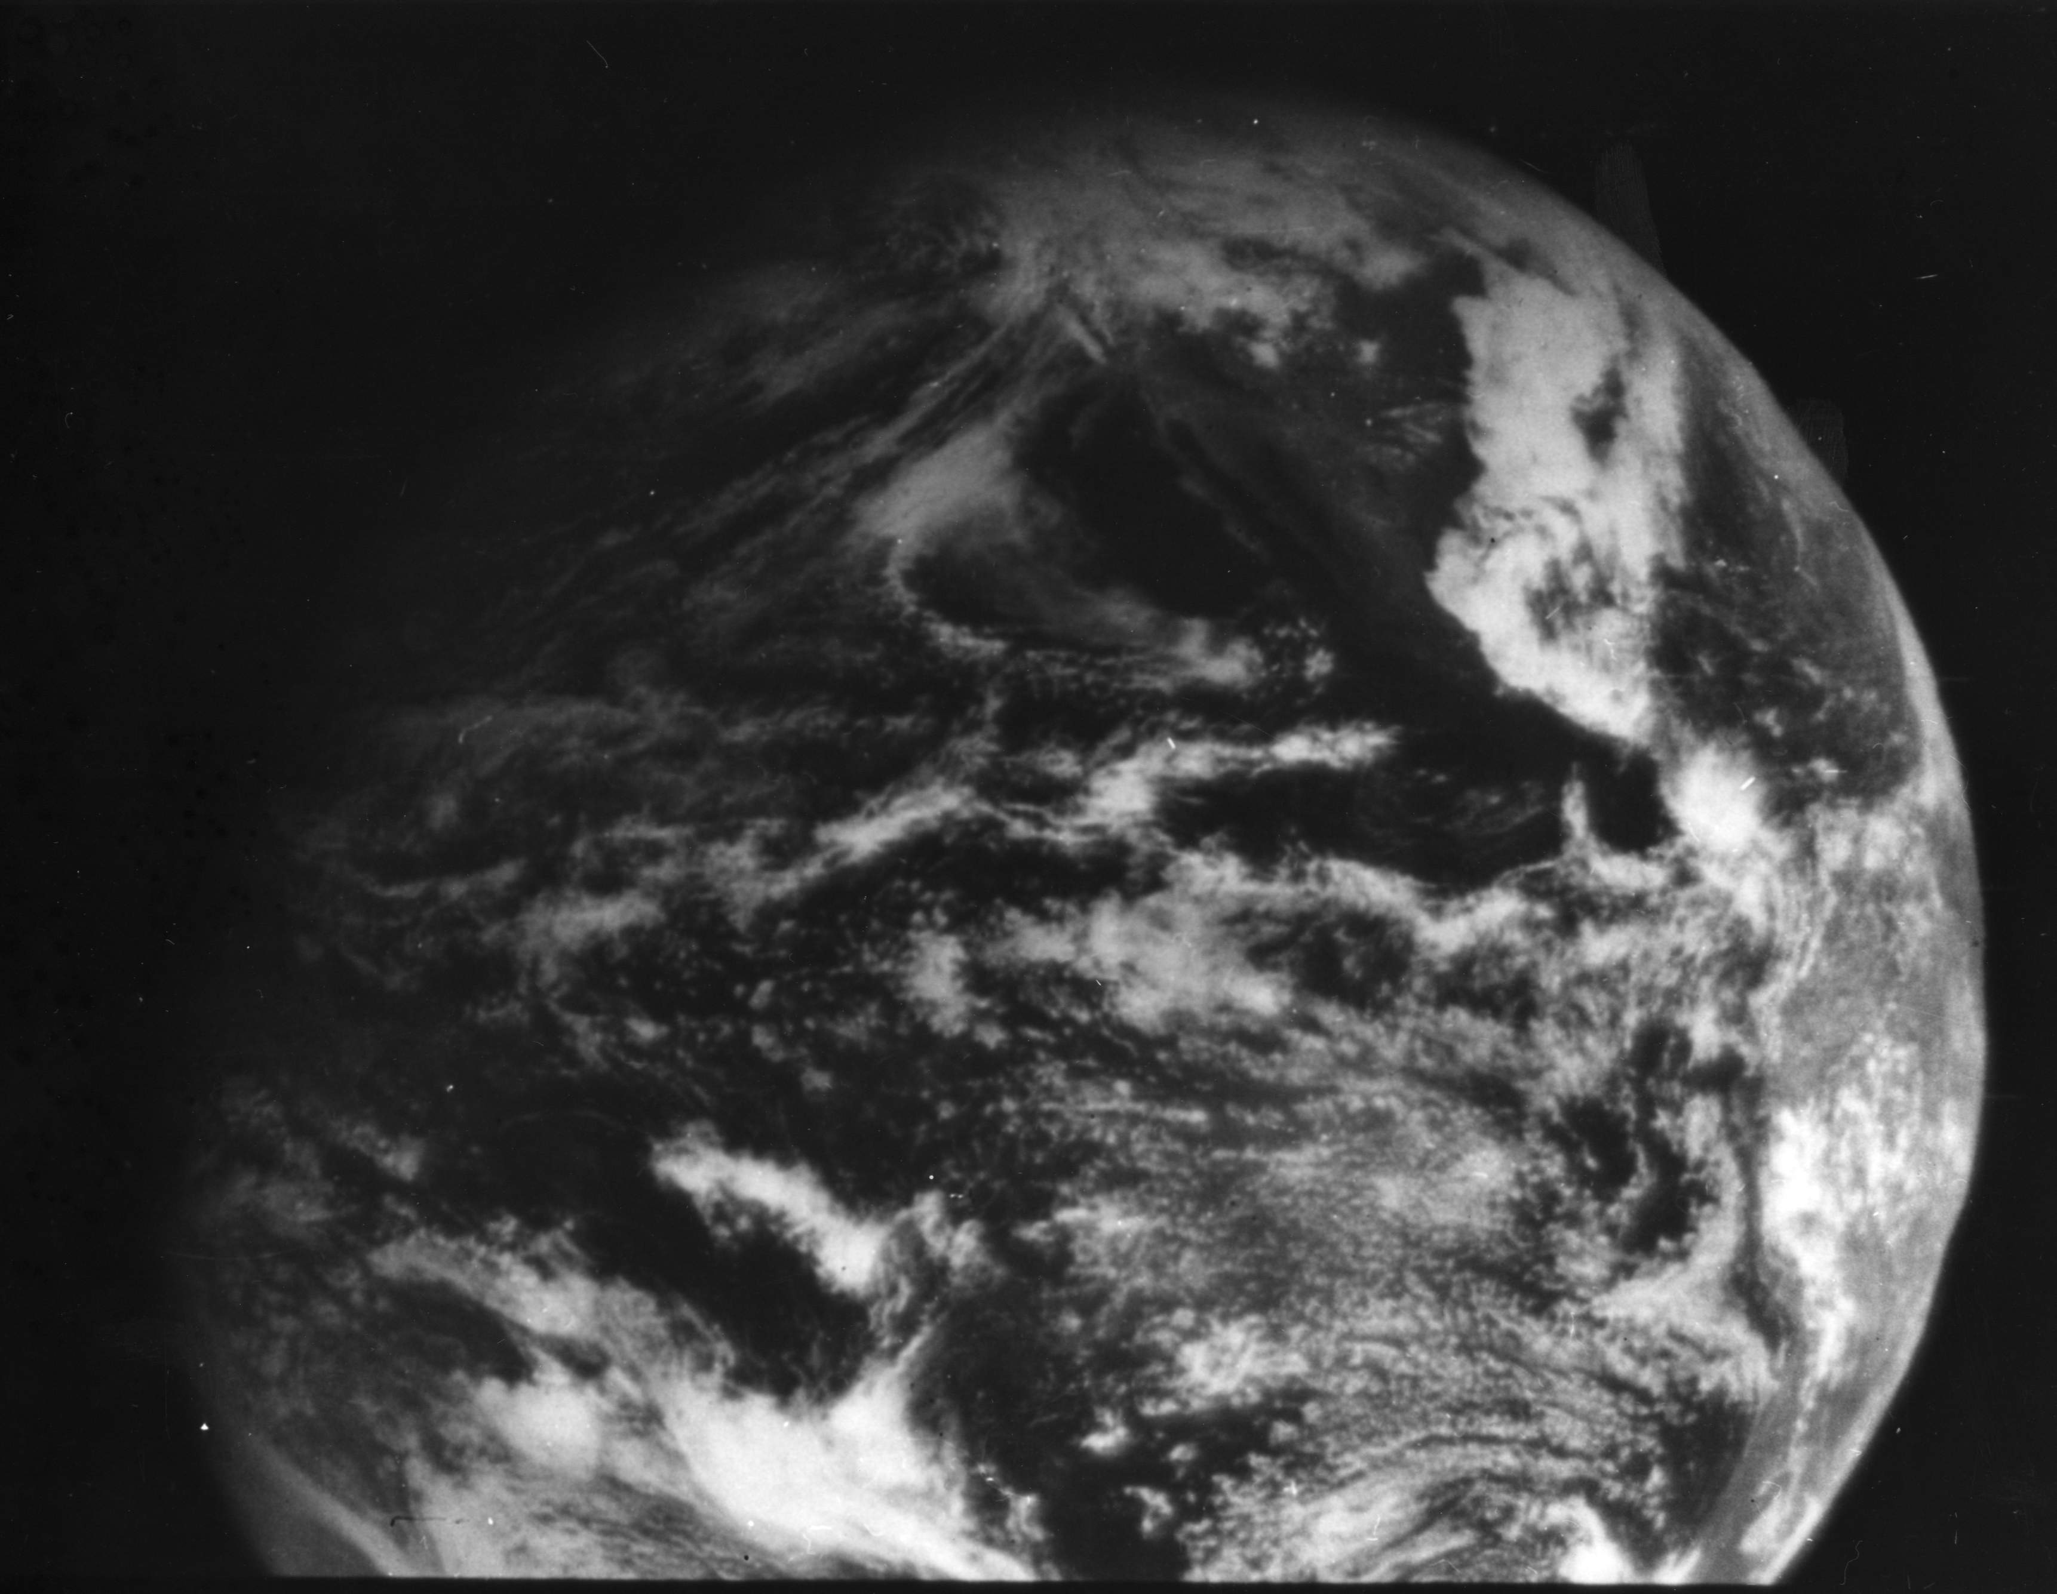
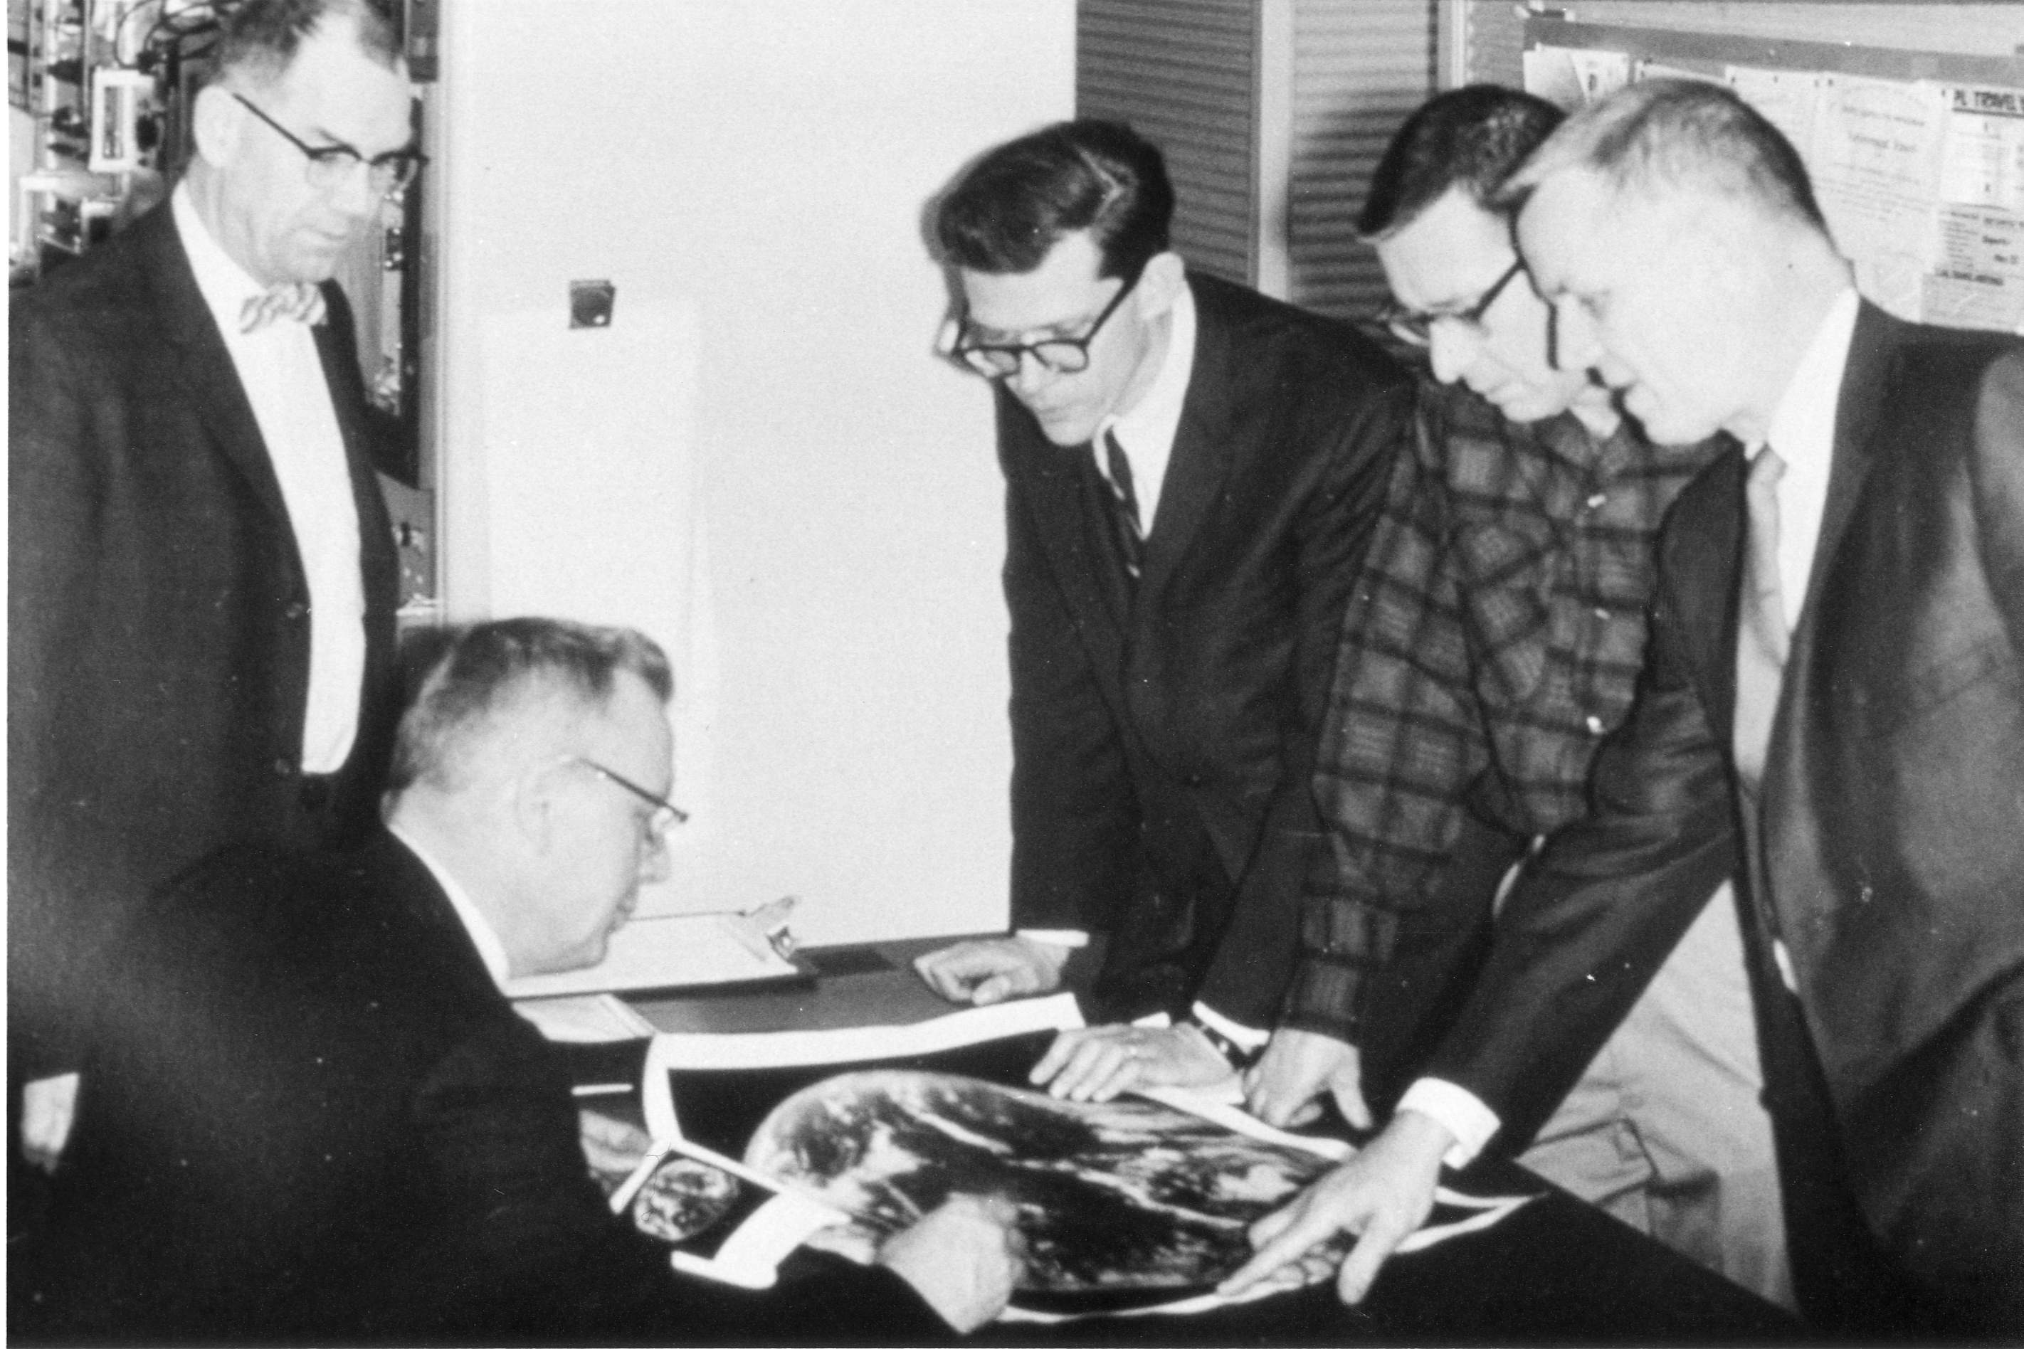
1966: ATS-1 launched
Applications Technology Satellite (ATS)-1 was the first geostationary imager, launched 6 December 1966. Imaging instrument designer and SSEC co-founder, Verner E. Suomi, proclaimed, “the clouds move, not the earth”.
11 December 1966
Notes:
http://cimss.ssec.wisc.edu/news/geo_image_anniversary.html

Slide 10
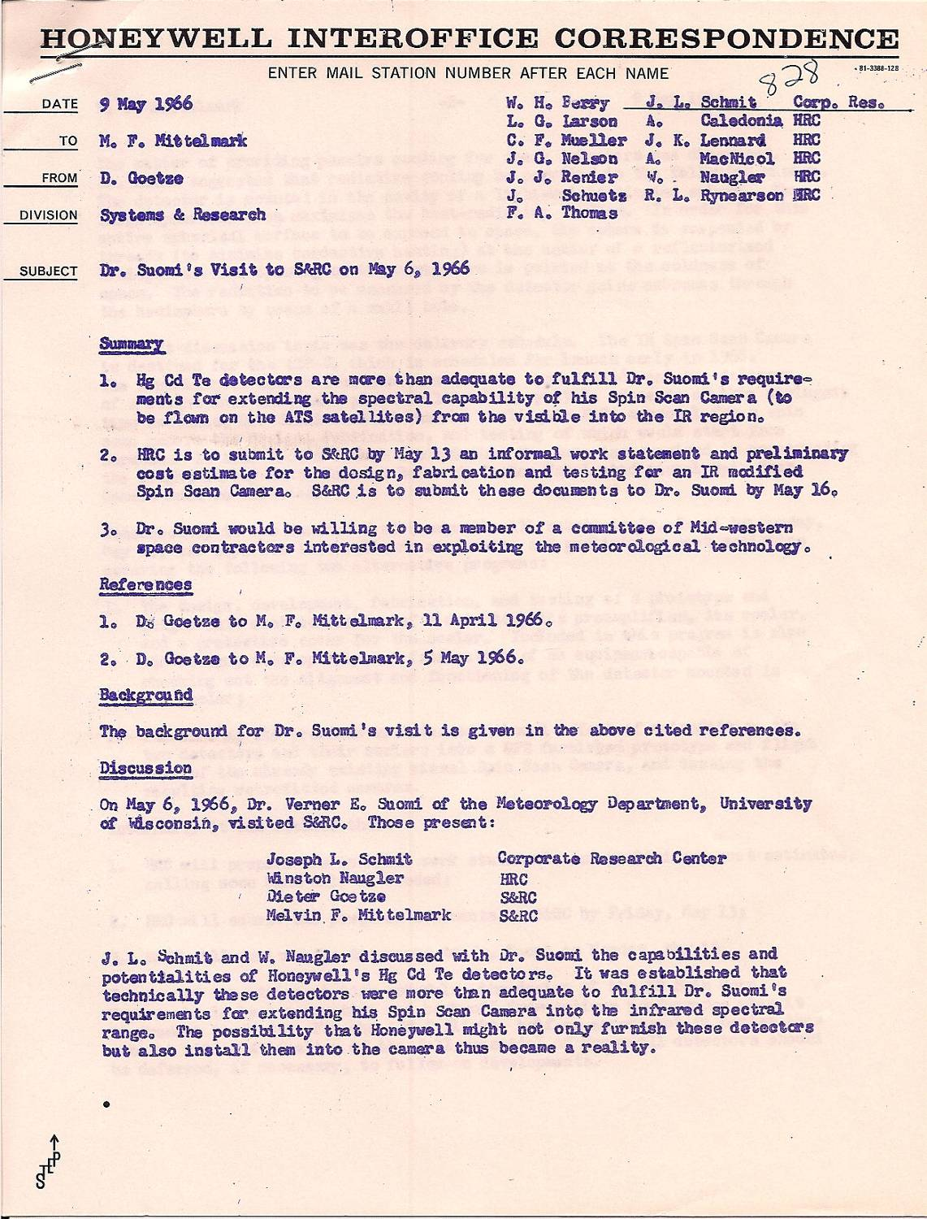
Honeywell memo (May 6, 1966 meeting). Note the idea of “…extending the spectral capability of [the] Spin Scan Camera (to be flown on the ATS) from the visible into the IR region”.

Slide 11
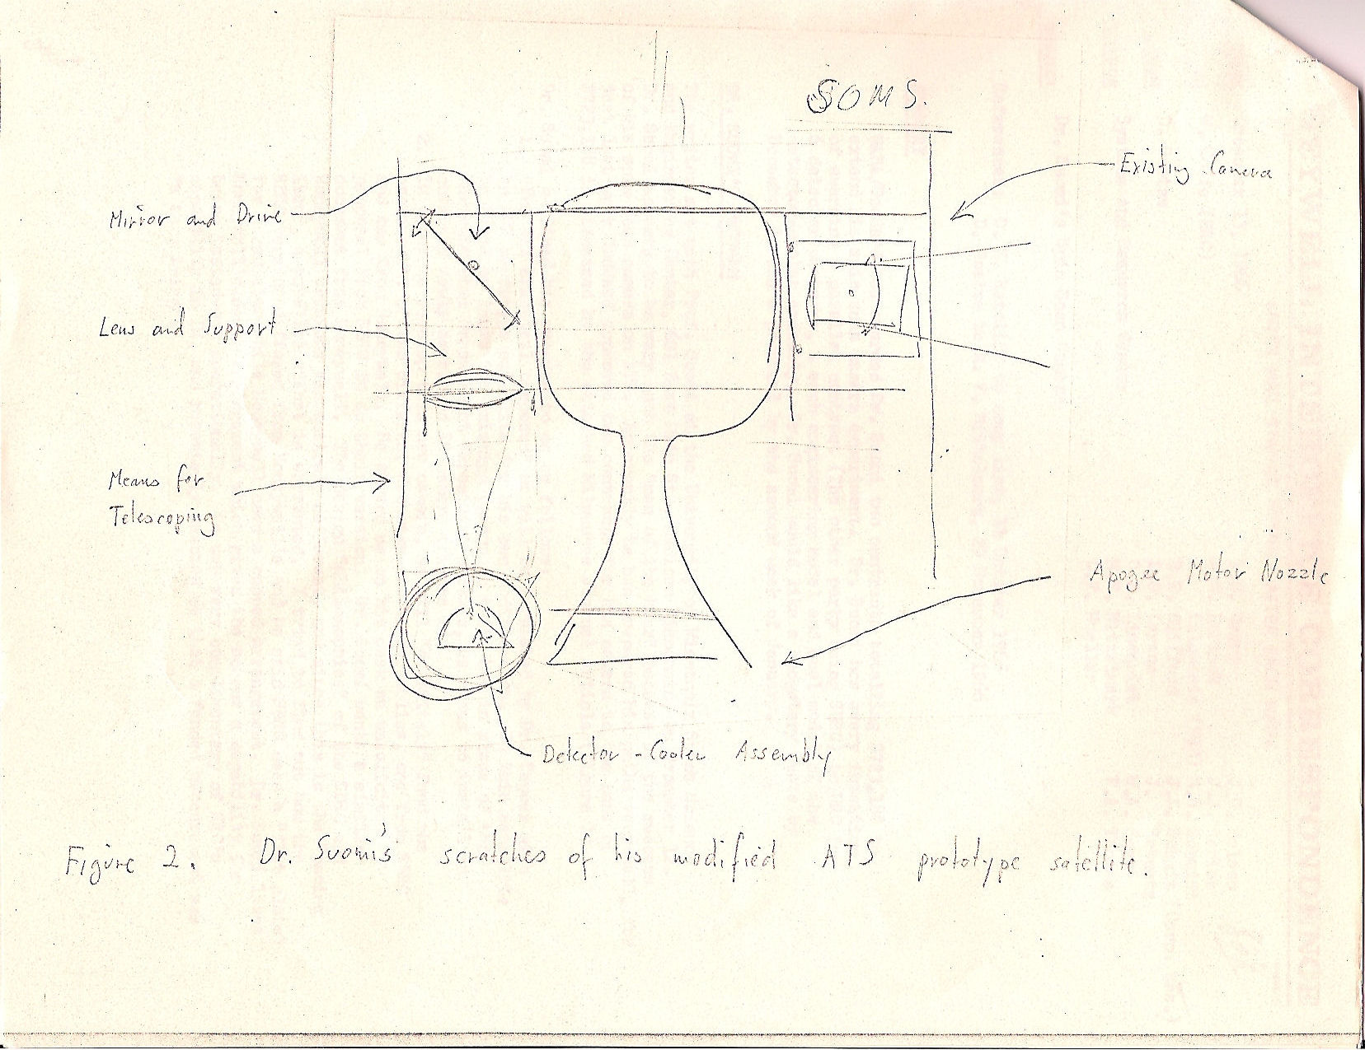
“Figure 2. Dr. Suomi’s “scratches” of his modified ATS prototype satellite”. (1966)
Unique insight to the early ideas of IR data in geostationary orbit by Dr. Suomi.
This was over eight years before SMS-1 did have IR data.
Notes:
Schmit, personal communication

Slide 12
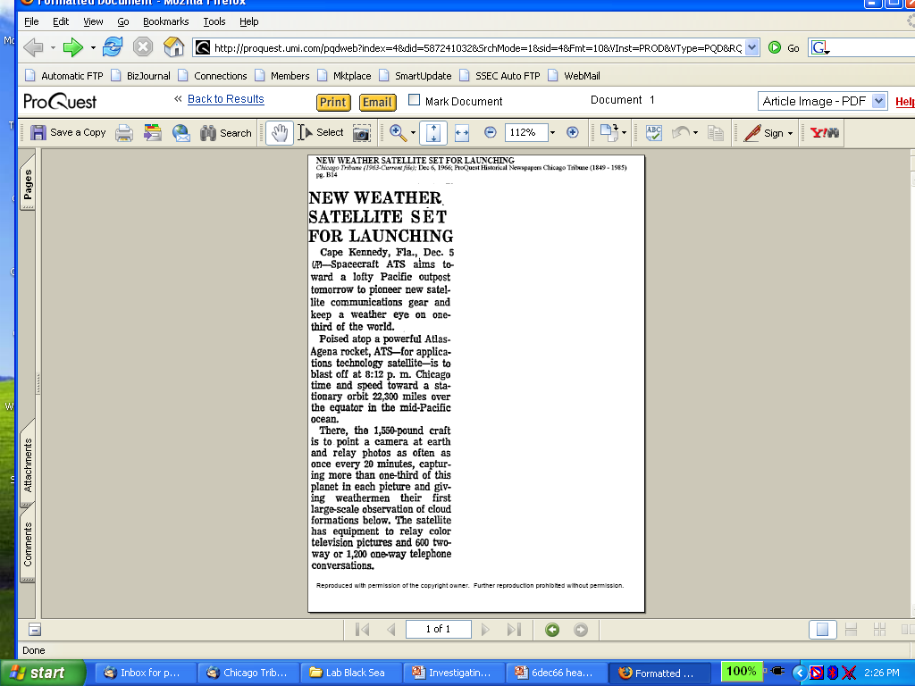
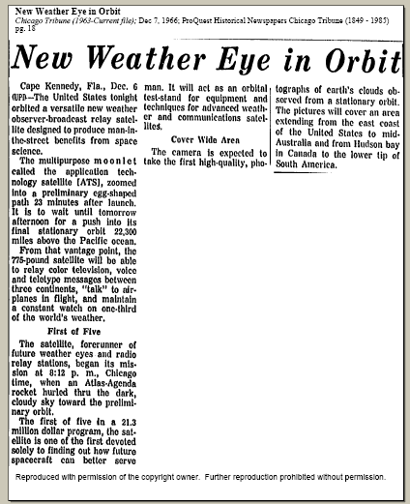
Suomi Introduced Time Continuous Imaging
Chicago Tribune
makes cautious
announcement
on 5 Dec 1966
of pending new
“weather eye”
On 7 Dec 1966 Tribune
declares
“multipurpose moonlet”
successfully launched
Notes:
Slide from Dr. Paul Menzel.

Slide 13
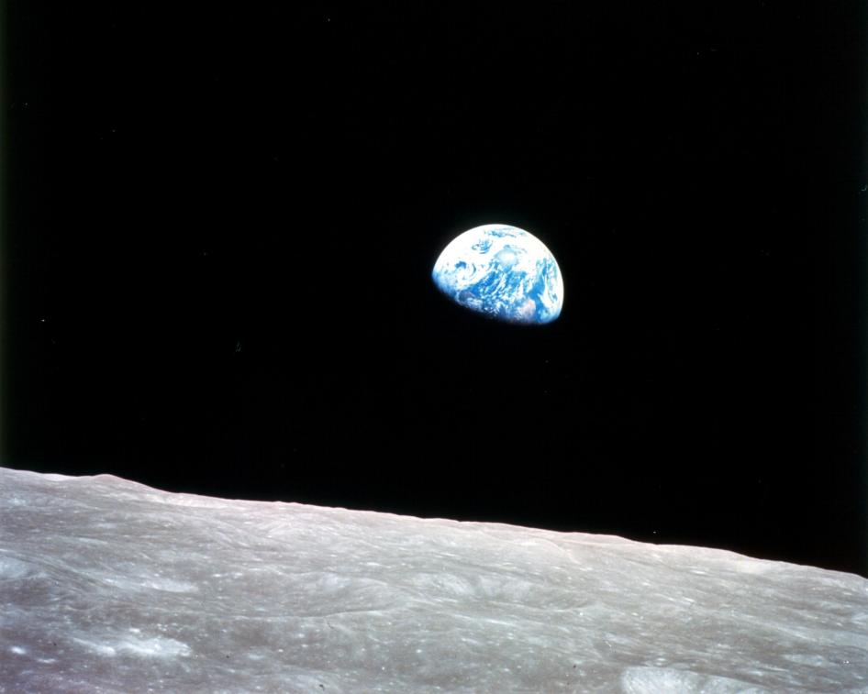
Apollo 8
December 24, 1968
Notes:
http://www.nasa.gov/multimedia/imagegallery/image_feature_1249.html#.VP4KiuGLXEM

Slide 14
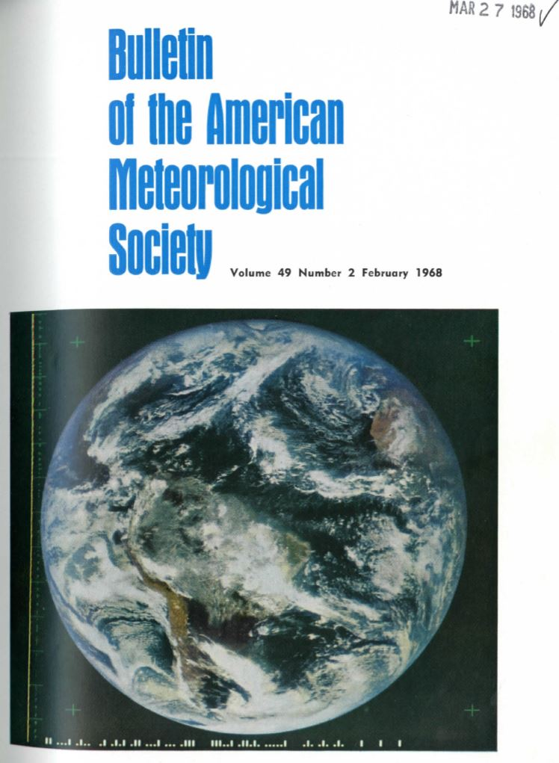
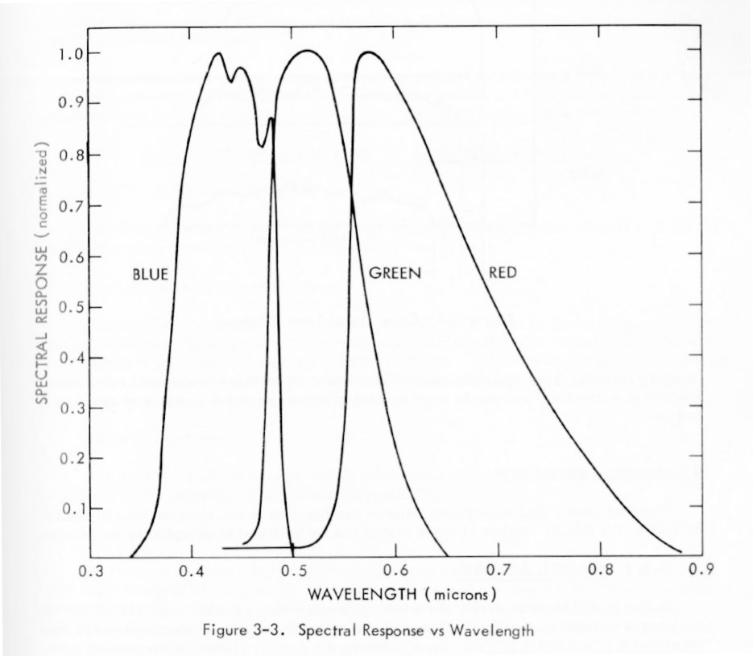
ATS-3
Cover photograph: The Earth in full color as seen from 35,800 km altitude. This photograph was taken by the Multicolor Spin-Scan Cloud Camera Experiment aboard the third Applied Technology Satellite (ATS-3) on 10 November 1967, when the satellite was located in a geosynchronous orbit over the equator north of the Amazonas Delta (see articles by V. E. Suomi and R. J. Parent, and G. Warnecke and W. S. Sunderlin on
pages 74 and 75). (NASA Photograph).
Notes:
http://journals.ametsoc.org/toc/bams/current

Slide 15
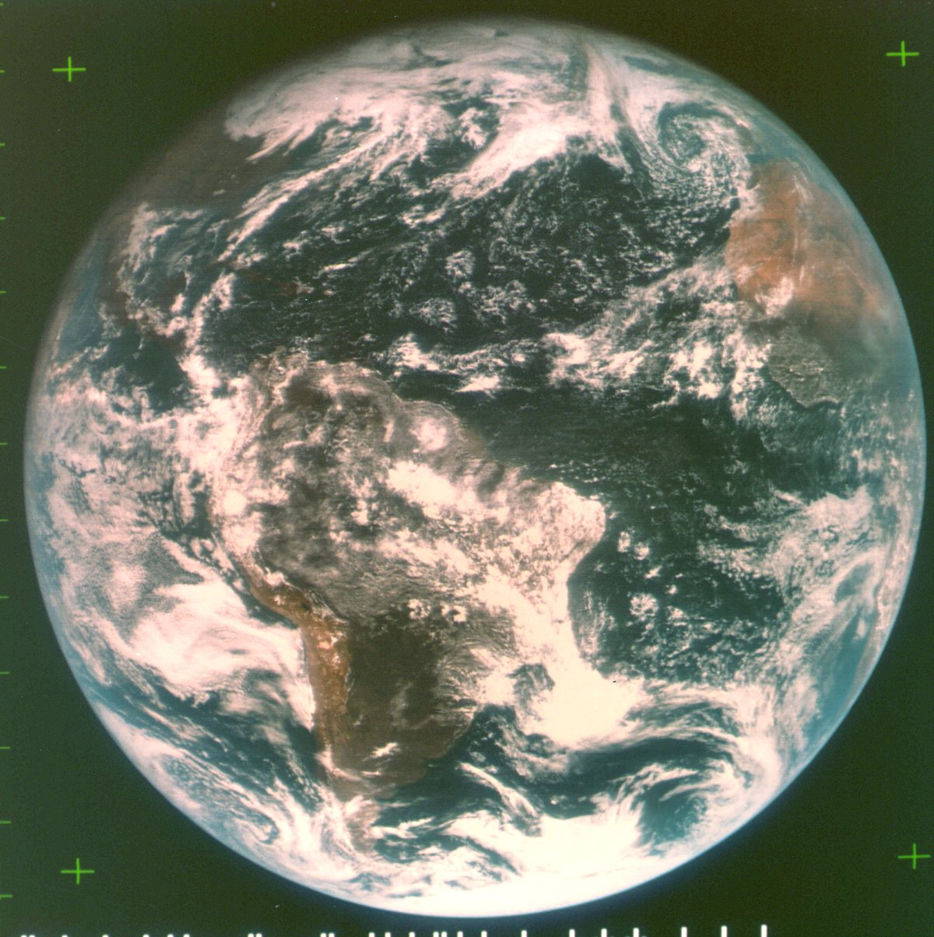
ATS-III November 18, 1967
The spin scan cloud camera provided full disk visible images of the earth and its cloud cover every 20 minutes.
Note the “natural color” image from the 3 visible spectral bands.
Notes:
Natural color images from the geo perspective are possible, as demonstrated in 1967.

Slide 16
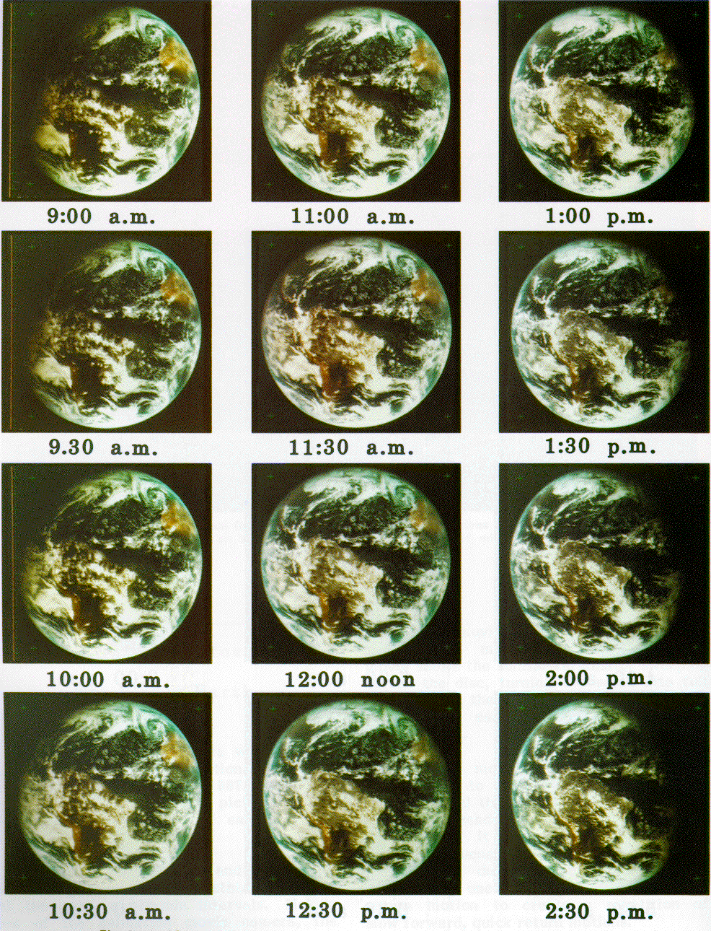
Suomi, Parent, and Fujita
create first color
movie of planet Earth with
ATS-III pictures

Slide 17
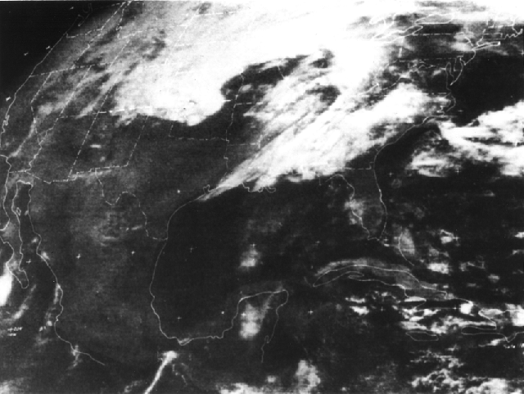
ATS-3: Visible (3 April 1974)
ATS -3

Slide 18
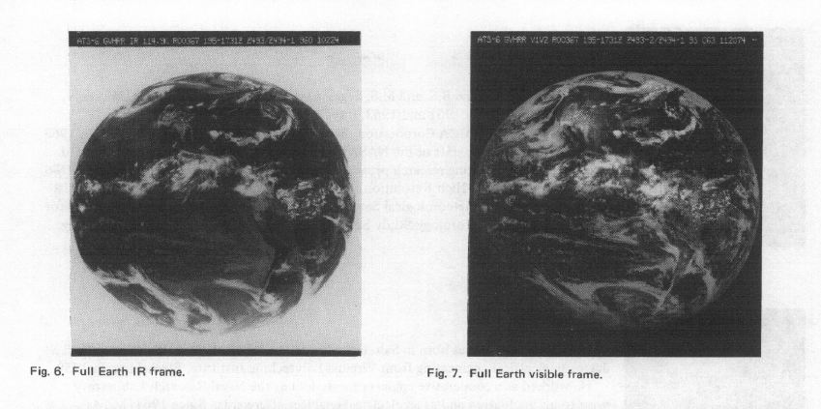
GVHRR
NASA's Geosynchronous Very High Resolution Radiometer (GVHRR), launched on ATS-6: 30 May 1974 at 13 UTC.
One infrared channel (10.5 to 12.5 um) and one visible channel (0.55 to 0.75 um)
  Approximately 10.8 and 5.4 km
July 14, 1974
Notes:
http://nssdc.gsfc.nasa.gov/nmc/datasetDisplay.do?id=ESAD-00165
http://nssdc.gsfc.nasa.gov/nmc/spacecraftOrbit.do?id=1974-039A

Slide 19
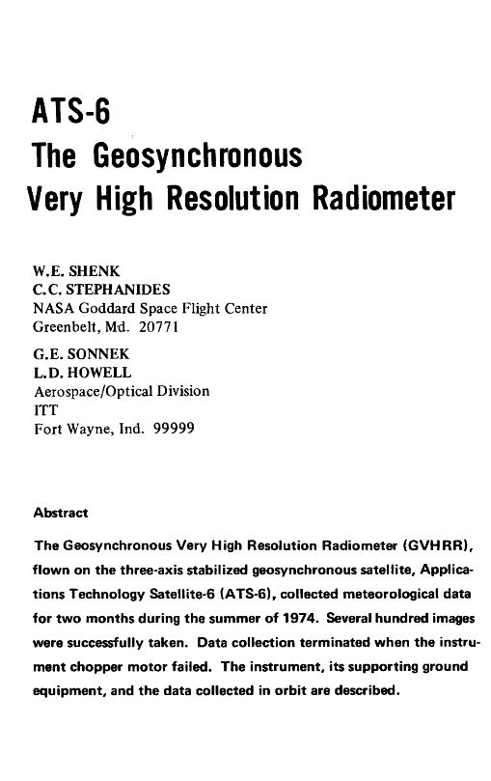
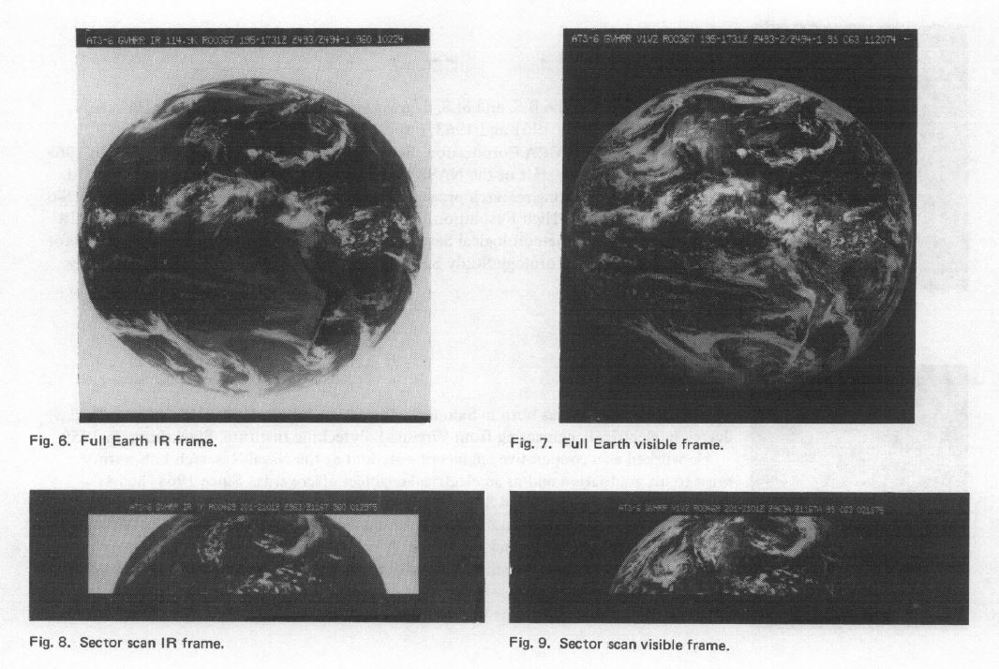
GVHRR
Geosynchronous Very High Resolution Radiometer
IEEE TRANSACTIONS ON AEROSPACE AND ELECTRONIC SYSTEMS VOL. AES-ll, NO. 6 NOVEMBER 1975

Slide 20
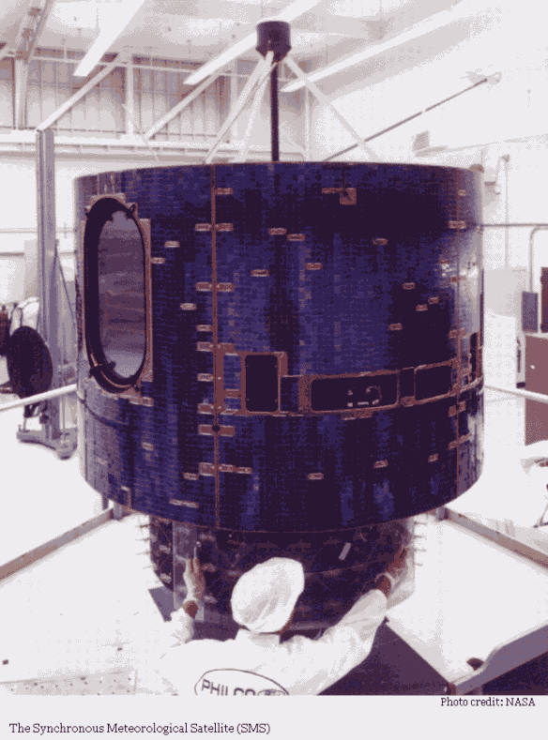
SMS (1974)
NASA's Synchronous Meteorological Satellite (SMS) with IR camera, launched on 17 May 1974.
Notes:
http://science.nasa.gov/missions/sms/

Slide 21
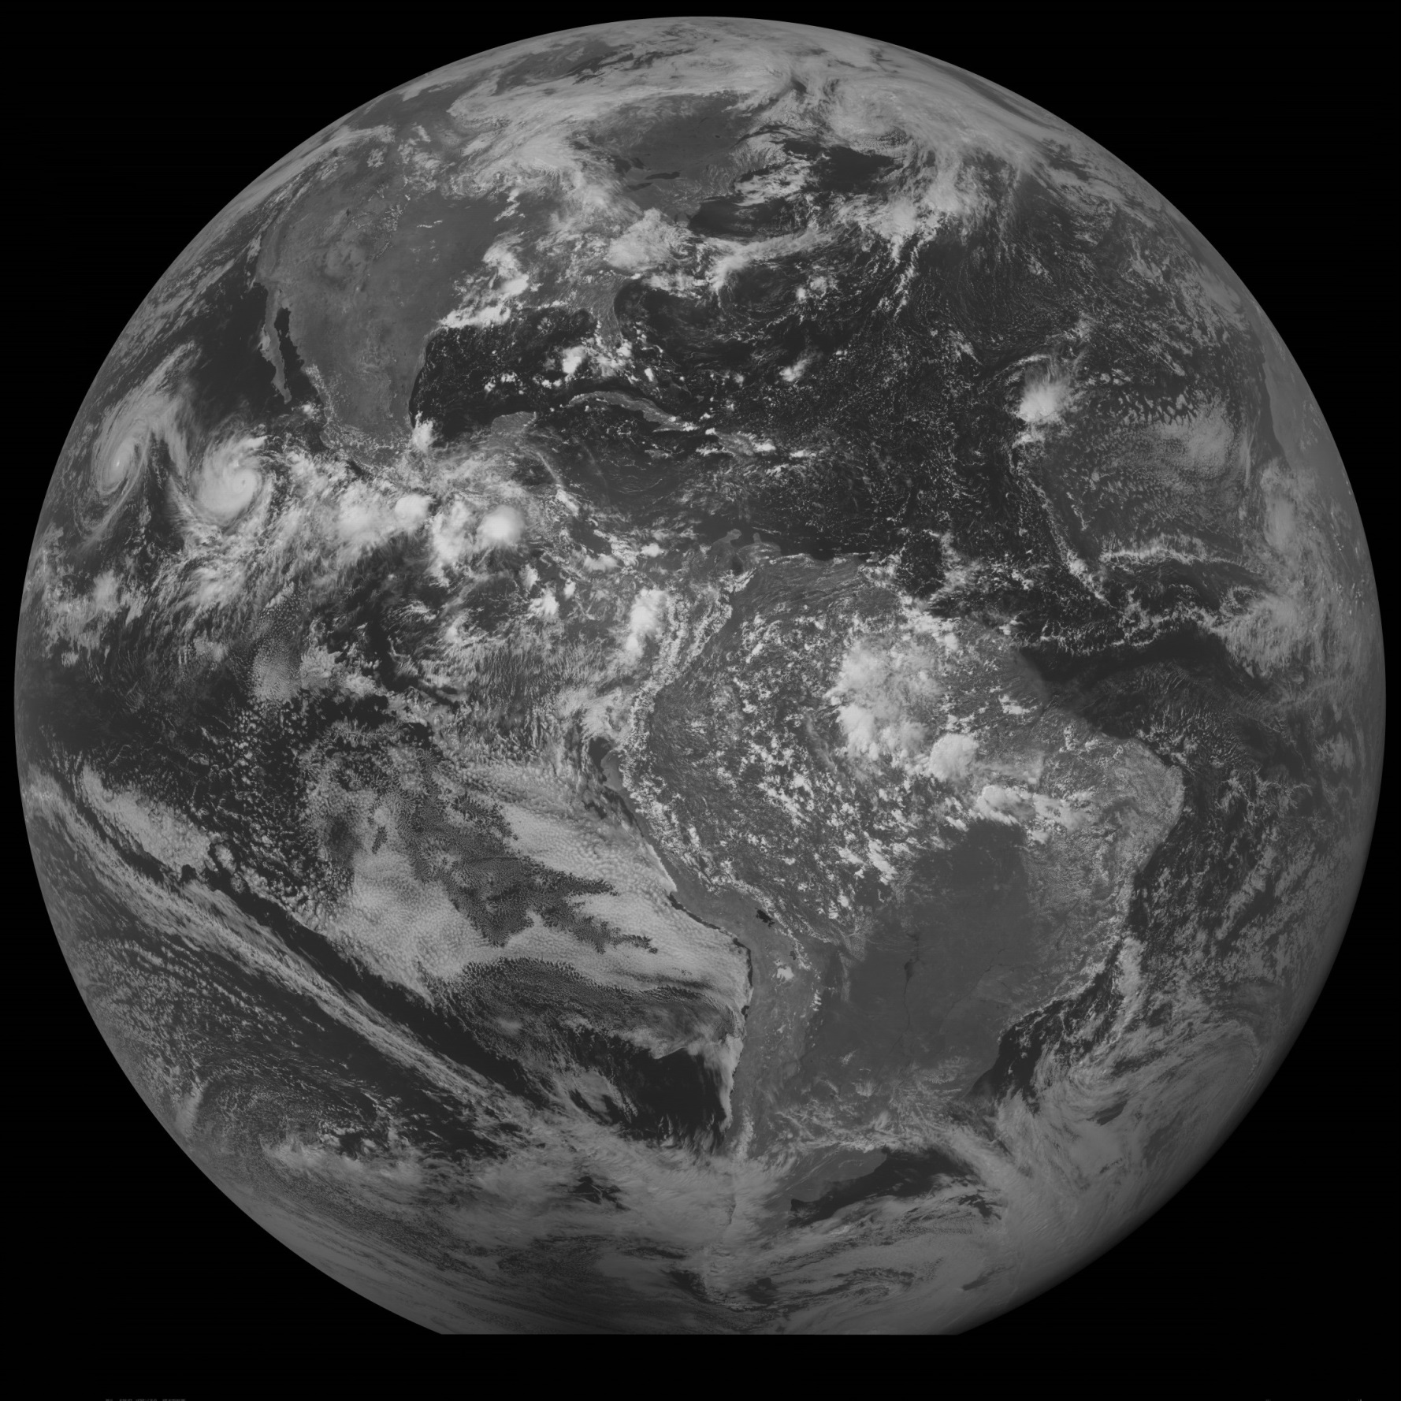
SMS-II
Enrique Fefa
22-August-1979!
Notes:
http://cimss.ssec.wisc.edu/goes/fd/
http://en.wikipedia.org/wiki/1979_Pacific_hurricane_season

Slide 22
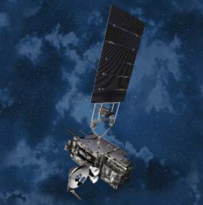
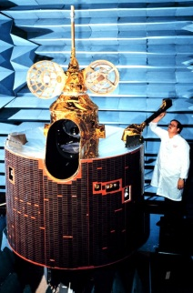
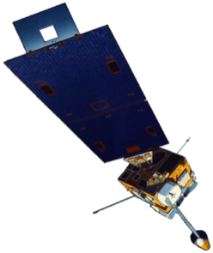
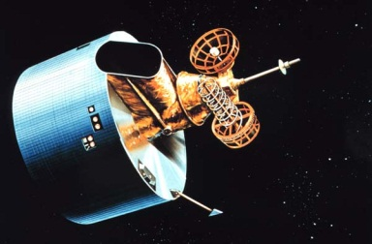
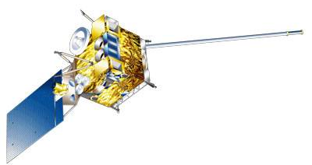
GOES History
GOES-1/3
Launched
1975
1977
1978
One visible and one infrared .
Operational.
GOES-4/7
Launched
1980
1981
1983
1987
VISSR–VAS visible, 12 IR. MSI (visible, IRW, and 2 additional IR channels)
GOES-8/12
Launched
1994
1995
1997
2000
2001
3-axis stabilized.
Imager Bands: 4 IR; 1 visible.
Operational Sounder
(18 IR bands)
GOES-13/14/15
Launched
2005
2009
2010
Better navigation and calibration.
No eclipse outages.
Better spatial resolutions for the 6.5 um on GOES-12+ and the 13.3 um band on GOES-14/15.
Operational Sounder
GOES-R/S/T/U
Planned Launch
2016
2017
2020
2025
Faster coverage.
16 Imager Bands.
Improved spatial.
No sounder.
GLM
Notes:
The circles represent an estimate of the impact of GOES on regional scale numerical models.

Slide 23
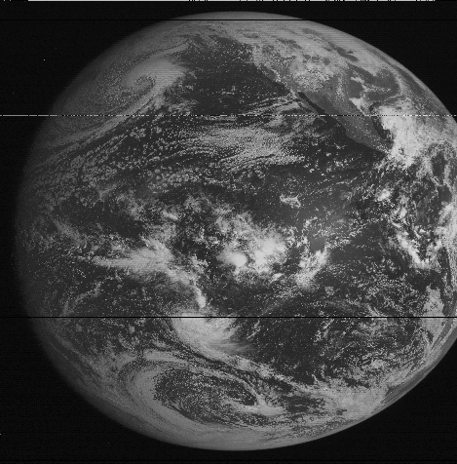
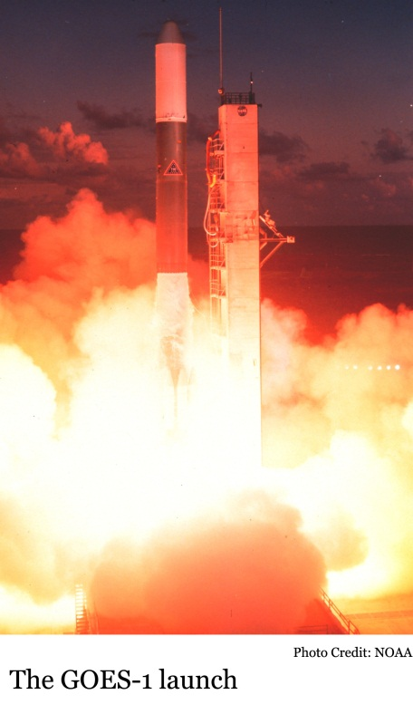
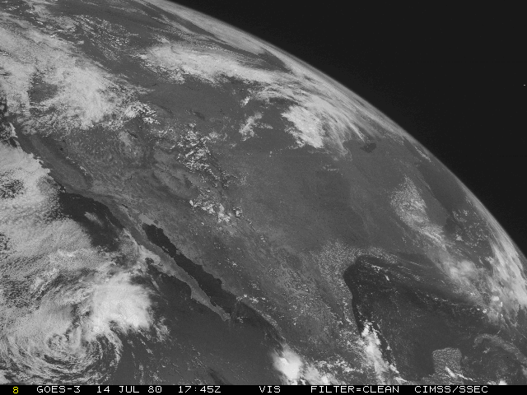
GOES-1 (1975)
GOES-1 launched on 16 October 1975
  One visible and One infrared (IR) band
GOES-1
GOES-3
Notes:
http://science.nasa.gov/missions/sms/

Slide 24
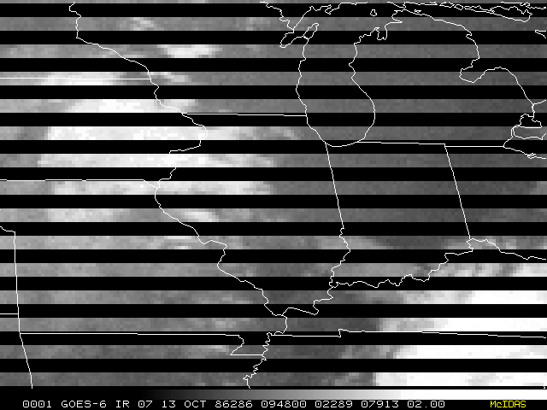
1980: GOES-4 (2nd Generation)
VISSR (Visible Infrared Spin Scan Radiometer) Up to 3 bands
Experimental Sounder – VAS
  VISSR Atmospheric Sounder
  12 bands
Multi-spectral imaging

Slide 25
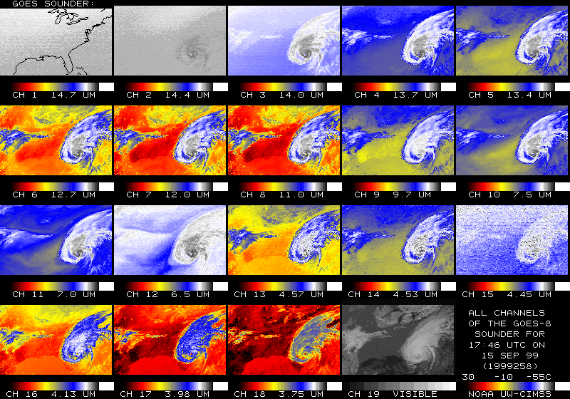
1994: GOES-8 (3rd Generation)
3-axis stabilized
Imager Bands:
  4 IR; 1 visible
  4-8 km IR IGFOV
Operational Sounder
  18 IR bands

Slide 26
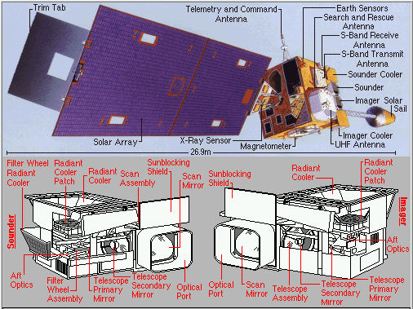
GOES-8/M Sounder
18 Infrared Channels (1 Visible Channel)
Filter Wheel Radiometer
Operational
Higher Signal-to-Noise

Slide 27


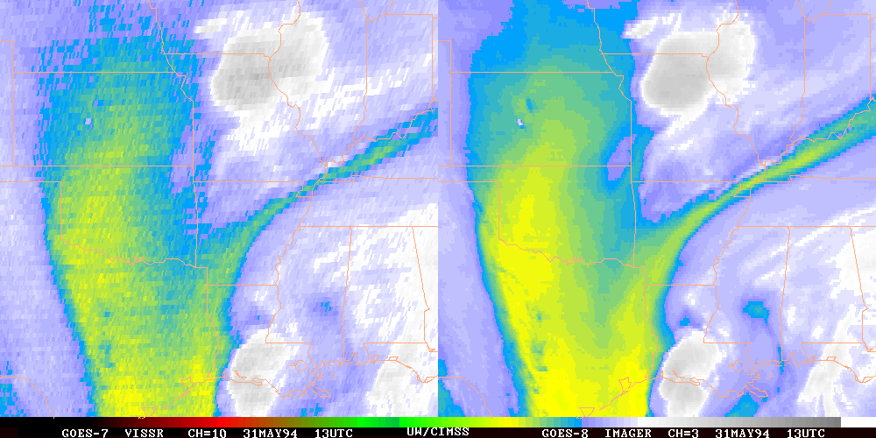
GOES-7:
GOES-8:

Slide 28
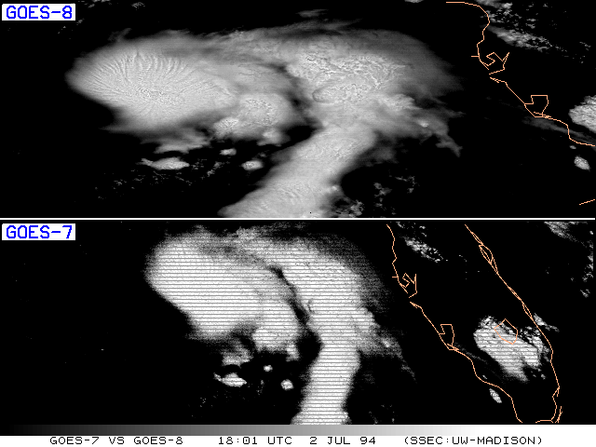
Note additional cloud-top structure is seen in the GOES-8 data.
Notes:
Visible band.

Slide 29
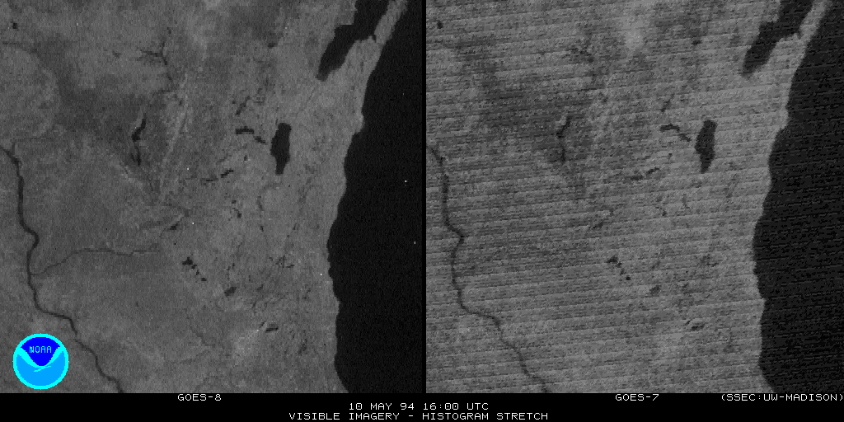
Note the improved data, even with a very similar “spatial resolution” seen in the GOES-8 data.
GOES-7
GOES-8

Slide 30
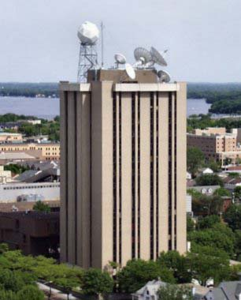
Outline
Pre-GOES and Early GOES
  First 3 Generations
Current GOES (13-15)
  Fourth Generation
GOES-R ABI
  Fifth Generation
Summary/Education
Lockheed Martin

Slide 31
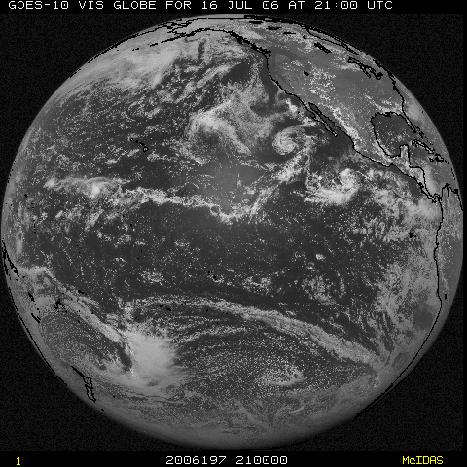
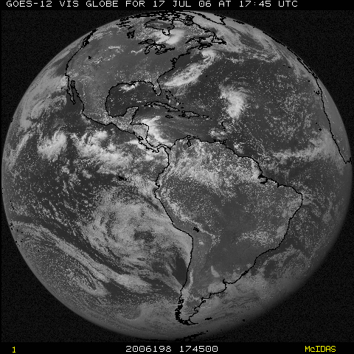
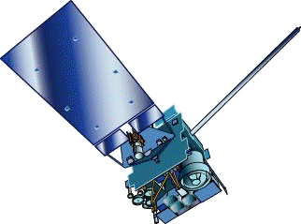
NOAA GOES Constellation
GOES-West
GOES-15
(135W)
GOES-East
GOES-13
(75W)
GOES-14 (105W) Storage

Slide 32
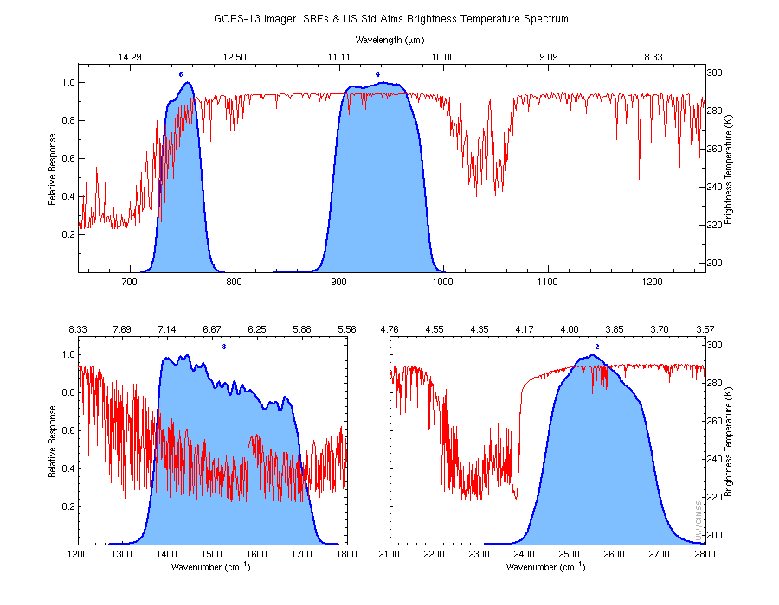
GOES Imager

Slide 33
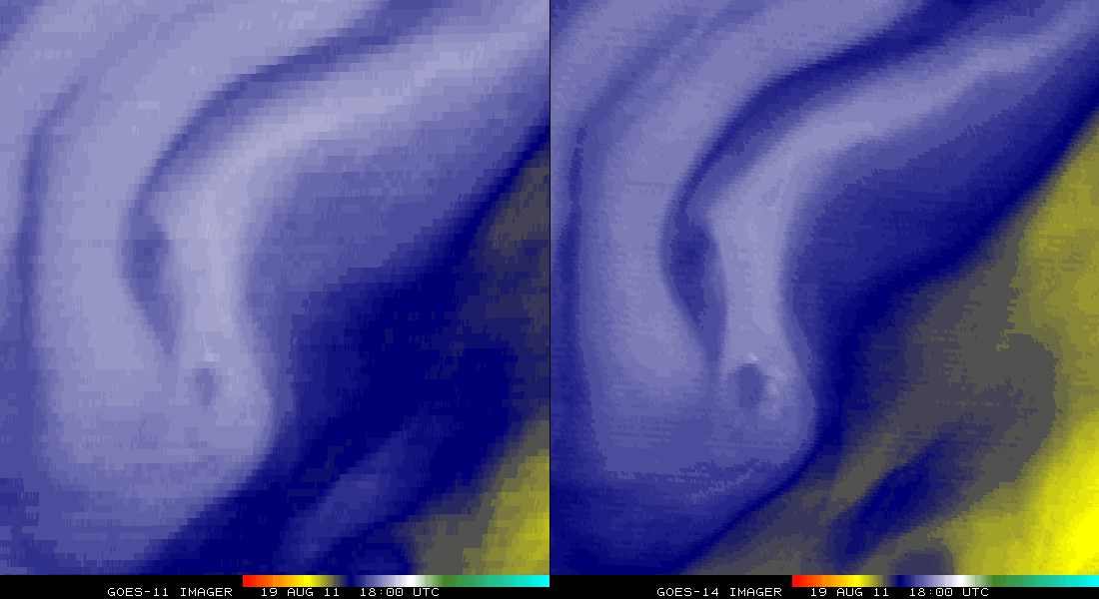
GOES-11 vs GOES-14
(Water Vapor)
Remapped into the same projection (band 3)
Note the finer resolution

Slide 34
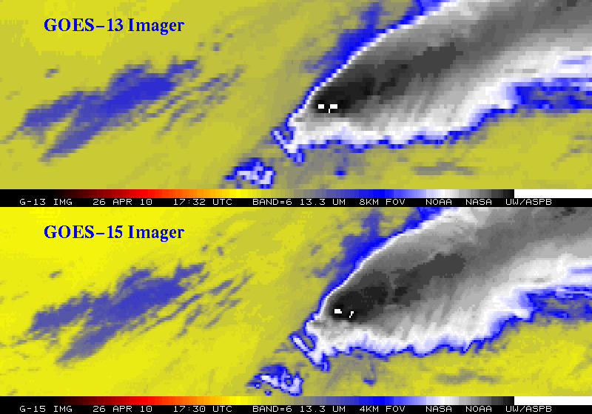
Improved spatial resolution of GOES-15 Imager band 6
The 13.3 um band 6 of the GOES-13 top panel) has an 8 km IGFOV (Instantaneous Geometric Field of View); while the same band on the GOES-15 (lower panel) has a 4 km IGFOV. Note the finer resolution of the cloud edges and the ‘cleaner’ image.
Notes:
GOES-14 (previously GOES-0) was launched on June 27, 2009.
The issue with the band 6 of the imager, was the detector order was initially flipped in the data stream. This was fixed on August 24, 2009 (not shown).
More information can be found at:
http://rammb.cira.colostate.edu/projects/goes-o/
http://cimss.ssec.wisc.edu/goes/blog/archives/3054
Don Hillger and Tim Schmit are co-leading the GOES-14 NOAA science test.
The above images were ingested by the SSEC data center in Madison, WI. Image generated by T. Schmit of NOAA NESDIS STAR ASPB.
###

Slide 35
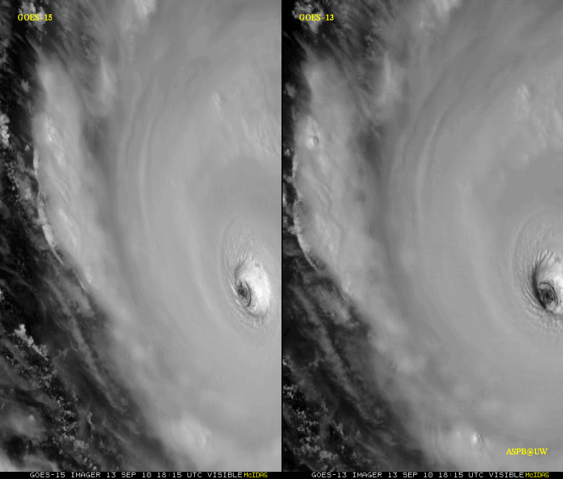
GOES-15 Science Test
The Science Test part of Post Launch Testing for GOES-15 occurred in the summer of 2010.
Co-led by Hillger and Schmit.
Unique 1-minute rapid scan imagery acquired
GOES-15 data analysis will continue. All the GVAR data archived.
Many products generated in near real-time.
A NOAA Technical Report was generated.
1-min
30-min
Unique GOES-15 Imager Visible data from the NOAA Science Test
Notes:
Igor

Slide 36



STAR’s Role in Post-Launch Tests for the Current GOES Series
STAR, along with several Cooperative Institutes, have had active roles in the Science Test part of Post Launch Testing for the current GOES series, including: GOES-8/9/10/11/12/13/14 and /15.
Science Test coordination involved CIMSS, CIRA, NASA/MSFC, SAB, and OSPO (and others).
GOES-15 Science Test web page http://rammb.cira.colostate.edu/projects/goes-p/ provides test schedules, daily implementation of those schedules, and initial results of the tests.
Several issues were addressed:
  Calibration
  Imagery
  Level 2 products (production and validations)
Data flow was tested to user sites (AWIPS/NWS level)
Unique scan scenarios: continuous full disk, 1-min rapid scan imagery, etc.
NOAA Technical Reports have been published.
First GOES-15
Imager
(all bands).
GOES-15 Sounder
(all bands).
NOAA Tech Report
Cover
STAR, along with its Cooperative Institutes, has led and contributed to successful NOAA Science tests that have occurred as part of past GOES Post Launch Tests (PLT).
Notes:
GOES-P was called GOES-15 after it successfully obtained geostationary orbit.
The Science Tests are time for learning about the satellite and collecting unique data, but to discover things wrong and a chance to correct them. With GOES-15 the main changes involved …
Full-disk GOES images courtesy of CIRA.

Slide 37

New GOES: Sample “1-min” imagery
GOES-12
GOES-14
See “what is happening”, not “what has happened”.
Notes:
Note the number of different levels of motion you can see (the cyclonic low level circulation over the ocean through the breaks in the higher clouds)... and you can't distinguish those on the GOES-12 loop.

Slide 38

XGOHI: GOES-10 and -12
By remapping GOES-10 and -12 imager data before GVAR generation (XGOHI), these imagers were able to be used after their operational lifetimes for an additional 6 total years for support over South America!
Sample coverage from GOES-12 imager when at 60 degrees West
GOES-12 Water Vapor Animation (3 years)

Slide 39

GOES-13 Optimized Schedule
Increased the coverage from the GOES-13 imager (May 2014). The size and/or start time of certain sectors was changed. The routine and Rapid Scan schedules were tested and implemented. More information is available at http://cimss.ssec.wisc.edu/goes/blog/archives/15068
CONUS sector (before)
Optimized CONUS sector (after)
More data
Comparison of the size of the Continental U.S. sector (before, left) and the extended coverage (after, right).
Notes:
Now more coverage both south and east of the current operational sector.

Slide 40

GOES-West RSO Restored
As a result of recent testing, at NESDIS, the NWS and CIMSS, GOES-15 (West) is once again able to call Rapid Scan Operations (RSO) over Hawaii
RSO was then called for almost 6 days to monitor Tropical Cyclone Ana
http://www.ospo.noaa.gov/Operations/GOES/schedules.html
http://cimss.ssec.wisc.edu/goes/blog/archives/16856
http://cimss.ssec.wisc.edu/goes/blog/archives/17027

Slide 41

GOES-14 Super Rapid Scan Operations to Prepare for GOES-R (SRSOR)
SRSOR plans for 2015 include May 18-June 12, and August 10-22:
  http://cimss.ssec.wisc.edu/goes/srsor2015/GOES-14_SRSOR.html
  Data during parts of 2012 (Hurricane Sandy, convection), 2013 (CA Rim Fire, convection) and 2014 (Hurricane Marie, convection):
  http://cimss.ssec.wisc.edu/goes/srsor/GOES-14_SRSOR.html
  http://cimss.ssec.wisc.edu/goes/srsor2013/GOES-14_SRSOR.html
  http://cimss.ssec.wisc.edu/goes/srsor2014/GOES-14_SRSOR.html
GOES-14 provided very unique data and offered a glimpse into the possibilities that will be provided by the ABI on GOES-R in one minute mesoscale imagery
GOES-14 visible image showing rapid convective development
Notes:
http://cimss.ssec.wisc.edu/goes/srsor2015/GOES-14_SRSOR.html

Slide 42

Outline
Pre-GOES and Early GOES
  First 3 Generations
Current GOES (13-15)
  Fourth Generation
GOES-R ABI
  Fifth Generation
Summary/Education
Lockheed Martin

Slide 43



From 1996
"Full disk imaging in 10 minutes is sought and so is 1 minute rapid scan modes over limited areas of say 1000 x 1000 km."
“These satellites could be first launched in 2008”
Notes:
http://ac.els-cdn.com/0094576596000215/1-s2.0-0094576596000215-main.pdf?_tid=86f5529e-c98d-11e4-8a46-00000aacb35f&acdnat=1426257222_f09810532f99876bc6014fff4f4d65be
NOAA's future earth observations from advanced GOES satellites
Dittberner G., Gird R., Heymann R., Howard E., Kirkner S., Uccellini L.
(1996) Acta Astronautica, 38 (4-8) , pp. 467-477.

Slide 44



Mission Planning
STAR very involved during the early GOES-R series development. This includes: formulation studies for both ABI and Advanced Baseline Sounder (ABS), ABI band selection and modification, etc.
ABI/ABS Requirements.
circa 1999/2000
Originally ABI was only 8 spectral bands, now it is 16. All ABI bands were modified with input from STAR and its Cooperative Institutes.
Notes:
Significant remaining scientific challenges for the specific science topic
Next step(s)
Instruments (current/future), techniques, testbed, transition, …
Path into applications/operations
Who will use it and how
How will it get out to the real world

Slide 45
1 0.52 – 0.72 0.62 Visible Daytime clouds, fog
8 1.3 – 1.9 1.6 Near IR Daytime clouds/snow, water/ice clouds
2 3.8 – 4.0 3.9 Shortwave IR Nighttime low clouds, fog, fire detection
3 6.5 – 7.0 6.75 Water Vapor 1 Upper tropospheric flow, winds
6 7.0 – 7.5 7.25 Water Vapor 2 Mid tropospheric flow, winds
4 10.2 – 11.2 10.7 IR Window 3 Clouds, low-level water vapor, fog, winds
5 11.5 – 12.5 12.0 IR Window 4 Low-level water vapor, volcanic ash
7 13.2 – 13.8 13.5 Carbon Dioxide Cloud-top parameters, heights for winds
ABI - 8
# Wavelengths Description Primary Use
Range (μm) Center
Launch was planned for 2008!
ABI – circa 1999
(8 total bands, most spectrally wide)
Notes:
These 8 bands represent the current GOES imager “six” and 1.6 and 7.2 um bands.

Slide 46
0.59 – 0.69 0.64 Visible Daytime cloud, smoke, fog
0.81 ­ 0.91 0.86* Solar window Daytime cloud, NDVI, fog, aerosol, ocean studies
1.36 - 1.39 1.375* Near IR Daytime thin cirrus detection
1.58 – 1.64 1.61 Near IR Daytime clouds/snow, water/ice clouds
3.8 – 4.0 3.9 Shortwave IR Nighttime low clouds, fog, fire detection
5.7 – 6.6 6.15 Water Vapor 1 Upper tropospheric flow, winds
6.8 – 7.2 7.0 Water Vapor 2 Mid tropospheric flow, winds
8.3 – 8.7 8.5* IR Window 1 Sulfuric acid aerosols, cloud phase
10.1 – 10.6 10.35* IR Window 2 Cloud particle size, sfc properties
10.8 – 11.6 11.2 IR Window 3 Clouds, low-level water vapor, fog, winds, SST
11.8 – 12.8 12.3 IR Window 4 Low-level water vapor, volcanic ash, SST
13.0 – 13.6 13.3 Carbon Dioxide Cloud-top parameters, heights for winds
Proposed ABI (8 or 12) channels
Wavelengths Description Primary Use
Range (μm) Center
* proposed additional channel to baseline of eight channels.
Notes:
As originally proposed by the National Weather Service, the ABI was to have a minimum of 8 spectral channels. The selected channels were close to the five channels on the GOES-8 -10 imagers ( 0.64, 3.9, 6.15, 11.2, and 12.3 μm) supplemented with a snow/cloud discriminating 1.6 μm channel, a mid-tropospheric 7.0 um water vapor channel, and a cloud height determining 13.3 μm channel. Two additional channels were proposed to expand the capabilities closer to meeting NWS requirements and to enhance opportunities for weather and climate research and applications; the IR windows at 8.5 μm and 10.35 μm offer improved moisture, cloud, aerosol, and surface sensing capabilities. In addition some of the ABI-8 spectral widths were modified to complement other satellite spectral channels and to capitalize on experience gained with the MODIS Airborne Simulator (MAS). To round out an ABI-12, another visible channel at 0.86 μm was added to help with the detection of aerosols and vegetation and a near infrared channel at 1.38 μm to detect very thin cirrus in the upper troposphere.
The addition of the 8.5 μm enables detection of volcanic cloud with sulfuric acid aerosols and thin cirrus in conjunction with the 11.2 μm channel as well as determination of cloud micro-physical properties with the 11.2 and 12.3 μm channels. This includes a more accurate delineation of ice from water clouds during the day or night.
The addition of the 10.35 μm improves determination of micro-physical properties of clouds with the 11.2 and 12.3 μm channels; this includes a more accurate determination of cloud particle size during the day and night. Also, the observation of surface properties (such as SST) is improved using the 10.35μm along with the 8.6, 11.2, and 12.3 μm channels. Finally, there is more sensitivity to low level moisture with the additional split windows.
The 0.86 μm channel provides synergy with the AVHRR/3, as it is similar its channel 2. This channel is used for determining vegetation amount, aerosols and ocean/land studies. Characterizing aerosols and their optical properties is essential for improving a number of satellite products, for example SST, ocean color and surface temperatures. This channel also enables very localized vegetation stress monitoring, fire danger monitoring, and albedo retrieval.
The 1.38 μm channel is copied from one on MODIS. It does not see into the lower troposphere due to water vapor sensitivity and thus it provides excellent daytime sensitivity to very thin cirrus. This will aid several products relying on clear skies in the infrared windows, for example SST.

Slide 47

IR channels on the current GOES and the proposed ABI
The IR bands when ABI had 12 total bands
UW-Madison/CIMSS
Notes:
This figure, generated by Mat Gunshor, shows the spectral coverage of the current GOES Imager (in red) and that proposed in the IR region for the ABI (Advanced Baseline Imager) (in green). A sample high spectral resolution earth-emitted spectra is also plotted (in blue). It’s apparent that the ABI has advantages over the current GOES Imager. For example, a 13.3 um band for cloud heights, two water vapor bands instead of one, and a band covering at the 8.5 um region (for cloud phase).

Slide 48
ABI Bands (proposed 18)
Current GOES Imagers
MSG/Sounder
MODIS/MTG/etc
Notes:
Band pass are approximate

Slide 49
Other considerations
Other bands considered on the ABI:
  a 0.55 um band, similar to MODIS for the generation of ‘natural color’ images.
  a 3.7 um band for better night-time cloud detection
It also should be noted that the ABI was designed to have a companion high-spectral infrared sounder. This is why the ABI only has one CO₂ band.

Slide 50
Options 3b. 2.6.6 VIIRS Compatibility Study
The Contractor shall assess the impact of modifying the Spectral Response Envelope of the reflective channels to be consistent with the current VIIRS design. The required changes are:
a) Move the 0.47 um channel to 0.488 um with a nominal bandwidth of 0.02 um,
b) Change the 0.64 um channel nominal bandwidth to 0.08 um,
c) Move the 0.86 um channel to 0.865 um with a nominal bandwidth of 0.039 um,
d) Move the 1.38 um channel to 1.378 um with a nominal bandwidth of 0.015 um,
e) Move the 2.26 um channel to 2.25 um with a nominal bandwidth of 0.050 um.

Slide 51
ABI 6.2 um, 7.0 um, and 7.4 um bands
Effects of changing central wavenumber
Current ABI Bandwidth
Possible ABI shifted Bandwidth
6.2 um band
5.7 um - 6.6 um
6.2 um band adjusted
5.77 um - 6.6 um
7.0 um band
6.8 um - 7.2 um
6.95 um band
6.75 um - 7.15 um
7.4 um band
7.3 um - 7.5 um
7.34 um band
7.24 um - 7.44 um

Slide 52


ABI 7.4 um Band
ABI 7.4 um
“ABI 7.34 um”

Slide 53

ABI bands 1-6
Notes:
Final column added: heritage. The ABI band 1 was suggested by Dr. Fred Mosher at a GOES Users' Conference.
The ABI band 3 was suggested by the late Dr. C. Rao (of the then ORA).
Some of these bands have been shifted to more closely match those on the VIIRS.

Slide 54

Visible and near-IR channels on the ABI
Snow, Phase
Part. size
Cirrus
Haze
Clouds
Veg.
The ABI visible and near-IR bands have many uses.
Notes:
Note how ABI bands 2 and 3 might indicate vegetation. ABI bands 2 and 5 (or 6) depict snow.
Schmit, T. J., M. M. Gunshor, W. P. Menzel, J. J. Gurka, J. Li, and A. S. Bachmeier, 2005: Introducing the next-generation Advanced Baseline Imager on GOES-R. Bull. Amer. Meteor. Soc., 86, 1079-1096.

Slide 55


AVIRIS: Linden_haze_0.439_0.498um (simulated ABI band 1)
The 0.47 um band was added, in part, due to a request from Fred Mosher, then of the AWC
Smoke
Notes:
AVIRIS (Airborne Visible/Infrared Imaging Spectrometer)
Simulated by convolving mock ABI spectral response functions with either AVIRIS data.
This band was chosen to better monitor daytime smoke, etc.

Slide 56

Linden_0.577_0.696_um (simulated ABI band 2)
Notes:
Simulated by convolving mock ABI spectral response functions with either AVIRIS data.

Slide 57


MODIS Detects Burn Scars in Louisiana
01 September 2000-- Pre-burning
17 September 2000-- Post-burning
Burn Scars
ABI will allow for diurnal characterizations of burn areas, this has implications for re-growth patterns.
Scars (dark regions) caused by biomass burning in early September are
evident in MODIS 250 m NIR channel 2 (0.85 μm) imagery on the 17th.
CIMSS, UW
MODIS Data from GSFC DAAC
Notes:
Figures from Chris Moeller, of CIMSS. The traditional visible 0.6um band does not show the burn scars (not shown).

Slide 58


GOES Visible Cannot Detect Burn Scars
01 September 2000-- Pre-burning
17 September 2000-- Post-burning
The GOES visible channel (0.52 - 0.72 μm) does not delineate the burn scars. However, the 0.85 μm channel on MODIS was able to detect the burn scars. This is another reason to include a second visible channel (0.81 - 0.91 μm) on the Advanced Baseline Imager (ABI).

Slide 59



1.88 μm (or 1.38 μm) is helpful for contrail detection
Clear?

Slide 60

ABI
Cirrus
Grass

Slide 61

ABI (1.61 um)
Example of MAS 0.66 and 1.61 um
convective cumulonimbus surrounded by lower-level water clouds
(King et al., JAOT, August 1996)

Slide 62

MODIS 0.65 µm -- Snow is bright (but so are clouds).
Snow
Notes:
Image from A. Heidnger of ASPB.

Slide 63

MODIS 1.6 µm -- Snow is darker.
Snow
Notes:
Image from A. Heidnger of ASPB.

Slide 64

ABI (10.35 μm)
Examples of MAS 0.66, 10.5-11.0, and 8.6-10.5 um reveal utility of new IR window for seeing through clouds to ice floes

Slide 65

ABI bands 7-16
Notes:
The ABI band 10 was modified to better depict upper-level SO2. (G. Ellrod and others)
The ABI band 11 was suggested by Steve Ackerman (CIMSS), based on HIRS experience.
The ABI band 13 was suggested by W. P. Menzel (then NOAA NESDIS).

Slide 66

Nocturnal Fog/Stratus Over the Northern Plains
“ABI” 4 minus 11 μm Difference
ABI image (from MODIS) shows greater detail in structure of fog.
Notes:
Note the ABI (from MODIS) image is better spatial resolution and better signal-to-noise ratio then the GOES-10 imager.
Schmit, T. J., M. M. Gunshor, W. P. Menzel, J. J. Gurka, J. Li, and A. S. Bachmeier, 2005: Introducing the next-generation Advanced Baseline Imager on GOES-R. Bull. Amer. Meteor. Soc., 86, 1079-1096.

Slide 67

Nocturnal Fog/Stratus Over the Northern Plains
GOES-10 4 minus 11 μm Difference
ABI image (from MODIS) shows greater detail in structure of fog.
Notes:
Schmit, T. J., M. M. Gunshor, W. P. Menzel, J. J. Gurka, J. Li, and A. S. Bachmeier, 2005: Introducing the next-generation Advanced Baseline Imager on GOES-R. Bull. Amer. Meteor. Soc., 86, 1079-1096.

Slide 68

Recent poster by Michael Eckert (FAA) noted that there was over $800K of aircraft savings in just two cases when the GOES-R fog and low stratus algorithm was applied to current GOES information. Of course the product will be much improved with ABI data!

Slide 69


Updated Cost-Benefit Analysis
(S. Bard et al, Centrec Consulting Group)
Net Present Value¹
of Benefits
from 2015-2027
($ Mil)
¹ Discounted at 7%
Total
[Additional over current]
Benefits -
$4,563 Mil
“…most likely underestimate the potential total benefits of the GOES-R …. beyond the current system, due to conservative assumptions relative to the effect of improved geostationary data on potential benefits are consistently employed throughout the analysis”
Notes:
http://www.centrec.com/assets/guc-extended-abstract.pdf

Slide 70
Areas Not Included in Analysis
Tropical cyclone forecast analysis
  Disruptions of economic operations
  Inland damages due to rain and wind effects
Instruments – Geostationary Lightning Mapper (GLM); Solar UV Imager (SUVI); Extreme UV/X-Ray Irradiance Sensor (EXIS); Space Environmental In-Situ Suite (SEISS); Magnetometer (MAG) and Unique Payload Services
Users – international; retrospective; DoD; data collection services
Economic sectors including commercial transportation, tourism, television
Societal benefit areas such as human health, climate, ecological, ocean…

Slide 71




GOES-12 and GOES-R ABI
Simulation of Grand Prix Fire/Southern California
GOES-12
GOES-R ABI
GOES-12
GOES-R ABI
Notes:
Here are two different fires from J. Feltz of CIMSS (using mcidas-v). What we can see is a more defined peak in the higher resolution data and it is easier to pick out individual hotspots. In addition, the higher saturation temperature of the ABI allows us to see that the fire is around 370K. ABI is simulated from MODIS.

Slide 72


Real-Time Aerosol Transport Model Assimilation of the Wildfire ABBA Fire Product
Using the Navy Aerosol Analysis and Prediction System (NAAPS)
GOES-8 Wildfire ABBA fire product
for the Pacific Northwest
Date: August 17, 2001
Time: 2200 UTC
FIRES
Smoke
NAAPS Model Aerosol Analysis
for the continental U.S.
Date: August 18, 2001
Time: 1200 UTC
Notes:
Over the past 2 years, D. Westphal at the Naval Research Laboratory (NRL) in Monterey, California has been assimilating half-hourly Geostationary Operational Environmental Satellite (GOES) Wildfire Automated Biomass Burning Algorithm (ABBA) fire products into the Navy Aerosol Analysis and Prediction System (NAAPS) in real time to analyze and predict aerosol extent, loading, and transport regimes. In August 2001 the NAAPS successfully documented the transport of smoke associated with wildfires burning in the western U.S. On August 18, the NAAPS analyzed a large smoke pall that extended north into Canada and south over the plains of Montana. This effort is part of a joint collaboration funded by the National Aeronautics and Space Administration (NASA) under the Earth Systems Enterprise (ESE) modeling and data analysis research program.

Slide 73

GOES-R ABI will detect SO2 plumes
Water Vapor Band Difference convolved from AIRS data
sees SO₂ plume from Montserrat Island, West Indies
SO₂ Plume
Current GOES Imager
No skill in monitoring
Figure courtesy of Kris Karnauskas
Current GOES Imager can not
detect SO₂
ABI 7.34 μm – 13.3 μm
Notes:
Current GOES can detect an ash cloud, but not the SO2 signature. The ABI can, if the plume is large and high enough.
Image on Right from:
Schmit, T. J., M. M. Gunshor, W. P. Menzel, J. J. Gurka, J. Li, and A. S. Bachmeier, 2005: Introducing the next-generation Advanced Baseline Imager on GOES-R. Bull. Amer. Meteor. Soc., 86, 1079-1096.

Slide 74



Volcanic Ash Plume: 11-12 and 8.5-11 μm images
One day after the Mt. Cleveland eruption
20 February 2001, 8:45 UTC
Simulated
ABI
(11-12 μm)
Simulated
ABI
(8.5-11 μm)
UW/CIMSS
Notes:
One of uses of the 8.5 um is better ash detection.

Slide 75







GOES-R ABI: Helps provide advanced weather Information to enable collaborative planning and efficient utilization of airspace routes through entire trajectory
Cloud Classification
Convective Initiation
Cloud & Moisture Imagery
Low Ceiling & Visibility
(Aerosols, clouds, dust)
Overshooting Top
Precipitation
Snow
Cloud Classification, Jet Stream,
Volcanic Ash, Turbulence,
Icing, Winds,
Convective Initiation
Mountain Waves
Cloud & Moisture Imagery
Cloud Top Information
SO2 Detection
Radiances
Cloud Classification
Lightning
Convective Initiation
Low Ceiling & Visibility
Overshooting Top
Icing
Precipitation
Snow
Fog and Low Stratus
Nowcasting
Convective Initiation
Cloud-Top Cooling
NWP Forecasts
(radiances, winds, fires, profiles, clouds, etc.)
Pre-flight
Post-flight
Post-flight observed weather product archives
Initial Slide from T. Carty
Notes:
Every Phase of flight
Actionable information
Deice
temp-gallon
Risk average

Slide 76


Mountain Waves in WV channel (6.7 µm)
7 April 2000, 1815 UTC
Simulated ABI
Actual GOES-8
Mountain waves over Colorado and New Mexico were induced by strong northwesterly flow associated with a pair of upper-tropospheric jet streaks moving across the elevated terrain of the southern and central Rocky Mountains. The mountain waves appear more well-defined over Colorado; in fact, several aircraft reported moderate to severe turbulence over that region.
Both images are shown in GOES projection.
UW/CIMSS

Slide 77

ABI -- 8.5 μm
Based on MODIS used with ABI window channels to separate water from ice clouds
The 8.5 um band was added, in part, due to a request in the late 1980s from Steve Ackerman, CIMSS.
Notes:
Another use of the 8.5 um band is a day and night cloud-top phase product.

Slide 78



Aerosol/Dust Optical Thickness Retrieval
Results from SEVIRI@EUMETSAT
In general, GOES-R products will be more quantitative that current GOES.
Figure courtesy of J. Li and P. Zhang
Notes:
The 8.5 um is also very helpful for dust detection.

Slide 79
















0.47 μm
0.64 μm
0.86 μm
1.38 μm
AWG Proxy ABI Simulations of Hurricane Katrina
1.61 μm
2.26 μm
3.9 μm
6.19 μm
NOAA/NESDIS STAR and GOES-R Imagery Team
6.95 μm
7.34 μm
8.5 μm
9.61 μm
10.35 μm
11.2 μm
12.3 μm
13.3 μm
Notes:
As shown in mcidas-v

Slide 80




Corresponding current Imager bands of Hurricane Katrina
NOAA/NESDIS STAR

Slide 81


Near Realtime WRF Chem ABI runs
http://cimss.ssec.wisc.edu/goes_r/proving-ground/wrf_chem_abi/wrf_chem_abi.html

Slide 82

Real GOES, Simulated ABI
Notes:
Both remapped to 10km. GOES imagery on top panel. Images displayed in Mcidas-X.

Slide 83

Real GOES, Simulated ABI
Notes:
Both remapped to 10km. GOES imagery on top panel. Images displayed in Mcidas-X.

Slide 84

Visible and near-IR channels on the ABI
Aerosols, Insolation
Clouds, Snow
Vegetation, Imagery
Cloud mask, Suspended matter
Snow, Phase
Cloud Particle size
Sample use only, many other uses
The ABI visible and near-IR bands have many uses.
Notes:
Schmit, T. J., M. M. Gunshor, W. P. Menzel, J. J. Gurka, J. Li, and A. S. Bachmeier, 2005: Introducing the next-generation Advanced Baseline Imager on GOES-R. Bull. Amer. Meteor. Soc., 86, 1079-1096.

Slide 85

The IR channels on the ABI
Clouds, Stability Indices
SST, Fires, Radiances
Ozone, Downward Radiation
Rainfall, Aerosol
Hurricane, Imagery
Cloud Phase, SST
Sample use only, many other uses
SO2, Radiances
Winds, WV profiling
TPW, Rainfall rate
Fires, Fog
ABI has many more bands than the current operational GOES imagers.
Notes:
Schmit, T. J., M. M. Gunshor, W. P. Menzel, J. J. Gurka, J. Li, and A. S. Bachmeier, 2005: Introducing the next-generation Advanced Baseline Imager on GOES-R. Bull. Amer. Meteor. Soc., 86, 1079-1096.

Slide 86
ABI Band “Champions”
CWL | Band # | Champion
0.47 | 1 | Fred Mosher
0.64 | 2 | Vern Suomi
0.86 | 3 | Nagaraja Rao
1.38 | 4 | Bo-Cai Gao
1.61 | 5 | L. Stowe
2.25 | 6 | M. King
3.9 | 7 | Vern Suomi
6.16 | 8 | Pierre Morel
6.93 | 9 | W. L. Smith
7.34 | 10 | Gary Ellrod
8.5 | 11 | S. Ackerman
9.61 | 12 | Art Neuendorffer
10.33 | 13 | W. P. Menzel
11.2 | 14 | Vern Suomi
12.3 | 15 | Vern Suomi
13.3 | 16 | W. L. Smith

Slide 87

Ackerman memo (1989)
8 micrometer…very useful in detecting …cirrus information … microphysical properties

Slide 88


GOES-R Schedule (2004)
Calendar Year
2002
2003
2004
2005
2006
2007
2008
2009
2010
2011
2012
2013
2014…
Instrument Contracts
(NASA/GSFC contracts)
ABI, HES, SIS, SEISS, GLM
Instrument contracts on-going
System Architecture Studies
(12 x industry contracts)
Architecture Studies Complete
PDRR RFP Preparation
PDRR Source Selection
PDRR preparations underway
Industry Announcement
Program Definition and Risk Reduction (PDRR)
PDRR
Instrument development responsibility transitioned to prime contractor
System Acquisition RFP Preparation
System Acquisition Source Selection
System Acquisition & Operations
System Acquisition & Operations
Launch
2012 launch date

Slide 89


Continuity of GOES Operational Satellite Program
2004
2005
2006
2007
2008
2009
2010
2011
2012
2013
2014
2015
2016
2017
2018
2019
2020
GOES 10
Backup
GOES 11
GOES West
GOES 12
GOES East
GOES 13
On-orbit Spare
GOES O
GOES P
GOES R
GOES S
In 2007: 2014 launch date for GOES-R
Satellite is operational beyond design life
On-orbit GOES storage
Operational

Slide 90

GOES Fly-out Schedule
Oct 2015 launch readiness date
http://www.goes-r.gov/

Slide 91

GOES Fly-out Schedule
March 2016 launch readiness date
http://www.goes-r.gov/

Slide 92

Continuity of GOES Operational Satellite Program
Importance of GOES-R is highlighted in that GOES-R will not go into storage mode, but into operations after the on-orbit PLT and extended validation.

Slide 93
The Advanced Baseline Imager:
ABI Current
Spectral Coverage
16 bands 5 bands
Spatial resolution
0.64 μm Visible 0.5 km Approx. 1 km
Other Visible/near-IR 1.0 km n/a
Bands (>2 μm) 2 km Approx. 4 km
Spatial coverage
Full disk 4 per hour Scheduled (3 hrly)
CONUS 12 per hour ~4 per hour
Mesoscale Every 30 sec n/a
Visible (reflective bands)
On-orbit calibration Yes No
Notes:
The ABI allows more bands, finer spatial resolution, faster refresh rates and on-orbit calibration of all bands!

Slide 94


Advanced Baseline Imager
5
4
3
X
Faster coverage
(5-minute full disk vs. 25-minute)
X
Improved spatial
resolution
(2 km IR vs. 4 km)
X
More spectral bands (16 on ABI vs. 5 on the current imager)
Notes:
Slide from J. Gerth, CIMSS.

Slide 95

Future vs. Current Spectral Bands
The current GOES (right) has 5 spectral bands, while the GOES-R series ABI (left) will have 16 spectral bands.

Slide 96



Three ABI water vapor bands
Current GOES
Future GOES
Images from J. Feltz
Notes:
Note the 3 layers of information possible from the ABI (right panel).
http://www.ssec.wisc.edu/mcidas/software/v/

Slide 97



Imager Coverage in ~30 minutes
 | Current Imager (Rapid Scan mode) | Future Imager (“Flex” mode (3))
Full Disk | 0 | 2
Northern Hemi | 1 | -
CONUS | 3 | 6
Mesoscale | 0 | 60
Full Disk
N. Hemisphere
CONUS
Mesoscale

Slide 98

  SRSOR

Slide 99

Rate of temporal cooling in the longwave infrared band
Cintineo et al., 2013 (CIMSS)

Slide 100

Monitoring The Co-Evolution Of
Total Lightning, Radar, and
GOES-14 Super Rapid Scan Observations
Of Deep Convective Clouds
Kristopher M. Bedka, Cecilia Wang, Patrick Minnis
NASA Langley Research Center
Ryan Rogers, Lawrence D. Carey
University of Alabama in Huntsville
Wayne Feltz
Cooperative Institute for Meteorological Satellite Studies
University of Wisconsin-Madison
Jan Kanak
Slovak Hydrometeorological Institute
Slide subset!

Slide 101
Above-Anvil Cirrus Plume
Severe Weather Relationships
Plumes appeared in advance of a severe weather report for 28 of the 33 (85%) events
  For the 5 events with no lead-time, the plumes emerged a maximum of 10 mins after the severe weather report
  For the other 28 events, the plumes appeared an average of 18 minutes in advance of severe weather with a standard deviation of 14 mins
  The large standard deviation was caused by 7 of the plumes providing greater than 30 minutes lead-time
The severe weather nowcast lead-times offered by GOES if it were operating in 15-30-minute operational and 7.5 min rapid scanning modes were determined
  A plume would have been observed prior to a severe weather report for 48% of the plume events if GOES were in normal operations; a plume would have been observed prior to a severe weather report for only 64% of the plume events if GOES were in 7.5 min rapid scan mode
  For the 48% of the events observed by all scan modes,
    SRSOR lead time = 27 mins,
    Rapid scan lead time = 22 mins,
    Operational lead time = 18 mins
Kristopher M. Bedka et al.
Notes:
http://journals.ametsoc.org/doi/abs/10.1175/WAF-D-14-00062.1

Slide 102


Improved products could be realized from combinations of ABI and HES (Hyperspectral Environmental Suite) data
Spatial
resolution
Temporal
resolution
Cloud
clearing
ABI
HES
Spectral
coverage
Surface
emissivity
Spectral resolution
cira 2004
HES cancelled in 2006

Slide 103

Why do we need a high spectral resolution sounder?
Analysis courtesy of Justin Sieglaff, CIMSS.
GOES-12 Sounder Bands
Smooth over required absorption lines
Compared to broadband sounders, observing absorption lines is mandatory to meeting requirements for temperature and moisture structure needed to improve weather forecasting
Many papers document science value of high spectral resolution sounder that support weather forecast needs. (Sieglaff et al.)
Notes:
These are calculated spectra, showing important features dealing with temperature and moisture are in the high-spectral data, but are smoothed over in the broad-band data. Figure courtesy of J. Sieglaff, CIMSS.
I’m not sure it is useful to show an entire spectrum. Rather I prefer to show the above and indicate that it is these little wiggles that make the HES so valuable and that the current GOES smears out.

Slide 104

Example spectral coverage
Current GOES Sounder spectral coverage and that possible from an advanced high-spectral sounder. The broad-band nature of the current GOES limits the vertical resolution.

Slide 105
Next Generation Geo Imagers
(multispectral (>11), on the order of 1km resolution, ~10 min FD)
2002 – SEVIRI (MSG) Europe
2014 – AHI (Himawari-8) Japan
2016 – ABI (GOES-R) USA
2016 – AGRI (FY4) China
2017 – MSU-GS (Electro-L) Russia
201? – ARCTICA (Molniya) Russia
2018 – AMI (KOMPSAT-2A) Korea
2019 – FCI (MTG) Europe
202? – anticipated ‘geo-like’ PCW. Canada
Notes:
First occurrence.

Slide 106

From MSG-SEVIRI to MTG-FCI
MTG FCI outbids MSG SEVIRI observations on cloud, aerosol, moisture and fire:
by adding new channels
by improving temporal-,
spatial-, and radiometric
resolution
High-Resolution Fast Imagery
a Full-Disk High-Spectral-resolution
Imagery (FDHSI)
Coverage Repeat cycle FDHSI mission 18ºx18º 10 min
HRFI mission 1/4 FD 2.5 min
Notes:
Flexible Combined Imager

Slide 107
MTG Provides a Total of Five Missions
FCI - Full Disk Scan Service (FCI-FDSS), global scales (Full Disk) RC = 10 min, with 16 channels at spatial resolution of 1 km (8 solar channels) and 2 km (8 thermal channels)
FCI - Rapid Scan Service (FCI-RSS), local scales (1/4th of Full Disk) RC = 2.5 min with 4 channels at high spatial resolution 0.5 km (2 solar channels @ 0.6 and 2.2 µm), and 1.0 km (2 thermal channels @ 3.8 and 10.5 µm)
    IRS => Repeat Cycle : 15 min per 1/4th of Full Disk; Spatial resolution : 4 km, spectral sampling at 0.625 cm⁻¹;
  Two bands: Long-Wave-IR 700 – 1210 cm⁻¹ ~ 820 spectral samples Mid-Wave-IR 1600 – 2175 cm⁻¹ ~ 920 spectral samples
LI, continuously observing 80% of Full Disk: Integration Time~1.5ms detection/mapping of Intra-Cloud and Cloud-Ground strokes at ~10km spatial resolution DE=90% (night) and DE=40% (overhead sun)
UVN Sounding, implemented as GMES Sentinel 4 Instruments provided by ESA

Slide 108

AHI Sectored Observations in 10 minutes
Full disk
Interval : 10 minutes (6 times per hour)
23 swath
Region 1 JAPAN (North-East)
Interval : 2.5 minutes (4 times in 10minutes)
Dimension : EW x NS: 2000 x 1000 km
2 swath
Region 1
N-E JAPAN
Region 2
S-W JAPAN
Region 3
Typhoon
Region 2 JAPAN (South-West)
Interval : 2.5 minutes (4 times in 10minutes)
Dimension : EW x NS: 2000 x 1000 km
2 swath
Region 3 Typhoon
Interval : 2.5 minutes (4 times in 10minutes)
Dimension : EW x NS: 1000 x 1000 km
2 swath
Region 5
Land mark
Region 4
Land mark
Region 4 Land mark
Interval : 0.5 minutes (20 times in 10minutes)
Dimension : EW x NS: 1000 x 500 km
1 swath
Region 5 Land mark
Interval : 0.5 minutes (20 times in 10minutes) Dimension : EW x NS: 1000 x 500 km
1 swath

Slide 109

McIDAS-X

Slide 110


Slide 111


Slide 112


Slide 113


Slide 114


Slide 115


Slide 116


Slide 117


Slide 118


Slide 119


Slide 120


Slide 121


Slide 122


Slide 123


Slide 124


Slide 125

0.6 um

Slide 126

0.86 um

Slide 127
0.6 um

Slide 128

1.6 um

Slide 129
0.6 um

Slide 130

2.3 um

Slide 131

10.4 um

Slide 132

13.3 um

Slide 133


MTSAT and AHI (visible) comparisons:
a glimpse into the ABI performance
Approximate spatial resolution: 1 km
Approximate spatial resolution: 0.5 km
Much improved spatial resolution on Japan’s ABI-like AHI.
T. Schmit
Notes:
Tim Schmit, ASPB with CIMSS.
MTSAT= JMA’s current imager; AHI = JMA’s next generation (ABI-like) imager. ABI = Advanced Baseline Imager
Data from:
http://www.data.jma.go.jp/mscweb/en/himawari89/space_segment/spsg_sample.html
Displayed in McIDAS-V
Images made with McIDAS-V by M. Gunshor, using a ‘square root’ enhancement.

Slide 134

MTSAT
Visible (25-Jan-2015)
?

Slide 135


AHI: 66 South -- Icebergs
Dark at 1.6 um
Notes:
These data are from those posted on the JMA web page.

Slide 136




































































4.3 COMS & GEO-KOMPSAT-2A
resolution 4times upgrade
channel 3times increase
products 3.5 times increase
COMS
Geo-KOMPSAT-2A
COMS
Geo-KOMPSAT-2A
COMS
VIS 1km
IR 4km
Geo-KOMPSAT-2A
VIS 0.5~1km
IR 2km
1
(Black and white)
4
(color image)
Cloud/pre. : 5
Cloud/pre. :19
VIS
Observation frequency 4 times
Aerosol : 5
Aerosol : 16
1hr
2
SW
IR
O
Full disk : 1
Full disk : 4
AMV : 3
AMV : 6
4
10
NH : 2
NH : 10
IR
Land sfc. : 3
Land sfc. : 11
…....
KP : every 15min
KP : every 2min
5 channel
16 channel
Total : 16
Total : 52

Slide 137





GOES-R main instruments
ABI – Advanced Baseline Imager
Space Weather/Solar
SEISS
SUVI
EXIS
Magnetometer
ABI covers the earth 5X faster than current Imager
Geostationary Lightning Mapper
Images courtesy of SOHO EIT, a joint NASA/ESA program
Unique Payload Services
No Sounder

Slide 138
GOES-R Series Overview
No dedicated Sounder
Advanced Baseline Imager (ABI)
Geostationary Lightning Mapper (GLM)
Space Weather
  Space Environmental In-Situ Suite (SEISS)
  Solar Ultra Violet Imager (SUVI)
  Extreme Ultra Violet/X-Ray Irradiance Sensor (EXIS)
  Magnetometer
Communications
  GOES Rebroadcast (GRB)
  Low Rate Information Transmissions (LRIT)
  Emergency Managers Weather Information Network (EMWIN)
  Search and Rescue (SAR)
  Data Collection System (DCS)
Notes:
Advanced Baseline Imager (ABI) Earth-viewing
Geostationary Lightning Mapper (GLM) Earth-viewing
Solar Ultra-Violet Imager (SUVI) Sun-viewing
EUVS and XRS Irradiance Sensors (EXIS) Sun-viewing
Space Environment In-Situ Suite (SEISS) Space-viewing
Magnetometer (MAG) Space-viewing

Slide 139

GOES-R
Folks who named the instruments
T. Schmit
M. Weinreb
J. Criscione?
M. Coakley
R. Heymann
Gary Cunningham?
Notes:
Graphic from LM

Slide 140


Slide 141


Slide 142



Baseline ABI Scan Modes
Scan mode (3) or ‘flex mode’ for the ABI:
- Full disk every 15 minutes + 5 min CONUS
+ 1-min mesoscales (2 locations).
[Scan mode (4) or ‘Continuous Full Disk’ (CFD) is a full disk every 5 min]
Notes:
CONUS image is the shifted center point.

Slide 143

CONUS from East and West (PUG Volume 4 Version C)
Notes:
Different days simulated.

Slide 144

CONUS from East and West (NOAT/GORWG-approved)
Notes:
Different days simulated.

Slide 145

ABI CONUS: West
(with increasing pixel size)
Notes:
GORWG-approved

Slide 146

ABI CONUS: East
(with increasing pixel size)
Note the northwest corner of the scan sees into space
Notes:
GORWG-approved

Slide 147
Recent Mode 3 (Flex mode)
“Time-Time” chart
Note the ‘white’ space is instrument idle time.
DRAFT!!!!!
Notes:
Copy and pasted from excel. Pasted as a picture. Resized to 44% by 44% of original. Arrange -> Align -> Align Center & Align Middle

Slide 148
Baseline Time-Time Mode 4
(Continuous Full Disk)
This is the Continuous Full Disk (every 5 min) mode
This is the highest data rate.

Slide 149
Exploratory ABI Scan Mode (draft)
At some point, other ABI scan modes could be possible.
  requires an upgrade to the ground system.
  ABI instrument is capable of supporting other scan modes.
One option is to use the ‘white space’ of when the ABI instrument is not scanning in mode 3 (‘flex’). For example, increase to an ‘extended CONUS’ image.
There are other optimized scan options as well, such as investigating a FD scan every 10 min to sync with global constellation (EUMETSAT, AHI, AGRI, etc.).

Slide 150
Draft Scan Mode ”6” with 10-min FD
In 10-min:
  1 Full Disk +
  2 CONUS +
  20 Meso-scale
The 10-min Full Disk would offer synergy with other geos and improved AMVs outside of CONUS, plus still allow for meso-scale observations.
This draft mode 6 ideally could be tested during PLPT (Post Launch Products Test).
This mode should be easier to implement at the Ground System, sense the scan sectors are the same size/locations as in mode 3.
DRAFT!
Notes:
Copy and pasted from excel. Pasted as a picture. Resized to 44% by 44% of original. Arrange -> Align -> Align Center & Align Middle

Slide 151

Draft Scan Mode ”6” with 10-min FD
Note less ‘white space’ than scan mode 3 (flex mode)
Time-time diagram from Exelis
Notes:
Copy and pasted from excel. Pasted as a picture. Resized to 44% by 44% of original. Arrange -> Align -> Align Center & Align Middle

Slide 152

http://www.goes-r.gov

Slide 153
GOES-R ABI Products
Baseline Products
Future Capabilities
Advanced Baseline Imager (ABI)
Aerosol Detection (Including Smoke and Dust) Aerosol Optical Depth (AOD) Clear Sky Masks Cloud and Moisture Imagery Cloud Optical Depth Cloud Particle Size Distribution Cloud Top Height Cloud Top Phase Cloud Top Pressure Cloud Top Temperature Derived Motion Winds Derived Stability Indices Downward Shortwave Radiation: Surface Fire/Hot Spot Characterization Hurricane Intensity Estimation Land Surface Temperature (Skin) Legacy Vertical Moisture Profile Legacy Vertical Temperature Profile Radiances Rainfall Rate/QPE Reflected Shortwave Radiation: TOA Sea Surface Temperature (Skin) Snow Cover Total Precipitable Water Volcanic Ash: Detection and Height
Advanced Baseline Imager (ABI)
Absorbed Shortwave Radiation: Surface Aerosol Particle Size Aircraft Icing Threat Cloud Ice Water Path Cloud Layers/Heights Cloud Liquid Water Cloud Type Convective Initiation Currents Currents: Offshore Downward Longwave Radiation: Surface Enhanced “V”/Overshooting Top Detection Flood/Standing Water Ice Cover Low Cloud and Fog Ozone Total Probability of Rainfall Rainfall Potential Sea and Lake Ice: Age Sea and Lake Ice: Concentration Sea and Lake Ice: Motion Snow Depth (Over Plains) SO₂ Detection Surface Albedo Surface Emissivity Tropopause Folding Turbulence Prediction Upward Longwave Radiation: Surface Upward Longwave Radiation: TOA Vegetation Fraction: Green Vegetation Index Visibility
+ others

Slide 154




Atmospheric Motion Vectors from GOES-R
Proxy: AMVs from special GOES-14 super-rapid-scan ops during Hurricane Sandy
Low-Level (700-950 hPa) Vectors from VIS
AMVs from 15-min images (routine GOES sampling) AMVs from 1-min images (meso GOES-R sampling)
1800 UTC 26 Oct, 2012
C. Velden (CIMSS)

Slide 155


GOES AMV (Atmospheric Motion Vector) Model Impact
Large positive impact on Eastern Pacific hurricane tracks using GOES “wind” information
(circa 2008)
Notes:
http://journals.ametsoc.org.ezproxy.library.wisc.edu/doi/pdf/10.1175/2007WAF2007010.1

Slide 156

Mike Pavolonis

Slide 157

The ash plume is clearly discernable in the Himawari-8 AHI imagery constructed using similar spectral channels
Klyuchevskoy ash plume
Mike Pavolonis
Notes:
The AHI resolution at a viewing angle of 65+ degrees is actually better than MTSAT or GOES at nadir.

Slide 158
The ash plume is not discernable in MTSAT false color imagery
Klyuchevskoy ash plume
Mike Pavolonis
Notes:
https://volcano.ssec.wisc.edu/

Slide 159


Near Real Time Integration of Satellite and Radar Data for Probabilistic Nearcasting of Severe Weather
Mike Pavolonis¹, John Cintineo², Justin Sieglaff², Dan Lindsey¹, and Eric Loken²
¹NOAA/NESDIS; ²University of Wisconsin – CIMSS/SSEC
Notes:
-Give an overview of a statistical model called ProbSevere that condenses large quantities of meteorlogical data into information needed to help forecast severe weather in the 0 to 60 minute timeframe
-Define “severe weather” – a thunderstorm that produces a tornado, winds of at least 58 mph, and/or hail at least 1 inch in diameter

Slide 160



Problem: Converting “Big Data” to Information
High-res Numerical Models
Satellite
Radar
1). Storm Environment
(Energetics of atmosphere)
3). Radar Intensity
2). Development of clouds in time captured by GOES
Probability a developing thunderstorm will produce severe weather in the future (up to 60 minutes)
Notes:
-Forecasters are confronted with large volumes of data relevant to severe weather
-Pre-storm environment: NWP and analyses
-In the relatively short time between the end of the pre-cumulus environment and convective initiation satellite data are often used in a qualitative manner
-After convective initiation, radar is easily the primary tool
-Satellite movies are used to qualitatively observe the evolution of cloud fields
-While satellite data alone is not a sufficient tool for warning operations, it has been significantly underutilized in the severe weather forecasting process.
-Prior to storm development high resolution models and analyses are used to extensively. Once storms form radar becomes the primary forecasting tool. Satellite imagery is most often used in a qualitative manner and is generally used very little once a radar signature develops.
-We have developed methods to utilize NWP, satellite, and radar data in a quantitative manner to improve short-term severe weather prediction using a simple statistical framework.
-The tool is called ProbSevere

Slide 161


Automated integration of information
A meteorologist sees developing storms and cloud clusters—not satellite pixels or radiances.
The same concepts apply to radar data.
Meteorologists view cells or storms—so the computer needs to identify and track radar cells and their evolution over time.
Notes:
-Extract storm-scale objects and track them in time
-Instantaneous satellite-derived cloud fields are not well-suited to the short-term severe weather forecasting, but temporal trends in those cloud properties are.
-Calculating temporal trends in satellite-derived cloud properties is not a trivial task.
-In order to capture temporal trends in cloud properties, object tracking is needed
-Collaboration with OU-CIMMS and NSSL was essential

Slide 162
Model Evaluation (2014)
We fully expect that the impact of the satellite component will be even greater with GOES-R (more frequent images, factor 4 improvement in spatial resolution, more spectral bands for inferring cloud properties, lightning mapping)
NWS:19 minutes
ProbSevere: 29 minutes
NWS:0.44
ProbSevere: 0.32
Notes:
9000 storms (860 severe) for 2014 validation
80% threshold for skill/lead-time plot (CSI: 32% model, 44% NWS)—CSI was 27% with median LT of 37 min @ 40% threshold.
May, June and July (1 August day)
Critical Success Index (CSI)

Slide 163


What information does the satellite provide?
2059 UTC Jun-18-2013
IA
IA
Prob = 93%
Prob = 40%
IL
IL
MO
MO
NWP + Satellite + Radar
NWP + Satellite + Radar
Time (UTC) | With Satellite | Without Satellite
1954 | 6% | 3%
1959 | 18% | 3%
2009 | 35% | 7%
2014 | 60% | 12%
2054 | 73% | 18%
2059 | 93% | 40%
Probability with satellite is 60% @ 2014 UTC (45 min before first severe report (2059 UTC)).
Probability without satellite is only 12%.

Slide 164




18 June 2013
VIS valid at 20:45 UTC
REF valid at 20:59 UTC
Wind and hail reports at 20:59 UTC (45 min later)
First SVR warning at 21:03 UTC (50 min later)
P(SVR) = 93%
P(SVR) = 40%
NWP + satellite + radar
NWP + radar only

Slide 165


Overshooting Tops and Thermal Couplets from GOES

Slide 166

Pseudo-Natural Color

Slide 167
GOES-14 SRSOR 1-min
Click for animations
PycroCu
Hotspots
Vis / 4um
Vis/IRW
1/5/15 min
Storm Rel
1/15 min
Derecho
Fog
Texas
Marie
Sandy
http://cimss.ssec.wisc.edu/goes/srsor/overview_training.html
Notes:
Animations at: ftp://ftp.ssec.wisc.edu/ABI/overview

Slide 168
SRSOR in SPC
7 direct references in SPC text forecast products during May and August GOES-14 SRSOR periods
  SPC forecasters consistently viewed the 1-min imagery in Operations, incorporating it into their decision-making
  Allowed for easier analysis, identification and tracking of:
    deepening and clumping of BL cu, vertical growth of cumulus convection, identification and tracking of boundaries, overshooting and collapsing storm tops, character of storm anvils, convectively generated outflow, gravity wave progression, visual assessment of storm-top divergence and flanking line development, diagnosis of near-storm environment though convective trends and cloud character,
    All on time scales not otherwise available.
  Over time, this imagery will allow forecasters to gain a better understanding of processes related to CI
William Line, SPC Satellite Liaison

Slide 169
GOES-14 SRSOR in SPC
“The one-minute imagery helped me to anticipate areas of new convective development as well, which was useful in developing short-term forecasts and mesoscale discussions for severe weather. ”
“… having the data available routinely would very likely, over time, allow forecasters to gain a better understanding of processes related to convective initiation, as these processes occurring within a cu field would be visually revealed in high temporal -resolution data in a way that 15- or 30-minute imagery cannot as clearly depict.”
“In the pre-storm environment, these data were especially helpful in monitoring the vertical growth of cumulus convection and in the identification of boundaries.”
“I found it to be very useful in… Using cloud character and trends to diagnose boundary locations and motion, and nowcast their potential for either CI or influences on upshear storms to interact therewith.”
“This has provided extra confidence and lead time for the issuance of two mesoscale discussions compared to the normal satellite update frequency/latency. … quite striking. It’s analogous to the difference between watching high-def TVs vs. standard def, ... Satellite imagery at 1-min temporal resolution needs to become the new standard for severe weather operations.”
“Post-storm initiation, the high-resolution data allowed for careful analysis of overshooting and collapsing tops, the character of the storm anvils (ie. health of the storm) and the identification of convectively generated outflows.”
http://satelliteliaisonblog.wordpress.com/category/spc/
Notes:
Highlights added.

Slide 170

Outline
Pre-GOES and Early GOES
  First 3 Generations
Current GOES (13-15)
  Fourth Generation
GOES-R ABI
  Fifth Generation
Summary/Education
Lockheed Martin

Slide 171
Approximate spectral and spatial resolutions of US GOES Imagers
~ Band Center (um) | 1975+ | 1981+ | 1994+ | 2003+ | 2010+ | 2016+
0.47
0.64
0.86
1.6
1.38
2.2
3.9
6.2
~6.7 |  | 14km
7.3
8.5
9.7
10.3
11.2
12.3
13.3
Visible
Near-IR
Box size represents pixel size
8
4
2
“MSI mode”
Infrared
Notes:
0.40 inches = 4km; 0.80 inches = 8km
MSI is Multi-Spectral Imaging Mode (dashed boxes)
This does not show other improvements: SNR, MTF, bit-depth, navigation, coverage rates, etc.
ATS and SMS not shown.

Slide 172
Approximate spectral and spatial resolutions of US GOES Imagers
~ Band Center (um) | GOES-1/3 | GOES-4/7 | GOES-8/11 | GOES-12/13 | GOES-13/15 | GOES-R+
0.47
0.64
0.86
1.6
1.38
2.2
3.9
6.2
~6.7 |  | 14km
7.3
8.5
9.7
10.3
11.2
12.3
13.3
Visible
Near-IR
Box size represents pixel size
8
4
2
“MSI mode”
Infrared
Notes:
0.40 inches = 4km; 0.80 inches = 8km
MSI is Multi-Spectral Imaging Mode (dashed boxes)
This does not show other improvements: SNR, MTF, bit-depth, navigation, coverage rates, etc.
ATS and SMS not shown.

Slide 173
Geostationary Imagers: Number of Spectral bands (~ resolution)
Time | Instruments | Visible/NearIR | Infrared (IR)
Late 1950s | N/A | N/A | N/A
1966+ | ATS-1/3 (Spin-Scan Cloud Camera) | 1 (0.1 μm) | N/A
1967+ | ATS-3 (Multicolor Spin-Scan Cloud Camera) | 3 (0.1 μm) | N/A
1974 | ATS-6 (Geosynchronous Very High Resolution Radiometer) | 1 (0.2 μm) | 1 (2 μm)
1974/1975 | SMS-1/2 (Visible Infrared Spin-Scan Radiometer (VISSR)) | 1 (0.15 μm) | 1 (2 μm)
1975+ | GOES-1/3 (VISSR) | 1 (0.2 μm) | 1 (1 μm)
1980+ | GOES-4/7 (VISSR + VAS) | 1 (0.2 μm) | 3 (1 μm)
1994+ | Imager-8/12 + Sounder | 1 (0.2 μm) | 4 (1 μm)
2010+ | Imager-13/15 + Sounder | 1 (0.2 μm) | 4 (1 μm)
2017+ | ABI | 6 (0.1 μm) | 10 (1 μm)
2033?
Large improvements with the ABI!
U.S. Meteorological Imagers
Notes:
Value in parenthesis is approximate 50% width of the visible or IR window.
http://cimss.ssec.wisc.edu/goes/calibration/
Values are approximate.

Slide 174
Geostationary Imagers:
Spatial Resolution (approximate)
Time | Instruments | Visible/NearIR | Infrared (IR)
Late 1950s | N/A | N/A | N/A
1966+ | ATS-1/3 (Spin-Scan Cloud Camera) | 4 km | N/A
1967+ | ATS-3 (Multicolor Spin-Scan Cloud Camera) | 4 km | N/A
1974 | ATS-6 (Geosynchronous Very High Resolution Radiometer) | 6 km | 11 km
1974/1975 | SMS-1/2 (Visible Infrared Spin-Scan Radiometer (VISSR)) | 1 km | 8 km
1975+ | GOES-1/3 (VISSR) | 1 km | 8 km
1980+ | GOES-4/7 (VISSR + VAS) | 1 km | 7-14 km
1994+ | Imager-8/12 + Sounder | 1 km | 4-8 km
2010+ | Imager-13/15 + Sounder | 1 km | 4 km
2017+ | ABI | 0.5 – 1 km | 2 km
2033?
Large improvements with the ABI!
U.S. Meteorological Imagers
Notes:
Values are approximate, at satellite sub-points. GOES Imager over-sampling not represented.

Slide 175
Geostationary Imagers:
Temporal Resolution
Time | Instruments | Visible/NearIR | Infrared (IR)
Late 1950s | N/A | N/A | N/A
1966+ | ATS-1/3 (Spin-Scan Cloud Camera) | 20 min | N/A
1967+ | ATS-3 (Multicolor Spin-Scan Cloud Camera) | ? | N/A
1974 | ATS-6 (Geosynchronous Very High Resolution Radiometer) | 25 min | 25 min
1974/1975 | SMS-1/2 (Visible Infrared Spin-Scan Radiometer (VISSR)) | 20 min | 20 min
1975+ | GOES-1/3 (VISSR) | 30 min | 30 min
1980+ | GOES-4/7 (VISSR + VAS) | 30 min | 30 min
1994+ | Imager-8/12 + Sounder | 7 – 30 min | 7 – 30 min
2010+ | Imager-13/15 + Sounder | 7 – 30 min | 7 – 30 min
2017+ | ABI | 0.5 - 5 - 15 min | 0.5 - 5 - 15 min
2033?
Large improvements with the ABI!
U.S. Meteorological Imagers
Notes:
Values are approximate. Times are routine, not special modes.

Slide 176

Tropospheric Emissions: Monitoring of Pollution (TEMPO)
This demo in geo is the first since VAS in 1980!

Slide 177


Slide 178


Slide 179


Slide 180
Three Groups of Users
Direct use of radiances/imagery
  Numerical models
  Forecasters
  Broadcasters
  General public/private sector/Internet
Direct use of satellite products
  Numerical models
  Forecasters
  Blended products, etc.
  General public/private sector/Internet
Use of services which use data/products
  Basically everyone!

Slide 181
Summary
The ABI on GOES-R will improve over the current instrument in many aspects:
  spatial, temporal, spectral, calibration, etc.
The great amount of information from the GOES-R will offer a continuation of current products and new products.
The ABI builds on previous experience/instruments:
  The ABI has already had a long history, even before launch.
Similar imagers by Europe, Japan, Korea, etc.
  ABI-like coverage of most of the globe!

Slide 182

Conclusions
The ABI on the GOES-R series continues the critical continuity of geostationary imagers and will have huge positive societal impacts, given its improved temporal, spatial, spectral and radiometric attributes.
Impact areas include, but are not limited to: weather, Numerical Weather Prediction, severe weather, hazards (volcanic ash plumes), aviation, environmental (fires), health (smoke), oceanographic, cryosphere, land, etc.

Slide 183



Acknowledgements
The authors would like to thank the entire GOES and GOES-R teams; both within the government, industry and academia.
The views, opinions, and findings contained in this presentation are those of the authors and should not be construed as an official National Oceanic and Atmospheric Administration or U.S. Government position, policy, or decision.

Slide 184

Educational Webapps Developed
NOAA NESDIS ASPB teamed up with CIMSS researchers to develop three educational WebApps to explore space, time and spectral resolutions of satellite imagery.
Part of the GOES-R Educational Proving Ground at CIMSS:
http://cimss.ssec.wisc.edu/education/goesr
Teacher feedback:
“…. Wow!! This is awesome!!
This is impressive. Thank you for sharing. This is great. Thanks for all your hard work and help!!!!
We are honored and will use it next week … Earth SySTEM Teacher Academy”
Sample interactive “Bandapp” educational webapp using simulated ABI images:
http://cimss.ssec.wisc.edu/goes/webapps/bandapp/
T. Schmit
Notes:
Tim Schmit, ASPB
https://ams.confex.com/ams/95Annual/webprogram/Paper265203.html ABI = Advanced Baseline Imager
Other new webapps: one to change both the spatial and temporal sampling and the other only the pixel sampling

Slide 185
Back-up slides
  Select Links
  GOES Sounder
  GOES Imager
  ProbSevere
  Proving Ground
  Training
  NEdT
  “Green” band
  High temporal/high spectral IR
  SO2
  References
  Pre-GVAR images
  Weighting Function Lab for the ABI IR bands
  Spacecraft image
Contact information: tim.j.schmit@noaa.gov

Slide 186

Web page
www.goes-r.gov

Slide 187
Select Links
  http://www.goes-r.gov
  http://cimss.ssec.wisc.edu/goes_r/proving-ground.html
  http://cimss.ssec.wisc.edu/goes_r/proving-ground/nssl_abi/nssl_abi_rt.html
  http://cimss.ssec.wisc.edu/goes/abi/
  http://cimss.ssec.wisc.edu/goes/blog/
  http://cimss.ssec.wisc.edu/goes_r/proving-ground/wrf_chem_abi/wrf_chem_abi.html
  http://cimss.ssec.wisc.edu/goes/srsor/GOES-14_SRSOR.html
  http://www.meted.ucar.edu/index.htm
Contact information: tim.j.schmit@noaa.gov

Slide 188

GOES-13 Sounder Dropped Data
A correction that re-claims previously missing Sounder data was developed by the OSPO, working with Exelis and others. These re-claimed data were provided, and then qualitatively and quantitatively analyzed at CIMSS. This correction is now operational (March 2014).
GOES-13 Sounder water vapor band (11) showing the missing data with the current image (left), along with the corrected and re-processed image (right) with a test version of the SPS (Sensor Processing System). While one band is shown, all GOES-13 Sounder bands are affected.

Slide 189


GOES-13 Imager Co-registration
Working with NOAA NESDIS OSPO for testing an updated GOES Imager co-registration correction. More information is available at http://fusedfog.ssec.wisc.edu/?p=910#Update17November and
http://cimss.ssec.wisc.edu/goes/blog/archives/17705
Improved product with latest (February 2015) imager co-registration correction
Notes:
Now more coverage both south and east of the current operational sector.

Slide 190

UW/CIMSS
GOES Sounder Ozone and Turbulence

Slide 191
Preparing for the GOES-R Series
Preparing for the GOES-R series in many ways:
  Mission planning (band selection, CONOPS, etc.)
  GOES-RRR
  AWG (leading roles by ASPB members on Imagery, Soundings, Cryosphere, Clouds and Aviation)
  Proving Ground with the NWS
  Instrument waiver requests
  Education/Training
    VISIT/COMET
    Developing educational webapps
Leveraging JMA’s AHI data
MTSAT (current)
AHI (future)
A glimpse into the future: much improved spatial resolution on Japan’s ABI-like AHI.
T. Schmit
Notes:
Tim Schmit, ASPB with CIMSS.
MTSAT= JMA’s current imager; AHI = JMA’s next generation (ABI-like) imager. ABI = Advanced Baseline Imager
Data from:
http://www.data.jma.go.jp/mscweb/en/himawari89/space_segment/spsg_sample.html
Displayed in McIDAS-V
Images made with McIDAS-V by M. Gunshor, using a ‘square root’ enhancement.

Slide 192
Additional Information
http://cimss.ssec.wisc.edu/severe_conv/probsev.html
Cintineo, J., M. Pavolonis, J. Sieglaff, and D. Lindsey, 2014: An Empirical Model for Assessing the Severe Weather Potential of Developing Convection. Wea. Forecasting. doi:10.1175/WAF-D-13-00113.1, in press.
Cintineo, John L., Michael J. Pavolonis, Justin M. Sieglaff, Andrew K. Heidinger, 2013: Evolution of Severe and Nonsevere Convection Inferred from GOES-Derived Cloud Properties. J. Appl. Meteor. Climatol., 52, 2009–2023.

Slide 193
ABI to Imager Noise Comparison
* From ITT at GUC7
ABI |  |  |  | GOES |  |  | -12 | -15
# | Freq. (um) | Spec | Worst Case Estimate* | # | Freq (um) | Spec | Measured (PLT) | Measured (PLT)
7 | 3.9 | 0.1 | 0.10 | 2 | 3.9 | 1.4 | 0.130 | 0.063
8 | 6.185 | 0.1 | 0.06
9 | 6.95 | 0.1 | 0.09 | 3 | 6.x | 1.0 | 0.15 | 0.17
10 | 7.34 | 0.1 | 0.11
11 | 8.5 | 0.1 | 0.04
12 | 9.61 | 0.1 | 0.04
13 | 10.35 | 0.1 | 0.05
14 | 11.2 | 0.1 | 0.04 | 4 | 10.7 | 0.35 | 0.11 | 0.06
15 | 12.3 | 0.1 | 0.05 | 5 | 12.0 | 0.35 | - | -
16 | 13.3 | 0.3 | 0.14 | 6 | 13.3 | 0.32 | 0.19 | 0.13
Similar instrument noise, even with 4-16 times finer spatial resolutions!
Notes:
NEdT is 300K for all bands, but the Water vapor bands are 240K for ABI and 230K for GOES!

Slide 194




Training and User Education Materials
New!
Online Training Modules
How Satellite Observations Impact NWP
GOES-R ABI: Next Generation Satellite Imaging (COMET)
GOES-R: Benefits of Next-Generation Environmental Monitoring (COMET)
Satellite Hydrology and Meteorology for Forecasters (SHyMet)
SPoRT product training modules
VISIT Training Resources
Commerce Learning Center
ABI Band Fact Sheets
New!
Printed Materials
GOES-R Fact Sheets (18)
User Readiness Plan
GRB Downlink Specifications and Product Users Guide
Proving Ground Demonstration Final Reports and Annual Reports
194
Notes:
GOES-R: Benefits of Next Generation Environmental Monitoring - Includes an overview of the mission, instruments, system and services, satellite synergy, the role of GOES-R in the Global Observing System as well an environmental monitoring section that addresses the benefits of GOES-R and the ability to monitor 13 unique hazards and phenomena.
GOES-R 101 - Targeted for Forecasters and anyone else interested in basic aspects of GOES-R
Satellite Hydrology and Meteorology (SHyMeT) - Dedicated to operational satellite meteorology. The Forecaster track of the SHyMet course covers satellite imagery interpretation, including feature identification, water vapor channels, and what to expect on GOES-R. There is a session on remote sensing data for operational hydrology as well as one relating to aviation hazards. Other topics include an understanding of the Dvorak method in tropical cyclone analysis and the utility of cloud composites in forecasting
CIMSS Satellite Meteorology for Grades 7-12 -Meteorology is an excellent topic to introduce middle and high school students to geoscience, physics, chemistry, and applied mathematics. Satellite Meteorology provides scientists and educators with exciting tools for investigation, inquiry, analysis and stewardship.
Commerce Learning Center: Forecasters can take these training courses and get credit for taking them

Slide 195

“How to make a wx satellite”
http://scijinks.jpl.nasa.gov/build-satellite/

Slide 196


Slide 197
Why do we need a high spectral resolution sounder?
Analysis courtesy of Justin Sieglaff, CIMSS.
GOES-12 Sounder Bands
Smooths over required absorption lines
Compared to broadband imagers and sounders, observing absorption lines is mandatory to meeting requirements for temperature and moisture structure needed to improve short-term weather forecasting
Many papers document science value of high spectral resolution sounder that support weather forecast needs. (Sieglaff et al.)
Notes:
These are calculated spectra, showing important features dealing with temperature and moisture are in the high-spectral data, but are smoothed over in the broad-band data. Figure courtesy of J. Sieglaff, CIMSS.
I’m not sure it is useful to show an entire spectrum. Rather I prefer to show the above and indicate that it is these little wiggles that make the HES so valuable and that the current GOES smears out.

Slide 198







Nearcasting Severe Weather using a high-time and high-spectral Infrared Observations
Weak gradients of low-level Theta-E are indicated by ABI which has only two water vapor channels.
A WRF model simulation of the June 12, 2002 IHOP case was used to generate simulated radiances from an Advanced Baseline Imager (ABI), a geostationary Hyper-spectral Environmental Sounder (HES), and simulated radar reflectivity.
Temperature and moisture profiles were retrieved from the radiance datasets and assimilated by the CIMSS Nearcasting Model and compared. Detailed Theta-E gradients were resolved by high-spectral observations.
Strong low-level Theta-E gradients are indicated by HES which has the ability to detect low-level moisture.
Simulated ABI
Simulated HES
5-hour NearCast for 2000 UTC
Low level Theta-E
5-hour NearCast for 2000 UTC
Low level Theta-E
Simulated composite reflectivity from nature run indication the formation of convection.
Simulated ABI
Simulated HES
5-hour NearCast for 2000 UTC
Low to Mid level Theta-E Differences
Rapid Development of Convection over Texas and Nebraska between 2000 and 2100 UTC 12 June 2002
5-hour NearCast for 2000 UTC
Low to Mid level Theta-E Differences
Broadband imagers do not have the needed vertical information
Notes:
Specific NOAA requirement(s) being addressed
Associated Science Question(s) being worked (objective(s) of the specific research effort)
(Traceability)
Who cares (recipients/beneficiaries of the work; societal benefit)?

Slide 199



Select References
Schmit, T. J., J. Li, S. A. Ackerman, and J. J. Gurka, 2009: High spectral and temporal resolution infrared measurements from geostationary orbit, Journal of Atmospheric and Oceanic Technology, 26, 2273 - 2292.
(a.k.a., why we need an advanced sounder)
Sieglaff, J., M., T. J. Schmit, W. P. Menzel, S. A. Ackerman, 2009: Inferring Convective Weather Characteristics with Geostationary High Spectral Resolution IR Window Measurements: A Look into the Future. J. Atmos. Oceanic Technol., 26, 1527–1541.
(a.k.a., potential now-casting applications)
Schmit, T. J., J. Li, J. J. Gurka, M. D. Goldberg, K. Schrab, J. Li, W. Feltz, 2008: The GOES-R ABI (Advanced Baseline Imager) and the continuation of current sounder products. J. of Appl. Meteor., 47, 2696–2711.
(a.k.a., the ABI isn’t an advanced sounder)

Slide 200
The relative vertical number of independent pieces of information is shown. Note that the moisture content is similar between the ABI and the current GOES Sounder. The Sounder does show more temperature information than the ABI. Caveat: Even if two systems have the same number of pieces of information, they may represent different vertical levels. This information content analysis does not account for any spatial or temporal differences.

Slide 201








USING GOES-R TO HELP MONITOR UPPER LEVEL SO₂
Anthony J. Schreiner*, Timothy J. Schmit#, Jun Li*, Gary P. Ellrod#, Mat Gunshor*
*CIMSS #NOAA/NESDIS
Simulated IR spectrums for “normal” and “SO₂ enriched” atmosphere and spectral response functions
Plume
Simulated GOES-R ABI
Image Difference
TOMS
Carn
Difference and GOES-R ABI SRF
Plume
Difference and the GOES Sounder SRF
GOES Sounder Image Difference

Slide 202


GOES-R ABI detects some SO2 plumes
Water Vapor Band Difference convolved from AIRS data
sees SO₂ plume from Montserrat Island, West Indies. High-spectral AIRS sees a larger brightness temperature difference.
SO₂ Plume
High-spectral sounder data gives a much greater brightness temperature difference (by almost a factor of 2) than broad-band instruments.
ABI 7.34 μm - 6.95 μm
AIRS 7.8 μm – 7.43 μm
Notes:
Current GOES can detect an ash cloud, but not the SO2. Note different color scales!

Slide 203


SRSOR Links
http://cimss.ssec.wisc.edu/goes/srsor/GOES-14_SRSOR.html
http://cimss.ssec.wisc.edu/goes/srsor2013/GOES-14_SRSOR.html
http://cimss.ssec.wisc.edu/goes/srsor2014/GOES-14_SRSOR.html
http://www.nesdis.noaa.gov/fourbox/09-23-13/

Slide 204
References
Schmit T.J., Goodman S.J., Lindsey D.T., R. M. Rabin, K. M. Bedka, M. M. Gunshor, J. L. Cintineo, C. S. Velden, A. S. Bachmeier, S. S. Lindstrom, and C. C. Schmidt, 2013: Geostationary operational environmental satellite (GOES)-14 super rapid scan operations to prepare for GOES-R. J. Appl. Remote Sens. 0001;7(1):073462. doi:10.1117/1.JRS.7.073462.
http://remotesensing.spiedigitallibrary.org/article.aspx?articleid=1790703
Schmit, Timothy J.; Gunshor, Mathew M.; Menzel, W. Paul; Gurka, James J.; Li, Jun and Bachmeier, A. Scott. Introducing the next-generation Advanced Baseline Imager on GOES-R. Bulletin of the American Meteorological Society, Volume 86, Issue 8, 2005, pp.1079-1096.
http://journals.ametsoc.org.ezproxy.library.wisc.edu/doi/pdf/10.1175/BAMS-86-8-1079

Slide 205








Pre-GVAR Images
S. Wanzong, UW-SSEC
GOES-1
GOES-2
GOES-3
GOES-4
GOES-5
GOES-6
GOES-7
SMS 1/2

Slide 206

ABI Clear-sky Weighting Functions

Slide 207

http://cimss.ssec.wisc.edu/goes/wf/ABI/

Slide 208

ABI Weighting Functions
As a function of….
  View angle

Slide 209

Visible and near-IR channels on the ABI
Cirrus
Snow
Haze
Clouds
Veg.
Part. size

Slide 210

Assembled GOES-R Spacecraft

