Slide 1
GOES-14 Super Rapid Scan Operations to Prepare for GOES-R (SRSOR)
SRSOR plans for 2015 include May 18-June 12, and August 10-22:
http://cimss.ssec.wisc.edu/goes/srsor2015/GOES-14_SRSOR.html
Data during parts of 2012 (Hurricane Sandy, convection), 2013 (CA Rim Fire, convection) and 2014 (Hurricane Marie, convection):
http://cimss.ssec.wisc.edu/goes/srsor/GOES-14_SRSOR.html
http://cimss.ssec.wisc.edu/goes/srsor2013/GOES-14_SRSOR.html
http://cimss.ssec.wisc.edu/goes/srsor2014/GOES-14_SRSOR.html
GOES-14 provided very unique data and offered a glimpse into the possibilities that will be provided by the ABI on GOES-R in one minute mesoscale imagery
GOES-14 visible image showing rapid convective development
Notes:
http://cimss.ssec.wisc.edu/goes/srsor2015/GOES-14_SRSOR.html

Slide 2
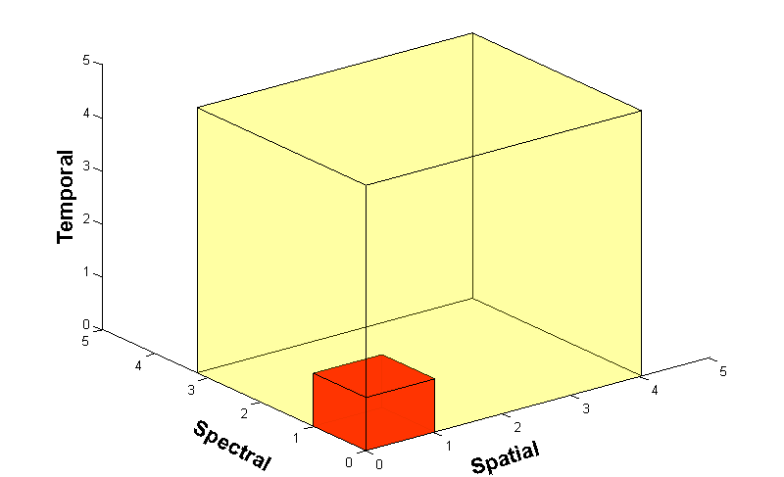
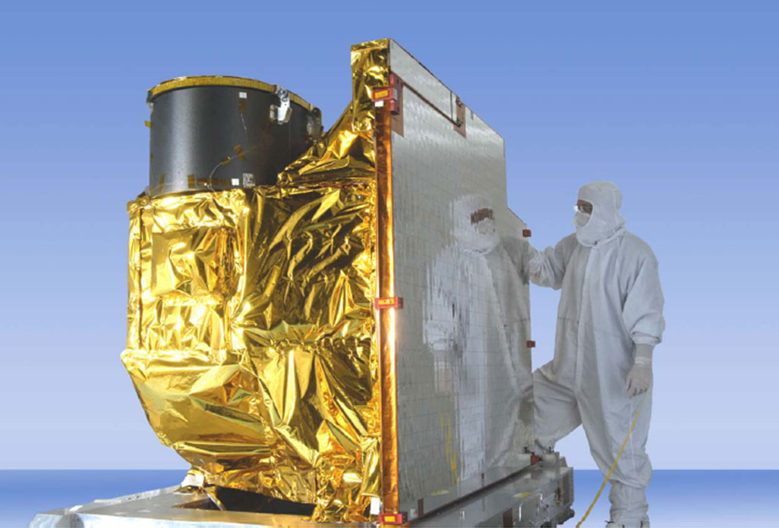
Advanced Baseline Imager
5
4
3
X
Faster coverage (5-minute full disk vs. 25-minute)
X
Improved spatial resolution
(2 km IR vs. 4 km)
X
More spectral bands (16 on ABI vs. 5 on the current imager)
Notes:
Slide from J. Gerth, CIMSS.

Slide 3
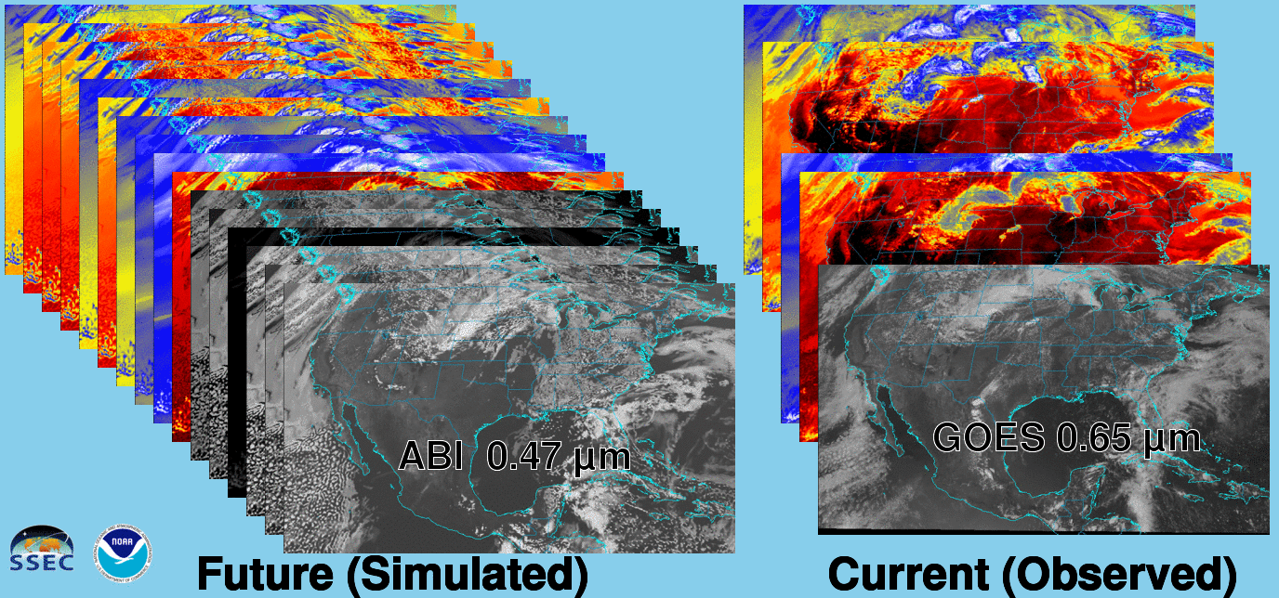
Future vs. Current Spectral Bands
The current GOES (right) has 5 spectral bands, while the GOES-R series ABI (left) will have 16 spectral bands.

Slide 4
GOES-14 SRSOR 1-min
Click for animations
PycroCu
Hotspots
Vis / 4um
Vis/IRW
1/5/15 min
Storm Rel
1/15 min
Derecho
Fog
Texas
Marie
Sandy
http://cimss.ssec.wisc.edu/goes/srsor/overview_training.html
Notes:
Animations at: ftp://ftp.ssec.wisc.edu/ABI/overview

