Slide 2
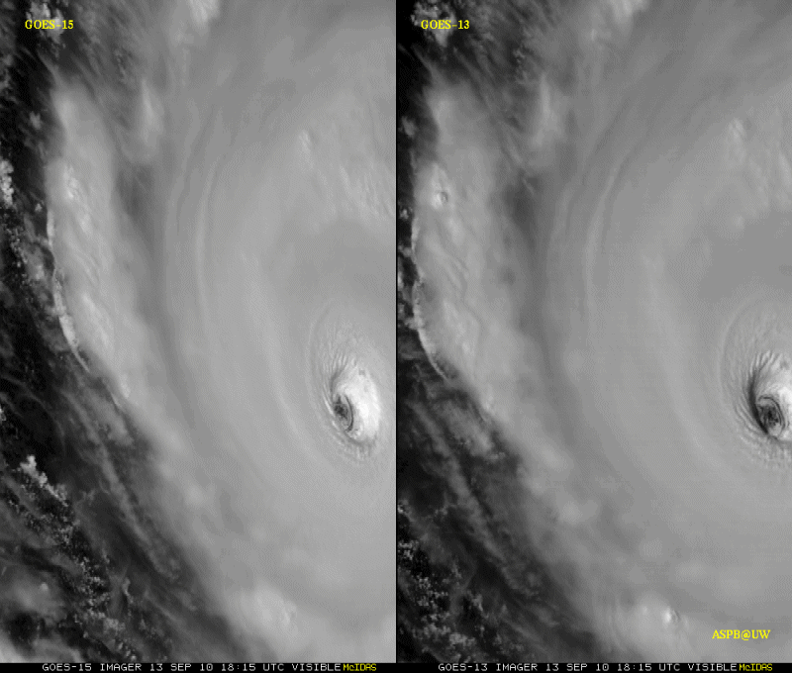
GOES-15: Sample “1-min” imagery
1-min
30-min
Visible data from the GOES-15 NOAA Science Test, lead by Hillger and Schmit
Notes:
Igor

Slide 3
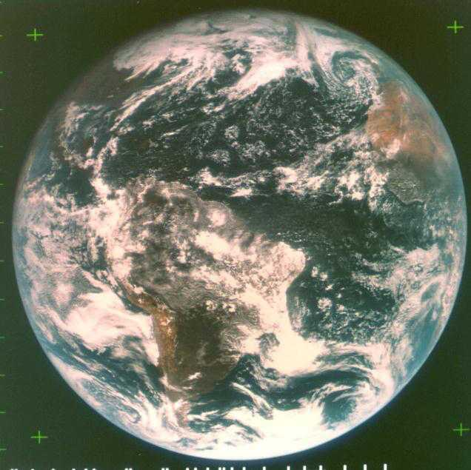
ATS-III 18Nov1967 15UTC

Slide 4
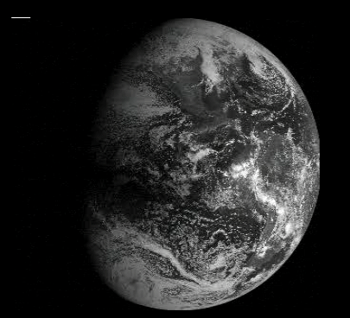
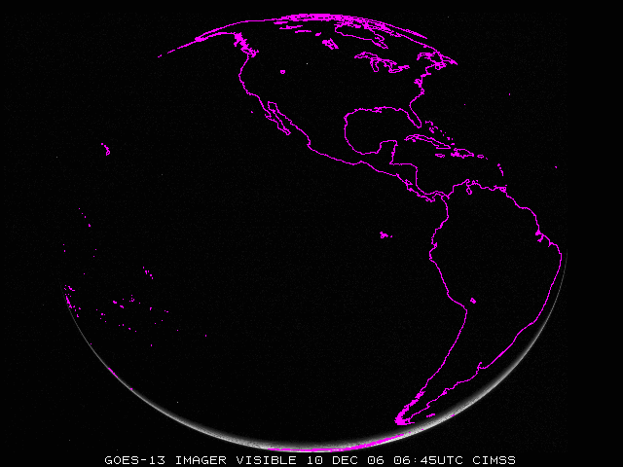

Slide 5
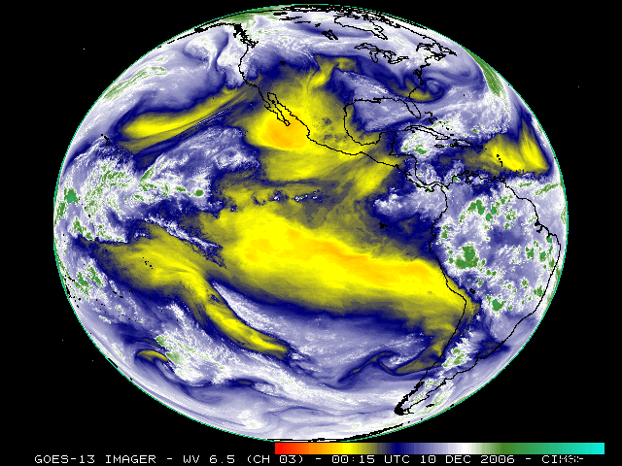
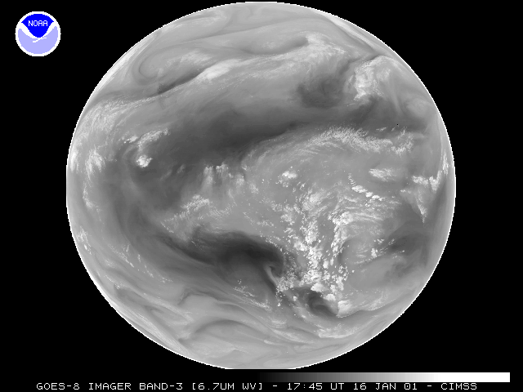

Slide 6
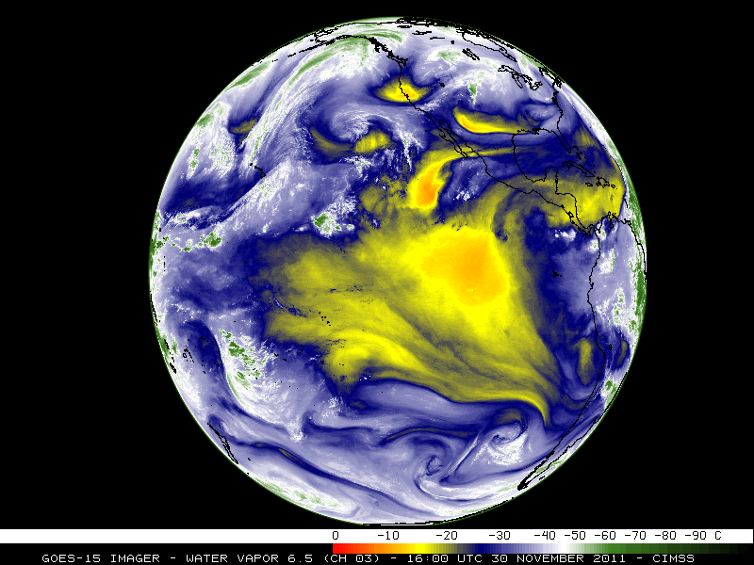

Slide 7
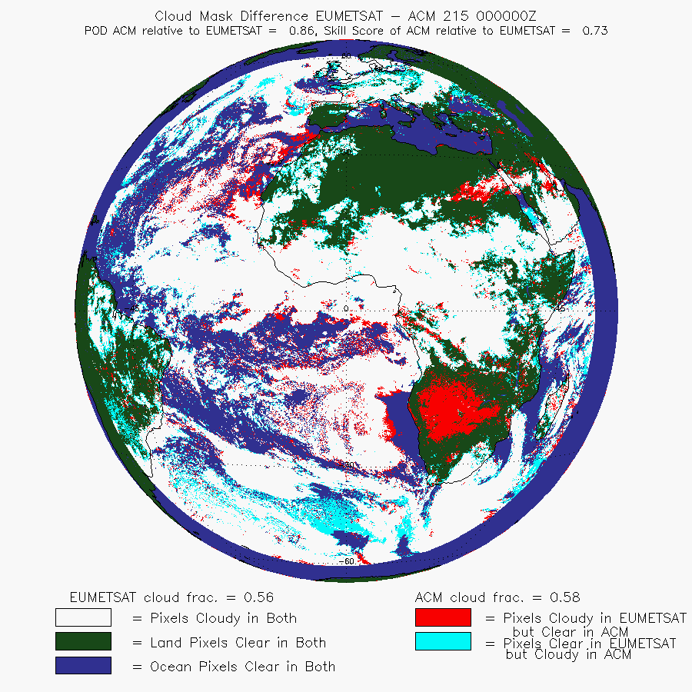
Inter-satellite ACM Comparison
The EUMETSAT Meteorological Product Extraction Facility (MPEF) Cloud Mask cloud mask provides a well-characterized mask designed for the imagery used as proxy
The animation on the right shows a comparison of the ACM run on data from SEVIRI as compared to the EUMETSAT cloud mask from that scene.
Inter-satellite comparisons of cloud mask (and other products) can provide insight as to deficiencies and improvement in both products (next slide)
A. Heidinger, ASPB

