Slide 1

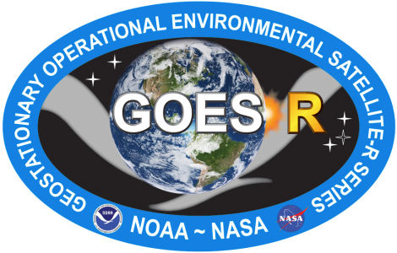
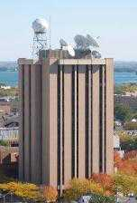
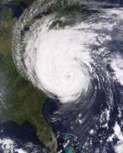
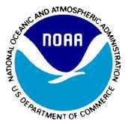

NWP Opportunities for Short‐time Ranges with the ABI on GOES‐R
  Timothy J. Schmit (tim.j.schmit@noaa.gov)
NOAA/NESDIS/Satellite Applications and Research
Advanced Satellite Products Branch (ASPB)
WARN-ON-FORECAST
AND HIGH IMPACT WEATHER WORKSHOP
Norman, Oklahoma
8 February 2012
UW-Madison
Notes:
Version of Feb 3, 2012.

Slide 2
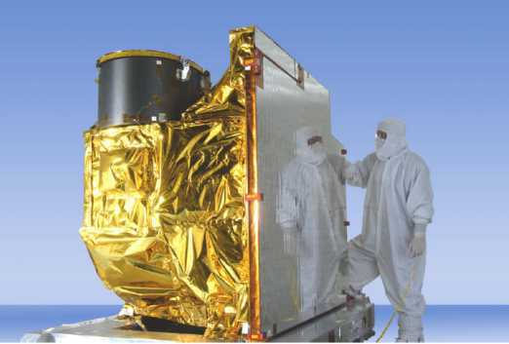
Outline
The Challenge
ABI (Advanced Baseline Imager)
  Temporal
  Spatial
  Spectral
Select Products
High Spectral res.
Summary
  More information
  Questions
Photo courtesy of ITT/Exelis

Slide 3
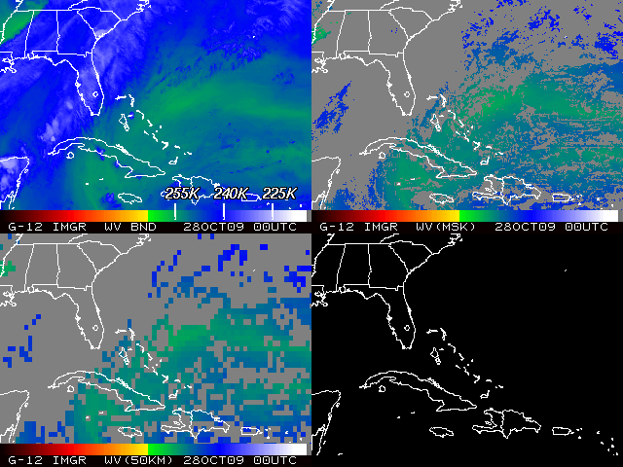
Satellite Data Assimilation
The challenge (from satellite imagery to NWP)!
Tony Schreiner

Slide 4
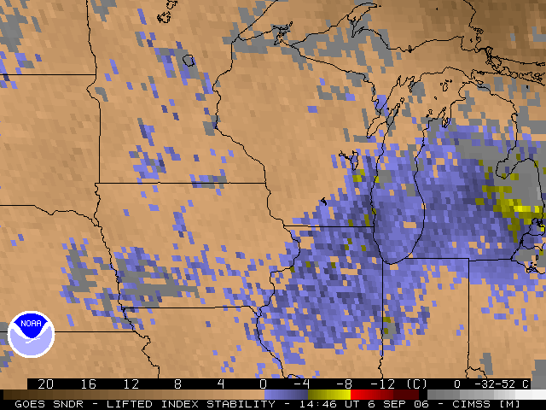
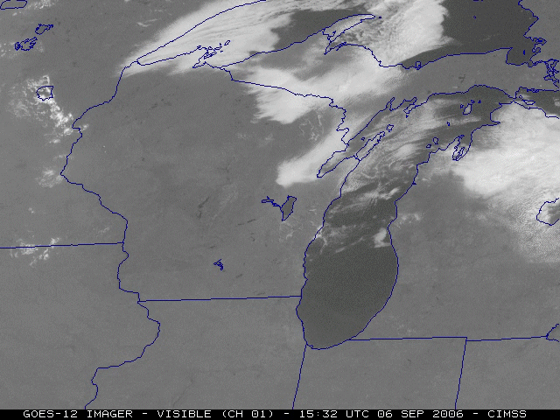
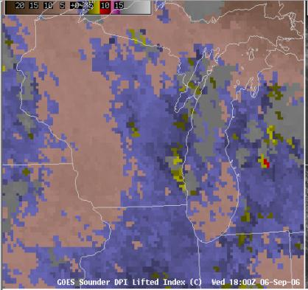
Need to monitor rapidly evolving situations

Slide 5
The Advanced Baseline Imager:
ABI Current
Spectral Coverage
16 bands 5 bands
Spatial resolution
0.64 μm Visible 0.5 km Approx. 1 km
Other Visible/near-IR 1.0 km n/a
Bands (>2 μm) 2 km Approx. 4 km
Spatial coverage
Full disk 4 per hour Scheduled (3 hrly)
CONUS 12 per hour ~4 per hour
Mesoscale Every 30 sec n/a
Visible (reflective bands)
On-orbit calibration Yes No

Slide 6
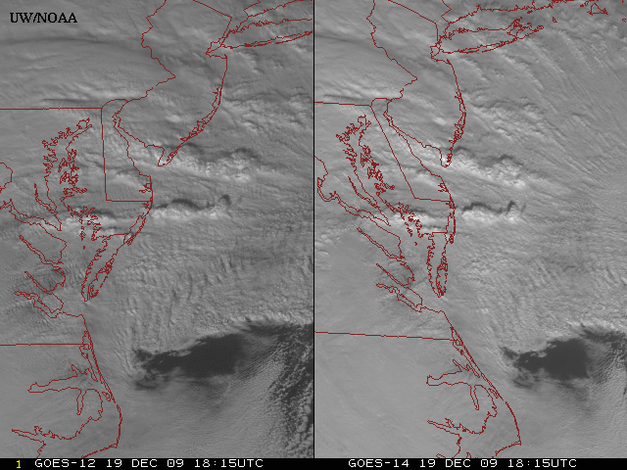
GOES-14: Sample “1-min” imagery
GOES-12
GOES-14
- Visible data from the GOES-14 NOAA Science Test, lead by Hillger and Schmit
- Can these type loops validate meso-scale models?
Notes:
Note the number of different levels of motion you can see (the cyclonic low level circulation over the ocean through the breaks in the higher clouds)... and you can't distinguish those on the GOES-12 loop.

Slide 7
GOES-R Products
Baseline Products
Future Capabilities
Advanced Baseline Imager (ABI)
Aerosol Detection (Including Smoke and Dust) Aerosol Optical Depth (AOD) Clear Sky Masks Cloud and Moisture Imagery Cloud Optical Depth Cloud Particle Size Distribution Cloud Top Height Cloud Top Phase Cloud Top Pressure Cloud Top Temperature Derived Motion Winds Derived Stability Indices Downward Shortwave Radiation: Surface Fire/Hot Spot Characterization Hurricane Intensity Estimation Land Surface Temperature (Skin) Legacy Vertical Moisture Profile Legacy Vertical Temperature Profile Radiances Rainfall Rate/QPE Reflected Shortwave Radiation: TOA Sea Surface Temperature (Skin) Snow Cover Total Precipitable Water Volcanic Ash: Detection and Height
Geostationary Lightning Mapper (GLM)
Lightning Detection: Events, Groups & Flashes
Space Environment In-Situ Suite (SEISS)
Energetic Heavy Ions Magnetospheric Electrons & Protons: Low Energy Magnetospheric Electrons: Med & High Energy Magnetospheric Protons: Med & High Energy Solar and Galactic Protons
Magnetometer (MAG)
Geomagnetic Field
Extreme Ultraviolet and X-ray Irradiance Suite (EXIS)
Solar Flux: EUV Solar Flux: X-ray Irradiance
Solar Ultraviolet Imager (SUVI)
Solar EUV Imagery
Advanced Baseline Imager (ABI)
Absorbed Shortwave Radiation: Surface Aerosol Particle Size Aircraft Icing Threat Cloud Ice Water Path Cloud Layers/Heights Cloud Liquid Water Cloud Type Convective Initiation Currents Currents: Offshore Downward Longwave Radiation: Surface Enhanced “V”/Overshooting Top Detection Flood/Standing Water Ice Cover Low Cloud and Fog Ozone Total Probability of Rainfall Rainfall Potential Sea and Lake Ice: Age Sea and Lake Ice: Concentration Sea and Lake Ice: Motion Snow Depth (Over Plains) SO₂ Detection Surface Albedo Surface Emissivity Tropopause Folding Turbulence Prediction Upward Longwave Radiation: Surface Upward Longwave Radiation: TOA Vegetation Fraction: Green Vegetation Index Visibility

Slide 8
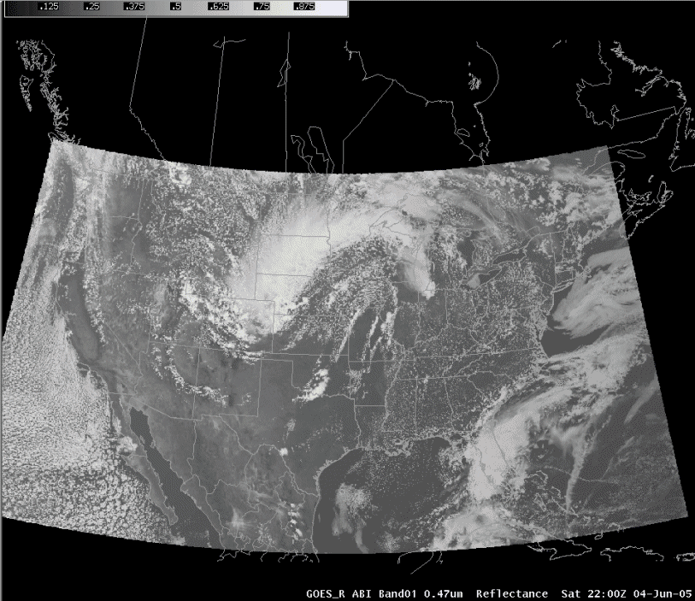
ABI in AWIPS (via netCDF)
J. Oktin et al., CIMSS
Simulated Advanced Baseline Imager (ABI) bands shown; in the legacy AWIPS (WES case).
Notes:
http://cimss.ssec.wisc.edu/goes/abi/

Slide 9
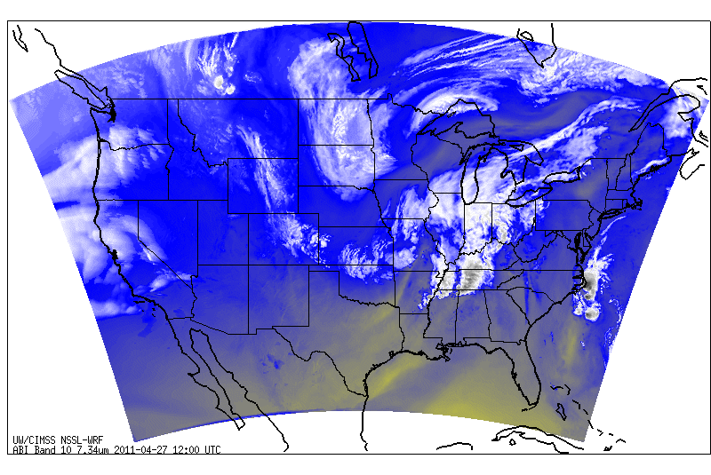
Simulated ABI band – NSSL WRF
- Run in near-realtime each day.
- Future plans call for all ABI bands to be simulated, currently only 8 or 9 are being generated.
http://cimss.ssec.wisc.edu/goes_r/proving-ground/nssl_abi/nssl_wrf_goes.html

Slide 10
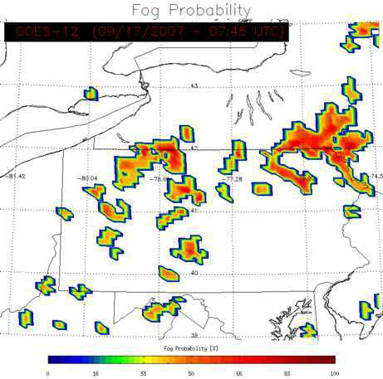
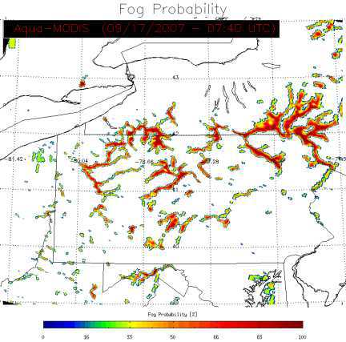
The “Future Capabilities” Fog Product
GOES
GOES-R alg.
M. Pavolonis
Notes:
What Is Fog and Low Stratus?
Fog is defined as a stratus cloud that has a cloud base at or close to the surface that reduces the surface visibility to less than 1 km. Even if the base of a stratus cloud is not in contact with the surface, however, it can be a hazard to aviation. The GOES-R Fog/Low Cloud Detection product is designed to quantitatively identify clouds that produce IFR or Low Instrument Flight Rules (LIFR) conditions.
The fog probability is based on textual and spectral information, as well as the difference between the cloud radiative temperature and surface temperature.
The current GOES fog products are limited to a qualitative brightness temperature difference approach (3.9μm - 11μm), available at 15 or 30-minute intervals, that can only be used at night. The GOES-R algorithm will produce a quantitative analysis of the probability that fog or low stratus is present, both day and night.
The GOES-R fog product can much more accurately capture hazardous valley fog events like this one on the east coast of the U.S., compared to current GOES

Slide 11
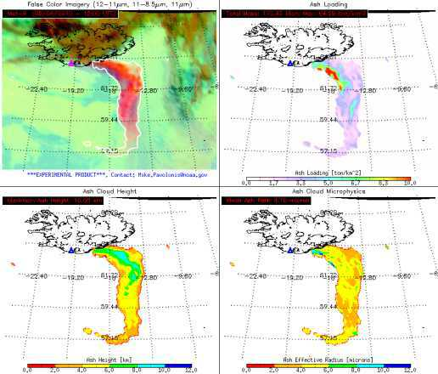
Volcanic Ash
Algorithm Highlights
  Detects volcanic ash and estimates its height and mass loading
  Leverages the new ABI 8.5 μm band, The 8.5 μm, 11.2 μm, and 12.3,11.2 μm channel pairs are used to detect volcanic ash
  An optimal estimation approach is used to estimate ash cloud temperature, emissivity and microphysical index.
  Ash cloud height determined from NWP profiles.
  Mass loading estimated from computed optical depth and effective particle size
  Leverages ABI’s new 8.5 μm channel, along with 11.2 μm and 12.3 μm for sensitivity to cloud microphysics (including composition)
Operational Applications
  Aviation safety
  Health safety
  Climate studies
Iceland's Eyjafjallajökull Volcano
False Color
Imagery
Mass
Loading
Ash
Height
Effective
Particle
Radius
11
11
11
11
M. Pavolonis
11
Notes:
11
11
11
11
11
Grand Comore Island, Comoros (11.75 S, 43.38 E)
summit elevation 2361 m
shield volcano
Karthala volcano is located on Grande Comore, the most westerly of four volcanic islands comprising the Comores Archipelago, between northern Madagascar and Mozambique. Karthala occupies the southern half of Grand Comore Island.

Slide 12
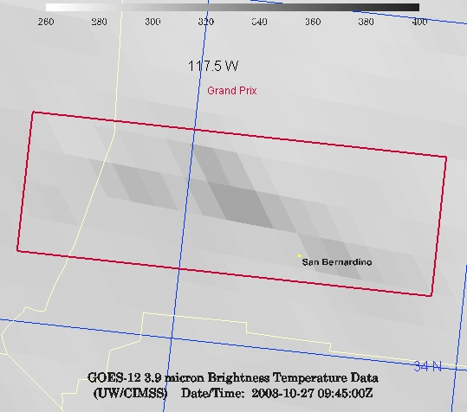
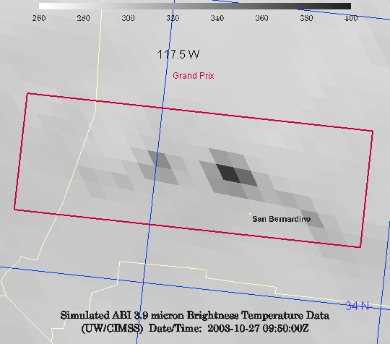
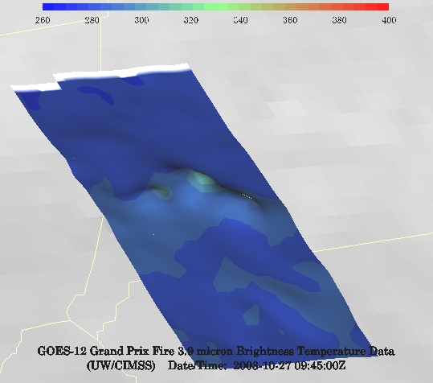
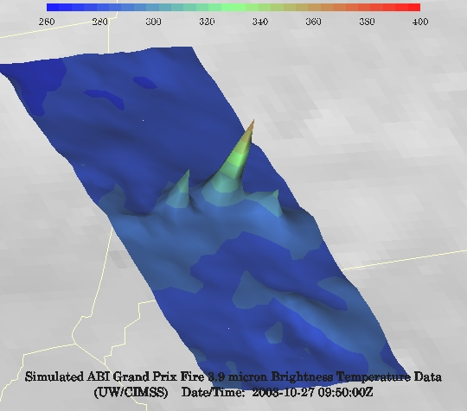
GOES-12 and GOES-R ABI
Simulation of Grand Prix Fire/Southern California
GOES-12
GOES-R ABI
GOES-12
GOES-R ABI
J. Feltz
Notes:
Here are two different fires. What we can see is a more defined peak in the higher resolution data and it is easier to pick out individual hotspots. In addition, the higher saturation tempearture of the ABI allows us to see that the fire is around 370K.

Slide 13
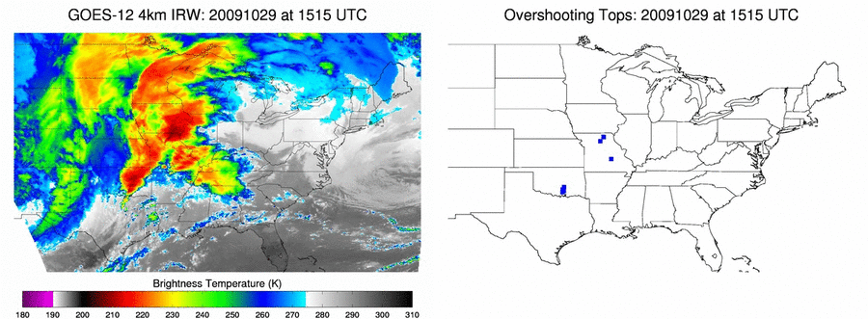
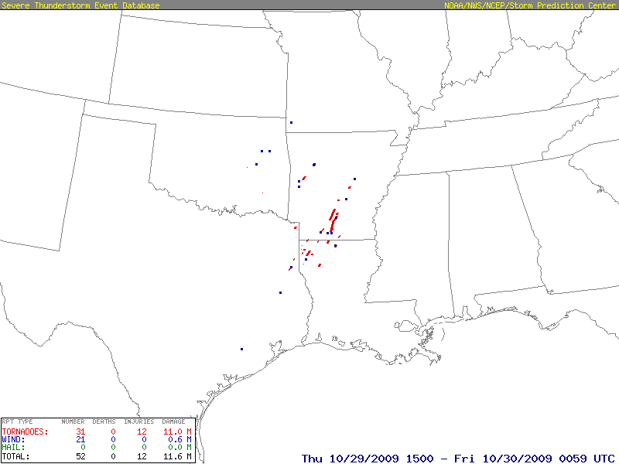
Application of OT Detection To Current GOES
Of course GOES-R will be better for a number of reasons!
13
Severe Weather Reports During the Animation Period
Wayne Feltz
Notes:
First algorithm summary slide

Slide 14



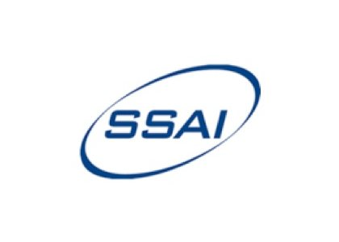

Comparison Between GOES-12 Overshooting Top Detections, WSR-88D Radar Reflectivity, and Severe Storm Reports
Richard J Dworak¹, Kristopher Bedka², Jason Brunner¹ and Wayne Feltz¹
¹ SSEC/CIMSS, UW-Madison
² Science Systems and Applications, Inc. @ NASA Langley
Notes:
2012 AMS meeting.

Slide 15
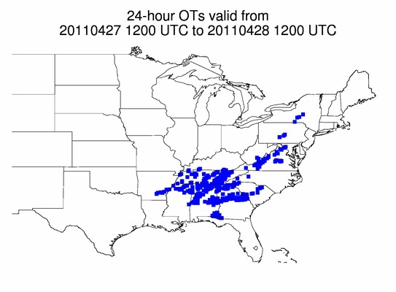
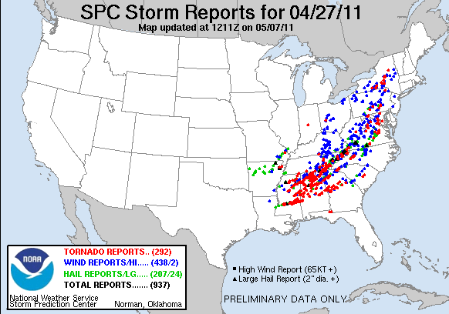
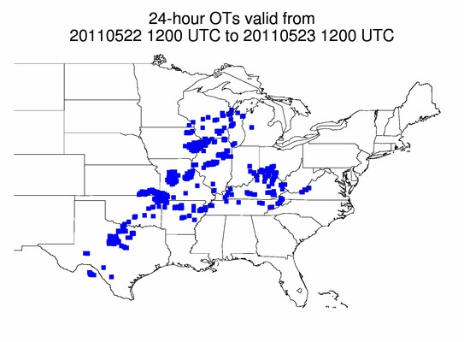
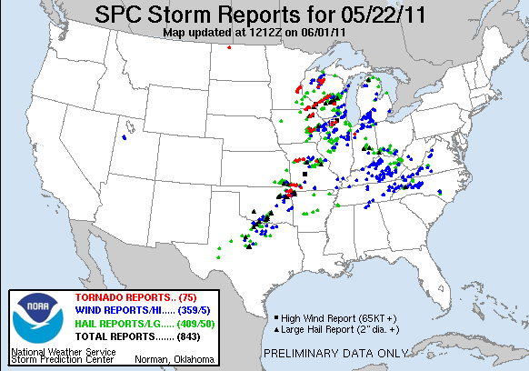
OT Detection Frequency Near Reported Severe Weather
Significant 2011 Severe Weather Outbreaks
Alabama Tornadoes: 4/27-28
Joplin, MO / Midwest Event: 5/22-23
NOTE: Not every OT signature is evident or detectable using current GOES imagery nor is every severe weather event caused by an OT-producing thunderstorm
Richard J Dworak, et al.

Slide 16
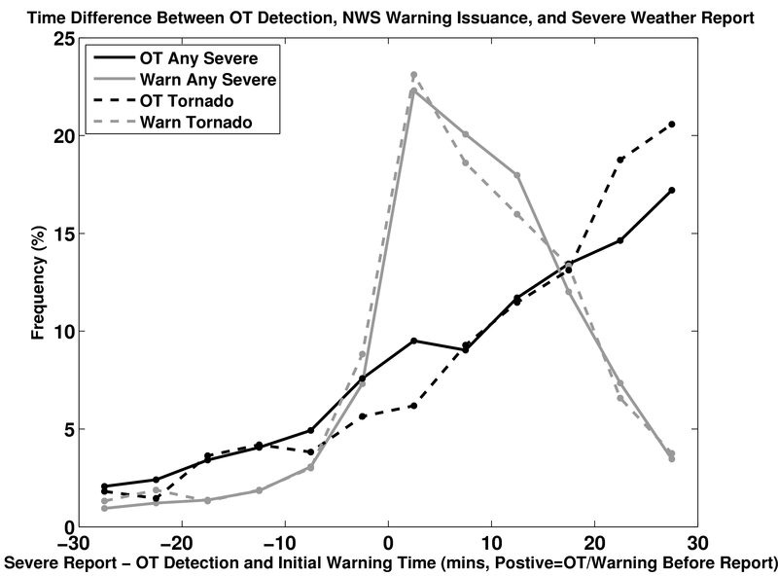
Relationship between Time of OT Detection, Severe Warning Issuance, and Severe Weather Report
An OT detection occurred before the severe report for 75% of the events with the greatest frequency occurring 25-30 min before report.
An OT detection preceded the warning for 33% of the severe cases. 9% of the severe events were unwarned
Results show a potential enhanced lead time at 20 ≤ minutes before severe weather event, indicating that the OT detection product can be used to increase situational awareness
Richard J Dworak, et al.

Slide 17
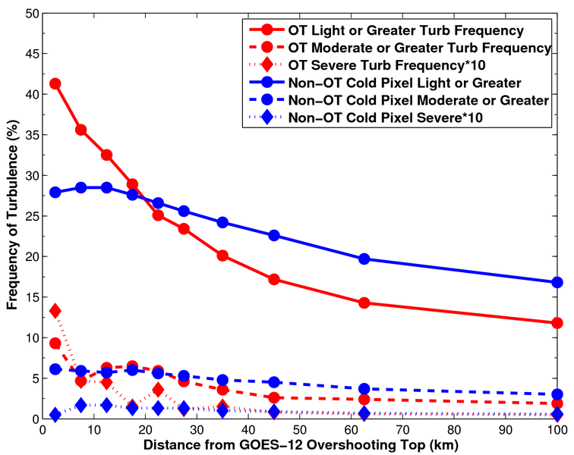
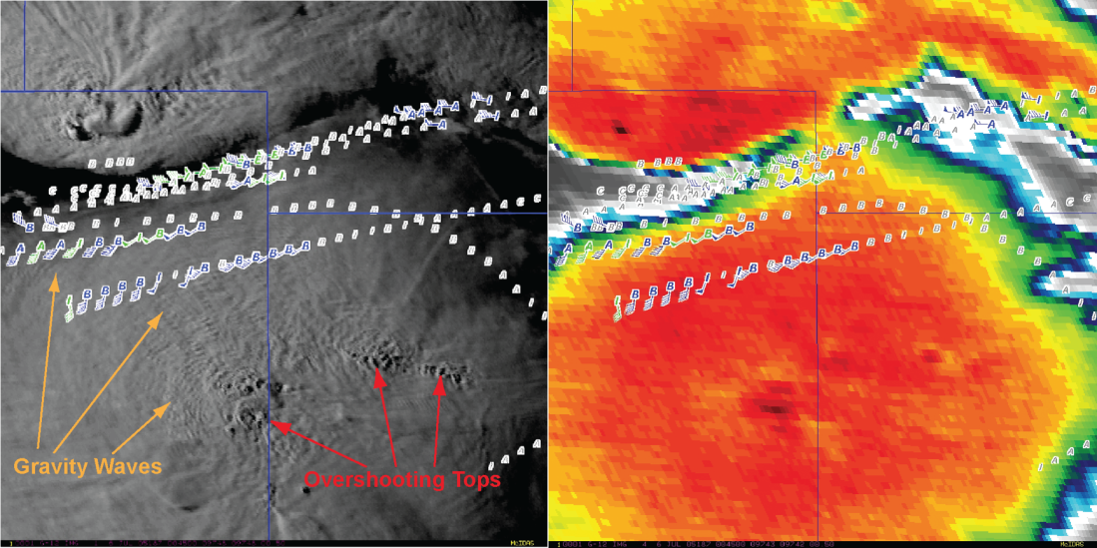
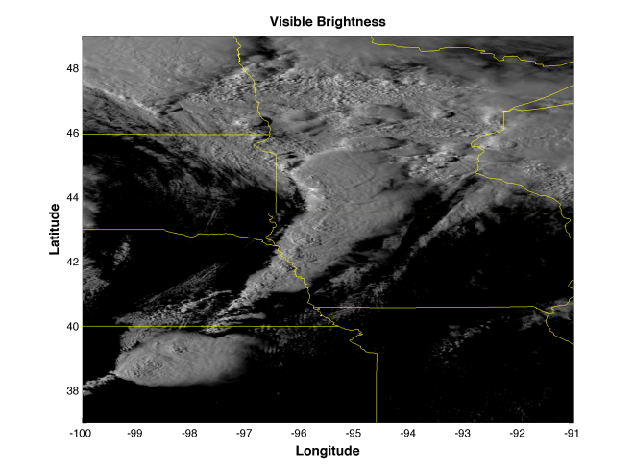
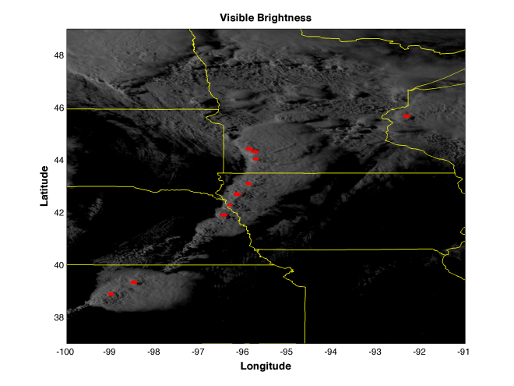
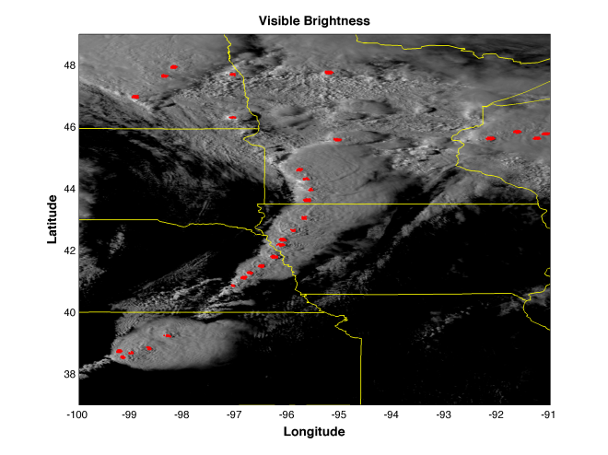
Deep Convection Characteristics and Turbulence Signatures: Overshooting Tops
Light Intensity Turbulence from EDR
Moderate Intensity Turbulence from EDR
2005-2007 Convective Seasons
Frequency and Intensity of Turbulence Increases as Aircraft Fly Closer to an Overshooting Top
Overshoots from AVHRR Degraded to 2 km ABI
Overshoots from 4 km GOES-12

Slide 18
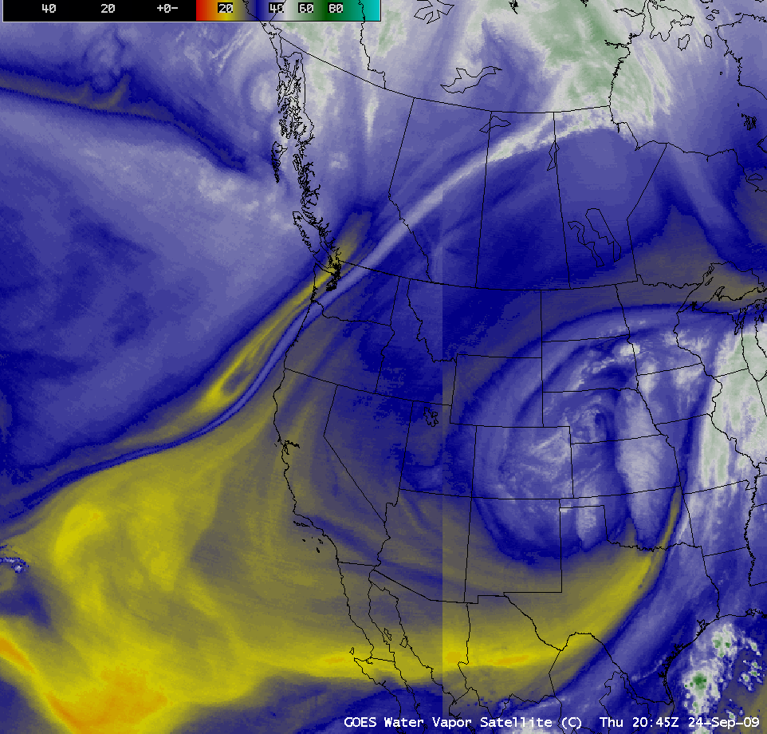
Simulated WV imagery in AWIPS (since 2006)
000
FXUS63 KMKX 301935
AFDMKX
AREA FORECAST DISCUSSION
NATIONAL WEATHER SERVICE MILWAUKEE/SULLIVAN WI
230 PM CDT WED AUG 30 2006
.DISCUSSION...FORECAST FOCUS ON LINGERING UPPER LOW AND STRONGER
UPPER LOW FOR NEXT WEEK.
IN THE NEAR TERM FIRST LOOK AT CRAS MODEL SATELLITE IMAGERY IS VERY
IMPRESSIVE. SO MUCH MODEL INFORMATION IS BEING PRESENTED IN ONE
IMAGE THAT CAN BE EASILY DIGESTED. ESPECIALLY WITH SAY 700MB NAM
HEIGHT OVERLAYED. CLOUD COVER AND CLOUD HEIGHTS...EASILY
IDENTIFIED STRATOCUMULUS SHIELDS. ALSO EASY TO CONVERT TO
CONCEPTUAL MODEL OF SYSTEM TYPE. …
Aune, Bachmeier, etc.
Notes:
Thanks to Bob Aune (ASPB) and crew.

Slide 19
High-Spectral, combined with High-Temporal Resolution is the key
Water Vapor and Carbon Dioxide absorption lines within the infrared window are sensitive to changes in the lower tropospheric thermodynamic state
  current GOES sounders are spectrally too broad to resolve these lines
High-time information obtained from a high spectral resolution IR GEO sounder would be very useful for monitoring pre-convective clear sky regions
  Can start with AIRS, IASI and CrIS
GOES-R previously had an advanced sounder (HES), which was removed in 2006
  requirements remain unmet

Slide 20
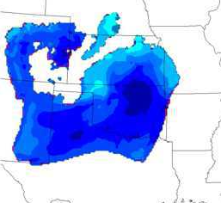
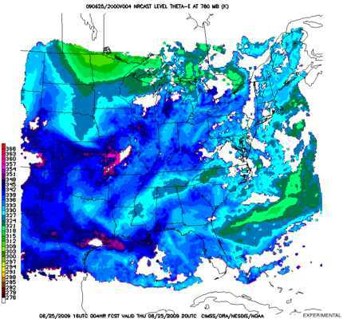
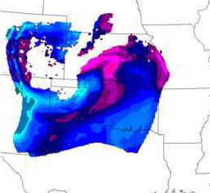
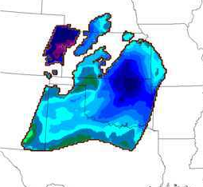
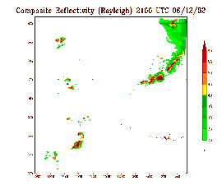
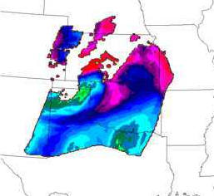
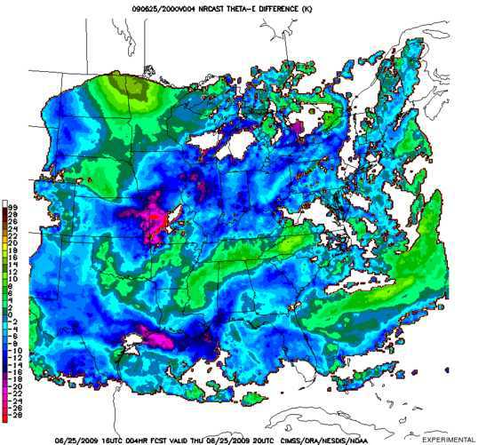
A Hyper-Spectral Geo-Sounder Could Near-cast Severe Weather
An Observing System Simulation Experiment
Simulated ABI
Robert Aune (NESDIS)
Simulated HES
Weak gradients of low-level Theta-E are indicated by ABI which has only two water vapor channels.
A WRF model simulation of the June 12, 2002 IHOP case was used to generate simulated radiances from a GOES-R Advanced Baseline Imager (ABI) and a geostationary Hyper-spectral Environmental Sounder (HES). Simulated radar reflectivity was also generated
Temperature and moisture profiles were retrieved from the simulated radiance datasets and assimilated by the CIMSS Near-casting Model and compared.
Strong low-level Theta-E gradients are indicated by HES which has the ability to detect low-level moisture.
5-hour NearCast for 2000 UTC
Low level Theta-E
5-hour NearCast for 2000 UTC
Low level Theta-E
Negative vertical Theta-E differences indicate where convection is likely.
Negative vertical Theta-E differences indicate where convection is likely.
Simulated composite reflectivity indication the formation of convection.
5-hour NearCast for 2000 UTC
Low to Mid level Theta-E Differences
Rapid Development of Convection over Texas and Nebraska between 2000 and 2100 UTC 12 June 2002
5-hour NearCast for 2000 UTC
Low to Mid level Theta-E Differences
Notes:
Precipitation products from NWP models tend to show patterns that are quite board and much smoother than observed. In addition, the source of moisture for the precipitation is often misrepresented – i.e., the precipitation forms for the wrong reason and/or the precipitation patterns become driven by the convective parameterizations themselves, not by details in the observed local moisture and wind fields.
In the case shown, the rapid convection developed only in the area where the 6 hour NearCasts showed strong signatures of Convective Instability in far NW IA – a fact that was lost to forecasters using the NWP guidance lone. It should also be noted that no GOES observations were available here after the convection began, although the destabilization shown in the NearCasts proper predicted the subsequent movement of the MCS.
It should also be noted that NWP models typically ‘limit’ the amount of convective instability that can be present in the models. In fact, the role of the ‘convective parameterizations’ is not be produce realistic thunderstorms, but rather to remove excessive thermal instabilities and ‘vertically misplaced latent heating’ which could adversely affect the model during an extended prediction. For example, the ECMWF readily recognizes the it’s convective schemes cause rainfall to occur too early during daytime over land in the tropics (they detect instability and try to remove it to quickly) and that the rainfall is unrealistic in that it ‘starts and stops’ much to often during the afternoon (due to repeated cycles of stabilization, followed by surface heating and destabilization). In addition, once the convective parameterization has been active for a period of time (even if incorrectly), boundary layer flows produced as a result of the parameterization often become dominant in the area around the storms, leading to further forecast errors.

Slide 21
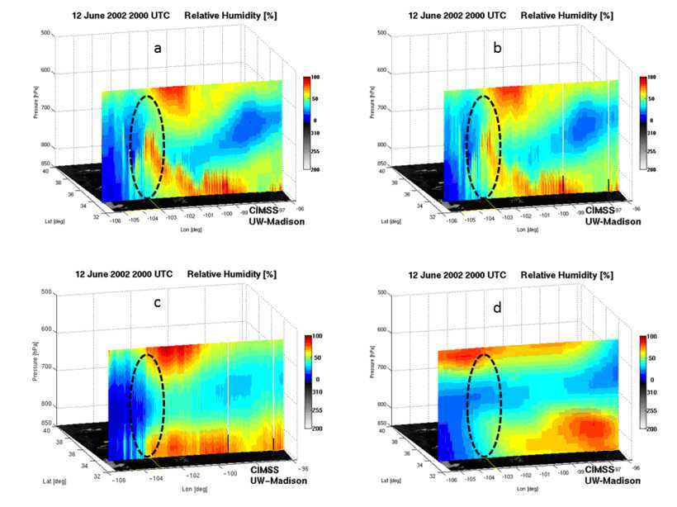
Evolution of the Vertical Moisture is the Key!
Simulated Relative humidity cross-section at 20 UTC 12 June 2002
“Truth”
“GEO advanced IR sounder ”
“ABI”
“RUC”
Li et. al.
Notes:
Warning information in pre-convection environment from geostationary advanced infrared sounding system – a simulation study using the IHOP case
Jun Li, Jinlong Li, Jason Otkin, Timothy J. Schmit, Chian-Yi, LiuJournal of Applied Meteorology and Climatology

Slide 22
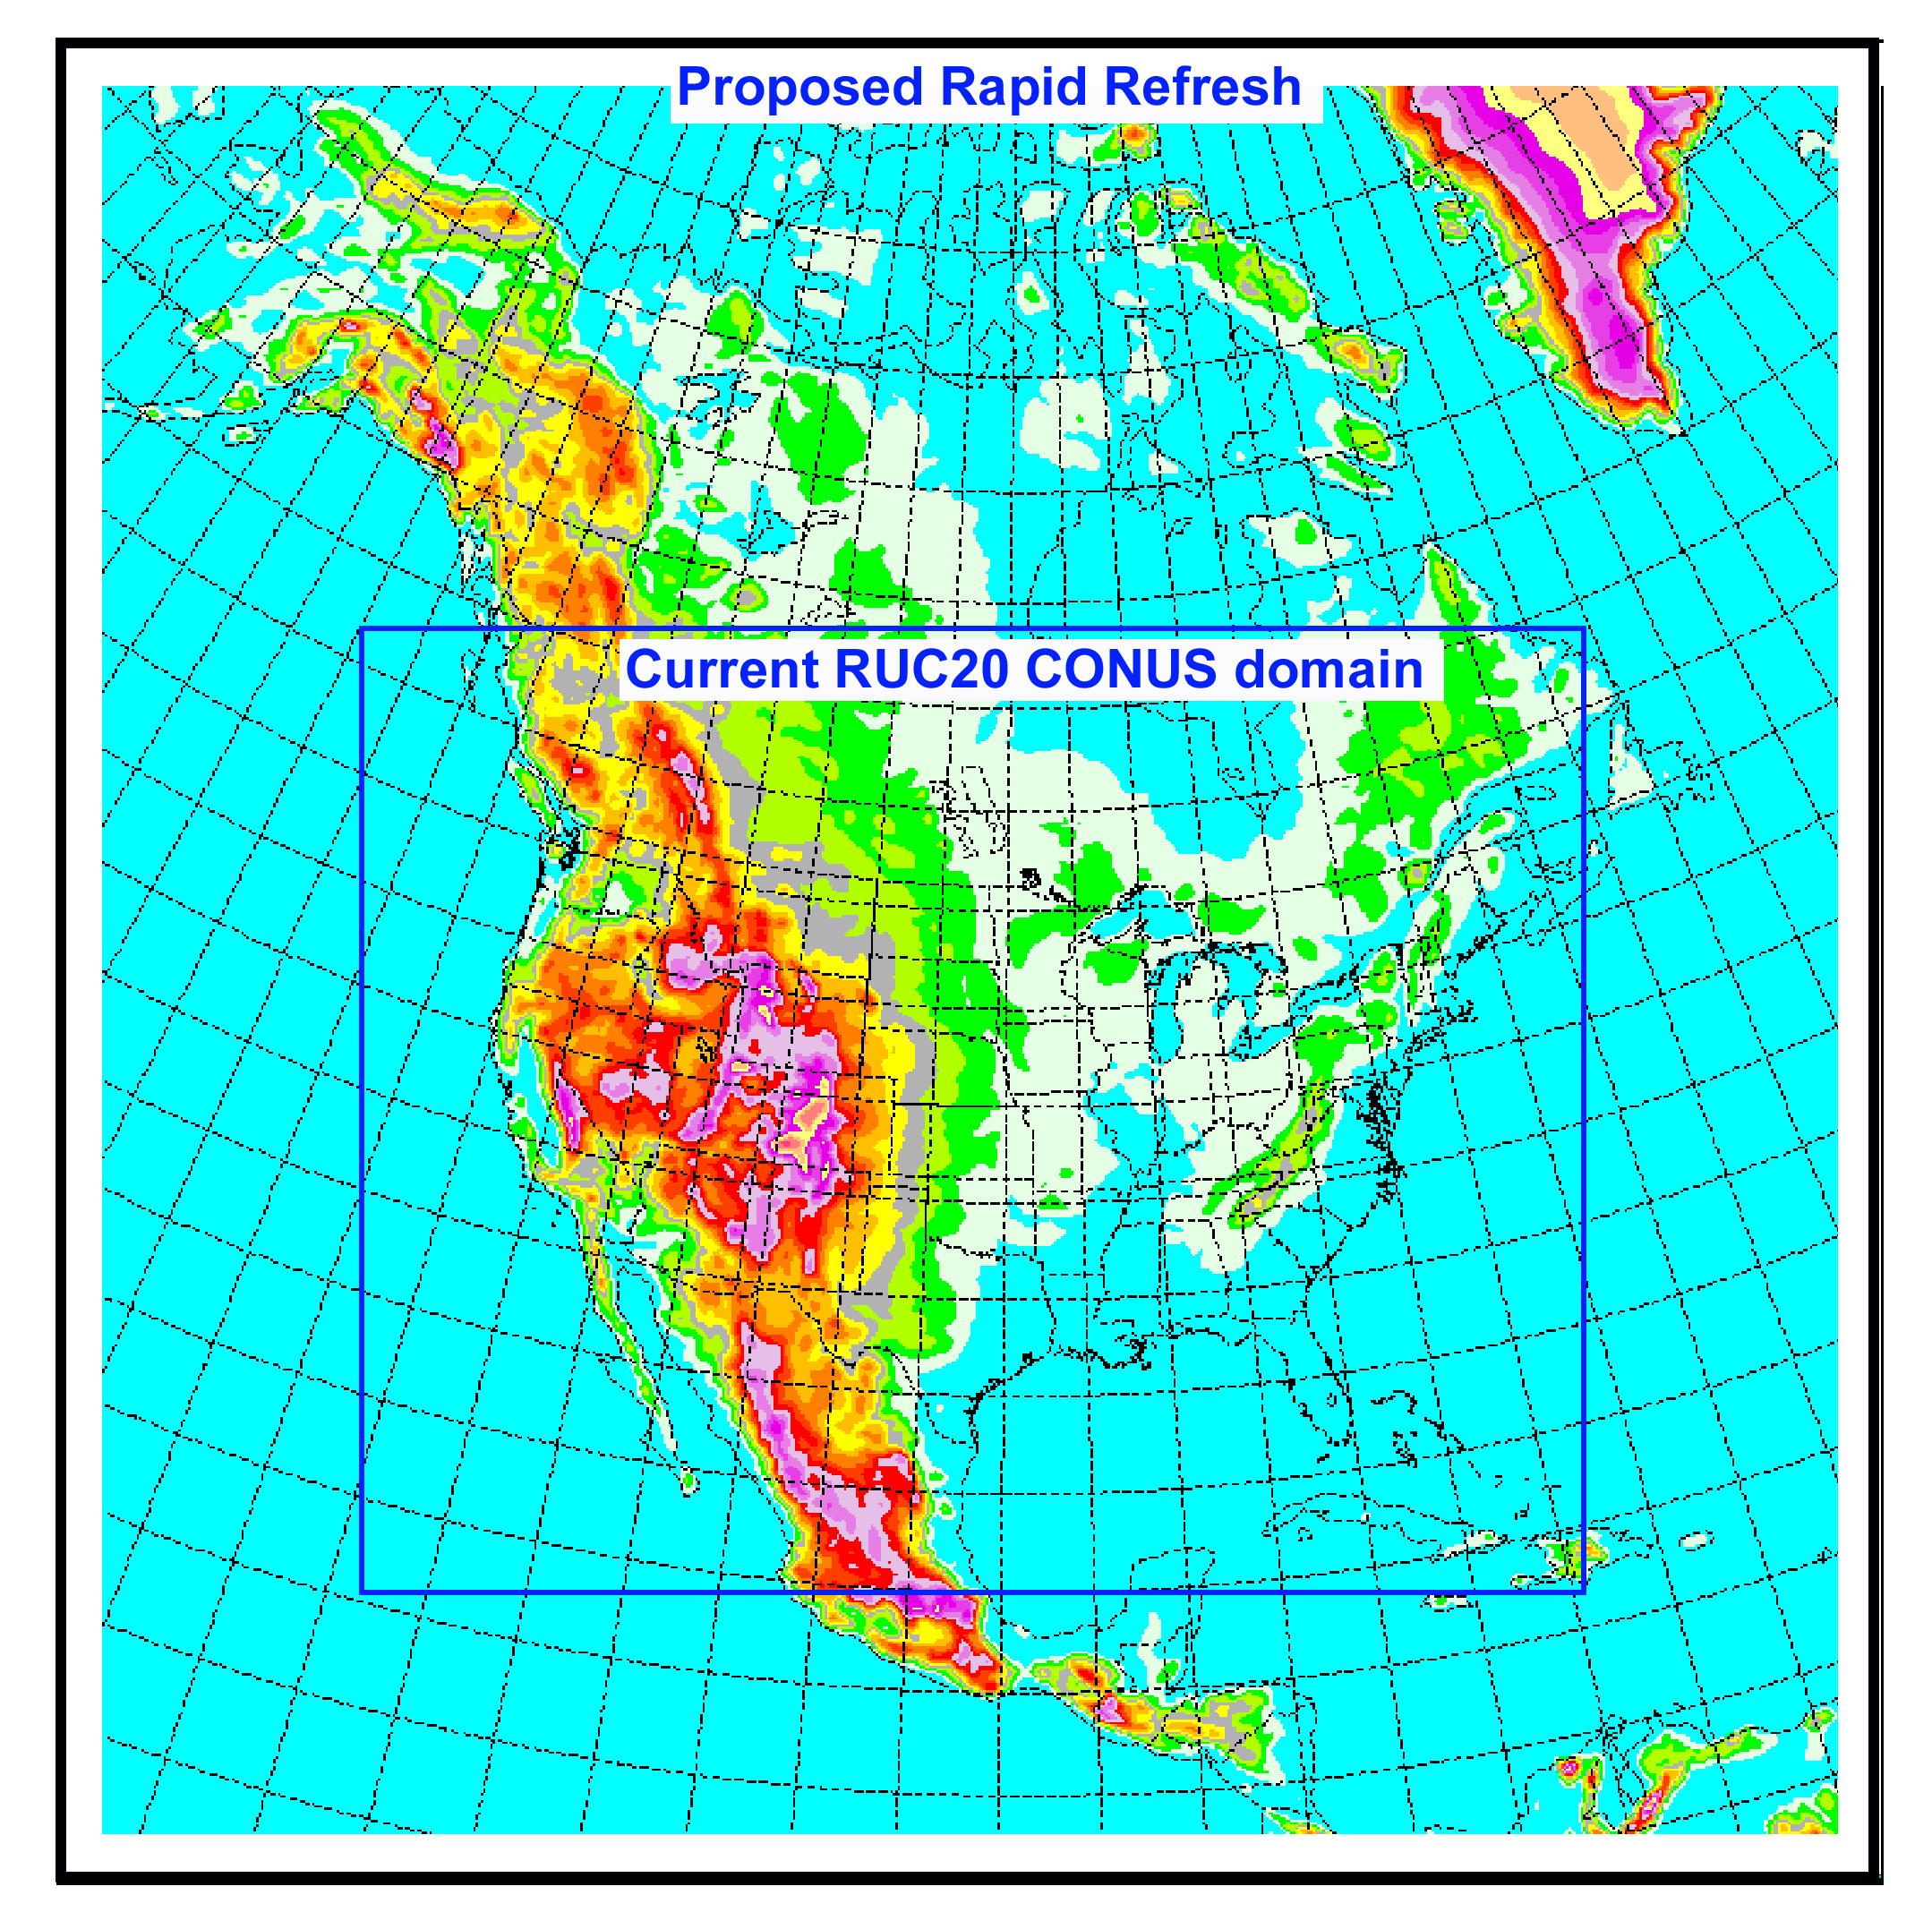


Assimilation of AIRS
SFOV retrievals in the
Rapid Refresh model
Project Goals
Evaluate ability of AIRS retrieved T, Q profiles (SFOV and 3x3) to improve short-range mesoscale forecasts of high impact weather
Determine best strategies for assimilating AIRS T, Q retrievals considering: -- obs error, bias correction
-- data thinning
-- quality control
AIRS impact assessment for real-time model configuration with full mix of observations
Rapid Refresh13
RUC-13
Haidao Lin, Steve Weygandt,
Ming Hu, Stan Benjamin
Global Systems Division
Collaboration with:
Tim Schmit – NOAA NESDIS
Jun Li, Jinlong Li – CIMSS, University of Wisconsin

Slide 23
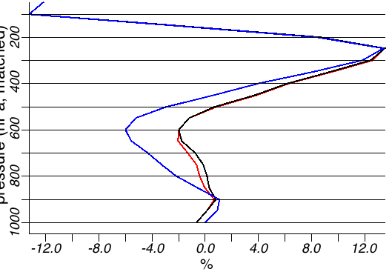
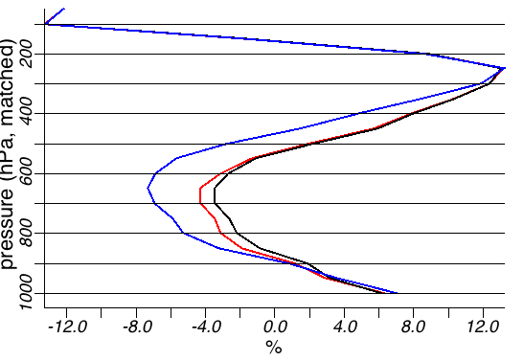
Impact of SFOV moisture on bias relative to radiosonde moisture
SFOV
NO bias
correct
Control
(no SFOV)
SFOV
WITH
bias correct
Dry
Moist
Dry
12-h
forecast
Moist
Analysis
Control (no SFOV Qv)
SFOV bias correction significantly reduces analysis and forecast
dry bias
SFOV Qv NO bias correct
SFOV Qv WITH bias correct

Slide 24
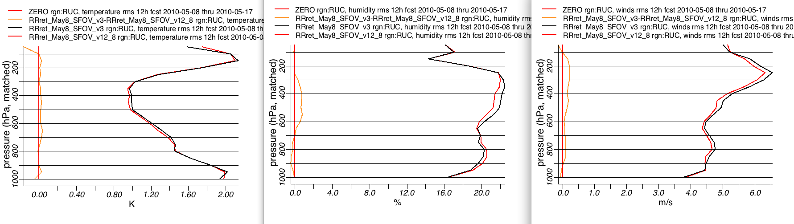
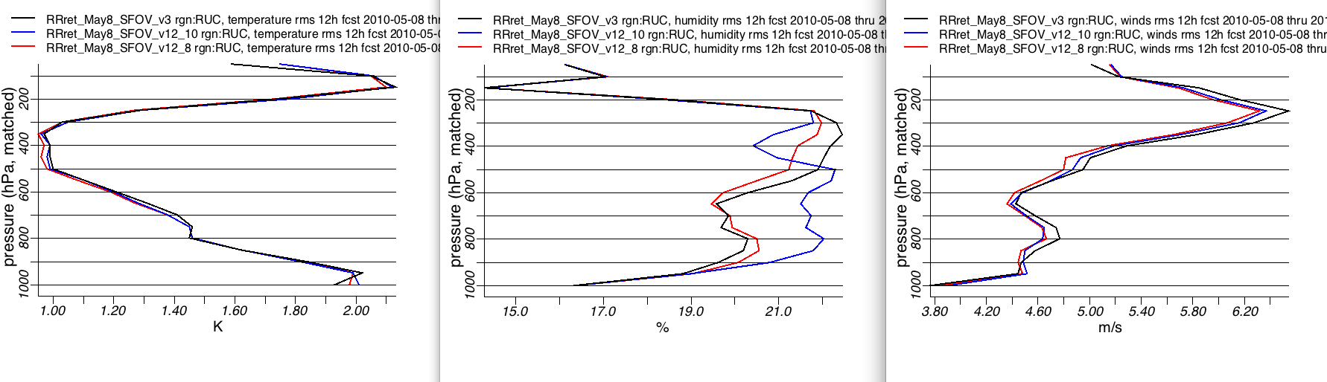
Impact of SFOV moisture on +12-h forecast RMS errors relative to raobs
DIFF
SFOV
better
DIFF
SFOV
better
Temperature
Relative Humidity
0.0 0.2
K
DIFF
SFOV
better
0.0 2.0
%
SFOV with bias correction better than control for nearly all level and all variables
Wind
Control (no SFOV Qv)
SFOV Qv NO bias correct
0.0 0.5
m/s
SFOV Qv WITH bias correct

Slide 25

Summary
The ABI on GOES-R will improve over the current instrument, including improved image navigation and registration and radiometer performance (colder patch temperatures, etc).
These improvements will greatly assist a host of data assimilation and NWP applications, especially on the regional and
meso-scales via both direct assimilation and in-direct validations.
Need to start with current geostationary data and products to best prepare for the ABI

Slide 26
Summary
There’s so much more information from the GOES-R instruments (ABI, GLM, etc), that the best way for the forecaster and others to quickly gain benefit is if the information is assimilated into the appropriately-scaled numerical weather prediction models.
  Need to use both clear and cloudy radiances
  May need to continue to use select products
The direct use of imagery and products will continue, for model comparisons, rapidly changing phenomena, etc.
  Satellite data will still be finer spatial and temporal than the NWP assimilations
Still need the vertical resolution of high-spectral, high-temporal observations!

Slide 27
Approximate spectral and spatial resolutions of US GOES Imagers
~ Band Center (um) | GOES-6/7 | GOES-8/11 | GOES-12/N | GOES-O/P | GOES-R+
0.47
0.64
0.86
1.6
1.38
2.2
3.9
6.2
6.5/6.7/7 | 14km
7.3
8.5
9.7
10.35
11.2
12.3
13.3
Visible
Near-IR
Box size represents pixel size
8
4
2
“MSI mode”
Infrared
Notes:
0.40 inches = 4km; 0.80 inches = 8km
MSI is Multi-Spectral Imaging Mode (dashed boxes)
This does not show other improvements: SNR, MTF, bit-depth, navigation, coverage rates, etc.

Slide 28
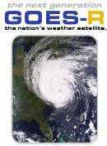

More information
GOES-R:
  http://www.goes-r.gov
  http://www.meted.ucar.edu/index.htm
  http://cimss.ssec.wisc.edu/goes_r/proving-ground.html
GOES and NASA:
  http://goespoes.gsfc.nasa.gov/goes/index.html
  http://goes.gsfc.nasa.gov/text/goes.databookn.html
UW/SSEC/CIMSS/ASPB:
  http://cimss.ssec.wisc.edu/goes_r/proving-ground/nssl_abi/nssl_abi_rt.html
  http://cimss.ssec.wisc.edu/goes_r/awg/proxy/nwp/
  http://cimss.ssec.wisc.edu/goes/abi/
  http://cimss.ssec.wisc.edu/goes/abi/wf
  http://cimss.ssec.wisc.edu/goes/blog/
  http://www.ssec.wisc.edu/data/geo/
AMS BAMS Article on the ABI (Aug. 2005)

Slide 29

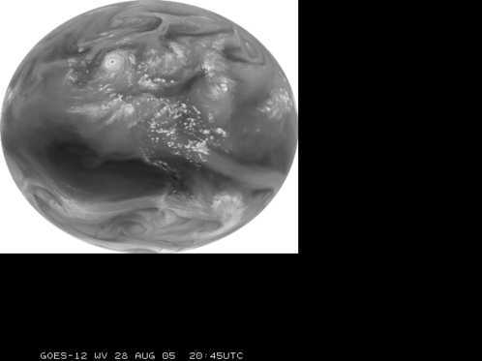
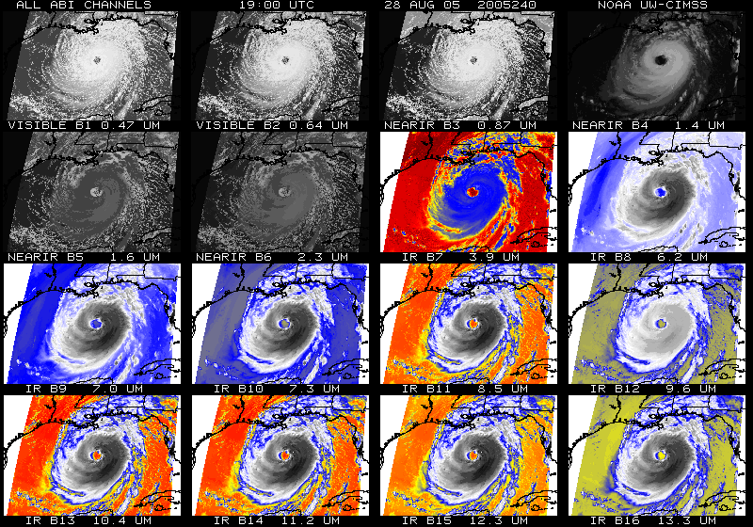
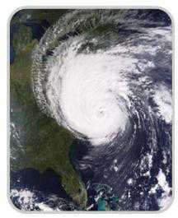
Acknowledgements
The authors would like to thank the entire GOES-R team (especially the GOES-R Program Office); within the government, industry and academia.
The views, opinions, and findings contained in this presentation are those of the author and should not be construed as an official National Oceanic and Atmospheric Administration or U.S. Government position, policy, or decision.

