Slide 1
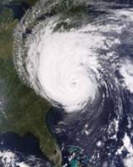
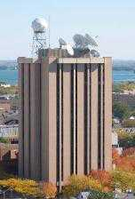
Why we need to understand the impacts of satellite data in our models, both now and in the future
Timothy J. Schmit (tim.j.schmit@noaa.gov)
NOAA/NESDIS/Satellite Applications and Research
Advanced Satellite Products Branch (ASPB)
Regional OSSE Workshop
Norman, Oklahoma
7 February 2012
UW-Madison
Notes:
Version of Feb 1st, 2012.

Slide 2
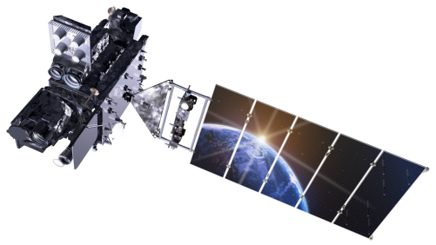
Summary
Need extensive, and up-to-date data denials with regional models to understand the impact of current data
Need detailed, and up-to-date regional OSSE’s to better define the potential benefits of future systems.
Focus on the shorter time scales.
Although, don’t rely only on OSSE’s.
Leverage field experiments and chemical-OSSE’s.

Slide 3
(Real life) Questions
Why do we need two GOES (-R)?
Why do we need GOES-R, if we have JPSS?
Why do we need JPSS, if we have GOES-R?
Could GOES accept a 50% availability?
How would 95% availability affect forecasts?
Why generate level 2 products?
Why do we need high-spectral on geo?
Often with turn-around times measured in hours!
Which means any analysis needs to be done before the question.
Lockheed Martin

Slide 4
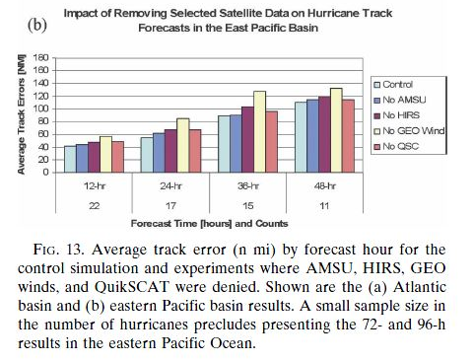
Sample Data Impact
GOES winds seems to have the largest impact on tropical cyclone tracks in the eastern Pacific.
Even larger than AMSU.
Zapotocny et al 2007.
Notes:
Zapotocny, Tom H.; Jung, James A.; Le Marshall, John F. and Treadon, Russ E. A two-season impact study of satellite and in situ data in the NCEP global data assimilation system. Weather and Forecasting, Volume 22, Issue 4, 2007, pp.887-909.

Slide 5
Impact Study of RAOB, GOES, and POES data on Eta Data Assimilation System
RAOBs, GOES and POES all contribute unique information!
Zapotocny, T. H., W. P. Menzel, J. A. Jung, and J. P. Nelson III, 2005: A four season impact study of rawinsonde, GOES and POES data in the Eta Data Assimilation System. Part I: The total contribution. Wea. Forecasting, 20, 161-177.
Zapotocny, T. H., W. P. Menzel, J. A. Jung, and J. P. Nelson III, 2005: A four season impact study of rawinsonde, GOES and POES data in the Eta Data Assimilation System. Part II: Contribution of the components. Wea. Forecasting, 20, 178-198.
Zapotocny, T. H., W. P. Menzel, J. P. Nelson III, and J. A. Jung, 2002: Impact Study of Five Satellite Data Types in the Eta Data Assimilation System in Three Seasons. Weather and Forecasting, 17, 263-285.
These are good studies, for example, comparing the relative impact of GOES and POES in regional and global models, but mostly with the Eta model.

Slide 6
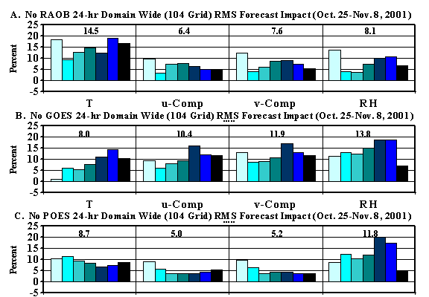
Oct 2001 forecast impact (%) for T, u, v, RH fields
after 24-hrs of Eta model integration
Zapotocny, 2005
Notes:
Time averaged forecast impact (%) results for four standard meteorological fields after 24-hrs of Eta model integration for the No RAOB (A), No GOES (B) and No POES (C) experiments. Results for the 104 grid are shown. The time period examined utilizes a 32 km EDAS for both the assimilation and forecast and extends from 0000 UTC 25 October 2001 through 1200 UTC 08 November 2001.
Raob impact decreases %5 in summer versus winter

Slide 7
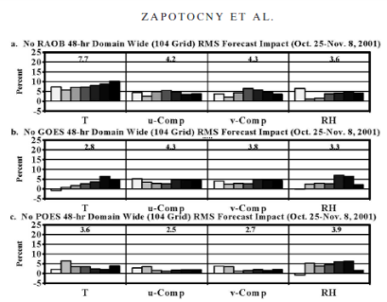
Positive Impact still at 48-hours
Regional forecast impact at 48 h
Overall, the forecast impact from virtually every parameter, data type, and level decreased from 24 to 48 h.
Some impacts decreased by as much as a factor of 3, while others decreased by substantially less.
A drop in forecast impact from 24 to 48 h is not surprising, considering the regional nature of the EDAS and the ever-growing importance of the lateral boundary conditions as the integration proceeds.
Finally, there is limited evidence that global models exhibit the opposite trend, with the importance of some remotely sensed data sources increasing as the length of the integration proceeds (T. J. Schmit, 2003, personal communication).
Zapotocny, 2005
Notes:
Zapotocny, T. H., W. P. Menzel, J. A. Jung, and J. P. Nelson III, 2005: A four season impact study of rawinsonde, GOES and POES data in the Eta Data Assimilation System. Part I: The total contribution. Wea. Forecasting, 20, 161-177.

Slide 8
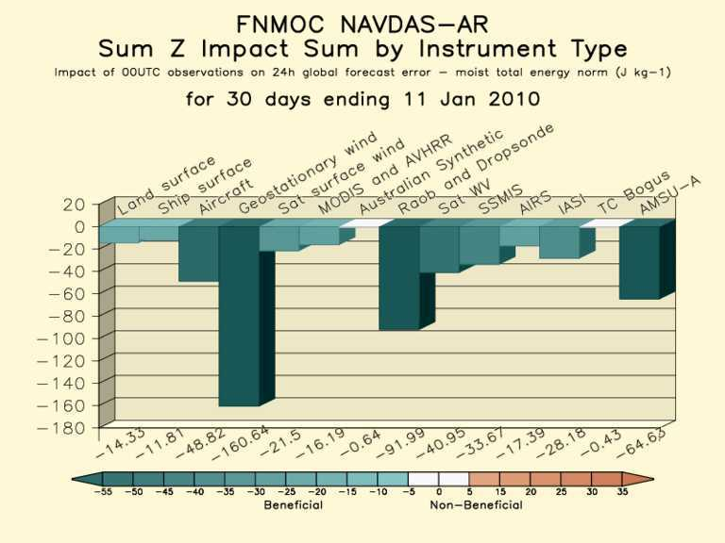
Importance of Satellite Data in NWP http://www.nrlmry.navy.mil/obsens/
Satellite Data has become the single most important component
of the global observing network for NWP
00, 06, 12, 18 UTC Observation Impact Sum
all
1
Nancy Baker, NRL
2
1
6
Negative value denotes improved forecast
Important to look at other levels than AC at 500 hPa.
Σ Sat Winds = -198.3
Σ Conv = -168.0
Σ Sat Radiances = -143.9

Slide 9
R-OSSE demonstrated improved capability of geostationary high-spectral measurements for detailing boundary layer moisture and deriving positive impact in near term forecast.
NOAA Tech Memo (2000)
Aune, Bob, et al. and United States National Environmental Satellite, Data, and Information Service. Preliminary findings from the geostationary interferometer observing system simulation experiments (OSSE) U.S. Dept. of Commerce, National Oceanic and Atmospheric Administration, National Environmental Satellite, Data, and Information Service, Washington, D.C. : 2000

Slide 10
Significant Findings from Geo-high-spectral measurements OSSE
Geo-Increased spectral resolution (Geo-I) provides low level (850 hPa RH) moisture information; Geo-Radiometer (Geo-R) only offers information well above BL (700 hPa RH)
S1- measure of reduction of error in horizontal gradients (Anthes, 1983).
OSSE 12 hr assimilation followed by 12 hr forecast
Notes:
This is seen again in the skill scores (indicative of how well the shape of the weather system is being forecast). The Geo-Interferometer improves the forecast by about 10 skill score points
at both 700 and 850 hPa, the GOES-Sounder provides very little at 12 hours.
S1- measure of reduction of error in horizontal gradients (Anthes, 1983).

Slide 11
Significant Findings from Geo-high-spectral measurements OSSE
Two polar orbiting (high-spectral resolution) (Leo) do not provide the temporal coverage to sustain forecast improvement out to 12 hours. Only the hourly Geo-Increased resolution (Geo-I) observations depict moisture changes for more forecast benefit.
This study pre-dates AIRS, IASI and CrIS!
OSSE 12 hr assimilation followed by 12 hr forecast
Notes:
This slide shows 850 RH using hourly Geo-I soundings and winds vs 6 hourly Leo-I soundings Conv (sfc obs, raobs, profiler, acars) vs Conv+Leo-I vs Conv+Geo-I vs Conv+Geo-Prfct (best = no noise). Two polar orbiting interferometers (Leo) do not provide the temporal coverage to sustain forecast improvement out to 12 hours. Only the hourly Geo-Interferometer (Geo-I) observations depict moisture changes well enough for forecast benefit.
S1- measure of reduction of error in horizontal gradients (Anthes, 1983).

Slide 12
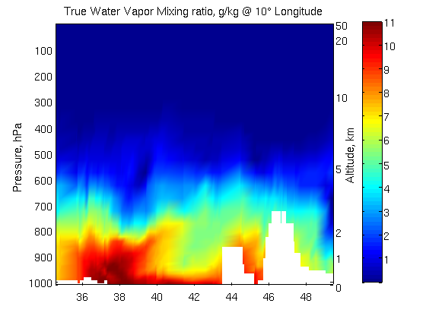
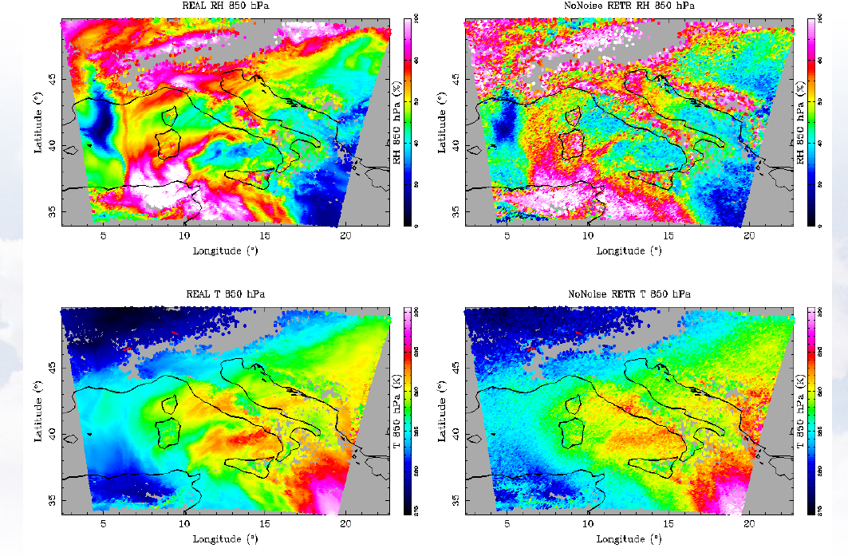
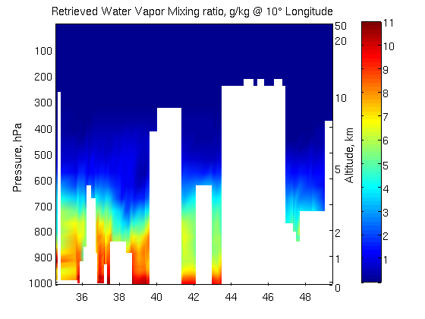
Optimal Estimation Retrieval: Tested on MTG-IRS Synthetic Radiances from COSMO-IT model
Low level flow of moisture rivers.
RH @
850 hPa
‘True’ (input)
T @
850 hPa
‘True’ (input)
Retrieved
© X.Clabet, EUMETSAT
Retrieved
© C. Serio C., G. Masiello, G. Grieco, DIFA
Slide: 12

Slide 13
Summary
Need extensive, and up-to-date data denials with regional models to understand the impact of current data
Need detailed, and up-to-date regional OSSE’s to better define the potential benefits of future systems.
Focus on the shorter time scales.
Although, don’t rely only on OSSE’s.
Leverage field experiments and chemical-OSSE’s.

Slide 14
Q: Why we need to understand the impacts of satellite data in our models, both now and in the future?
A: If we don’t, the amount of information available to use in the future could be drastically limited.
Plus, to better understand the characteristics of numerical model guidance, the input data need to be understood.
Notes:
Version of Dec 6th, 2011

Slide 15
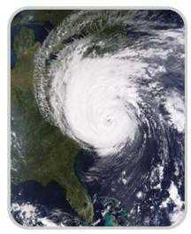
Disclaimer
The views, opinions, and findings contained in this presentation are those of the author and should not be construed as an official National Oceanic and Atmospheric Administration or U.S. Government position, policy, or decision.

Slide 16
Impact Study of RAOB, GOES, and POES data on Eta Data Assimilation System
RAOBs, GOES and POES all contribute unique information!
Zapotocny, T. H., W. P. Menzel, J. A. Jung, and J. P. Nelson III, 2005: A four season impact study of rawinsonde, GOES and POES data in the Eta Data Assimilation System. Part I: The total contribution. Wea. Forecasting, 20, 161-177.
Zapotocny, T. H., W. P. Menzel, J. A. Jung, and J. P. Nelson III, 2005: A four season impact study of rawinsonde, GOES and POES data in the Eta Data Assimilation System. Part II: Contribution of the components. Wea. Forecasting, 20, 178-198.
Zapotocny, T. H., W. P. Menzel, J. P. Nelson III, and J. A. Jung, 2002: Impact Study of Five Satellite Data Types in the Eta Data Assimilation System in Three Seasons. Weather and Forecasting, 17, 263-285.

Slide 17
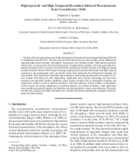
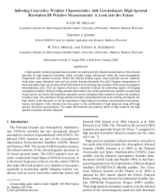
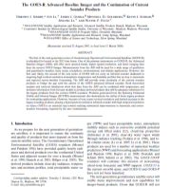
Select High-Spectral References
Schmit, T. J., J. Li, S. A. Ackerman, and J. J. Gurka, 2009: High spectral and temporal resolution infrared measurements from geostationary orbit, Journal of Atmospheric and Oceanic Technology, 26, 2273 - 2292. (a.k.a., why we need an advanced sounder)
Sieglaff, J., M., T. J. Schmit, W. P. Menzel, S. A. Ackerman, 2009: Inferring Convective Weather Characteristics with Geostationary High Spectral Resolution IR Window Measurements: A Look into the Future. J. Atmos. Oceanic Technol., 26, 1527–1541. (a.k.a., potential now-casting applications)
Schmit, T. J., J. Li, J. J. Gurka, M. D. Goldberg, K. Schrab, J. Li, W. Feltz, 2008: The GOES-R ABI (Advanced Baseline Imager) and the continuation of current sounder products. J. of Appl. Meteor., 47, 2696–2711. (a.k.a., the ABI isn’t an advanced sounder)

