Slide 1


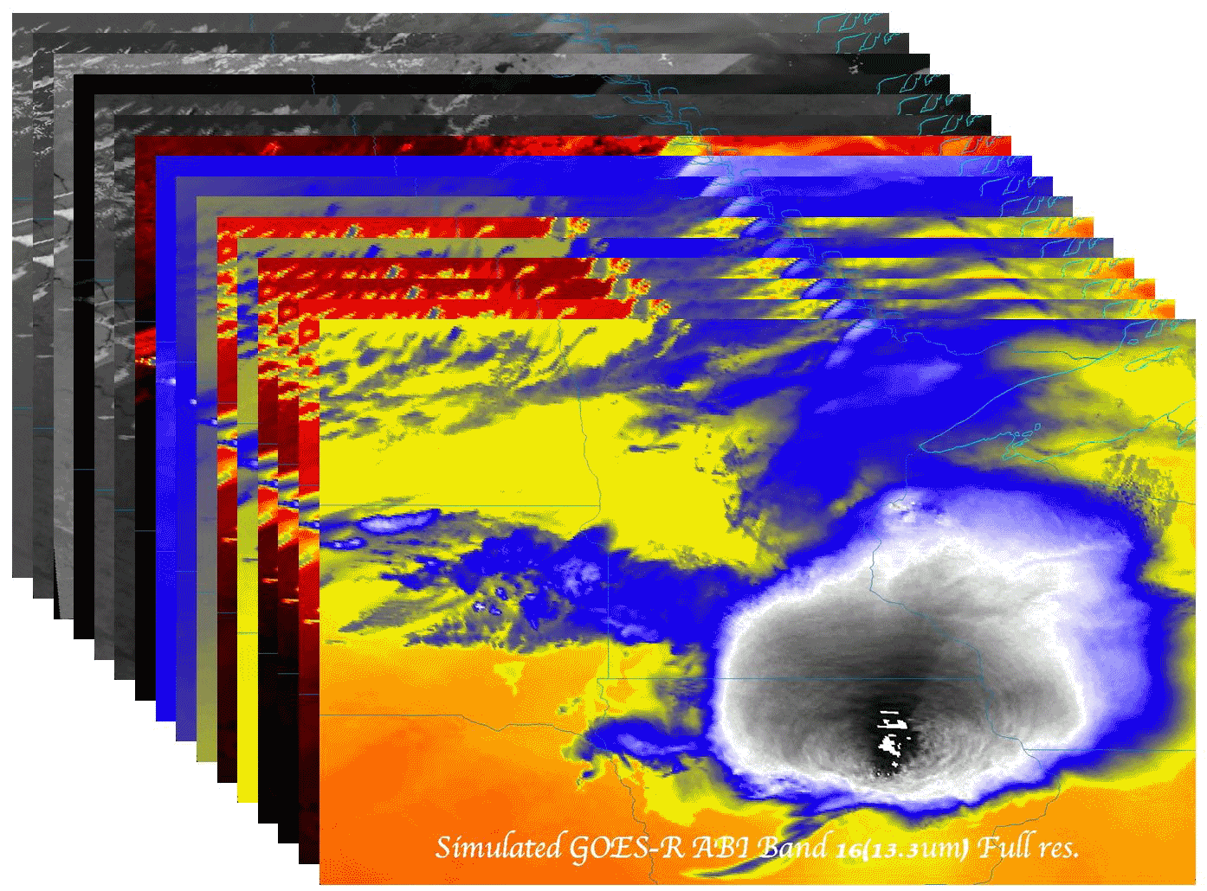
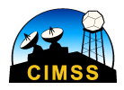
The History and Evolution of the GOES-R Advanced Baseline Imager
  Timothy J. Schmit (tim.j.schmit@noaa.gov)
NOAA/NESDIS/Satellite Applications and Research
Advanced Satellite Products Branch (ASPB)
Madison, WI
Former National Hurricane Center director Robert Sheets once said that if he had only one tool to do his forecasting job, it would be the geostationary weather satellite.
Invited presentation at the PMSR
Fort Wayne, Indiana
March 26, 2015
UW-Madison

Slide 2
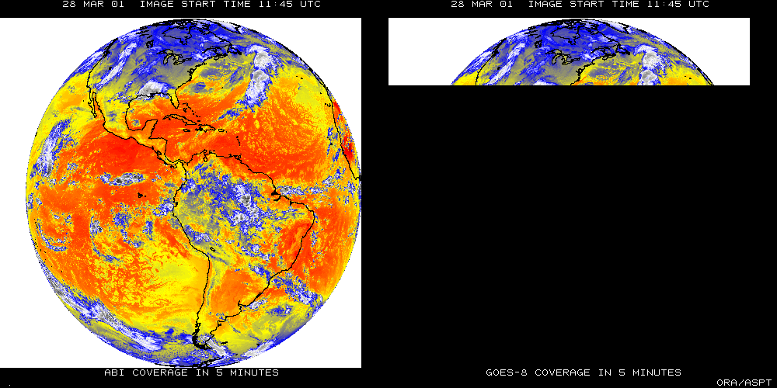
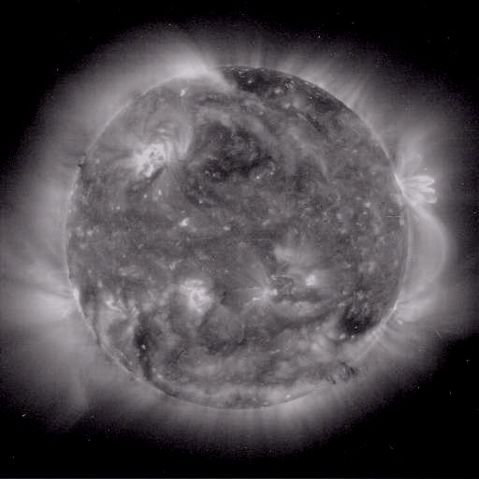
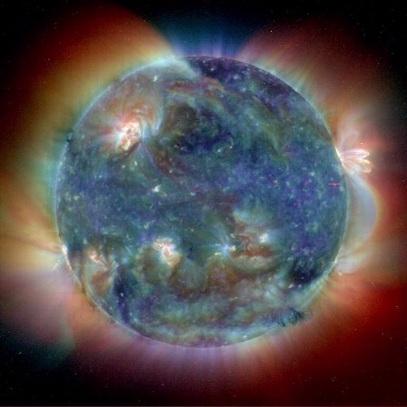
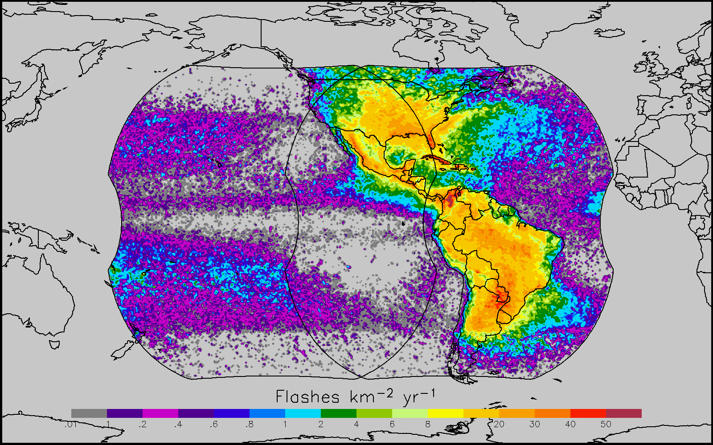
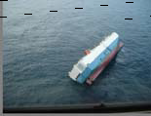
GOES-R main instruments
ABI – Advanced Baseline Imager
Space Weather/Solar
SEISS
SUVI
EXIS
Magnetometer
ABI covers the earth 5X faster than current Imager
Geostationary Lightning Mapper
Images courtesy of SOHO EIT, a joint NASA/ESA program
Unique Payload Services
No Sounder

Slide 3
GOES-R Series Overview
No dedicated Sounder
Advanced Baseline Imager (ABI)
Geostationary Lightning Mapper (GLM)
Space Weather
  Space Environmental In-Situ Suite (SEISS)
  Solar Ultra Violet Imager (SUVI)
  Extreme Ultra Violet/X-Ray Irradiance Sensor (EXIS)
  Magnetometer
Communications
  GOES Rebroadcast (GRB)
  Low Rate Information Transmissions (LRIT)
  Emergency Managers Weather Information Network (EMWIN)
  Search and Rescue (SAR)
  Data Collection System (DCS)
Notes:
Advanced Baseline Imager (ABI) Earth-viewing
Geostationary Lightning Mapper (GLM) Earth-viewing
Solar Ultra-Violet Imager (SUVI) Sun-viewing
EUVS and XRS Irradiance Sensors (EXIS) Sun-viewing
Space Environment In-Situ Suite (SEISS) Space-viewing
Magnetometer (MAG) Space-viewing

Slide 4
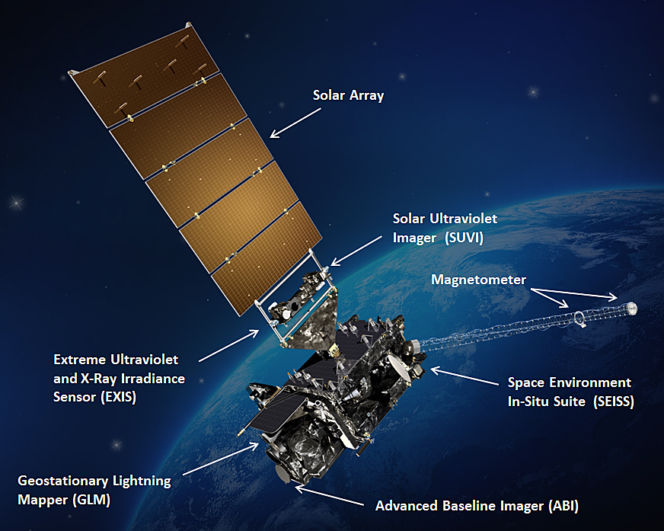
GOES-R
Folks who named the instruments
T. Schmit
M. Weinreb
J. Criscione?
M. Coakley
R. Heymann
Gary Cunningham?
Notes:
Graphic from LM

Slide 5
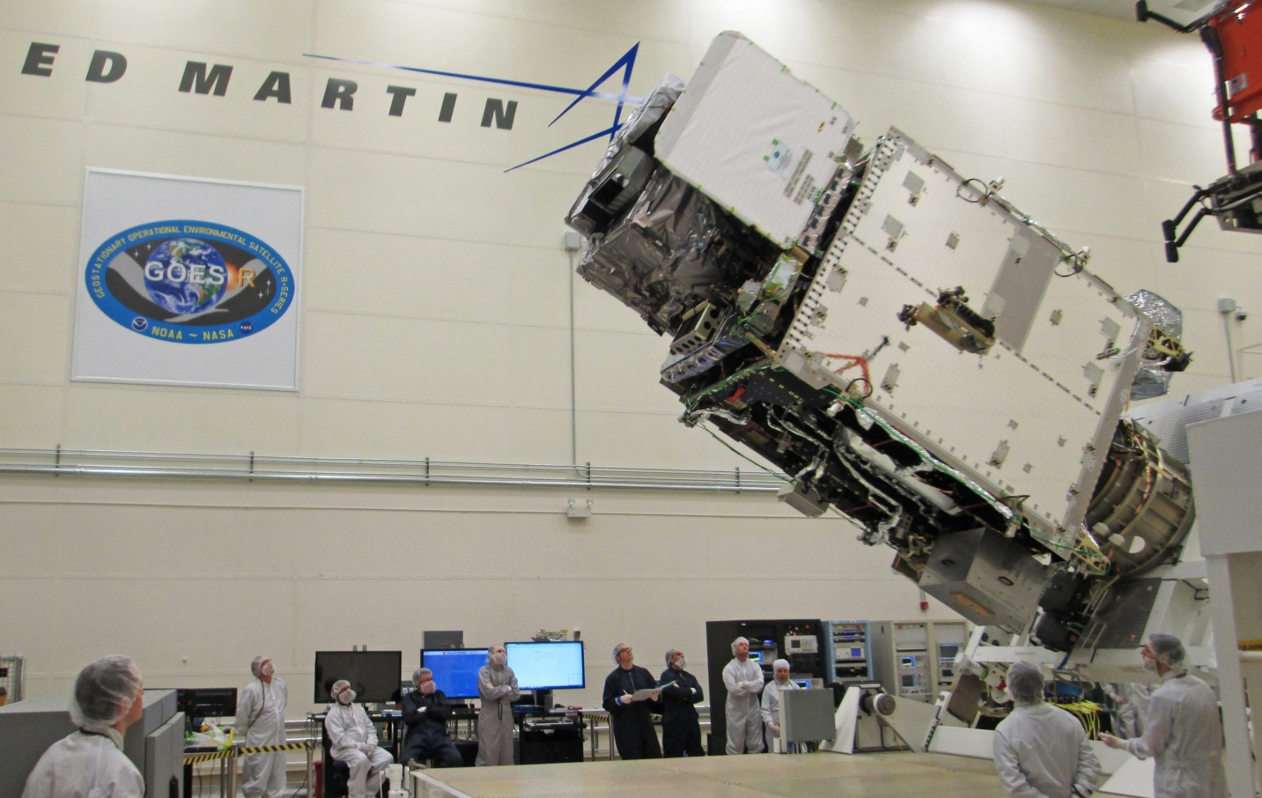
Assembled GOES-R Spacecraft

Slide 6
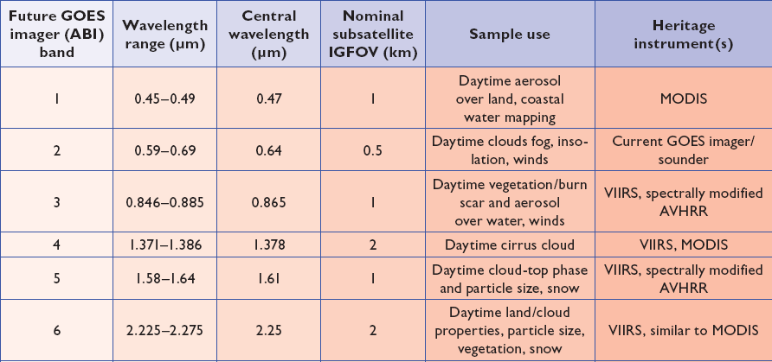
ABI bands 1-6
Notes:
Final column added: heritage. The ABI band 1 was suggested by Dr. Fred Mosher at a GOES Users' Conference.
The ABI band 3 was suggested by the late Dr. C. Rao (of the then ORA).
Some of these bands have been shifted to more closely match those on the VIIRS.

Slide 7
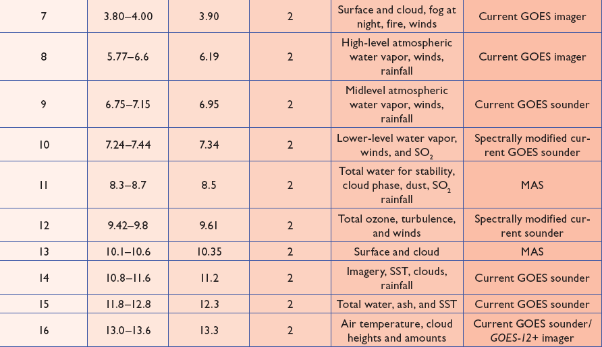
ABI bands 7-16
Notes:
The ABI band 10 was modified to better depict upper-level SO2. (G. Ellrod and others)
The ABI band 11 was suggested by Steve Ackerman (CIMSS), based on HIRS experience.
The ABI band 13 was suggested by W. P. Menzel (then NOAA NESDIS).

Slide 8
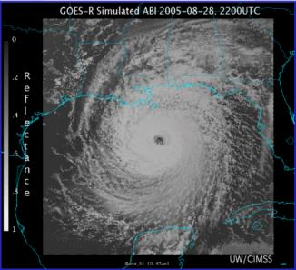
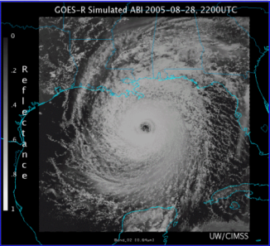
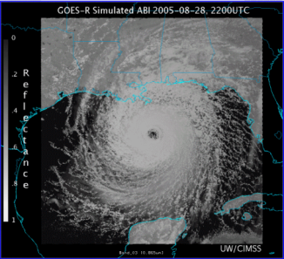
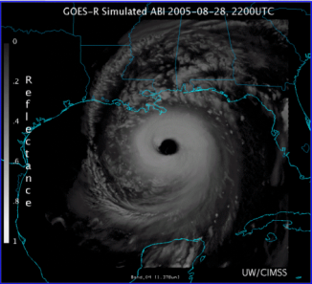
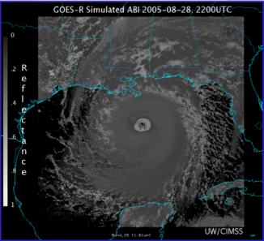
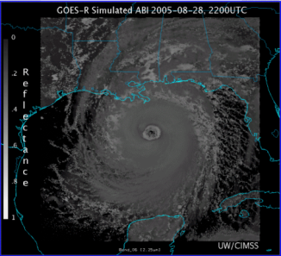
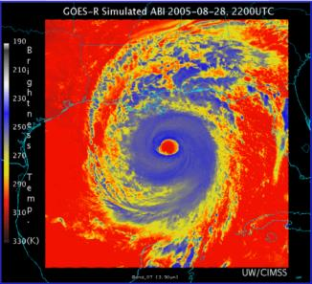
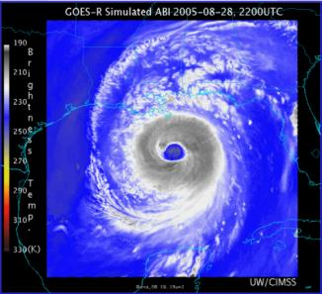
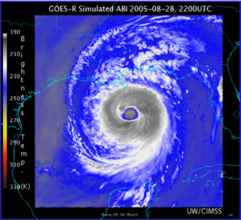
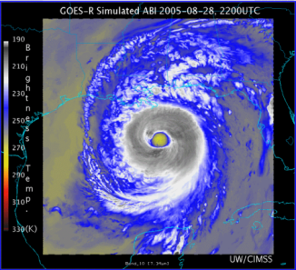
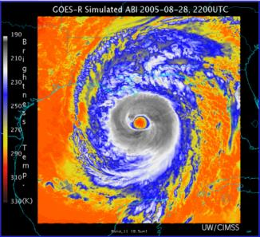
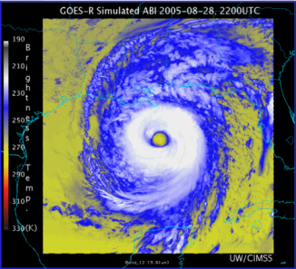
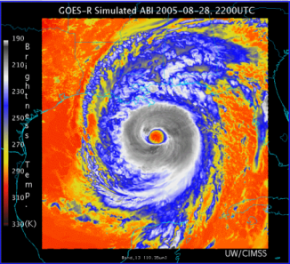
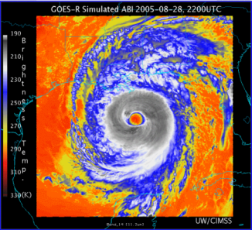
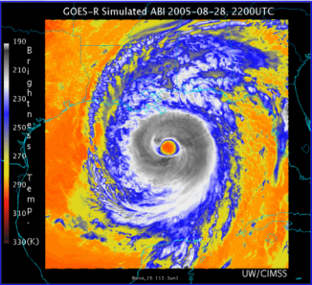
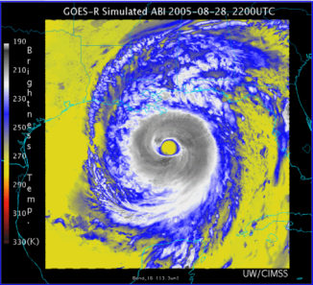
0.47 μm
0.64 μm
0.86 μm
1.38 μm
AWG Proxy ABI Simulations of Hurricane Katrina
1.61 μm
2.26 μm
3.9 μm
6.19 μm
NOAA/NESDIS STAR and GOES-R Imagery Team
6.95 μm
7.34 μm
8.5 μm
9.61 μm
10.35 μm
11.2 μm
12.3 μm
13.3 μm
Notes:
As shown in mcidas-v

Slide 9

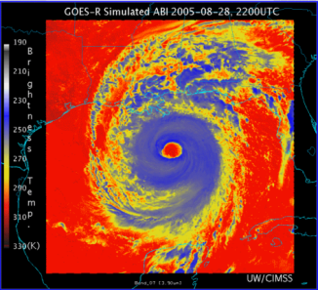

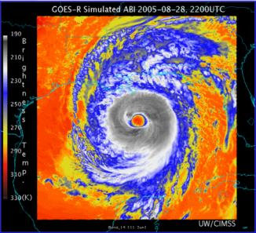
Corresponding current Imager bands of Hurricane Katrina
NOAA/NESDIS STAR

Slide 10
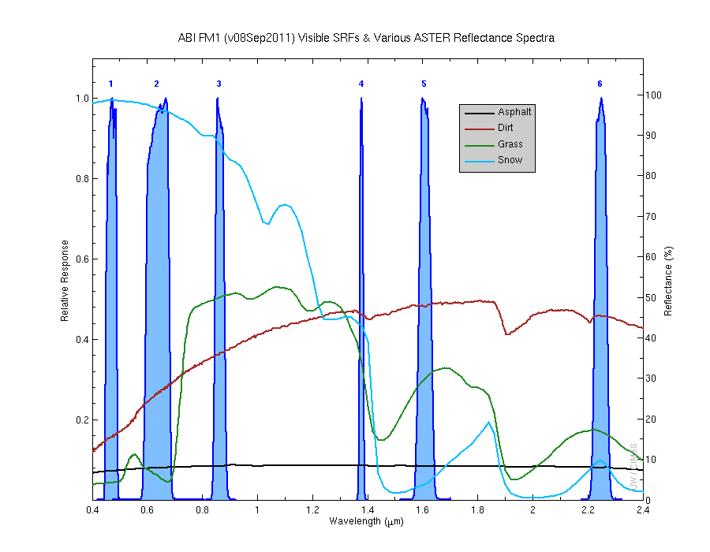
Visible and near-IR channels on the ABI
Aerosols, Insolation
Clouds, Snow
Vegetation, Imagery
Cloud mask, Suspended matter
Snow, Phase
Cloud Particle size
Sample use only, many other uses
The ABI visible and near-IR bands have many uses.
Notes:
Schmit, T. J., M. M. Gunshor, W. P. Menzel, J. J. Gurka, J. Li, and A. S. Bachmeier, 2005: Introducing the next-generation Advanced Baseline Imager on GOES-R. Bull. Amer. Meteor. Soc., 86, 1079-1096.

Slide 11
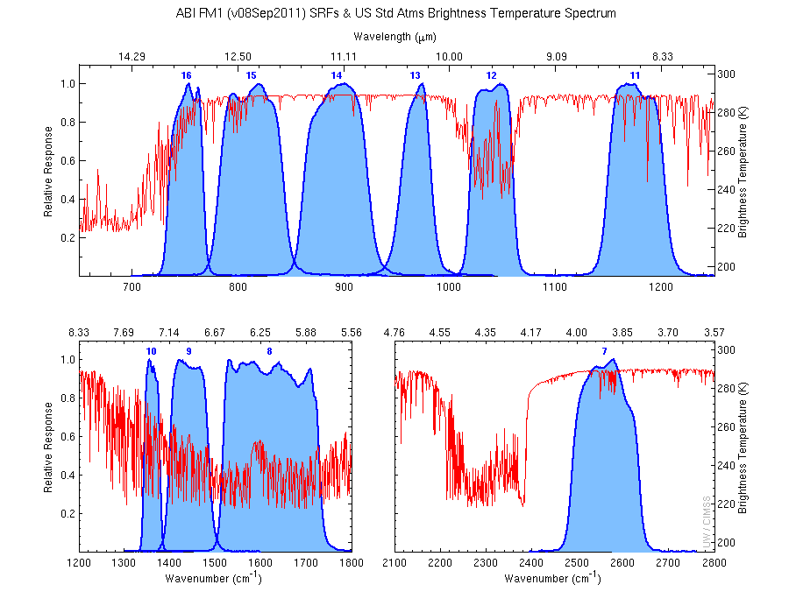
The IR channels on the ABI
Clouds, Stability Indices
SST, Fires, Radiances
Ozone, Downward Radiation
Rainfall, Aerosol
Hurricane, Imagery
Cloud Phase, SST
Sample use only, many other uses
SO2, Radiances
Winds, WV profiling
TPW, Rainfall rate
Fires, Fog
ABI has many more bands than the current operational GOES imagers.
Notes:
Schmit, T. J., M. M. Gunshor, W. P. Menzel, J. J. Gurka, J. Li, and A. S. Bachmeier, 2005: Introducing the next-generation Advanced Baseline Imager on GOES-R. Bull. Amer. Meteor. Soc., 86, 1079-1096.

Slide 12

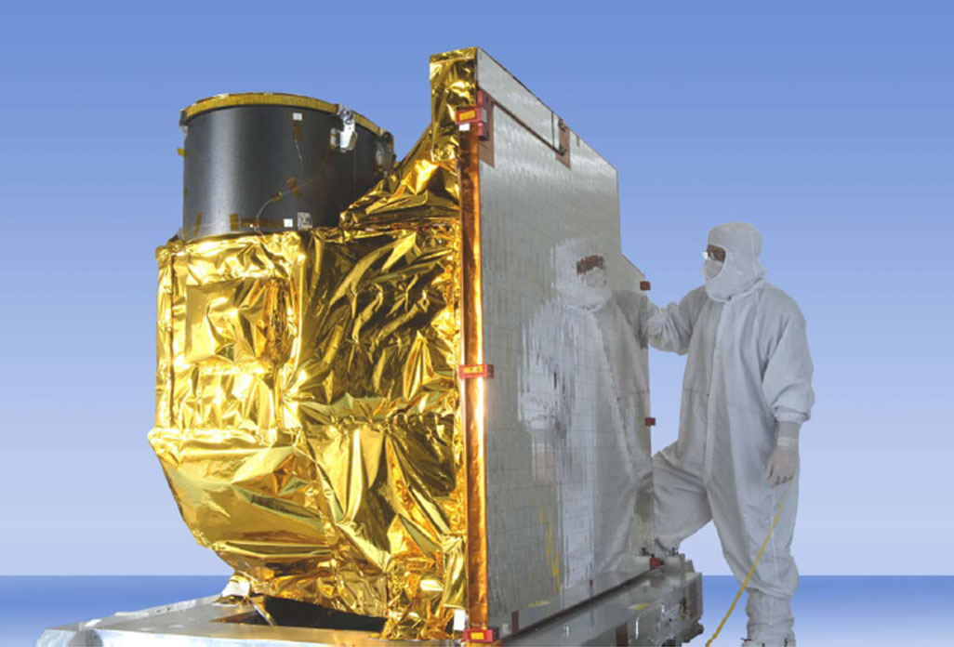
Advanced Baseline Imager
5
4
3
X
Faster coverage
(5-minute full disk vs. 25-minute)
X
Improved spatial
resolution
(2 km IR vs. 4 km)
X
More spectral bands (16 on ABI vs. 5 on the current imager)
Notes:
Slide from J. Gerth, CIMSS.

Slide 13
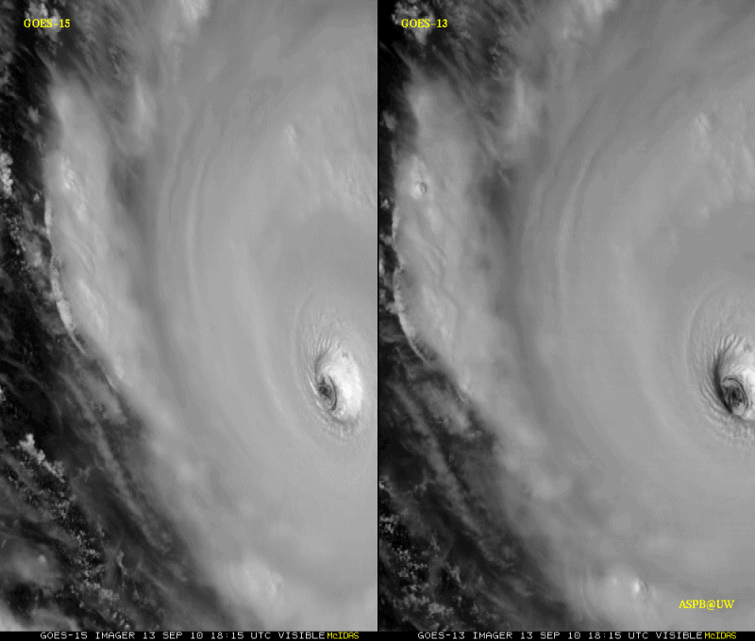
GOES-15 Science Test
The Science Test part of Post Launch Testing for GOES-15 occurred in the summer of 2010.
Co-led by Hillger and Schmit.
Unique 1-minute rapid scan imagery acquired
GOES-15 data analysis will continue. All the GVAR data archived.
Many products generated in near real-time.
A NOAA Technical Report was generated.
1-min
30-min
Unique GOES-15 Imager Visible data from the NOAA Science Test
Notes:
Igor

Slide 14
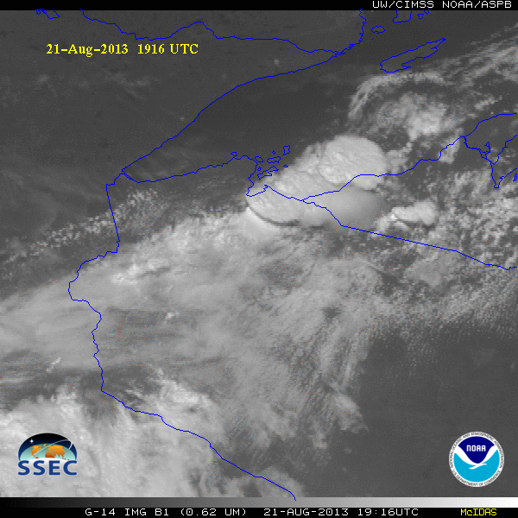
GOES-14 Super Rapid Scan Operations to Prepare for GOES-R (SRSOR)
SRSOR plans for 2015 include May 18-June 12, and August 10-22:
  http://cimss.ssec.wisc.edu/goes/srsor2015/GOES-14_SRSOR.html
  Data during parts of 2012 (Hurricane Sandy, convection), 2013 (CA Rim Fire, convection) and 2014 (Hurricane Marie, convection):
  http://cimss.ssec.wisc.edu/goes/srsor/GOES-14_SRSOR.html
  http://cimss.ssec.wisc.edu/goes/srsor2013/GOES-14_SRSOR.html
  http://cimss.ssec.wisc.edu/goes/srsor2014/GOES-14_SRSOR.html
GOES-14 provided very unique data and offered a glimpse into the possibilities that will be provided by the ABI on GOES-R in one minute mesoscale imagery
GOES-14 visible image showing rapid convective development
Notes:
http://cimss.ssec.wisc.edu/goes/srsor2015/GOES-14_SRSOR.html

Slide 15
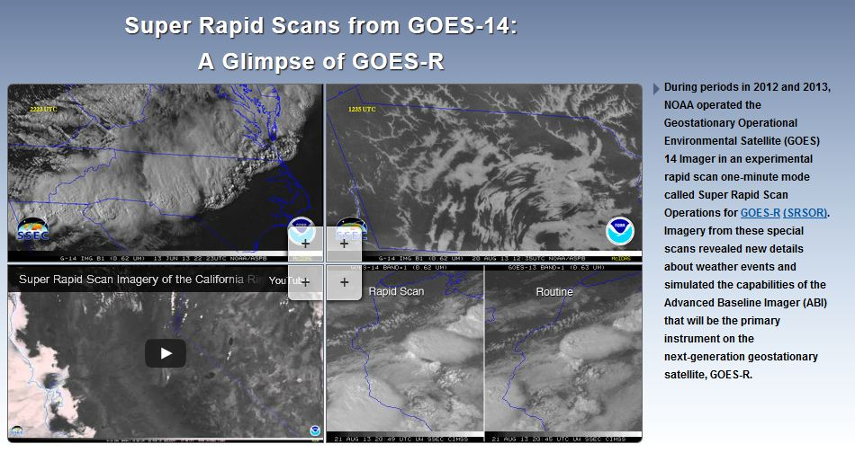

SRSOR Links
http://cimss.ssec.wisc.edu/goes/srsor/GOES-14_SRSOR.html
http://cimss.ssec.wisc.edu/goes/srsor2013/GOES-14_SRSOR.html
http://cimss.ssec.wisc.edu/goes/srsor2014/GOES-14_SRSOR.html
http://www.nesdis.noaa.gov/fourbox/09-23-13/

Slide 16
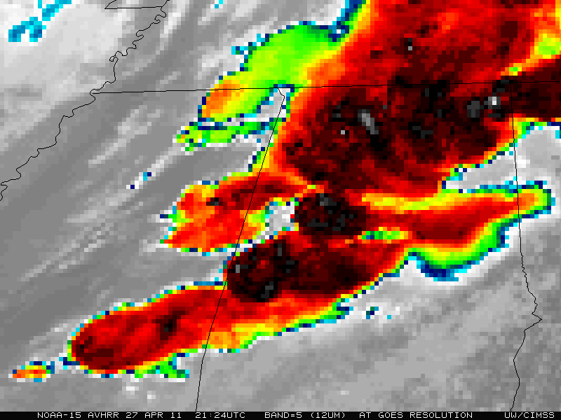

Slide 17


Slide 18
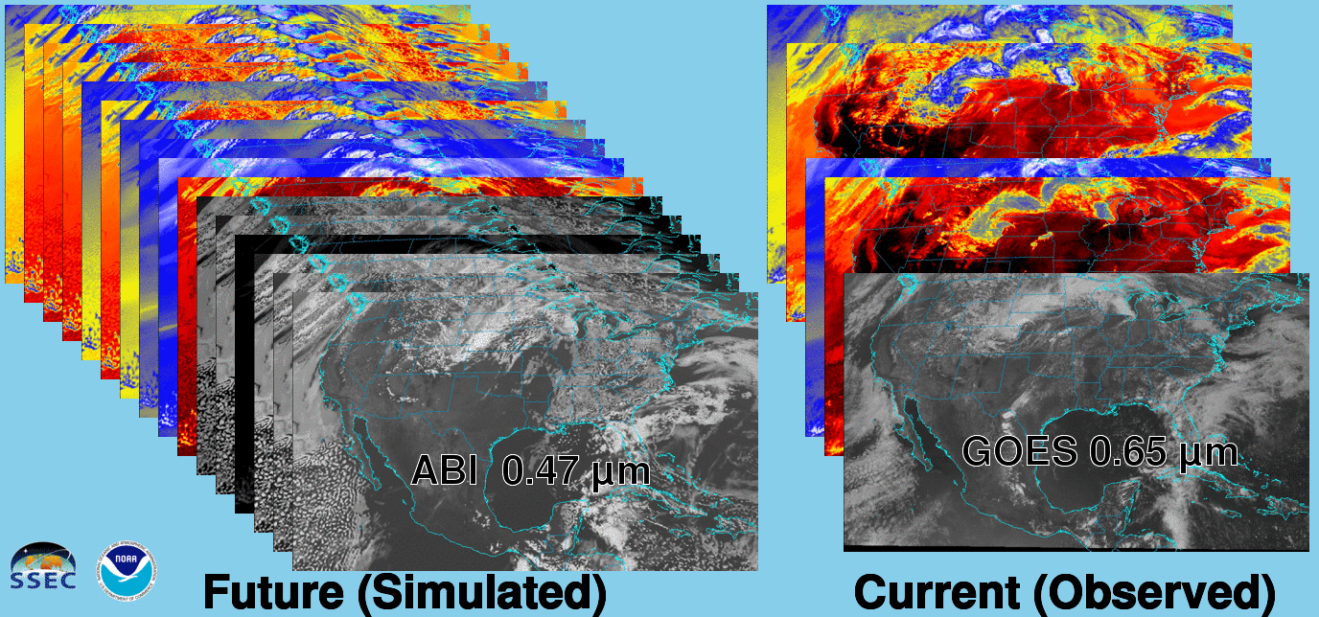
Future vs. Current Spectral Bands
The current GOES (right) has 5 spectral bands, while the GOES-R series ABI (left) will have 16 spectral bands.

Slide 19
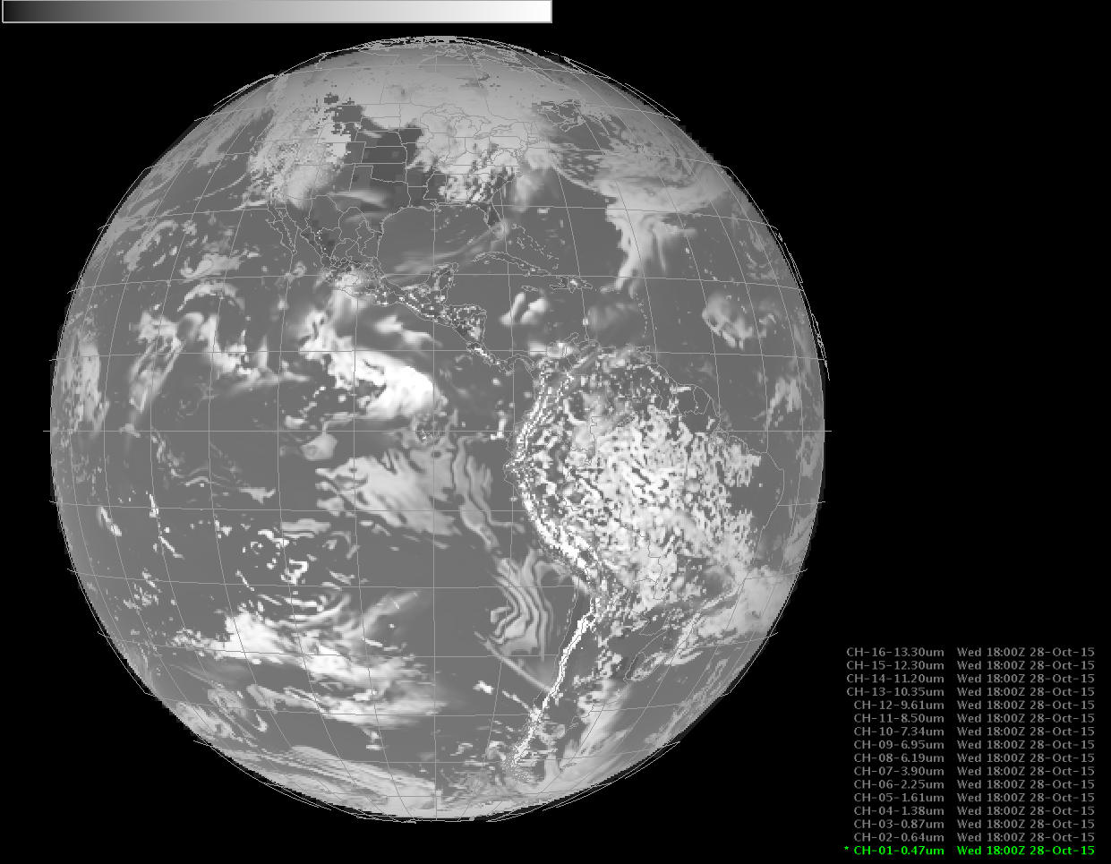
Simulated data, in AWIPS-2

Slide 20
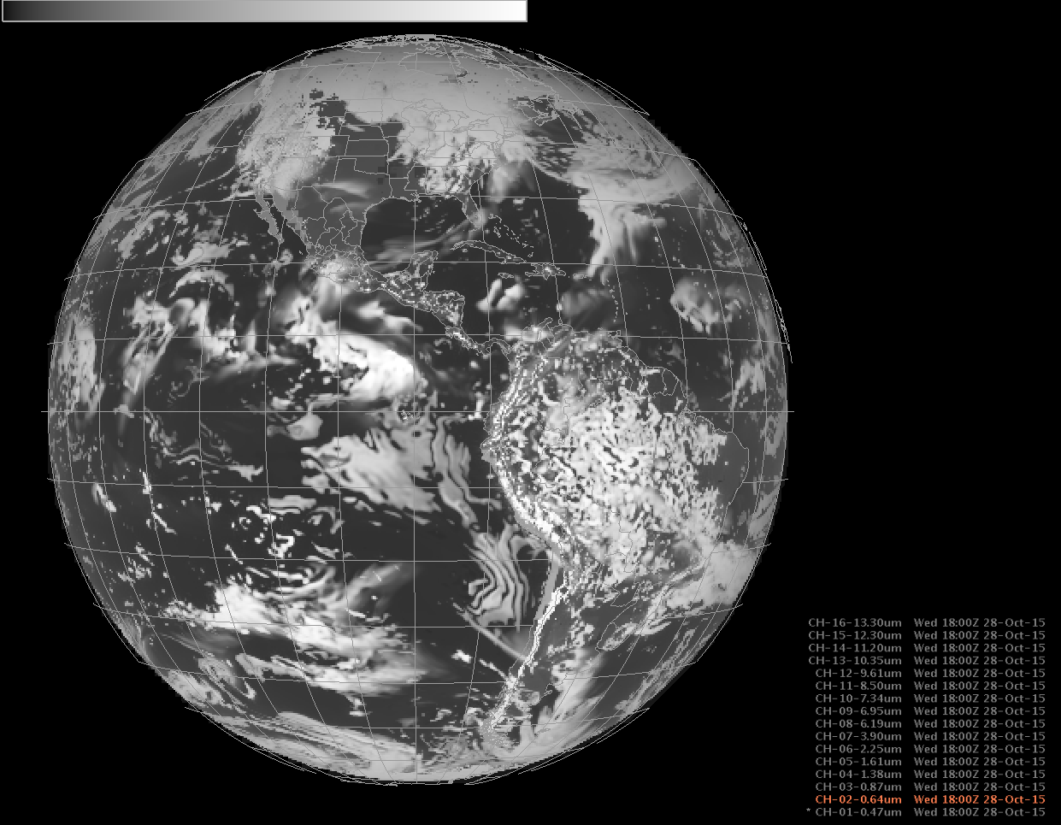

Slide 21
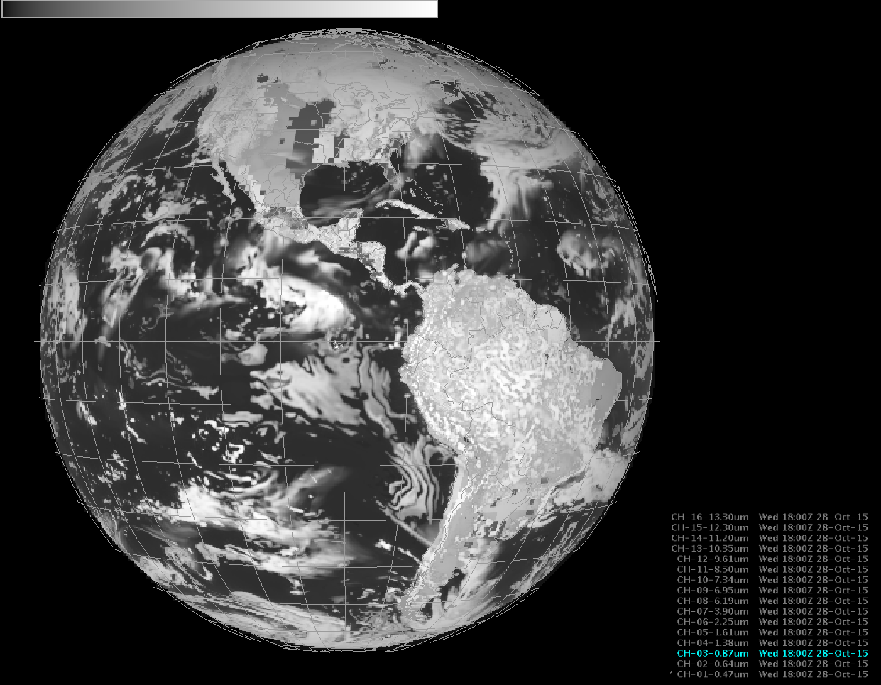

Slide 22
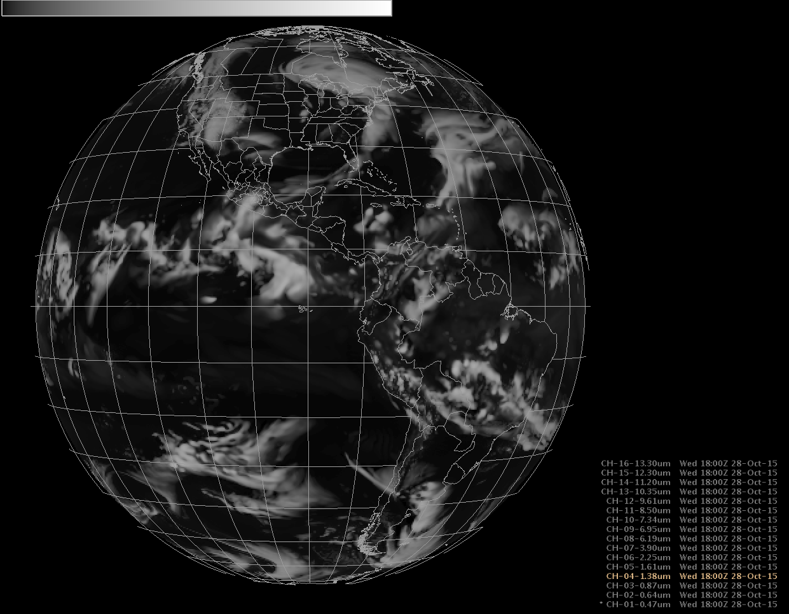

Slide 23
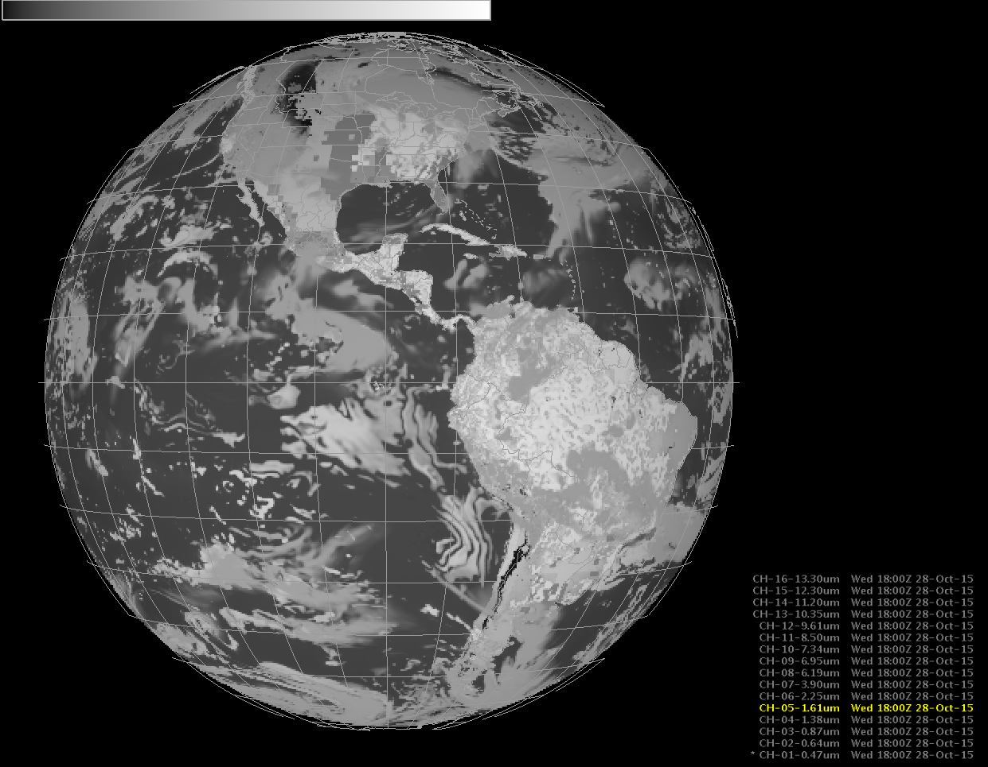

Slide 24
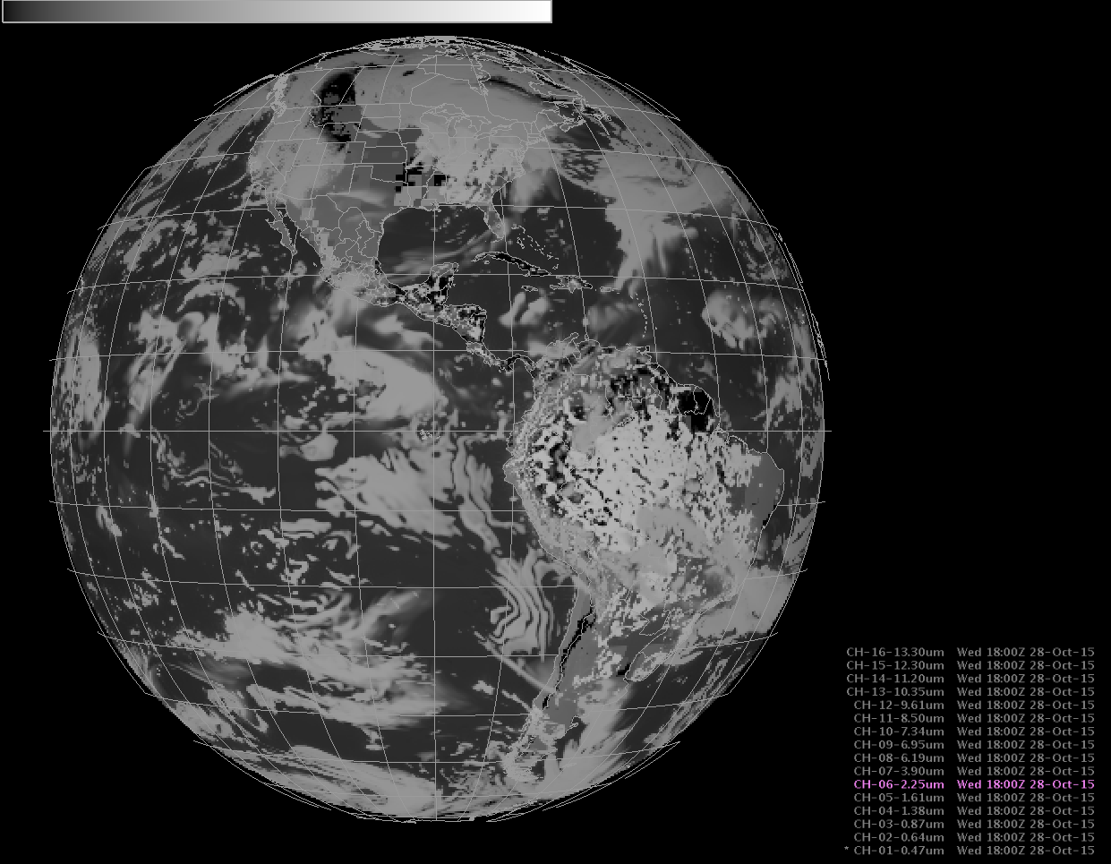

Slide 25
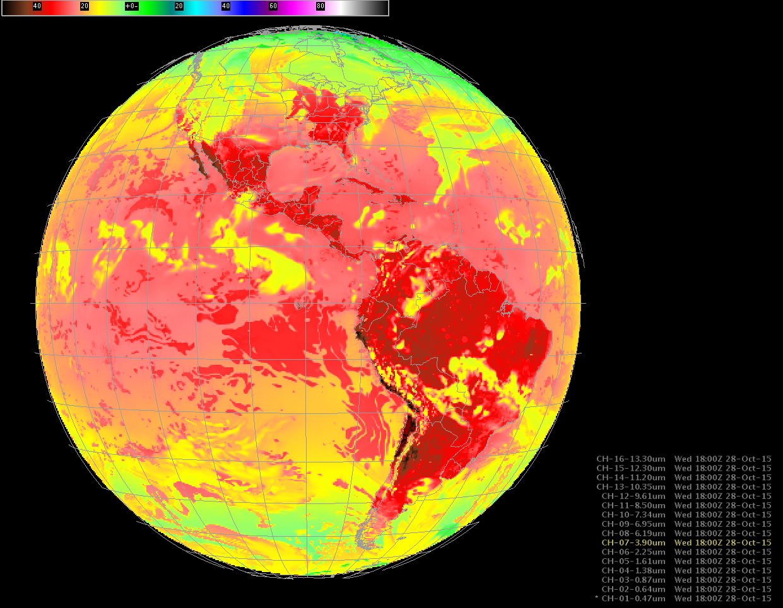

Slide 26
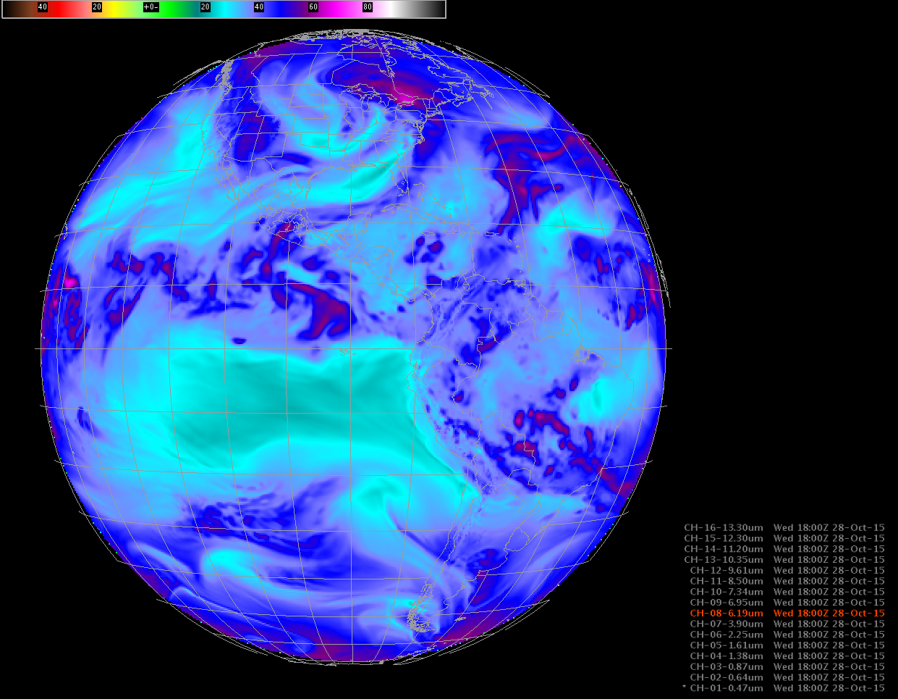

Slide 27
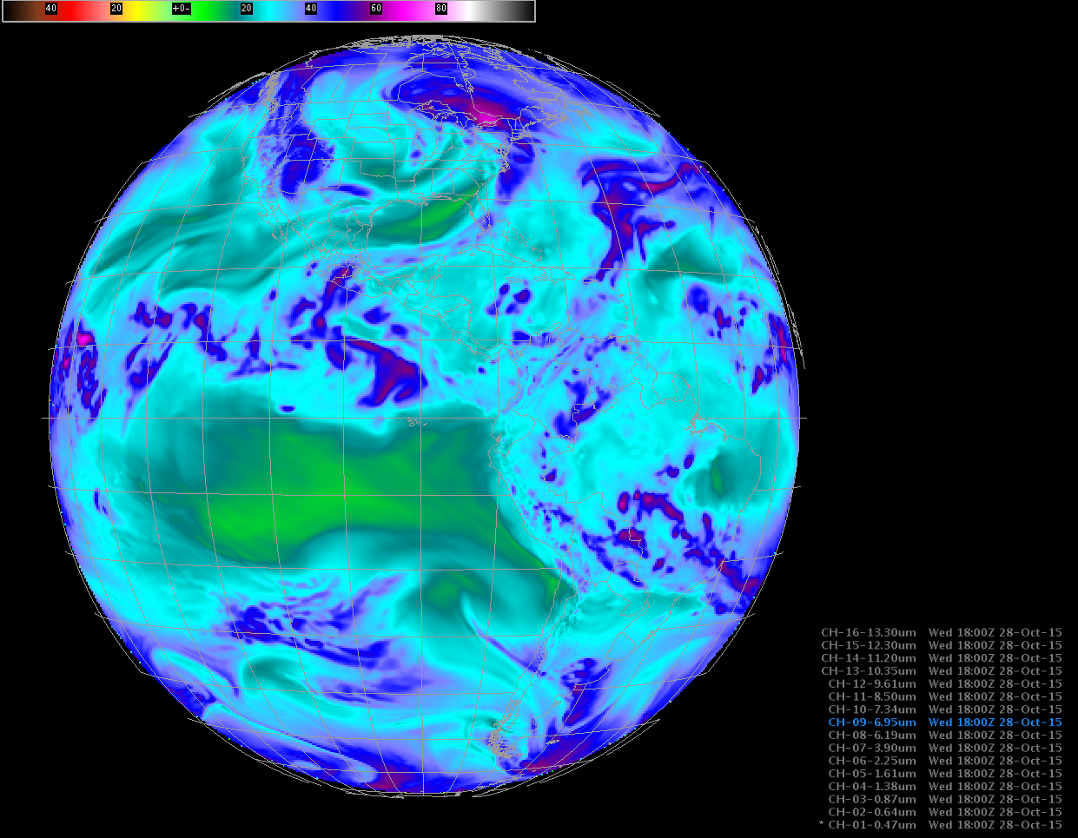

Slide 28
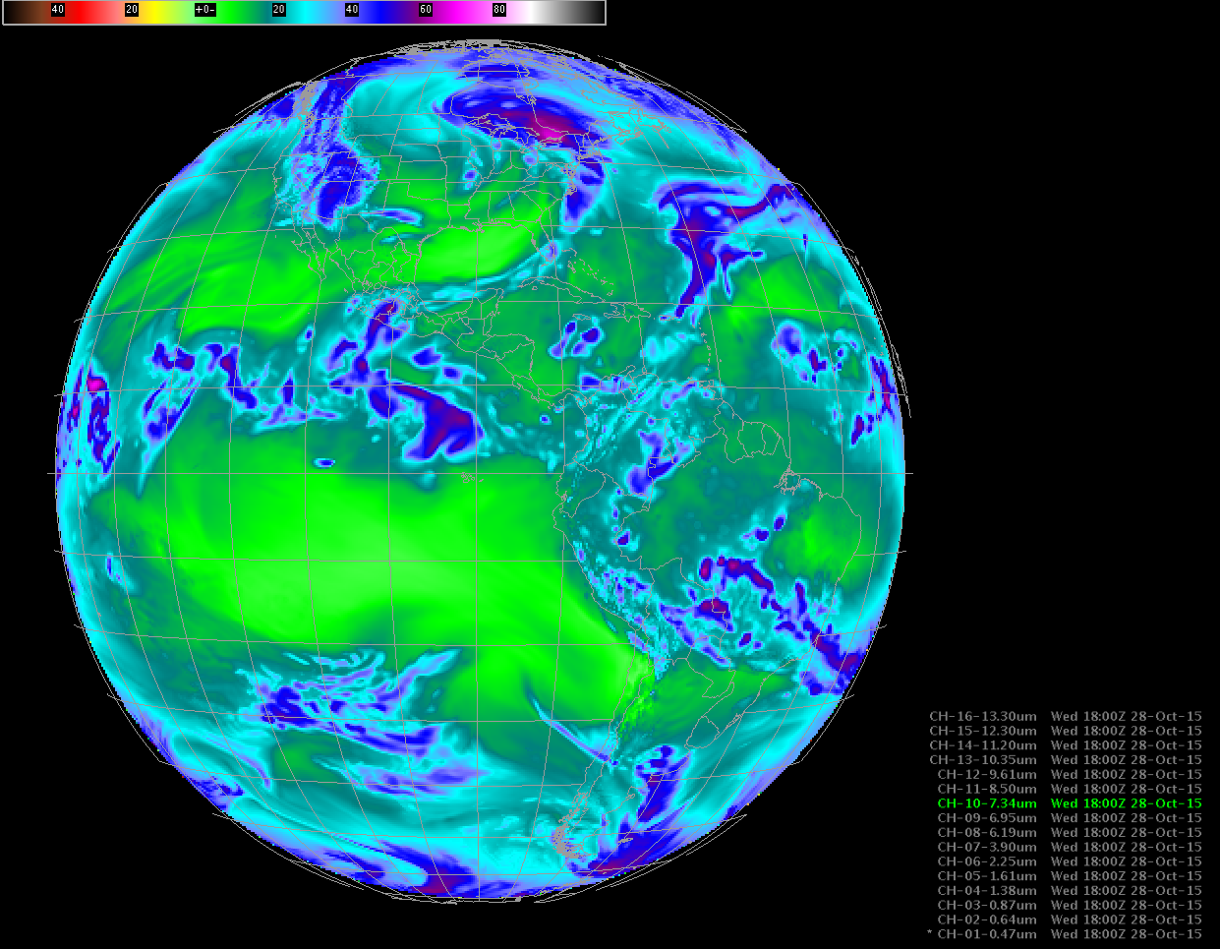

Slide 29
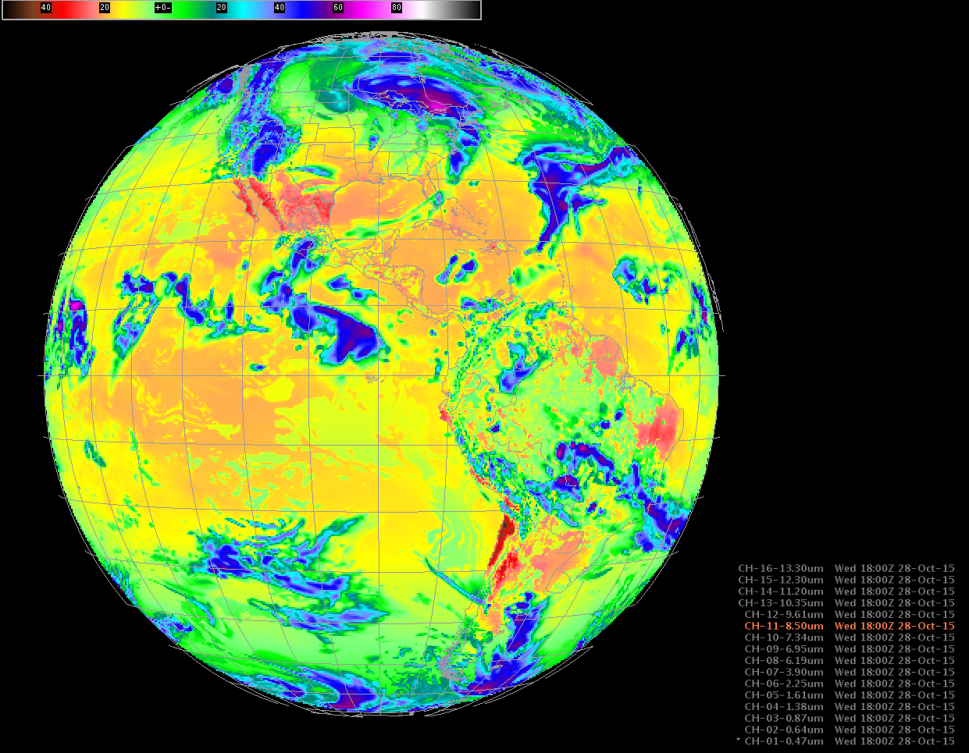

Slide 30
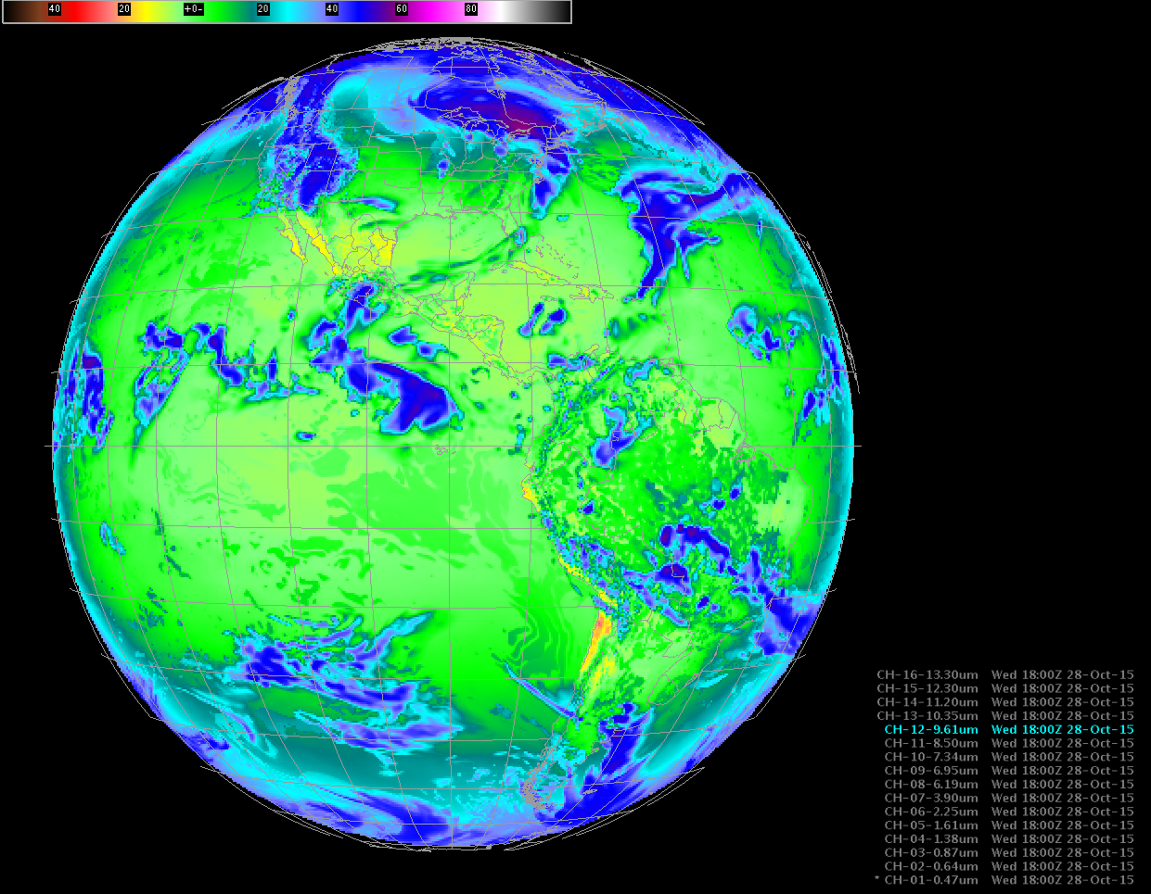

Slide 31
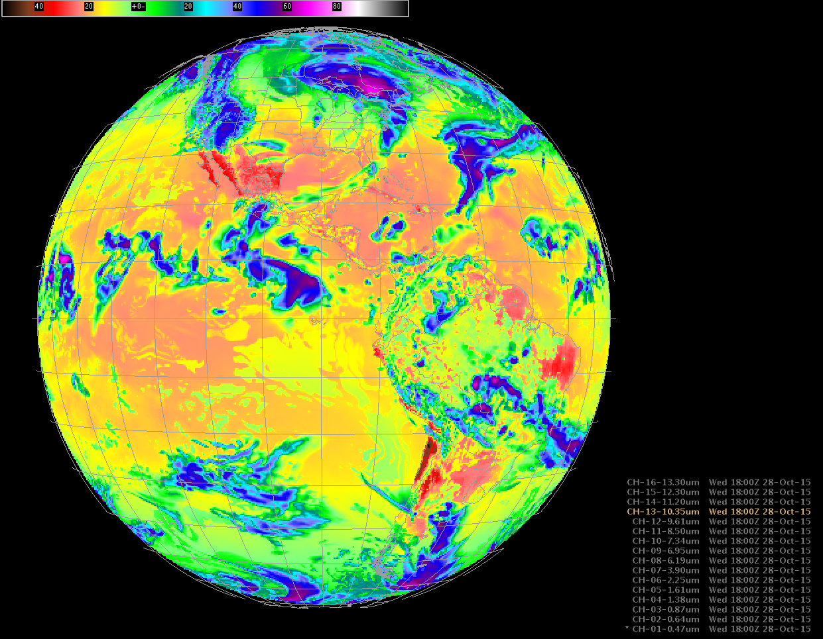

Slide 32


Slide 33


Slide 34


Slide 35



Baseline ABI Scan Modes
Scan mode (3) or ‘flex mode’ for the ABI:
- Full disk every 15 minutes + 5 min CONUS
+ 1-min mesoscales (2 locations).
[Scan mode (4) or ‘Continuous Full Disk’ (CFD) is a full disk every 5 min]
Notes:
CONUS image is the shifted center point.

Slide 36

CONUS from East and West (NOAT/GORWG-approved)
Notes:
Different days simulated.

Slide 37
Recent Mode 3 (Flex mode)
“Time-Time” chart
Note the ‘white’ space is instrument idle time.
DRAFT!!!!!
Notes:
Copy and pasted from excel. Pasted as a picture. Resized to 44% by 44% of original. Arrange -> Align -> Align Center & Align Middle

Slide 38
Baseline Time-Time Mode 4
(Continuous Full Disk)
This is the Continuous Full Disk (every 5 min) mode
This is the highest data rate.

Slide 39

http://www.goes-r.gov

Slide 40
GOES-R ABI Products
Baseline Products
Future Capabilities
Advanced Baseline Imager (ABI)
Aerosol Detection (Including Smoke and Dust) Aerosol Optical Depth (AOD) Clear Sky Masks Cloud and Moisture Imagery Cloud Optical Depth Cloud Particle Size Distribution Cloud Top Height Cloud Top Phase Cloud Top Pressure Cloud Top Temperature Derived Motion Winds Derived Stability Indices Downward Shortwave Radiation: Surface Fire/Hot Spot Characterization Hurricane Intensity Estimation Land Surface Temperature (Skin) Legacy Vertical Moisture Profile Legacy Vertical Temperature Profile Radiances Rainfall Rate/QPE Reflected Shortwave Radiation: TOA Sea Surface Temperature (Skin) Snow Cover Total Precipitable Water Volcanic Ash: Detection and Height
Advanced Baseline Imager (ABI)
Absorbed Shortwave Radiation: Surface Aerosol Particle Size Aircraft Icing Threat Cloud Ice Water Path Cloud Layers/Heights Cloud Liquid Water Cloud Type Convective Initiation Currents Currents: Offshore Downward Longwave Radiation: Surface Enhanced “V”/Overshooting Top Detection Flood/Standing Water Ice Cover Low Cloud and Fog Ozone Total Probability of Rainfall Rainfall Potential Sea and Lake Ice: Age Sea and Lake Ice: Concentration Sea and Lake Ice: Motion Snow Depth (Over Plains) SO₂ Detection Surface Albedo Surface Emissivity Tropopause Folding Turbulence Prediction Upward Longwave Radiation: Surface Upward Longwave Radiation: TOA Vegetation Fraction: Green Vegetation Index Visibility
+ others

Slide 41

Pseudo-Natural Color

Slide 42

Educational Webapps Developed
NOAA NESDIS ASPB teamed up with CIMSS researchers to develop three educational WebApps to explore space, time and spectral resolutions of satellite imagery.
Part of the GOES-R Educational Proving Ground at CIMSS:
http://cimss.ssec.wisc.edu/education/goesr
Teacher feedback:
“…. Wow!! This is awesome!!
This is impressive. Thank you for sharing. This is great. Thanks for all your hard work and help!!!!
We are honored and will use it next week … Earth SySTEM Teacher Academy”
Sample interactive “Bandapp” educational webapp using simulated ABI images:
http://cimss.ssec.wisc.edu/goes/webapps/bandapp/
T. Schmit
Notes:
Tim Schmit, ASPB
https://ams.confex.com/ams/95Annual/webprogram/Paper265203.html ABI = Advanced Baseline Imager
Other new webapps: one to change both the spatial and temporal sampling and the other only the pixel sampling

Slide 43

Actual AHI data, in McIDAS-X

Slide 44


Slide 45


Slide 46


Slide 47


Slide 48


Slide 49


Slide 50


Slide 51


Slide 52


Slide 53


Slide 54


Slide 55


Slide 56


Slide 57


Slide 58


Slide 59



Recent AHI image
in RealEarth

Slide 60
Summary
The ABI on GOES-R will improve over the current instrument in many aspects:
  spatial, temporal, spectral, calibration, etc.
The great amount of information from the GOES-R will offer a continuation of current products and new products.
The ABI builds on previous experience/instruments:
  The ABI has already had a long history, even before launch.
Similar imagers by Europe, Japan, Korea, etc.
  ABI-like coverage of most of the globe!

Slide 61
Approximate spectral and spatial resolutions of US GOES Imagers
~ Band Center (um) | GOES-1/3 | GOES-4/7 | GOES-8/11 | GOES-12/13 | GOES-13/15 | GOES-R+
0.47
0.64
0.86
1.6
1.38
2.2
3.9
6.2
~6.7 |  | 14km
7.3
8.5
9.7
10.3
11.2
12.3
13.3
Visible
Near-IR
Box size represents pixel size
8
4
2
“MSI mode”
Infrared
Notes:
0.40 inches = 4km; 0.80 inches = 8km
MSI is Multi-Spectral Imaging Mode (dashed boxes)
This does not show other improvements: SNR, MTF, bit-depth, navigation, coverage rates, etc.
ATS and SMS not shown.

Slide 62

Conclusions
The ABI on the GOES-R series continues the critical continuity of geostationary imagers and will have huge positive societal impacts, given its improved temporal, spatial, spectral and radiometric attributes.
Impact areas include, but are not limited to: weather, Numerical Weather Prediction, severe weather, hazards (volcanic ash plumes), aviation, environmental (fires), health (smoke), oceanographic, cryosphere, land, etc.

Slide 63



Acknowledgements
The authors would like to thank the entire GOES and GOES-R teams; both within the government, industry and academia.
The views, opinions, and findings contained in this presentation are those of the authors and should not be construed as an official National Oceanic and Atmospheric Administration or U.S. Government position, policy, or decision.

