Slide 1
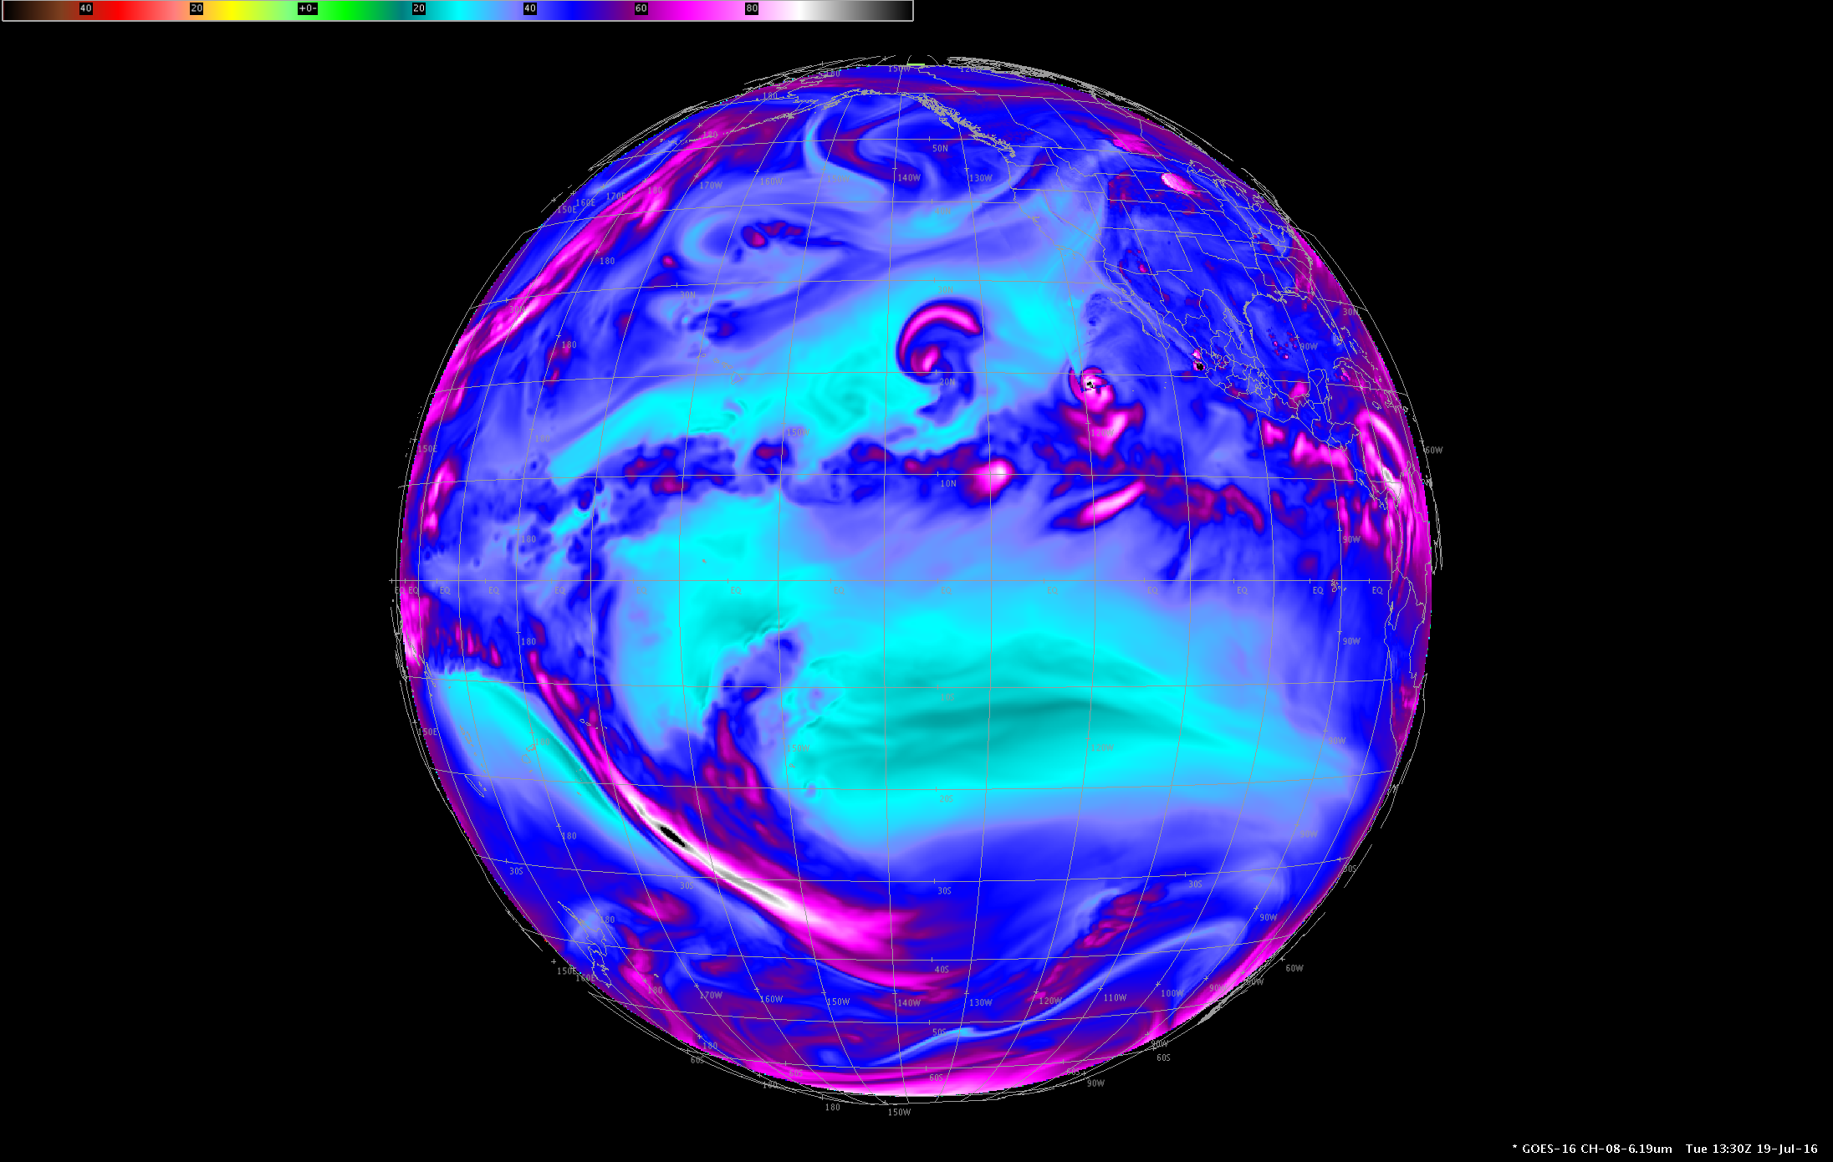
GOES-West coverage from 137W
Simulated imagery
Shown in AWIPS

Slide 2
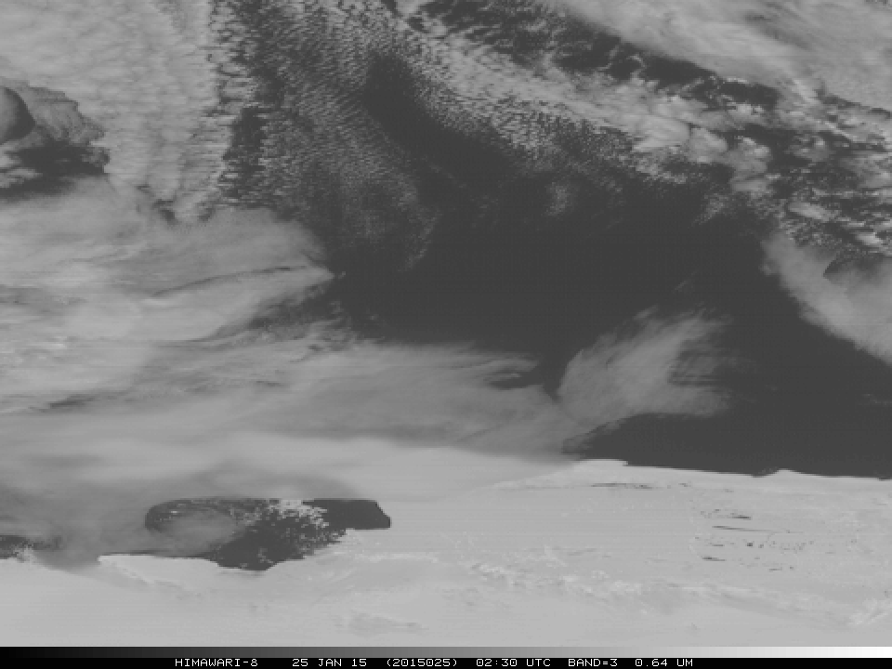
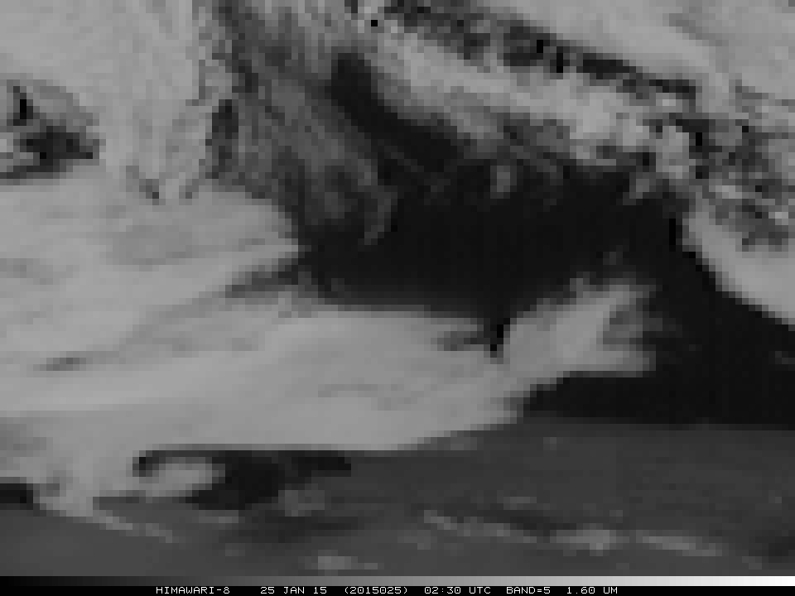
Ice floes
(AHI near Antarctica)
Bright at 0.64 micrometer
Dark at 1.6 micrometer

Slide 3
Mount Pavlof volcano in Alaska
animation

Slide 4
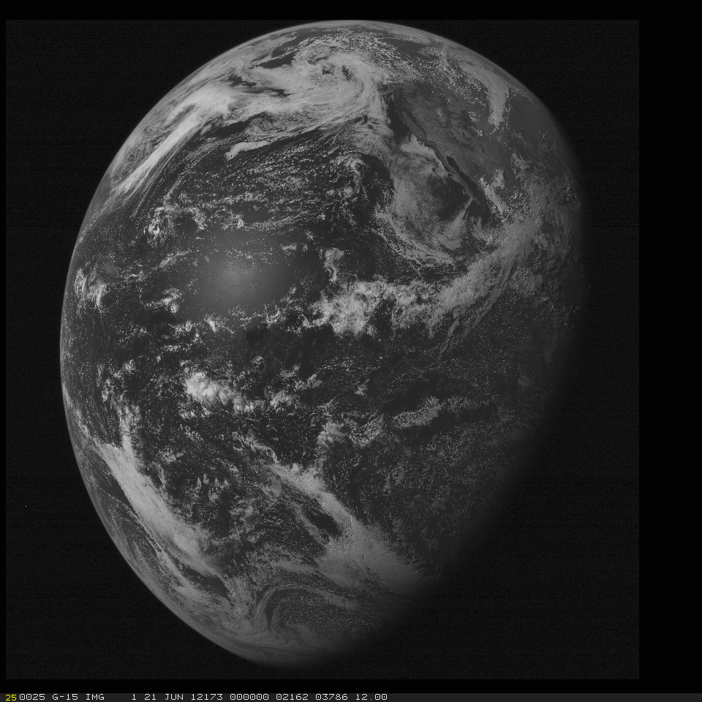
GOES
(Current)

Slide 5
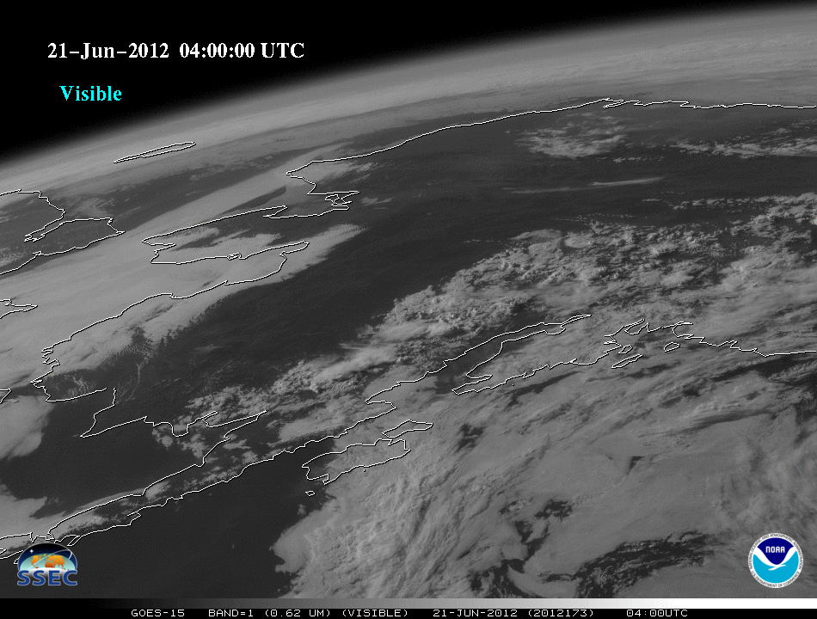

Slide 6
Ice flow
animation

Slide 7
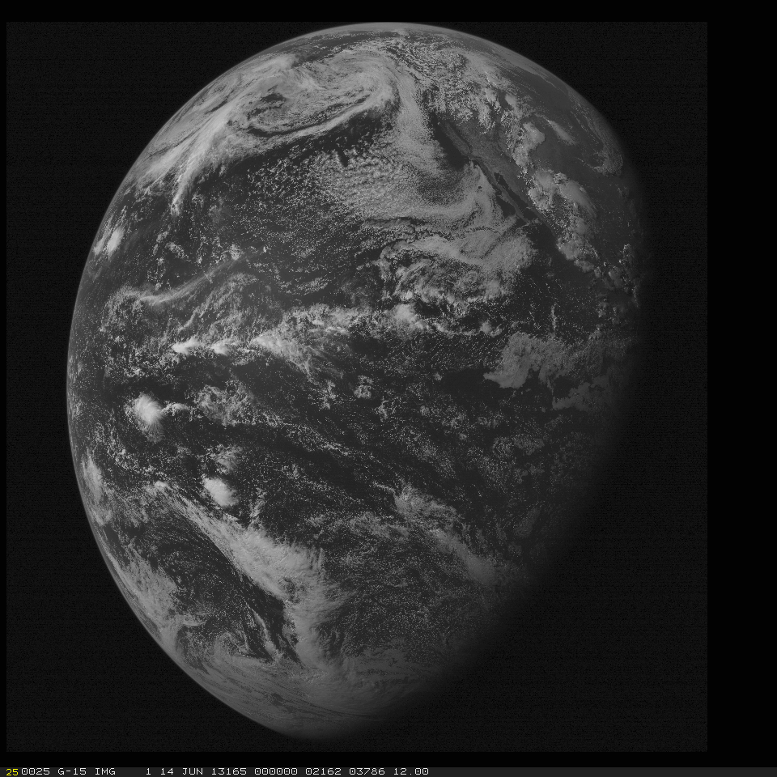
GOES
(Current)

Slide 8
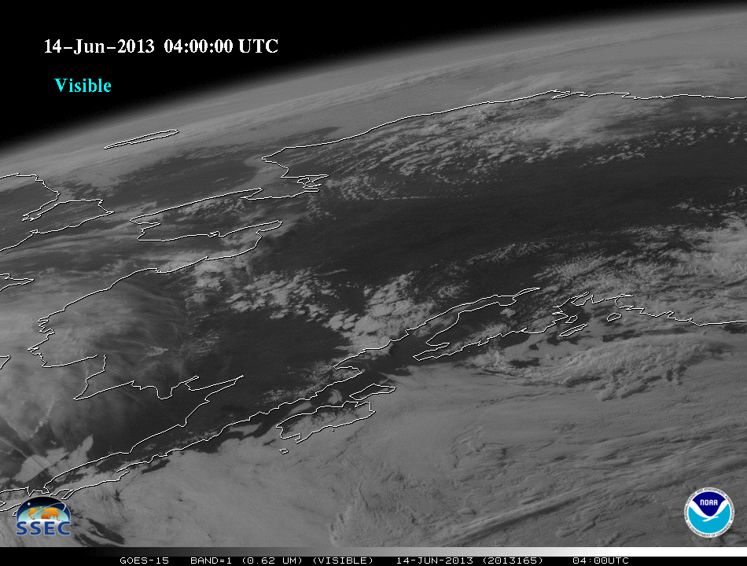

Slide 9
animation
Thunderstorm

Slide 10
ABI
Pixels size by latitude, along the longitude line of satellite nadir.
In general, even at 50 degrees view angles, the spatial resolution of the ABI is comparable to today’s imager at the satellite sub-point.
Figure from J. Key, ASPB

