Slide 1
J1 VIIRS BBR Waiver Analysis
JAFIIR Team at UW-Madison/CIMSS:
Mat Gunshor, Hong Zhang, and Allen Huang
STAR Fire Product Lead:
Ivan Csiszar

Slide 2
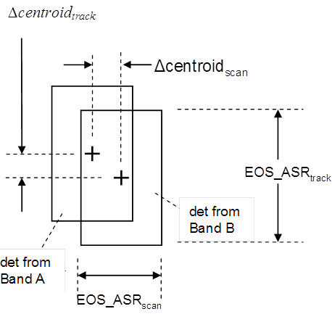
Band to band registration
From J1_VIIRS_Waiver_Working_Group_141206a.pptx:
BBR evaluated in terms of product of (1-Δtrack) (1-Δscan)
  Higher value means better coregistration; more area overlap
Requirements on track and scan product are stratified:
  I bands shall be coregistered to each other to >0.8
  M9, M12, M13, M14, M15, and M16 coregistered to >0.8
  M3, M5, and M11 shall be coregistered to >0.70
  All other M bands shall be coregistered to >0.64
  I bands binned 2x2 and M bands coregistered to >0.64
Non-compliances are likely for J1 relative to the >0.8 specs
  S-NPP had a waiver for BBR to these same requirements
J1 has better BBR performance in scan direction compared to S-NPP
Unfortunately J1 has poorer BBR performance in track direction than S-NPP
  Offset of VisNIR M-bands relative to SW, MW, LWIR M-bands in TVAC: Δtrack ~ 0.07
  Offset of VisNIR I-bands (i1, i2) relative to I-bands (i3, i4, i5) in TVAC: Δtrack ~ 0.14
Science data product impacts due to J1’s BBR non-compliance will behave differently across the scan swath than on S-NPP
  On S-NPP, impacts of Δscan offsets are reduced in the 2:1 and 3:1 aggregation zones
  On J1, impacts of Δtrack offsets at nadir will be similar to those at scene edges

Slide 3
S-NPP BBR
From J1_VIIRS_Waiver_Working_Group_141206a.pptx:
Above the diagonal are the Coregistration Factors (CF) achieved by SNPP VIIRS (values in white cells below the diagonal are the requirements for each band pair)

Slide 4
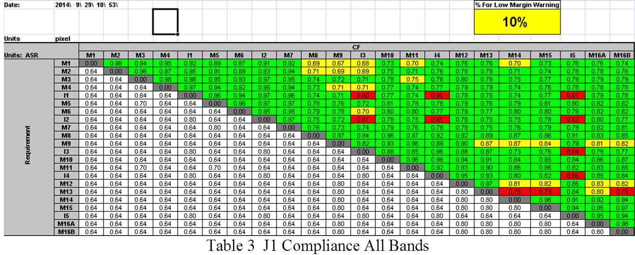
J1 BBR
From J1_VIIRS_Waiver_Working_Group_141206a.pptx:
In almost all cases J1 performs the same or better than F1
Updates to the thermal/optical model in the analysis may improve results further

Slide 5
Simulating a Band-To-Band Registration Error
The BBR for M-Bands on J1 is compliant with the exception of M13 with M14, M15, and M16.
  The specification is 0.8 and it is 0.79 and 0.78.
The BBR for I-Bands relative to each other is non-compliant for nearly every band-combination.
  Particularly worrisome would be the I-4/I-5 combination (3.7 / 11um bands). This has the potential for affecting Cloud products and Active Fires. These errors are less than half of one pixel, but considerably larger than the specification of 0.8
We will focus on the I-Bands; the M-Bands non-compliance does not raise an alarm.

Slide 6
Registration errors on other instruments
GOES-14 Imager has a co-registration error between the 3.9 and 11um bands.
  This error sometimes exceeds a pixel.
  This error has led to “false fog” detection.
    Along rivers and lake edges, the 3.9-11um difference gets large because one band is essentially seeing water and the other sees land, and this can lead to reporting fog where there is none, in an area where we might expect fog (such as a river valley).
  We want to be sure that the I4-I5 (3.7-11um) difference will be okay.

Slide 7
BBR Simulation By Spatial Interpolation
BBR evaluated in terms of product of (1-Δtrack) (1-Δscan)
  Higher value means better coregistration; more area overlap
BBR is given but the actual error along track or along scan (Δtrack or Δscan) is unknown.
  Assume the pixels are square and that Δtrack = Δscan.
  Assume the pixel size is 1 unit x 1 unit.
BBR=(1 – Δ)(1 – Δ)
Example: BBR=0.64 results from a Δ= 0.2
  BBR=(1 – Δ)(1 – Δ) - Make quadratic to solve for Δ
  BBR=Δ² - 2Δ + 1
  Δ² - 2Δ + (1-BBR) = 0
  For BBR=0.64:
  Δ² - 2Δ + (1-0.64) = 0 So…
  Δ = 0.2 (or 1.8 but we know it has to be <1)
An image can be “nudged” by Δ in the along-track and along-scan directions. Pixel A becomes A’, using a weighted average of pixels A, B, C, and D. The area of A that overlaps A’ is equal to the BBR (0.8*0.8=0.64). The areas of B, C, & D that overlap A’ are functions of Δ and are the same for B and C = Δ*(1-Δ). The area overlapping with D is Δ*Δ.
A
B
A’
1-Δ
C
D
Δ
1-Δ
Δ

Slide 8
BBR Simulation By Spatial Interpolation
So…
A’ = A*[BBR] + B*[Δ*(1-Δ)] + C*[Δ*(1-Δ)] + D*[Δ*Δ]
And this is done for every pixel in the image.
Note: at the bottom edge and right edge of the data array the pixels are left as the original image.
This simulates a Band to Band Registration (BBR) error between two bands.
BBR gets very complicated with products that employ three or more bands that all have registration errors between them.
To simplify, we are just going to apply this simulation to one band at a time
We will apply to one I-band and run Clouds and Fires
A
B
A’
1-Δ
C
D
Δ
1-Δ
Δ

Slide 9
Simulations are imperfect
S-NPP VIIRS already has a BBR error.
We do not know the magnitude of the along-track error or the along-scan error and have to make assumptions (that they are equal, that pixels are square).
We do not know the direction of the error and have assumed it is “down” and “right” in the data array as data are read in (not necessarily “south” and “east”).

Slide 10
Clouds: The Waiver Case
August 21, 2014 at 08:03UTC
  Over Hudson Bay, including cloudy scenes over land and water as well as clear over the east coast of the bay.
Applied the BBR simulation to the I-4 (3.7um) Band of 0.66 (BBR overlap between I4 and I5)
Ran both the CLAVR-x products and the VIIRS Cloud Mask in CSPP.

Slide 11
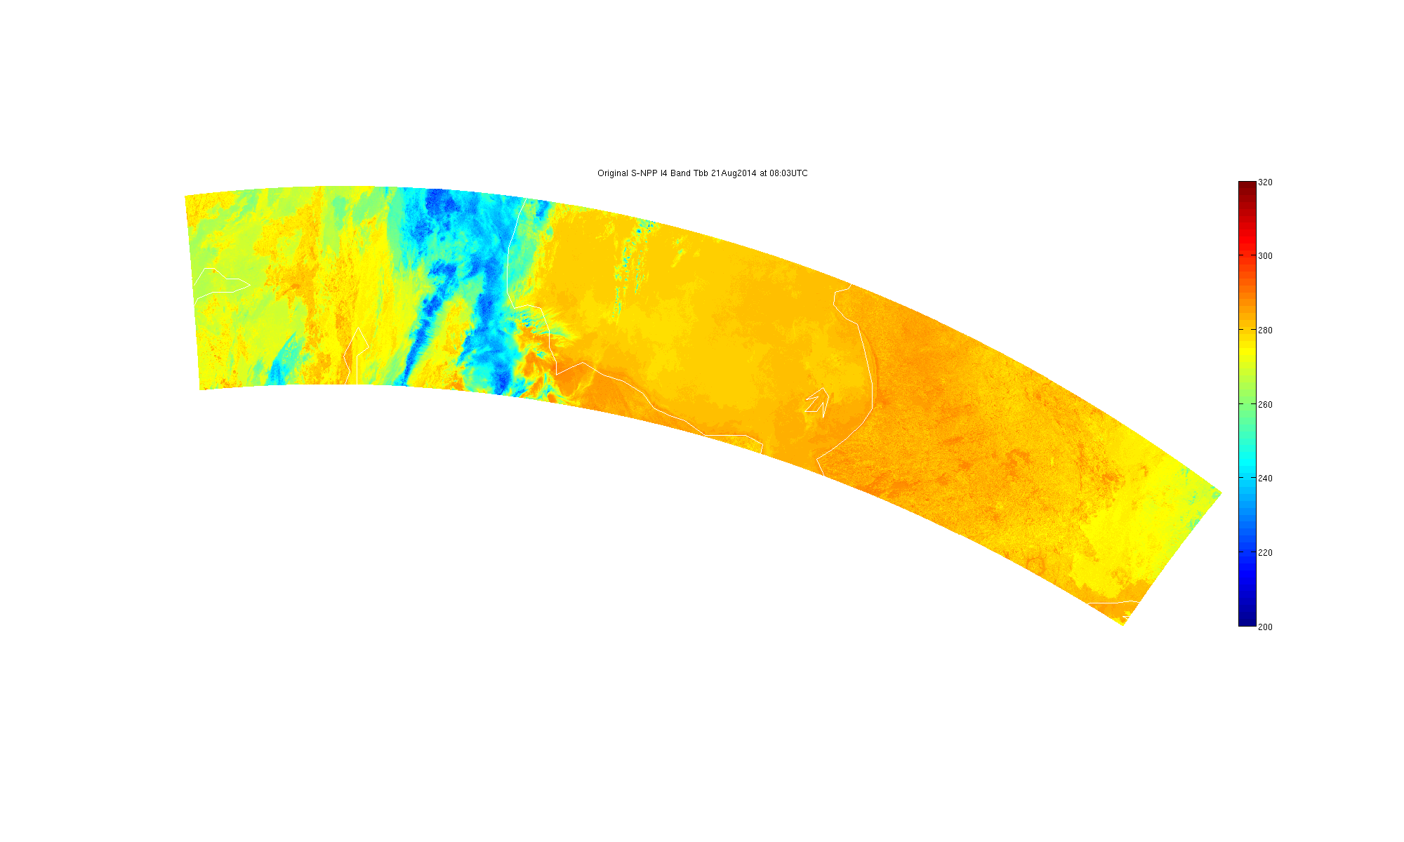
Original I4 Band Brightness Temperature
21 Aug 2014 08:03UTC
Hudson Bay (coastline drawn by Matlab is poor resolution; east coastline evident).
I4 is the 3.7um band, high spatial resolution

Slide 12

Altered I4 Band Brightness Temperature
21 Aug 2014 08:03UTC
Hudson Bay (coastline drawn by Matlab is poor resolution; east coastline evident).
I4 is the 3.7um band, high spatial resolution
Alteration was the application of BBR simulation described earlier. BBR=0.66

Slide 13
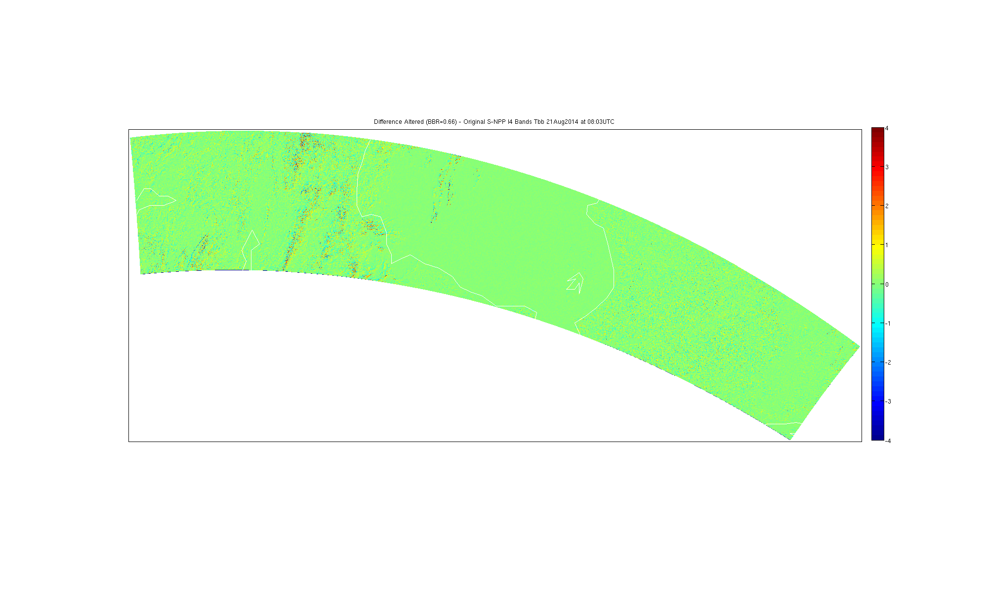
Altered-Original I4 Band Brightness Temp Diff
21 Aug 2014 08:03UTC
Hudson Bay (coastline drawn by Matlab is poor resolution; east coastline less evident).
I4 is the 3.7um band, high spatial resolution
Alteration was the application of BBR simulation described earlier. BBR=0.66

Slide 14
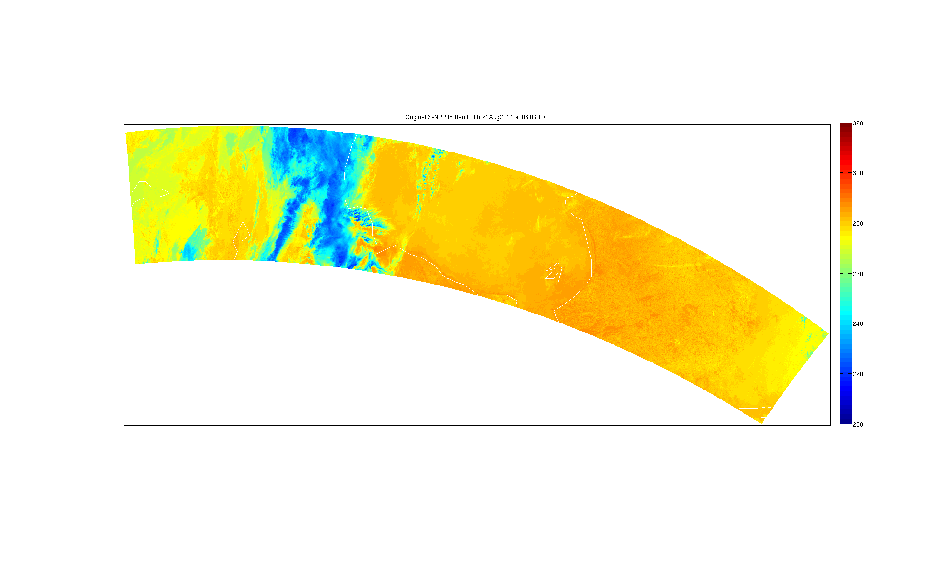
Original I5 Band Brightness Temperature
21 Aug 2014 08:03UTC
Hudson Bay (coastline drawn by Matlab is poor resolution; east coastline evident).
I5 is the 11um band, high spatial resolution “IR Window”

Slide 15
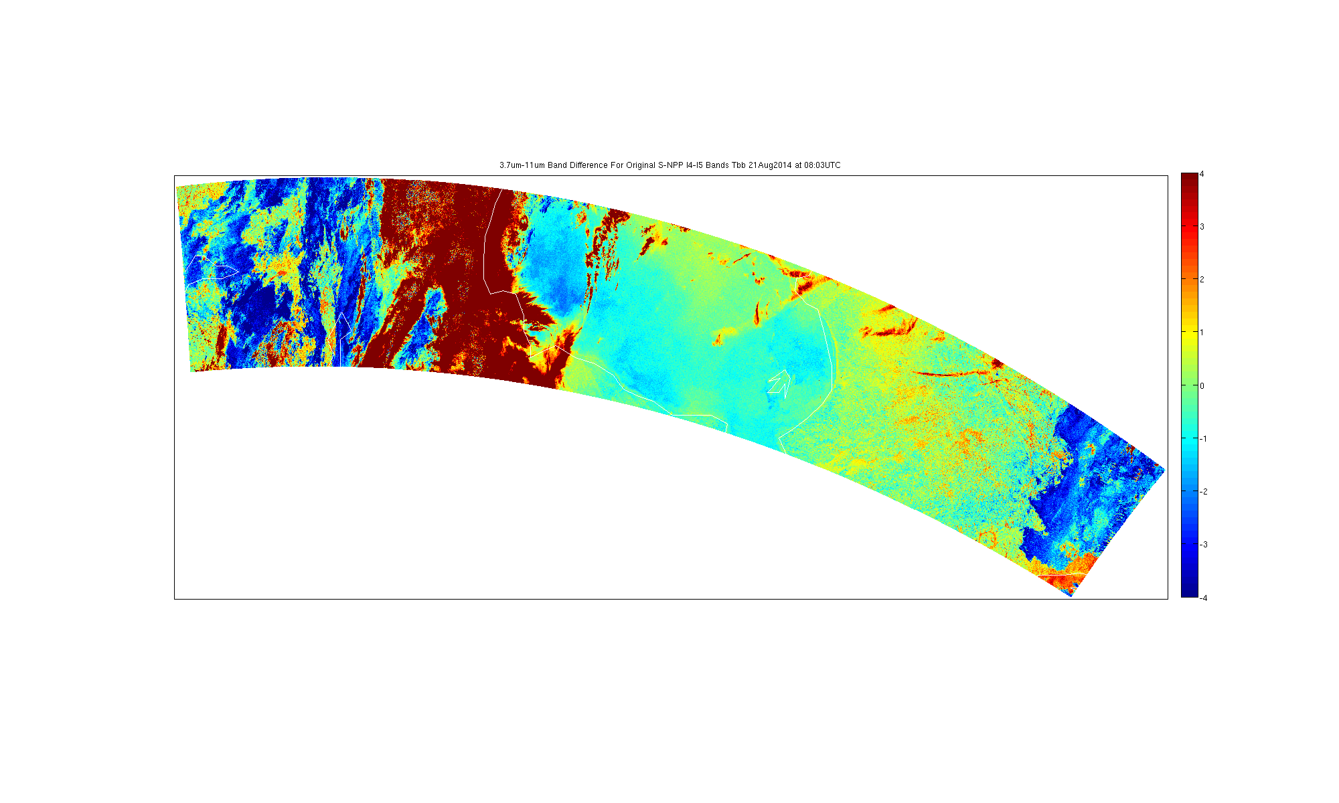
Original I4 – I5 Band Brightness Temp Diff
21 Aug 2014 08:03UTC
Hudson Bay (coastline drawn by Matlab is poor resolution; east coastline evident).
This is 3.7-11um band difference; can be used to detect fog (not an official product).

Slide 16

Altered I4 – I5 Band Brightness Temp Diff
21 Aug 2014 08:03UTC
Hudson Bay (coastline drawn by Matlab is poor resolution; east coastline evident).
This is 3.7-11um band difference; can be used to detect fog (not an official product).
I5 in this case is not altered, only I4 is altered with BBR=0.66

Slide 17
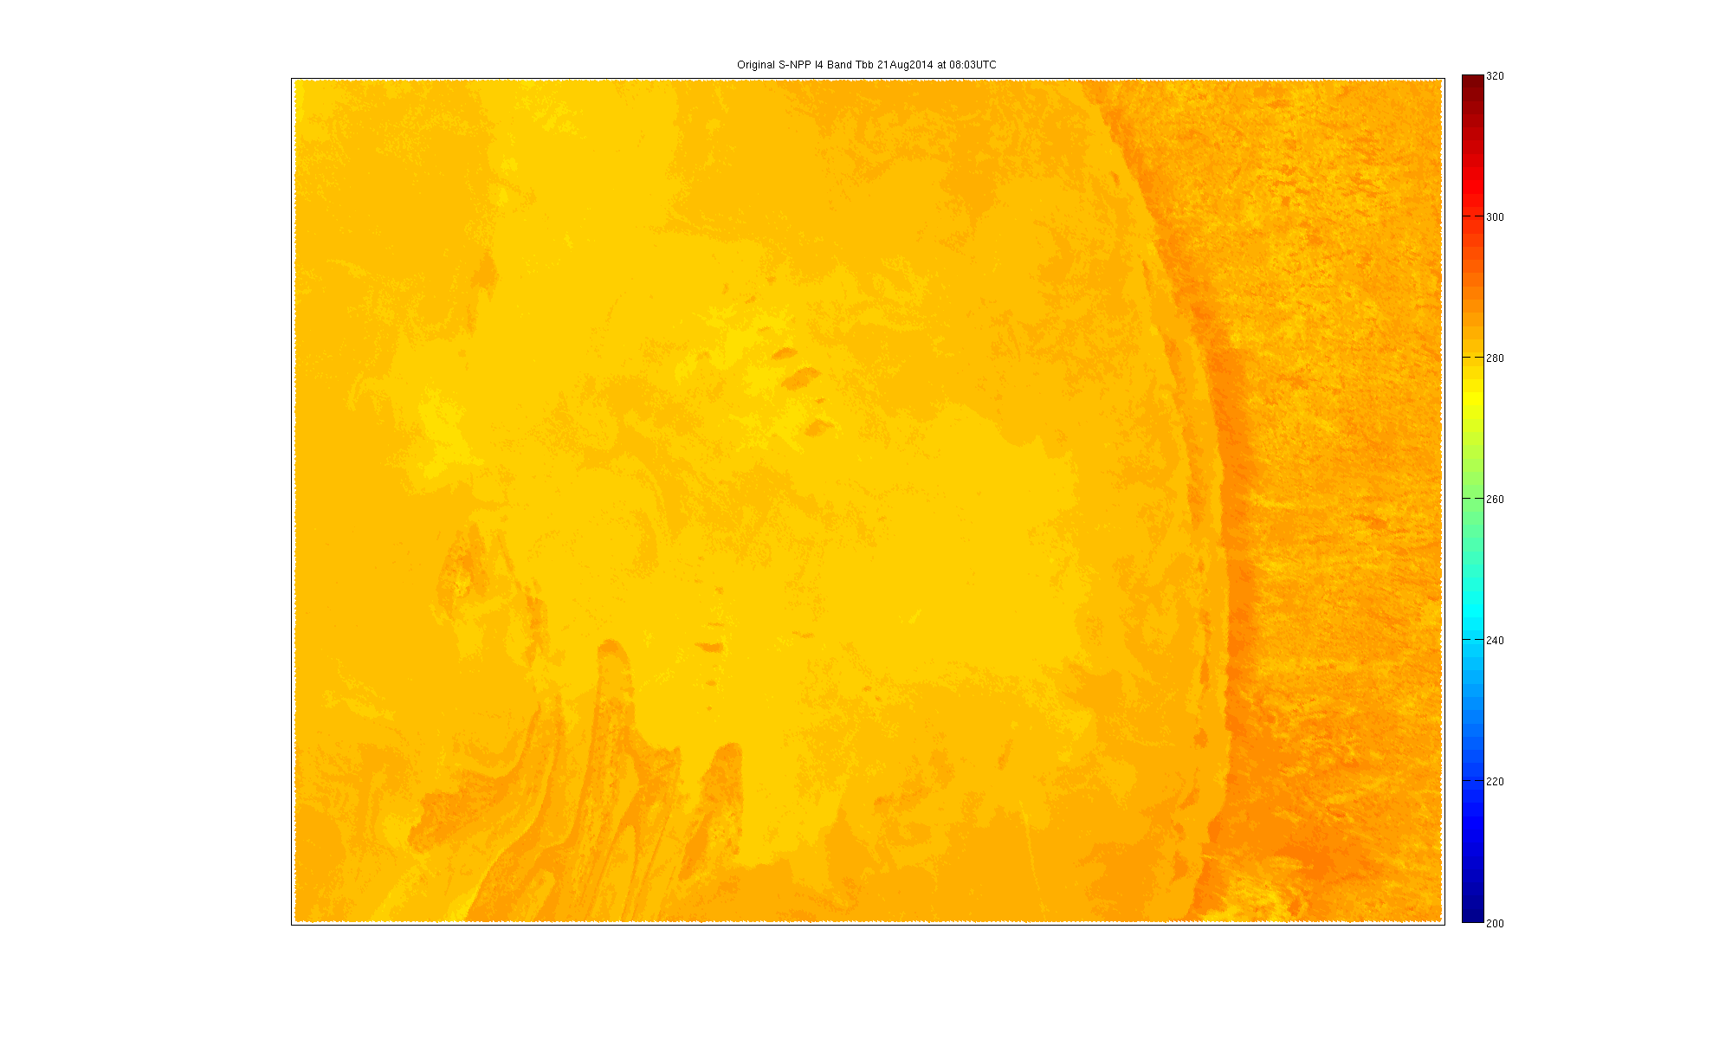
Original I4 Band Brightness Temperature
21 Aug 2014 08:03UTC
Zoomed in on Hudson Bay; east coastline evident.

Slide 18

Altered I4 Band Brightness Temperature
21 Aug 2014 08:03UTC
Zoomed in on Hudson Bay; east coastline evident.
I4 altered with BBR=0.66

Slide 19
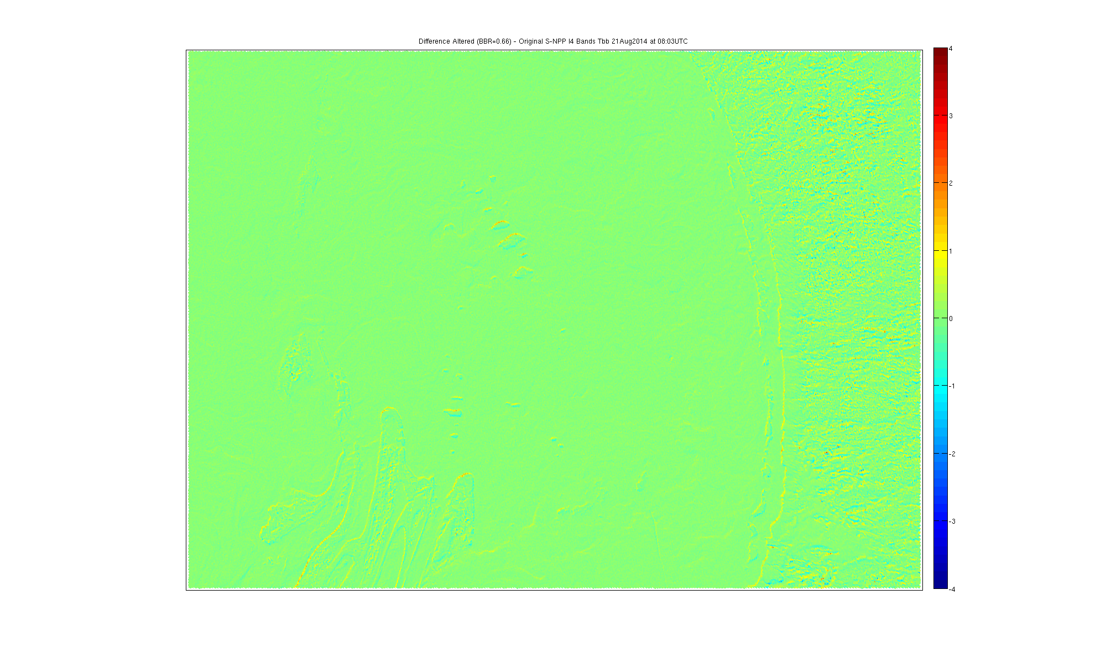
Altered-Original I4 Band Brightness Temp Diff
21 Aug 2014 08:03UTC
Zoomed in on Hudson Bay; east coastline evident.
I4 altered with BBR=0.66

Slide 20
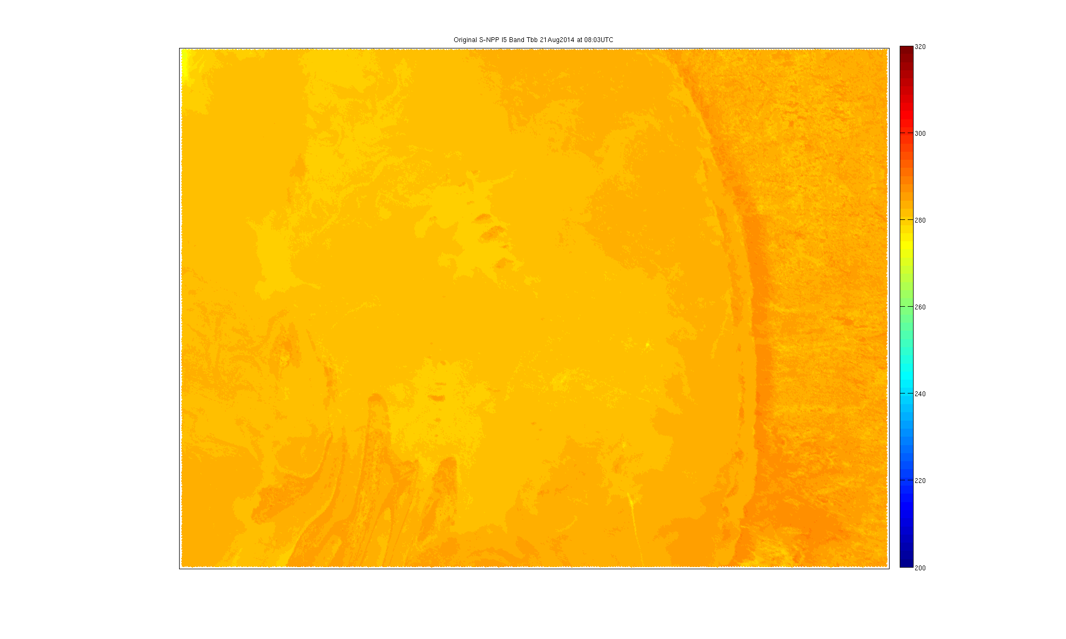
Original I5 Band Brightness Temperature
21 Aug 2014 08:03UTC
Zoomed in on Hudson Bay; east coastline evident.

Slide 21
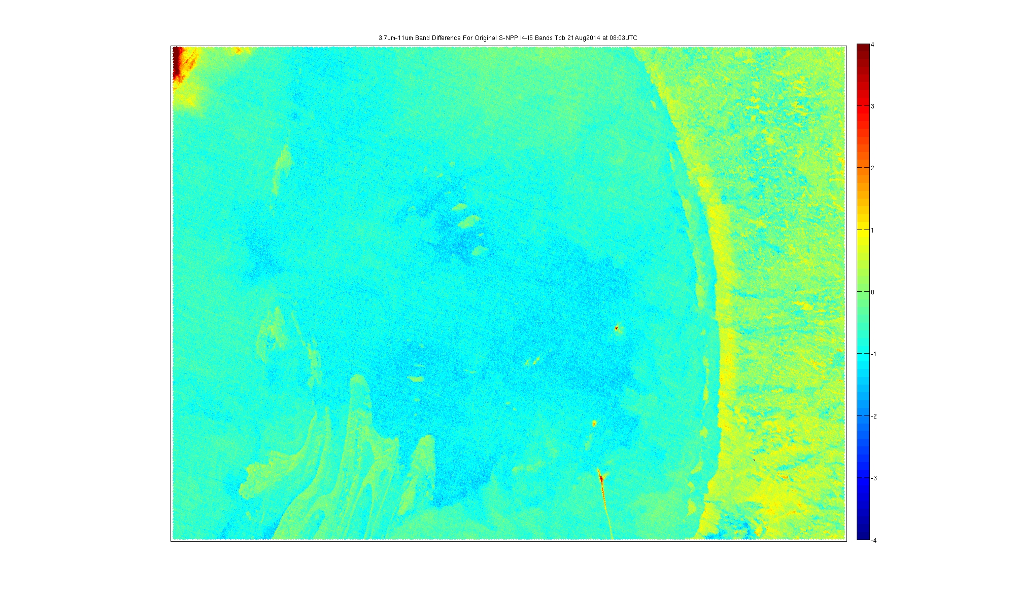
Original I4 – I5 Band Brightness Temp Diff
21 Aug 2014 08:03UTC
Zoomed in on Hudson Bay; east coastline evident.
3.7-11um Band Difference could be used to detect Fog; differences around 1K along coastline.

Slide 22

Altered I4 – I5 Band Brightness Temp Diff
21 Aug 2014 08:03UTC
Zoomed in on Hudson Bay; east coastline evident. I4 altered with BBR=0.66, I5 is unaltered.
3.7-11um Band Difference could be used to detect Fog; with differences around 1K along coastline this is not worrisome for false detection of fog in this case.

Slide 23
CLAVR-x Results
http://www.ssec.wisc.edu/grafiir/JAFIIR/CLAVRx_VIIRS_BBR/
  No quantitative effect on these products
  Not surprising result to cloud team.

Slide 24
VIIRS Cloud Mask
http://www.ssec.wisc.edu/grafiir/JAFIIR/VIIRS_BBR/
  Minor effects for AllQuality and HighQuality Cloud Masks. Fewer than 1% of the pixels are affected
  Not surprising result to cloud team

Slide 25
Active Fires: The Waiver Case
California Rim Fire
August 22, 2013 at 10:08UTC
Applied the BBR simulation to the I-5 (3.7um) Band of 0.66 (BBR overlap between I4 and I5)

Slide 26
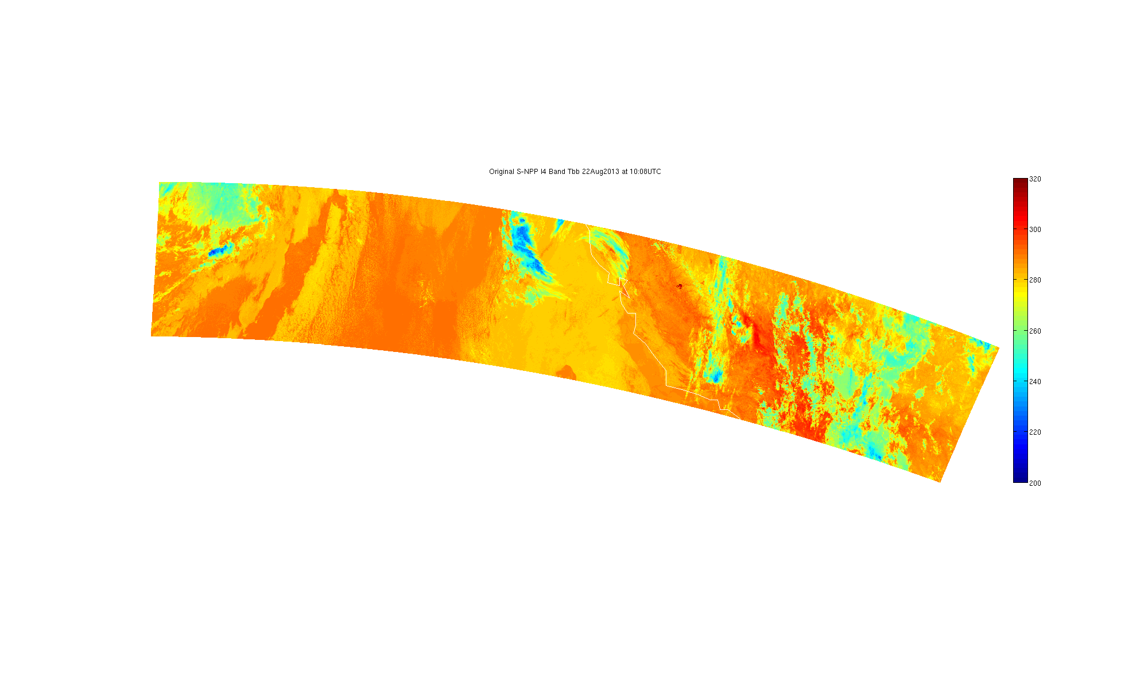
Original I4 Band Brightness Temperature
22 Aug 2013 10:08UTC
California Rim Fire highlighted by box.
I4 is the 3.7um band, high spatial resolution and sensitive to fires/hotspots

Slide 27
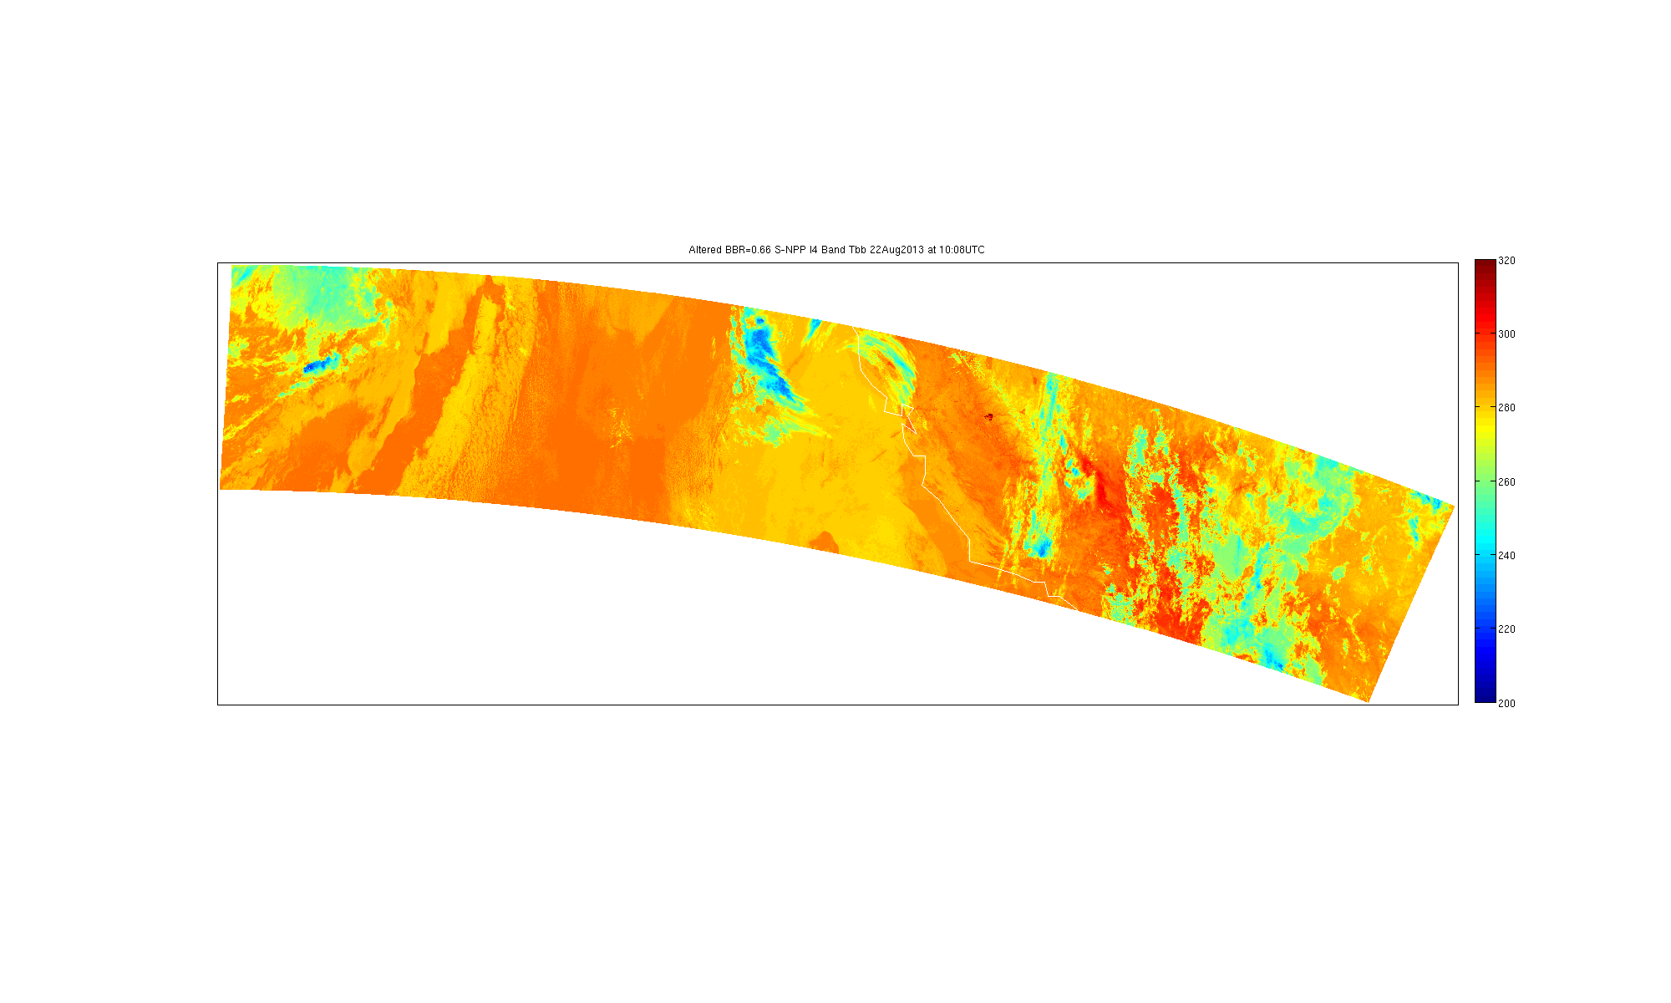
Altered I4 Band Brightness Temperature
22 Aug 2013 10:08UTC
California Rim Fire highlighted by box.
I4 is the 3.7um band, high spatial resolution and sensitive to fires/hotspots
Alteration was the application of BBR simulation described earlier. BBR=0.66

Slide 28
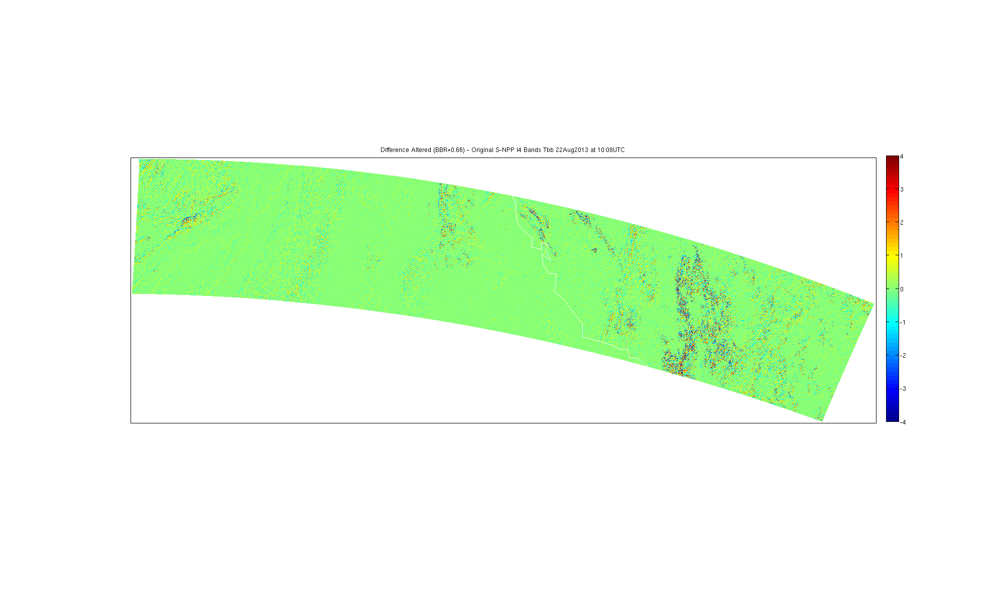
Altered-Original I4 Band Brightness Temp Diff
22 Aug 2013 10:08UTC
California Rim Fire highlighted by box.
I4 is the 3.7um band, high spatial resolution and sensitive to fires/hotspots
The difference between the altered data and the original is easy to spot.
Actual differences between -11 and 26K.

Slide 29
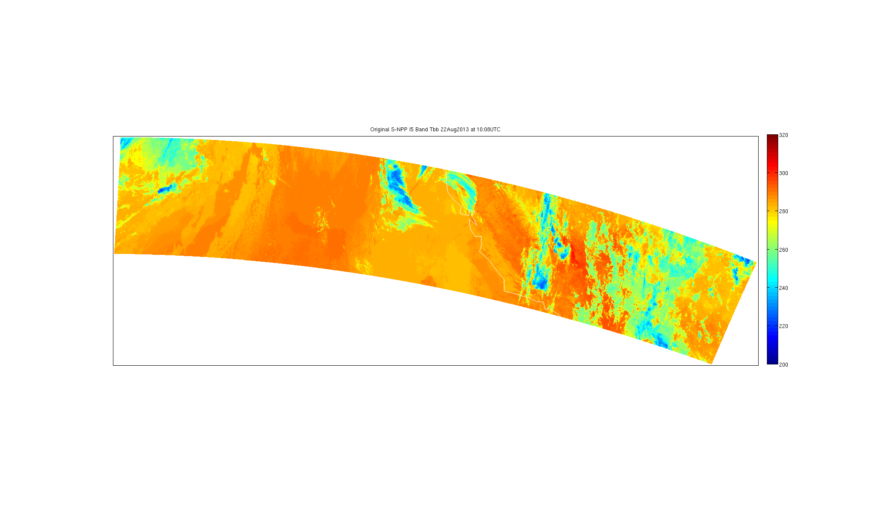
Original I5 Band Brightness Temperature
22 Aug 2013 10:08UTC
California Rim Fire highlighted by box.
I5 is the 11um band, high spatial resolution “IR Window”

Slide 30

Altered I5 Band Brightness Temperature
22 Aug 2013 10:08UTC
California Rim Fire highlighted by box.
I5 is the 11um band, high spatial resolution “IR Window”
Alteration was the application of BBR simulation described earlier. BBR=0.66

Slide 31
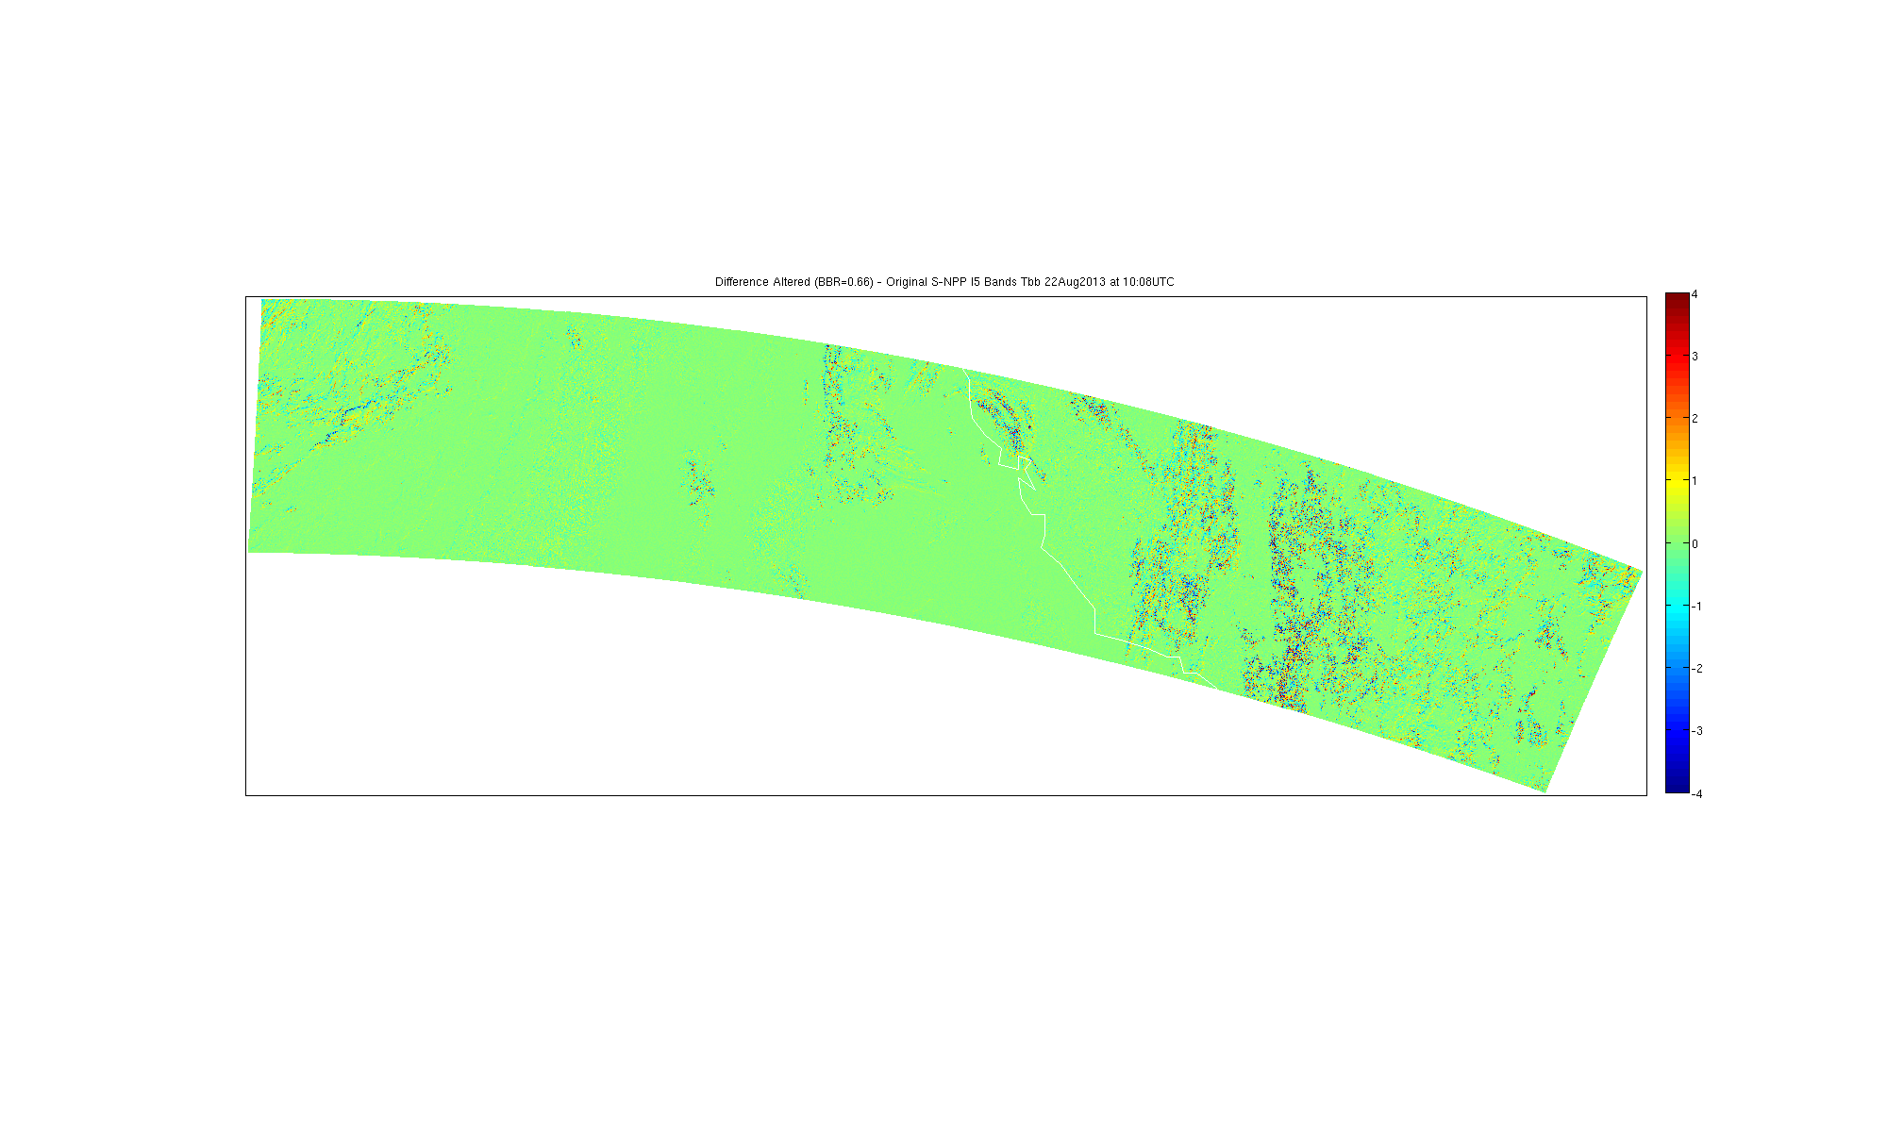
Altered-Original I5 Band Brightness Temp Diff
22 Aug 2013 10:08UTC
California Rim Fire highlighted by box.
I5 is the 11um band, high spatial resolution “IR Window”
The difference between the altered data and the original is less obvious in this band.
Actual differences between -10 and 10K.

Slide 32
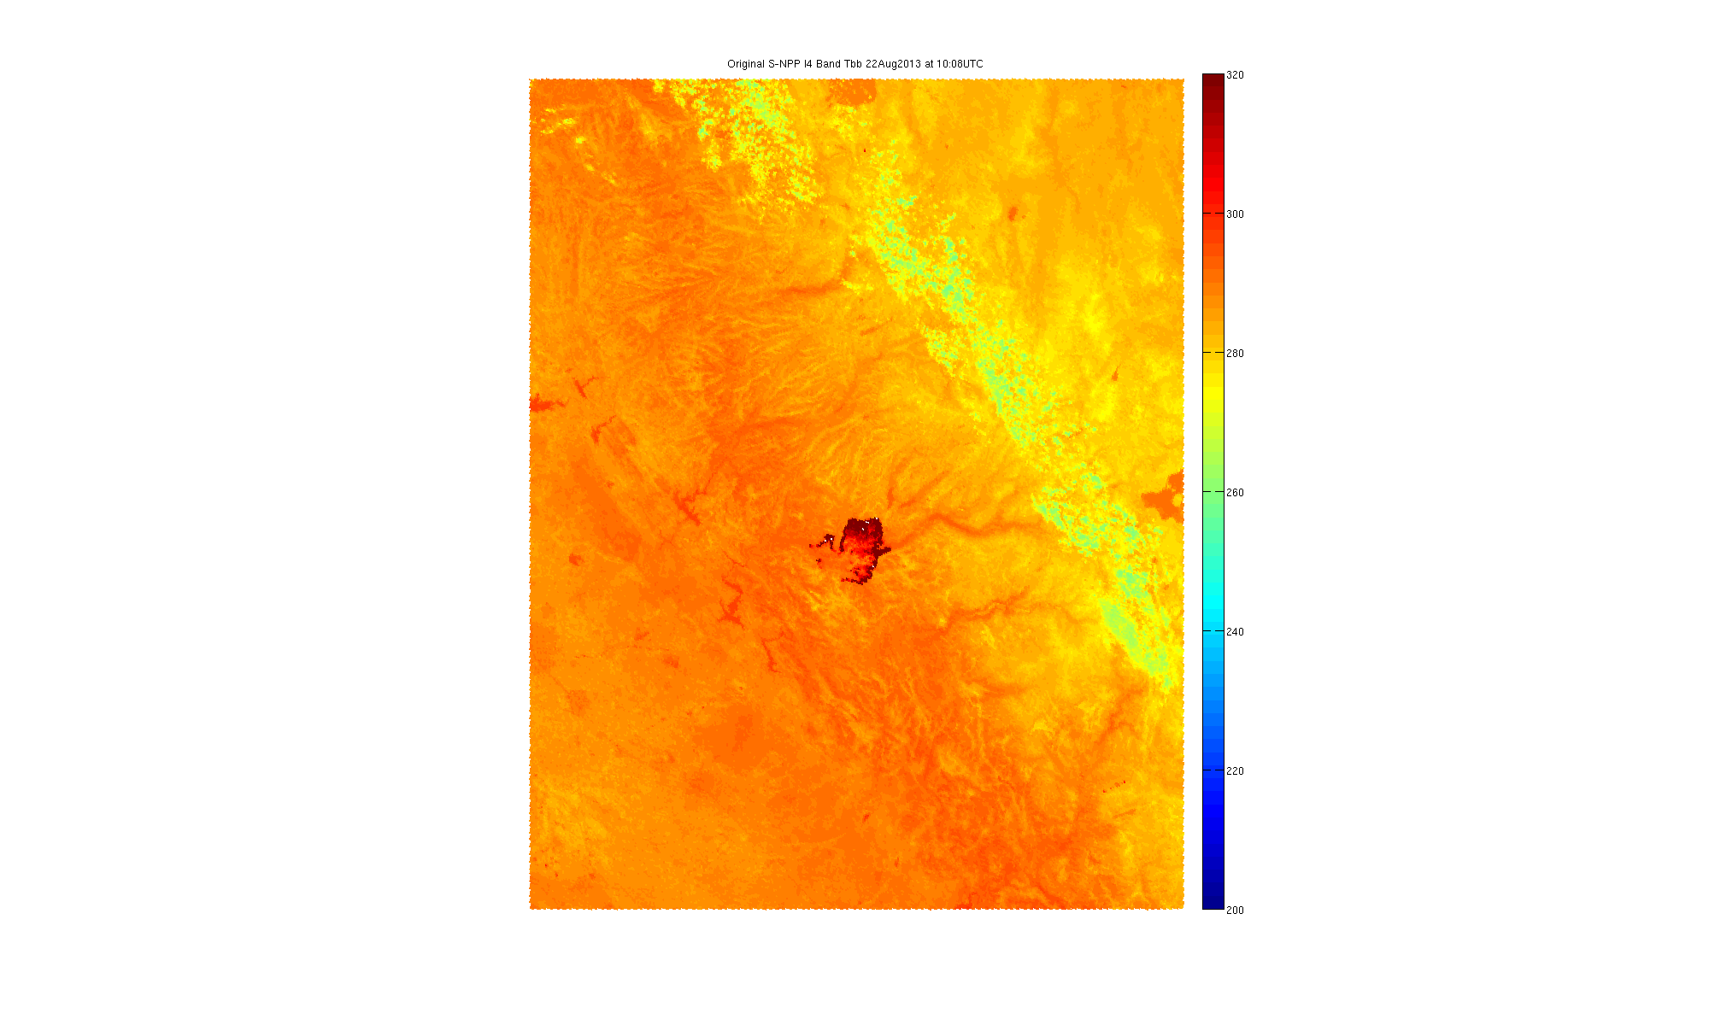
Original I4 Band Brightness Temperature
22 Aug 2013 10:08UTC

Slide 33

Altered I4 Band Brightness Temperature
22 Aug 2013 10:08UTC
Note the “shifting” of the fire to the northwest caused by application of BBR effect.

Slide 34
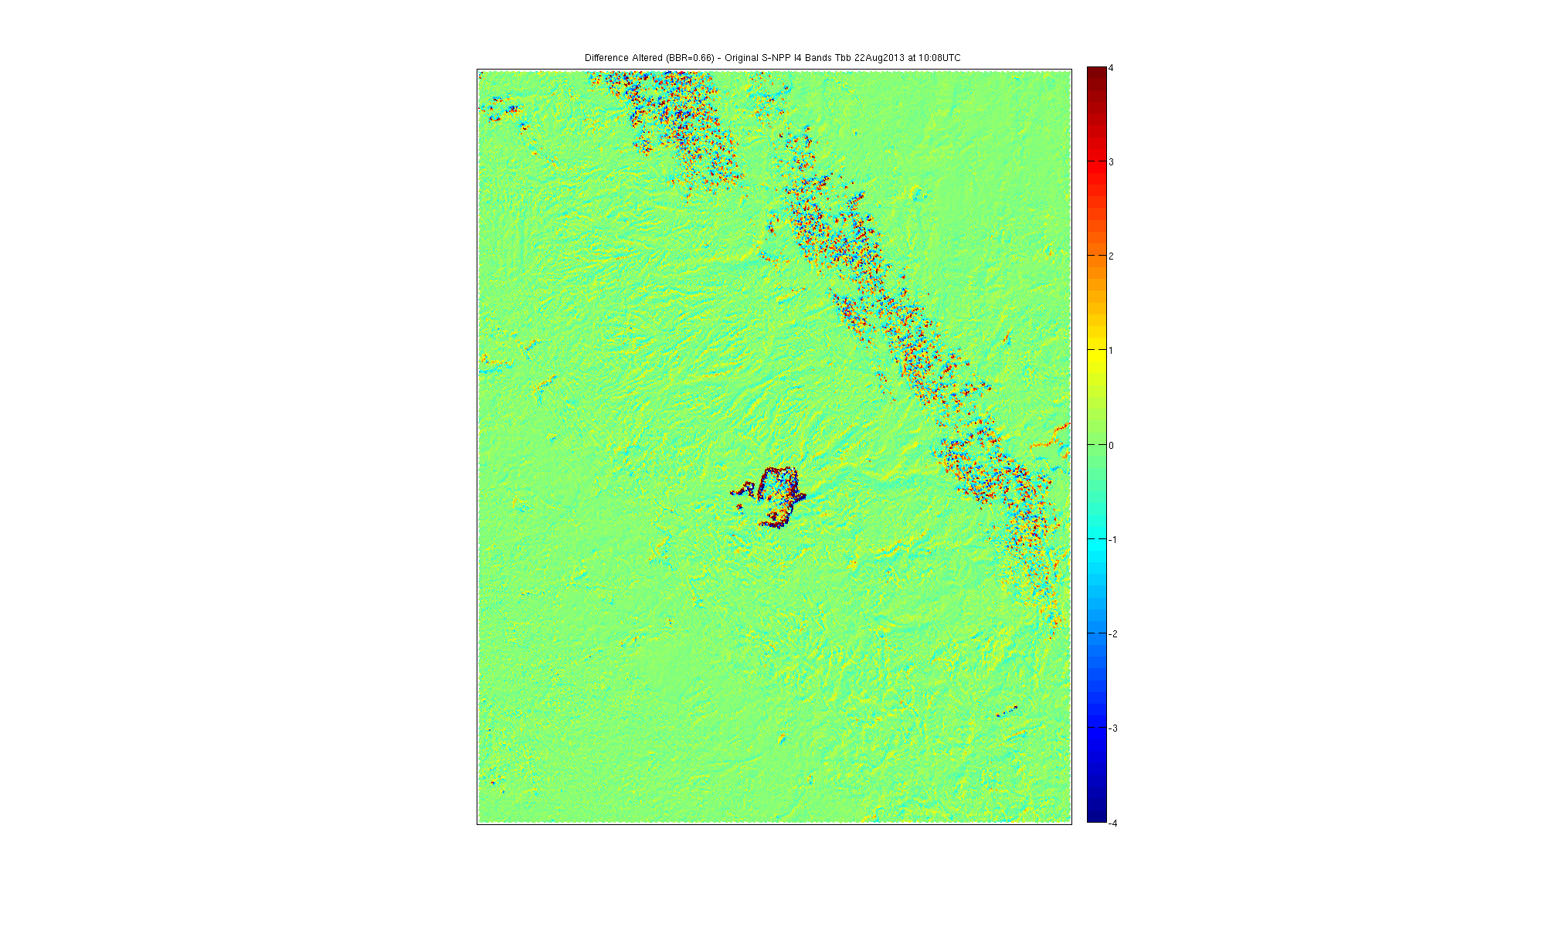
Altered-Original I4 Band Brightness Temp Diff
22 Aug 2013 10:08UTC
Actual differences between -11 and 26K.

Slide 35
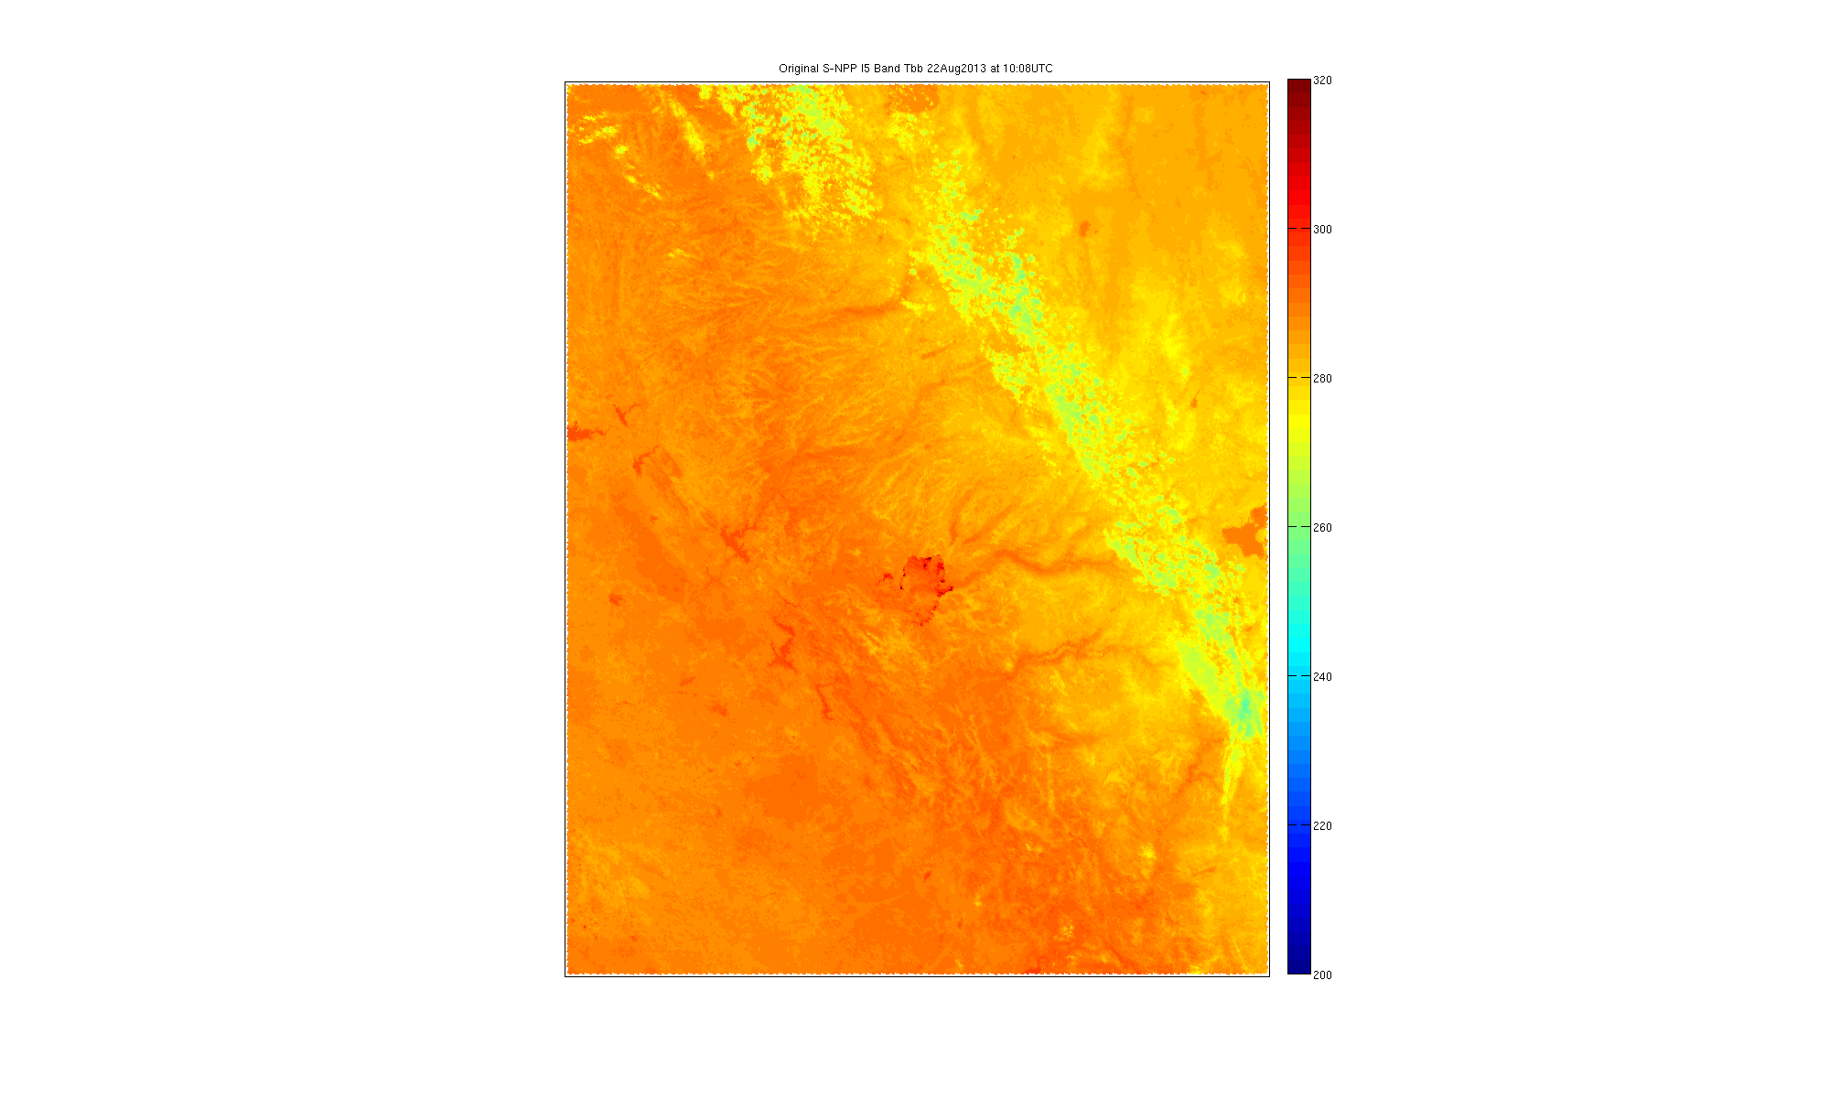
Original I5 Band Brightness Temperature
22 Aug 2013 10:08UTC

Slide 36

Altered I5 Band Brightness Temperature
22 Aug 2013 10:08UTC

Slide 37
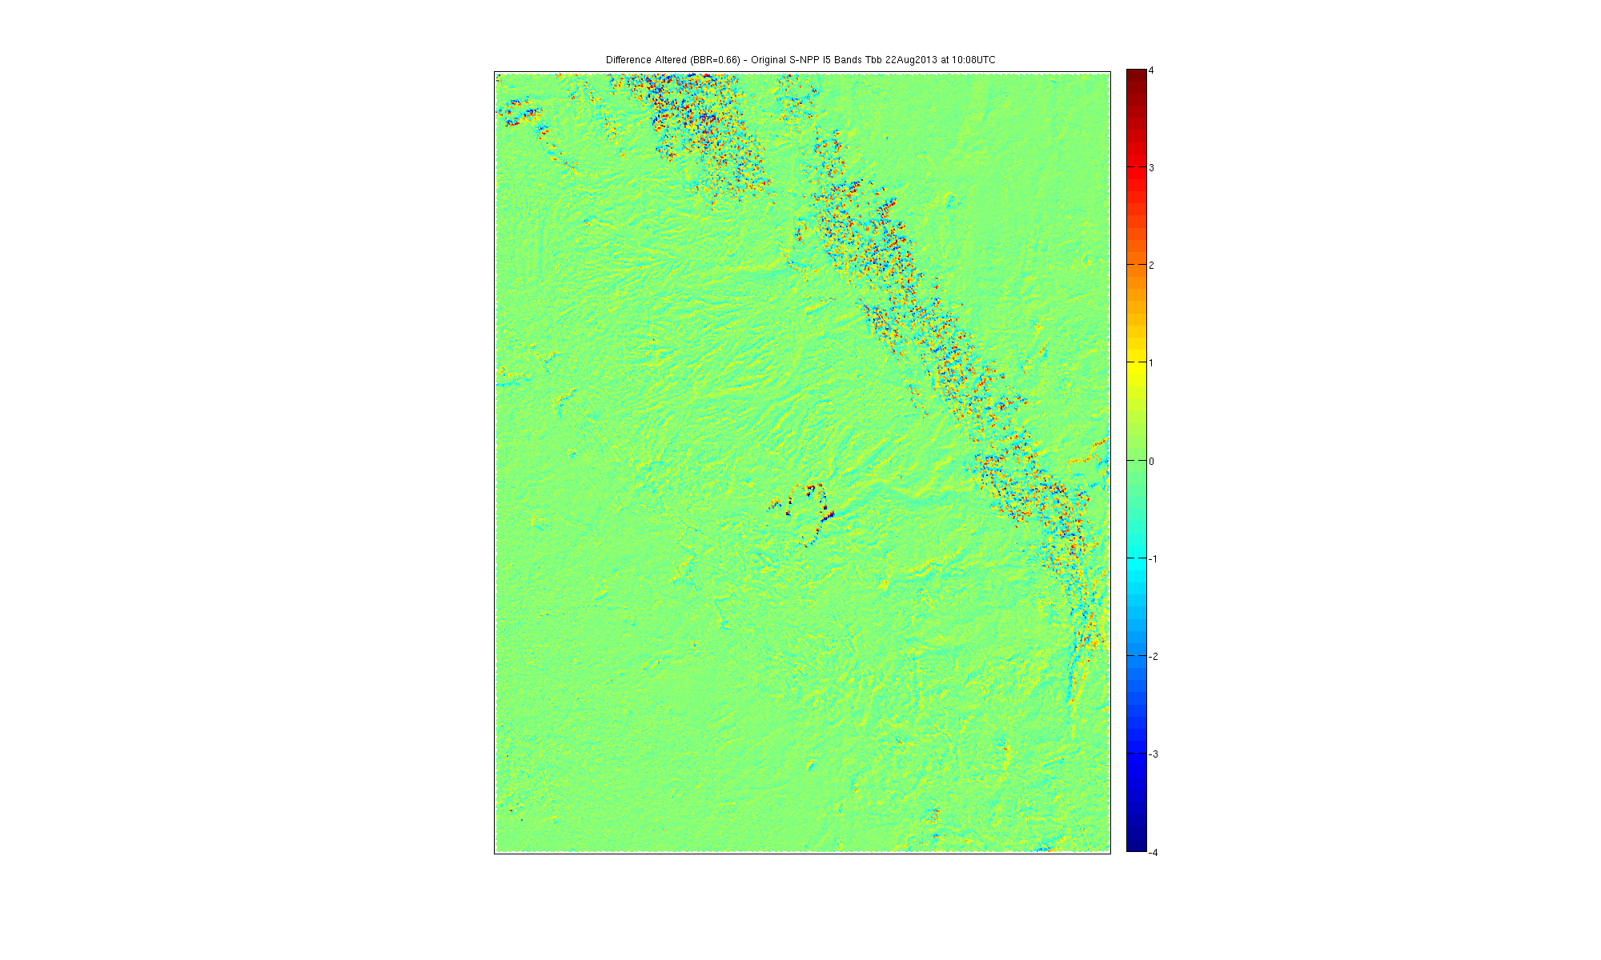
Altered-Original I5 Band Brightness Temp Diff
22 Aug 2013 10:08UTC

Slide 38
Fire Team Analysis…

Slide 39
Active Fires: The Waiver Case
Fires in Canada
December 17, 2014 at 09:33UTC
Applied the BBR simulation to the I-5 (3.7um) Band of 0.66 (BBR overlap between I4 and I5)

Slide 40
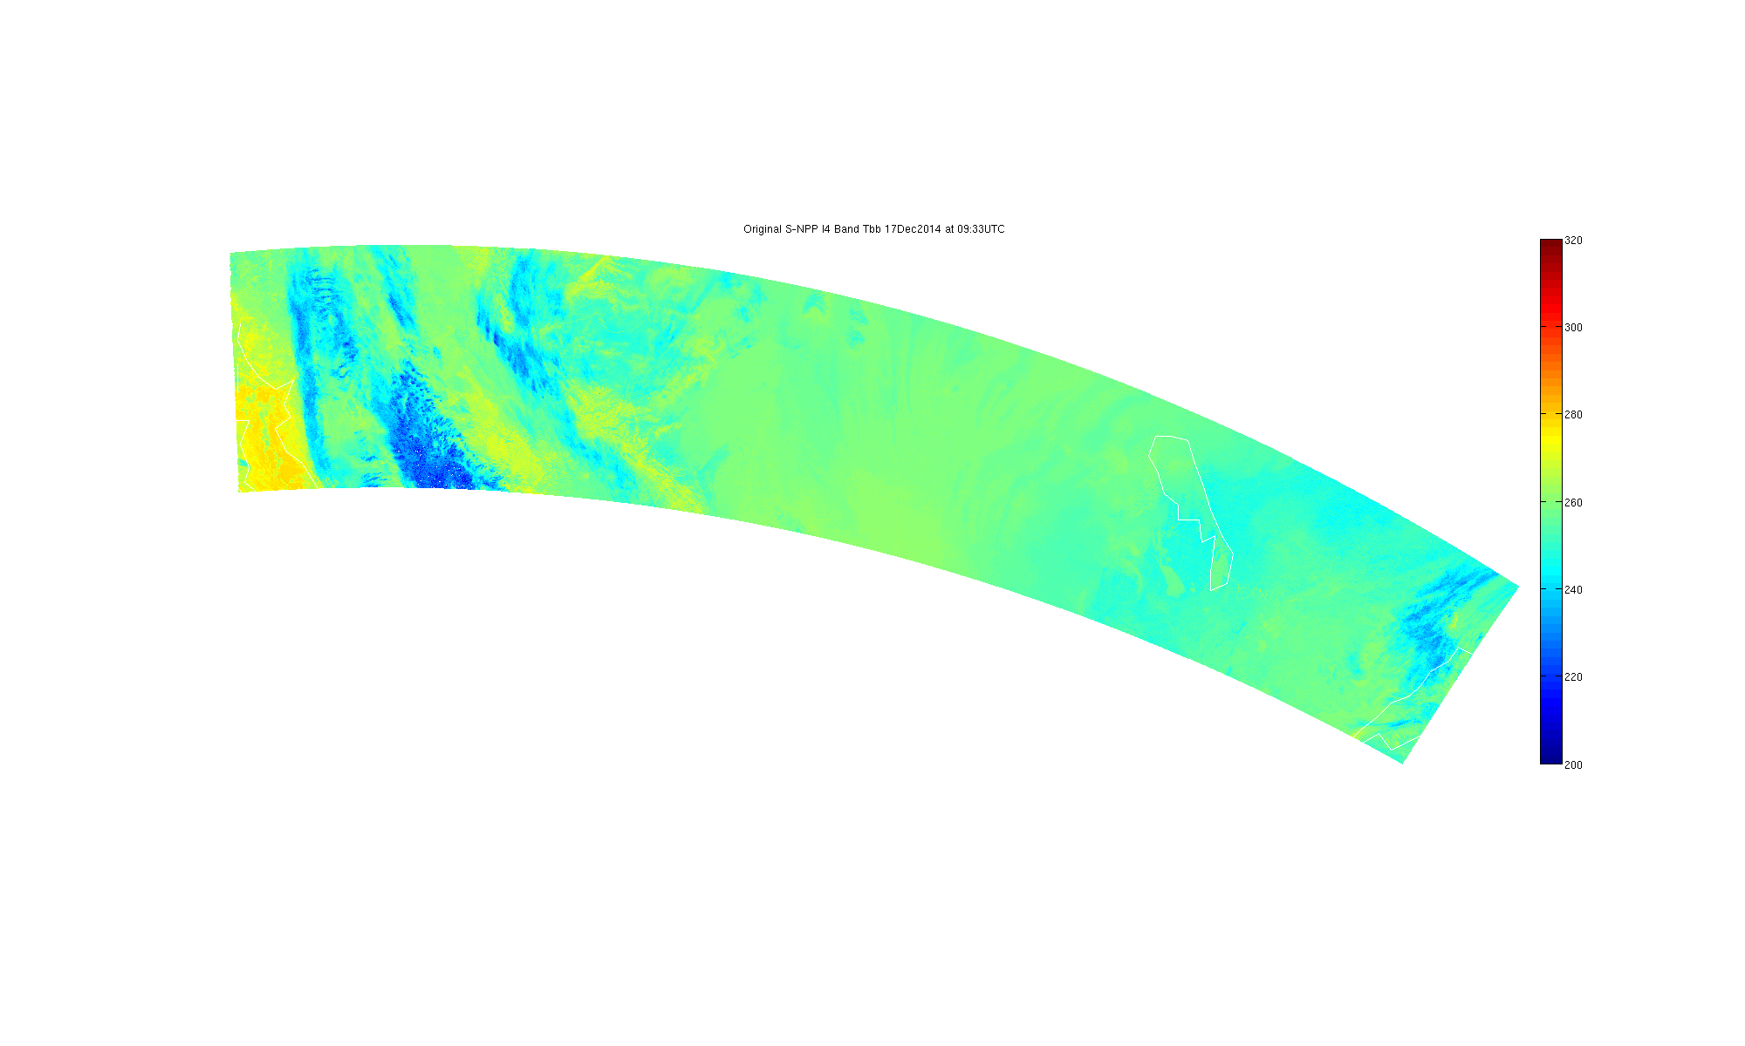
Original I4 Band Brightness Temperature
17 Dec 2014 09:33UTC
Fires are too small to see in this image.
I4 is the 3.7um band, high spatial resolution and sensitive to fires/hotspots

Slide 41
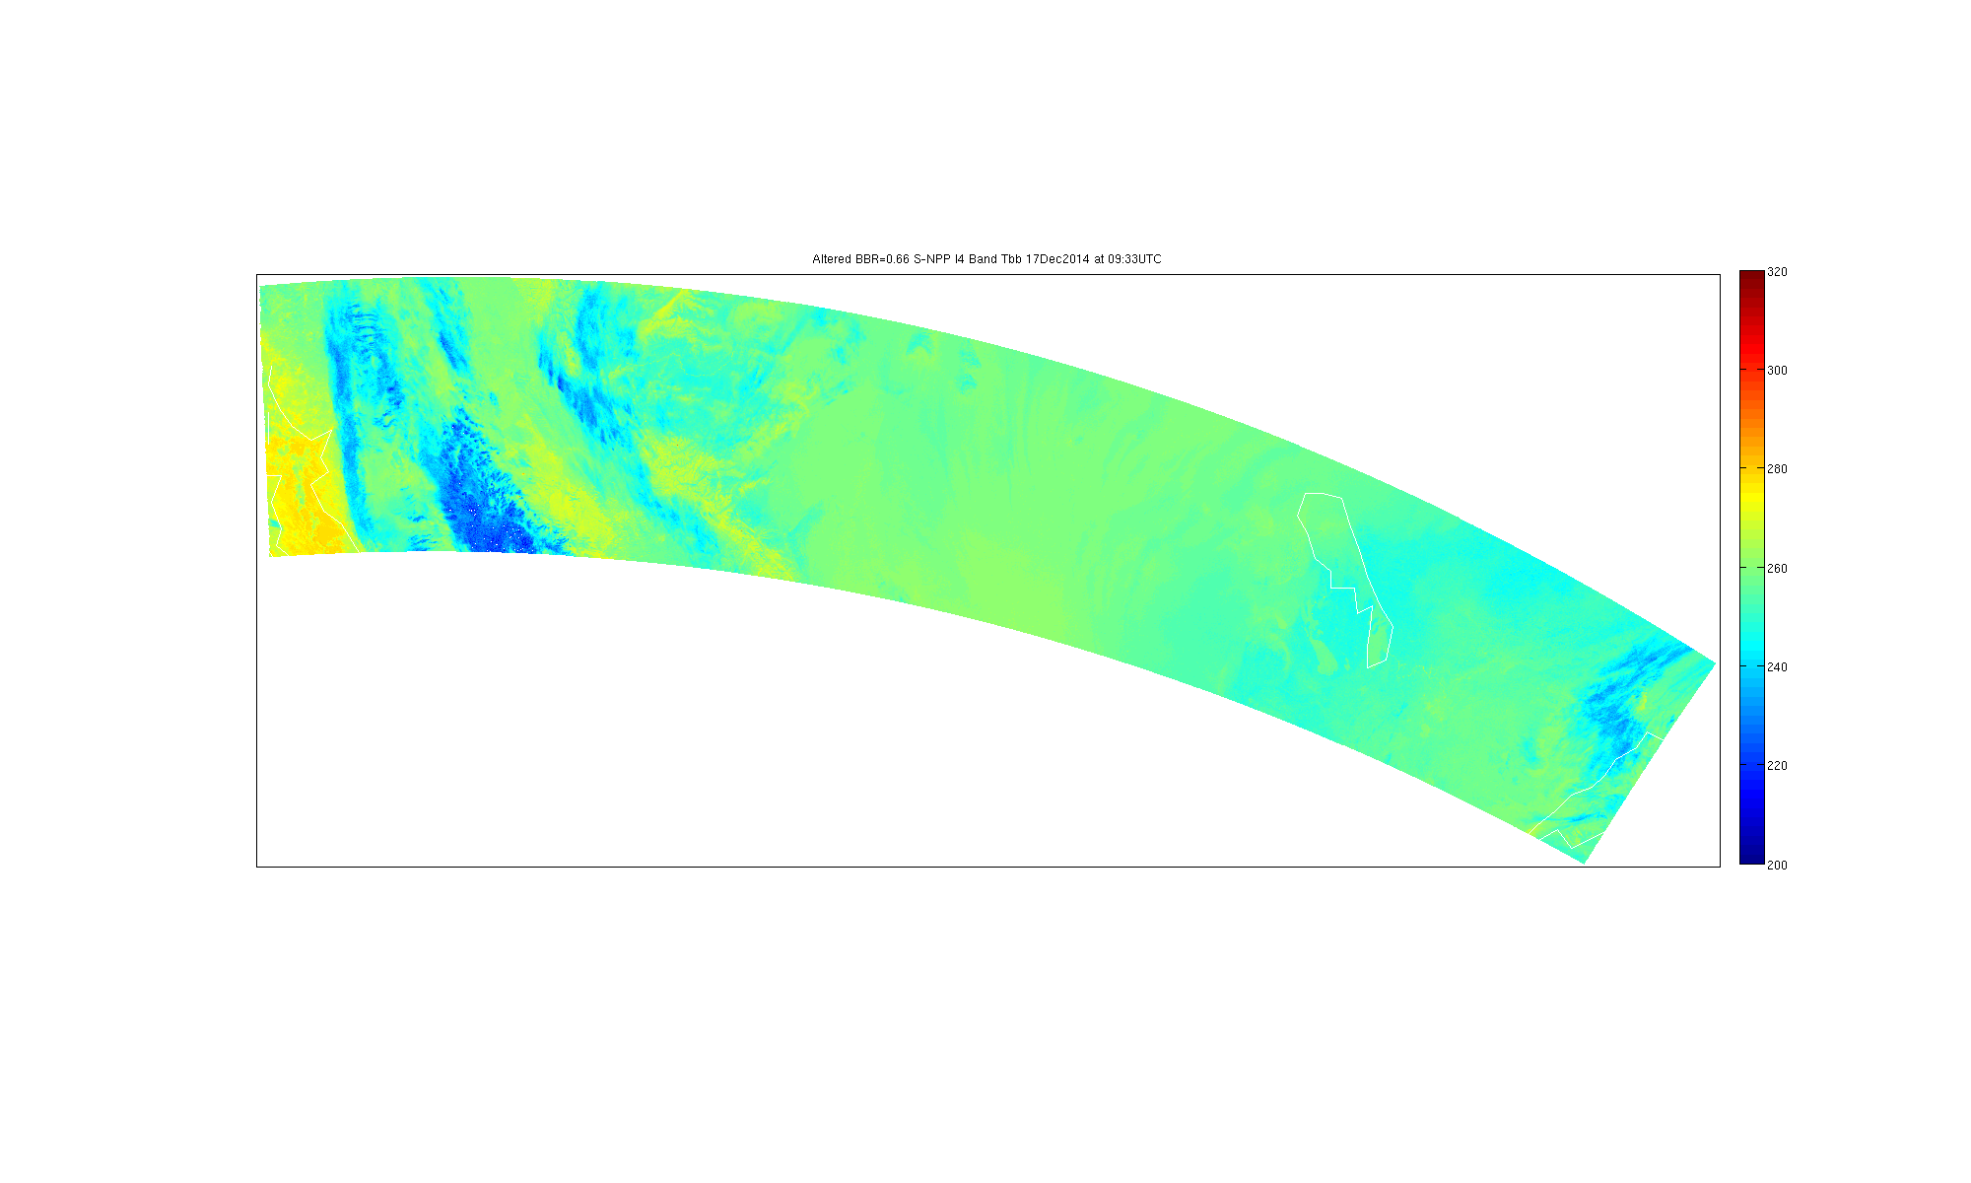
Altered I4 Band Brightness Temperature
17 Dec 2014 09:33UTC
Fires are too small to see in this image.
I4 is the 3.7um band, high spatial resolution and sensitive to fires/hotspots
Alteration was the application of BBR simulation described earlier. BBR=0.66

Slide 42
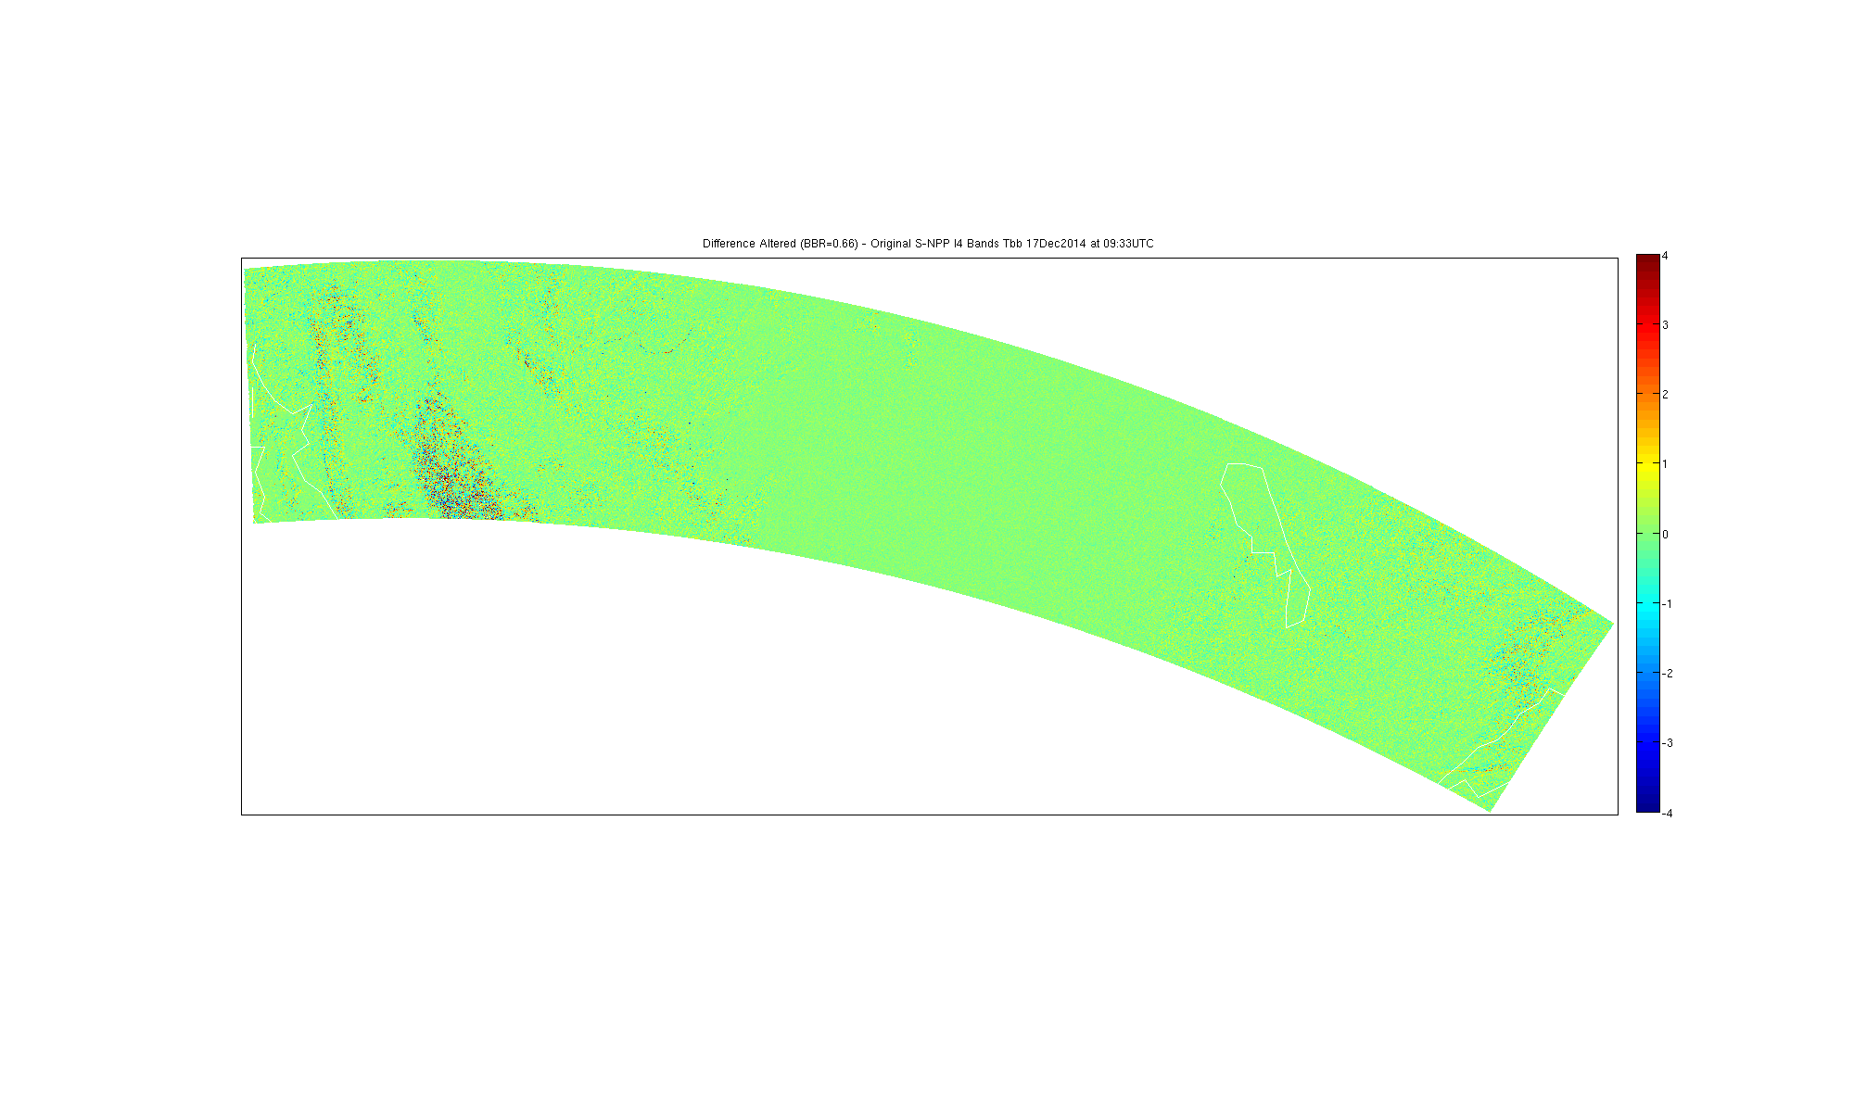
Altered-Original I4 Band Brightness Temp Diff
17 Dec 2014 09:33UTC
Fires are too small to see in this image.
I4 is the 3.7um band, high spatial resolution and sensitive to fires/hotspots
Actual differences between -11 and 30K.

Slide 43
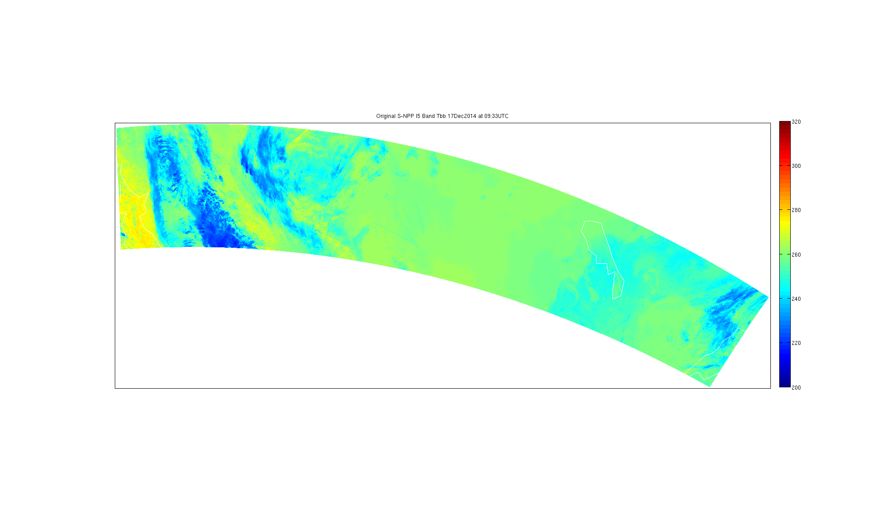
Original I5 Band Brightness Temperature
17 Dec 2014 09:33UTC
I5 is the 11um band, high spatial resolution “IR Window”

Slide 44
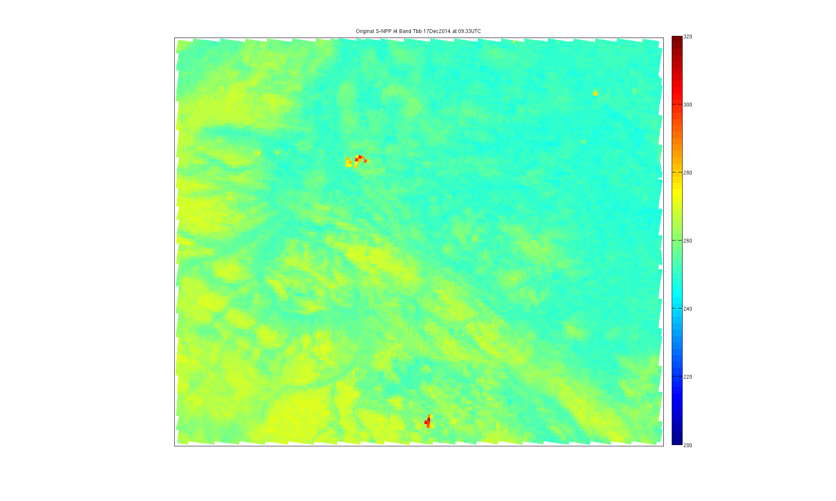
Original I4 Band Brightness Temperature
17 Dec 2014 09:33UTC
Fires are apparent in this magnified image.
I4 is the 3.7um band, high spatial resolution and sensitive to fires/hotspots

Slide 45

Altered I4 Band Brightness Temperature
17 Dec 2014 09:33UTC
Fires are apparent in this magnified image. Note shifting of fire pixels from original.
I4 is the 3.7um band, high spatial resolution and sensitive to fires/hotspots
Alteration was the application of BBR simulation described earlier. BBR=0.66

Slide 46
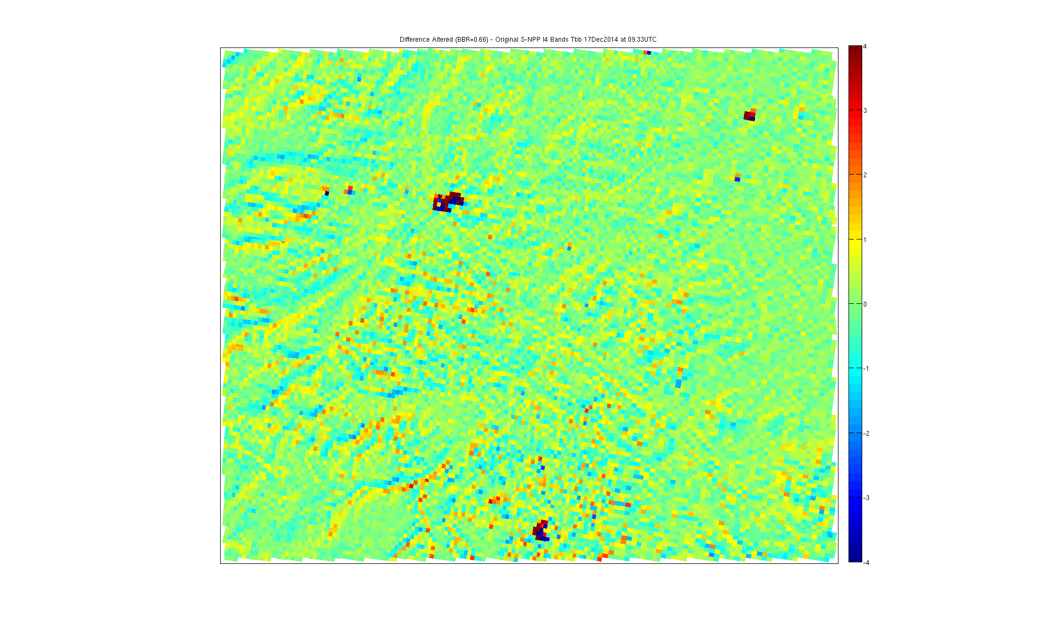
Altered-Original I4 Band Brightness Temp Diff
17 Dec 2014 09:33UTC
There are large brightness temperature differences in the hot pixels.
I4 is the 3.7um band, high spatial resolution and sensitive to fires/hotspots
Actual differences between -11K and +30K.

Slide 47
Fire Team Analysis…

Slide 48
Mitigation Strategy
Based on information shared at Waiver Working Group telecons, there was a mitigation strategy prepared for S-NPP VIIRS registration errors which was never implemented because the error did not seem to be impacting products.
  This mitigation strategy sounded similar to one used on current GOES involving spatial interpolation of one or more of the bands to match the navigation of another band.
Spatially interpolating the 3.7 or 3.9um bands should be avoided. Spatially interpolating these data will significantly impact the Active Fire product, and will likely have a more negative impact on fire detection than the BBR error itself.
  In the case of GOES, even though the 3.9um band was the band with the error, the 11um band is being spatially interpolated to better match the 3.9um, leaving the 3.9um radiances alone and preserving the integrity of the data for use in the fire product.
Since the mitigation strategy for S-NPP was not deemed necessary we do not anticipate it being necessary for J1.

Slide 49
Final Observations/Thoughts
Does not appear that I-Bands are used quantitatively in cloud products, only used in a minor way.
The errors in the M-bands are so small as to be either in compliance or close enough to compliance to not be worth simulating.
JAFIIR Team relied on help from Fire Team for Active Fires output.
If necessary to implement a BBR correction on ground, it is important that any spatial interpolation that occurs does not occur with the fire sensitive bands (M13, I4).
  Spatial interpolation of the shortwave window data will adversely affect the Active Fire product.
  In the California Rim Fire I4 temperatures were altered by over 20K by spatial interpolation.
We do not see a need to implement a BBR correction at this time.

