Slide 1
Backscatter in GOES-13
Mat Gunshor, Jim Nelson (CIMSS/UW-Madison)
Tim Schmit (NOAA/NESDIS/STAR)

Slide 2
Background
GOES-16 ABI imagery has show some sort of backscatter phenomenon that can be seen moving quickly across successive CONUS and FD images (some of the VIS/NIR bands and shortwave window band 7).
This appears to be caused when the satellite happens to be in the direct line between the sun and the part of the earth ABI is scanning. Due to earth/sun/satellite geometry, this will only occur for a limited number of days in fall and spring.

Slide 3
GOES-16 CONUS, October 7, 2017 17:37 UTC
Time difference images show the solar backscattering effect as it moves across CONUS. The blue/orange couplet is a negative/positive difference couplet indicating bright (VIS/NIR) or warm (IR) moved across the images used in the difference.

Slide 4
Background
The question was raised if this was seen with the previous GOES series of imagers and was just not widely reported.
GOES-13 data from October 2006, when GOES-13 was at the checkout location of 89.5 West (GOES-16 was at 89.3 West during October 2017)
The answer appears to be “yes” – a similar feature is noticeable in GOES-13 on October 7, 2006 but mostly only in time difference images.
Because GOES-13 Imager takes images far less frequently than ABI, it is more difficult to notice the effect, which moves across the CONUS rapidly.
Because of the fast moving nature of the effect, it shows up fairly sharply in the 5-minute CONUS images of ABI. But in the 15-minute CONUS of GOES-13, it is less noticeable and much less clear.
The effect is also less obvious in the 0.64um band on ABI than some of the other ABI bands that are not on GOES-13, such as the 1.61 and 2.25um.
Other improvements on ABI such as bit depth, signal-to-noise, calibration, etc may also make this effect more noticeable in ABI than on previous GOES.

Slide 5
GOES-13 CONUS, October 7, 2006 17:45UTC
0.64um Visible
3.9um Shortwave IR
0.64um Visible
Time Difference
(17:45-17:32)
3.9um Shortwave IR
Time Difference
(17:45-17:32)
The blue/orange “couplet” indicative of the effect in the time differences can be seen perhaps most clearly in this image (blue on the west indicates cooling or darkening, orange indicates heating or brightening)

Slide 6
GOES-13 CONUS, October 7, 2006 14:15-19:45 UTC
0.64um Visible
3.9um Shortwave IR
0.64um Visible
Time Difference
3.9um Shortwave IR
Time Difference
Animation. Individual frames on following slides.

Slide 7
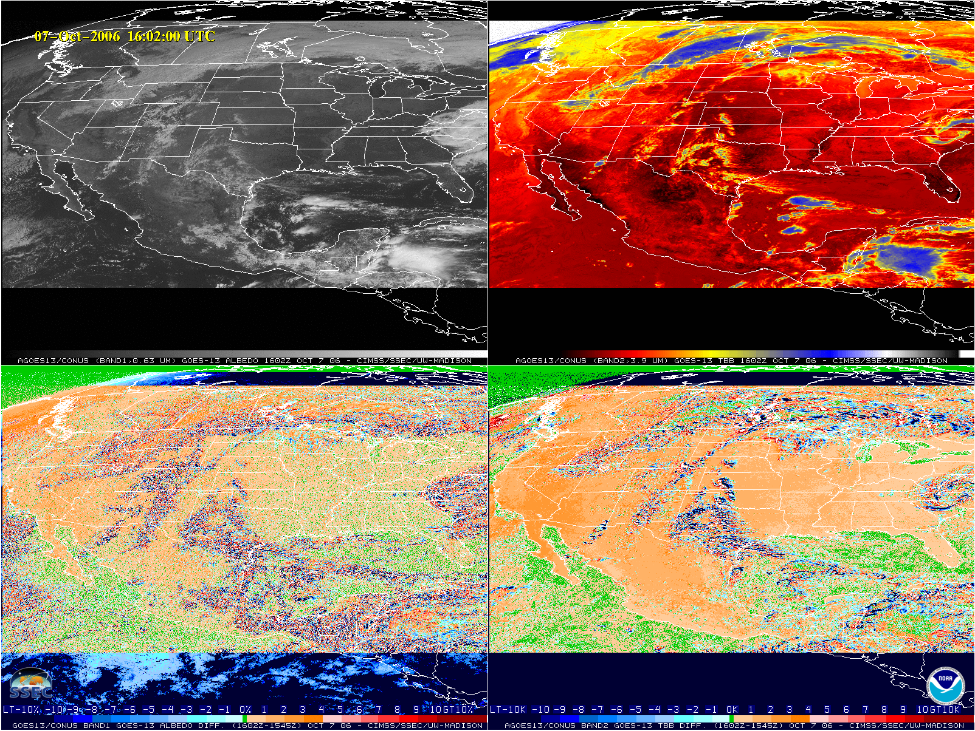
Individual Frames from 16:02 UTC to 19:45 UTC on October 7, 2006
0.64um Visible
3.9um Shortwave IR
0.64um Visible
Time Difference
3.9um Shortwave IR
Time Difference
Band, Times, Date appear on bottom of all four panels.

Slide 8
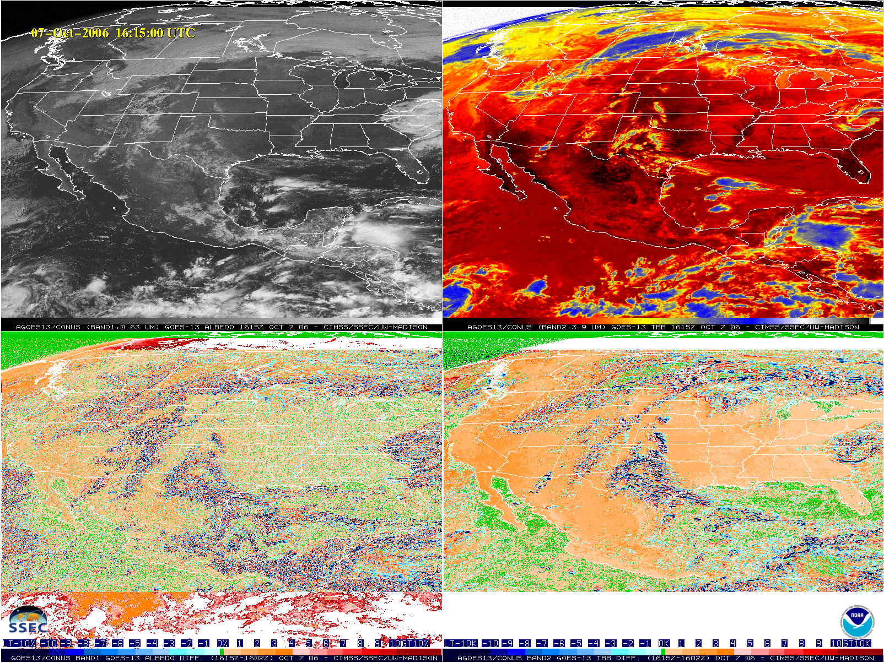
0.64um Visible
3.9um Shortwave IR
0.64um Visible
Time Difference
3.9um Shortwave IR
Time Difference

Slide 9
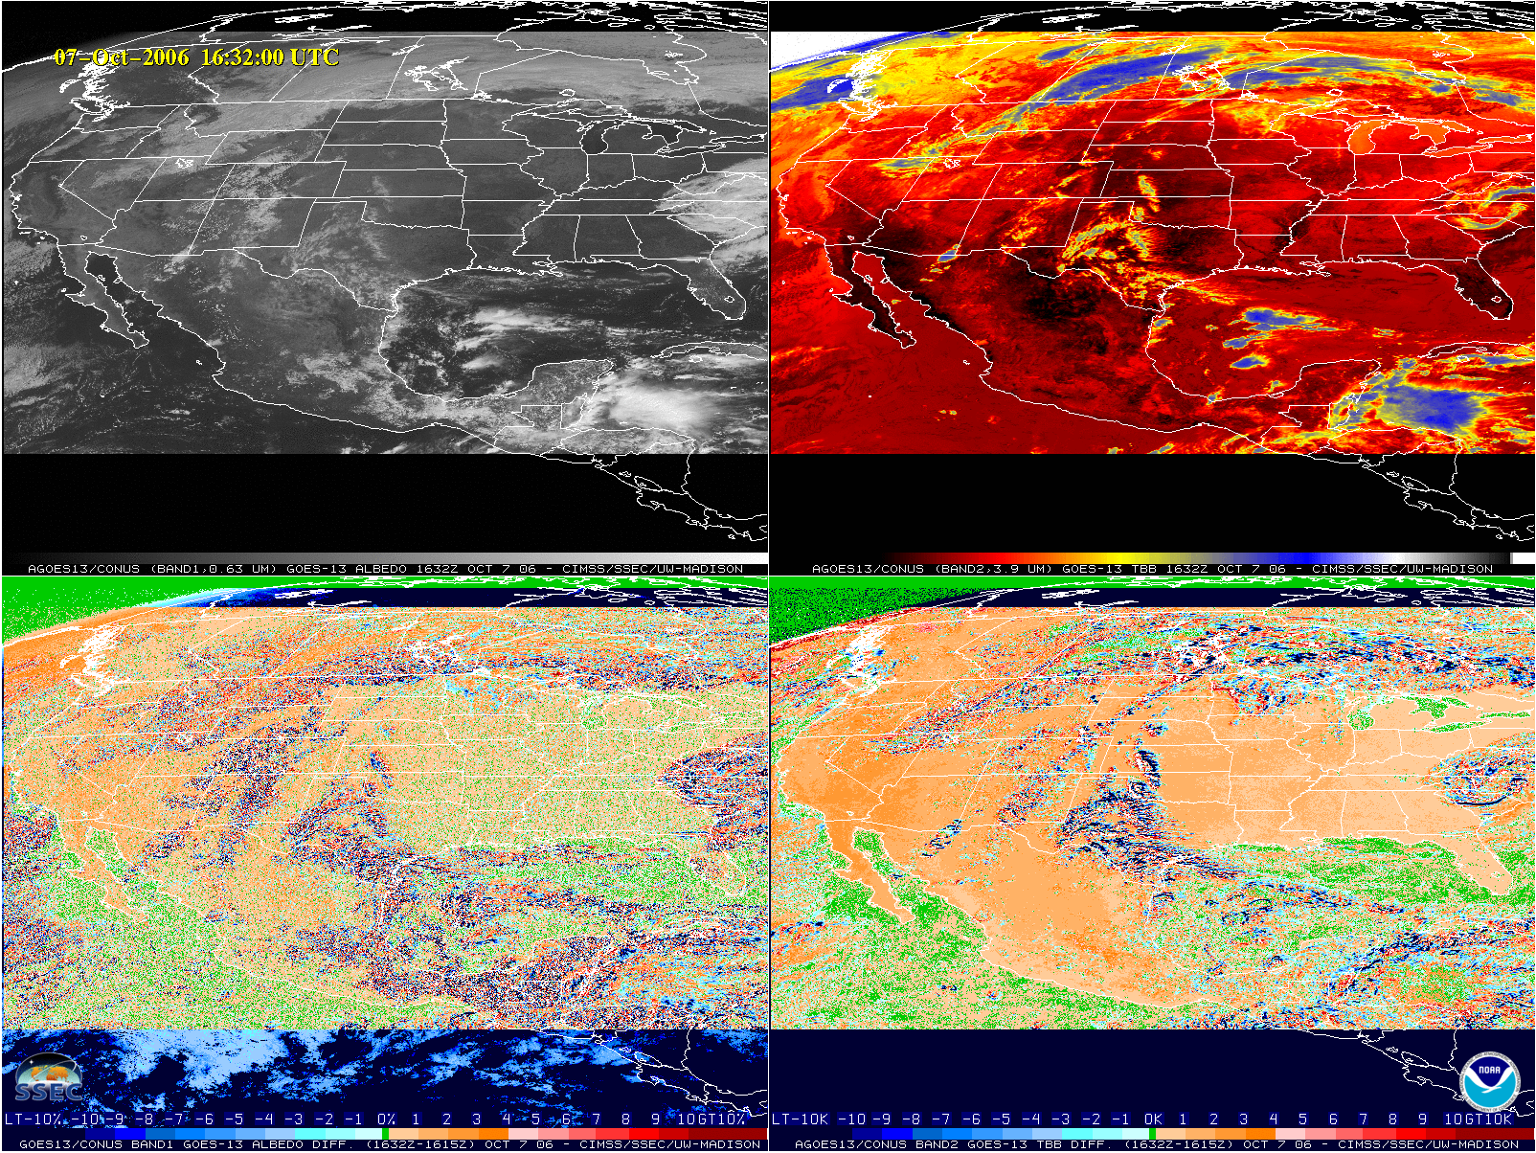
0.64um Visible
3.9um Shortwave IR
0.64um Visible
Time Difference
3.9um Shortwave IR
Time Difference

Slide 10
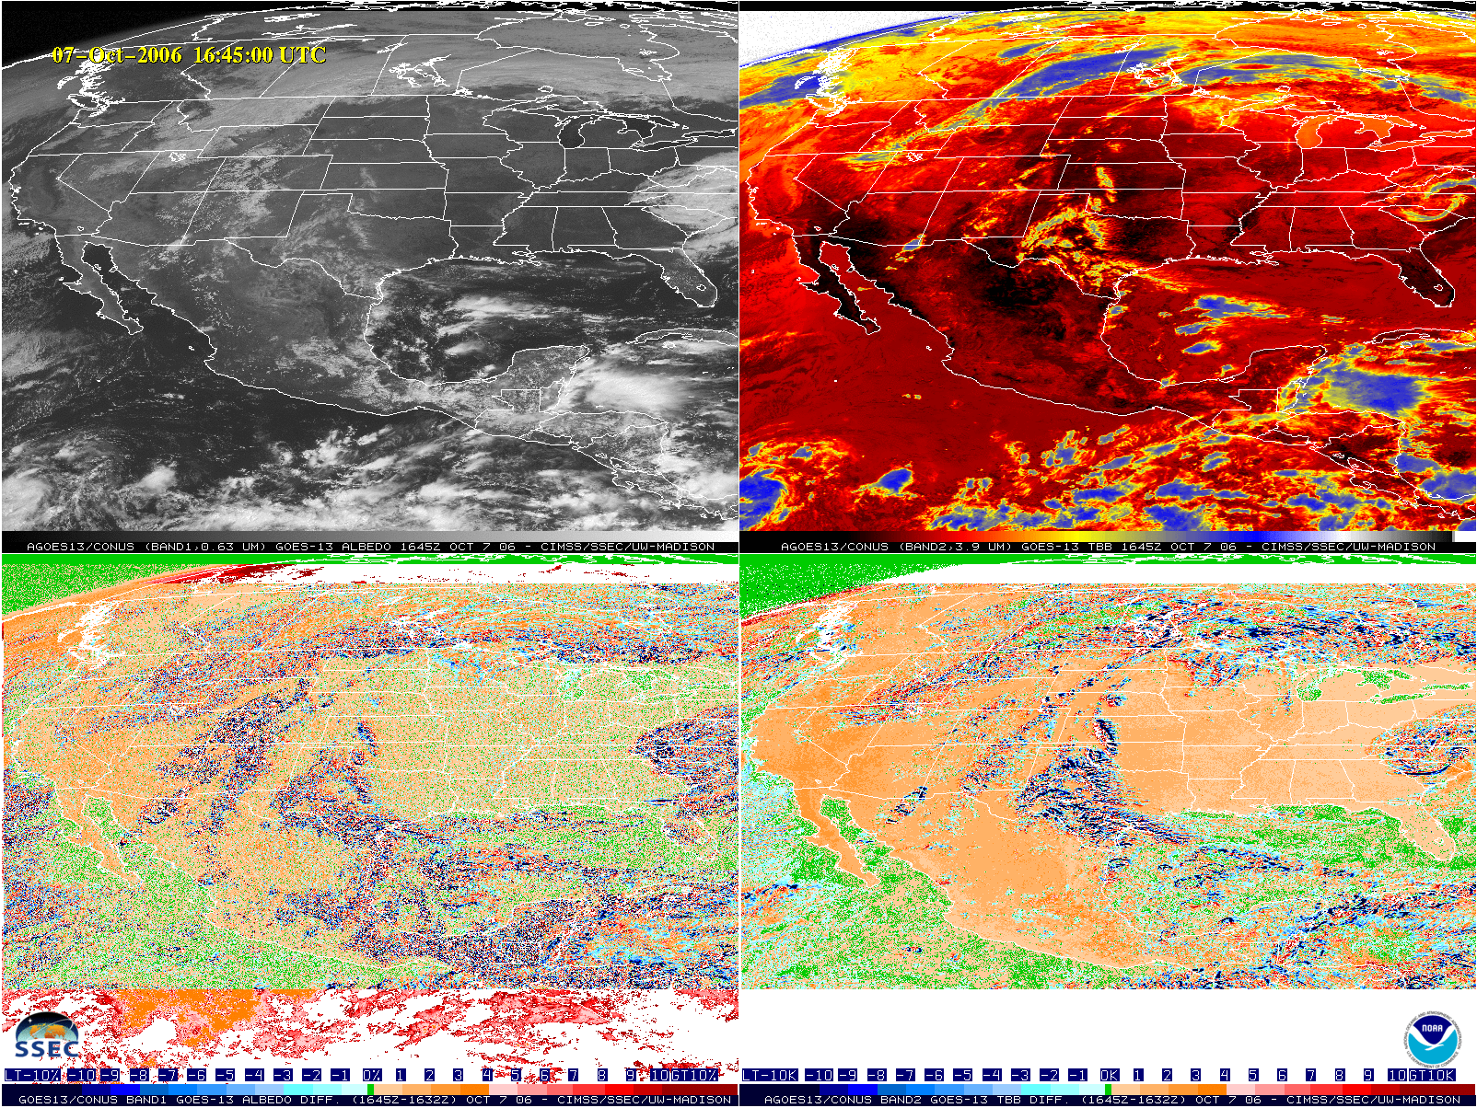
0.64um Visible
3.9um Shortwave IR
0.64um Visible
Time Difference
3.9um Shortwave IR
Time Difference

Slide 11
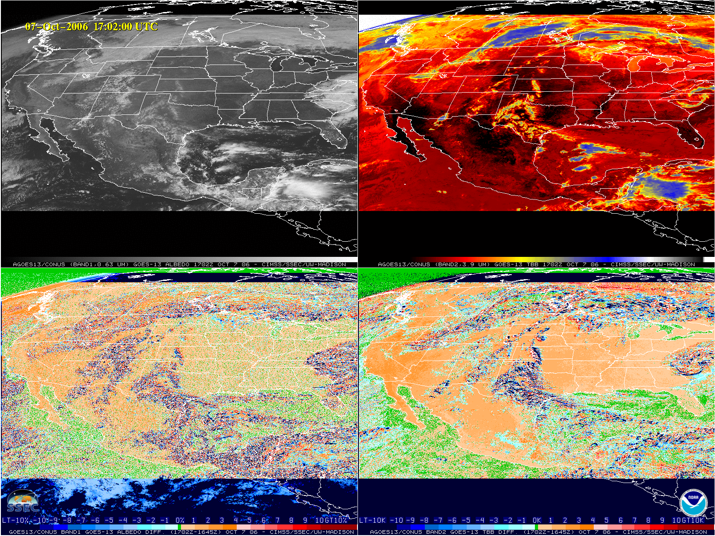
0.64um Visible
3.9um Shortwave IR
0.64um Visible
Time Difference
3.9um Shortwave IR
Time Difference

Slide 12
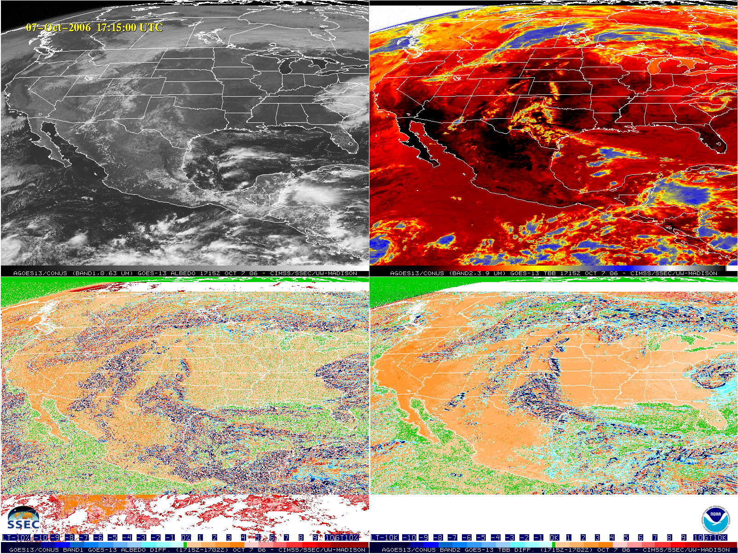
0.64um Visible
3.9um Shortwave IR
0.64um Visible
Time Difference
3.9um Shortwave IR
Time Difference

Slide 13
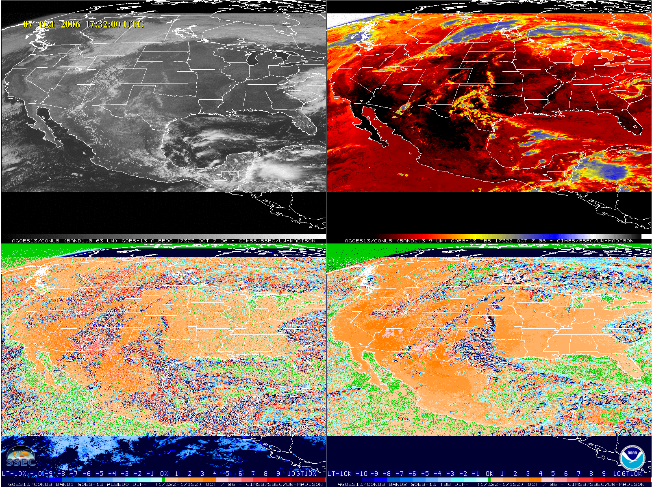
0.64um Visible
3.9um Shortwave IR
0.64um Visible
Time Difference
3.9um Shortwave IR
Time Difference
Notice the brightening (darker orange) in the difference images.

Slide 14
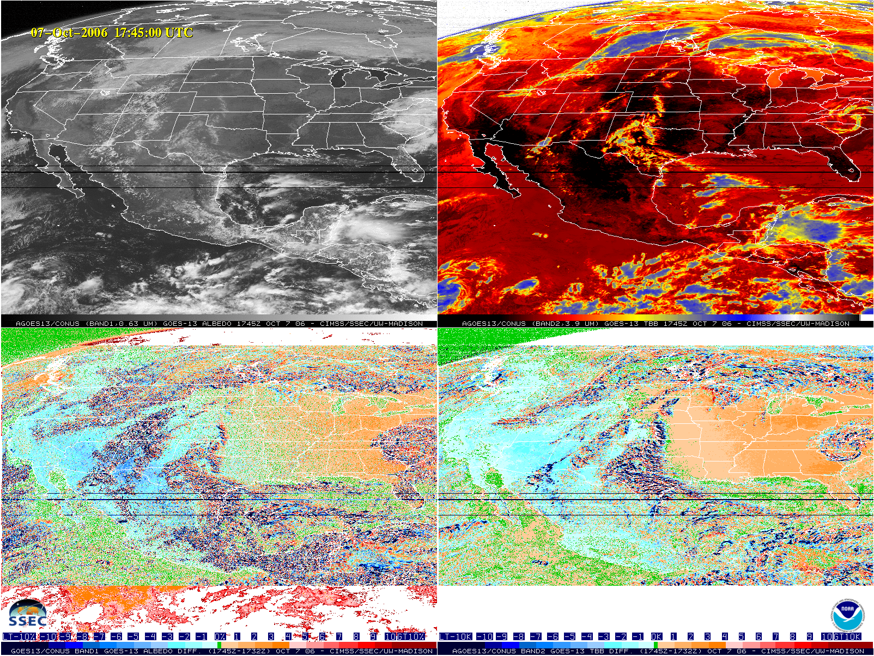
0.64um Visible
3.9um Shortwave IR
0.64um Visible
Time Difference
3.9um Shortwave IR
Time Difference
Notice the orange/blue couplet as the effect moves across CONUS in the difference images.

Slide 15
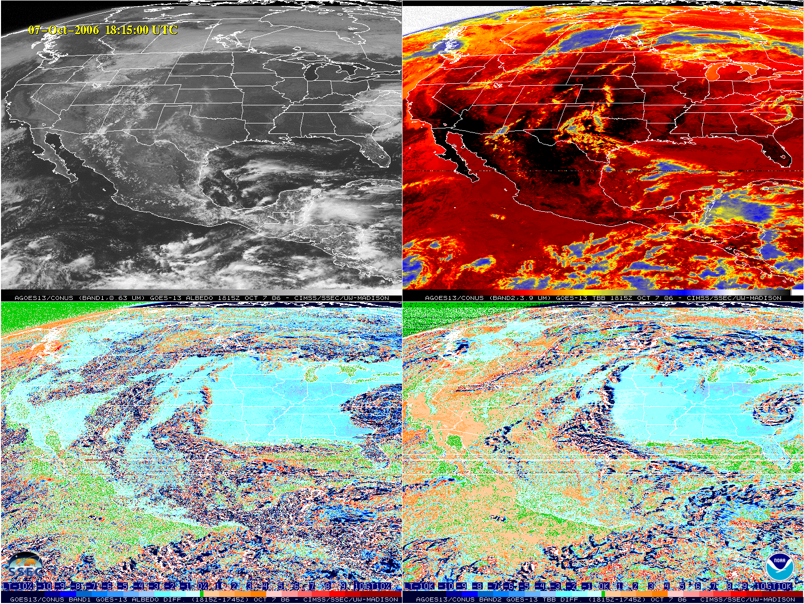
0.64um Visible
3.9um Shortwave IR
0.64um Visible
Time Difference
3.9um Shortwave IR
Time Difference
Notice the cooling/darkening blue hues across CONUS in the difference images.

Slide 16
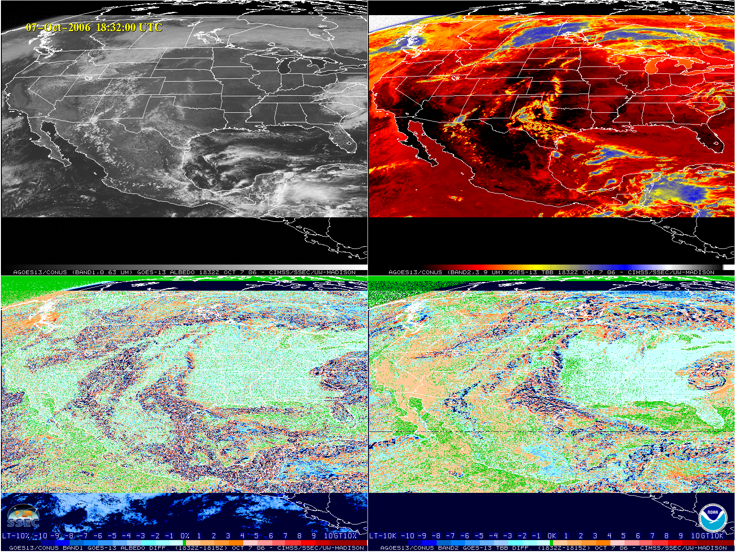
0.64um Visible
3.9um Shortwave IR
0.64um Visible
Time Difference
3.9um Shortwave IR
Time Difference

Slide 17
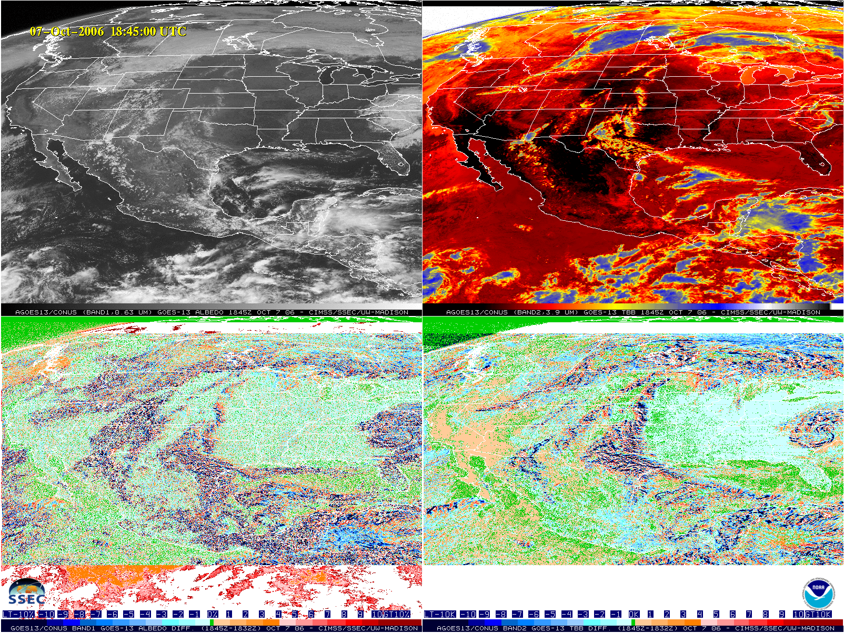
0.64um Visible
3.9um Shortwave IR
0.64um Visible
Time Difference
3.9um Shortwave IR
Time Difference

Slide 18
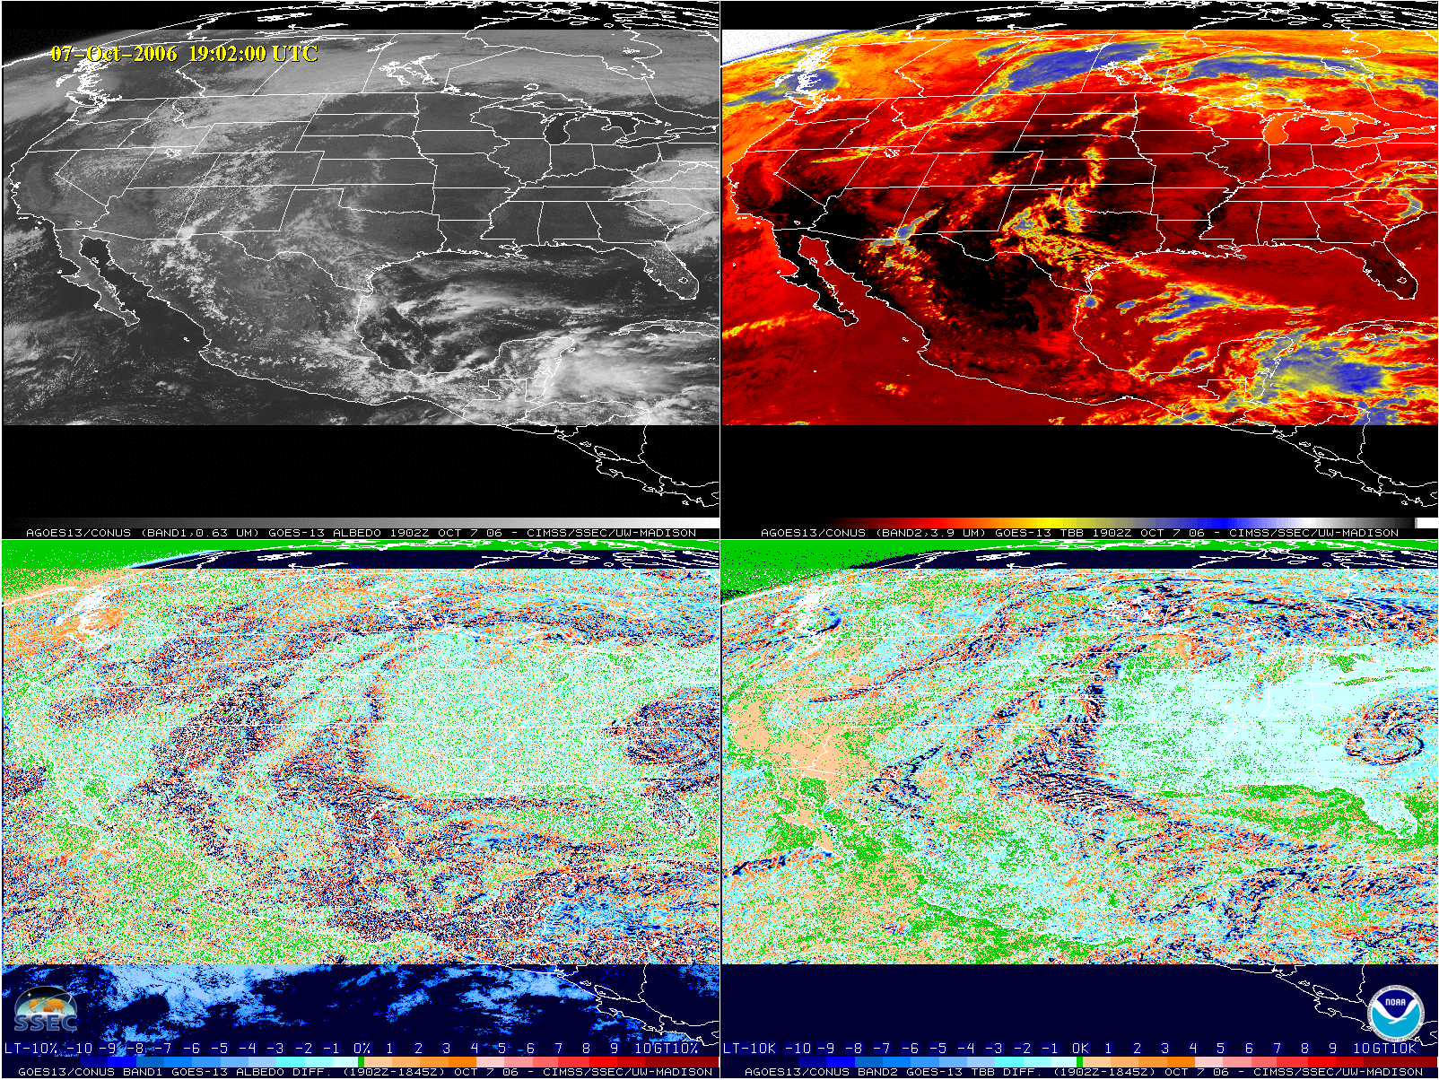
0.64um Visible
3.9um Shortwave IR
0.64um Visible
Time Difference
3.9um Shortwave IR
Time Difference

Slide 19
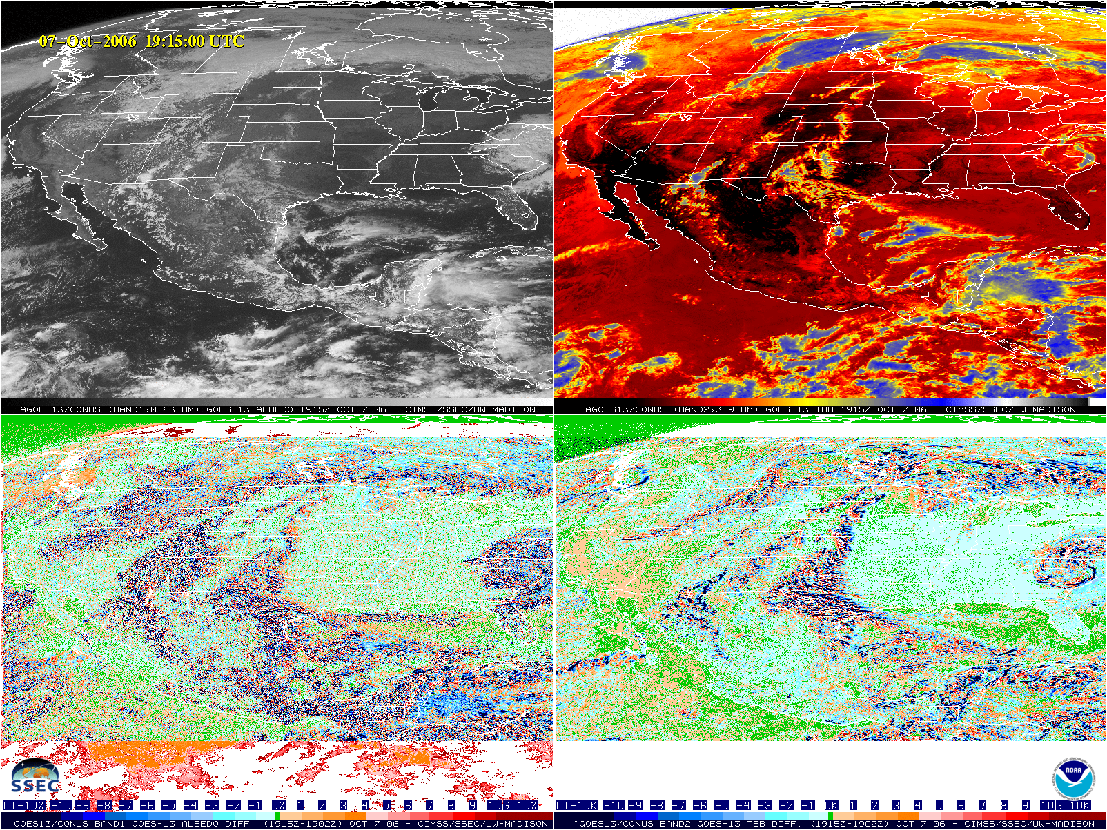
0.64um Visible
3.9um Shortwave IR
0.64um Visible
Time Difference
3.9um Shortwave IR
Time Difference

Slide 20
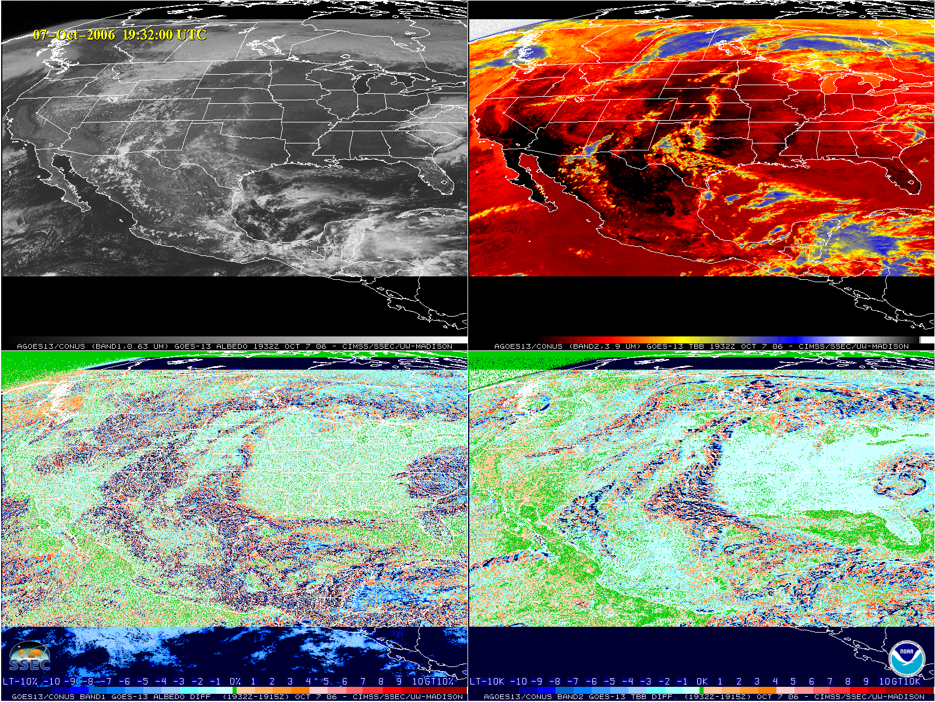
0.64um Visible
3.9um Shortwave IR
0.64um Visible
Time Difference
3.9um Shortwave IR
Time Difference

Slide 21
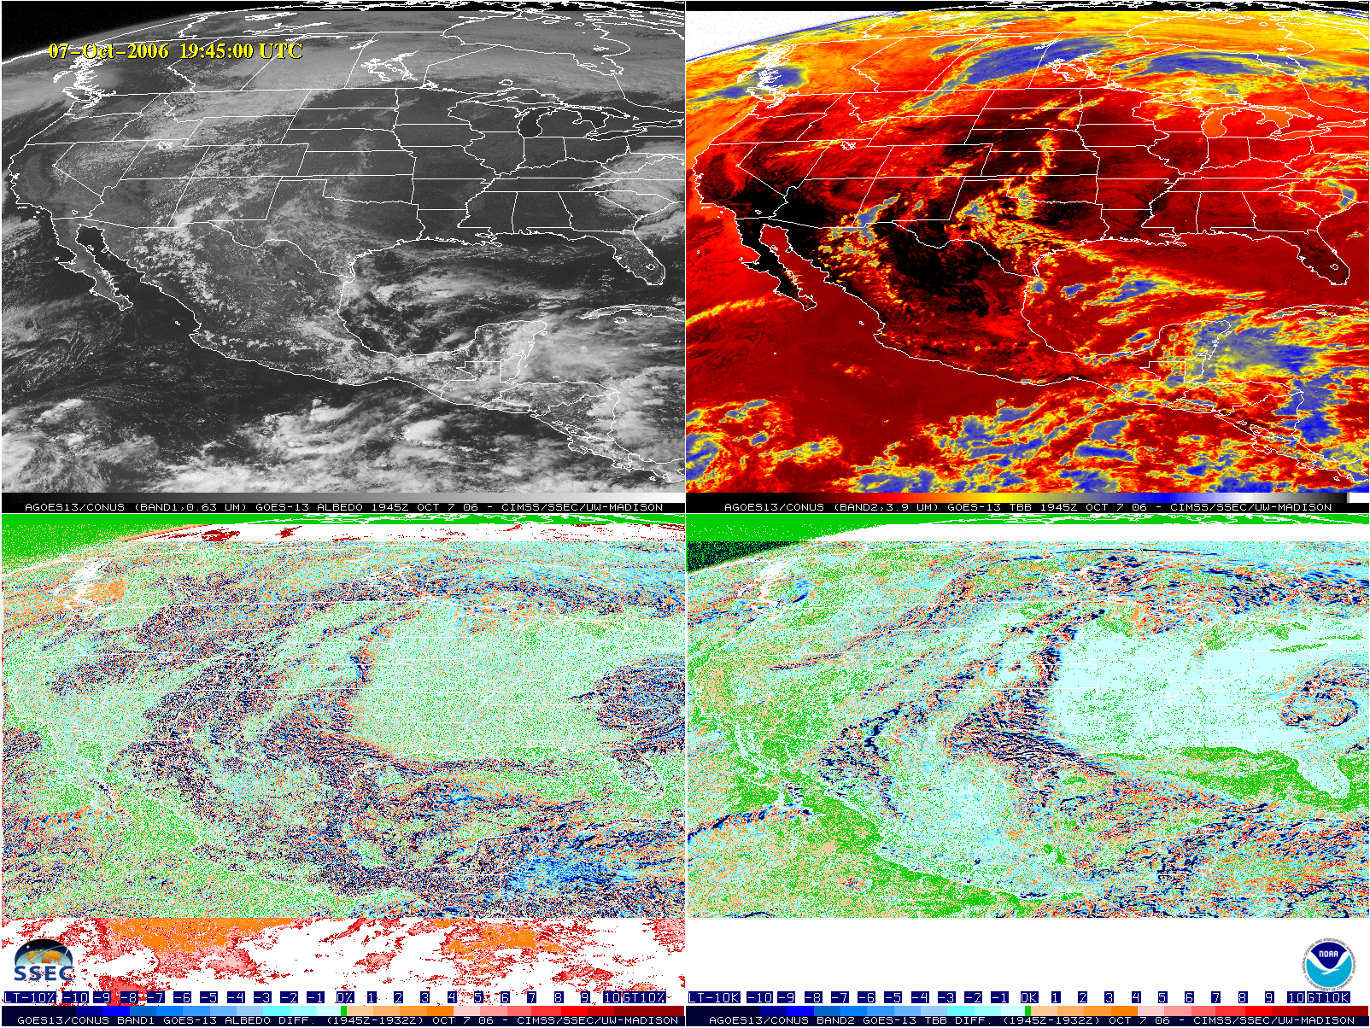
0.64um Visible
3.9um Shortwave IR
0.64um Visible
Time Difference
3.9um Shortwave IR
Time Difference

Slide 22
Summary
GOES-13 was at nearly the same location in 2006 as GOES-16 during the GOES-16 PLT and therefore would experience similar solar angles on similar days.
Time difference images of both GOES-13 Imager visible band 1 and shortwave IR band 2 exhibit a similar effect to what is seen today with ABI in terms of backscatter due to solar illumination on the earth directly in line with the sun, earth, and satellite.
The effect in GOES-13 is less easily detected because of several reasons.
GOES-13 images are taken less frequently.
The effect is less apparent in the 0.64um band on ABI, so it is not the best band to use for this though it’s the only visible band on GOES-13.
The 3.9um band on GOES-13 is lower spatial resolution than that on ABI.
Other improvements on ABI such as bit depth, signal-to-noise, calibration, etc may also make this effect more noticeable in ABI than on previous GOES.

