Slide 1
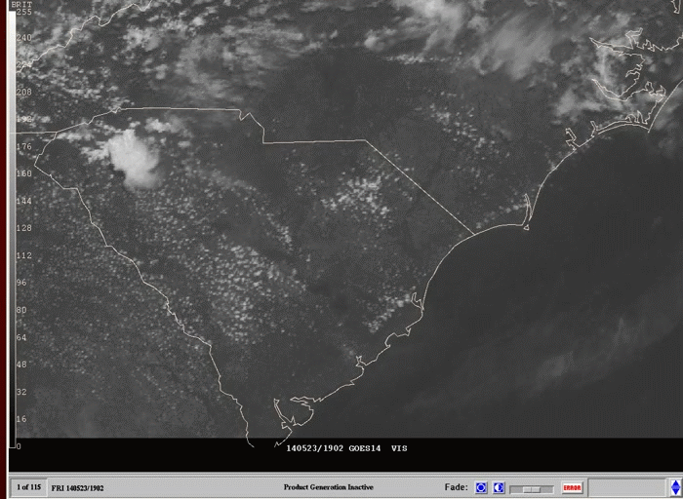
Questions/Comments?

