Slide 1


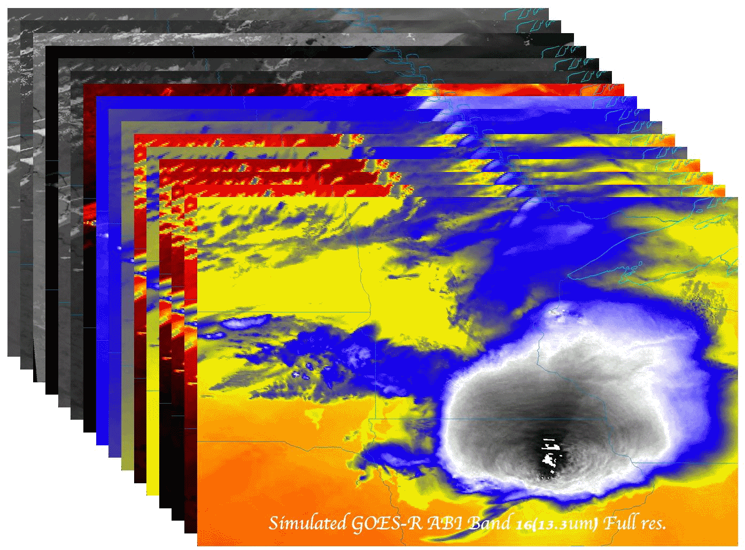

From Photons to Functions
(for the ABI on the GOES-R series)
  Timothy J. Schmit (tim.j.schmit@noaa.gov)
NOAA/NESDIS/Satellite Applications and Research
Advanced Satellite Products Branch (ASPB), Madison, WI
And lots of other folks, especially Dr. W. Paul Menzel, CIMSS and
Dr. Paul C. Griffith, Harris!
Training
Kansas City, MO
3 March 2016
UW-Madison

Slide 2
What’s needed on a satellite to monitor convection?
1.
2.
3.
4.
5.
6.
7.
8.
9.

Slide 3
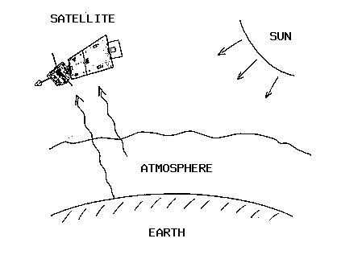
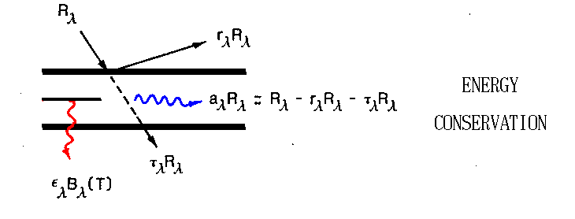
Radiative Transfer
Classic COMET module
http://cimss.ssec.wisc.edu/goes/comet/radiative_transfer.html

Slide 4
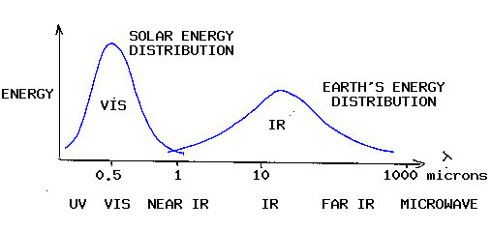
Radiative Transfer
Classic COMET module
http://cimss.ssec.wisc.edu/goes/comet/radiative_transfer.html

Slide 5
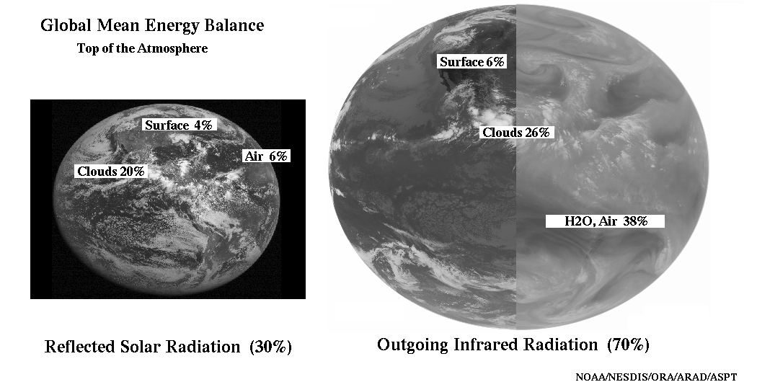
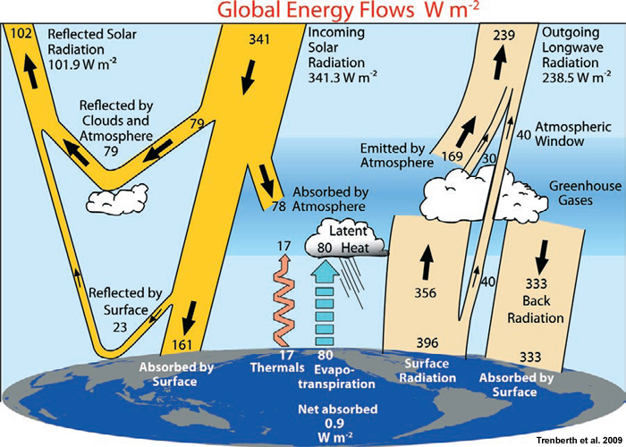
Radiation
Budget

Slide 6
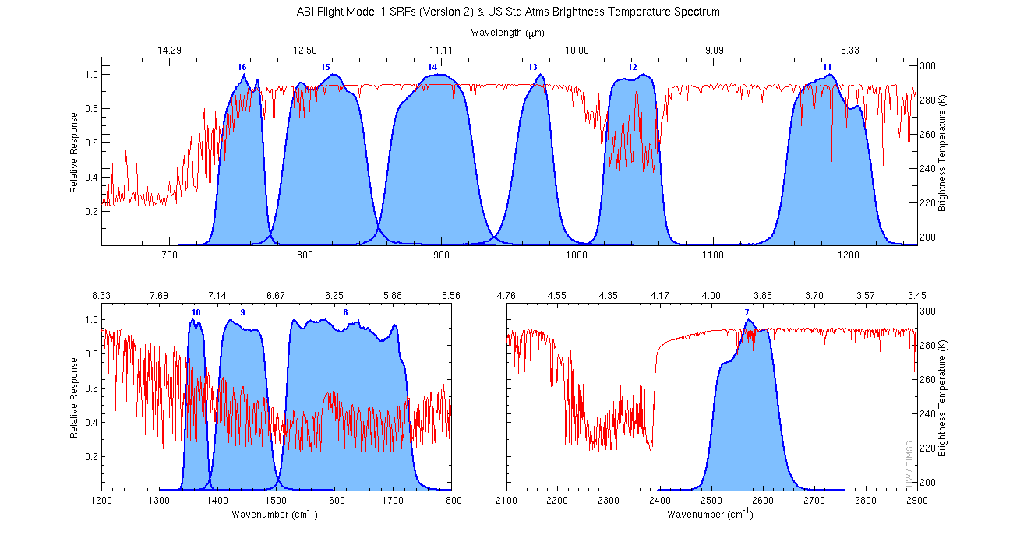
Earth emitted spectra

Slide 7
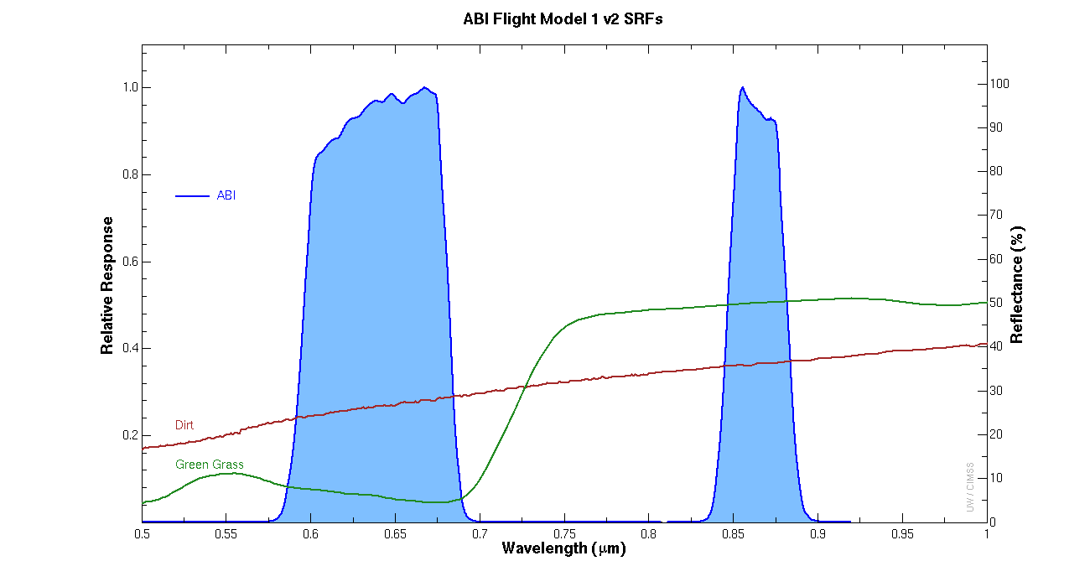

Slide 8
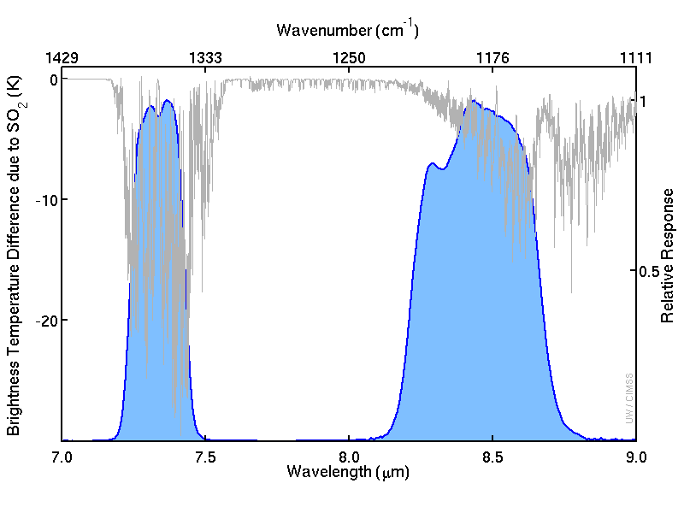

Slide 9
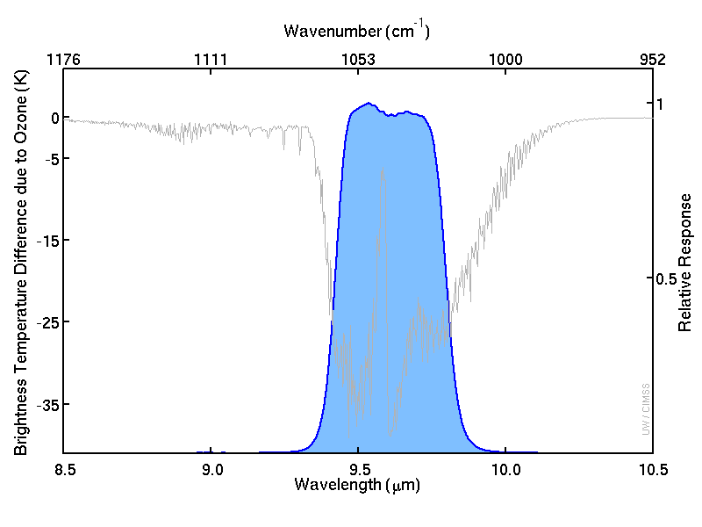

Slide 10
Rapid Scan – New Flexibility for Next Generation Geostationary Imaging
Dr. Paul C. Griffith
2015 EUMETSAT Meteorological Satellite Conference
Toulouse, France, 22 September 2015
This document is not subject to the controls of the International Traffic in Arms Regulations (ITAR) or the Export Administration Regulations (EAR).

Slide 11
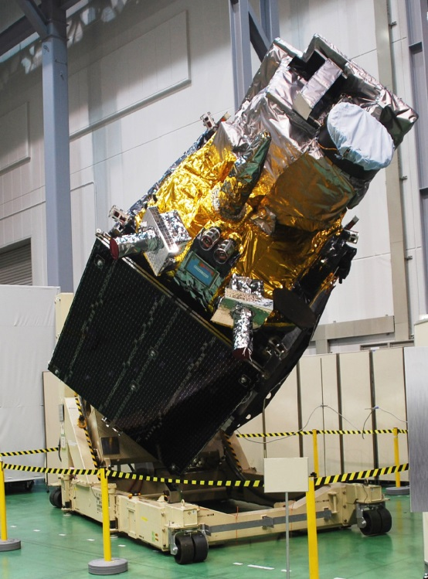
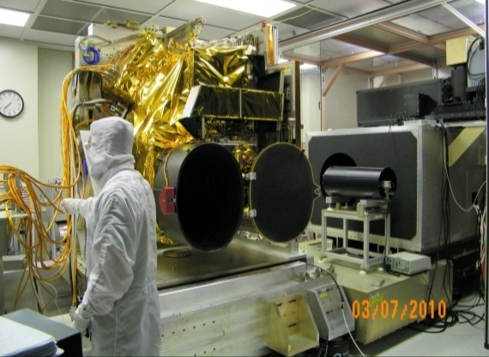
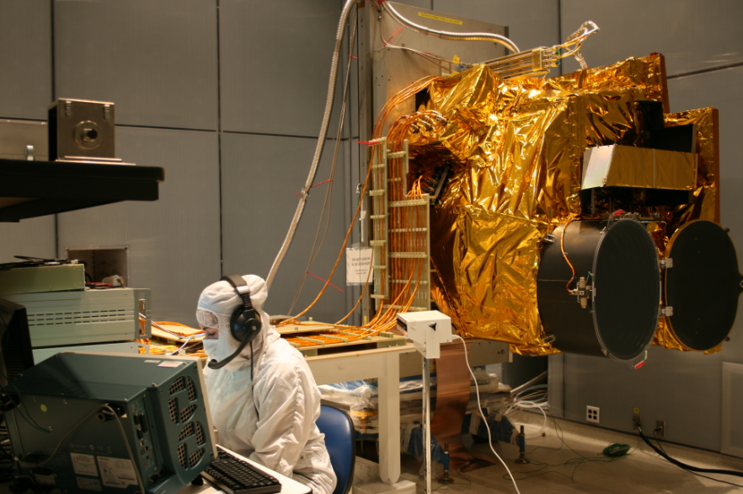
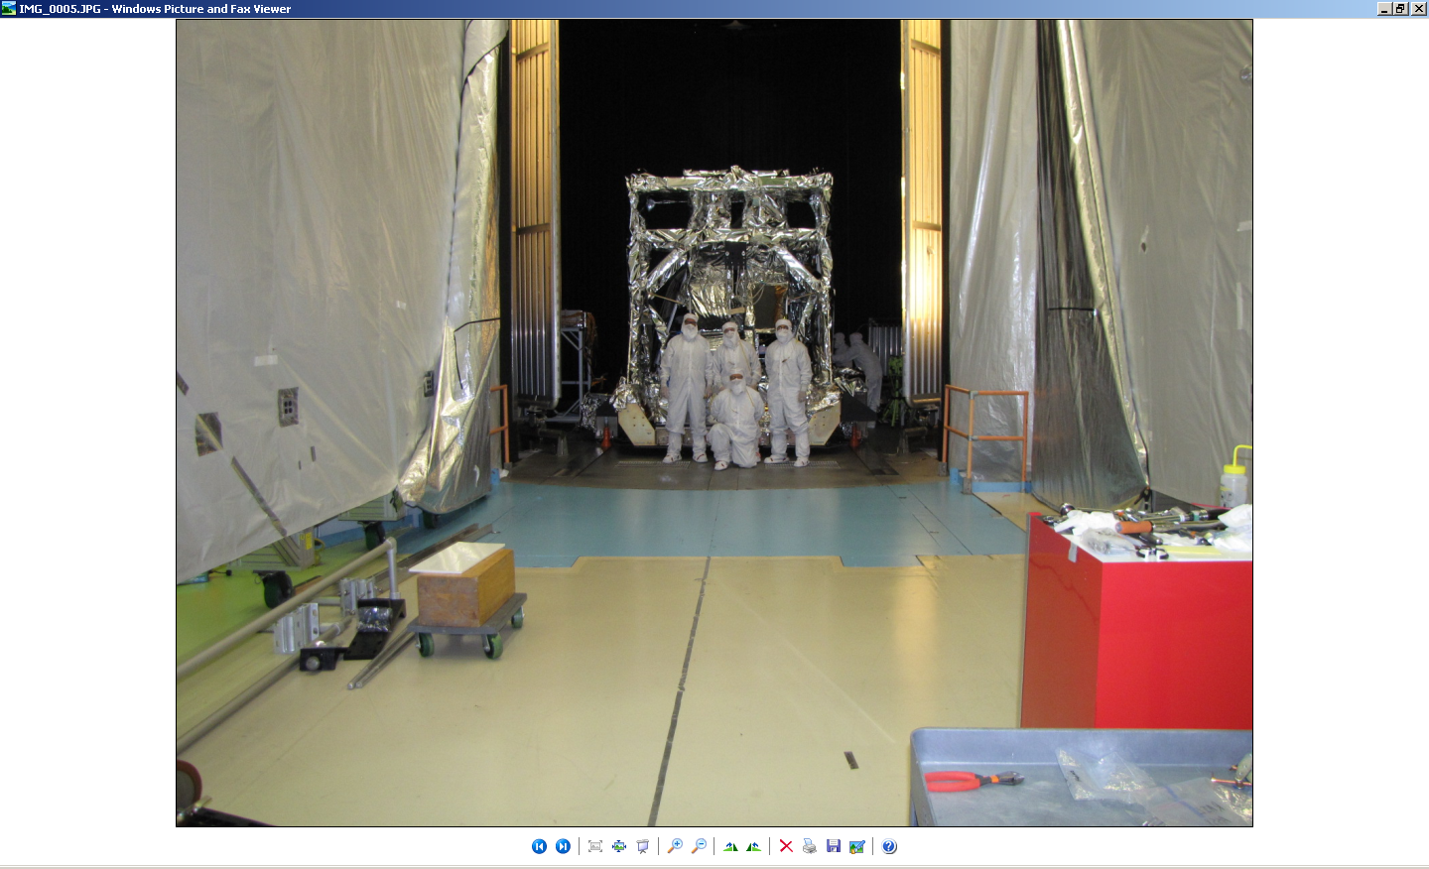
ABI-Class Imager is a Mature Product Line
Himawari 8
Supporting three missions:
  GOES-R (ABI), Himawari (AHI),
  GEO-KOMPSAT-2A (AMI)
Four flight models delivered
  ABI PFM: Integrated on GOES-R spacecraft
  AHI-8: Operating on orbit (Himawari-8)
  ABI FM2: Delivered
  AHI-9: Integrated on Himawari-9 spacecraft
Three more in production at Harris
  ABI FM3, ABI FM4, AMI
Mitsubishi Electric Corporation
ABI Bench
ABI EMI
ABI TVAC

Slide 12
ABI’s 2-Mirror Scanner Key to Rapid Scan Capability
Scan Mirrors
Scans parallel to equator without rotating image
  100% scan coverage efficiency
Lowest inertia and power
2x EW and NS mechanical-to-optical motion
Inherently polarization compensating
  At nadir, polarization introduced by reflection off NS scanner is canceled by reflection off of EW scanner
Z (Earth)
Blackbody
Calibration
Target
X
(East)
Y
(South)
Delivers fast slews and accurate slow scans with minimal disturbance

Slide 13
On-Orbit Operations:
Raster Scan vs. Boustrophedonic
GOES N Imager
Boustrophedonic
(“as the ox plows”)
GOES-R ABI
Default = Raster Scan
Capable of boustrophedonic
Raster scan results in higher quality images
  Constant time interval across swath boundary
Only possible because of Harris’ advanced scanner
  Smooth, fast slews at low power with little spacecraft disturbance
ABI baseline scan rate = 0.024434 rad/s (1.4 degree/s)
  Scan rate can be increased or decreased if different EW ASD
  is desired

Slide 14
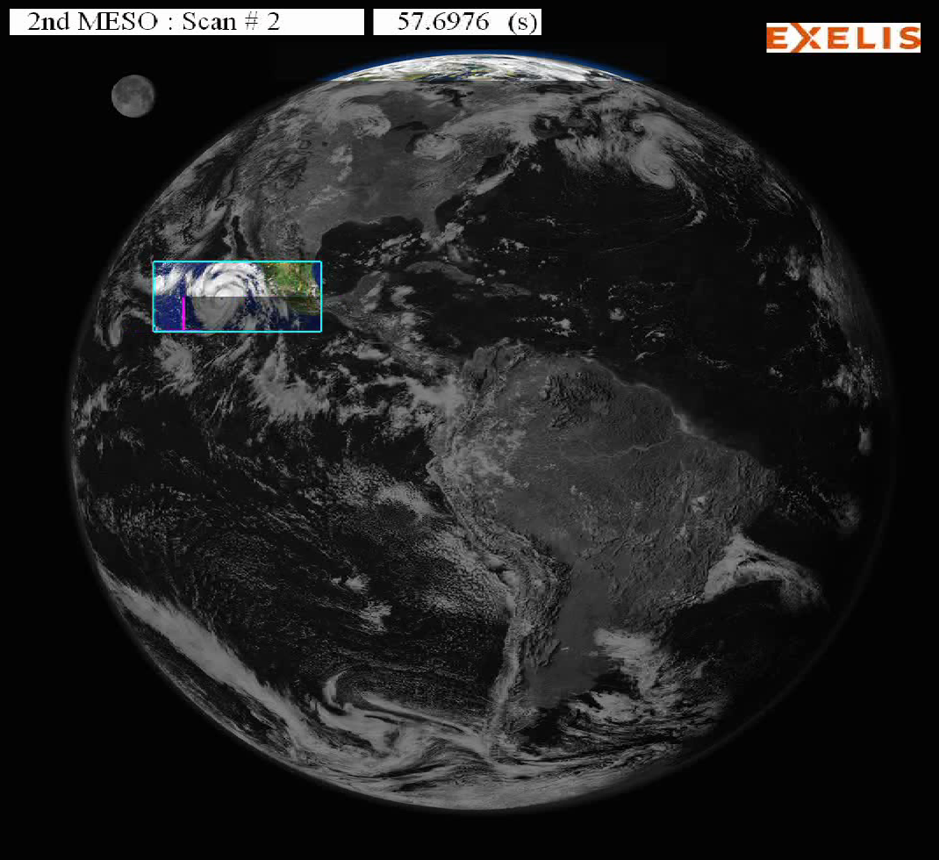

Paradigm Shift to Swath-based Image Collection Key to ABI’s Coverage Flexibility
Full Disk Swath
CONUS Swath
Meso Scene
30 s
Scan Mode 3 demonstrates ABI’s ability to interleave Full Disk (Earth), regional (CONUS), and local area (Meso) scenes
  Different sizes
  Different locations
  Different repetition intervals
  One instrument
64 scenes and 48 timelines stored on board; updated on orbit
  Seamless transition between timelines requires only one command

Slide 15
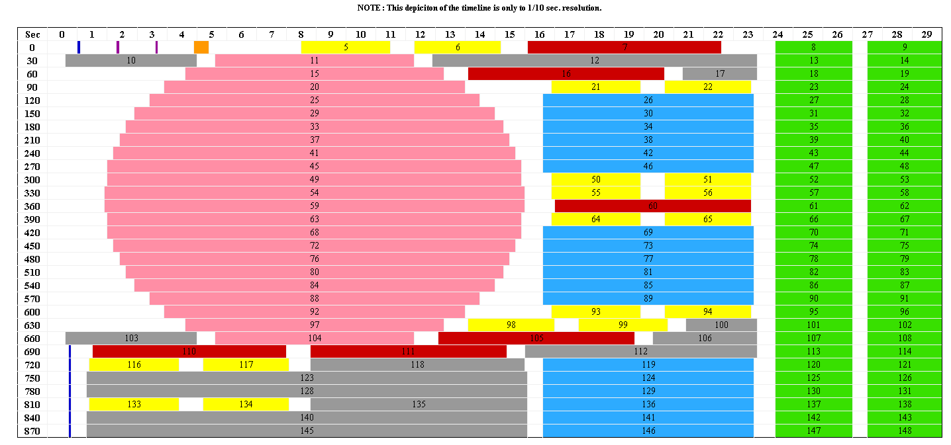
Scan Mode 3 Timeline (Flex Mode) Delivers Storm Watch Every 30 Seconds
30 seconds
Blackbody
IR Star
Spacelook
Vis Star
CONUS
Meso
Full
Disk
Nadir
Note: Autonomous spacelook collected with each Full Disk swath
MISTiC
Meso: one every 30 seconds or two at 1 minute intervals each
Scene locations can be changed on the fly (no interruption of timeline)

Slide 16
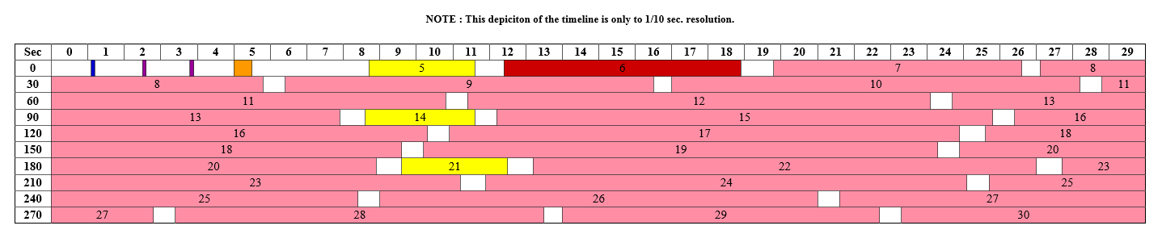
Scan Mode 4 (Continuous Full Disk) Provides Efficient Image Collection
30 seconds
Full
Disk
Note: Autonomous spacelook collected with each Full Disk swath
Scan Mode 4 timeline used when no rapid scan imagery desired
Provides 5 minute update of entire Earth instead of just CONUS
Maneuvers | Duration | Percentage
Scanning | 276.127 s | 92%
Slewing | 23.873 s | 8%
Total | 300.000 s | 100%

Slide 17
ABI’s Unique Calibration and Validation Capabilities
Dr. Paul C. Griffith
2015 EUMETSAT Meteorological Satellite Conference
Toulouse, France, 23 September 2015
This document is not subject to the controls of the International Traffic in Arms Regulations (ITAR) or the Export Administration Regulations (EAR).

Slide 18
ABI Optical Architecture:
Simple Solution to Mission Needs
SM2
(EW)
S1
Fold
Mirror
Scan
Mirrors
FMA
Telescope
Exit Pupil
+X
W1
W2
-Y
CS
W3
Optical Path
-Z
SM1
(NS)
S2
VNIR
0.47, 0.64,
0.865, 1.378,
1.61, 2.25
(170 K†)
MWIR
3.9, 6.185,
6.95, 7.34, 8.5
(60 K)
60 K
CS, S2, MWIR
& LWIR FPMs
LWIR
9.61, 10.35,
11.2, 12.3, 13.3
(60 K)
170 K†
W3, VNIR FPM
300 K
Remaining structure
†PFM = 180K

Slide 19
Detector Selection Capability Provides Operational Redundancy
Externally: Line array
Internally: 2D array
detectors
Select best element in each row
Redundant detectors both by having more columns and another electronics side
Requirement: one operational element per downlinked row per side

Slide 20
Detector Elements: IFOV, Rows, Columns
Channels (wavelengths in µm) | Resolution (km) | IFOV (µrad) |  | Rows | Columns
 |  | NS | EW
0.64 | 0.5 | 10.5 | 12.4 | 1460 | 3
0.47, 0.51, 0.86 | 1 | 22.9 | 22.9 | 676 | 6
1.61, 2.26 | 2 | 42 | 51.5 | 372 | 6
3.9, 6.18, 6.95, 7.34, 8.5, 9.61 | 2 | 47.7 | 51.5 | 332 | 6
10.35, 11.2, 12.3, 13.3 | 2 | 38.1 | 34.3 | 408 | 6
Resolution = pixel spacing of final image after resampling
  1 km = 28 μrad
Lots more detectors!
77,400 detector elements total; 7,856 downlinked

Slide 21
Advanced Imagers Pose Calibration Challenges
Large number of detector elements
  Much more to be calibrated
  Increased risk of striping
Large FOV
  Much larger than traditional vicarious calibration scenes
Greater calibration accuracy expectations
Lots more detectors!
Parameter | Units | Himawari-7 | AHI | Ratio
Channels |  | 5 | 16 | 3.2
Detector Elements: total |  | 24 | 77,400 | 3225
Detector Elements: downlinked |  | 16 | 7,856 | 491
NS FOV: max channel | μrad | 274 | 16,311 | 60
EW FOV: max FPM | μrad | 140 | 33,203 | 237
Harris’ ABI-class imager provides calibration solutions

Slide 22
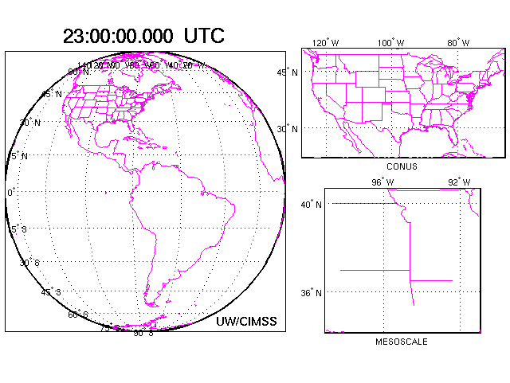
Example of Flex Mode Scanning
The ABI may also be operated in a five-minute continuous full disk mode.

Slide 23

Draft -- GRB SYSTEM
Satellite
Satellite
“Re-broadcast”
“Level 1b”
(L-band)
“Downlink”
Level 0
GRB Local Ingest + Radiance conversion s/w
Products
CDA
Users
Calibrate
Navigation
3. Remap to perfect geo
(Send scaled radiances, etc.)
Archive
Notes:
Level 1b is calibrated (to radiances and/or reflectance factor), navigated and remapped data.
Radiance conversion software to for converting the radiances to brightness temperatures (or reflectance) and then to brightness values.

Slide 24
Swath Overlap
There is over-lap, swath to swath (figure not to scale).
How many swaths in a full disk image?

Slide 25
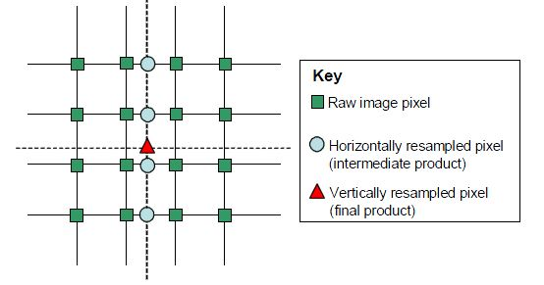
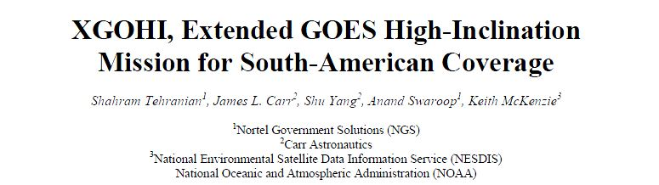
From Detectors to Pixels
16 detectors are used to build one pixel (in the fixed grid format)
Similar to the GOES-10 / 12 “XGoHi” remapping

Slide 26
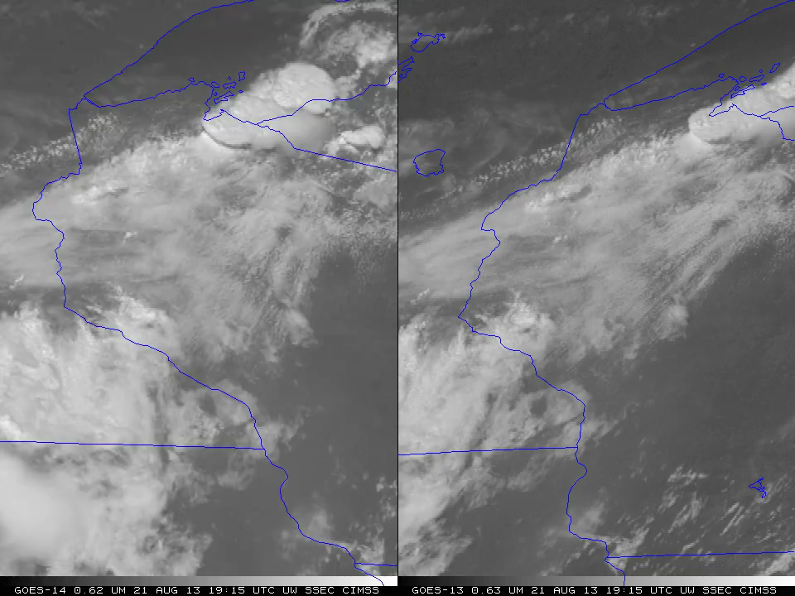
1-min imagery
1-min mode (SRSOR from GOES-14)
Operational (GOES-13)

Slide 27
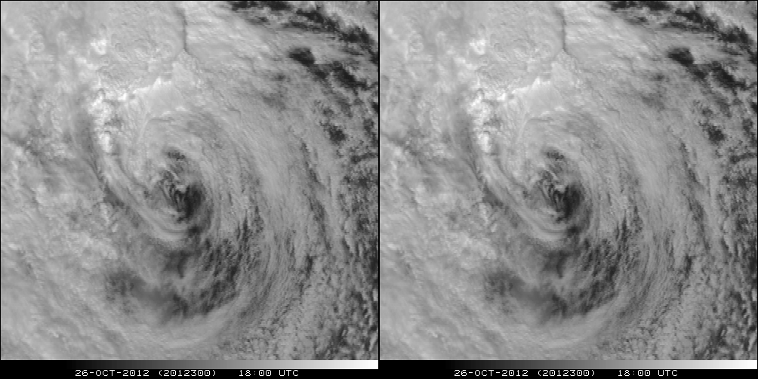
A Glimpse into the Future
ABI-like
Hurricane Sandy from GOES-14 at two temporal resolutions

Slide 28
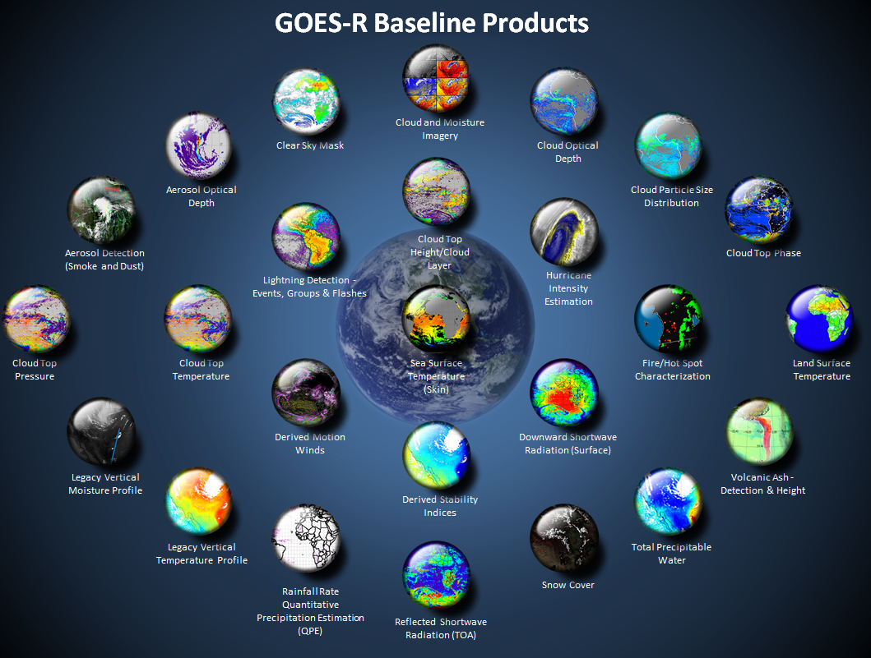
http://www.goes-r.gov

Slide 29
GOES-R ABI Products
Baseline Products
Future Capabilities
Advanced Baseline Imager (ABI)
Aerosol Detection (Including Smoke and Dust) Aerosol Optical Depth (AOD) Clear Sky Masks Cloud and Moisture Imagery Cloud Optical Depth Cloud Particle Size Distribution Cloud Top Height Cloud Top Phase Cloud Top Pressure Cloud Top Temperature Derived Motion Winds Derived Stability Indices Downward Shortwave Radiation: Surface Fire/Hot Spot Characterization Hurricane Intensity Estimation Land Surface Temperature (Skin) Legacy Vertical Moisture Profile Legacy Vertical Temperature Profile Radiances Rainfall Rate/QPE Reflected Shortwave Radiation: TOA Sea Surface Temperature (Skin) Snow Cover Total Precipitable Water Volcanic Ash: Detection and Height
Advanced Baseline Imager (ABI)
Absorbed Shortwave Radiation: Surface Aerosol Particle Size Aircraft Icing Threat Cloud Ice Water Path Cloud Layers/Heights Cloud Liquid Water Cloud Type Convective Initiation Currents Currents: Offshore Downward Longwave Radiation: Surface Enhanced “V”/Overshooting Top Detection Flood/Standing Water Ice Cover Low Cloud and Fog Ozone Total Probability of Rainfall Rainfall Potential Sea and Lake Ice: Age Sea and Lake Ice: Concentration Sea and Lake Ice: Motion Snow Depth (Over Plains) SO₂ Detection Surface Albedo Surface Emissivity Tropopause Folding Turbulence Prediction Upward Longwave Radiation: Surface Upward Longwave Radiation: TOA Vegetation Fraction: Green Vegetation Index Visibility
+ others

Slide 30
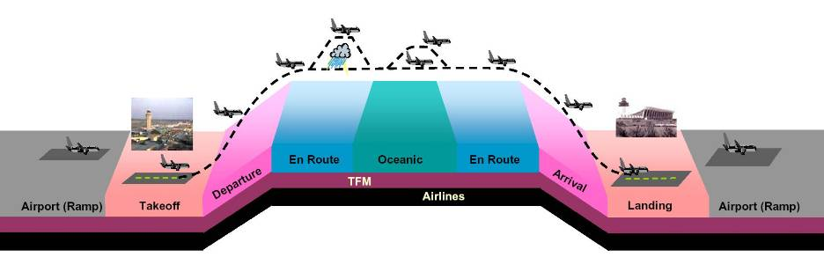


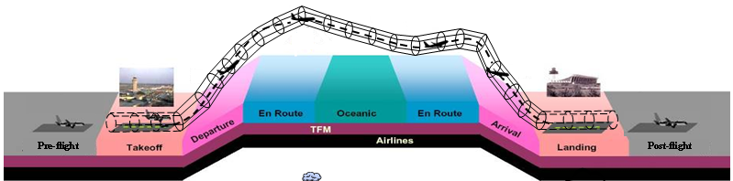



GOES-R: Helps provide advanced weather Information to enable collaborative planning and efficient utilization of airspace routes through entire trajectory
Cloud Classification
Convective Initiation
Cloud & Moisture Imagery
Low Ceiling & Visibility
Overshooting Top
Precipitation
Snow
Cloud Classification, Jet Stream,
Volcanic Ash, Turbulence,
Icing, Winds,
Convective Initiation
Mountain Waves
Imagery
Cloud Top Information
SO2 Detection
Radiances
Cloud Classification
Lightning
Convective Initiation
Low Ceiling & Visibility
Overshooting Top
Icing
Precipitation
Snow
Fog and Low Stratus
Nowcasting
Convective Initiation
Cloud-Top Cooling
NWP Forecasts
Solar Storms
Pre-flight
Post-flight
Post-flight observed weather product archives
Initial Slide from T. Carty
Notes:
Every Phase of flight
Actionable information
Deice
temp-gallon
Risk average

Slide 31
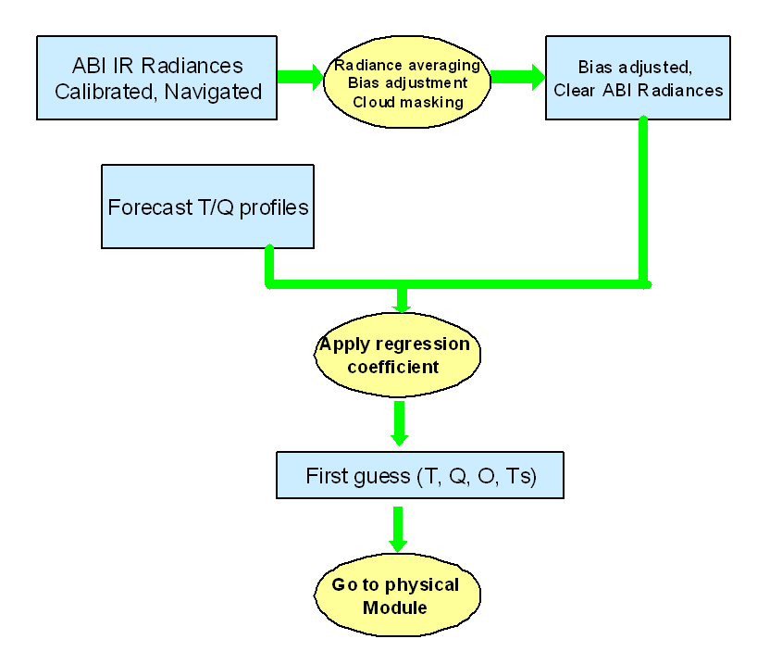
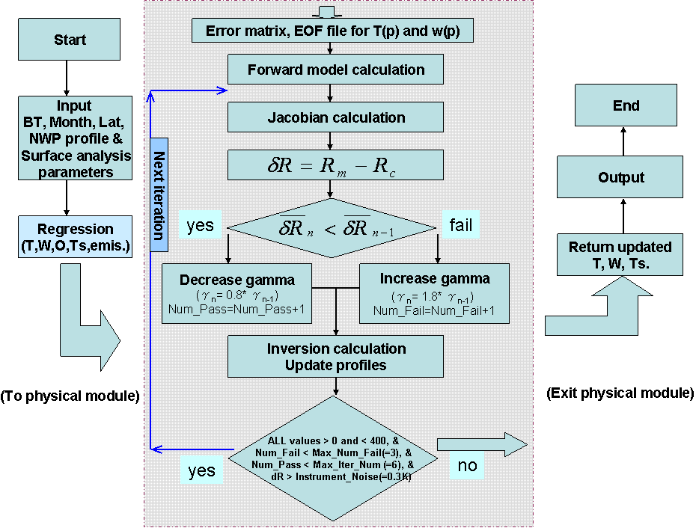
LAP from GOES-R AWG (Overview)
Regression flowchart
Variational iterative physical retrieval flowchart

Slide 32
LAP from GOES-R AWG (Overview)
The sketch map of all ancillary inputs and routines applied in the LAP sounding algorithm. External routines are shown in colored boxes.

Slide 33
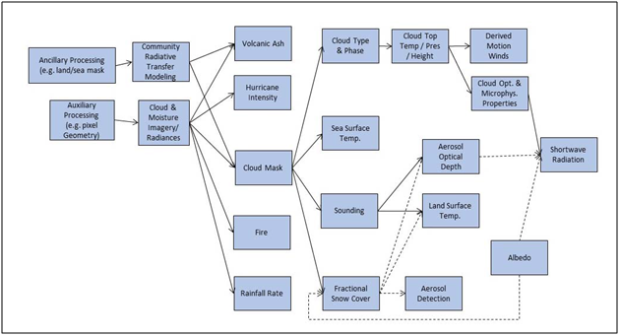
End-to-End product precedence flow of ABI derived products.
The dashed lines represent secondary paths

Slide 34
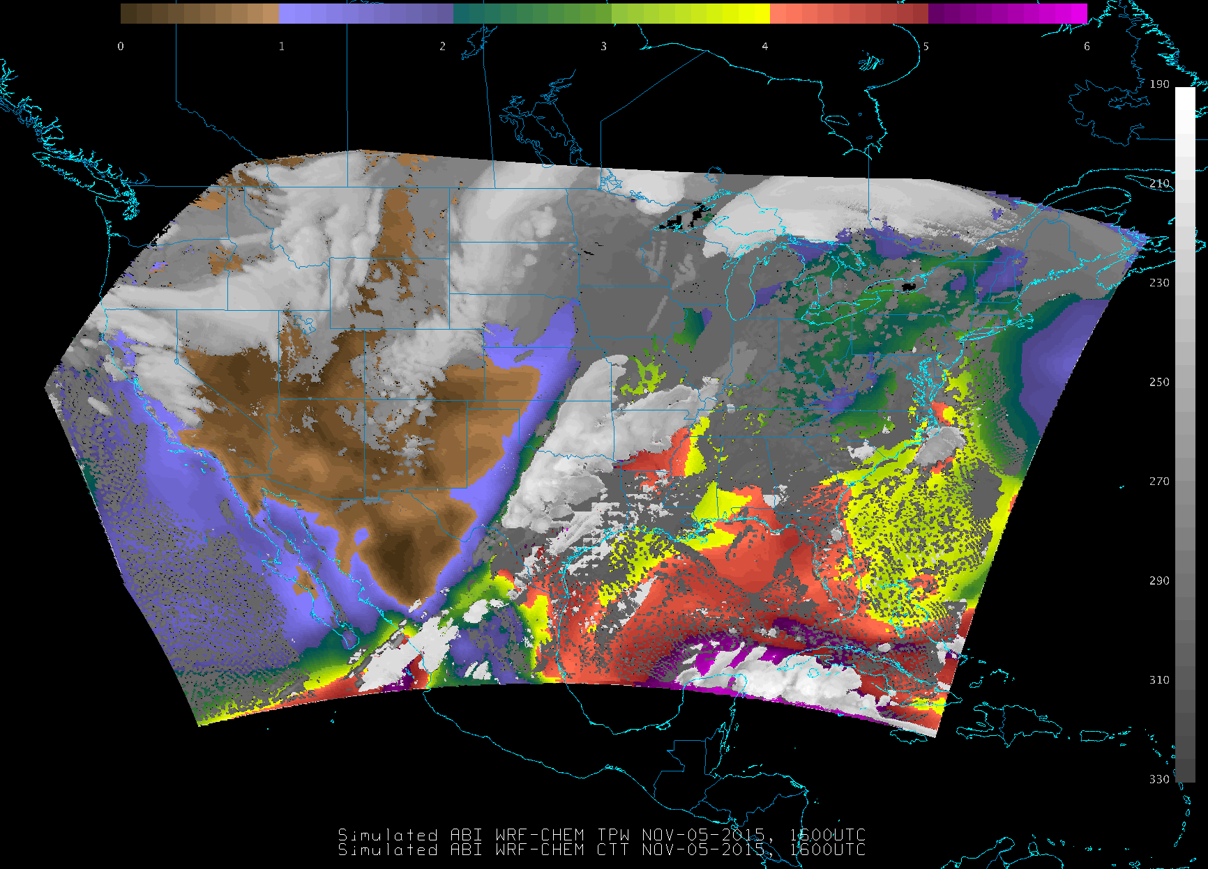
Actually 2 products…TPW and CTT

Slide 35
Bridging the gap between imagery and products
Qualitative
Quantitative
Both
Notes:
Right now most views are either qualitative images OR quantitative derived products. How best to combine the strengths?

Slide 36
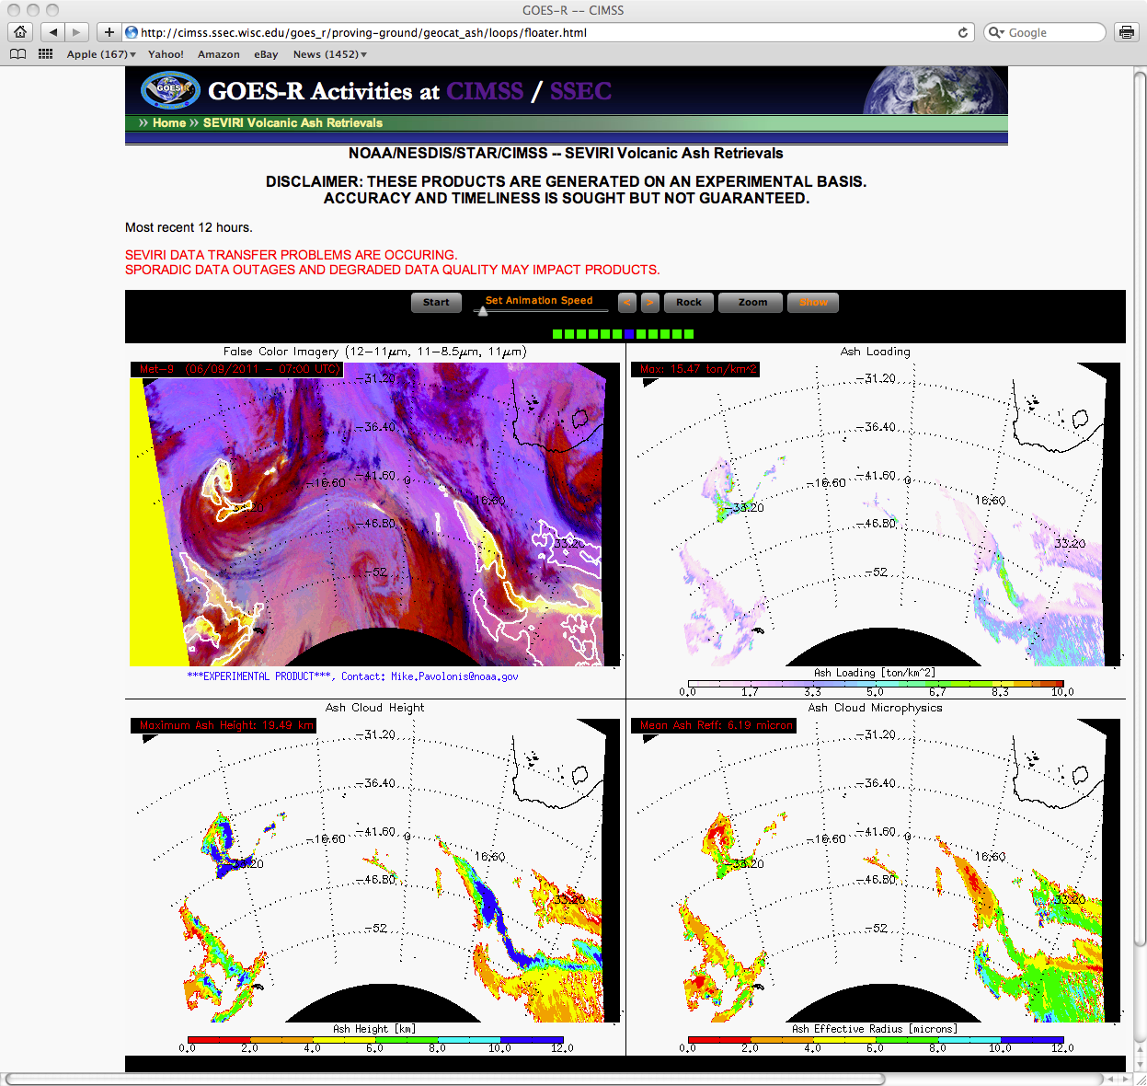
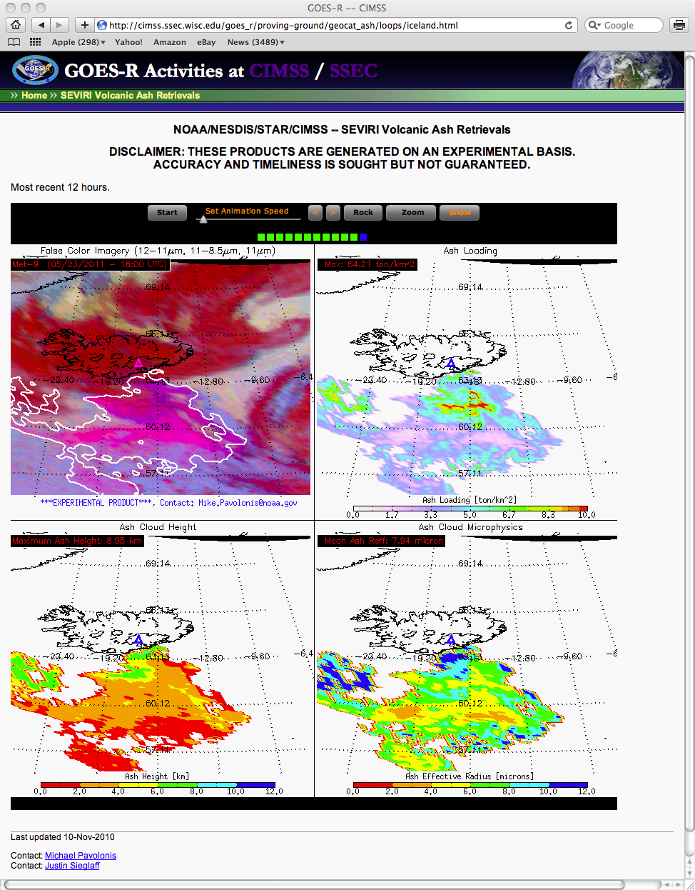
http://cimss.ssec.wisc.edu/goesr/proving-ground/geocat_ash
Cordon Caulle
Grimsvotn
Using contours to highlight quantitative product (over RGB)
Pavolonis
Notes:
Using contours is one method to “combine” a quantitative product with an RGB.
-June 4
-May 21

Slide 37
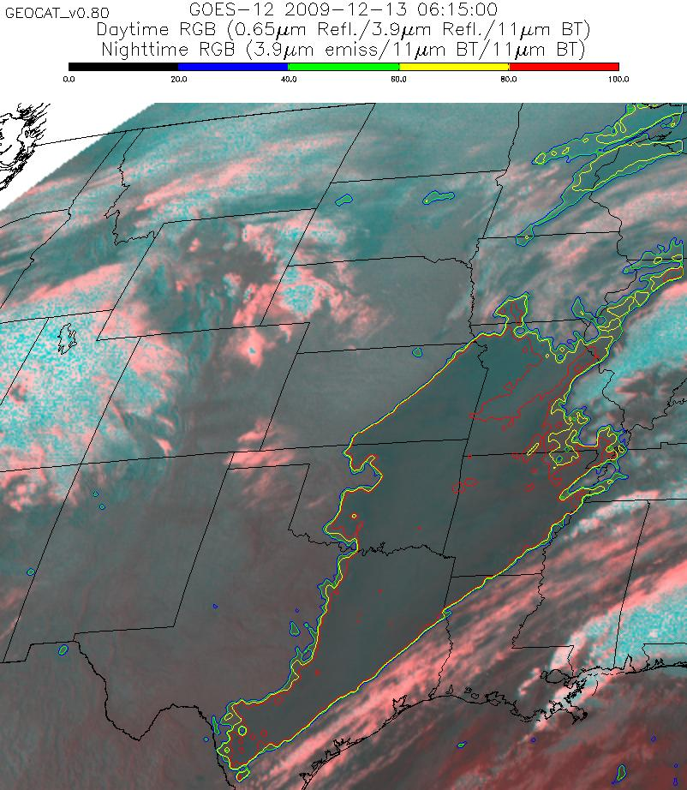
The quantitative assessment of cloud ceiling can be overlaid on top of imagery to make the product more appealing to forecasters.
The ability to contour the IFR and MVFR probabilities will soon be available in AWIPS.
Using contours to highlight quantitative product (over RGB)
Pavolonis
Notes:
Using contours is one method to “combine” a quantitative product with an RGB. This case for cloud ceilings.

Slide 38
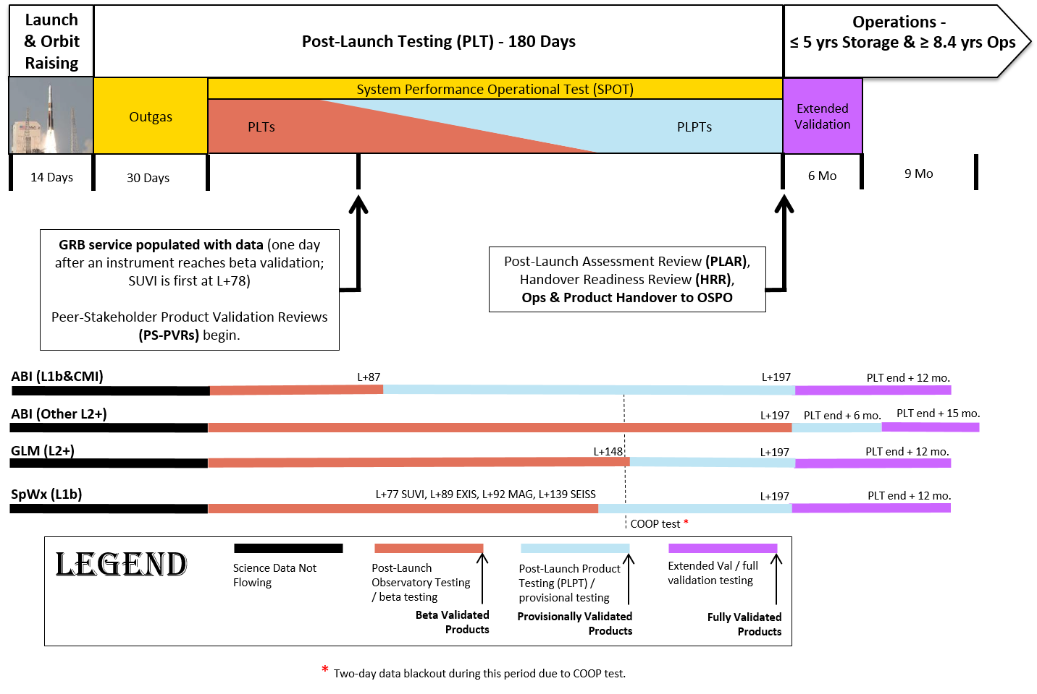
Data Release Strategy
Internal Flow
L+15 Days
External Distribution
L+78 Days
Operations Handover
L+6 Months
East/West Assignment
L+12 Months
Declaration of Maturity
Milestones occurs at
Peer-Stakeholder Product
Validation Reviews (PS-PVRs)
Notes:
ABI L1b requires more cal/val than previous GOES Imagers, which is why cal/val will take longer. The ABI L1b data quality could be considered analogous to MODIS.

Slide 39
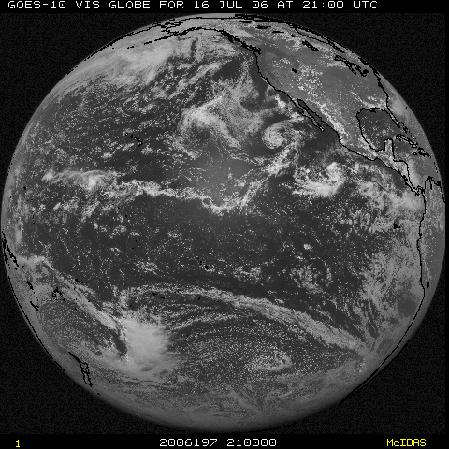
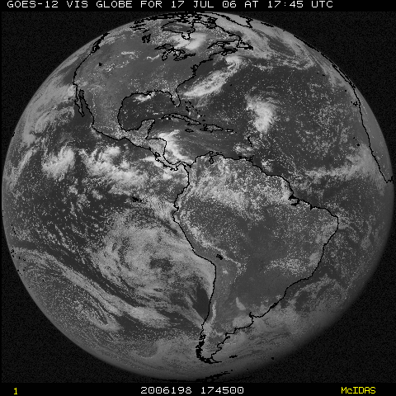
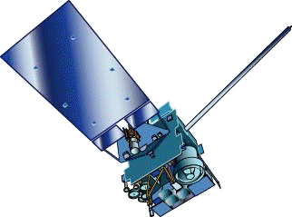
NOAA GOES Constellation
GOES-13
(75W)
GOES-15
(135W)
Operational
Operational
GOES-14
(105W)
Back-up
Notes:
Template footer obscured. Fixed.
Estimate during mid-2010.

Slide 40
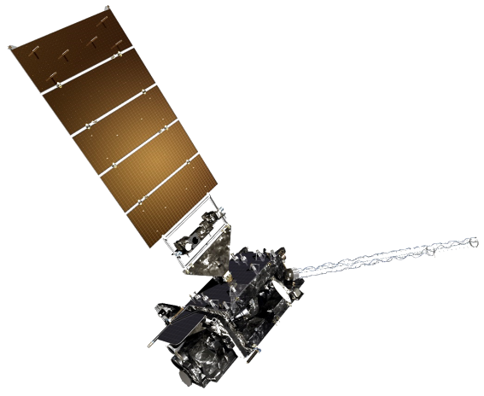
NOAA GOES Constellation
GOES-13 or -14
(75W)
GOES-15 or -14
(135W)
Operational
Operational
GOES-16
(90W)
PLT/PLPT
Notes:
Template footer obscured. Fixed.
Estimate during mid-2010.

Slide 41
NOAA GOES Constellation
GOES-16
(75W)
GOES-15 or -14
(135W)
Operational
Operational
Inconsistent views wrt resolutions from East and West
GOES-17
(90W)
PLT/PLPT
Notes:
Template footer obscured. Fixed.
Estimate during mid-2010.

Slide 42
NOAA GOES Constellation
GOES-13 or -14
(75W)
GOES-16
(137W)
Operational
Operational
Inconsistent views wrt resolutions from East and West
GOES-17
(90W)
PLT/PLPT
Notes:
Template footer obscured. Fixed.
Estimate during mid-2010.

Slide 43
NOAA GOES Constellation
GOES-16 or -17
(75W)
GOES-16 or -17
(137W)
Operational
Operational
Consistent views wrt resolutions from East and West
GOES-18
(90W)
PLT/PLPT
Notes:
Template footer obscured. Fixed.
Estimate during mid-2010.

Slide 44
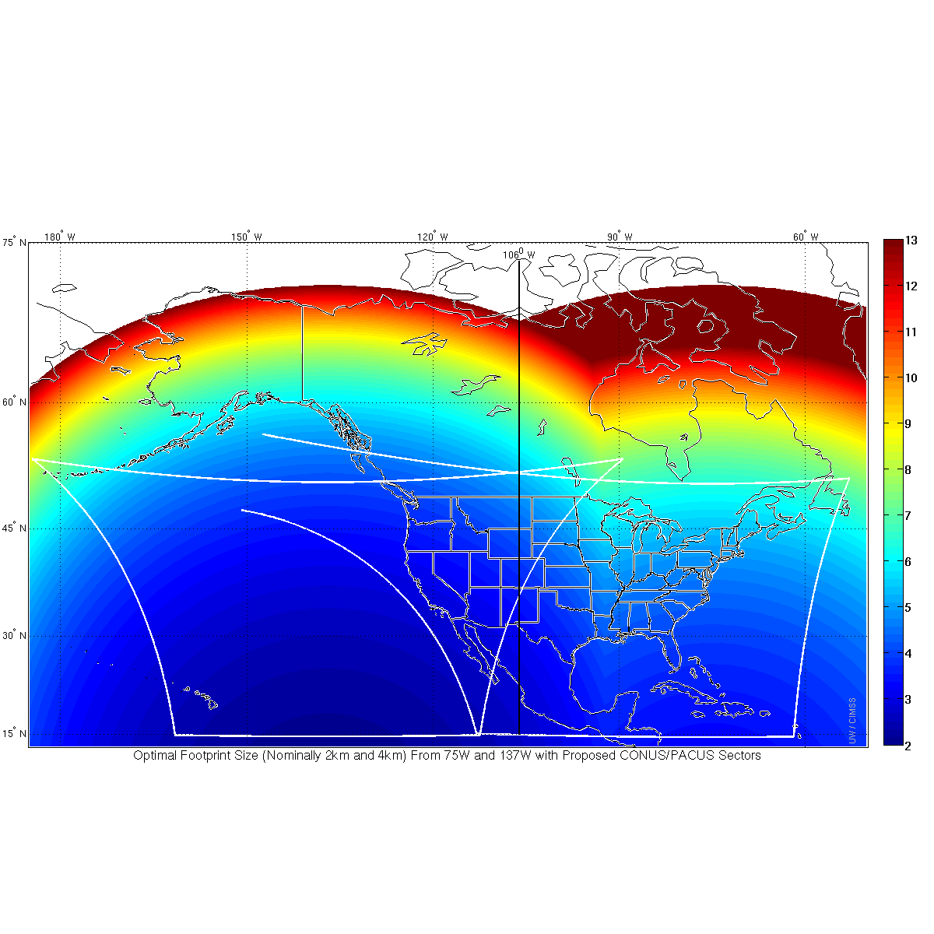
GOES-R as GOES West
GOES-13 as GOES East
Infrared Resolution color coded
106 W
GOES-R resolution is better than GOES-13 far to the east of the midpoint
(106 W) between the two sub-satellite points (all the way to ~92 W!)
Similarly, if GOES-R were GOES-East, there would be better pixel resolution
Compared to GOES-15 all the way to 120 W!

Slide 45
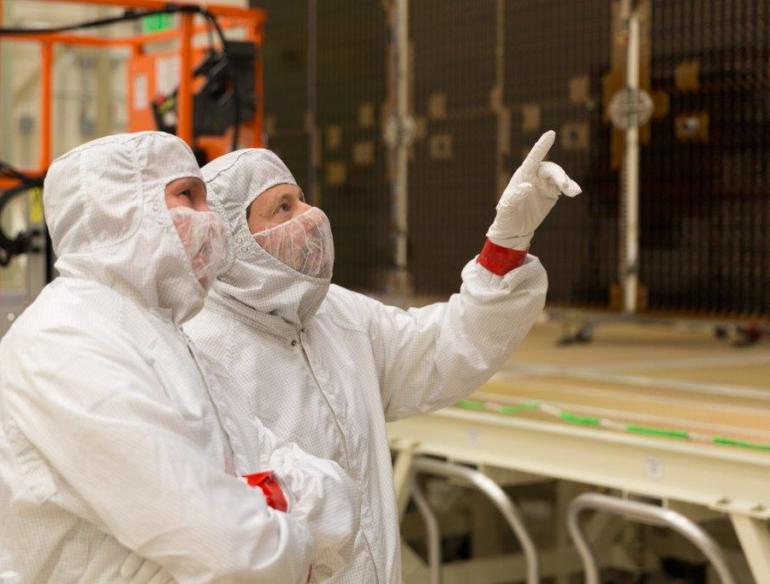
GOES-R Series web site
http://www.goes-r.gov
Lockheed Martin

Slide 46
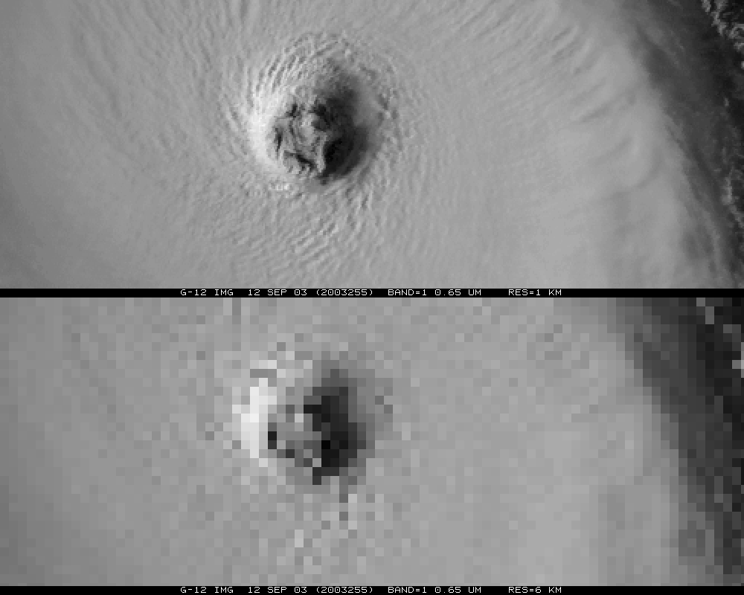
~1 km
~6 km
Notes:
ABI band 2 (0.6 micrometers) will be finer resolution than the imagery shown and the 6km may be worse since this is 6km in a Mercator.

Slide 47
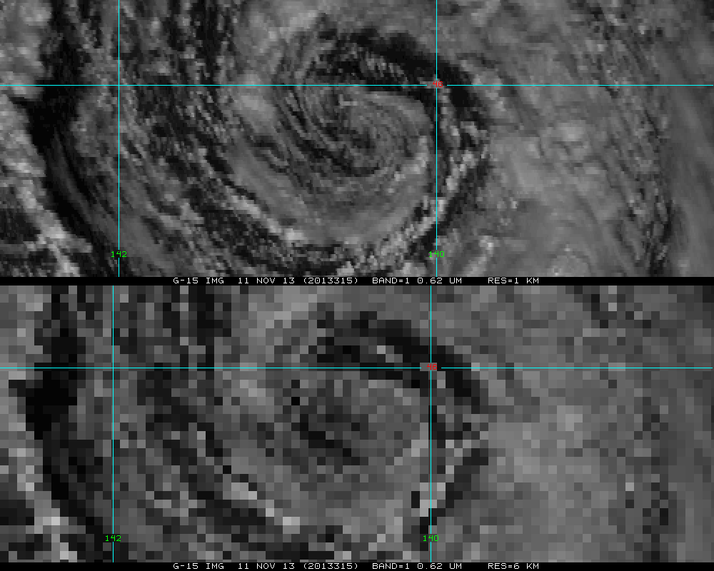
~1 km
~6 km
Notes:
ABI band 2 (0.6 micrometers) will be finer resolution than the imagery shown and the 6km may be worse since this is 6km in a Mercator.

