Slide 1


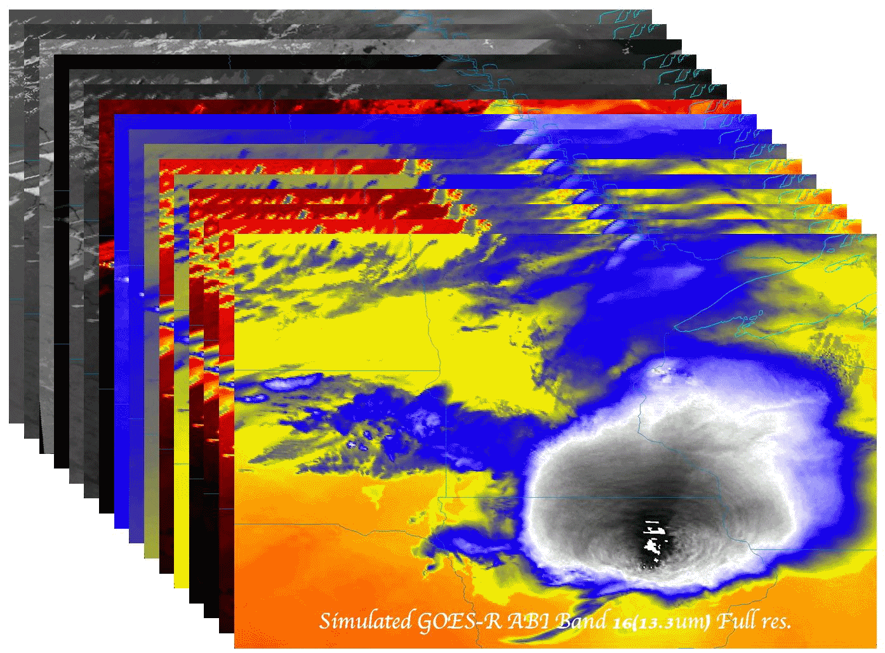

The ABI on GOES-R Series
  Timothy J. Schmit (tim.j.schmit@noaa.gov)
NOAA/NESDIS/Satellite Applications and Research
Advanced Satellite Products Branch (ASPB)
  Jordan Gerth (jordan.gerth@noaa.gov)
CIMSS
Madison, WI
Plus many, many more…
GOES-R User Readiness
Kansas City
June 16, 2015
UW-Madison

Slide 2

Thanks to…
Paul Menzel, Steven J. Goodman, Daniel T. Lindsey, Robert M. Rabin, Kristopher M. Bedka, John L. Cintineo, Christopher S. Velden, A. Scott Bachmeier, Scott Lindstrom, Mat Gunshor, Chris Schmidt
Kaba Bah, Joleen Feltz, Tom Whittaker, Margaret Mooney, Andy Heidinger, William Straka, Jun Li, Steve Ackerman, Bob Aune, Don Hillger, Tony Schreiner, Justin Sieglaff, Jim Jung, Elaine Prins, Brad Pierce, Wayne Feltz, Jean Phillips, Linda Hedges, Jim Nelson, Gary Wade, Don Hillger, Jinlong Li, Jing Zheng, Allen Huang, Bob Rabin, the SSEC data center, Mike Pavolonis, Jaime Daniels, ASPB, STAR, NESDIS, NSSL, MUG, Kevin Ludlum, GOES operators, GOES shift supervisors, Mark DeMaria, Dave Martin, Joe Schmit and many others!
GOES-R Program Office, Greg Mandt, NASA, Exelis Industries, Lockheed Martin, and other industry partners, etc.
You.

Slide 3
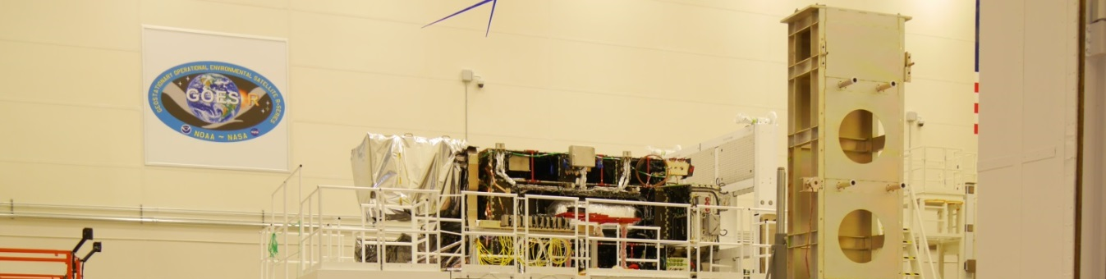
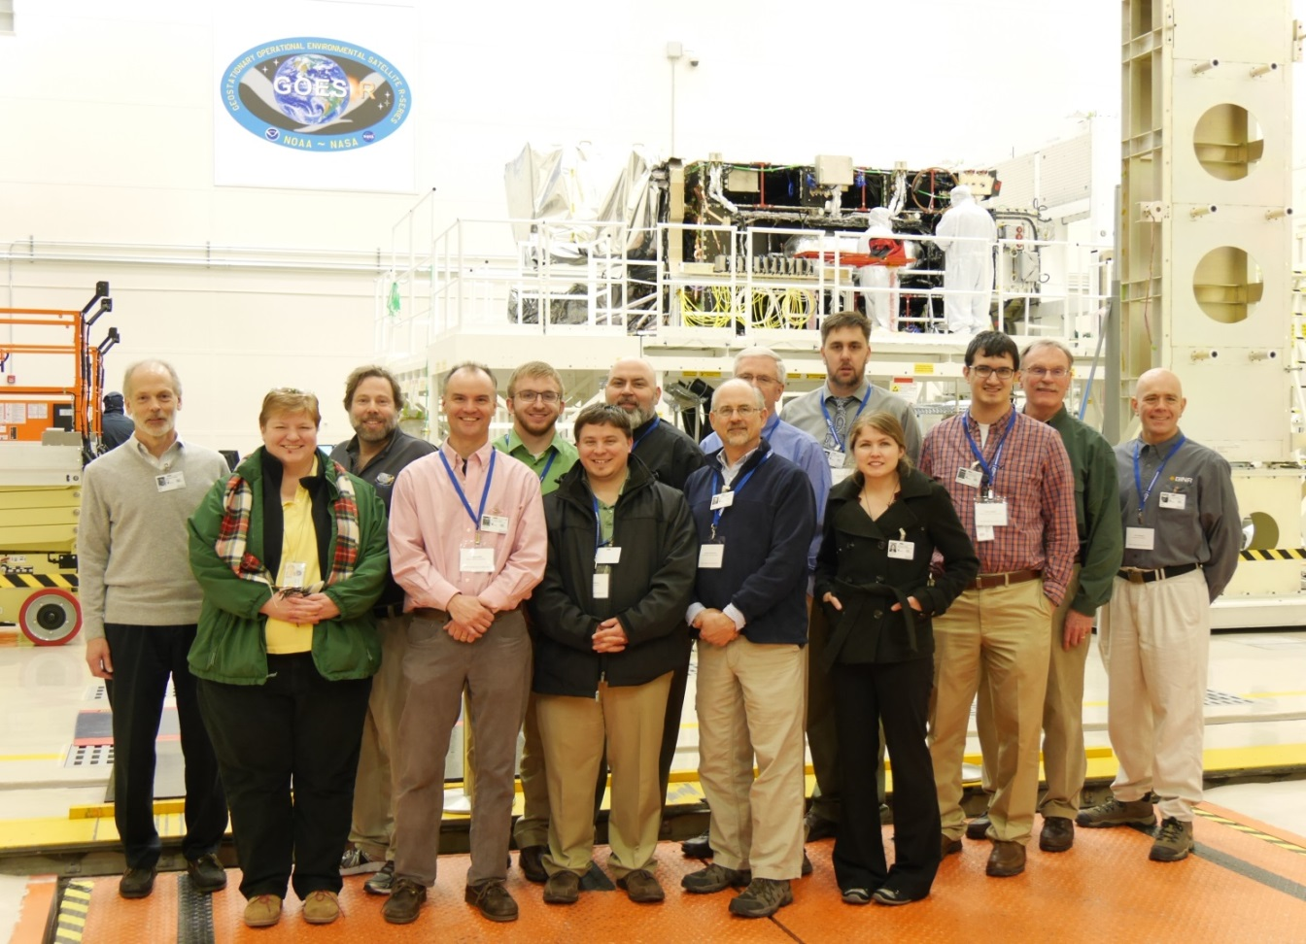
Outline
Overview
ABI
  Spectral
  Temporal
  Spatial
Other
Summary
More information
Lockheed Martin

Slide 4
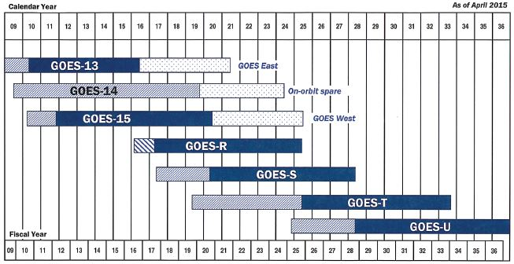
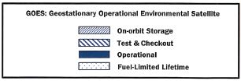

GOES Flyout Chart w/
Fuel-Limited Lifetime Phase Added

Slide 5

Validation and Availability for GOES-R Baseline Products
GOES-R Launch
to 89.5° West
Operations Handover
(includes Products)
On-Orbit East/West
Operations
Milestone:
Program Phase:
Extended Validation
Pre-Launch | PLT (6 months) | Post-Handover
L1b Product Activities
L1b Validation - Products recertified against pre-launch instrument performance
‘First Light’ Data captures shared from Instruments
Insertion of L1b products into GRB service is controlled by ground system and will occur as products are certified
(Figure from Matt Seybold from NOAA Satellite Conference)
Notes:
More precisely: L1b Validation – On-orbit product performance recertified against pre-launch analytically-predicted product performance.

Slide 6
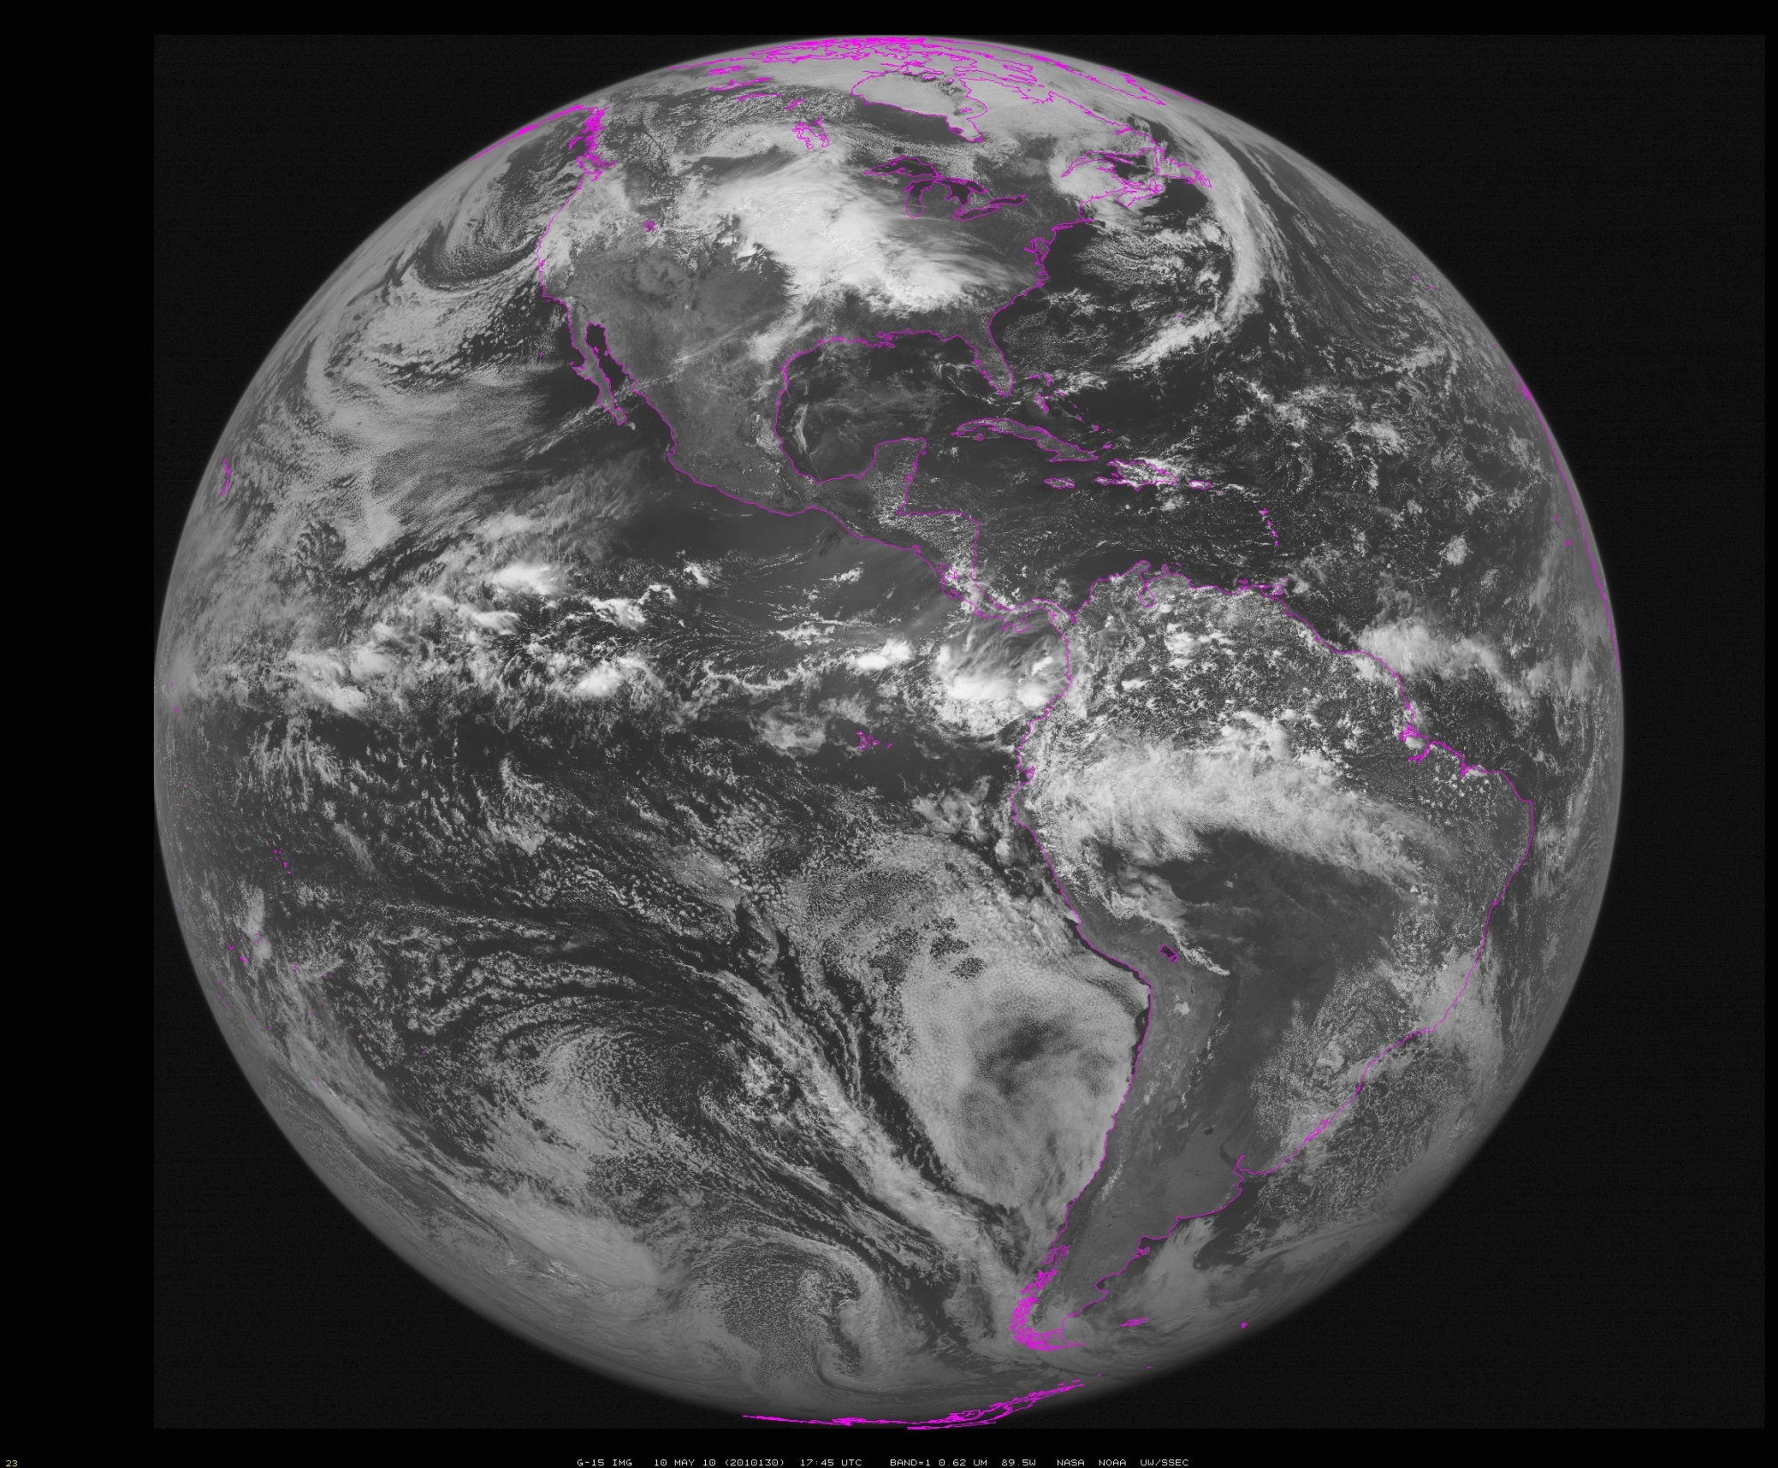
~90W (Approximate location of GOES-R during check-out)
Notes:
Data from SSEC Data Center

Slide 7
The Advanced Baseline Imager:
ABI Current
Spectral Coverage
16 bands 5 bands
Spatial resolution
0.64 μm Visible 0.5 km Approx. 1 km
Other Visible/near-IR 1.0 km n/a
Bands (>2 μm) 2 km Approx. 4 km
Spatial coverage
Full disk Every 15 min Scheduled (3 hrly)
CONUS Every 5 min ~4 per hour
Mesoscale Every 30 sec n/a
Visible (reflective bands)
On-orbit calibration Yes No
Notes:
The ABI allows more bands, finer spatial resolution, faster refresh rates and on-orbit calibration of all bands!

Slide 8
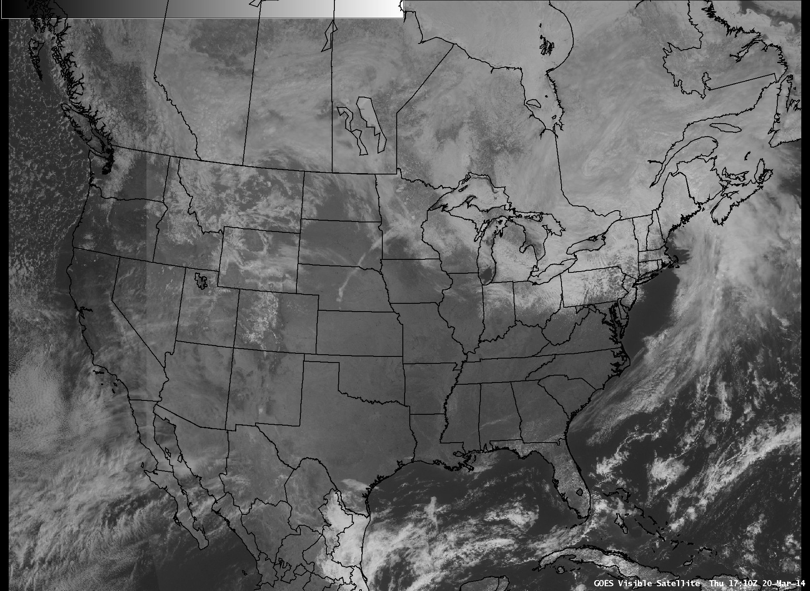
seam

Slide 9

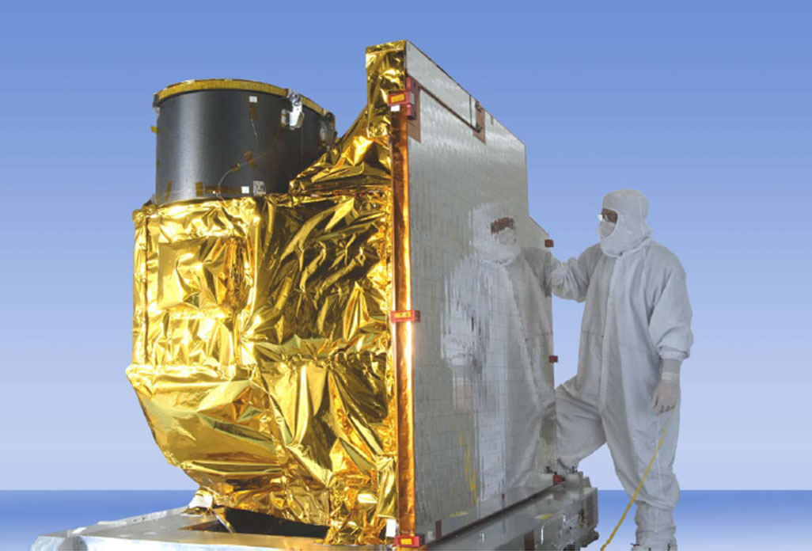
Advanced Baseline Imager
5
4
3
X
Faster coverage
(5-minute full disk vs. 25-minute)
X
Improved spatial
resolution
(2 km IR vs. 4 km)
X
More spectral bands (16 on ABI vs. 5 on the current imager)
Notes:
Slide from J. Gerth, CIMSS.

Slide 10
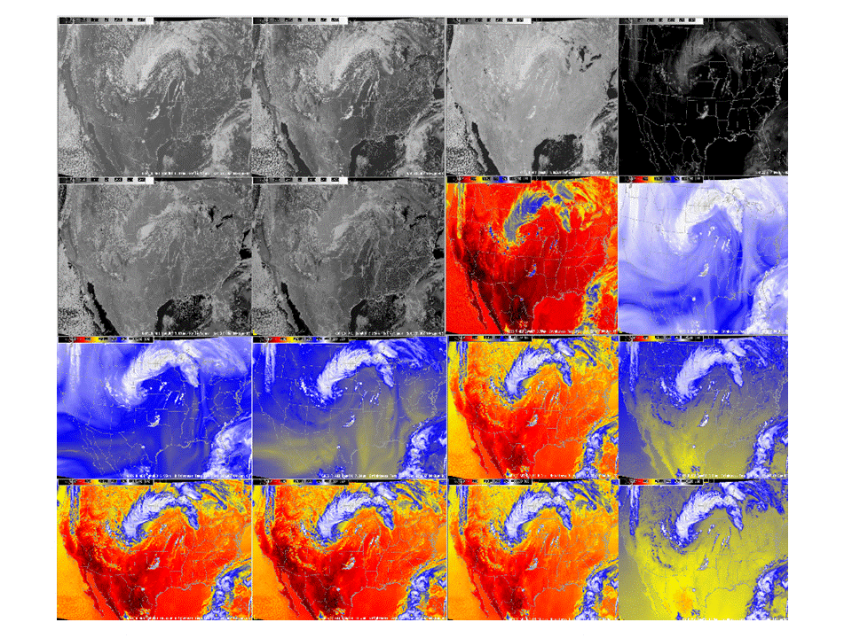
Simulated ABI bands (as shown in AWIPS)
0.47 μm
0.64 μm
0.86 μm
1.38 μm
1.61 μm
2.26 μm
3.9 μm
6.19 μm
6.95 μm
7.34 μm
8.5 μm
9.61 μm
10.35 μm
11.2 μm
12.3 μm
13.3 μm

Slide 11
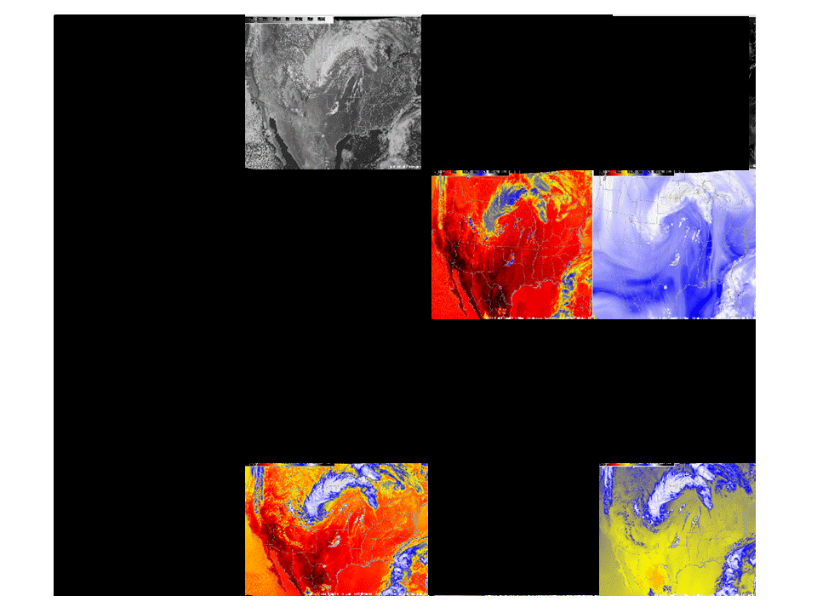
Current GOES Imager band selection

Slide 12
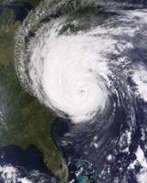
Outline
Overview
ABI
  Spectral
  Temporal
  Spatial
Other
Summary
More information

Slide 13
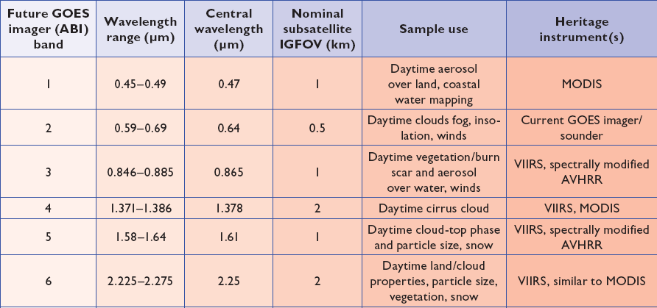
ABI bands 1-6
Approximate:
2 visible bands and 4 near infrared bands on the ABI, compared to only one on today’s imager
Notes:
Final column added: heritage. The ABI band 1 was suggested by Dr. Fred Mosher at a GOES Users' Conference.
The ABI band 3 was suggested by the late Dr. C. Rao (of the then ORA).
Some of these bands have been shifted to more closely match those on the VIIRS.

Slide 14
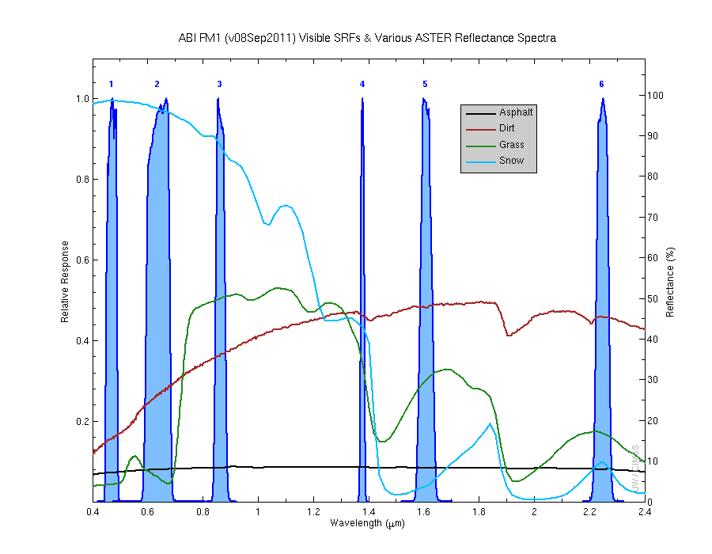
Visible and near-IR channels on the ABI
Aerosols, Insolation
Clouds, Snow
Vegetation, Imagery
Cloud mask, Suspended matter
Snow, Phase
Cloud Particle size
Sample use only, many other uses
The ABI visible and near-IR bands have many uses.
Notes:
Schmit, T. J., M. M. Gunshor, W. P. Menzel, J. J. Gurka, J. Li, and A. S. Bachmeier, 2005: Introducing the next-generation Advanced Baseline Imager on GOES-R. Bull. Amer. Meteor. Soc., 86, 1079-1096.

Slide 15
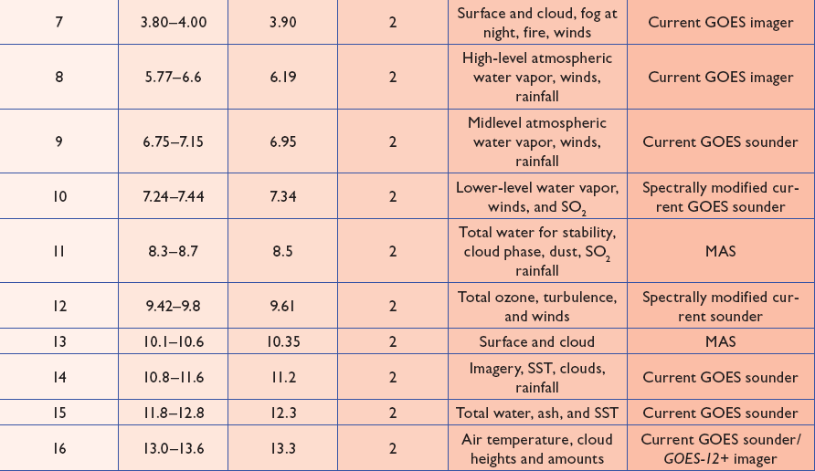
ABI bands 7-16
Approximate:
10 infrared bands on the ABI, compared to four on today’s imager
Notes:
The ABI band 10 was modified to better depict upper-level SO2. (G. Ellrod and others)
The ABI band 11 was suggested by Steve Ackerman (CIMSS), based on HIRS experience.
The ABI band 13 was suggested by W. P. Menzel (then NOAA NESDIS).

Slide 16
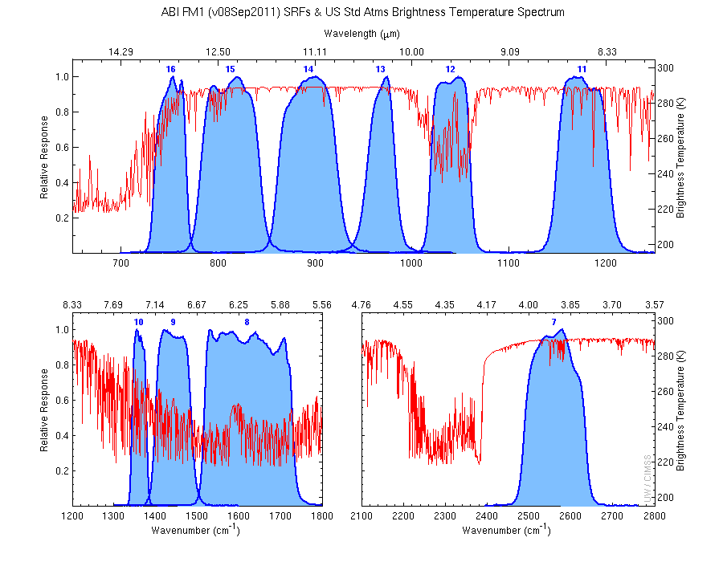
The IR channels on the ABI
Clouds, Stability Indices
Cloud Phase, SO2, dust
Fires, Radiances
Ozone, Downward Radiation
Rainfall, Aerosol
Hurricane, Imagery
Sample use only, many other uses
SO2, Radiances
Winds, WV profiling
TPW, Rainfall rate
Fires, Fog
ABI has many more bands than the current operational GOES imagers.
Notes:
Schmit, T. J., M. M. Gunshor, W. P. Menzel, J. J. Gurka, J. Li, and A. S. Bachmeier, 2005: Introducing the next-generation Advanced Baseline Imager on GOES-R. Bull. Amer. Meteor. Soc., 86, 1079-1096.

Slide 17
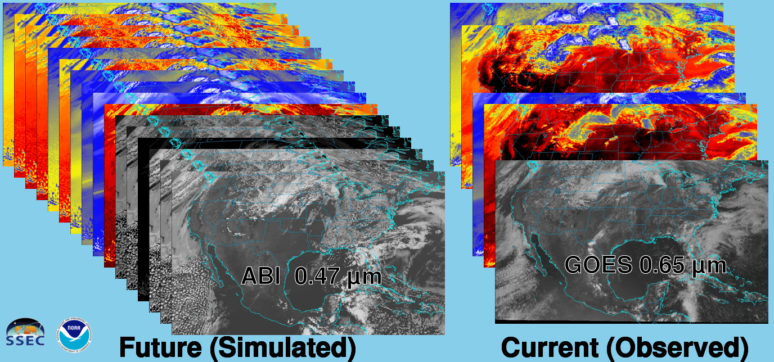
Future vs. Current Spectral Bands
The current GOES (right) has 5 spectral bands, while the GOES-R series ABI (left) will have 16 spectral bands.

Slide 18
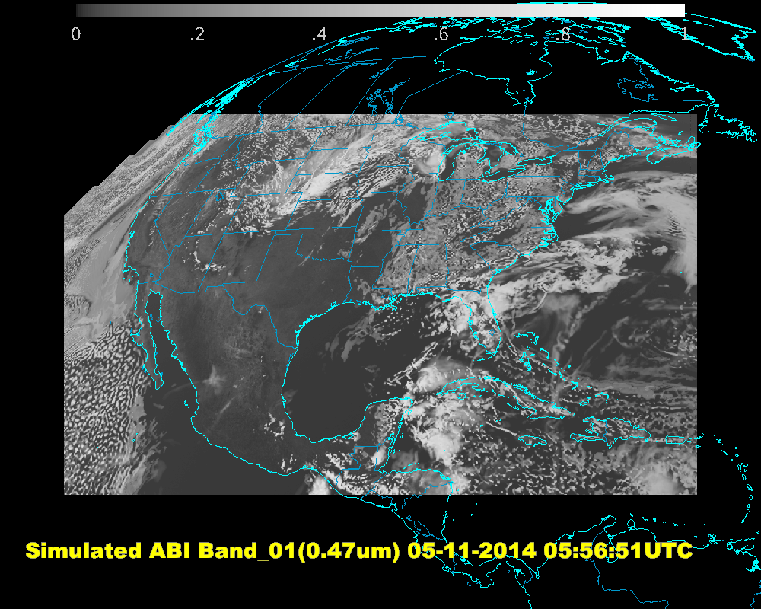
ABI Band 01 Generated by DOE-0, Visualized by McIDAS-V Script
Notes:
This date & time is a processing time, not the time the data represent.

Slide 19
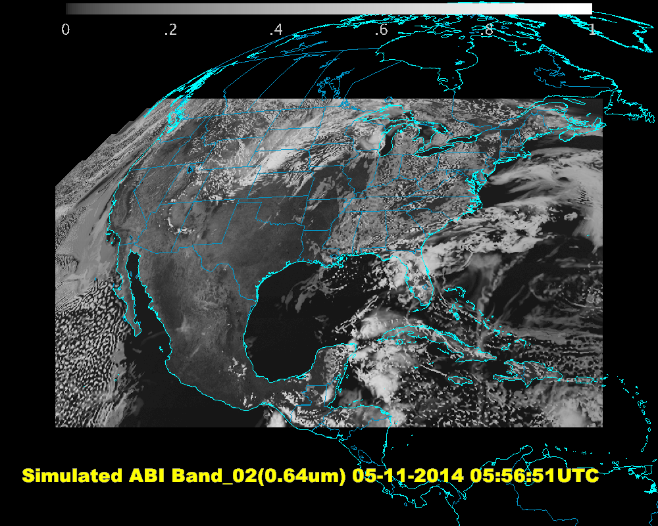
ABI Band 02 Generated by DOE-0, Visualized by McIDAS-V Script

Slide 20
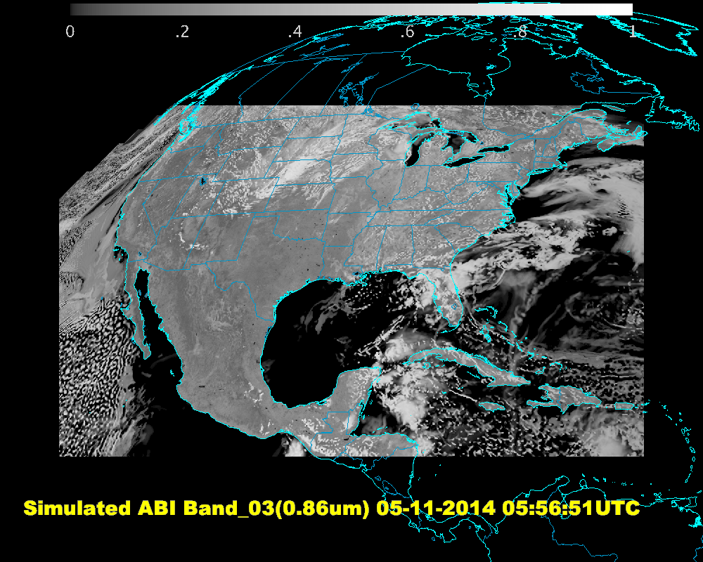
ABI Band 03 Generated by DOE-0, Visualized by McIDAS-V Script

Slide 21
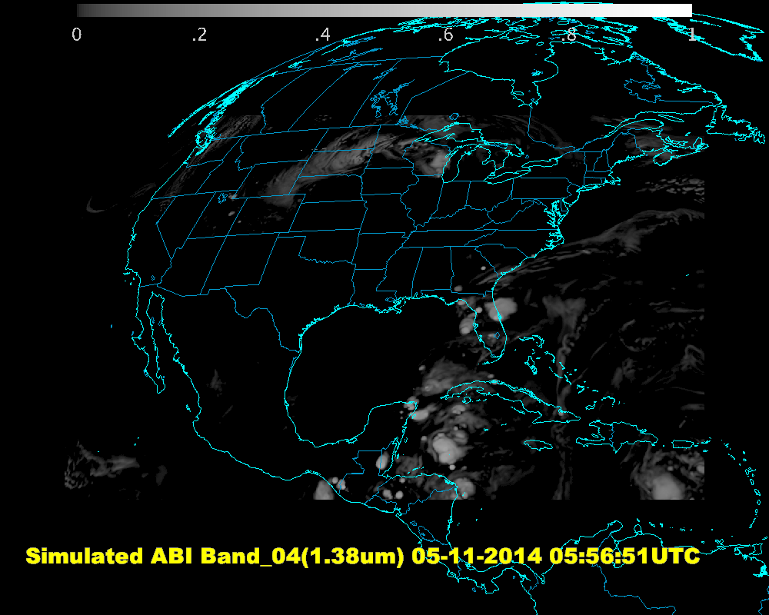
ABI Band 04 Generated by DOE-0, Visualized by McIDAS-V Script

Slide 22
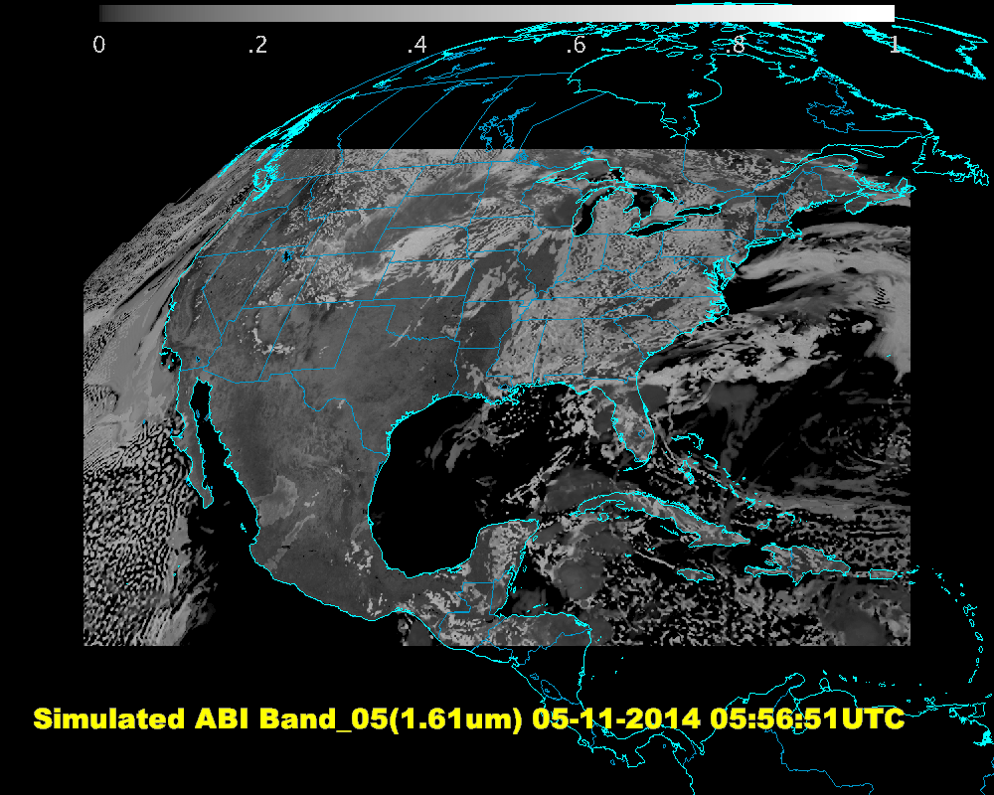
ABI Band 05 Generated by DOE-0, Visualized by McIDAS-V Script

Slide 23
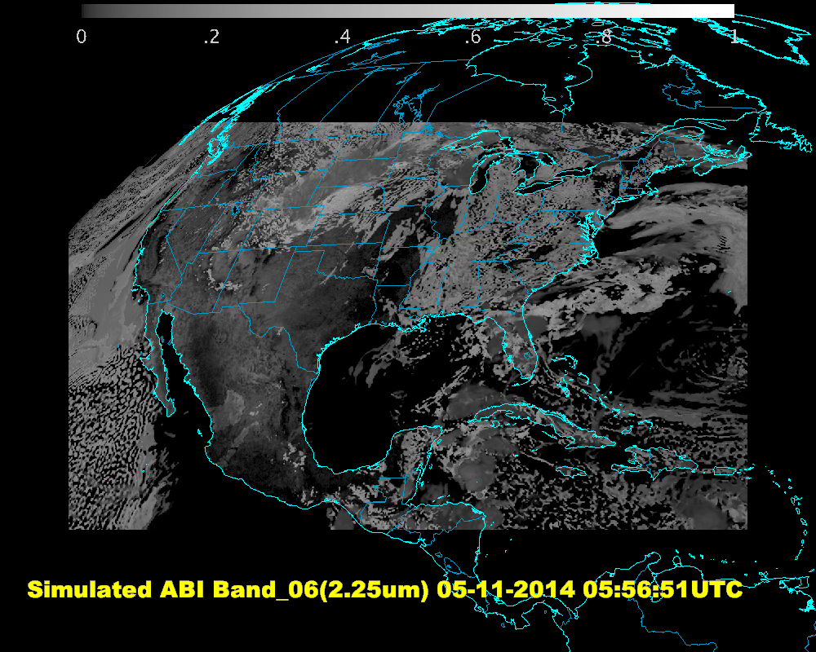
ABI Band 06 Generated by DOE-0, Visualized by McIDAS-V Script

Slide 24
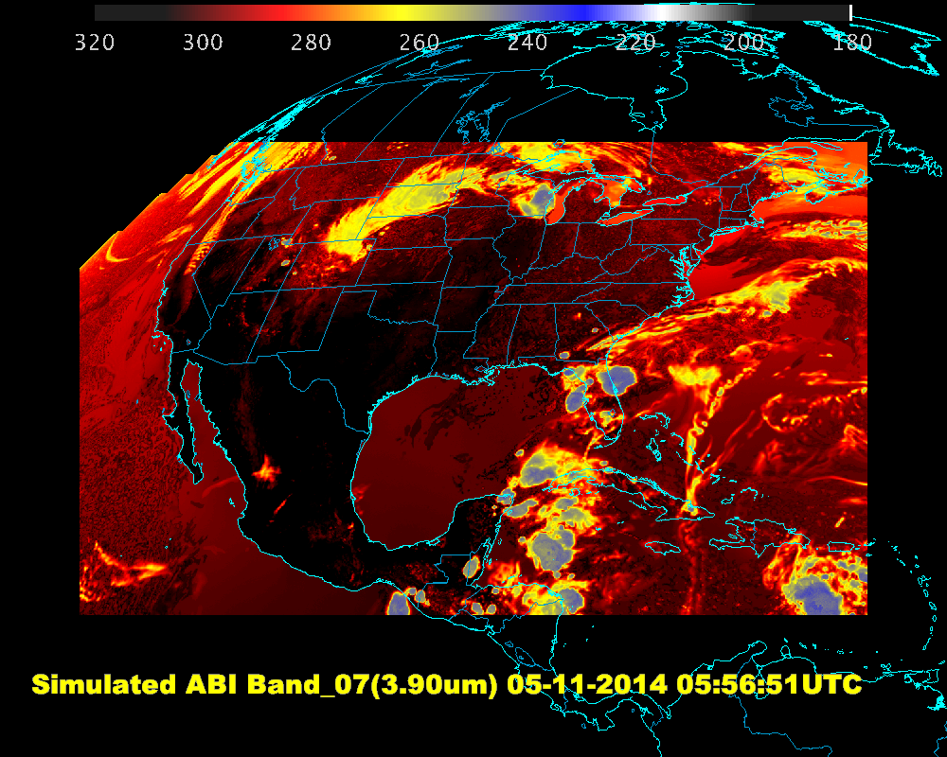
ABI Band 07 Generated by DOE-0, Visualized by McIDAS-V Script

Slide 25
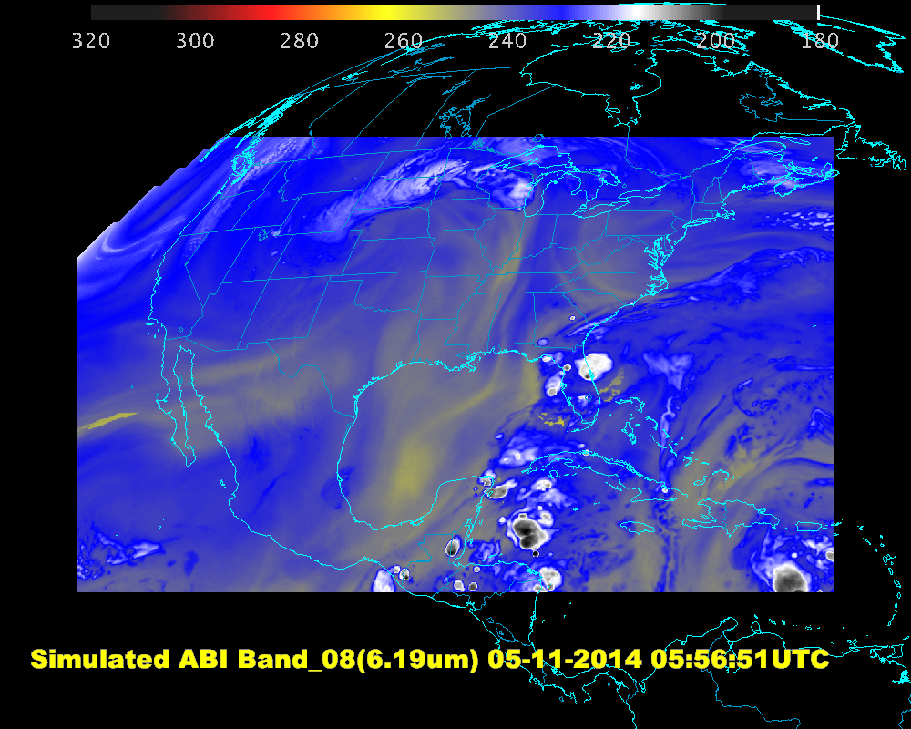
ABI Band 08 Generated by DOE-0, Visualized by McIDAS-V Script

Slide 26
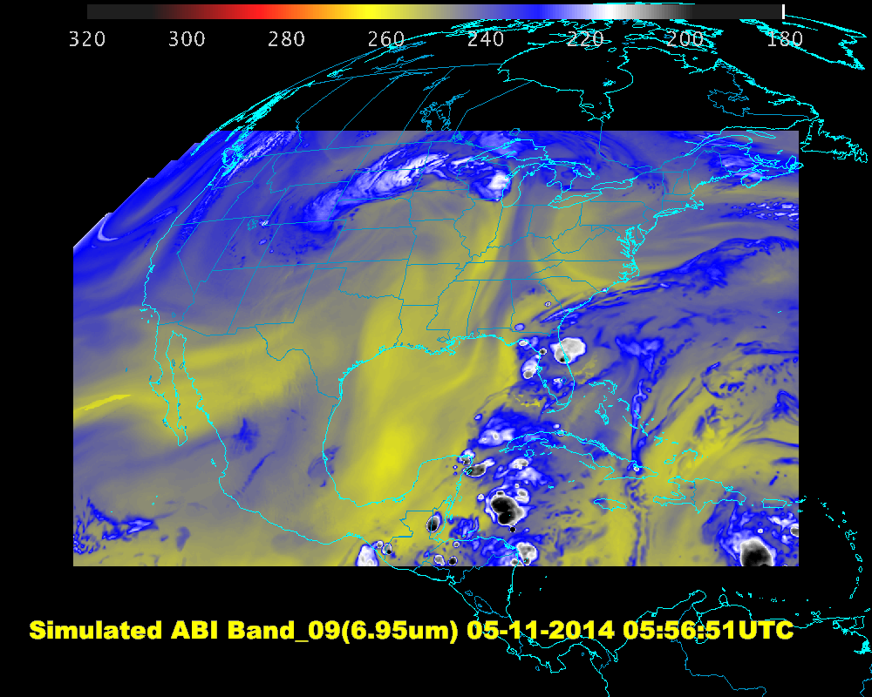
ABI Band 09 Generated by DOE-0, Visualized by McIDAS-V Script

Slide 27
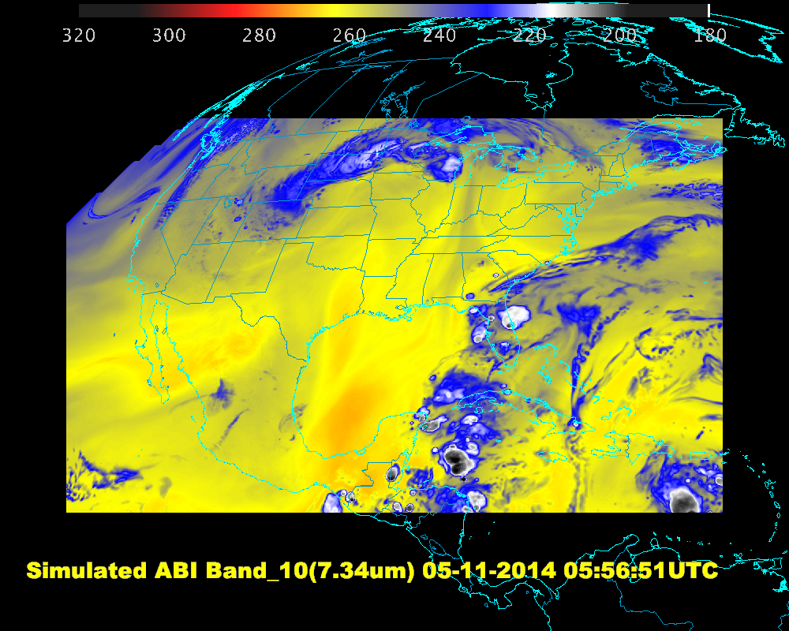
ABI Band 10 Generated by DOE-0, Visualized by McIDAS-V Script

Slide 28
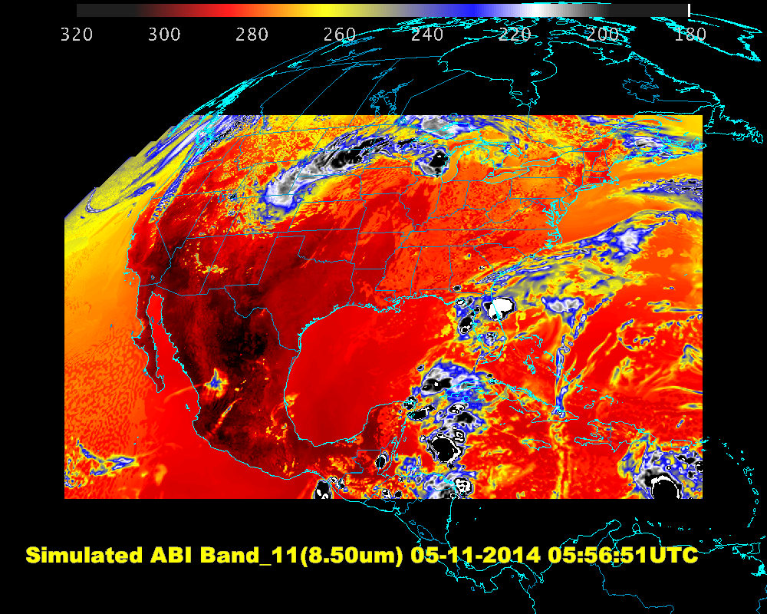
ABI Band 11 Generated by DOE-0, Visualized by McIDAS-V Script

Slide 29
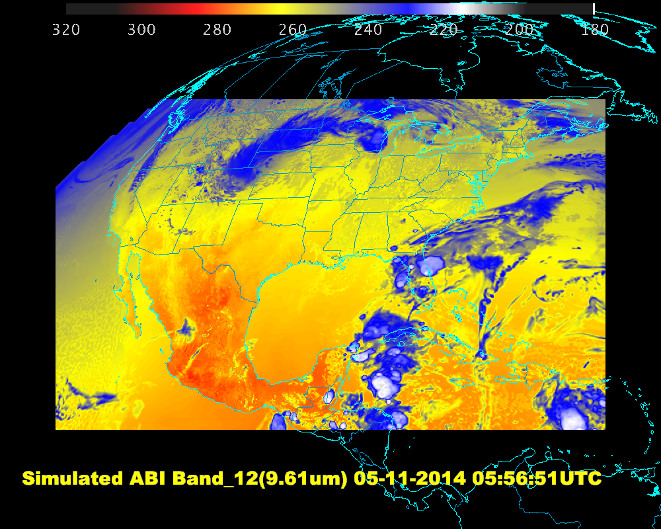
ABI Band 12 Generated by DOE-0, Visualized by McIDAS-V Script

Slide 30
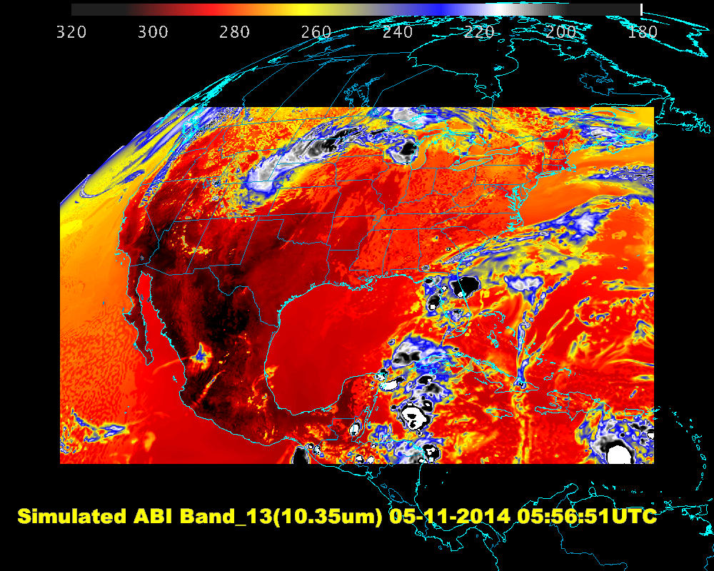
ABI Band 13 Generated by DOE-0, Visualized by McIDAS-V Script

Slide 31
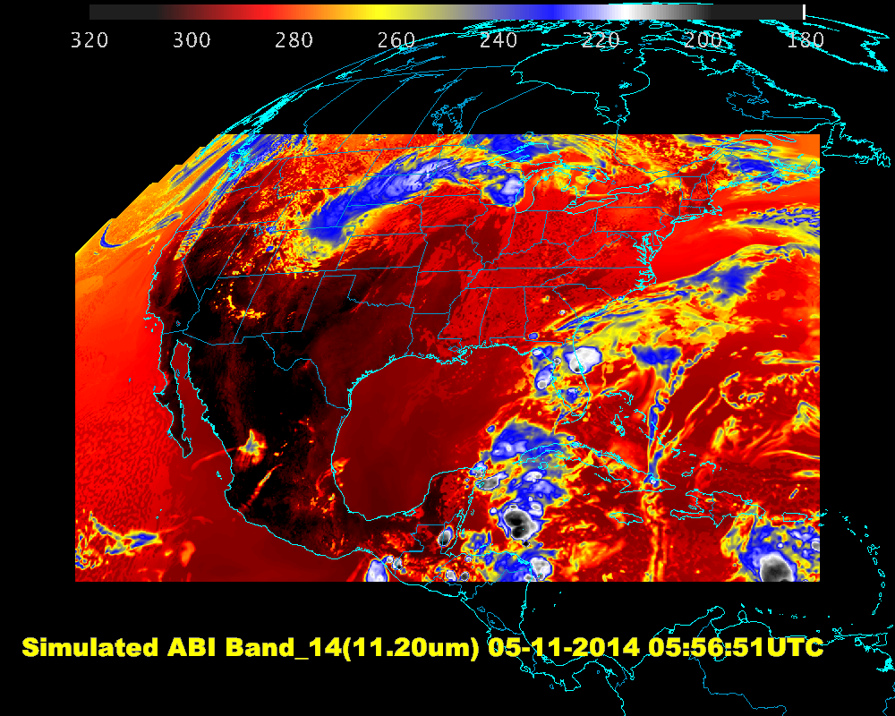
ABI Band 14 Generated by DOE-0, Visualized by McIDAS-V Script

Slide 32
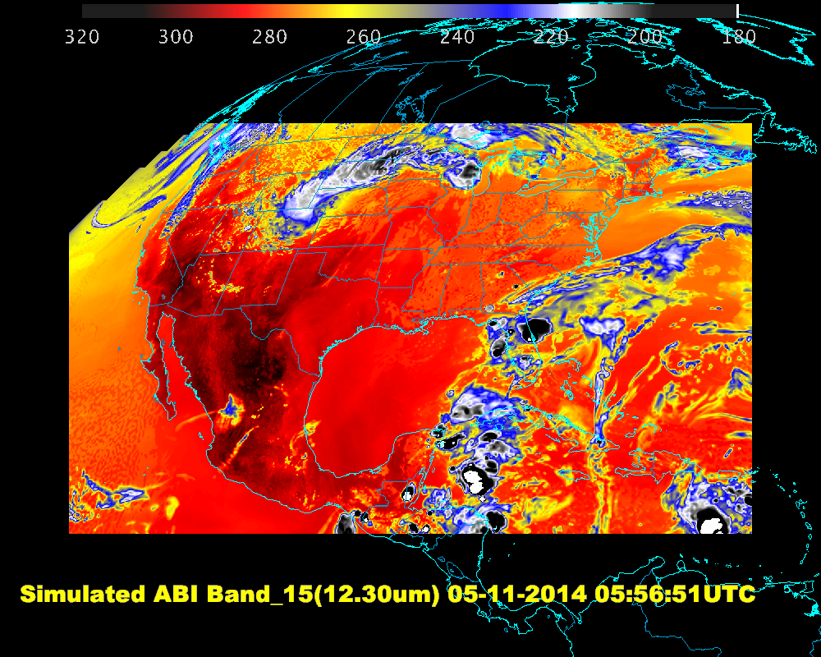
ABI Band 15 Generated by DOE-0, Visualized by McIDAS-V Script

Slide 33
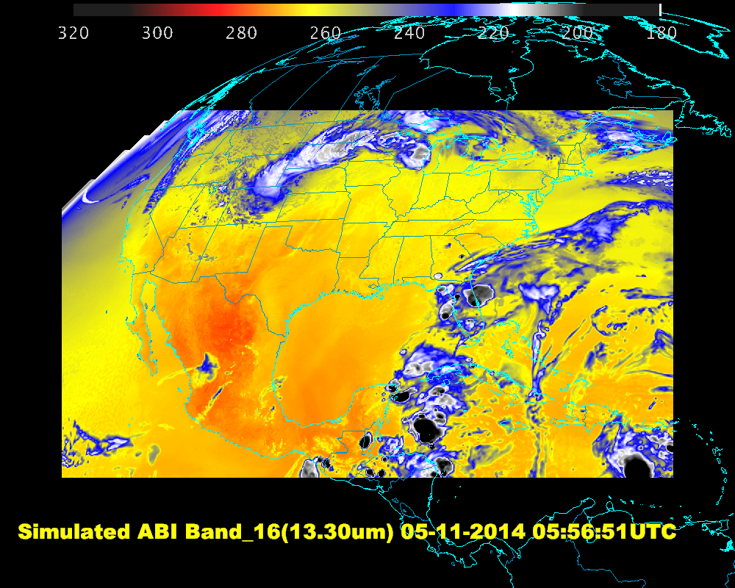
ABI Band 16 Generated by DOE-0, Visualized by McIDAS-V Script

Slide 34
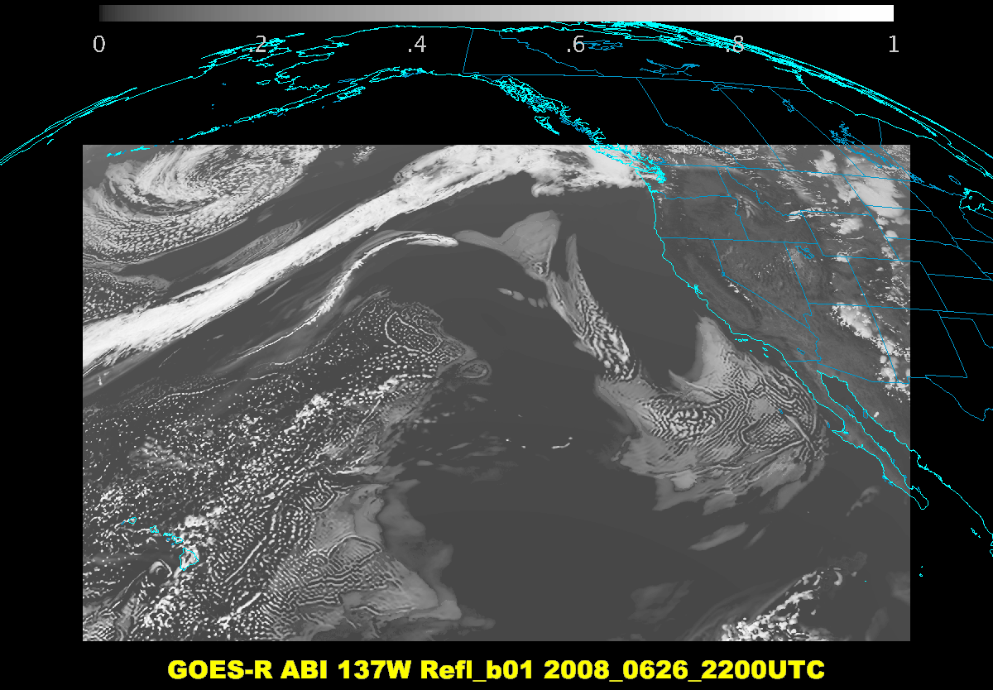
0.47 um

Slide 35
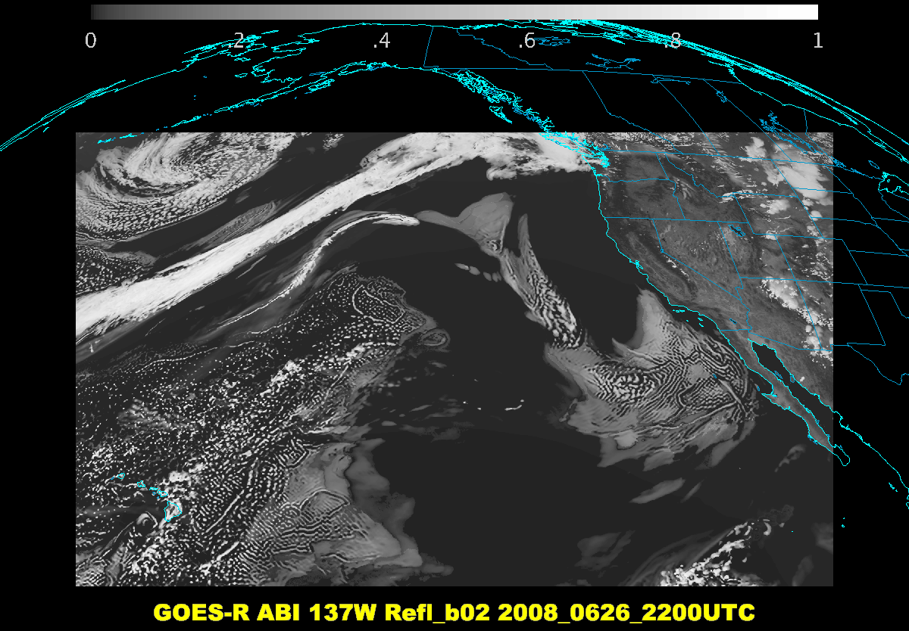
0.64 um

Slide 36
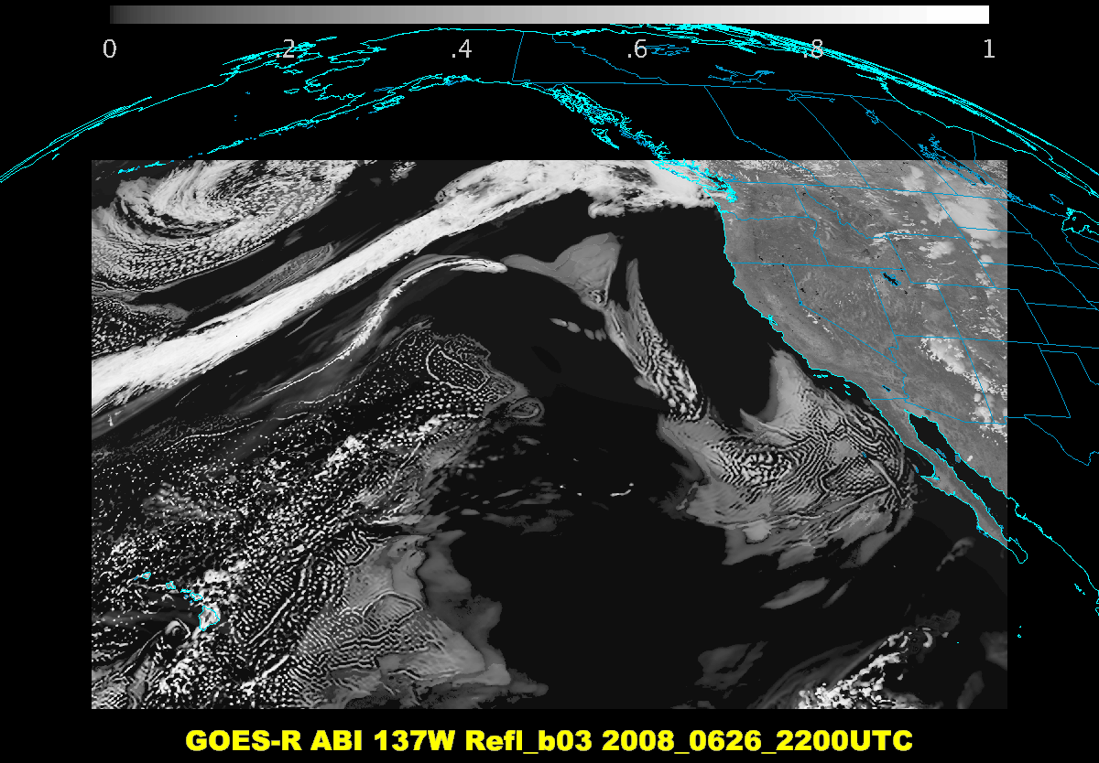
0.86 um

Slide 37
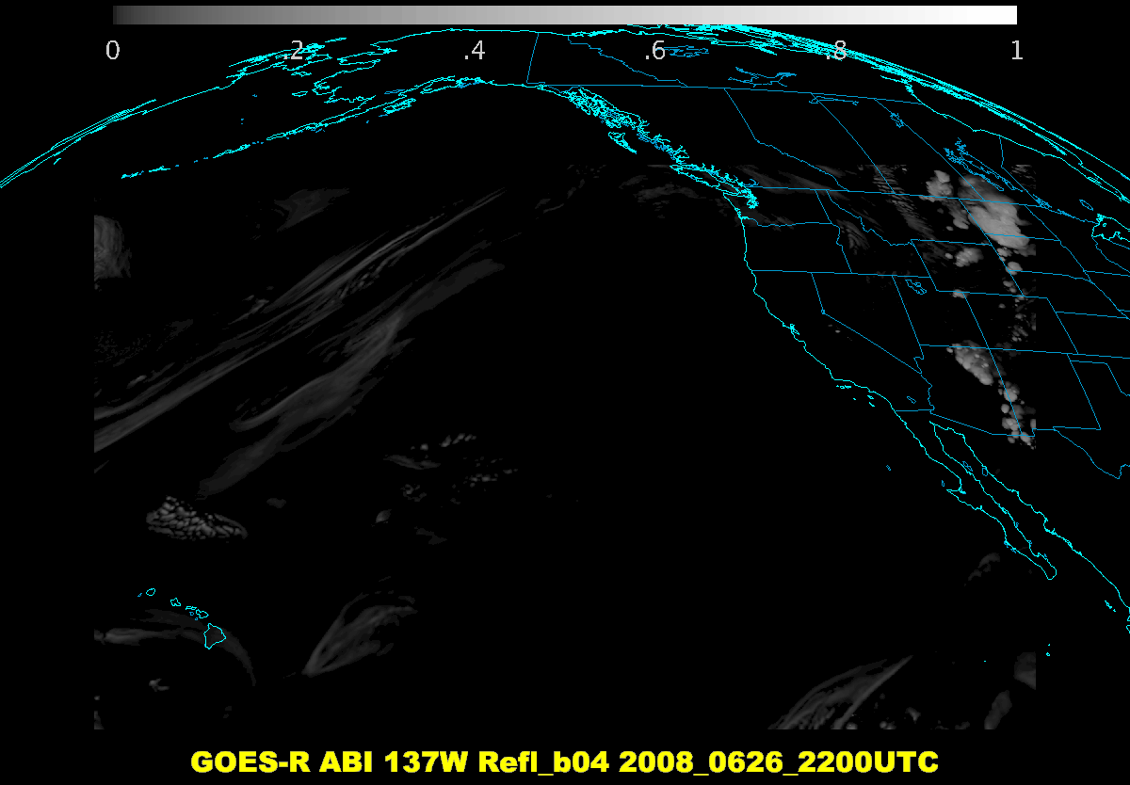
1.37 um

Slide 38
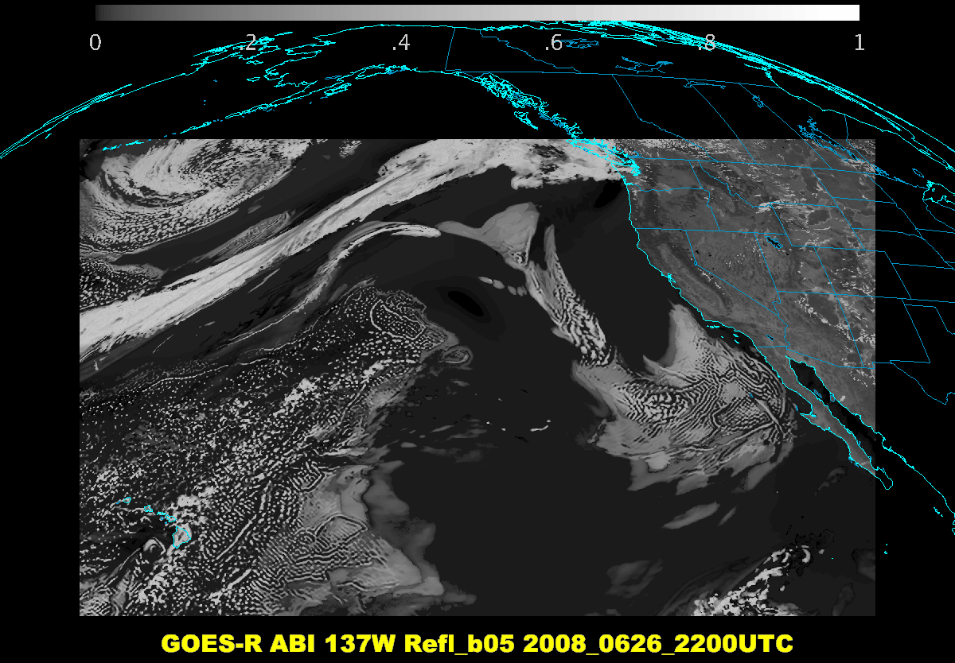
1.6 um

Slide 39
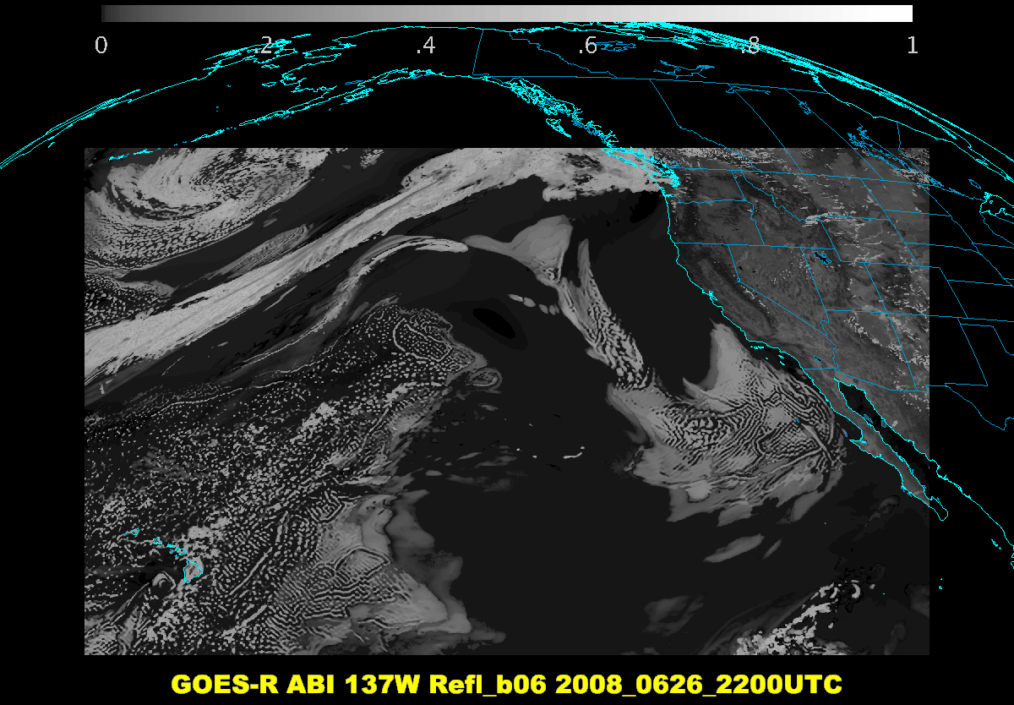
2.24 um

Slide 40
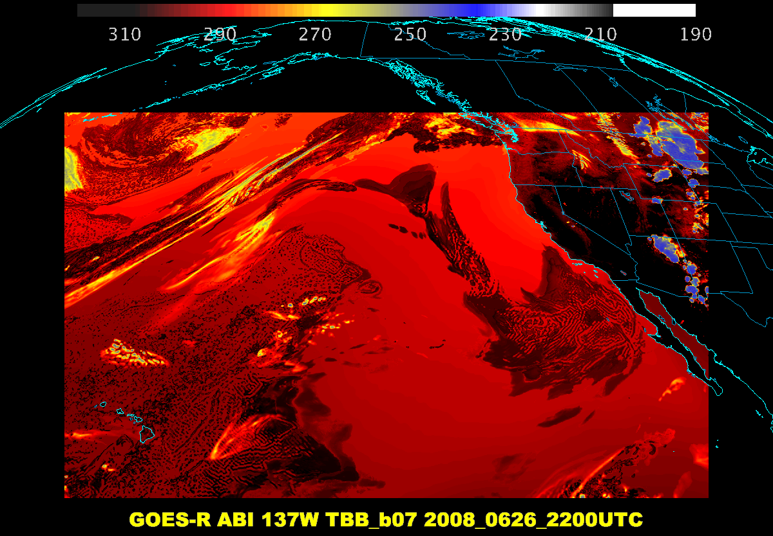
3.9 um

Slide 41
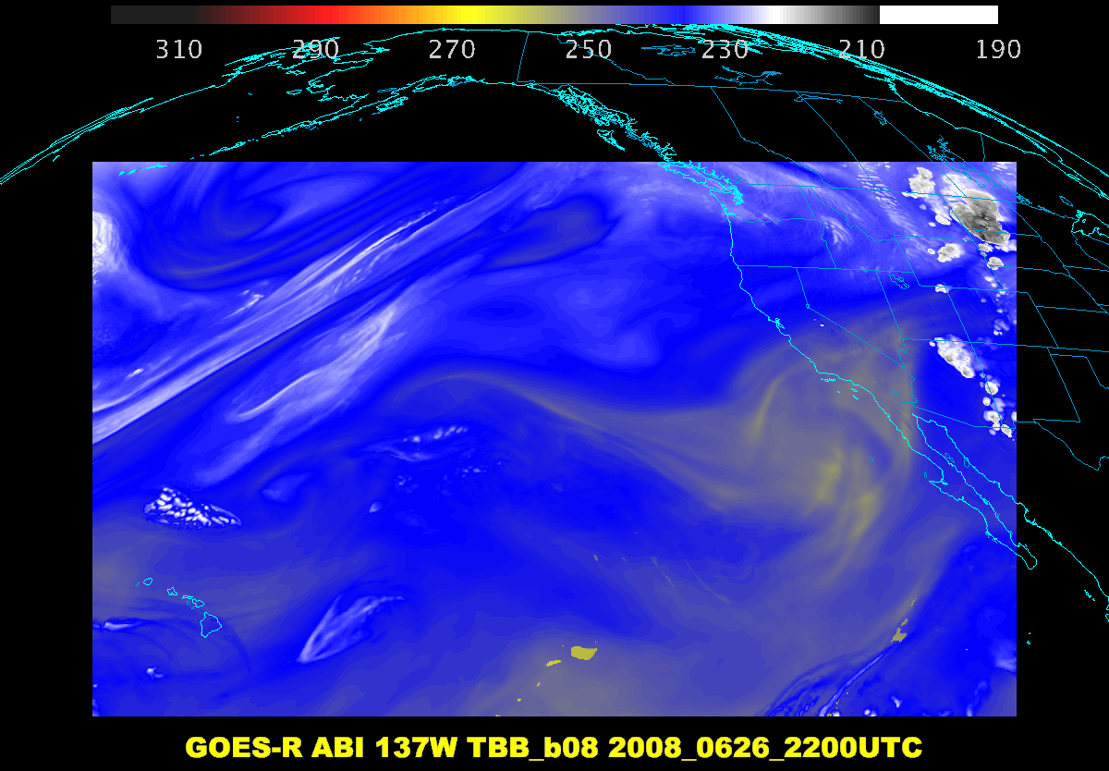
6.2 um

Slide 42
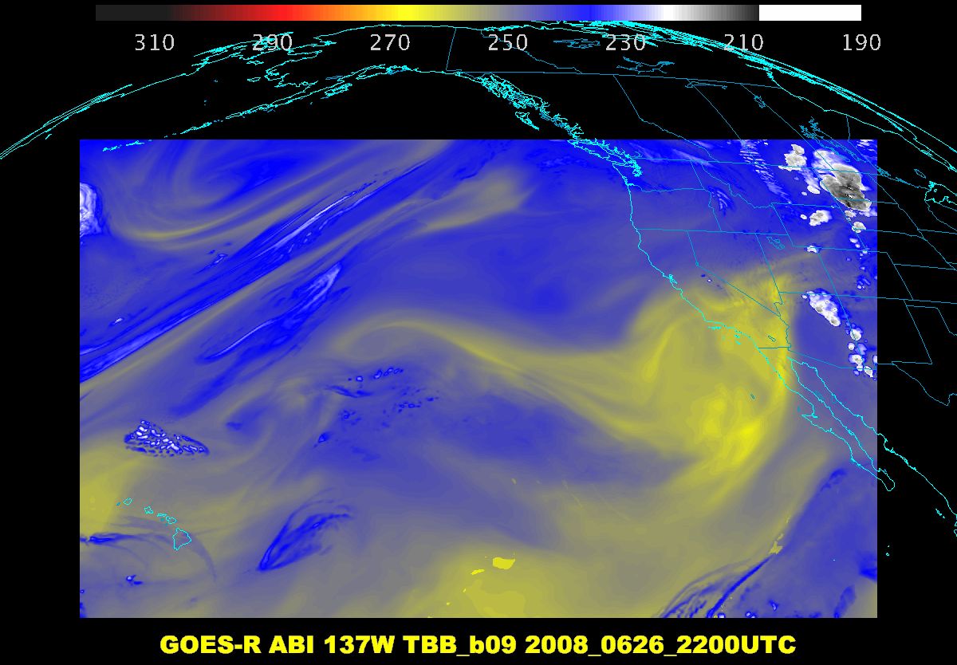
6.9 um

Slide 43
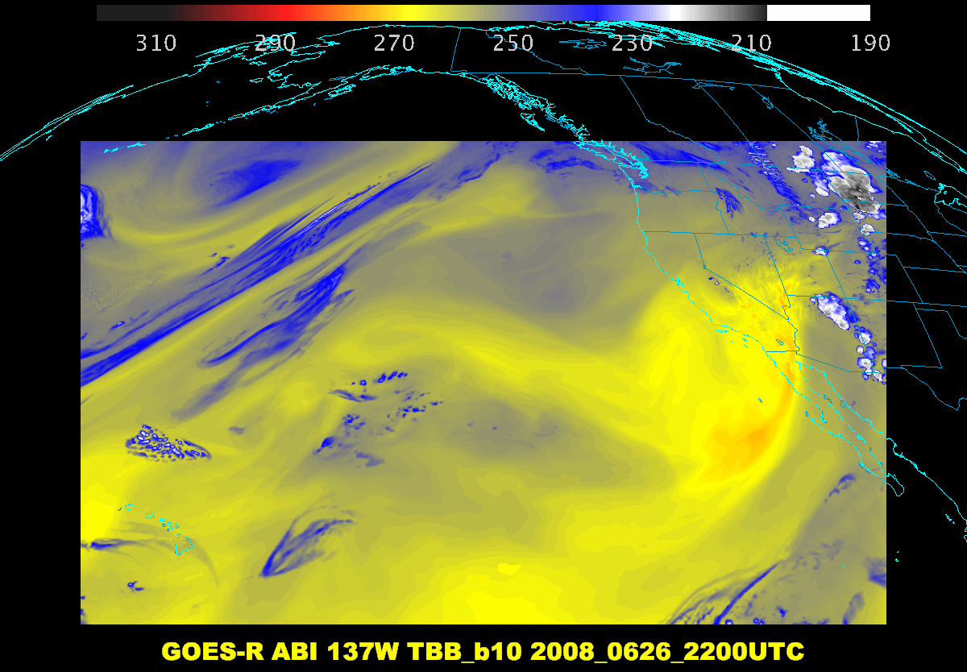
7.3 um

Slide 44
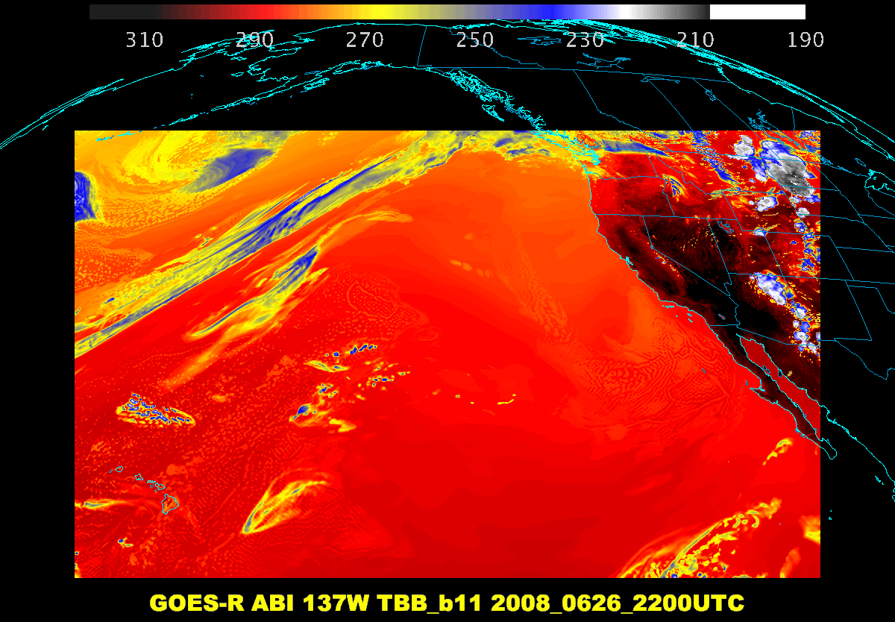
8.4 um

Slide 45
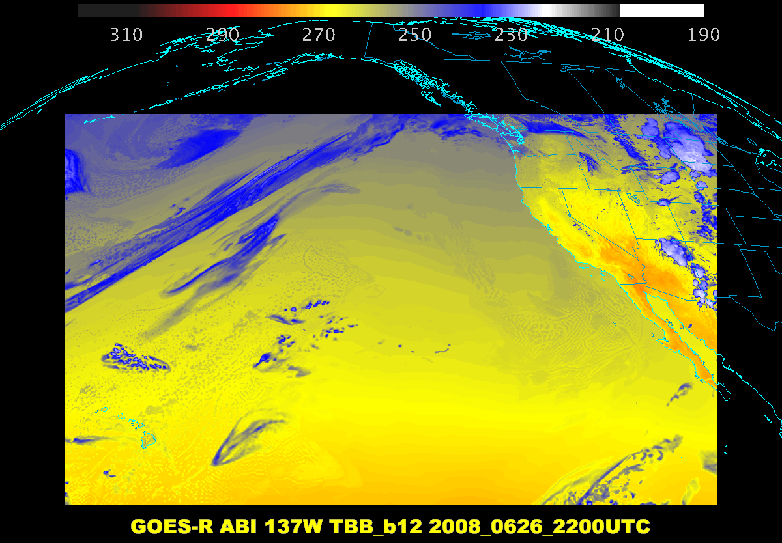
9.6 um

Slide 46
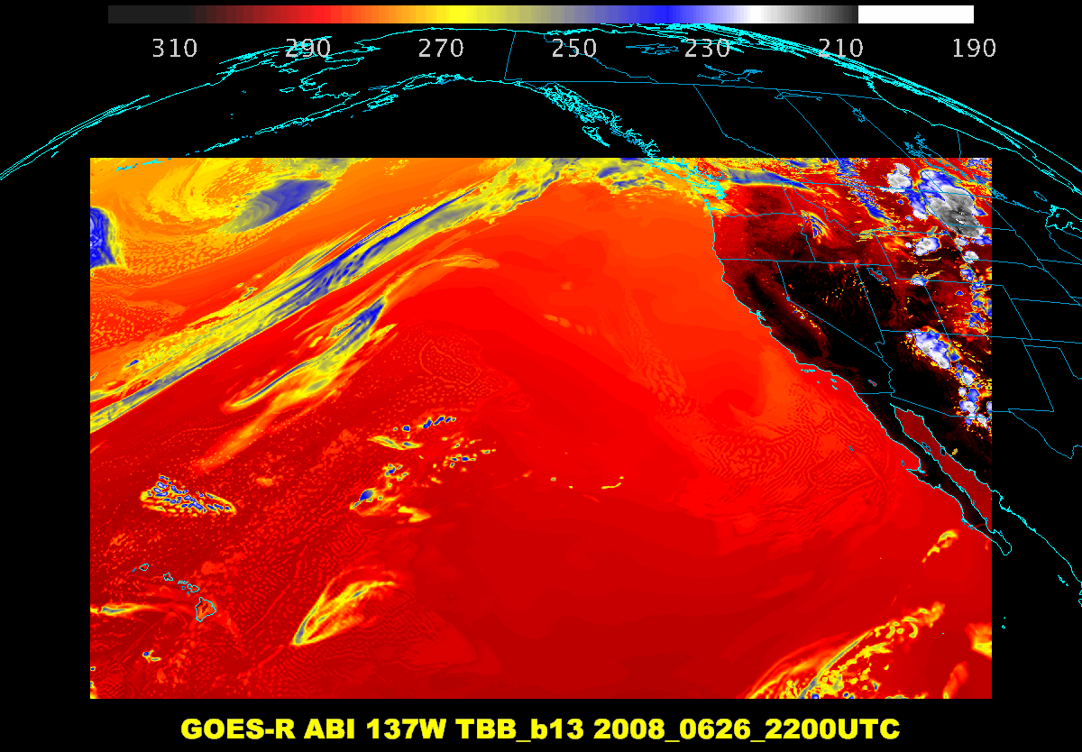
10.3 um

Slide 47
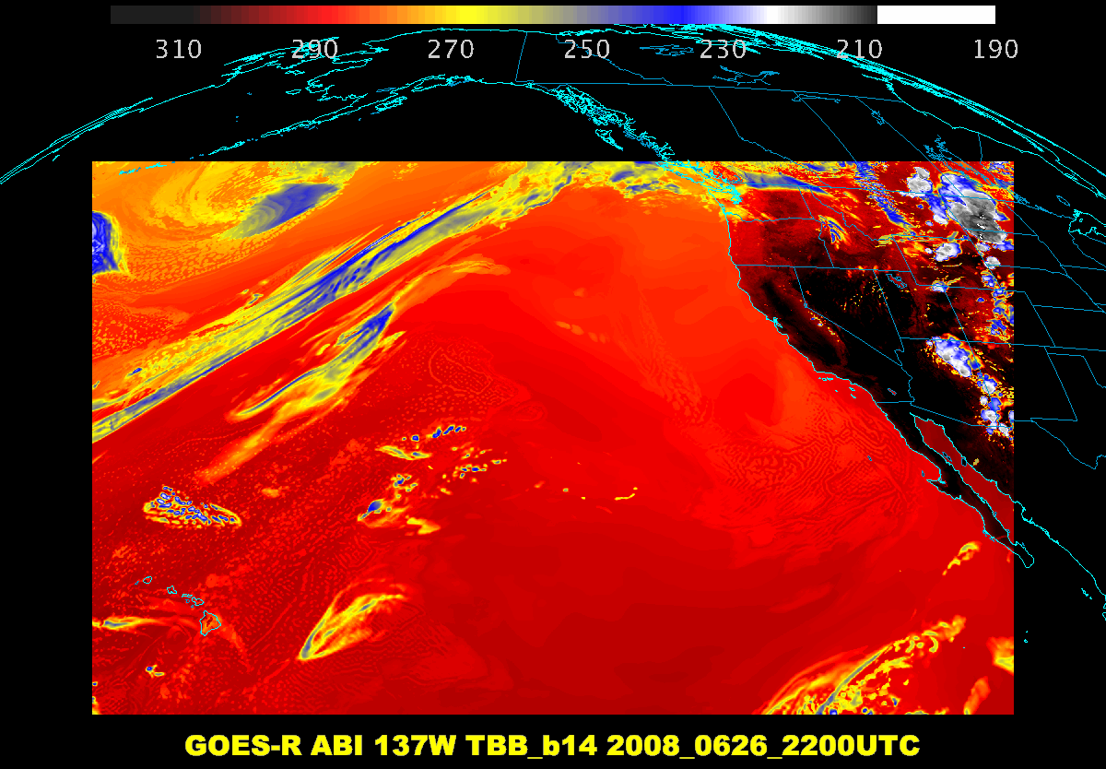
11.2 um

Slide 48
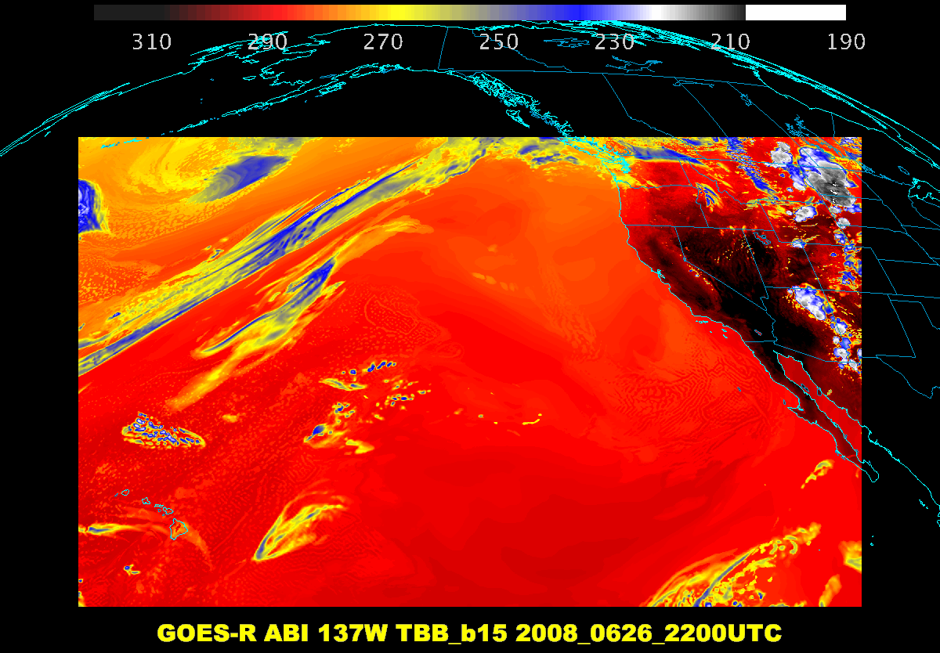
12.2 um

Slide 49
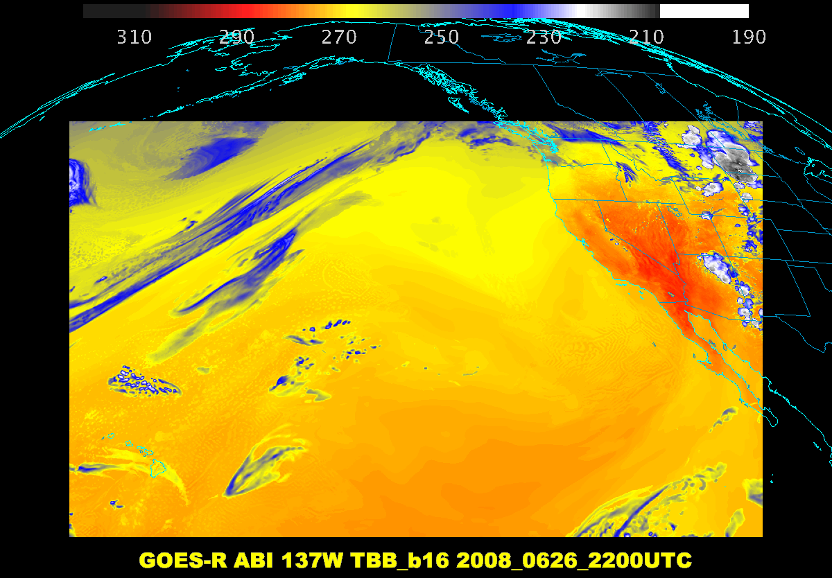
13.3 um

Slide 50
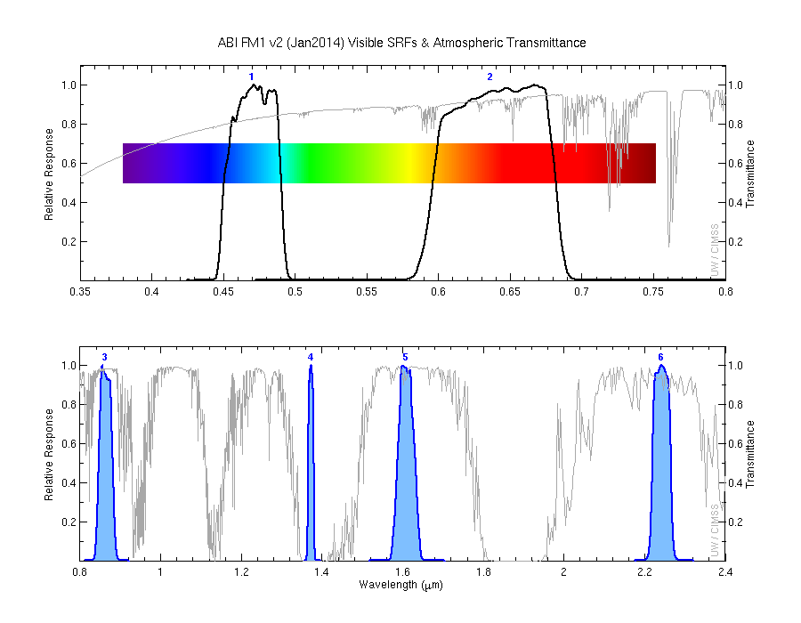
Visible and Near-IR bands on the ABI ….

Slide 51
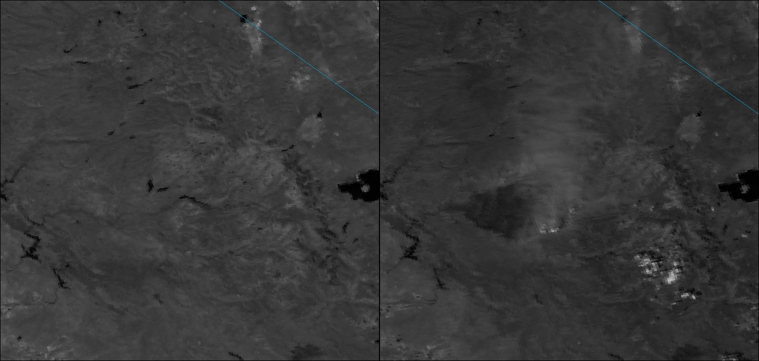
0.865 μm is helpful for burn scar detection
NASA’s VIIRS M7 band (0.865 μm) is shown for two times. On the left is before (August 13, 2013) and on the right is after (August 30, 2013) the California Rim Fire. Note the smoke plume and pyrocumulus along the periphery of the dark burn scar near the center of the image on the right, and the large burn scar just to the west of the smoke plume.

Slide 52




1.88 μm (or 1.38 μm) is helpful for contrail detection
Aircraft case -- Clear?

Slide 53



Using the 1.6 um ABI band for cloud phase….and elevated dust

Slide 54


Why we can see hot fires in the 2.2 um (and 1.6 um) ABI bands
Radiance versus wavelength
AHI images over Australia on March 23, 2015 of bands 3.9 μm (left) 1.6 μm (right) showing a fire. The AHI 1.6 μm is nominally 2 km spatial resolution, while on the ABI the band will be 1 km.

Slide 55
AHI Band | AHI Approximate Central Wavelength [μm] | ABI Approximate Central Wavelength [μm] | ABI Band | Type | Nickname | Information
1 | 0.47 | 0.47 | 1 | Vis | Blue | Blue
2 | 0.51 |  |  | Vis | Green | Green
3 | 0.64 | 0.64 | 2 | Vis | Red | Red
4 | 0.86 | 0.86 | 3 | NIR | Veggie | Vegetation
 |  | 1.37 | 4 | NIR
5 | 1.6 | 1.6 | 5 | NIR | Phase/Snow | Snow/Ice
6 | 2.3 | 2.24 | 6 | NIR | Particle size | Cloud particle size
7 | 3.9 | 3.9 | 7 | IR | Shortwave | Shortwave IR window
8 | 6.2 | 6.2 | 8 | WV | Upper-level | Upper-level tropospheric water vapor
9 | 6.9 | 6.9 | 9 | WV | Mid-level | Upper/mid-level tropospheric water
10 | 7.3 | 7.3 | 10 | WV | Lower-level | Lower mid-level water vapor
11 | 8.6 | 8.4 | 11 | IR | Phase | Cloud-top phase
12 | 9.6 | 9.6 | 12 | IR | Ozone | Ozone (total)
13 | 10.4 | 10.3 | 13 | IR | Clean window | Clean IR longwave window
14 | 11.2 | 11.2 | 14 | IR | Window | Traditional IR longwave window
15 | 12.4 | 12.3 | 15 | IR | “Dirty” window | “Dirty” longwave window
16 | 13.3 | 13.3 | 16 | IR | CO₂ | CO₂ longwave
AHI and ABI
Notes:
Thanks to JMA for the format and some of the info on this slide.

Slide 56
AHI Band | Central Wavelength [μm] | Type | Nickname | Information
1 | 0.47 | Vis | Blue | Blue
2 | 0.51 | Vis | Green | Green
3 | 0.64 | Vis | Red | Red
4 | 0.86 | NIR | Veggie | Vegetation
5 | 1.6 | NIR | Phase/Snow | Snow/Ice
6 | 2.3 | NIR | Particle size | Cloud particle size
7 | 3.9 | IR | Shortwave | Shortwave IR window
8 | 6.2 | WV | Upper-level | Upper-level tropospheric water vapor
9 | 6.9 | WV | Mid-level | Upper/mid-level tropospheric water
10 | 7.3 | WV | Lower-level | Lower mid-level water vapor
11 | 8.6 | IR | Phase | Cloud-top phase
12 | 9.6 | IR | Ozone | Ozone (total)
13 | 10.4 | IR | Clean window | Clean IR longwave window
14 | 11.2 | IR | Window | Traditional IR longwave window
15 | 12.4 | IR | “Dirty” window | “Dirty” longwave window
16 | 13.3 | IR | CO₂ | CO₂ longwave
AHI
Notes:
Thanks to JMA for the format and some of the info on this slide.

Slide 57
ABI Band | Central Wavelength [μm] | Type | Nickname | Information
1 | 0.47 | Vis | Blue | Blue
2 | 0.64 | Vis | Red | Red
3 | 0.86 | NIR | Veggie | Vegetation
4 | 1.37 | NIR | Cirrus | Upper level Cirrus/elevated dust
5 | 1.6 | NIR | Snow/phase | Snow/Ice
6 | 2.24 | NIR | Particle size | Cloud particle size
7 | 3.9 | IR | Shortwave | Shortwave IR window
8 | 6.2 | WV | Upper-level | Upper-level tropospheric water vapor
9 | 6.9 | WV | Mid-level | Upper/mid-level tropospheric water
10 | 7.3 | WV | Lower-level | Lower mid-level water vapor
11 | 8.4 | IR | Phase | Cloud-top phase
12 | 9.6 | IR | Ozone | Ozone (total)
13 | 10.3 | IR | Clean window | Clean IR longwave window
14 | 11.2 | IR | Window | Traditional IR longwave window
15 | 12.3 | IR | “Dirty” window | “Dirty” longwave window
16 | 13.3 | IR | CO₂ | CO₂ longwave
ABI

Slide 58


Slide 59


Slide 60


Slide 61


Slide 62


Slide 63


Slide 64


Slide 65


Slide 66


Slide 67


Slide 68


Slide 69


Slide 70


Slide 71


Slide 72


Slide 73


Slide 74

Educational Webapps Developed
NOAA NESDIS ASPB teamed up with CIMSS researchers to develop three educational WebApps to explore space, time and spectral resolutions of satellite imagery.
Part of the GOES-R Educational Proving Ground at CIMSS:
http://cimss.ssec.wisc.edu/education/goesr
Teacher feedback:
“…. Wow!! This is awesome!!
This is impressive. Thank you for sharing. This is great. Thanks for all your hard work and help!!!!
We are honored and will use it next week … Earth SySTEM Teacher Academy”
Sample interactive “Bandapp” educational webapp using simulated ABI images:
http://cimss.ssec.wisc.edu/goes/webapps/bandapp/
T. Schmit
Notes:
Tim Schmit, ASPB
https://ams.confex.com/ams/95Annual/webprogram/Paper265203.html ABI = Advanced Baseline Imager
Other new webapps: one to change both the spatial and temporal sampling and the other only the pixel sampling

Slide 75

There are also several case studies using current GOES imagery (5 spectral bands)
with the option to add descriptive annotations,
or add map outlines.

Slide 76

Mouse over anywhere in the image to get an interactive pop-up chart that provides data (reflectance
& temperature)
for each band at that location.

Slide 77
Hands-on…Spectral
Step through the ABI spectral bands (and turn on the interactive chart)
  One of the simulated cases
  http://cimss.ssec.wisc.edu/education/apps/bandapp/overview_goes-r.html
  or
  http://cimss.ssec.wisc.edu/goes/webapps/bandapp/
Or step through the AHI spectral bands (and turn on the interactive chart)
  One of the observed cases
  http://cimss.ssec.wisc.edu/education/apps/bandapp/overview_ahi_first_images.html
  or
  http://cimss.ssec.wisc.edu/goes/webapps/bandapp/overview_ahi_first_images.html

Slide 78



Three ABI water vapor bands
Current GOES
Future GOES
Images from J. Feltz
Notes:
Note the 3 layers of information possible from the ABI (right panel).
http://www.ssec.wisc.edu/mcidas/software/v/

Slide 79
Weighting Functions
How the transmittance varies with height
The layer of the atmosphere observed by a given spectral band
Depends on the band, input temperature, moisture, ozone profiles, skin temperature, surface emissivity, plus the view (zenith) angle.
Clear-sky fast forward calculations
A surface emissivity value of 1 is used for each band.

Slide 80

Rsfc R1 R2
top of the atmosphere
τ2 = transmittance of upper layer of atm
τ1= transmittance of lower layer of atm
blackbody earth surface.
R_{obs} =
R_{sfc} τ1 τ2 + R1 (1-τ1) τ2 + R2 (1- τ2)
From W. P. Menzel
Notes:
From W. P. Menzel

Slide 81

ABI Clear-sky Weighting Functions

Slide 82

http://cimss.ssec.wisc.edu/goes/wf/ABI/

Slide 83

ABI Weighting Functions
As a function of….
  View angle

Slide 84
Hands-on….Weighting Functions
How many mid-level water vapor bands?
How many window bands?
Which band peaks the highest in the atmosphere?
What’s the cleanest IR window?
  Select an atmosphere and view angle:
  http://cimss.ssec.wisc.edu/goes/wf/ABI/
  Look at realtime GOES WF
  http://cimss.ssec.wisc.edu/goes/wf/

Slide 85


RGB Web App

Slide 86


Sat RGB
Select an input for each band
Click “Combine Channels”

Slide 87
Hands-on….Red-Green-Blue
Combine the bands to bring out a feature of interest
  http://cimss.ssec.wisc.edu/goes/webapps/satrgb/overview.html
  One of the simulated ABI cases
  http://cimss.ssec.wisc.edu/education/apps/bandapp/overview_goes-r.html
  One of the observed AHI cases
  http://cimss.ssec.wisc.edu/goes/webapps/satrgb/overview_ahi.html

Slide 88
Outline
Overview
ABI
  Spectral
  Temporal
  Spatial
Other
Summary
More information

Slide 89



Baseline ABI Scan Modes
Scan mode (3) or ‘flex mode’ for the ABI:
- Full disk every 15 minutes + 5 min CONUS
+ 1-min mesoscales (2 locations).
[Scan mode (4) or ‘Continuous Full Disk’ (CFD) is a full disk every 5 min]
Notes:
CONUS image is the shifted center point.

Slide 90
Recent Mode 3 (Flex mode)
“Time-Time” chart
Note the ‘white’ space is instrument idle time.
Draft
Notes:
Copy and pasted from excel. Pasted as a picture. Resized to 44% by 44% of original. Arrange -> Align -> Align Center & Align Middle

Slide 91
Baseline Time-Time Mode 4
(Continuous Full Disk)
This is the Continuous Full Disk (every 5 min) mode
This is the highest data rate.

Slide 92

Figure courtesy of J. Li, CIMSS
Concept of flex mode scanning animation

Slide 93

Loop over Peoria

Slide 94

GOES-15 Science Test
The Science Test part of Post Launch Testing for GOES-15 occurred in the summer of 2010.
Co-led by Hillger and Schmit.
Unique 1-minute rapid scan imagery acquired
GOES-15 data analysis will continue. All the GVAR data archived.
Many products generated in near real-time.
A NOAA Technical Report was generated.
1-min
30-min
Unique GOES-15 Imager Visible data from the NOAA Science Test
Notes:
Igor

Slide 95

Sample “1-min” visible imagery
GOES-12
GOES-14
See “what is happening”, not “what has happened”.
Notes:
Note the number of different levels of motion you can see (the cyclonic low level circulation over the ocean through the breaks in the higher clouds)... and you can't distinguish those on the GOES-12 loop.

Slide 96

Flex Mode (3) would offer a total of 4 meso-scale sectors, from the combined 2 satellite constellation.
PROPOSED
Notes:
Of course there would also be 2 meso possible from the ABI at GOES-East

Slide 97

ABI CONUS sector scan coverage from East and West (NOAT/GORWG-approved)
Notes:
Different days simulated.

Slide 98

Outline
Overview
ABI
  Spectral
  Temporal
  Spatial
Other
Summary
More information
Lockheed Martin

Slide 99

ABI IR Pixel size from West and East
(proposed ABI CONUS West and East)
East Optimal
West Optimal

Slide 100

ABI
In general, even at 50 degrees view angles, the spatial resolution of the ABI is comparable to today’s imager at the satellite sub-point.
Figure from J. Key, ASPB

Slide 101

<30
<40
<50
<60
Current GOES-East Sample LZA’s

Slide 102

<30
<40
<50
<60
Current GOES-West Sample LZA’s

Slide 103




GOES-12 and GOES-R ABI
Simulation of Grand Prix Fire/Southern California
GOES-12
GOES-R ABI
GOES-12
GOES-R ABI
Notes:
Here are two different fires from J. Feltz of CIMSS (using mcidas-v). What we can see is a more defined peak in the higher resolution data and it is easier to pick out individual hotspots. In addition, the higher saturation temperature of the ABI allows us to see that the fire is around 370K. ABI is simulated from MODIS.

Slide 104

GOES
Figure courtesy of K. Bedka and W. Feltz

Slide 105

“ABI” from MODIS
Figure courtesy of K. Bedka and W. Feltz

Slide 106

Nocturnal Fog/Stratus Over the Northern Plains
“ABI” 4 minus 11 μm Difference
ABI image (from MODIS) shows greater detail in structure of fog.
Notes:
Note the ABI (from MODIS) image is better spatial resolution and better signal-to-noise ratio then the GOES-10 imager.
Schmit, T. J., M. M. Gunshor, W. P. Menzel, J. J. Gurka, J. Li, and A. S. Bachmeier, 2005: Introducing the next-generation Advanced Baseline Imager on GOES-R. Bull. Amer. Meteor. Soc., 86, 1079-1096.

Slide 107

Nocturnal Fog/Stratus Over the Northern Plains
GOES-10 4 minus 11 μm Difference
ABI image (from MODIS) shows greater detail in structure of fog.
Notes:
Schmit, T. J., M. M. Gunshor, W. P. Menzel, J. J. Gurka, J. Li, and A. S. Bachmeier, 2005: Introducing the next-generation Advanced Baseline Imager on GOES-R. Bull. Amer. Meteor. Soc., 86, 1079-1096.

Slide 108


GOES-14 Super Rapid Scan Operations to Prepare for GOES-R (SRSOR)
SRSOR for 2015 include May 18-June 12, and August 10-22:
  http://cimss.ssec.wisc.edu/goes/srsor2015/GOES-14_SRSOR.html
  Data during parts of 2012 (Hurricane Sandy, convection), 2013 (CA Rim Fire, convection) and 2014 (Hurricane Marie, convection):
  http://cimss.ssec.wisc.edu/goes/srsor/GOES-14_SRSOR.html
  http://cimss.ssec.wisc.edu/goes/srsor2013/GOES-14_SRSOR.html
  http://cimss.ssec.wisc.edu/goes/srsor2014/GOES-14_SRSOR.html
GOES-14 provided very unique data and offered a glimpse into the possibilities that will be provided by the ABI on GOES-R in one minute mesoscale imagery
GOES-14 visible image showing rapid convective
(loops over just half an hour)
Notes:
http://cimss.ssec.wisc.edu/goes/srsor2015/GOES-14_SRSOR.html

Slide 109

SRSOR vs Meso
GOES-R ABI (Meso)
1 per minute for 2 locations
Operational
(with FD + CONUS)
GOES (SRSOR)
~1 per minute
Experimental
(no other imagery)

Slide 110

http://cimss.ssec.wisc.edu/goes/applets/overview.html

Slide 111


Slide 112


Slide 113
Hands-on….Temporal/Spatial
Choose a case to example the temporal and/or spatial resolutions:
  http://cimss.ssec.wisc.edu/goes/applets/overview.html
  or
  http://cimss.ssec.wisc.edu/education/apps/abi/
Via temporal sampling, can you get Hurricane Sandy to appear to rotate backwards?
Can you observe an enhanced v signature in the IR case over MN?

Slide 114

Outline
Overview
ABI
  Spectral
  Temporal
  Spatial
Other
Summary
More information

Slide 115

http://www.goes-r.gov

Slide 116
GOES-R ABI Products
Baseline Products
Future Capabilities
Advanced Baseline Imager (ABI)
Aerosol Detection (Including Smoke and Dust) Aerosol Optical Depth (AOD) Clear Sky Masks Cloud and Moisture Imagery Cloud Optical Depth Cloud Particle Size Distribution Cloud Top Height Cloud Top Phase Cloud Top Pressure Cloud Top Temperature Derived Motion Winds Derived Stability Indices Downward Shortwave Radiation: Surface Fire/Hot Spot Characterization Hurricane Intensity Estimation Land Surface Temperature (Skin) Legacy Vertical Moisture Profile Legacy Vertical Temperature Profile Radiances Rainfall Rate/QPE Reflected Shortwave Radiation: TOA Sea Surface Temperature (Skin) Snow Cover Total Precipitable Water Volcanic Ash: Detection and Height
Advanced Baseline Imager (ABI)
Absorbed Shortwave Radiation: Surface Aerosol Particle Size Aircraft Icing Threat Cloud Ice Water Path Cloud Layers/Heights Cloud Liquid Water Cloud Type Convective Initiation Currents Currents: Offshore Downward Longwave Radiation: Surface Enhanced “V”/Overshooting Top Detection Flood/Standing Water Ice Cover Low Cloud and Fog Ozone Total Probability of Rainfall Rainfall Potential Sea and Lake Ice: Age Sea and Lake Ice: Concentration Sea and Lake Ice: Motion Snow Depth (Over Plains) SO₂ Detection Surface Albedo Surface Emissivity Tropopause Folding Turbulence Prediction Upward Longwave Radiation: Surface Upward Longwave Radiation: TOA Vegetation Fraction: Green Vegetation Index Visibility
+ others

Slide 117
Bridging the gap between imagery and products
Qualitative
Quantitative
Both
Notes:
Right now most views are either qualitative images OR quantitative derived products. How best to combine the strengths?

Slide 118


http://cimss.ssec.wisc.edu/goesr/proving-ground/geocat_ash
Cordon Caulle
Grimsvotn
Using contours to highlight quantitative product (over RGB)
Pavolonis
Notes:
Using contours is one method to “combine” a quantitative product with an RGB.
-June 4
-May 21

Slide 119

The quantitative assessment of cloud ceiling can be overlaid on top of imagery to make the product more appealing to forecasters.
The ability to contour the IFR and MVFR probabilities will soon be available in AWIPS.
Using contours to highlight quantitative product (over RGB)
Pavolonis
Notes:
Using contours is one method to “combine” a quantitative product with an RGB. This case for cloud ceilings.

Slide 120

Mike Pavolonis

Slide 121

The ash plume is clearly discernable in the Himawari-8 AHI imagery constructed using similar spectral channels
Klyuchevskoy ash plume
Mike Pavolonis
Notes:
The AHI resolution at a viewing angle of 65+ degrees is actually better than MTSAT or GOES at nadir.

Slide 122
The ash plume is not discernable in MTSAT false color imagery
Klyuchevskoy ash plume
Mike Pavolonis
Notes:
https://volcano.ssec.wisc.edu/

Slide 123

Himawari-8 Imagery – Real Earth http://re.ssec.wisc.edu - All 16 Bands
http://realearth.ssec.wisc.edu/s/32VeT
Notes:
View of the Web UI showing the Himawari-8 Full Disk Vis and IR (Bands 2 and 14). This can be found in the “Presets” portion of the Layers control. Just click on the “Himawari” category to get a listing of predefined Himawari Channel selections for various geographic sectors. These images can be animated as a time series or as individual channels at a specific time.

Slide 124

http://realearth.ssec.wisc.edu/s/U2Vhb
Real Earth “Features” can be easily shared via Facebook, Twitter or Embedded Email
Notes:
The Share feature of the UI allows users to capture the contents of a RE display (either static or animation) suitable for FaceBook, Twitter or embedded email. Here is an example of the Himawari-8 Australia sector.

Slide 125
Exploratory ABI Scan Mode (draft)
At some point, other ABI scan modes could be possible.
  requires an upgrade to the ground system.
  ABI instrument is capable of supporting other scan modes.
One option is to use the ‘white space’ of when the ABI instrument is not scanning in mode 3 (‘flex’). For example, increase to an ‘extended CONUS’ image.
There are other optimized scan options as well, such as investigating a FD scan every 10 min to sync with global constellation (EUMETSAT, AHI, AGRI, etc.).

Slide 126
Draft Scan Mode ”6” with 10-min FD
In 10-min:
  1 Full Disk +
  2 CONUS +
  20 Meso-scale
The 10-min Full Disk would offer synergy with other geos and improved AMVs outside of CONUS, plus still allow for meso-scale observations.
This draft mode 6 ideally could be tested during PLPT (Post Launch Products Test).
This mode should be easier to implement at the Ground System, sense the scan sectors are the same size/locations as in mode 3.
DRAFT!

Slide 127

Draft Scan Mode ”6” with 10-min FD
Note less ‘white space’ than scan mode 3 (flex mode)
Time-time diagram from Exelis
Notes:
Copy and pasted from excel. Pasted as a picture. Resized to 44% by 44% of original. Arrange -> Align -> Align Center & Align Middle

Slide 128

AHI Observation Modes:
Areas and Temporal resolution
Full disk
Interval : 10 minutes (6 times per hour)
Region 1
NE-JAPAN
Region 1 JAPAN (North-East)
Interval : 2.5 minutes (4 times in 10 min)
Dimension : EW x NS: 2000 x 1000 km
Region 2
SW-JAPAN
Region 2 JAPAN (South-West)
Interval : 2.5 minutes (4 times in 10 min)
Dimension : EW x NS: 2000 x 1000 km
Region 3
Target Area
Region 3 Target Area
Interval : 2.5 minutes (4 times in 10 min)
Dimension : EW x NS: 1000 x 1000 km
Region 4
Landmark Area
Region 5
Landmark Area
Region 4 Landmark Area
Interval : 30 seconds (20 times in 10 min)
Dimension : EW x NS: 1000 x 500 km
Region 5 Landmark Area
Interval : 30 seconds (20 times in 10 min)
Dimension : EW x NS: 1000 x 500 km
Notes:
128

Slide 129

JMA’s AHI
25-January-2015
02:30 UTC
S. Miller (CIRA) on behalf of the GOES-R AWG Imagery Team

Slide 130

Pseudo-Natural Color

Slide 131


Realtime WRF Chem and GFS ABI runs
http://cimss.ssec.wisc.edu/goes_r/proving-ground/wrf_chem_abi/wrf_chem_abi.html
Realtime simulated ABI Data used for GOES-R ground system testing

Slide 132

Near Realtime GFS ABI runs
RaFTR-CIMSS-SIM data
Screenshot of Simulated ABI data at 140E from the National Headquarters Development system (NHDA) - AWIPS-II GOES-R test (January 23, 2015) Image from Joe Zajic.

Slide 133

Outline
Overview
ABI
  Spectral
  Temporal
  Spatial
Other
Summary
More information

Slide 134
Approximate spectral and spatial resolutions of US GOES Imagers
~ Band Center (um) | GOES-1/3 | GOES-4/7 | GOES-8/11 | GOES-12/13 | GOES-13/15 | GOES-R+
0.47
0.64
0.86
1.6
1.38
2.2
3.9
6.2
~6.7 |  | 14km
7.3
8.5
9.7
10.3
11.2
12.3
13.3
Visible
Near-IR
Box size represents pixel size
8
4
2
“MSI mode”
Infrared
Notes:
0.40 inches = 4km; 0.80 inches = 8km
MSI is Multi-Spectral Imaging Mode (dashed boxes)
This does not show other improvements: SNR, MTF, bit-depth, navigation, coverage rates, etc.
ATS and SMS not shown.

Slide 135

















Slide 136
Geostationary Imagers: Number of Spectral bands (~ width)
Time | Instruments | Visible/NearIR | Infrared (IR)
Late 1950s | N/A | N/A | N/A
1966+ | ATS-1/3 (Spin-Scan Cloud Camera) | 1 (0.1 μm) | N/A
1967+ | ATS-3 (Multicolor Spin-Scan Cloud Camera) | 3 (0.1 μm) | N/A
1974 | ATS-6 (Geosynchronous Very High Resolution Radiometer) | 1 (0.2 μm) | 1 (2 μm)
1974/1975 | SMS-1/2 (Visible Infrared Spin-Scan Radiometer (VISSR)) | 1 (0.15 μm) | 1 (2 μm)
1975+ | GOES-1/3 (VISSR) | 1 (0.2 μm) | 1 (1 μm)
1980+ | GOES-4/7 (VISSR + VAS) | 1 (0.2 μm) | 3 (1 μm)
1994+ | Imager-8/12 + Sounder | 1 (0.2 μm) | 4 (1 μm)
2010+ | Imager-13/15 + Sounder | 1 (0.2 μm) | 4 (1 μm)
2017+ | ABI | 6 (0.1 μm) | 10 (1 μm)
2033?
Large improvements with the ABI!
U.S. Meteorological Imagers
Notes:
Value in parenthesis is approximate 50% width of the visible or IR window.
http://cimss.ssec.wisc.edu/goes/calibration/
Values are approximate.

Slide 137
Geostationary Imagers:
Spatial Resolution (approximate)
Time | Instruments | Visible/NearIR | Infrared (IR)
Late 1950s | N/A | N/A | N/A
1966+ | ATS-1/3 (Spin-Scan Cloud Camera) | 4 km | N/A
1967+ | ATS-3 (Multicolor Spin-Scan Cloud Camera) | 4 km | N/A
1974 | ATS-6 (Geosynchronous Very High Resolution Radiometer) | 6 km | 11 km
1974/1975 | SMS-1/2 (Visible Infrared Spin-Scan Radiometer (VISSR)) | 1 km | 8 km
1975+ | GOES-1/3 (VISSR) | 1 km | 8 km
1980+ | GOES-4/7 (VISSR + VAS) | 1 km | 7-14 km
1994+ | Imager-8/12 + Sounder | 1 km | 4-8 km
2010+ | Imager-13/15 + Sounder | 1 km | 4 km
2017+ | ABI | 0.5 – 1 km | 2 km
2033?
Large improvements with the ABI!
U.S. Meteorological Imagers
Notes:
Values are approximate, at satellite sub-points. GOES Imager over-sampling not represented.

Slide 138
Geostationary Imagers:
Temporal Resolution
Time | Instruments | Visible/NearIR | Infrared (IR)
Late 1950s | N/A | N/A | N/A
1966+ | ATS-1/3 (Spin-Scan Cloud Camera) | 20 min | N/A
1967+ | ATS-3 (Multicolor Spin-Scan Cloud Camera) | 20 min | N/A
1974 | ATS-6 (Geosynchronous Very High Resolution Radiometer) | 25 min | 25 min
1974/1975 | SMS-1/2 (Visible Infrared Spin-Scan Radiometer (VISSR)) | 20 min | 20 min
1975+ | GOES-1/3 (VISSR) | 30 min | 30 min
1980+ | GOES-4/7 (VISSR + VAS) | 30 min | 30 min
1994+ | Imager-8/12 + Sounder | 7 – 30 min | 7 – 30 min
2010+ | Imager-13/15 + Sounder | 7 – 30 min | 7 – 30 min
2017+ | ABI | 0.5 - 5 - 15 min | 0.5 - 5 - 15 min
2033?
Large improvements with the ABI!
U.S. Meteorological Imagers
Notes:
Values are approximate. Times are routine, not special modes.

Slide 139

Summary
1. The GOES-R ABI provides mission continuity
2. Two times the image navigation quality
3. Three times the number of imaging bands
4. Four times the spatial resolutions
5. Five times the coverage rate
- Special GOES-14 1-min data pathfinder

Slide 140
Outline
Overview
ABI
  Spectral
  Temporal
  Spatial
Other
Summary
More information

Slide 141

ABI Bands Quick Information Guides
http://www.goes-r.gov/education/ABI-bands-quick-info.html

Slide 142
Select Links
  http://www.goes-r.gov
  http://cimss.ssec.wisc.edu/education/goesr
  http://cimss.ssec.wisc.edu/goes_r/proving-ground.html
  http://satelliteconferences.noaa.gov/2015/
  http://cimss.ssec.wisc.edu/goes/abi/
  http://cimss.ssec.wisc.edu/goes/blog/
  http://cimss.ssec.wisc.edu/goes_r/proving-ground/wrf_chem_abi/wrf_chem_abi.html
  http://cimss.ssec.wisc.edu/goes/srsor2015/GOES-14_SRSOR.html
  http://www.meted.ucar.edu/index.htm
Contact information: Tim.J.Schmit@noaa.gov

Slide 143
Back-up

Slide 144

Data Flow
Current plans call for several data delivery methods, for real-time, these are:
  GOES-R ReBroadcast (RGB) (National Centers)
  SBN (“NOAA Port”).
  Other (pull)
Hence, what GOES-R data you have may depend on your access method. For example, courser data outside of CONUS and certain sectors. Note that this plan is not ‘set in stone’.
GOES-R
GRB
AWIPS
Image from Matt Seybold

Slide 145

Ground System (GS) FPS, Appendix E
Outside of CONUS, Hawaii, Alaska and Puerto Rico regional, imagery will be 6 km in AWIPS (for the data via the SBN).
http://www.goes-r.gov/resources/docs/GOES-R_GS_FPS.pdf

Slide 146

Approximate Puerto Rico regional coverage
(from GS FPS)
Shown in satellite projection

Slide 147

~1 km
~6 km
Notes:
ABI band 2 (0.6 micrometers) will be finer resolution than the imagery shown and the 6km may be worse since this is 6km in a Mercator.

Slide 148

~1 km
~6 km
Notes:
ABI band 2 (0.6 micrometers) will be finer resolution than the imagery shown and the 6km may be worse since this is 6km in a Mercator.

