Slide 1


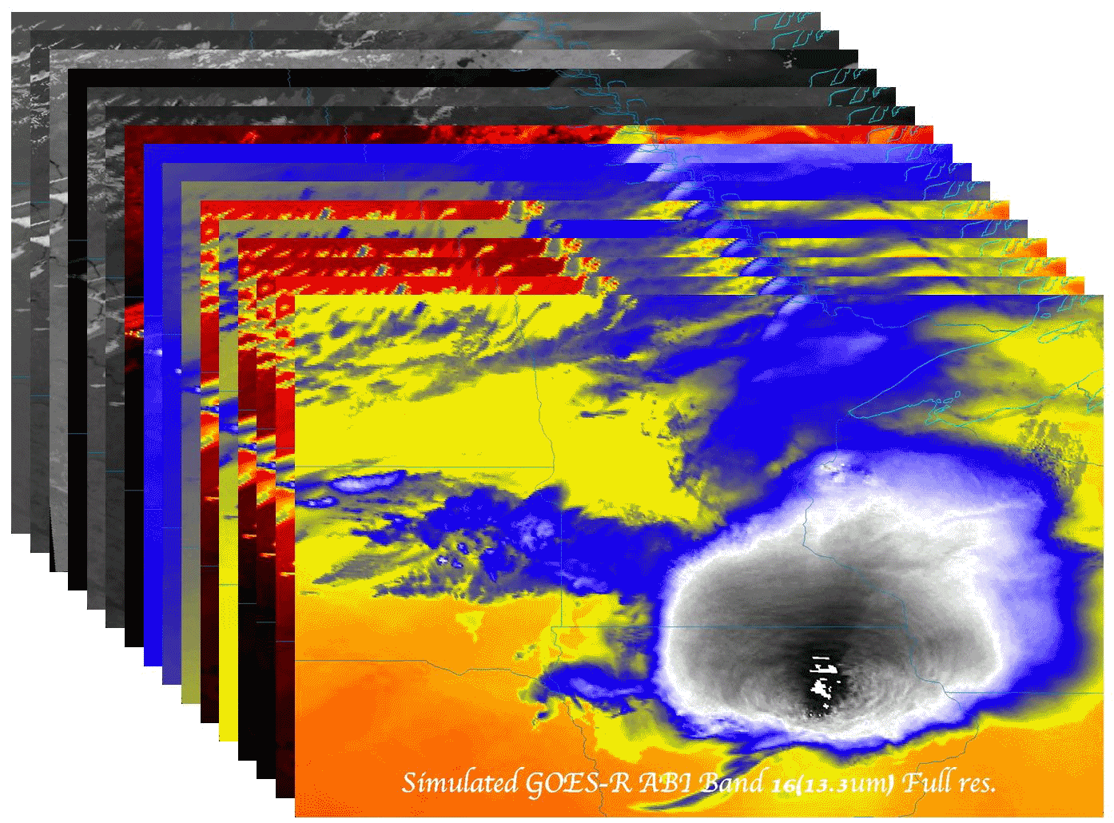

The ABI on GOES-R Series
  Timothy J. Schmit (tim.j.schmit@noaa.gov)
NOAA/NESDIS/Satellite Applications and Research
Advanced Satellite Products Branch (ASPB)
  Jordan Gerth (jordan.gerth@noaa.gov)
CIMSS
Madison, WI
Plus many, many more…
GOES-R User Readiness
Kansas City
June 16, 2015
UW-Madison

Slide 2

Thanks to…
Paul Menzel, Steven J. Goodman, Daniel T. Lindsey, Robert M. Rabin, Kristopher M. Bedka, John L. Cintineo, Christopher S. Velden, A. Scott Bachmeier, Scott Lindstrom, Mat Gunshor, Chris Schmidt
Kaba Bah, Joleen Feltz, Tom Whittaker, Margaret Mooney, Andy Heidinger, William Straka, Jun Li, Steve Ackerman, Bob Aune, Don Hillger, Tony Schreiner, Justin Sieglaff, Jim Jung, Elaine Prins, Brad Pierce, Wayne Feltz, Jean Phillips, Linda Hedges, Jim Nelson, Gary Wade, Don Hillger, Jinlong Li, Jing Zheng, Allen Huang, Bob Rabin, the SSEC data center, Mike Pavolonis, Jaime Daniels, ASPB, STAR, NESDIS, NSSL, MUG, Kevin Ludlum, GOES operators, GOES shift supervisors, Mark DeMaria, Dave Martin, Joe Schmit and many others!
GOES-R Program Office, Greg Mandt, NASA, Exelis Industries, Lockheed Martin, and other industry partners, etc.
You.

Slide 3
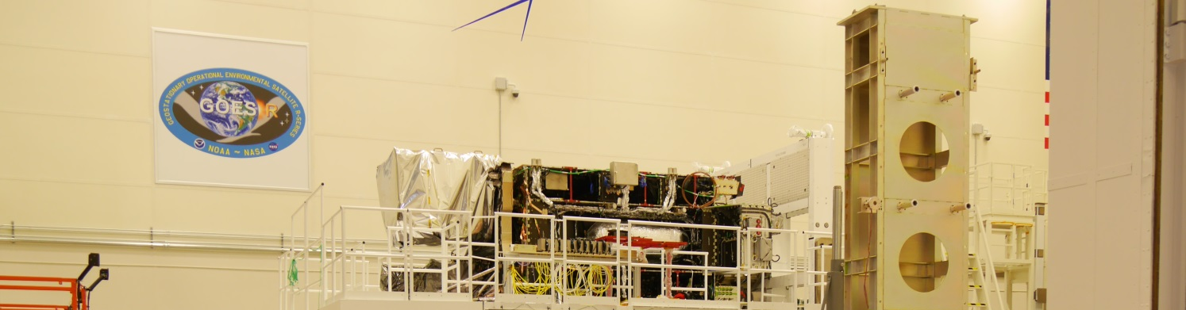
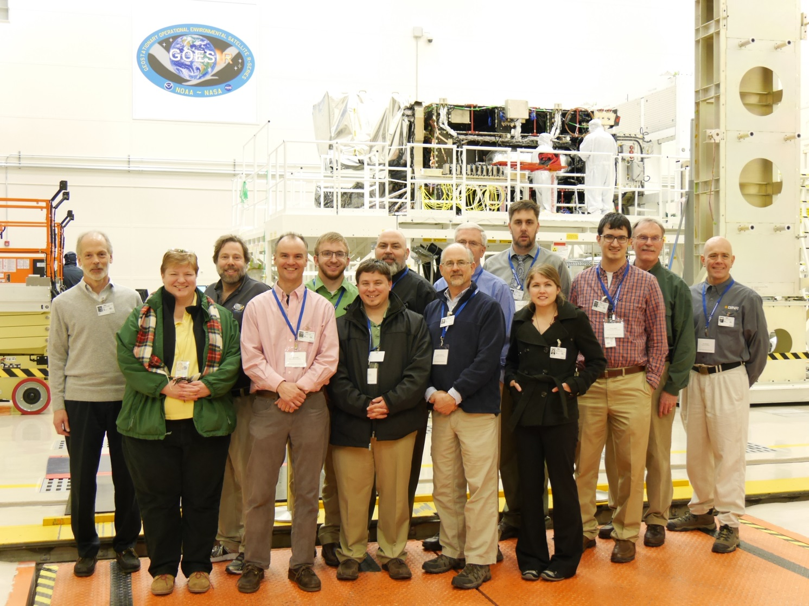
Outline
Overview
ABI
  Spectral
  Temporal
  Spatial
Other
Summary
More information
Lockheed Martin

Slide 4
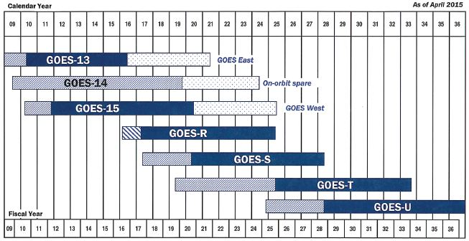
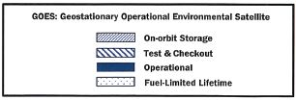

GOES Flyout Chart w/
Fuel-Limited Lifetime Phase Added

Slide 5

Validation and Availability for GOES-R Baseline Products
GOES-R Launch
to 89.5° West
Operations Handover
(includes Products)
On-Orbit East/West
Operations
Milestone:
Program Phase:
Extended Validation
Pre-Launch | PLT (6 months) | Post-Handover
L1b Product Activities
L1b Validation - Products recertified against pre-launch instrument performance
‘First Light’ Data captures shared from Instruments
Insertion of L1b products into GRB service is controlled by ground system and will occur as products are certified
L2+ Product Activities
L2+ Validation – Same certification process as L1b products
However, L2+ certification begins after L1b products and the portfolio will mature at an overall slower rate with some products certified post-Operations Handover
Distribution Testing
Testing of Distribution Requirements for GRB, AWIPS, and PDA will occur with Integration & Test Customers, utilizing a terrestrial test-purpose data flow from Wallops to NSOF
Mission Notifications
Mission notifications will inform users of new product operations and caveats (e.g. GOES maneuver data caveats) leading up to, during, and after Operations Handover
Notes:
More precisely: L1b Validation – On-orbit product performance recertified against pre-launch analytically-predicted product performance.

Slide 6
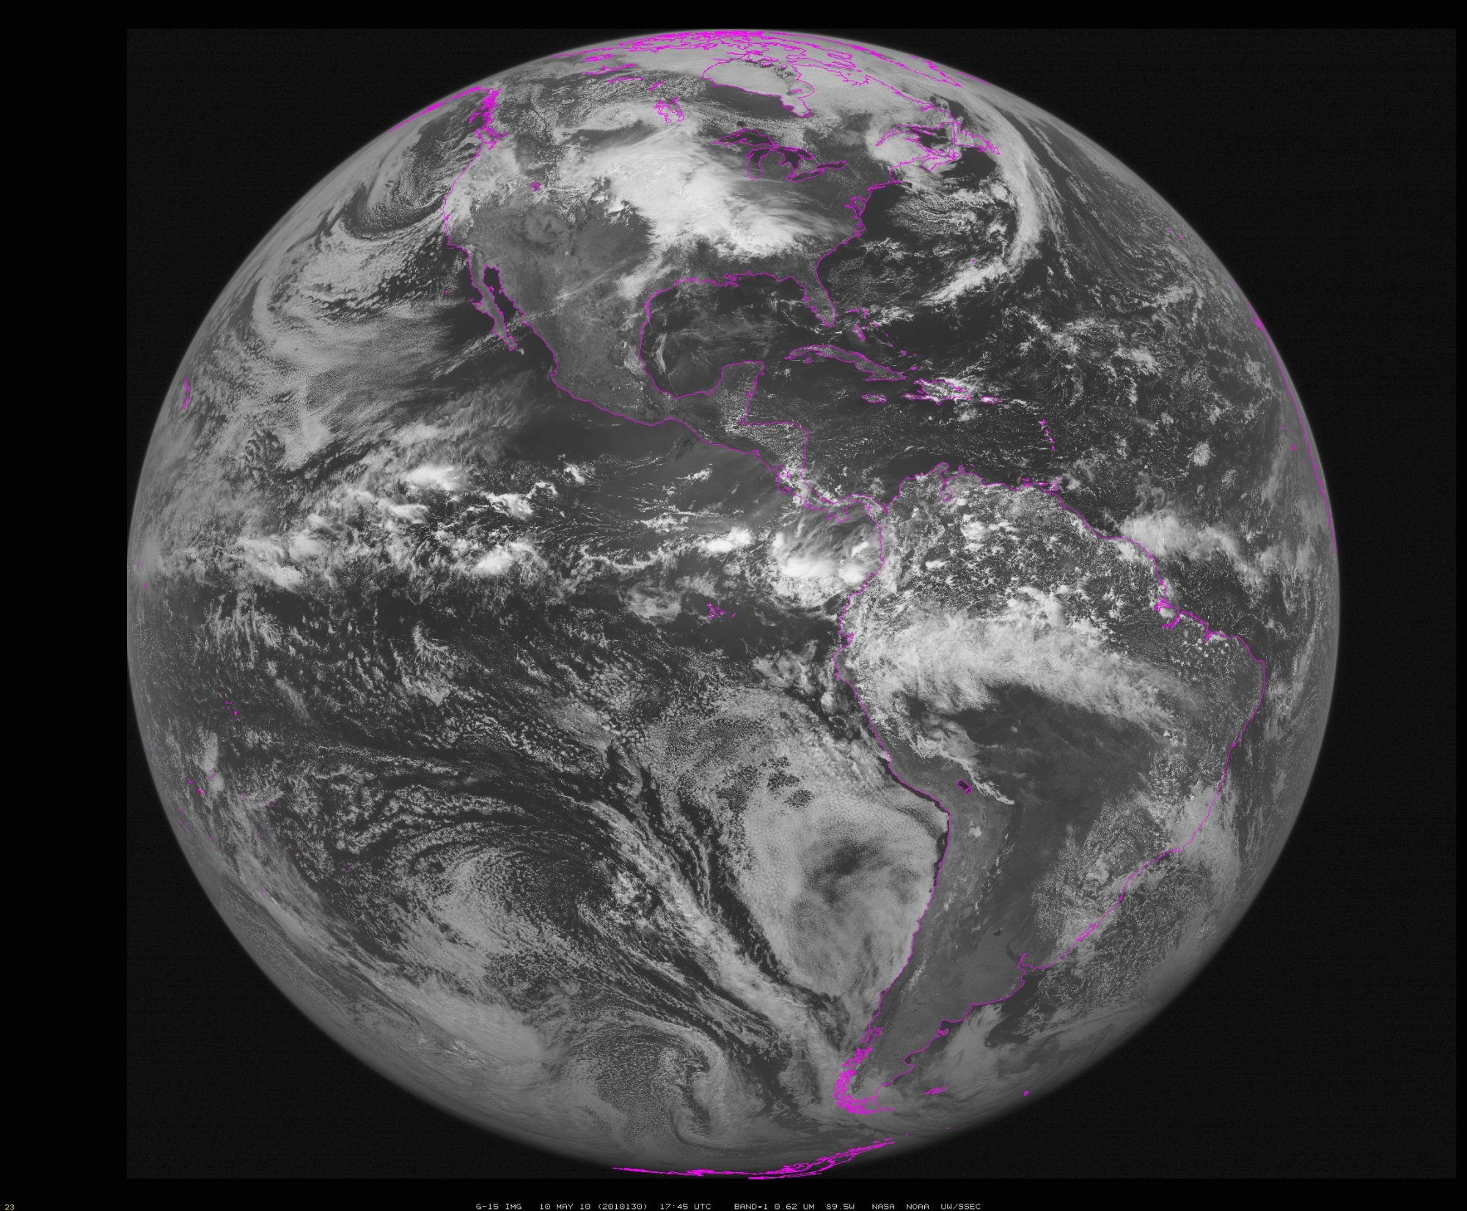
~90W (Approximate location of GOES-R during check-out)
Notes:
Data from SSEC Data Center

Slide 7
The Advanced Baseline Imager:
ABI Current
Spectral Coverage
16 bands 5 bands
Spatial resolution
0.64 μm Visible 0.5 km Approx. 1 km
Other Visible/near-IR 1.0 km n/a
Bands (>2 μm) 2 km Approx. 4 km
Spatial coverage
Full disk Every 15 min Scheduled (3 hrly)
CONUS Every 5 min ~4 per hour
Mesoscale Every 30 sec n/a
Visible (reflective bands)
On-orbit calibration Yes No
Notes:
The ABI allows more bands, finer spatial resolution, faster refresh rates and on-orbit calibration of all bands!

Slide 8
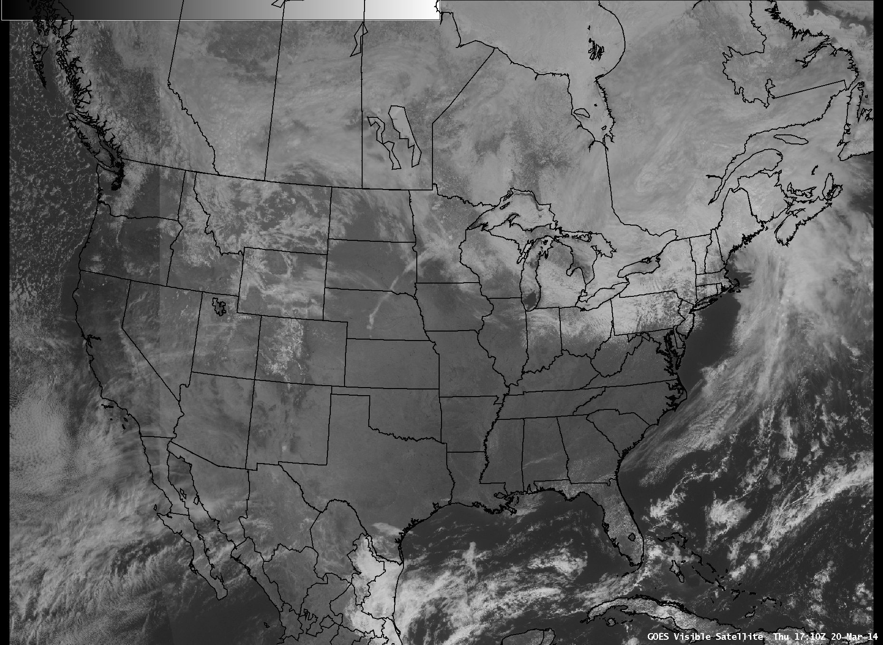
seam

Slide 9

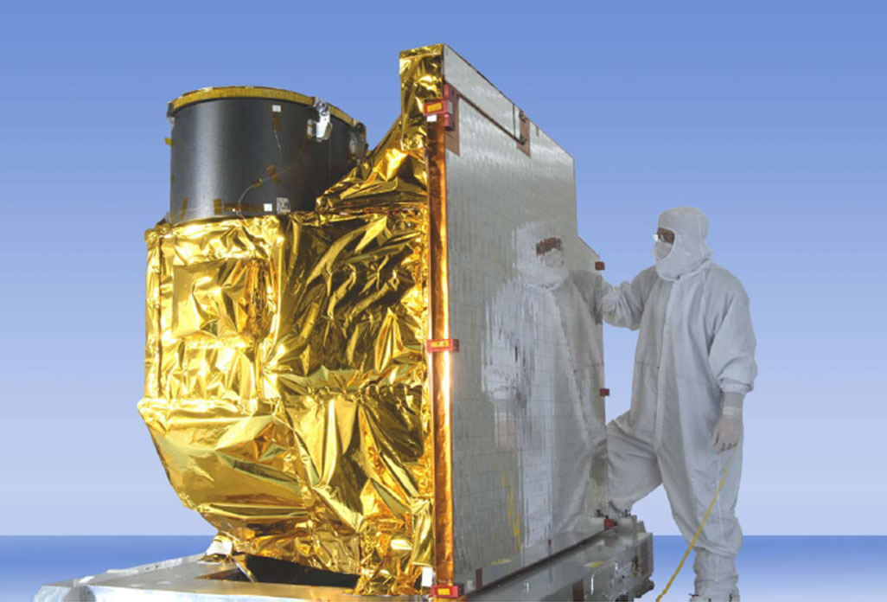
Advanced Baseline Imager
5
4
3
X
Faster coverage
(5-minute full disk vs. 25-minute)
X
Improved spatial
resolution
(2 km IR vs. 4 km)
X
More spectral bands (16 on ABI vs. 5 on the current imager)
Notes:
Slide from J. Gerth, CIMSS.

Slide 10
Data Flow
Current plans call for several data delivery methods, for real-time, these are:
  GOES-R ReBroadcast (GRB) (National Centers)
  SBN.
  Other (pull)
Hence, what GOES-R data you have may depend on your access method. For example, courser data outside of CONUS and certain sectors.

Slide 11
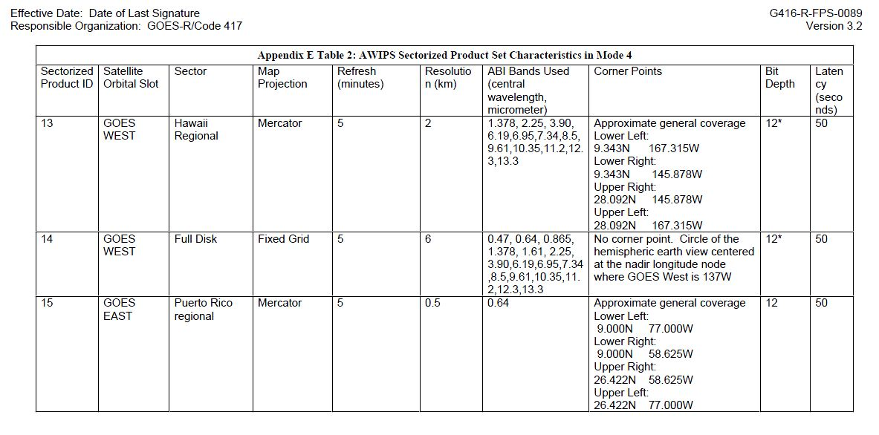
Ground System (GS) FPS, Appendix E
Outside of CONUS, Hawaii, Alaska and Puerto Rico regional, imagery will be 6 km in AWIPS (for the data via the SBN).
http://www.goes-r.gov/resources/docs/GOES-R_GS_FPS.pdf

Slide 12
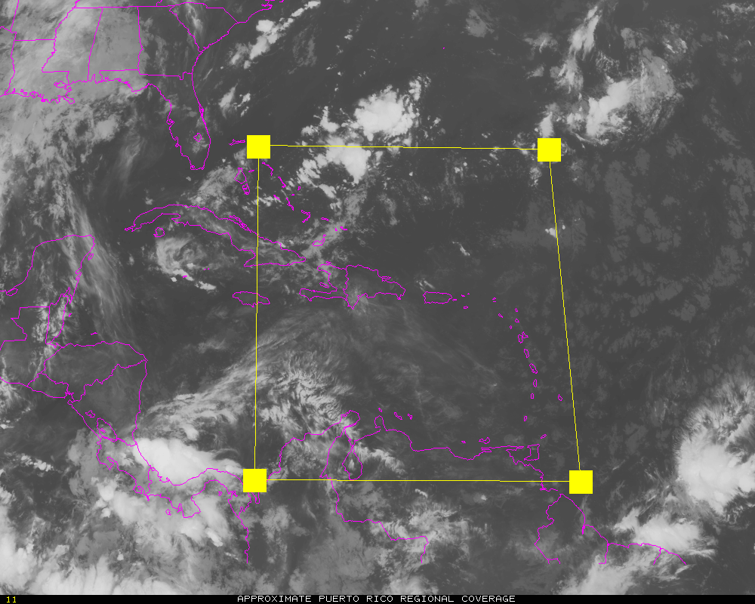
Approximate Puerto Rico regional coverage
(from GS FPS)
Shown in satellite projection

Slide 13
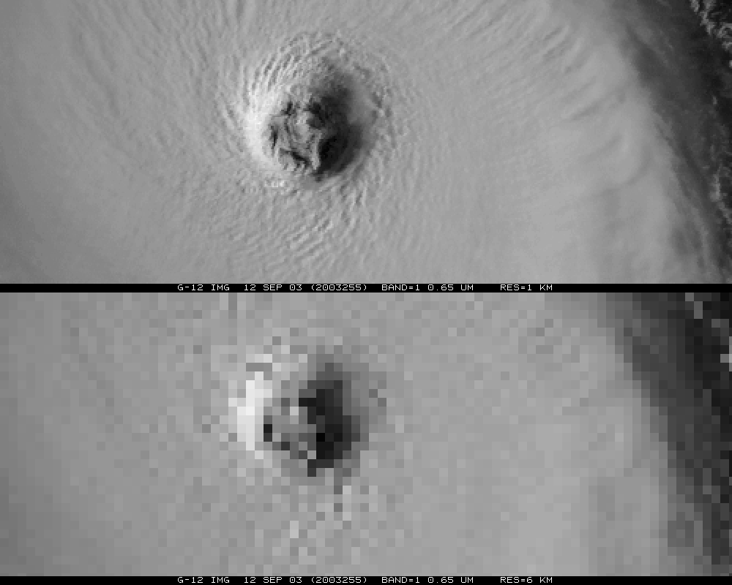
~1 km
~6 km
Notes:
ABI band 2 (0.6 micrometers) will be finer resolution than the imagery shown and the 6km may be worse since this is 6km in a Mercator.

Slide 14
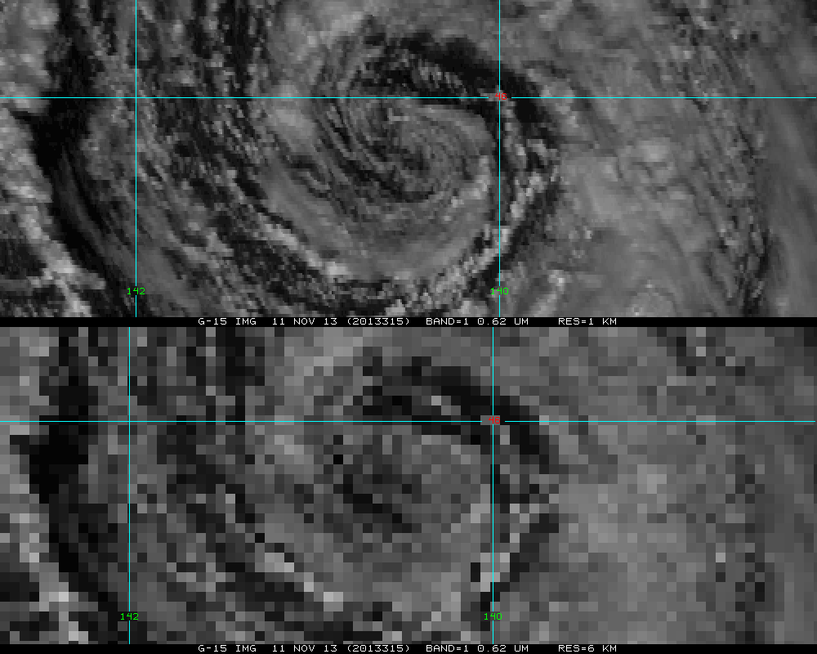
~1 km
~6 km
Notes:
ABI band 2 (0.6 micrometers) will be finer resolution than the imagery shown and the 6km may be worse since this is 6km in a Mercator.

Slide 15
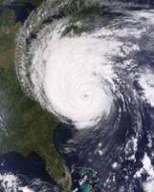
Outline
Overview
ABI
  Spectral
  Temporal
  Spatial
Other
Summary
More information

Slide 16
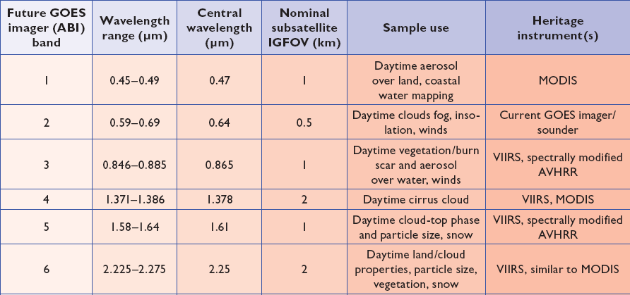
ABI bands 1-6
2 visible band and 4 near infrared bands on the ABI, compared to only one on today’s imager
Notes:
Final column added: heritage. The ABI band 1 was suggested by Dr. Fred Mosher at a GOES Users' Conference.
The ABI band 3 was suggested by the late Dr. C. Rao (of the then ORA).
Some of these bands have been shifted to more closely match those on the VIIRS.

Slide 17
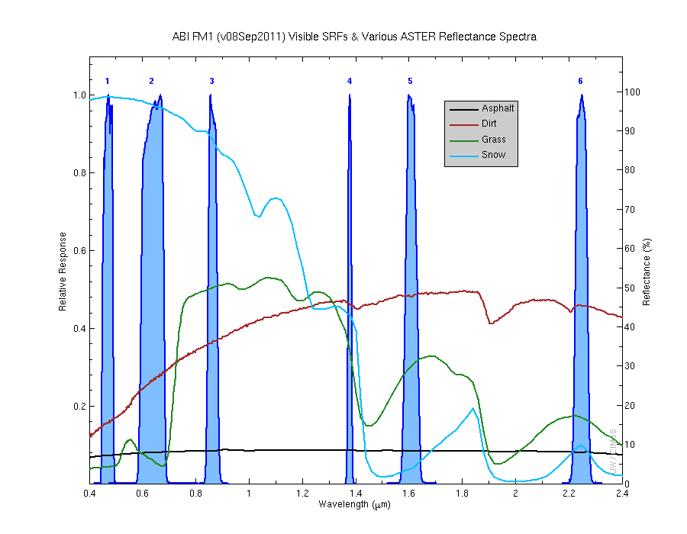
Visible and near-IR channels on the ABI
Aerosols, Insolation
Clouds, Snow
Vegetation, Imagery
Cloud mask, Suspended matter
Snow, Phase
Cloud Particle size
Sample use only, many other uses
The ABI visible and near-IR bands have many uses.
Notes:
Schmit, T. J., M. M. Gunshor, W. P. Menzel, J. J. Gurka, J. Li, and A. S. Bachmeier, 2005: Introducing the next-generation Advanced Baseline Imager on GOES-R. Bull. Amer. Meteor. Soc., 86, 1079-1096.

Slide 18
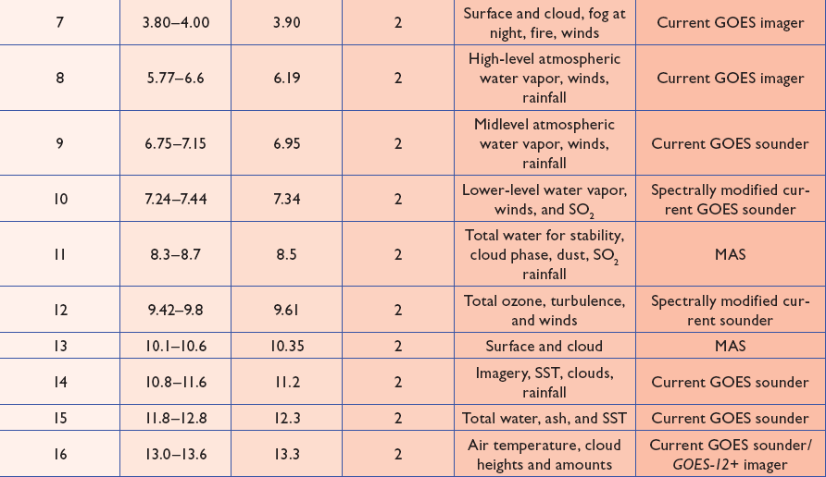
ABI bands 7-16
10 infrared bands on the ABI, compared to four on today’s imager
Notes:
The ABI band 10 was modified to better depict upper-level SO2. (G. Ellrod and others)
The ABI band 11 was suggested by Steve Ackerman (CIMSS), based on HIRS experience.
The ABI band 13 was suggested by W. P. Menzel (then NOAA NESDIS).

Slide 19
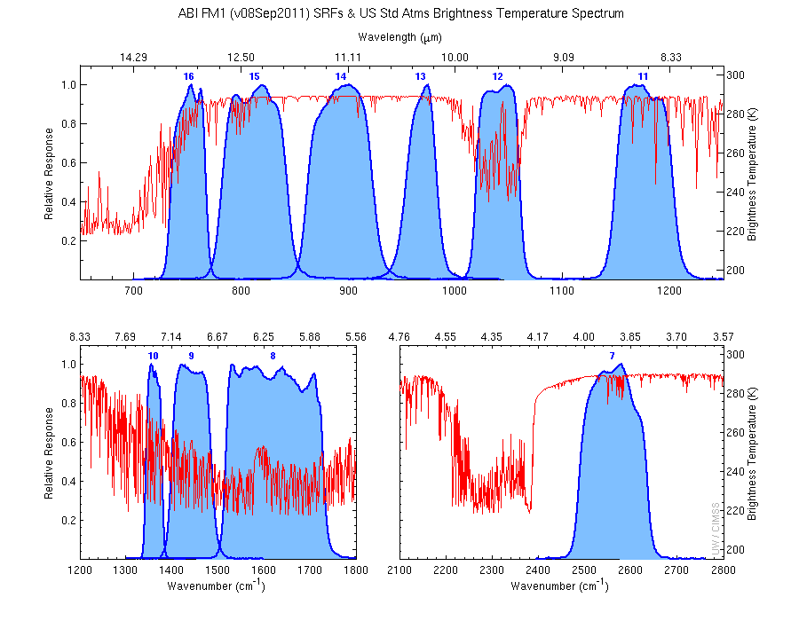
The IR channels on the ABI
Clouds, Stability Indices
SST, Fires, Radiances
Ozone, Downward Radiation
Rainfall, Aerosol
Hurricane, Imagery
Cloud Phase, SST
Sample use only, many other uses
SO2, Radiances
Winds, WV profiling
TPW, Rainfall rate
Fires, Fog
ABI has many more bands than the current operational GOES imagers.
Notes:
Schmit, T. J., M. M. Gunshor, W. P. Menzel, J. J. Gurka, J. Li, and A. S. Bachmeier, 2005: Introducing the next-generation Advanced Baseline Imager on GOES-R. Bull. Amer. Meteor. Soc., 86, 1079-1096.

Slide 20
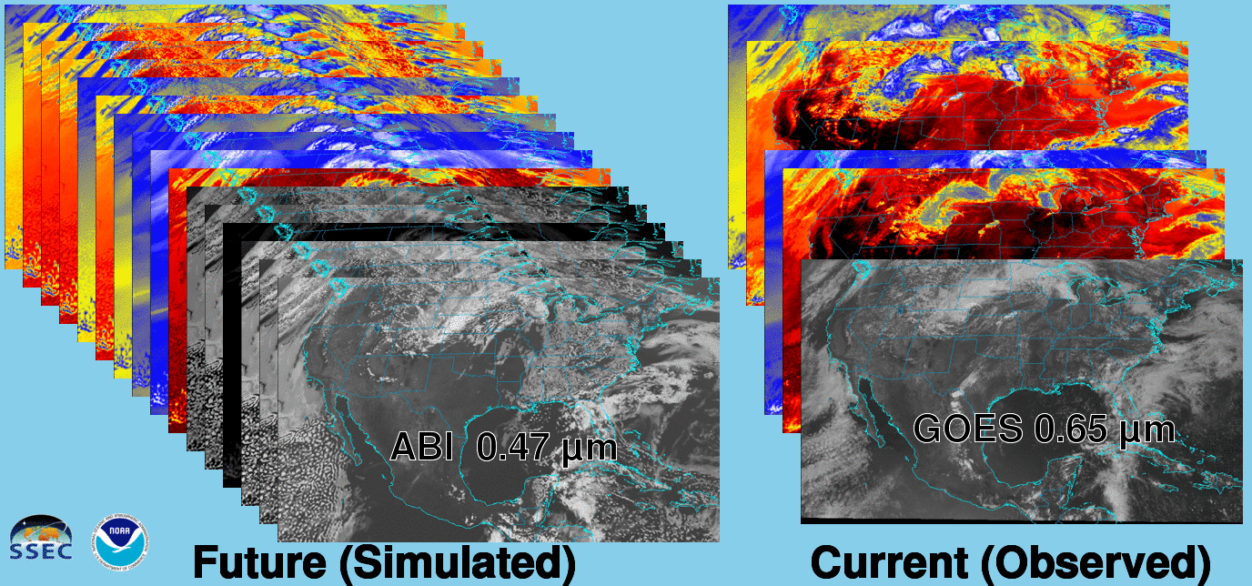
Future vs. Current Spectral Bands
The current GOES (right) has 5 spectral bands, while the GOES-R series ABI (left) will have 16 spectral bands.

Slide 21
CONUS Scans from GOES-West and –East for the GOES-R Era
Timothy J. Schmit
(NOAA/NESDIS/ASPB)
Mat Gunshor, Kaba Bah, Jordan Gerth
(CIMSS)
University of Wisconsin-Madison -- Madison, WI

Slide 22
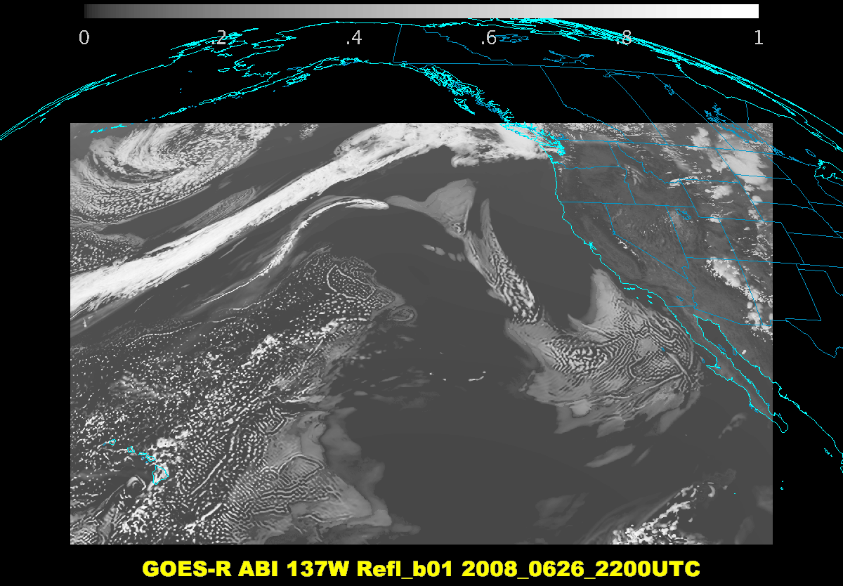

Slide 23
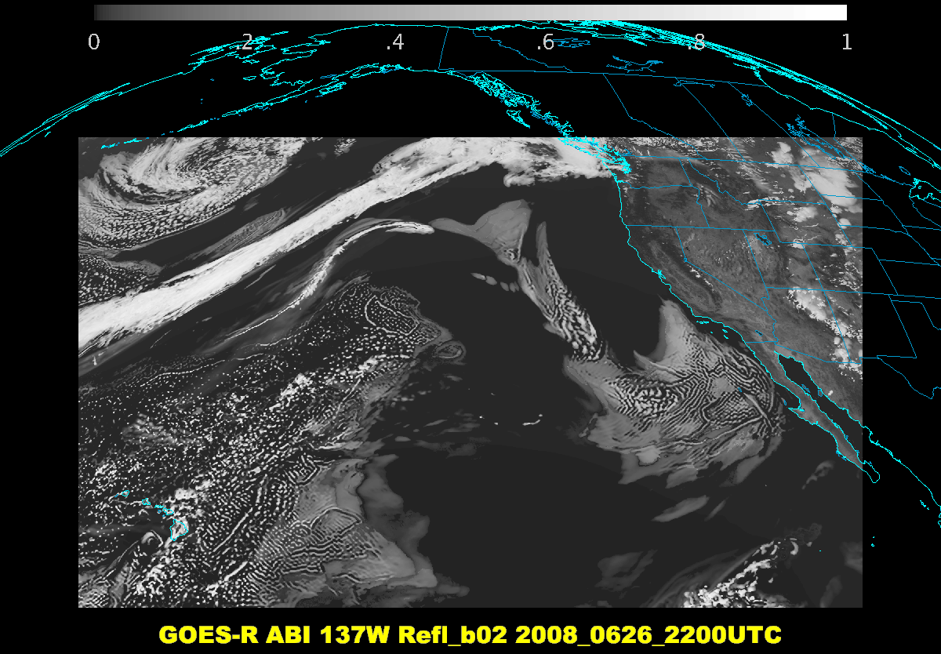

Slide 24
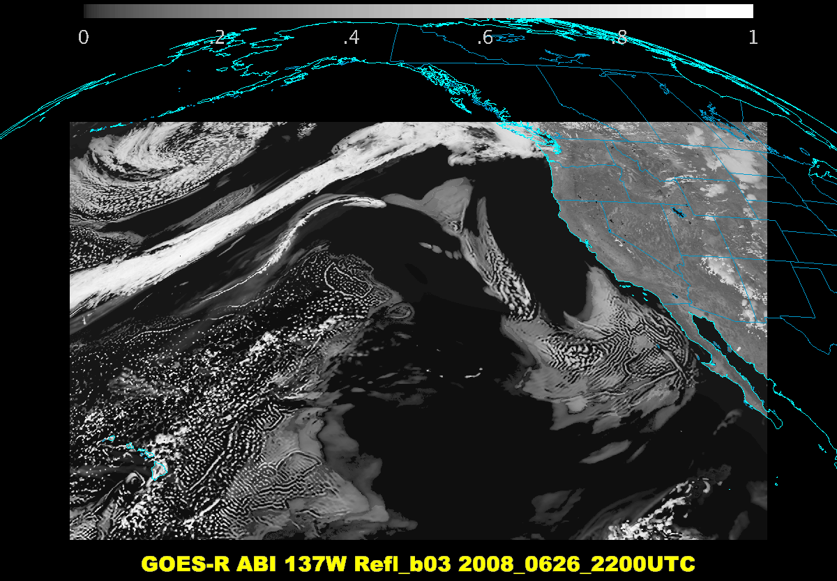

Slide 25
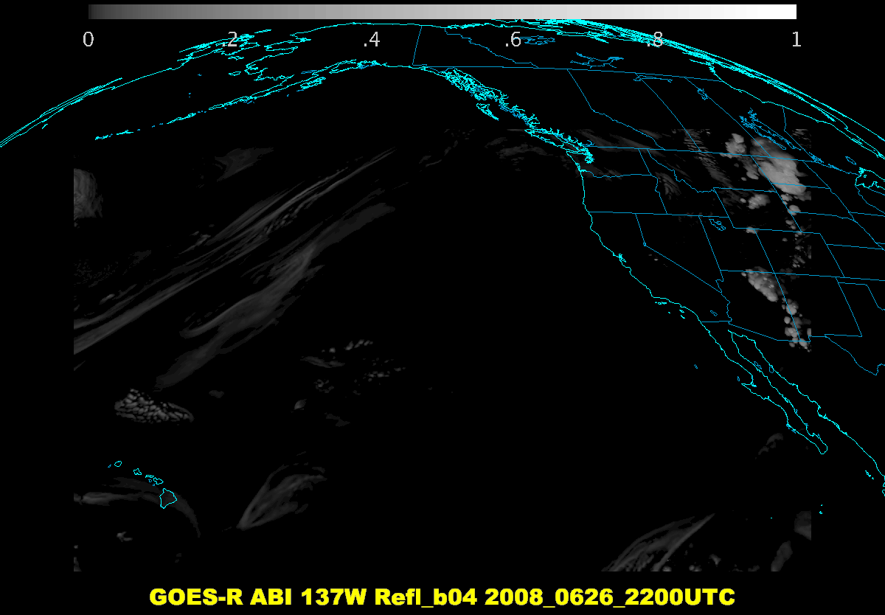

Slide 26
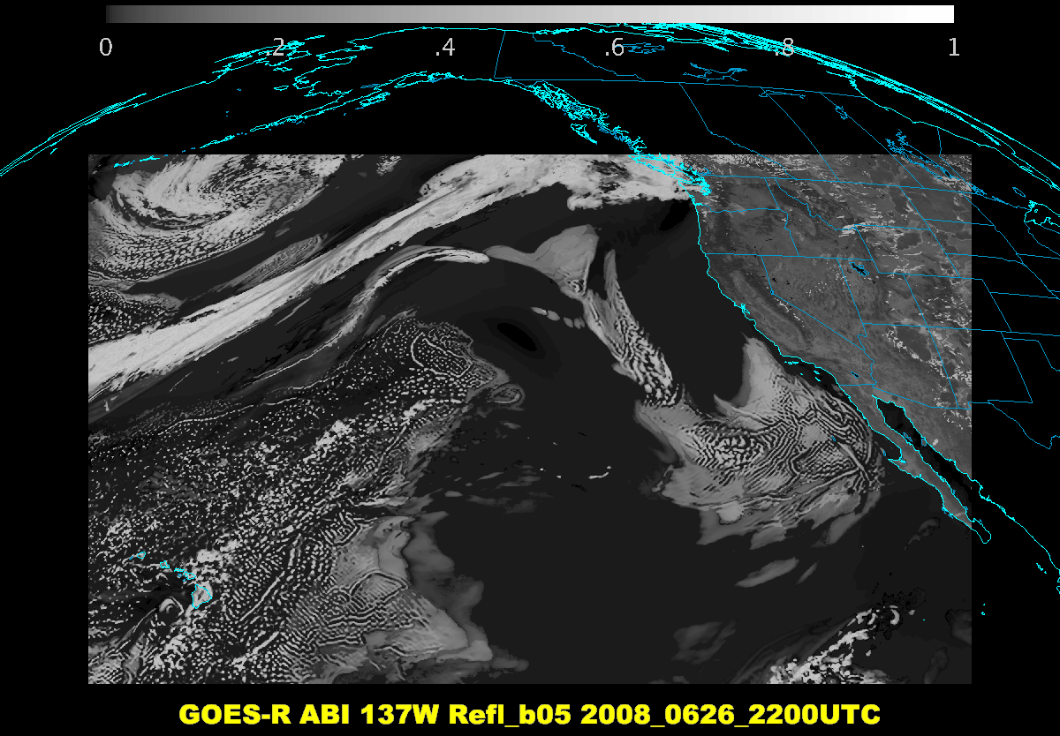

Slide 27
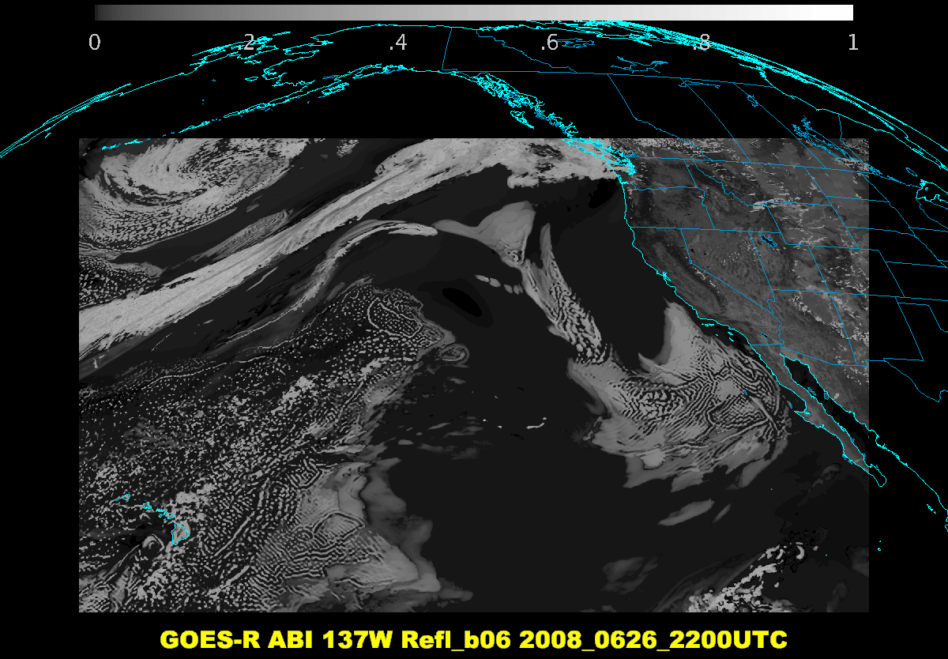

Slide 28
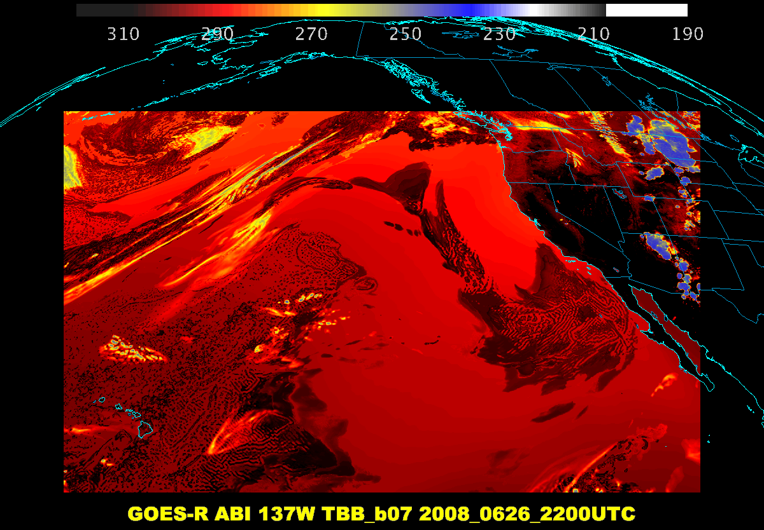

Slide 29
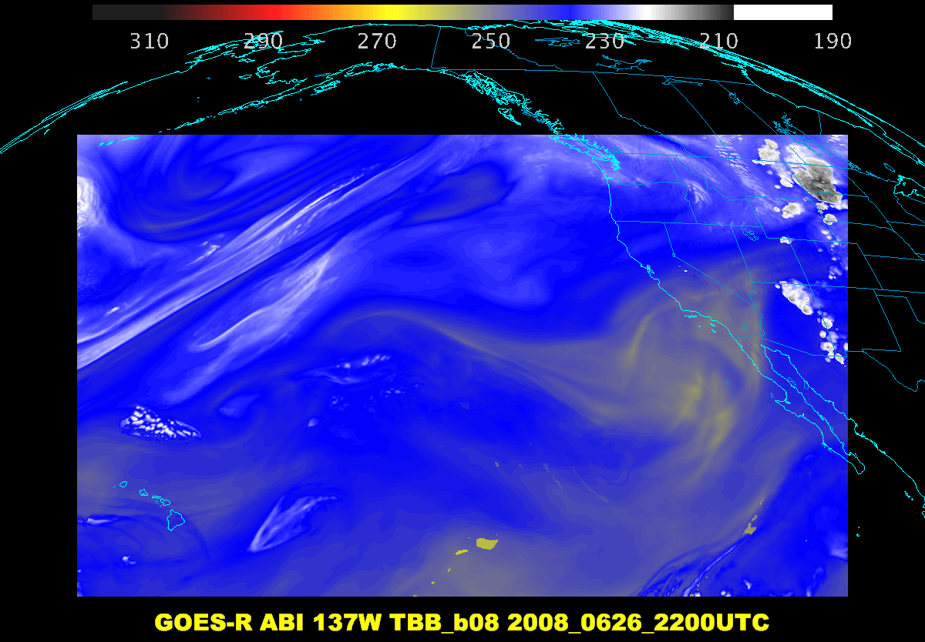

Slide 30
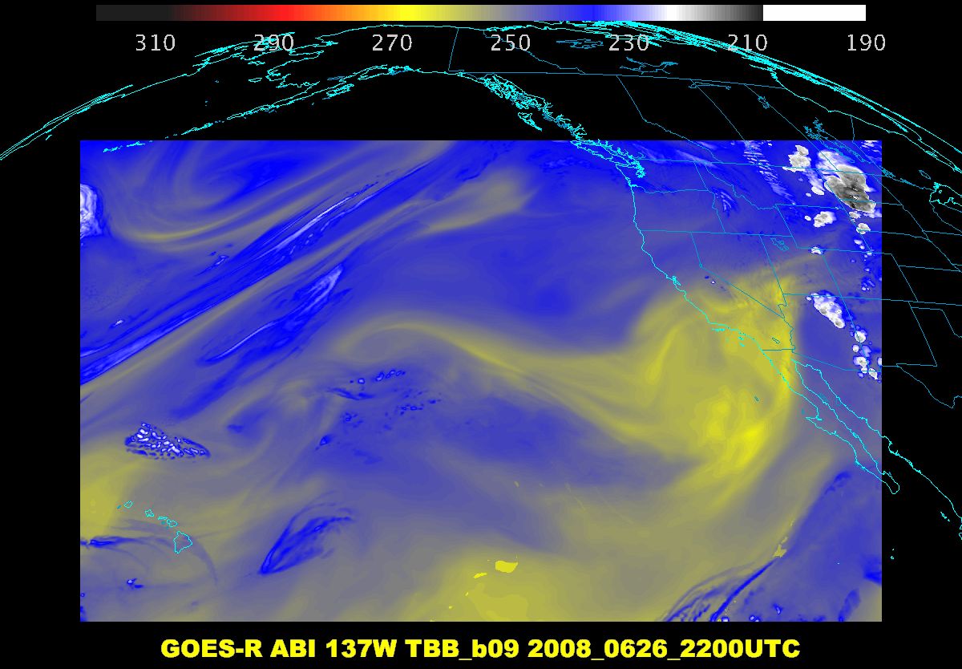

Slide 31
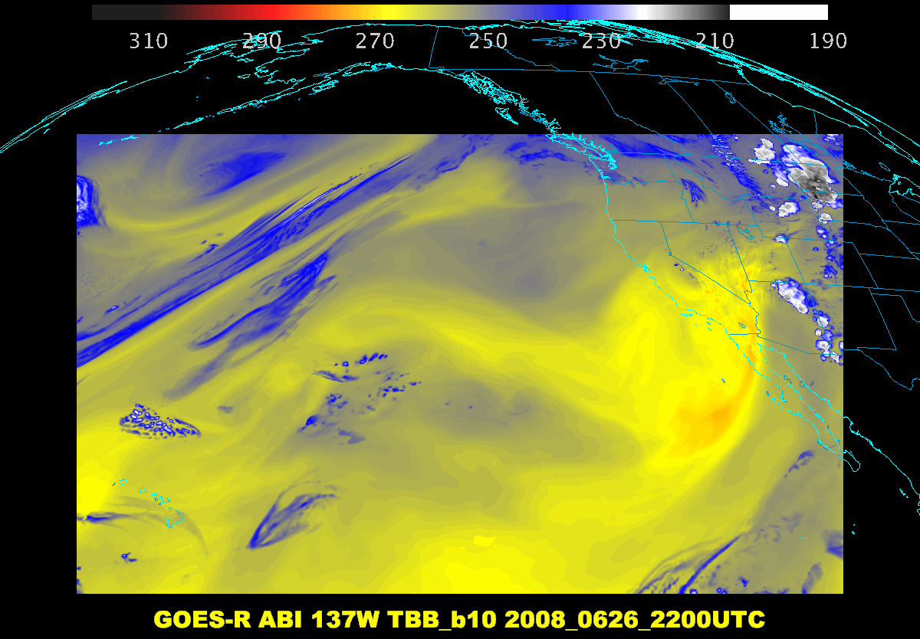

Slide 32
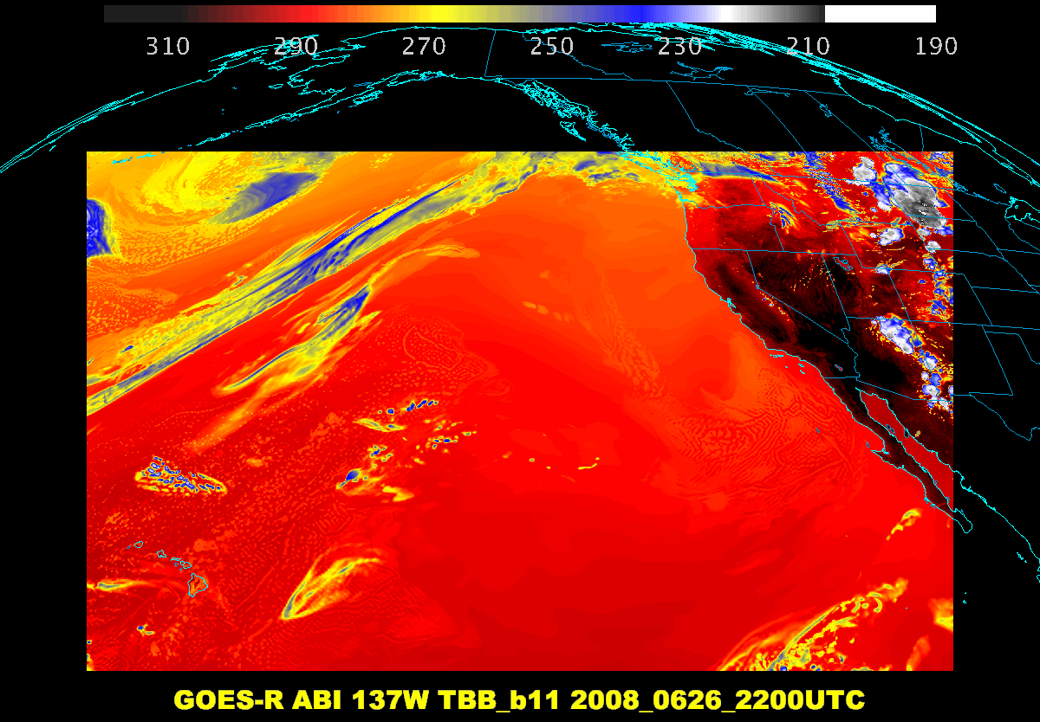

Slide 33
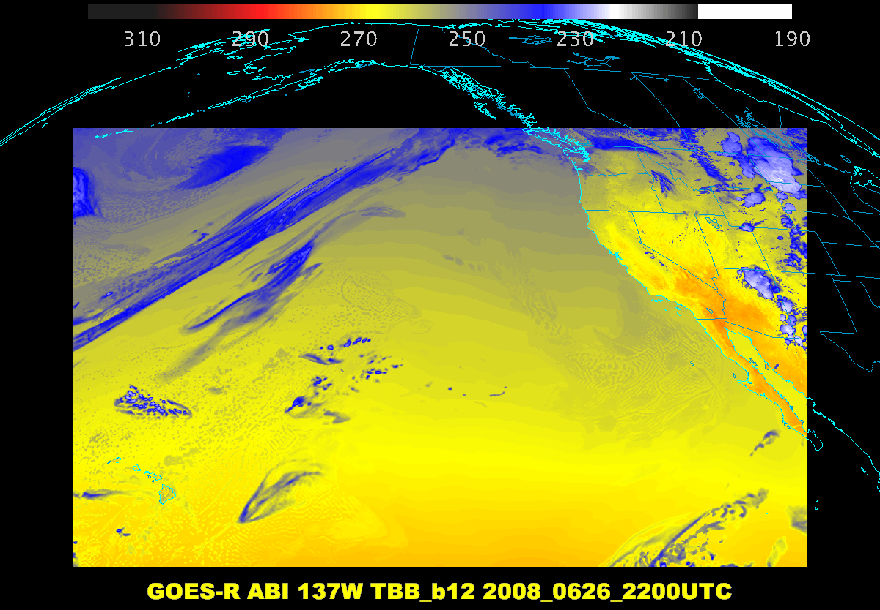

Slide 34
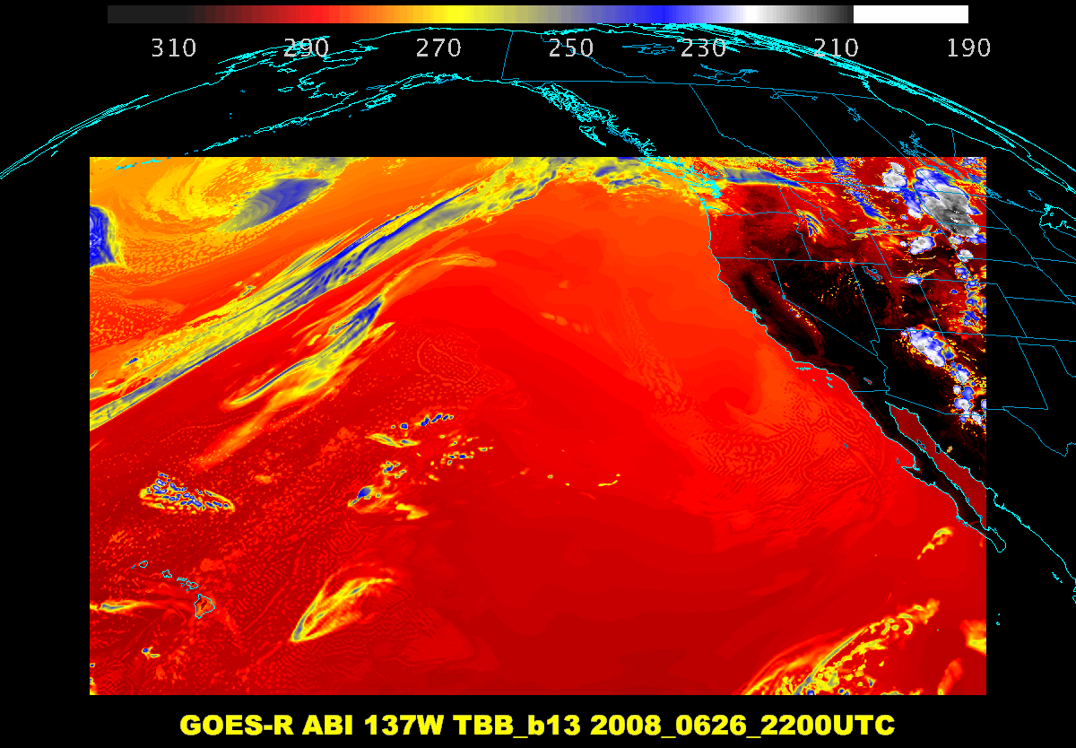

Slide 35
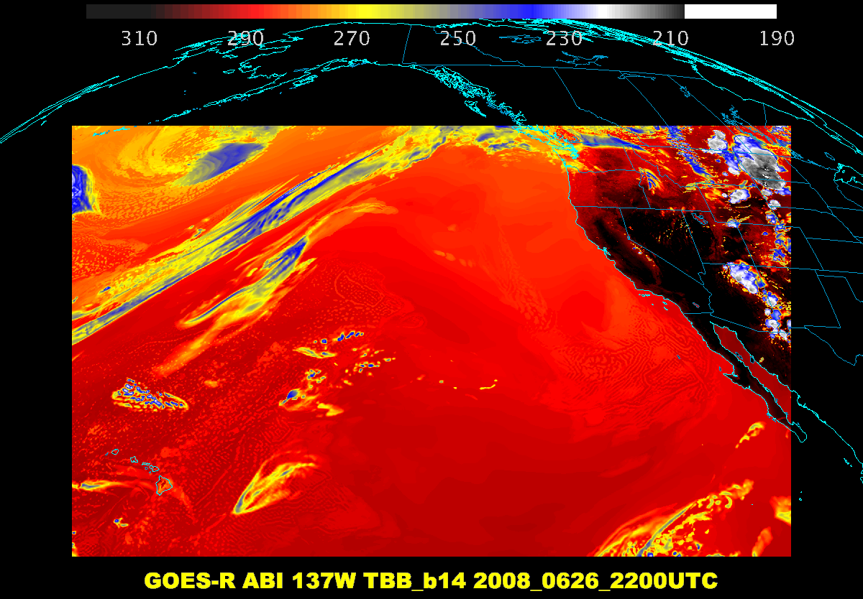

Slide 36
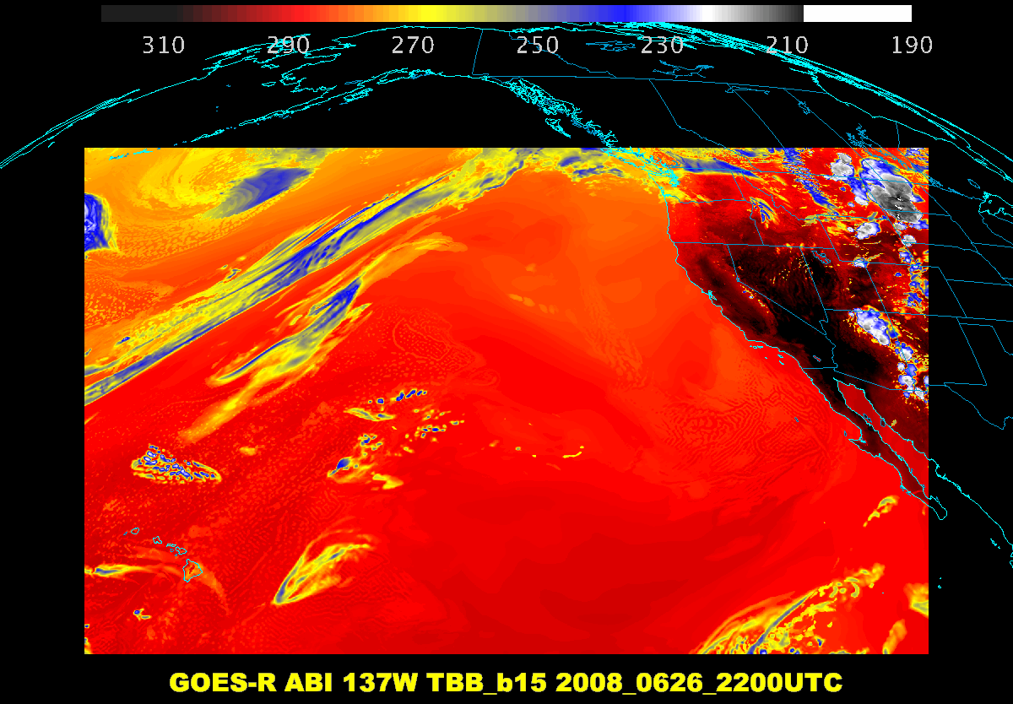

Slide 37
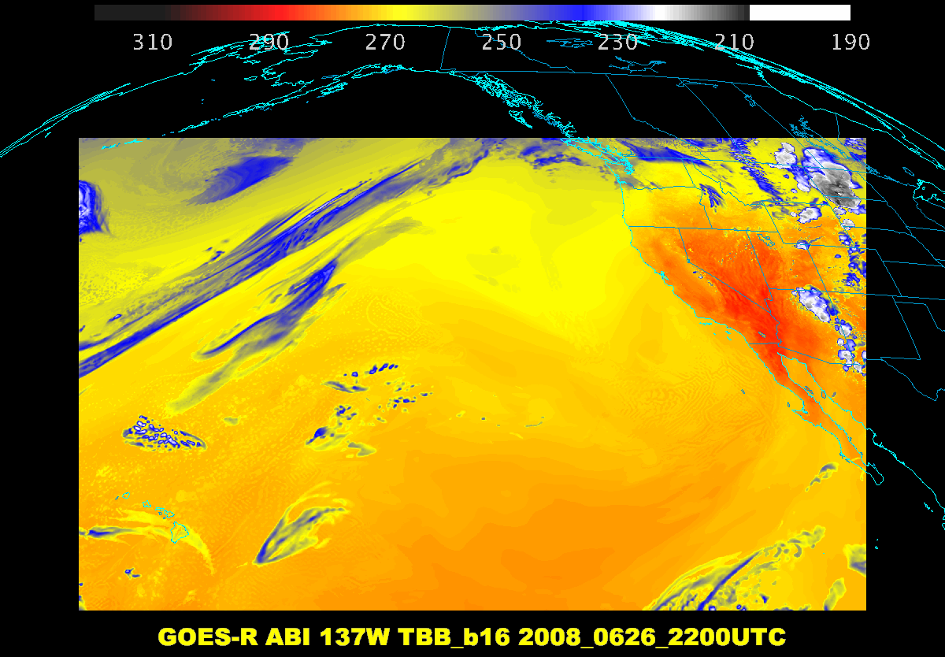

Slide 38
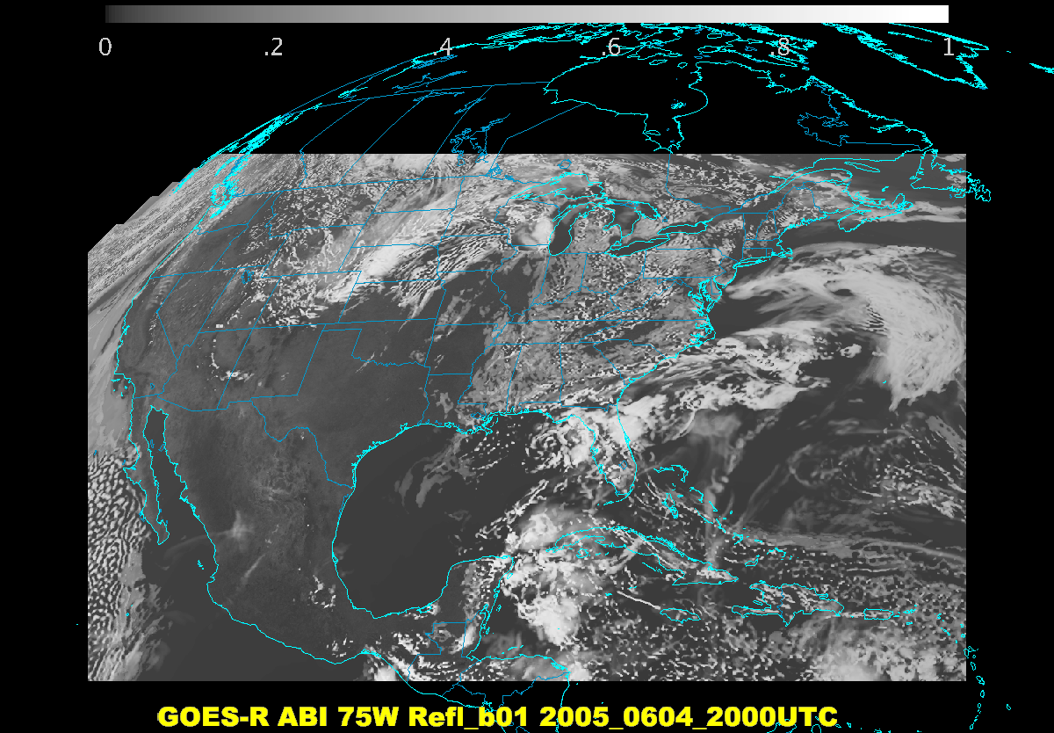

Slide 39
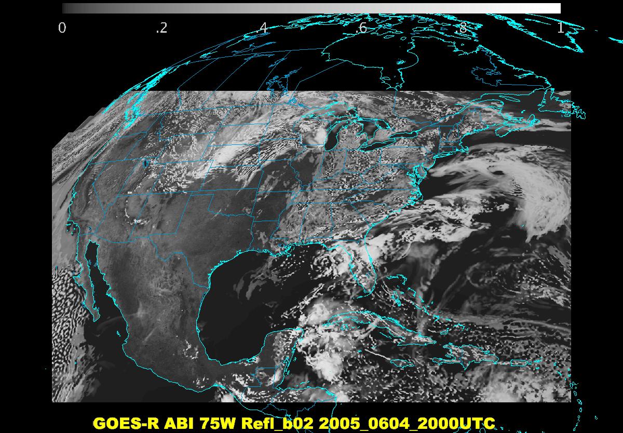

Slide 40
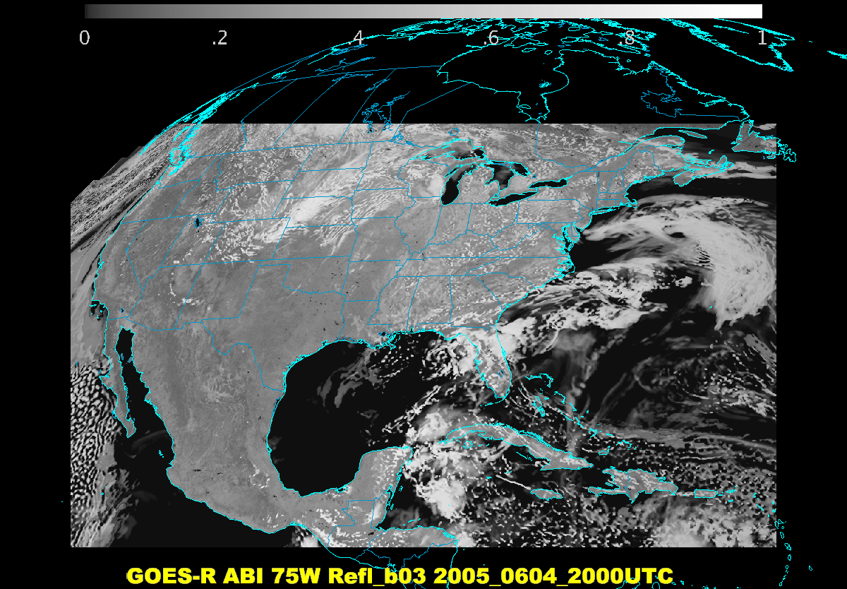

Slide 41
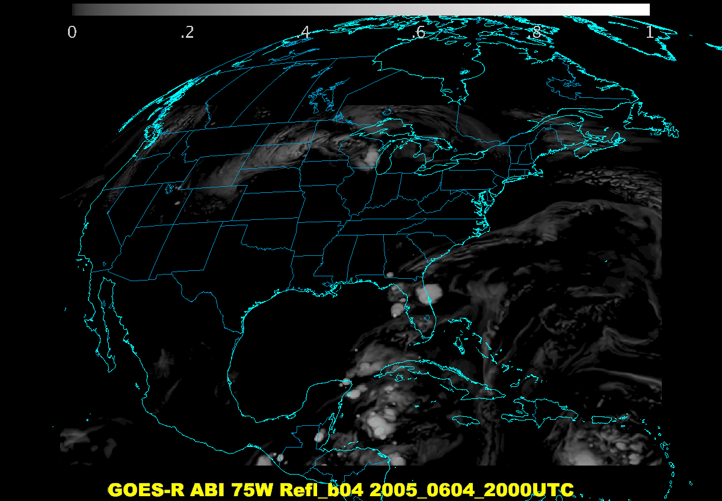

Slide 42
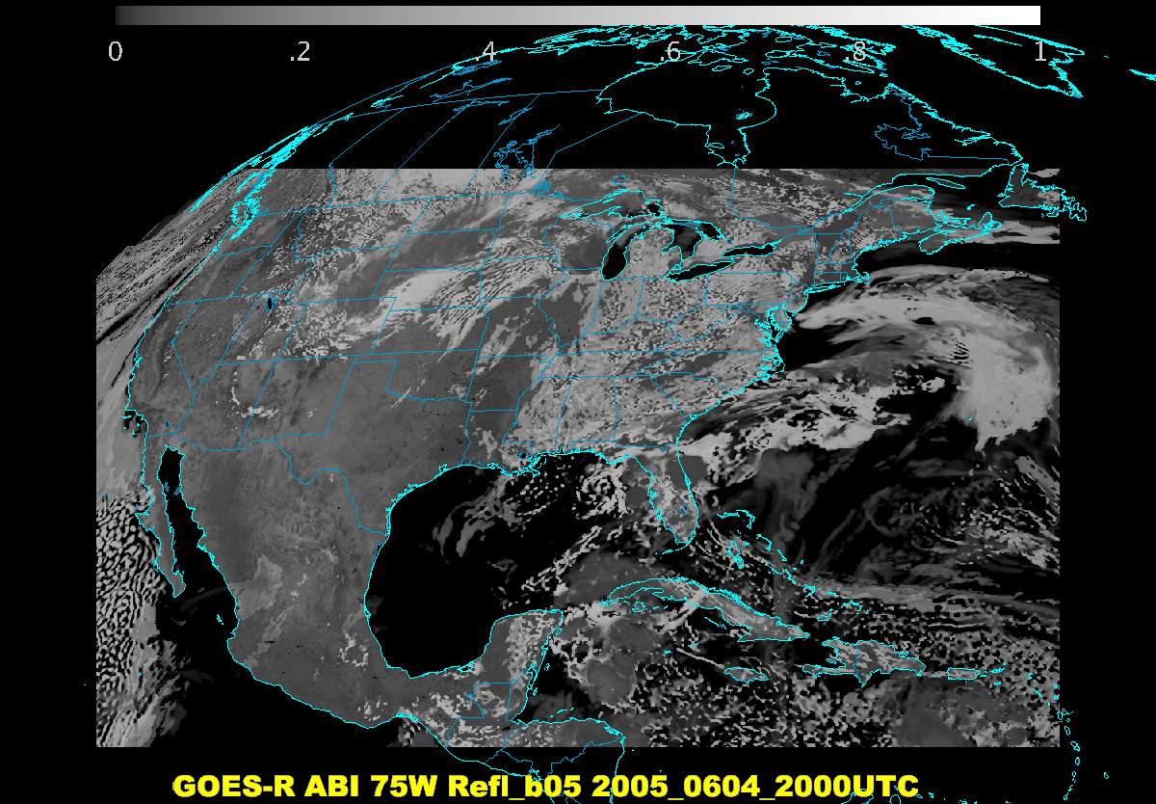

Slide 43
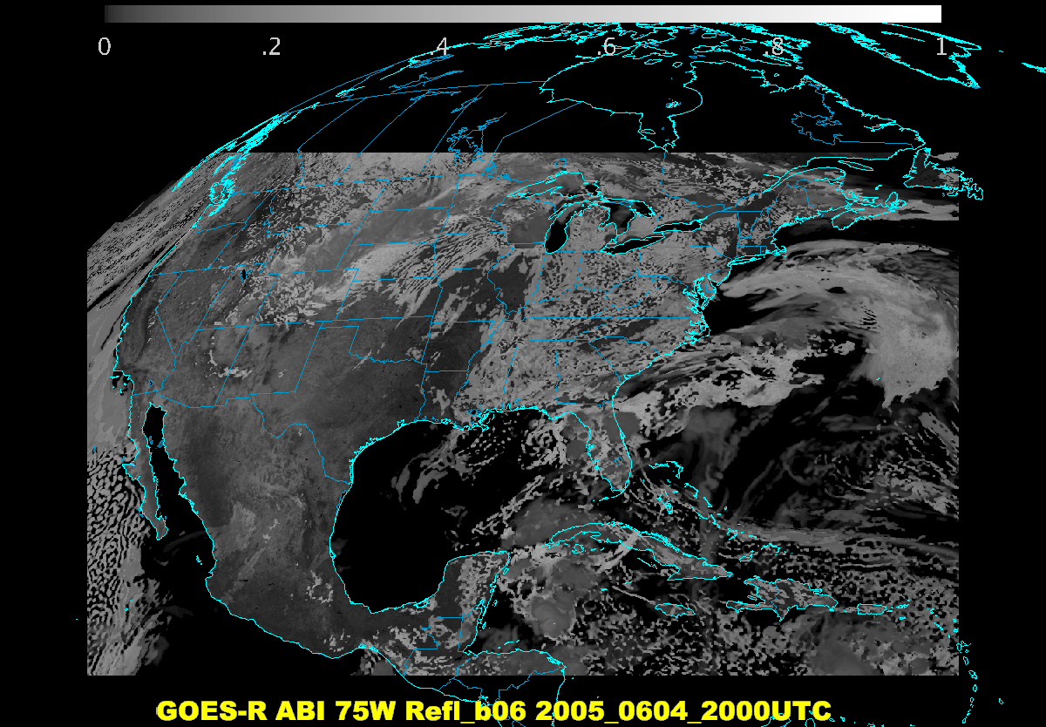

Slide 44
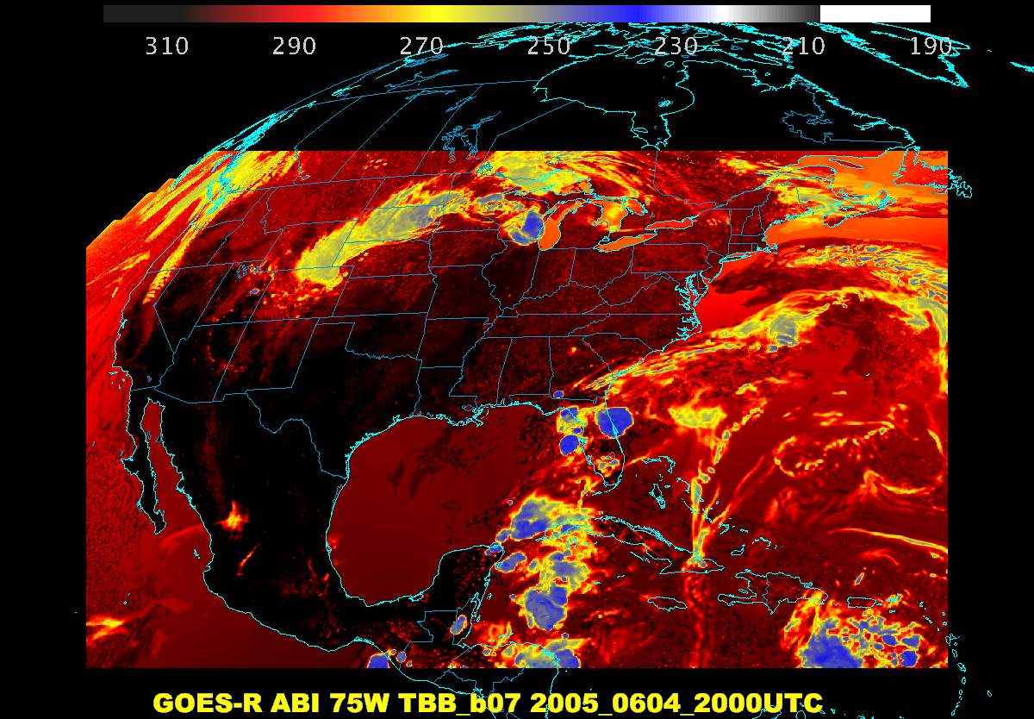

Slide 45
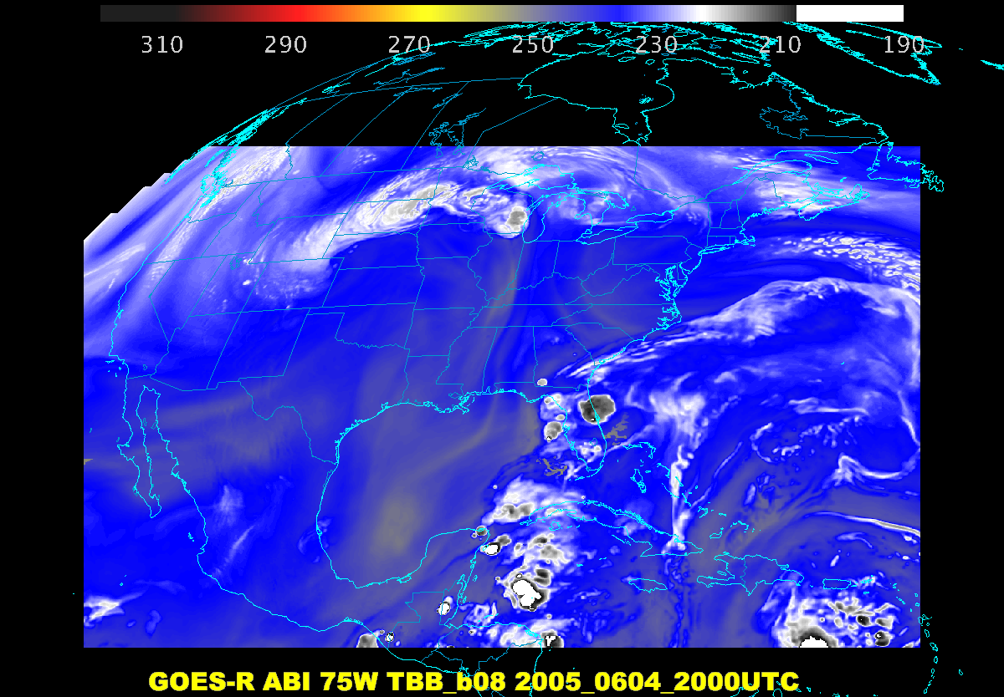

Slide 46
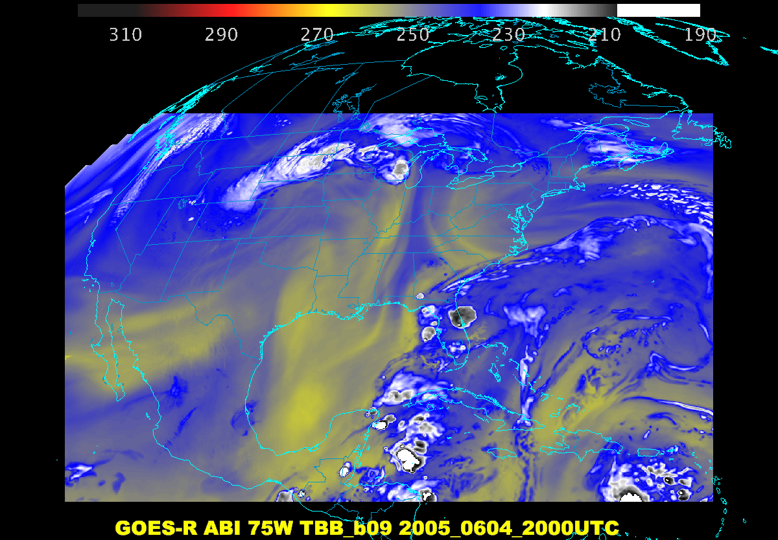

Slide 47
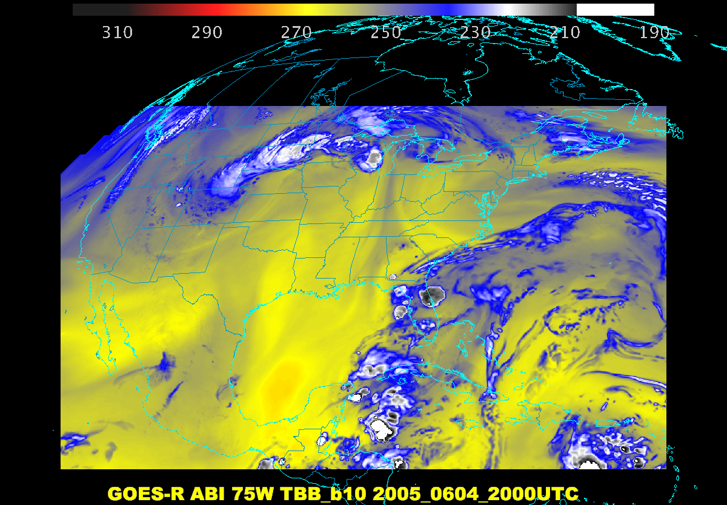

Slide 48
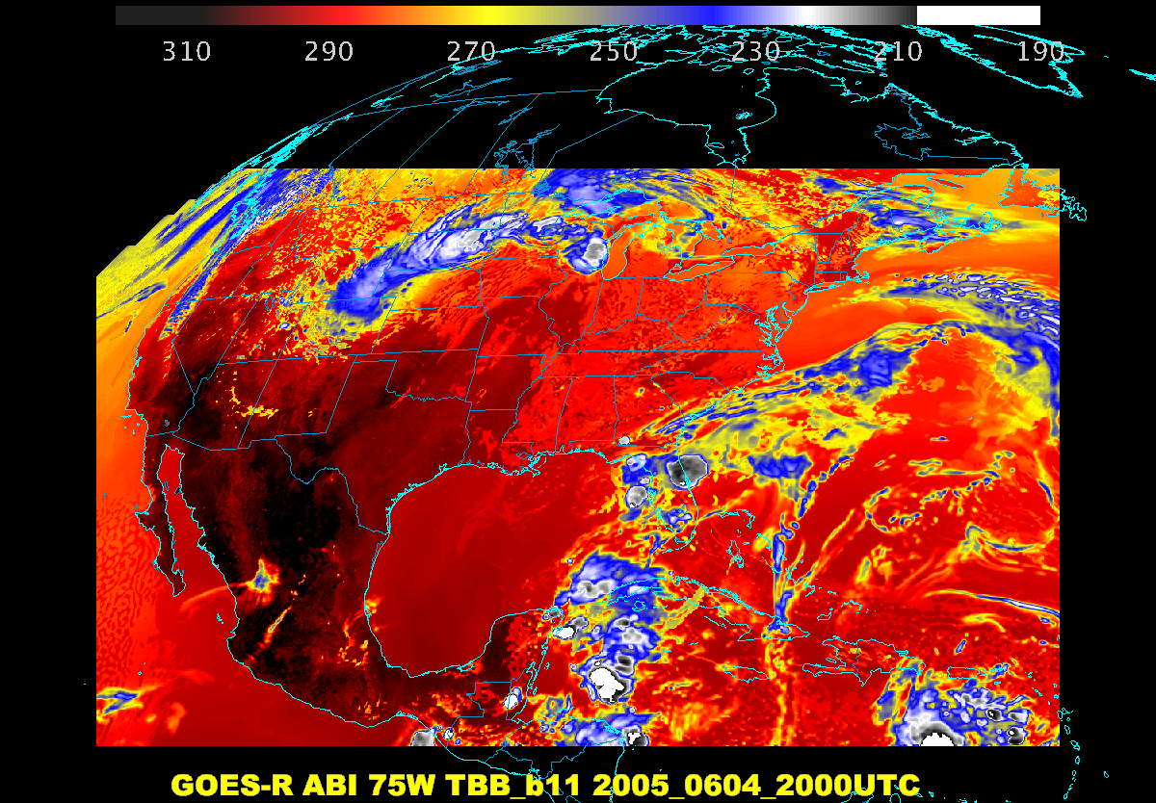

Slide 49
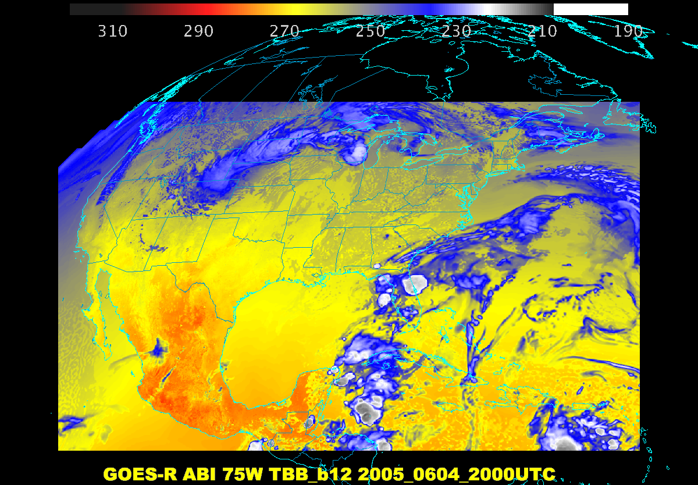

Slide 50
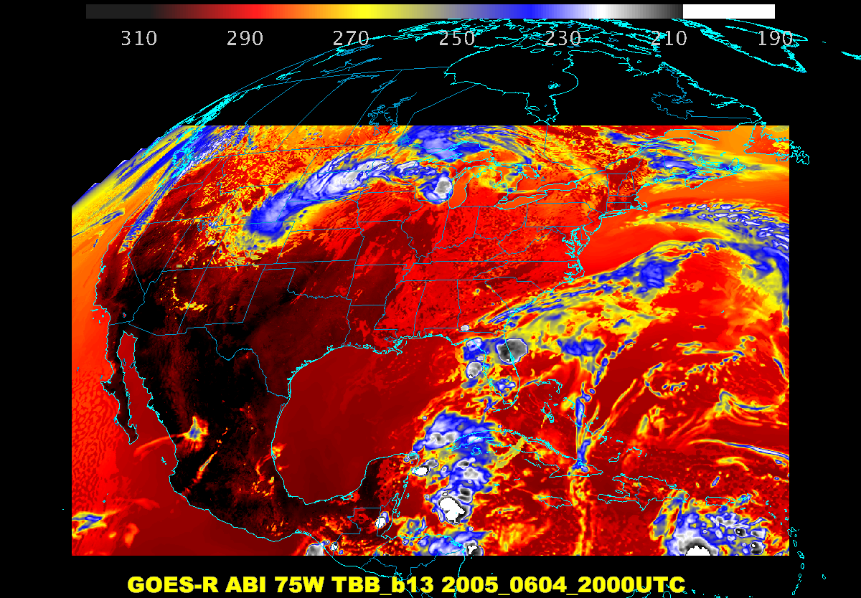

Slide 51
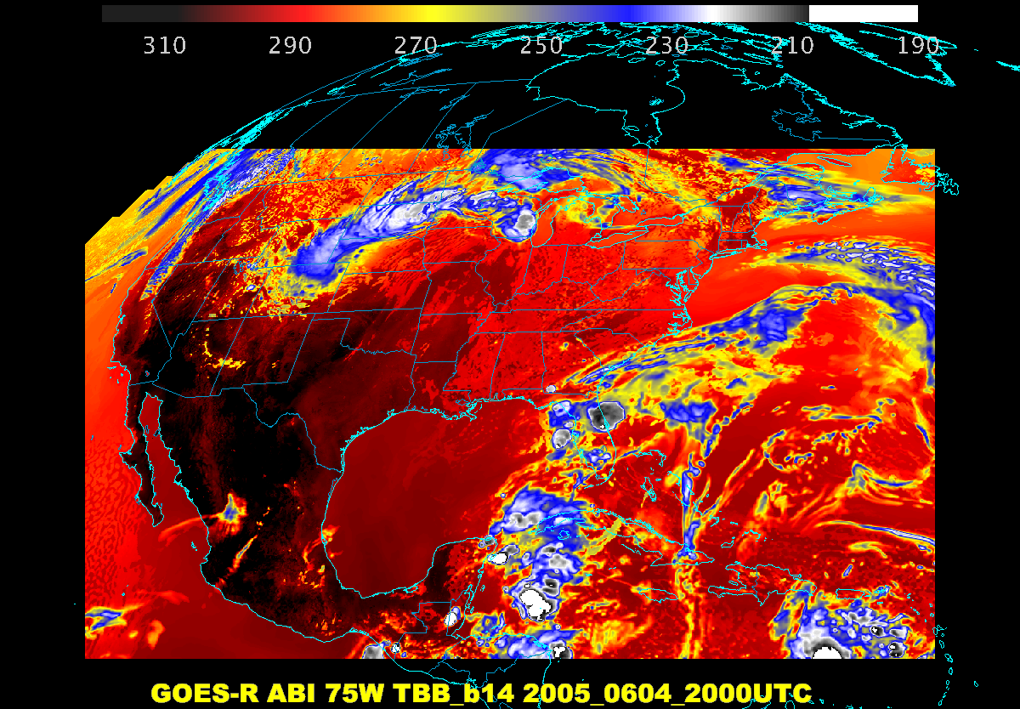

Slide 52
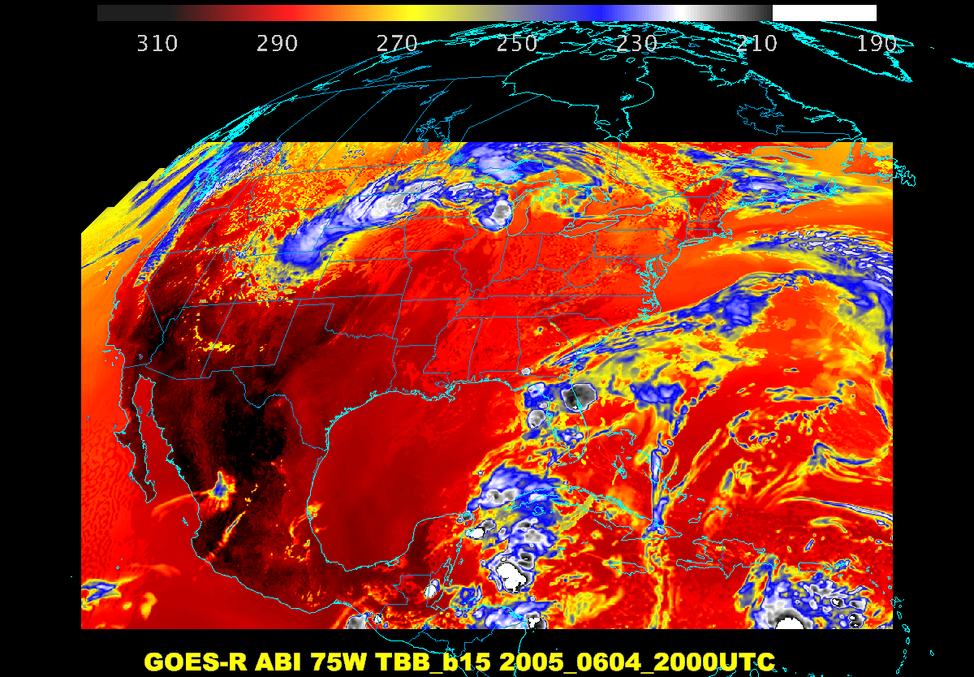

Slide 53
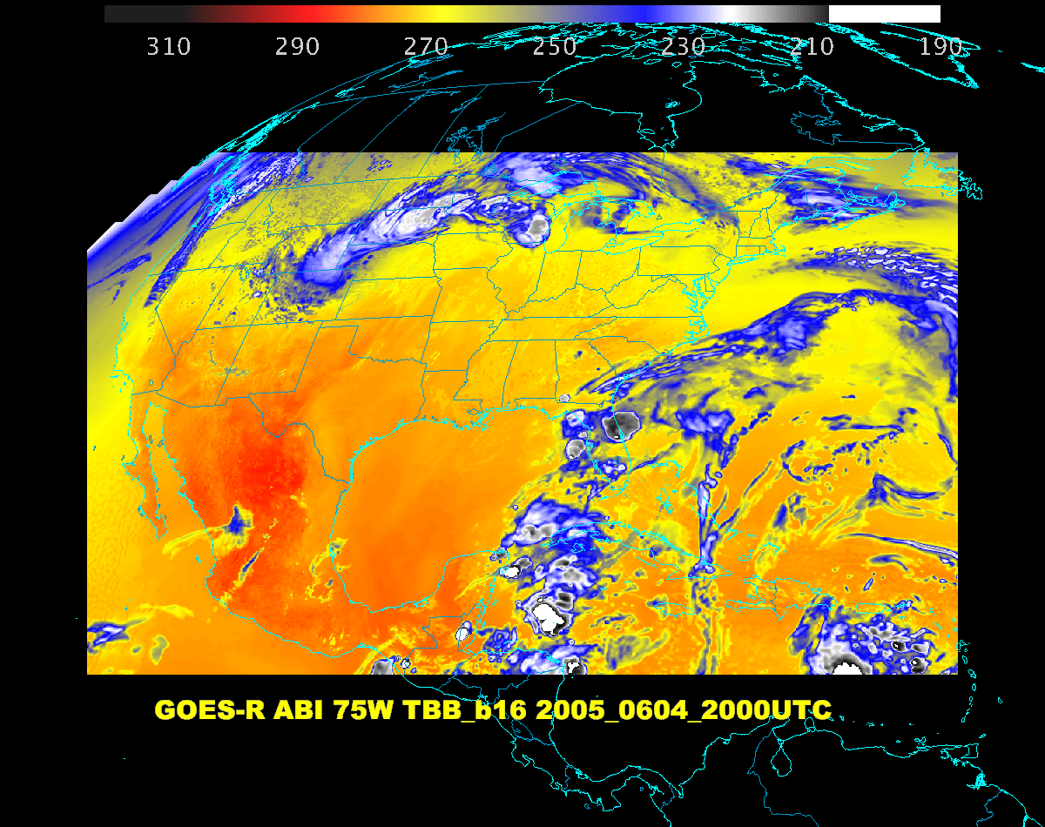

Slide 54




1.88 μm (or 1.38 μm) is helpful for contrail detection
Aircraft case -- Clear?

Slide 55


Why we can see hot fires in the 2.2 um (and 1.6 um) ABI bands
Radiance versus wavelength
AHI images over Australia on March 23, 2015 of bands 3.9 μm (left) 1.6 μm (right) showing a fire. The AHI 1.6 μm is nominally 2 km spatial resolution, while on the ABI the band will be 1 km.

Slide 57

Blue and Red bands on the ABI ….

Slide 58
Hands-on….
Step through the ABI spectral bands (and turn on the interactive chart)
  One of the simulated cases
  http://cimss.ssec.wisc.edu/education/apps/bandapp/overview_goes-r.html
Or step through the AHI spectral bands (and turn on the interactive chart)
  One of the observed cases
  http://cimss.ssec.wisc.edu/education/apps/bandapp/overview_ahi_first_images.html
  http://cimss.ssec.wisc.edu/education/apps/bandapp/overview_ahi_first_images.html

Slide 59



Three ABI water vapor bands
Current GOES
Future GOES
Images from J. Feltz
Notes:
Note the 3 layers of information possible from the ABI (right panel).
http://www.ssec.wisc.edu/mcidas/software/v/

Slide 60
Weighting Functions
How the transmittance varies with height
The layer of the atmosphere observed by a given spectral band
Depends on the band, input temperature, moisture, ozone profiles, skin temperature, surface emissivity, plus the view (zenith) angle.
Clear-sky fast forward calculations
A surface emissivity value of 1 is used for each band.

Slide 61

Rsfc R1 R2
top of the atmosphere
τ2 = transmittance of upper layer of atm
τ1= transmittance of lower layer of atm
blackbody earth surface.
R_{obs} =
R_{sfc} τ1 τ2 + R1 (1-τ1) τ2 + R2 (1- τ2)
From W. P. Menzel
Notes:
From W. P. Menzel

Slide 62

ABI Clear-sky Weighting Functions

Slide 63

http://cimss.ssec.wisc.edu/goes/wf/ABI/

Slide 64

ABI Weighting Functions
As a function of….
  View angle

Slide 65
Hands-on….WF
WV bands (3)
  One of the simulated cases
  http://cimss.ssec.wisc.edu/education/apps/bandapp/overview_goes-r.html
What’s the cleanest IR window?
  One of the observed cases
  http://cimss.ssec.wisc.edu/education/apps/bandapp/overview_ahi_first_images.html
  http://cimss.ssec.wisc.edu/education/apps/bandapp/overview_ahi_first_images.html

Slide 67
RGB + Qualitative
Webapp
http://cimss.ssec.wisc.edu/goes/webapps/satrgb/overview.html
http://cimss.ssec.wisc.edu/goes/webapps/satrgb/overview_ahi.html

Slide 68
Outline
Overview
ABI
  Spectral
  Temporal
  Spatial
Other
Summary
More information

Slide 69


Baseline ABI Scan Modes
Scan mode (3) or ‘flex mode’ for the ABI:
- Full disk every 15 minutes + 5 min CONUS
+ 1-min mesoscales (2 locations).
[Scan mode (4) or ‘Continuous Full Disk’ (CFD) is a full disk every 5 min]
Notes:
CONUS image is the shifted center point.

Slide 70
Recent Mode 3 (Flex mode)
“Time-Time” chart
Note the ‘white’ space is instrument idle time.
DRAFT!!!!!
Notes:
Copy and pasted from excel. Pasted as a picture. Resized to 44% by 44% of original. Arrange -> Align -> Align Center & Align Middle

Slide 71
Baseline Time-Time Mode 4
(Continuous Full Disk)
This is the Continuous Full Disk (every 5 min) mode
This is the highest data rate.

Slide 72

Figure courtesy of J. Li, CIMSS
Concept of flex mode scanning animation

Slide 73

Loop over Peoria

Slide 74

GOES-15 Science Test
The Science Test part of Post Launch Testing for GOES-15 occurred in the summer of 2010.
Co-led by Hillger and Schmit.
Unique 1-minute rapid scan imagery acquired
GOES-15 data analysis will continue. All the GVAR data archived.
Many products generated in near real-time.
A NOAA Technical Report was generated.
1-min
30-min
Unique GOES-15 Imager Visible data from the NOAA Science Test
Notes:
Igor

Slide 75

Sample “1-min” visible imagery
GOES-12
GOES-14
See “what is happening”, not “what has happened”.
Notes:
Note the number of different levels of motion you can see (the cyclonic low level circulation over the ocean through the breaks in the higher clouds)... and you can't distinguish those on the GOES-12 loop.

Slide 76

Flex Mode (3) would offer a total of 4 meso-scale sectors, from the combined 2 satellite constellation.
PROPOSED
Notes:
Of course there would also be 2 meso possible from the ABI at GOES-East

Slide 77

ABI CONUS sector scan coverage from East and West (NOAT/GORWG-approved)
Notes:
Different days simulated.

Slide 78

Outline
Overview
ABI
  Spectral
  Temporal
  Spatial
Other
Summary
More information
Lockheed Martin

Slide 79

ABI IR Pixel size from West and East
(proposed ABI CONUS West and East)
East Optimal
West Optimal

Slide 80

ABI
In general, even at 50 degrees view angles, the spatial resolution of the ABI is comparable to today’s imager at the satellite sub-point.
Figure from J. Key, ASPB

Slide 81

<30
<40
<50
<60
Current GOES-East Sample LZA’s

Slide 82

<30
<40
<50
<60
Current GOES-West Sample LZA’s

Slide 83




GOES-12 and GOES-R ABI
Simulation of Grand Prix Fire/Southern California
GOES-12
GOES-R ABI
GOES-12
GOES-R ABI
Notes:
Here are two different fires from J. Feltz of CIMSS (using mcidas-v). What we can see is a more defined peak in the higher resolution data and it is easier to pick out individual hotspots. In addition, the higher saturation temperature of the ABI allows us to see that the fire is around 370K. ABI is simulated from MODIS.

Slide 84

GOES
Figure courtesy of K. Bedka and W. Feltz

Slide 85

“ABI” from MODIS
Figure courtesy of K. Bedka and W. Feltz

Slide 86

Nocturnal Fog/Stratus Over the Northern Plains
“ABI” 4 minus 11 μm Difference
ABI image (from MODIS) shows greater detail in structure of fog.
Notes:
Note the ABI (from MODIS) image is better spatial resolution and better signal-to-noise ratio then the GOES-10 imager.
Schmit, T. J., M. M. Gunshor, W. P. Menzel, J. J. Gurka, J. Li, and A. S. Bachmeier, 2005: Introducing the next-generation Advanced Baseline Imager on GOES-R. Bull. Amer. Meteor. Soc., 86, 1079-1096.

Slide 87

Nocturnal Fog/Stratus Over the Northern Plains
GOES-10 4 minus 11 μm Difference
ABI image (from MODIS) shows greater detail in structure of fog.
Notes:
Schmit, T. J., M. M. Gunshor, W. P. Menzel, J. J. Gurka, J. Li, and A. S. Bachmeier, 2005: Introducing the next-generation Advanced Baseline Imager on GOES-R. Bull. Amer. Meteor. Soc., 86, 1079-1096.

Slide 88

GOES-14 Super Rapid Scan Operations to Prepare for GOES-R (SRSOR)
SRSOR plans for 2015 include May 18-June 12, and August 10-22:
  http://cimss.ssec.wisc.edu/goes/srsor2015/GOES-14_SRSOR.html
  Data during parts of 2012 (Hurricane Sandy, convection), 2013 (CA Rim Fire, convection) and 2014 (Hurricane Marie, convection):
  http://cimss.ssec.wisc.edu/goes/srsor/GOES-14_SRSOR.html
  http://cimss.ssec.wisc.edu/goes/srsor2013/GOES-14_SRSOR.html
  http://cimss.ssec.wisc.edu/goes/srsor2014/GOES-14_SRSOR.html
GOES-14 provided very unique data and offered a glimpse into the possibilities that will be provided by the ABI on GOES-R in one minute mesoscale imagery
GOES-14 visible image showing rapid convective development
Notes:
http://cimss.ssec.wisc.edu/goes/srsor2015/GOES-14_SRSOR.html

Slide 89

Monitoring The Co-Evolution Of
Total Lightning, Radar, and
GOES-14 Super Rapid Scan Observations
Of Deep Convective Clouds
Kristopher M. Bedka, Cecilia Wang, Patrick Minnis
NASA Langley Research Center
Ryan Rogers, Lawrence D. Carey
University of Alabama in Huntsville
Wayne Feltz
Cooperative Institute for Meteorological Satellite Studies
University of Wisconsin-Madison
Jan Kanak
Slovak Hydrometeorological Institute
Slide subset!

Slide 90
Above-Anvil Cirrus Plume
Severe Weather Relationships
Plumes appeared in advance of a severe weather report for 28 of the 33 (85%) events
  For the 5 events with no lead-time, the plumes emerged a maximum of 10 mins after the severe weather report
  For the other 28 events, the plumes appeared an average of 18 minutes in advance of severe weather with a standard deviation of 14 mins
  The large standard deviation was caused by 7 of the plumes providing greater than 30 minutes lead-time
The severe weather nowcast lead-times offered by GOES if it were operating in 15-30-minute operational and 7.5 min rapid scanning modes were determined
  A plume would have been observed prior to a severe weather report for 48% of the plume events if GOES were in normal operations; a plume would have been observed prior to a severe weather report for only 64% of the plume events if GOES were in 7.5 min rapid scan mode
  For the 48% of the events observed by all scan modes,
    SRSOR lead time = 27 mins,
    Rapid scan lead time = 22 mins,
    Operational lead time = 18 mins
Kristopher M. Bedka et al.
Notes:
http://journals.ametsoc.org/doi/abs/10.1175/WAF-D-14-00062.1

Slide 91

http://cimss.ssec.wisc.edu/goes/applets/overview.html

Slide 92


Slide 93


Slide 94
Hands-on….WF
WV bands (3)
  One of the simulated cases
  http://cimss.ssec.wisc.edu/education/apps/bandapp/overview_goes-r.html
What’s the cleanest IR window?
  One of the observed cases
  http://cimss.ssec.wisc.edu/education/apps/bandapp/overview_ahi_first_images.html
  http://cimss.ssec.wisc.edu/education/apps/bandapp/overview_ahi_first_images.html

Slide 95

Educational Webapps Developed
NOAA NESDIS ASPB teamed up with CIMSS researchers to develop three educational WebApps to explore space, time and spectral resolutions of satellite imagery.
Part of the GOES-R Educational Proving Ground at CIMSS:
http://cimss.ssec.wisc.edu/education/goesr
Teacher feedback:
“…. Wow!! This is awesome!!
This is impressive. Thank you for sharing. This is great. Thanks for all your hard work and help!!!!
We are honored and will use it next week … Earth SySTEM Teacher Academy”
Sample interactive “Bandapp” educational webapp using simulated ABI images:
http://cimss.ssec.wisc.edu/goes/webapps/bandapp/
T. Schmit
Notes:
Tim Schmit, ASPB
https://ams.confex.com/ams/95Annual/webprogram/Paper265203.html ABI = Advanced Baseline Imager
Other new webapps: one to change both the spatial and temporal sampling and the other only the pixel sampling

Slide 96



Three WebApps!
http://cimss.ssec.wisc.edu/education/goesr/

Slide 97

Mouse over anywhere in the image to get an interactive pop-up chart that provides data (reflectance
& temperature)
for each band at that location!

Slide 98

There are also several case studies using current GOES imagery (5 spectral bands)
with the option to add descriptive annotations,
or add map outlines.

Slide 100

Outline
Overview
ABI
  Spectral
  Temporal
  Spatial
Other
Summary
More information

Slide 101

http://www.goes-r.gov

Slide 102
GOES-R ABI Products
Baseline Products
Future Capabilities
Advanced Baseline Imager (ABI)
Aerosol Detection (Including Smoke and Dust) Aerosol Optical Depth (AOD) Clear Sky Masks Cloud and Moisture Imagery Cloud Optical Depth Cloud Particle Size Distribution Cloud Top Height Cloud Top Phase Cloud Top Pressure Cloud Top Temperature Derived Motion Winds Derived Stability Indices Downward Shortwave Radiation: Surface Fire/Hot Spot Characterization Hurricane Intensity Estimation Land Surface Temperature (Skin) Legacy Vertical Moisture Profile Legacy Vertical Temperature Profile Radiances Rainfall Rate/QPE Reflected Shortwave Radiation: TOA Sea Surface Temperature (Skin) Snow Cover Total Precipitable Water Volcanic Ash: Detection and Height
Advanced Baseline Imager (ABI)
Absorbed Shortwave Radiation: Surface Aerosol Particle Size Aircraft Icing Threat Cloud Ice Water Path Cloud Layers/Heights Cloud Liquid Water Cloud Type Convective Initiation Currents Currents: Offshore Downward Longwave Radiation: Surface Enhanced “V”/Overshooting Top Detection Flood/Standing Water Ice Cover Low Cloud and Fog Ozone Total Probability of Rainfall Rainfall Potential Sea and Lake Ice: Age Sea and Lake Ice: Concentration Sea and Lake Ice: Motion Snow Depth (Over Plains) SO₂ Detection Surface Albedo Surface Emissivity Tropopause Folding Turbulence Prediction Upward Longwave Radiation: Surface Upward Longwave Radiation: TOA Vegetation Fraction: Green Vegetation Index Visibility
+ others

Slide 103

Mike Pavolonis

Slide 104

The ash plume is clearly discernable in the Himawari-8 AHI imagery constructed using similar spectral channels
Klyuchevskoy ash plume
Mike Pavolonis
Notes:
The AHI resolution at a viewing angle of 65+ degrees is actually better than MTSAT or GOES at nadir.

Slide 105
The ash plume is not discernable in MTSAT false color imagery
Klyuchevskoy ash plume
Poster 2-47: Volcanic Cloud Detection, Characterization, Alerting, and Modeling Applications for GOES-R
Mike Pavolonis
Notes:
https://volcano.ssec.wisc.edu/

Slide 106
Exploratory ABI Scan Mode (draft)
At some point, other ABI scan modes could be possible.
  requires an upgrade to the ground system.
  ABI instrument is capable of supporting other scan modes.
One option is to use the ‘white space’ of when the ABI instrument is not scanning in mode 3 (‘flex’). For example, increase to an ‘extended CONUS’ image.
There are other optimized scan options as well, such as investigating a FD scan every 10 min to sync with global constellation (EUMETSAT, AHI, AGRI, etc.).

Slide 107
Draft Scan Mode ”6” with 10-min FD
In 10-min:
  1 Full Disk +
  2 CONUS +
  20 Meso-scale
The 10-min Full Disk would offer synergy with other geos and improved AMVs outside of CONUS, plus still allow for meso-scale observations.
This draft mode 6 ideally could be tested during PLPT (Post Launch Products Test).
This mode should be easier to implement at the Ground System, sense the scan sectors are the same size/locations as in mode 3.
DRAFT!

Slide 108

Draft Scan Mode ”6” with 10-min FD
Note less ‘white space’ than scan mode 3 (flex mode)
Time-time diagram from Exelis
Notes:
Copy and pasted from excel. Pasted as a picture. Resized to 44% by 44% of original. Arrange -> Align -> Align Center & Align Middle

Slide 109

AHI Observation Modes:
Areas and Temporal resolution
Full disk
Interval : 10 minutes (6 times per hour)
Region 1
NE-JAPAN
Region 1 JAPAN (North-East)
Interval : 2.5 minutes (4 times in 10 min)
Dimension : EW x NS: 2000 x 1000 km
Region 2
SW-JAPAN
Region 2 JAPAN (South-West)
Interval : 2.5 minutes (4 times in 10 min)
Dimension : EW x NS: 2000 x 1000 km
Region 3
Target Area
Region 3 Target Area
Interval : 2.5 minutes (4 times in 10 min)
Dimension : EW x NS: 1000 x 1000 km
Region 4
Landmark Area
Region 5
Landmark Area
Region 4 Landmark Area
Interval : 30 seconds (20 times in 10 min)
Dimension : EW x NS: 1000 x 500 km
Region 5 Landmark Area
Interval : 30 seconds (20 times in 10 min)
Dimension : EW x NS: 1000 x 500 km
Notes:
109

Slide 110

JMA’s AHI
25-January-2015
02:30 UTC
S. Miller (CIRA) on behalf of the GOES-R AWG Imagery Team

Slide 111

Pseudo-Natural Color

Slide 112

Outline
Overview
ABI
  Spectral
  Temporal
  Spatial
Other
Summary
More information

Slide 113
Approximate spectral and spatial resolutions of US GOES Imagers
~ Band Center (um) | GOES-1/3 | GOES-4/7 | GOES-8/11 | GOES-12/13 | GOES-13/15 | GOES-R+
0.47
0.64
0.86
1.6
1.38
2.2
3.9
6.2
~6.7 |  | 14km
7.3
8.5
9.7
10.3
11.2
12.3
13.3
Visible
Near-IR
Box size represents pixel size
8
4
2
“MSI mode”
Infrared
Notes:
0.40 inches = 4km; 0.80 inches = 8km
MSI is Multi-Spectral Imaging Mode (dashed boxes)
This does not show other improvements: SNR, MTF, bit-depth, navigation, coverage rates, etc.
ATS and SMS not shown.

Slide 114
Geostationary Imagers: Number of Spectral bands (~ width)
Time | Instruments | Visible/NearIR | Infrared (IR)
Late 1950s | N/A | N/A | N/A
1966+ | ATS-1/3 (Spin-Scan Cloud Camera) | 1 (0.1 μm) | N/A
1967+ | ATS-3 (Multicolor Spin-Scan Cloud Camera) | 3 (0.1 μm) | N/A
1974 | ATS-6 (Geosynchronous Very High Resolution Radiometer) | 1 (0.2 μm) | 1 (2 μm)
1974/1975 | SMS-1/2 (Visible Infrared Spin-Scan Radiometer (VISSR)) | 1 (0.15 μm) | 1 (2 μm)
1975+ | GOES-1/3 (VISSR) | 1 (0.2 μm) | 1 (1 μm)
1980+ | GOES-4/7 (VISSR + VAS) | 1 (0.2 μm) | 3 (1 μm)
1994+ | Imager-8/12 + Sounder | 1 (0.2 μm) | 4 (1 μm)
2010+ | Imager-13/15 + Sounder | 1 (0.2 μm) | 4 (1 μm)
2017+ | ABI | 6 (0.1 μm) | 10 (1 μm)
2033?
Large improvements with the ABI!
U.S. Meteorological Imagers
Notes:
Value in parenthesis is approximate 50% width of the visible or IR window.
http://cimss.ssec.wisc.edu/goes/calibration/
Values are approximate.

Slide 115
Geostationary Imagers:
Spatial Resolution (approximate)
Time | Instruments | Visible/NearIR | Infrared (IR)
Late 1950s | N/A | N/A | N/A
1966+ | ATS-1/3 (Spin-Scan Cloud Camera) | 4 km | N/A
1967+ | ATS-3 (Multicolor Spin-Scan Cloud Camera) | 4 km | N/A
1974 | ATS-6 (Geosynchronous Very High Resolution Radiometer) | 6 km | 11 km
1974/1975 | SMS-1/2 (Visible Infrared Spin-Scan Radiometer (VISSR)) | 1 km | 8 km
1975+ | GOES-1/3 (VISSR) | 1 km | 8 km
1980+ | GOES-4/7 (VISSR + VAS) | 1 km | 7-14 km
1994+ | Imager-8/12 + Sounder | 1 km | 4-8 km
2010+ | Imager-13/15 + Sounder | 1 km | 4 km
2017+ | ABI | 0.5 – 1 km | 2 km
2033?
Large improvements with the ABI!
U.S. Meteorological Imagers
Notes:
Values are approximate, at satellite sub-points. GOES Imager over-sampling not represented.

Slide 116
Geostationary Imagers:
Temporal Resolution
Time | Instruments | Visible/NearIR | Infrared (IR)
Late 1950s | N/A | N/A | N/A
1966+ | ATS-1/3 (Spin-Scan Cloud Camera) | 20 min | N/A
1967+ | ATS-3 (Multicolor Spin-Scan Cloud Camera) | 20 min | N/A
1974 | ATS-6 (Geosynchronous Very High Resolution Radiometer) | 25 min | 25 min
1974/1975 | SMS-1/2 (Visible Infrared Spin-Scan Radiometer (VISSR)) | 20 min | 20 min
1975+ | GOES-1/3 (VISSR) | 30 min | 30 min
1980+ | GOES-4/7 (VISSR + VAS) | 30 min | 30 min
1994+ | Imager-8/12 + Sounder | 7 – 30 min | 7 – 30 min
2010+ | Imager-13/15 + Sounder | 7 – 30 min | 7 – 30 min
2017+ | ABI | 0.5 - 5 - 15 min | 0.5 - 5 - 15 min
2033?
Large improvements with the ABI!
U.S. Meteorological Imagers
Notes:
Values are approximate. Times are routine, not special modes.

Slide 117

Summary
1. The GOES-R ABI provides mission continuity
2. Two times the image navigation quality
3. Three times the number of imaging bands
4. Four times the spatial resolutions
5. Five times the coverage rate
- Special GOES-14 1-min data pathfinder

Slide 118
Outline
Overview
ABI
  Spectral
  Temporal
  Spatial
Other
Summary
More information

Slide 119

ABI Bands Quick Information Guides
http://www.goes-r.gov/education/ABI-bands-quick-info.html

Slide 120
Select Links
  http://www.goes-r.gov
  http://cimss.ssec.wisc.edu/education/goesr
  http://cimss.ssec.wisc.edu/goes_r/proving-ground.html
  http://cimss.ssec.wisc.edu/goes_r/proving-ground/nssl_abi/nssl_abi_rt.html
  http://cimss.ssec.wisc.edu/goes/abi/
  http://cimss.ssec.wisc.edu/goes/blog/
  http://cimss.ssec.wisc.edu/goes_r/proving-ground/wrf_chem_abi/wrf_chem_abi.html
  http://cimss.ssec.wisc.edu/goes/srsor/GOES-14_SRSOR.html
  http://www.meted.ucar.edu/index.htm
Contact information: Tim.J.Schmit@noaa.gov

