Slide 1
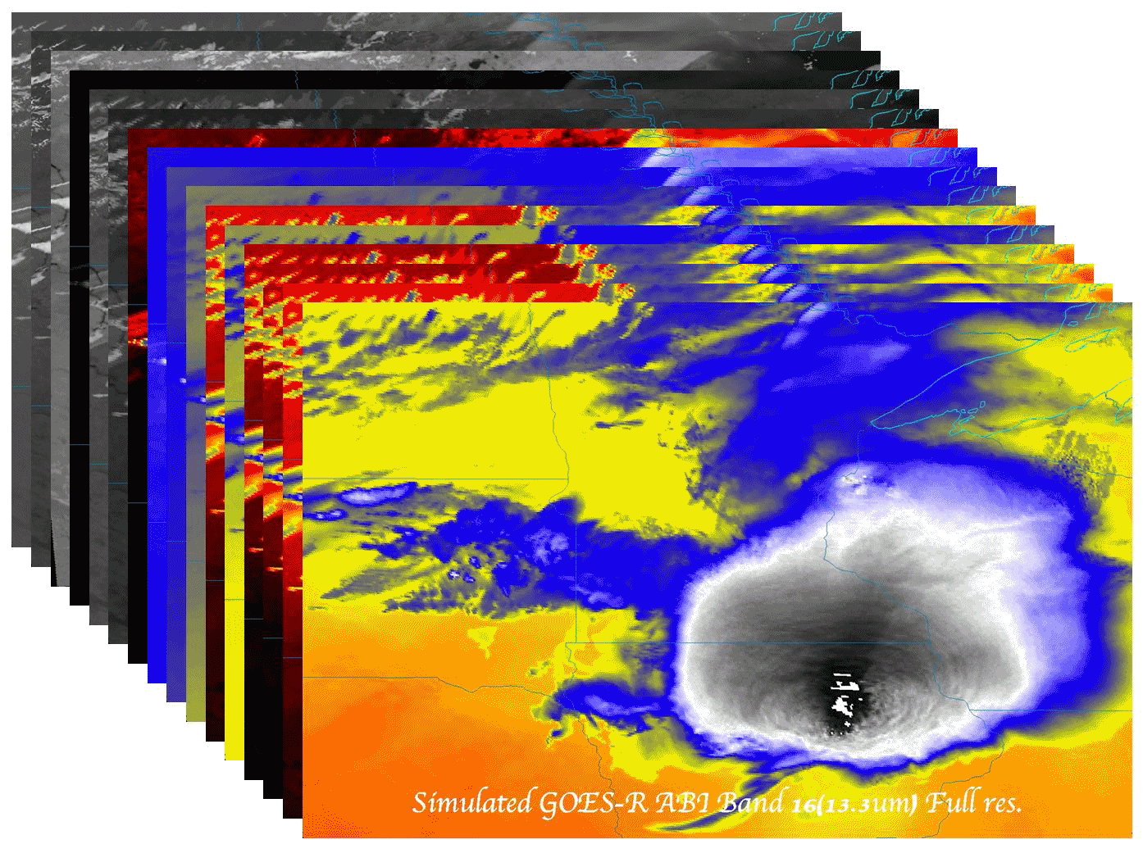
Near-Real-Time validation of simulated GOES-R ABI radiances and derived products, using the WRF-Chem model forecast over CONUS for all 16 ABI bands Kaba Bah¹, Marek Rogal¹, Tom Greenwald¹, Brad Pierce², Allen Lenzen¹, Jim Nelson¹, Jason Otkin¹, Todd Schaack¹, Jim Davies¹, Eva Borbas¹, Justin Sieglaff¹ and Hung-Lung Huang¹ ¹Cooperative Institute for Meteorological Satellite Studies (CIMSS), Space Science and Engineering Center (SSEC), University of Wisconsin – Madison, Wisconsin 53706, U.S.A ²NOAA/NESDIS Office of Research and Applications, Advanced Satellite Products Branch (ASPB), Madison, WI, 53706, U.S.A.
NOAA Satellite Science Week
March 18-22, 2013

Slide 2
GOAL:
Support GOES-R PG activates with proxy datasets using CRTM V2.1 with inputs from WRF-CHEM 8km air quality simulations coupled to global chemical aerosol and ozone analysis from (RAQMS)
Data:
Hourly netCDF Fixed Grid Format (FGF) files are generated daily and made available for real-time download
(ftp://ftp.ssec.wisc.edu/ABI/REALTIME_PROXY/)
Imagery :
Hourly images are generated and uploaded daily to the CIMSS PG website:
http://cimss.ssec.wisc.edu/goes_r/proving-ground/wrf_chem_abi/wrf_chem_abi.html
Products:
Hourly netCDF files are used as input into GEOCAT, to generate real-time GOES-R ABI baseline cloud, sounding, and ozone retrievals.

Slide 3
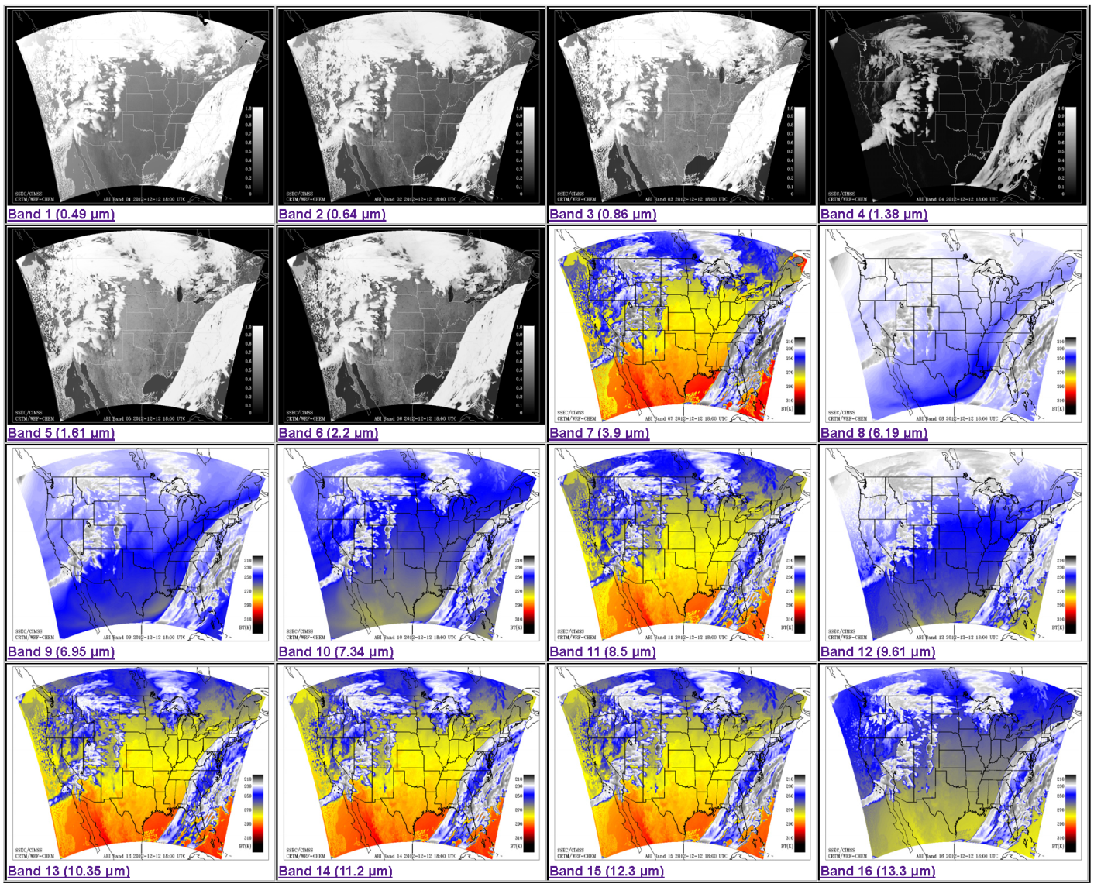
Online daily WRF-CHEM images of all 16 ABI bands at CIMSS PG website

Slide 4
Near-Real-Time Validation
GOES-13 Sounder data (collected at SSEC) are used to verify select visible and IR bands of the simulated ABI data.
Both simulated ABI data and observed sounder data are remapped and converted to the currently accepted GOES Re-Broadcast (GRB) 2 km FGF. These files contain Level 1b products with radiometric and geometric correction applied to produce parameters in physical units.
Clear and cloudy data points are identified using both simulated and GOES cloud masks. Glance (a Python software tool developed at CIMSS) and IDL statistical procedures are run to monitor statistics between the simulated data and observations.
Routine validation procedures:
[I] Visualization and simple differencing.
[II] Scatter analysis (clear, cloudy, land, water).
[III] PDF comps. (clear, cloudy, land, water).
[IV] Time series plots.

Slide 5
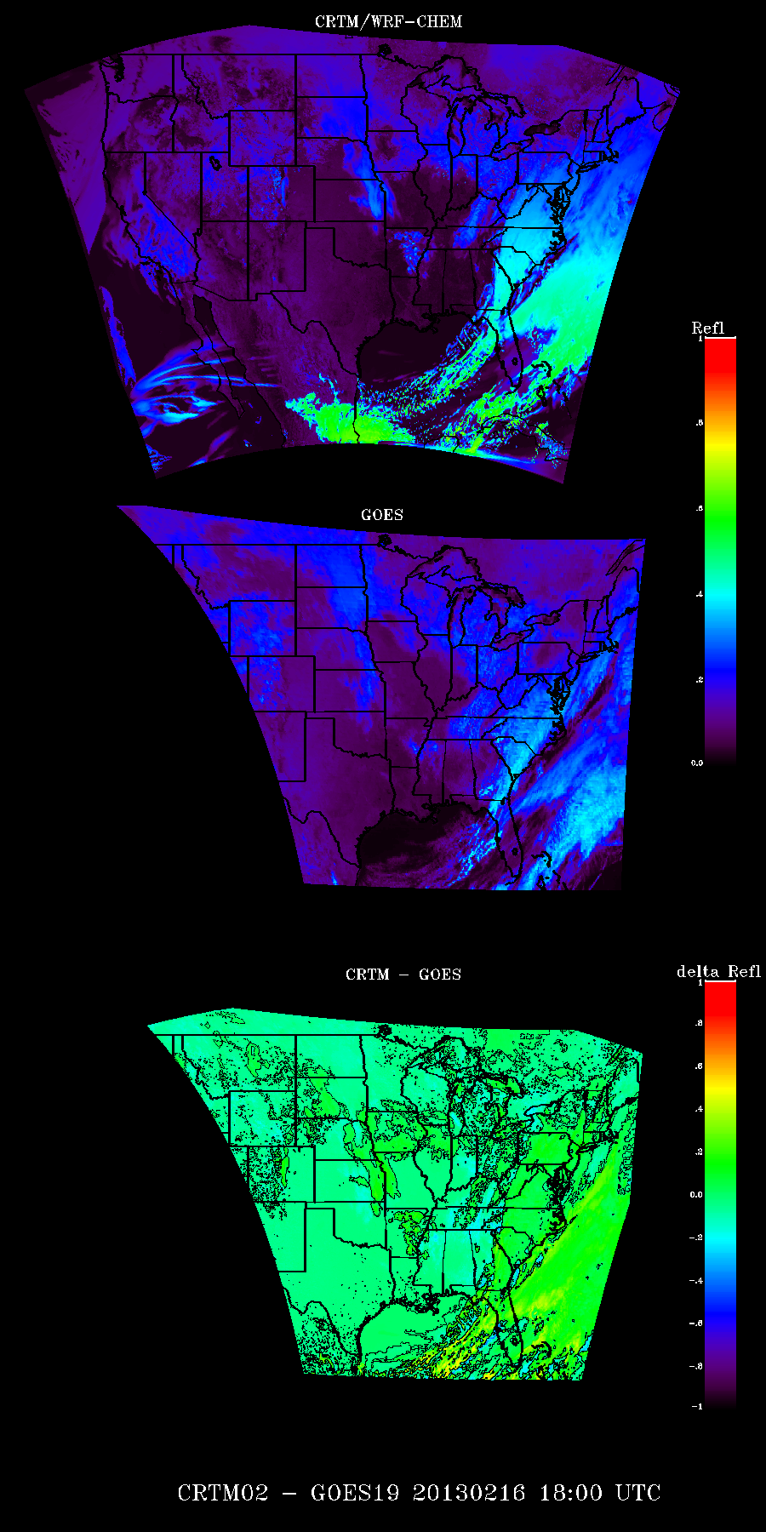
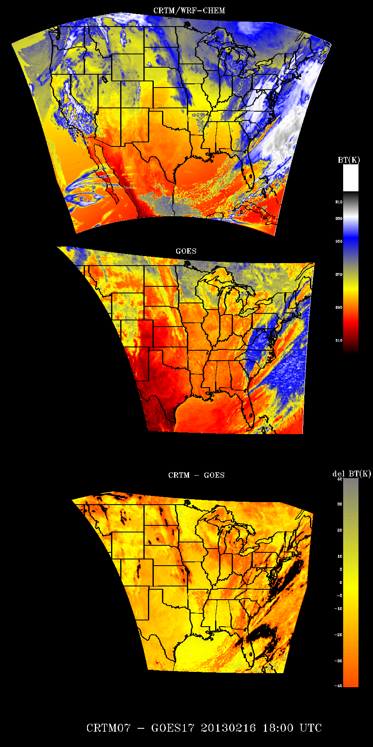
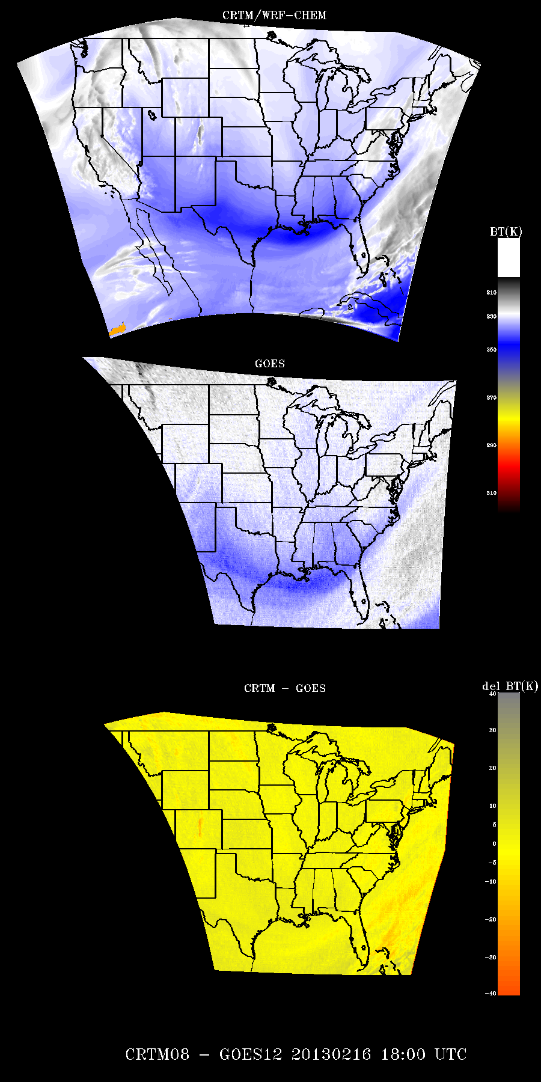
ABI Proxy – GOES-13 Sounder 18Z February 16, 2013
ABI Band 02 (0.64 micron)
ABI Band 07 (3.90 micron)
ABI Band 08 (6.15 micron)

Slide 6
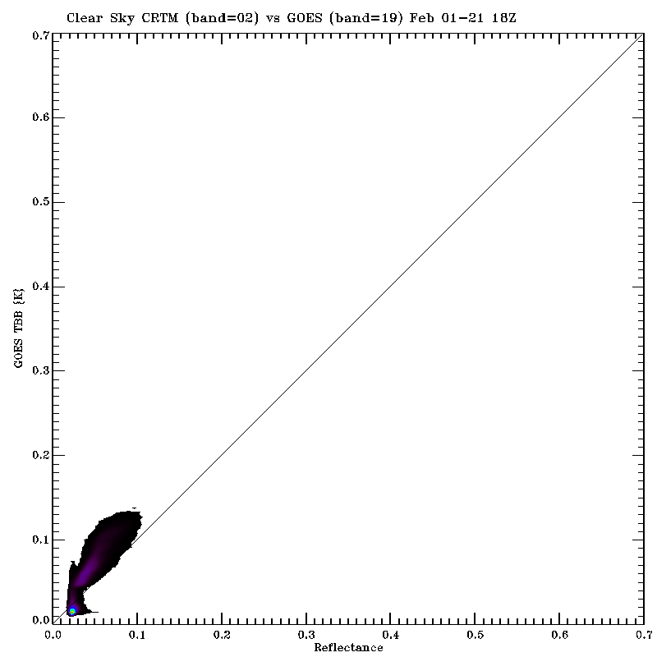
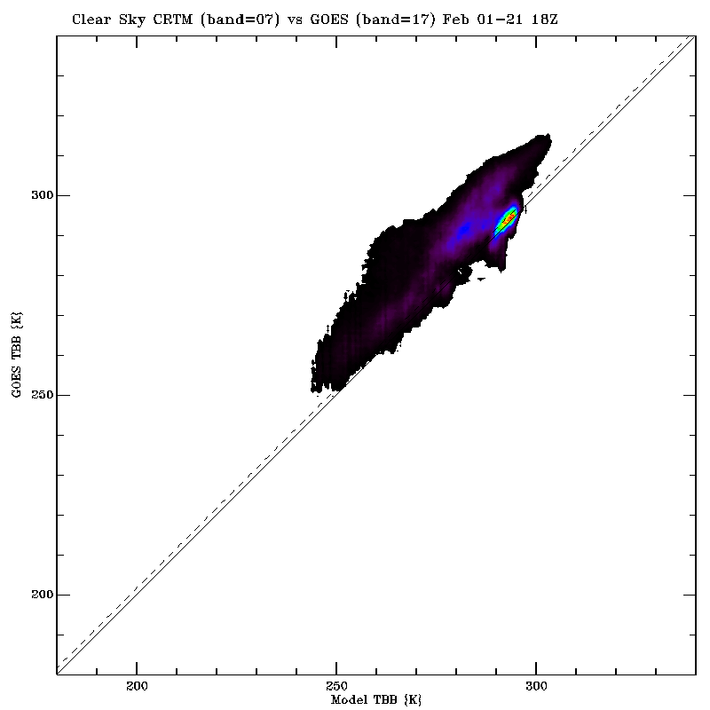
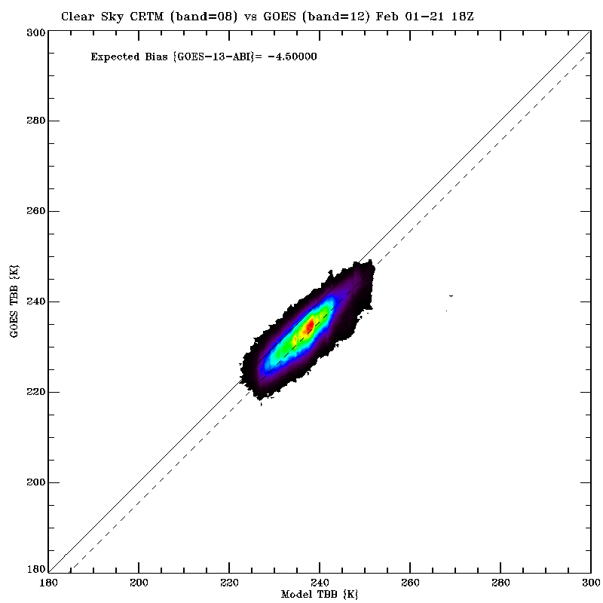
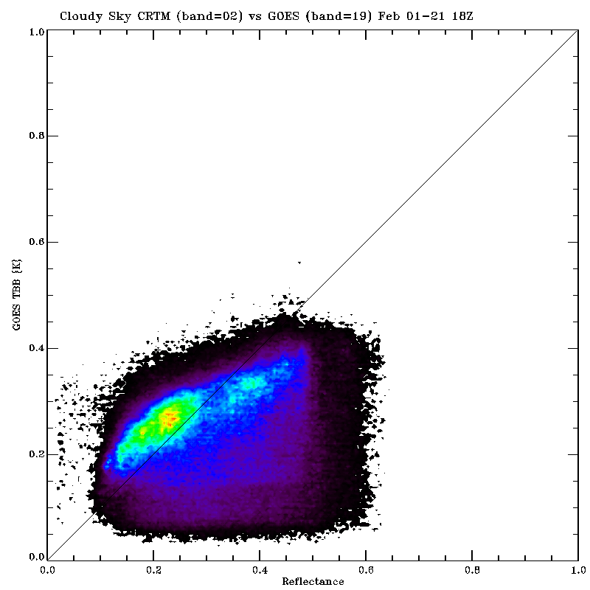
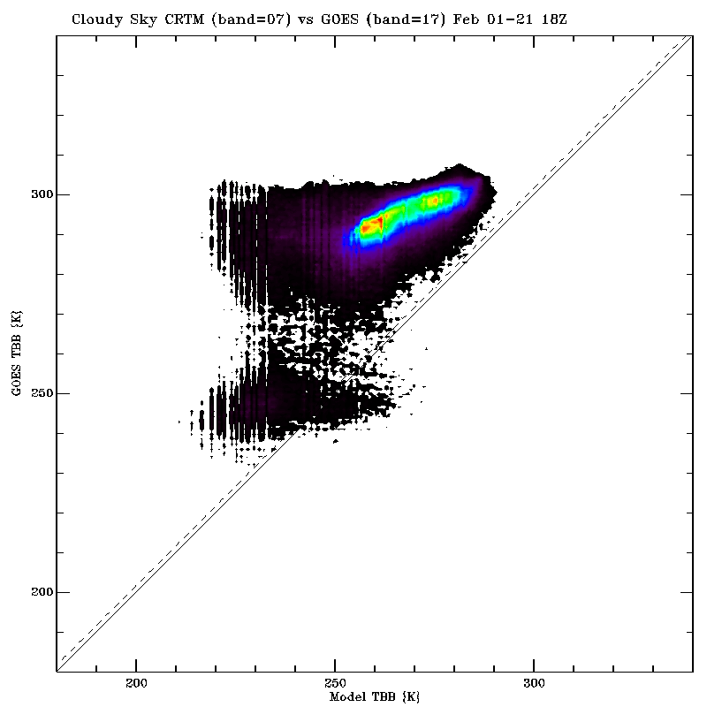
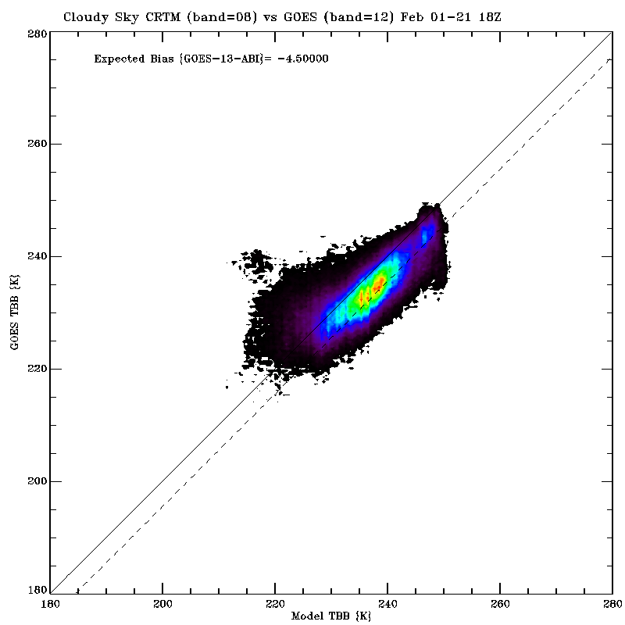
ABI Proxy vs GOES-13 Sounder 18Z February 1-21, 2013
ABI Band 02 (0.64 micron)
ABI Band 07 (3.90 micron)
ABI Band 08 (6.15 micron)
Clear
Clear
Clear
Cloudy
Cloudy
Cloudy

Slide 7
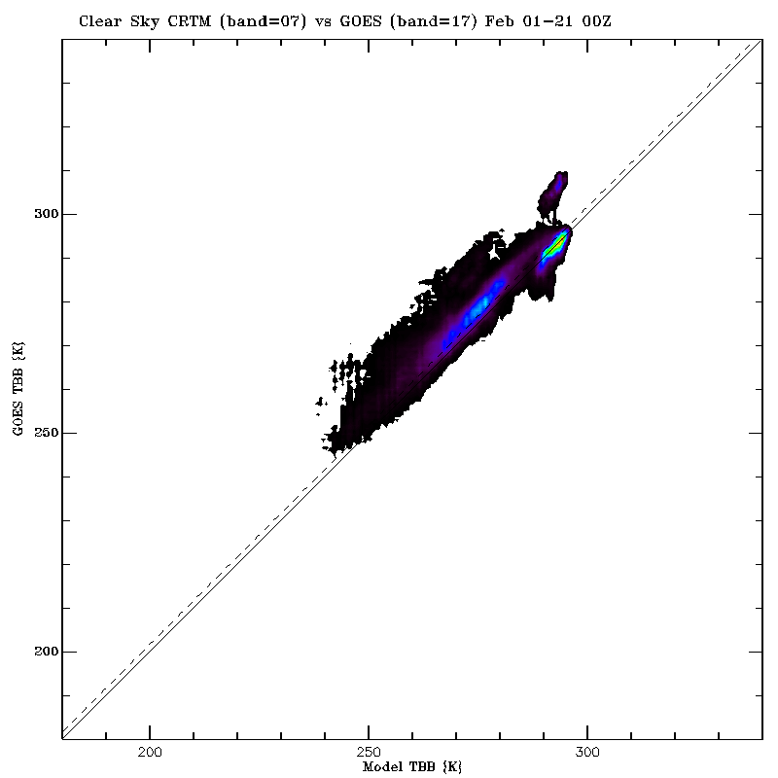
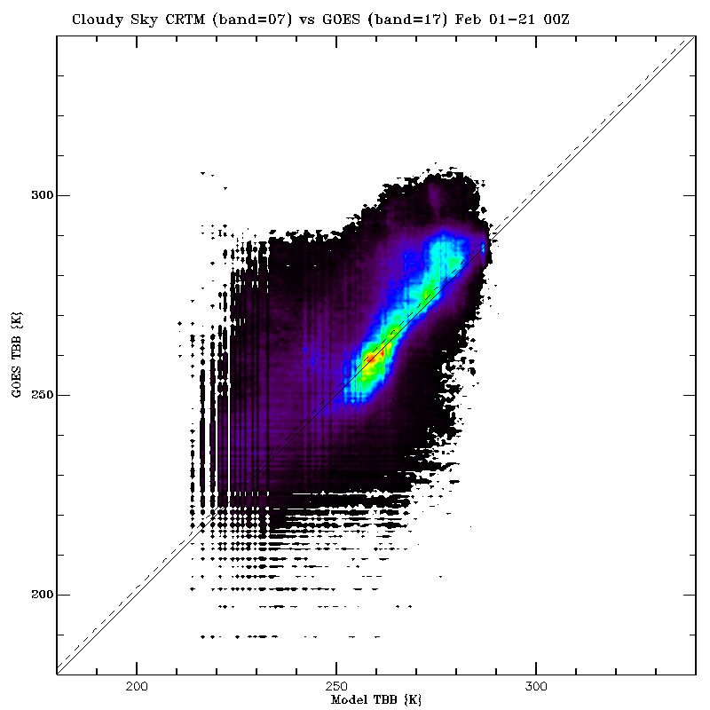
ABI Proxy Band 07 (3.90 micron) vs GOES-13 Sounder February 1-21, 2013
00Z February 1-21, 2013
18Z February 1-21, 2013
Simulated ABI Band 07 (3.90 micron) is in good agreement with GOES-13 3.9 micron band under clear sky conditions since climatological MODIS IR surface emissivity is used in CRTM
Nighttime Clear
Daytime Clear
Nighttime Cloudy
Simulated ABI Band 07 (3.90 micron) is in poor agreement with GOES-13 3.9 micron band during the daytime under cloudy conditions since the CRTM neglects solar reflection for the ABI 3.9 micron band
Daytime Cloudy

Slide 8
ABI Proxy Band 02 (0.64 micron) vs GOES-13 Sounder February 1-21, 2013
Simulated ABI Band 02 (0.64 micron) cloudy reflectances systematically underestimates GOES-13 by 20-30% at sunrise and 5-10% at sunset and frequently overestimates GOES-13 by 10-15% during mid-day (18Z).
Low (680-950hPa) and High (<440hPa) clouds tend to show the largest biases at sunrise and mid-day while Mid-level (440-680hPa) clouds tend to show the largest biases at sunset

Slide 9
Summary Validation Statistics (ABI Proxy-GOES-13 Sounder) February, 2013
ABI Band (microns) | Clear | Cloudy | Clear/ Land | Clear/ Water | Cloudy/ Land | Cloudy/ Water | Expected
02 (0.64) | -15.80% | -0.35% | -15.15% | -8.67% | -4.36% | 5.71% | NA
07 (3.90) | -6.37K | -18.17K | -7.82K | -3.14K | -18.18K | -18.03K | NA
08 (6.15) | 3.49K | 2.40K | 3.25K | 3.92K | 1.93K | 2.78K | 4.5K
09 (7.0) | -4.11K | -4.47K | -4.08K | -4.31K | -4.71K | -4.25K | -1.9K
10 (7.4) | -2.10K | -2.66K | -1.91K | -2.53K | -2.95K | -2.56K | -1.6K
12 (9.7) | -2.82K | -2.82K | -2.17K | -1.08K | -2.56K | -3.01K | -0.3K
14 (11.2) | -1.81K | -4.32K | -2.65K | 0.35K | -4.64K | -4.10K | 0.0K
16 (13.3) | 2.16K | -0.60K | 1.67K | 4.39K | -1.25K | -0.06K | 3.3K
Expected biases account for different ABI and GOES-13 spectral response functions and are computed using a standard US atmosphere

Slide 10
Conclusions
We have developed a RAQMS/WRFCHEM/CRTM based framework for generation of real-time proxy radiances for all GOES-R ABI bands and are now routinely delivering hourly proxy GRB files to AIT on a daily basis.
We have developed a real-time validation system to assess the fidelity of the proxy radiances using GOES Sounder data which includes:
[I] Visualization and simple differencing.
[II] Scatter analysis (clear, cloudy, land, water).
[III] PDF comps. (clear, cloudy, land, water).
[IV] Time series plots (clear, high, mid, and low clouds, land, water)
Validation results during February, 2013 show that:
ABI IR proxy bands (7,8,9,10,12,14,16) are generally within 1-2K of the expected biases except for ABI band 07 (3.9 micron) which shows large negative biases for cloudy scenes during the daytime due to the neglect of solar reflection in the CRTM cloudy radiance calculation for this ABI band.
ABI visible band 02 (0.64micron) is generally within 5% for cloudy scenes and within 10 to 15 percent for clear ocean and clear land scenes, respectively, which is reasonable given that GOES visible bands are not calibrated.

