Slide 1
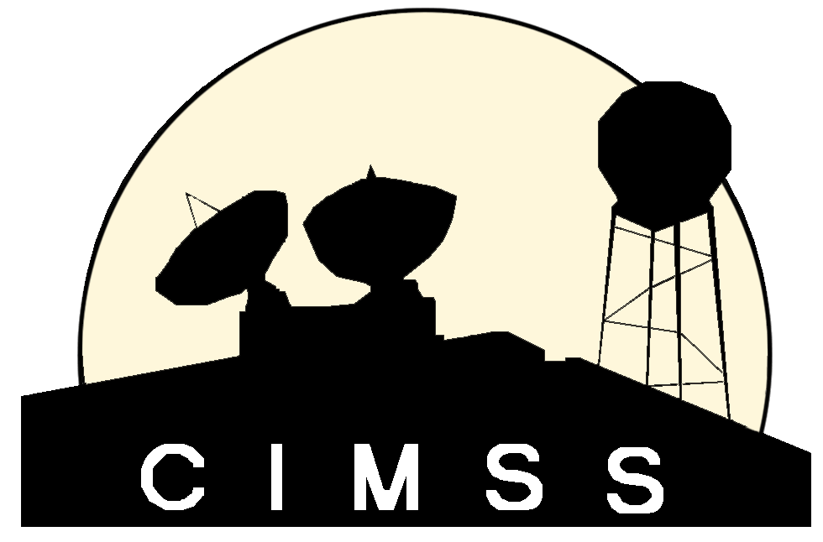
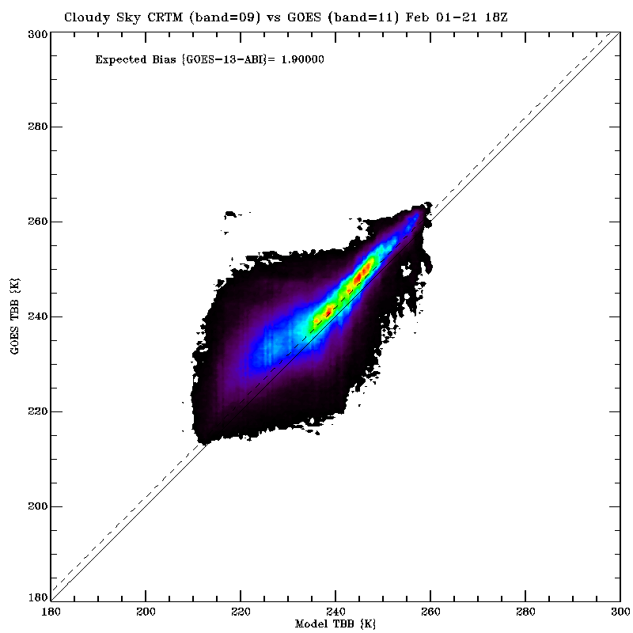
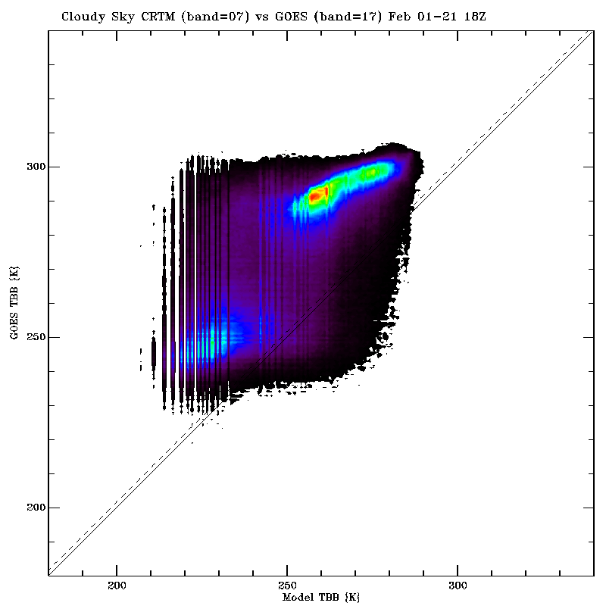
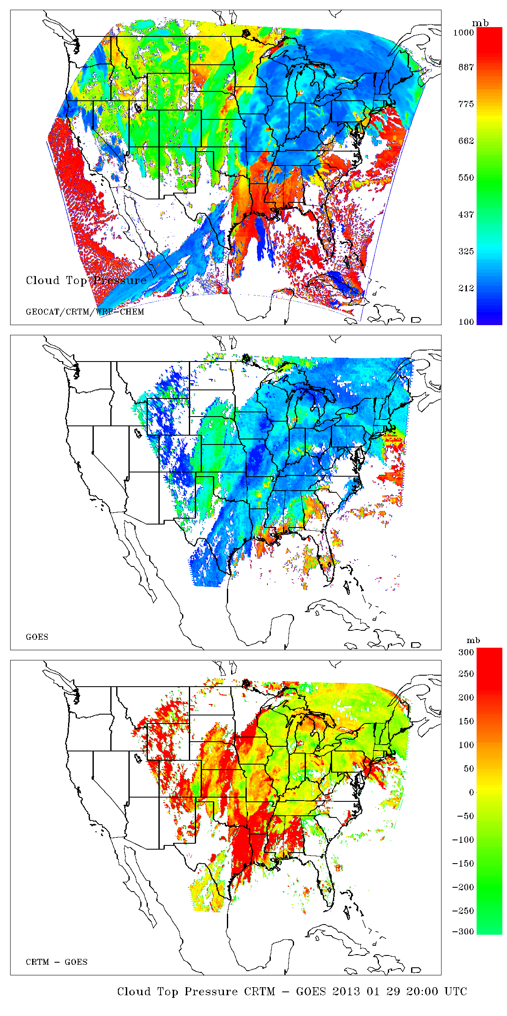
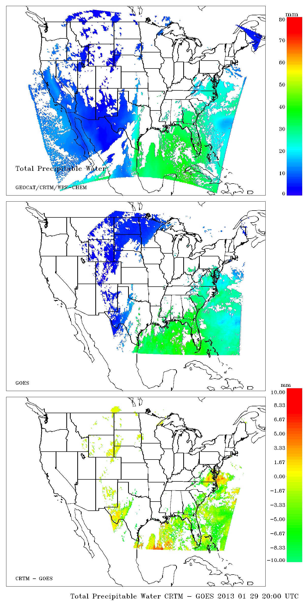
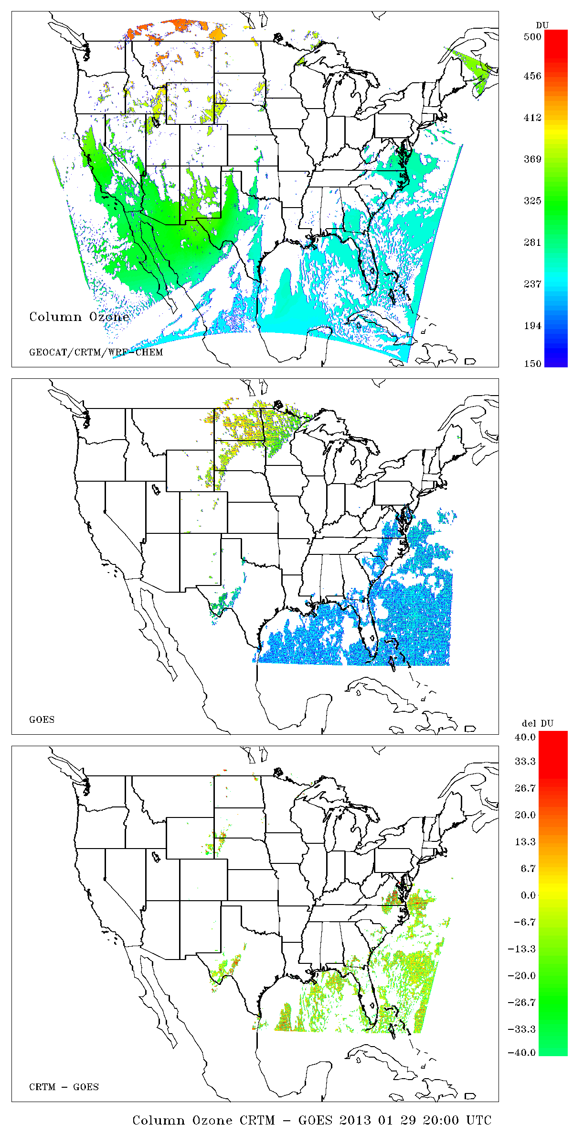
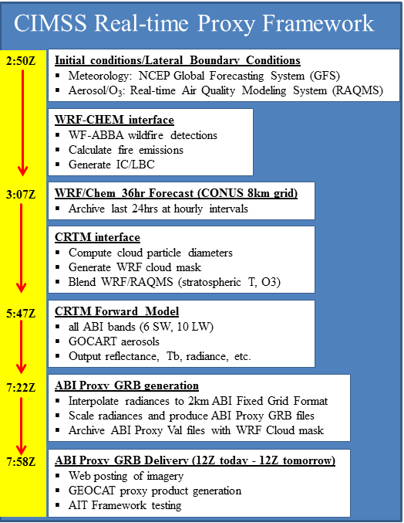
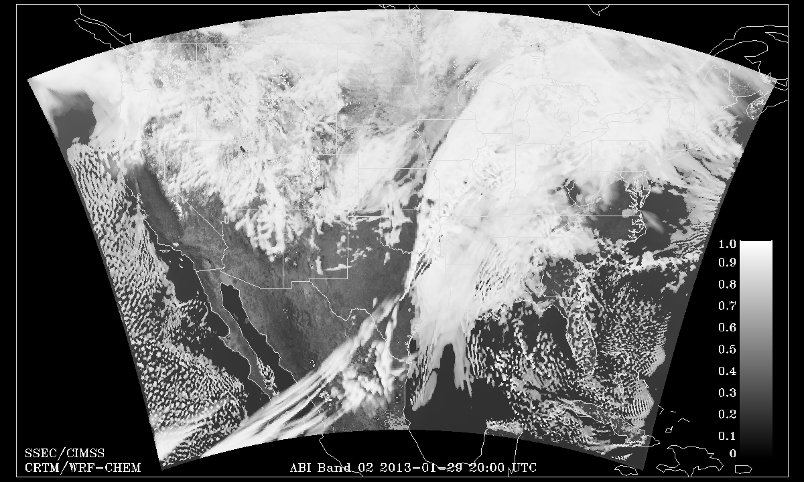
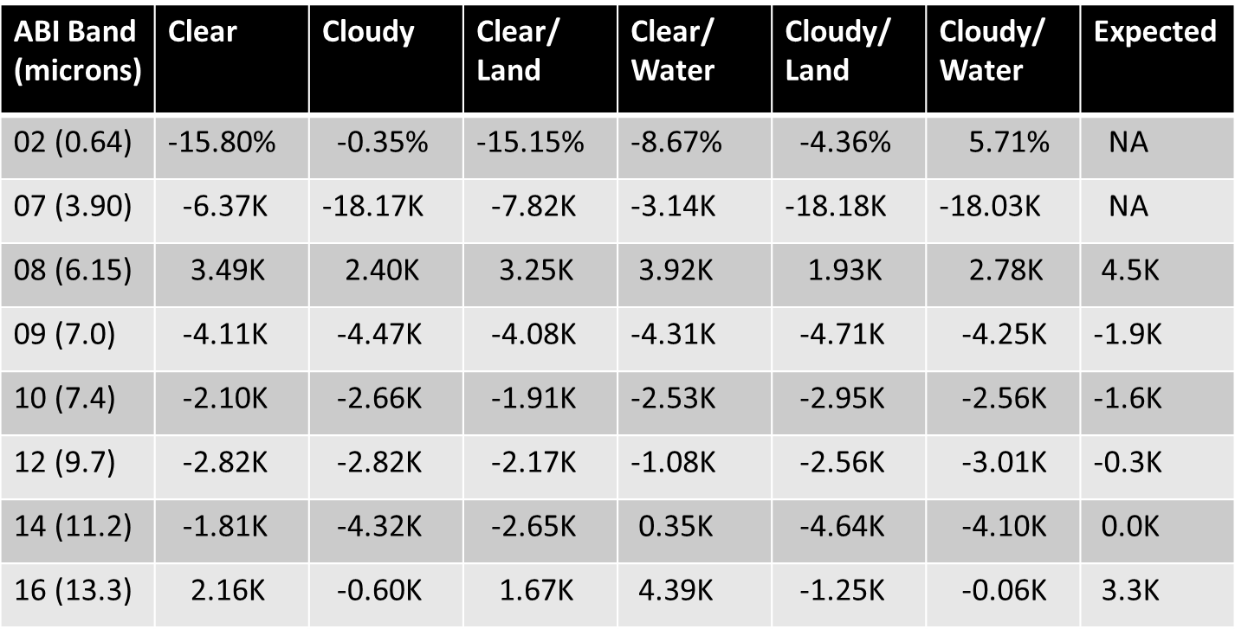
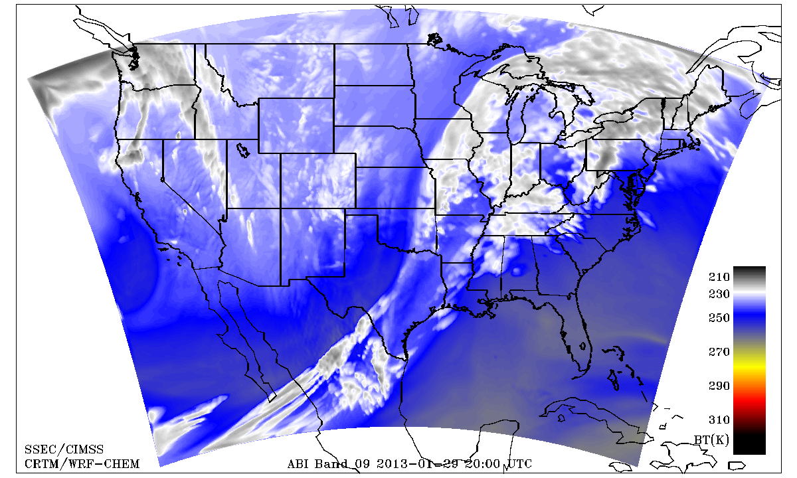
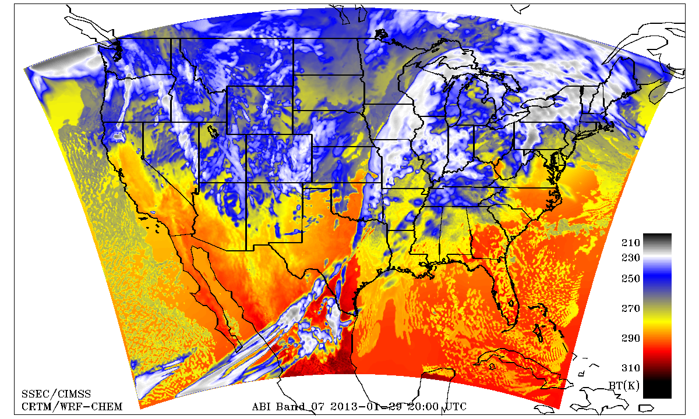
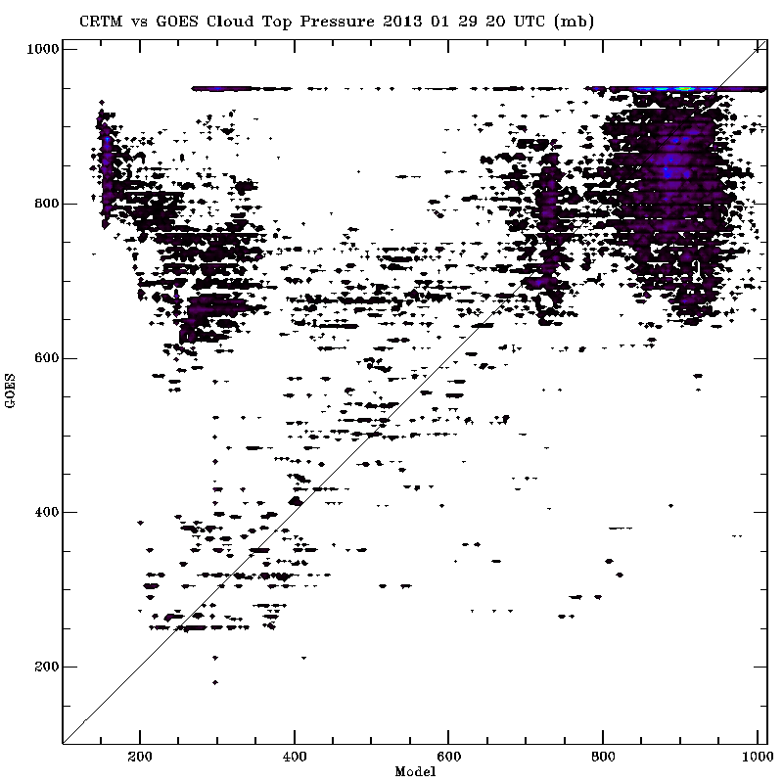
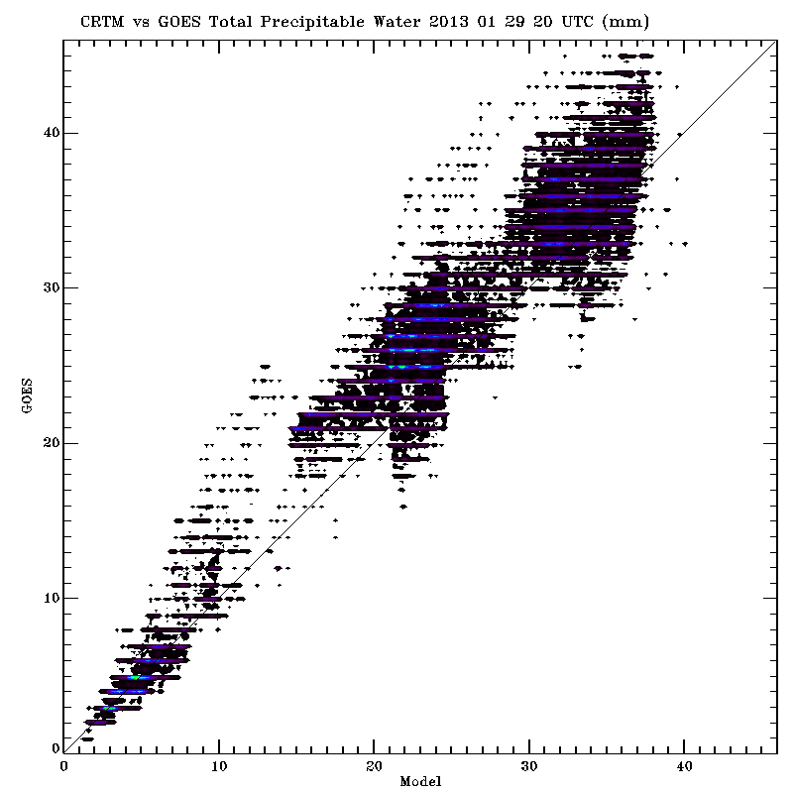
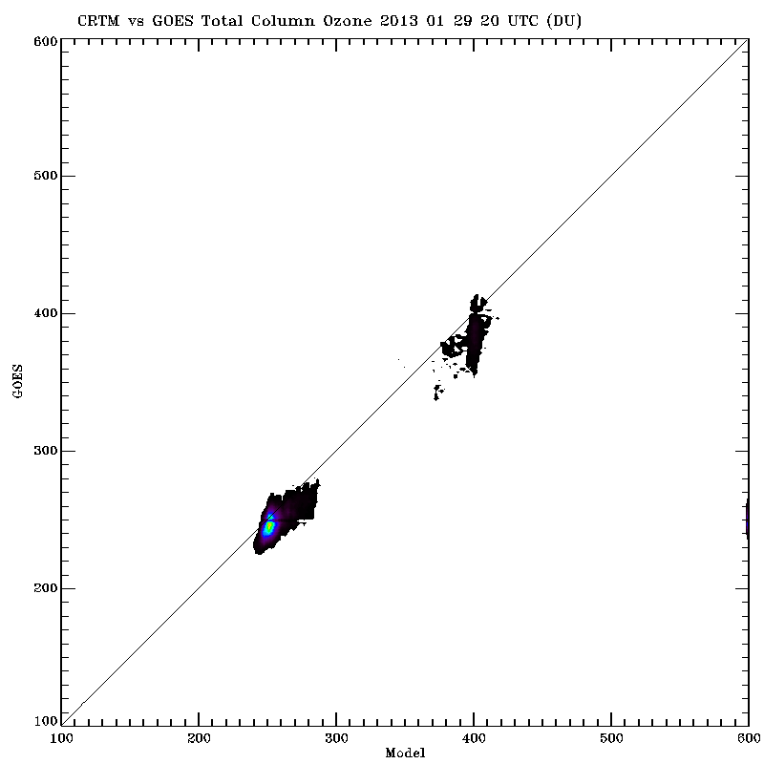
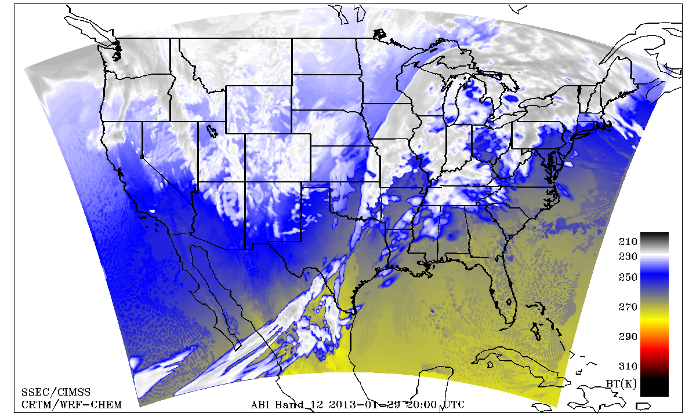
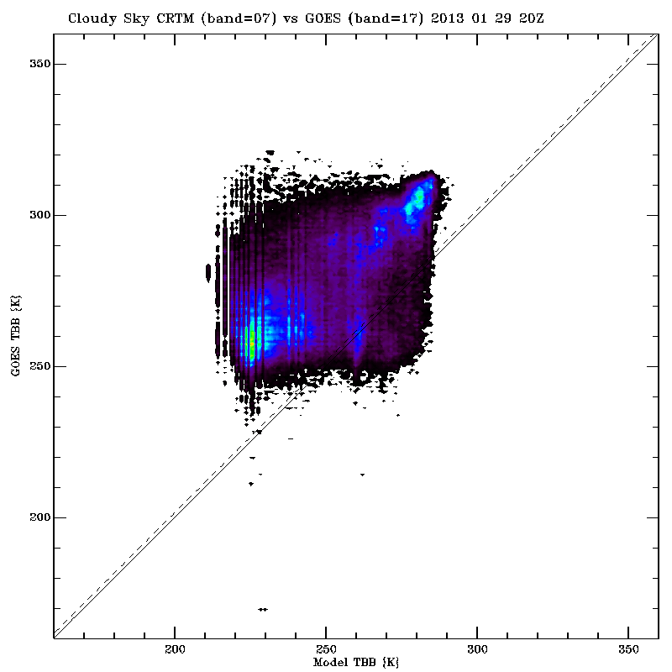
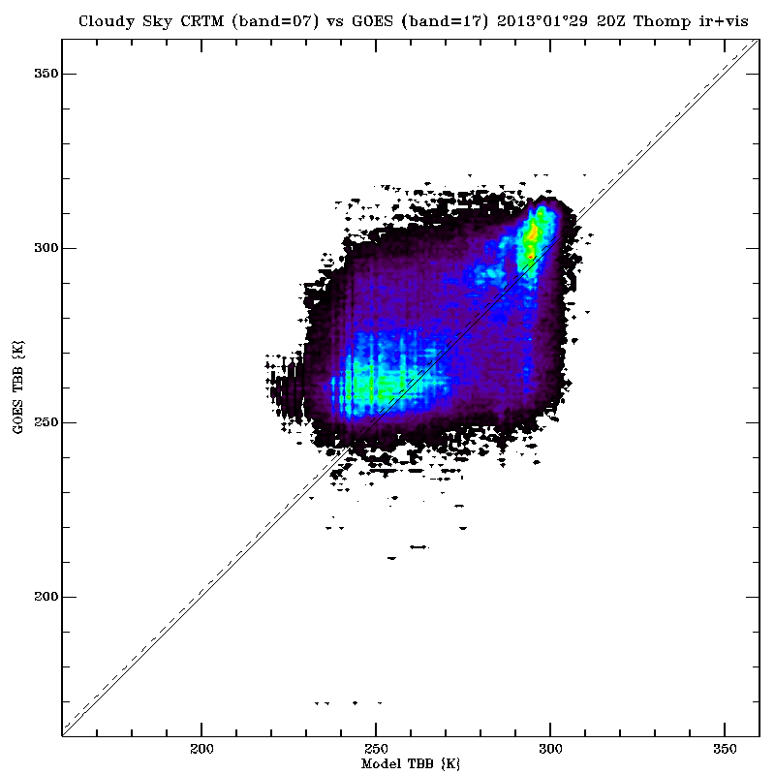
Near-Real-Time validation of simulated GOES-R ABI radiances and derived products, using the WRF-Chem model forecast over CONUS for all 16 ABI bands
Marek Rogal, Kaba Bah, Tom Greenwald, Brad Pierce*, Allen Lenzen, Jim Nelson, Jason Otkin, Todd Schaack, Jim Davies,
Eva Borbas, Justin Sieglaff and Hung-Lung (Allen) Huang
Cooperative Institute for Meteorological Satellite Studies (CIMSS), University of Wisconsin-Madison
* NOAA/NESDIS
Goals
Novel system developed to:
Provide near-real-time proxy ABI data from WRF-Chem model forecasts over CONUS using
the Community Radiative Transfer Model (CRTM) for all 16 ABI bands. (including products)
Remap it to the ABI Fixed Grid Format, compatible with GOES-R Re-Broadcast Level 1b data
Provide a validation system for verification of model simulated ABI radiances and derived
products in near-real-time
Community Impact:
System will allow forecasters and other users to prepare for the new information that the ABI will provide on the atmosphere, clouds and the surface making use of the future GOES ReBroadcast (GRB) data and GOES-R ABI algorithms
These data can also be used for GOES-R pre-launch activities, such as testing GOES-R ground system throughput, and providing synthetic ABI imagery and products to AWIPS users
GOES-R ABI AWG Algorithm Validation
ABI Synthetic Radiance Validation
Proxy ABI radiances are used as input to the CIMSS GEOstationary Cloud Algorithm Test-bed (GEOCAT) to generate baseline ABI sounding, ozone, and cloud retrievals. We then use the GEOCAT output to perform comparisons between the ABI simulated products and GOES Sounder DPI.
Brightness Temperature Validation
a)
b)
a)
b)
c)
Generation of Simulated ABI Radiances and Products
Figure 1: Synthetic ABI imagery valid 20Z 01/29/2013
Visible band 02 (0.64µm)
‘water vapor’ band 09 (6.95µm)
‘hybrid IR+VIS’ band07 (3.9µm)
‘Ozone’ band 12 (9.6µm)
Figure 4. Comparison of ABI Proxy Band 09 (6.95µm) vs GOES-13 Sounder band 11 (a),
ABI Proxy Band 07 (3.9µm) vs GOES-13 Sounder band 17 (b) during February 1-21, 2013 (‘cloudy’ regions)
a)
Clear
Summary Validation Statistics (ABI Proxy-GOES-13 Sounder) February, 2013
b)
Figure 2. GEOCAT simulated ABI retrievals vs GOES-13 Cloud Top Pressure (a), Total Precipitable Water (b), and Column Ozone (c), on 20Z, Jan 29, 2013
Expected biases account for different ABI and GOES-13 spectral response functions and are computed using a standard US atmosphere
Large cold biases with respect to GOES observations occur in the 3.9 micron radiances using the standard CRTM and default WRF-CHEM configuration.
We found that the large cold biases with respect to GOES Tb observations in cloudy regions (Figure 5a) were largely due to the fact that the CRTM does not account for solar reflectance in the 3.9 µm band.
Experiments showed that including solar reflectance contributions in the CRTM 3.9 µm band calculations reduces the cold bias for low clouds but introduces a large warm bias for high clouds with the WSM6 microphysics package (not shown)
We conducted further experiments using the Thompson microphysics scheme instead of WSM6. This significantly reduced the predicted cirrus cloud ice mixing ratios compared to the WSM6 cloud microphysics and led to improved comparisons with GOES Tb for both high and low clouds (Figure 5b).
c)
a)
b)
c)
Near-Real-Time Verification
d)
Results of 3.9 µm sensitivity experiments
Cloudy
Figure 3. Scatter plots of GEOCAT simulated (a) Cloud Top Pressure, (b) Total Precipitable Water, and (c) Total Column Ozone vs GOES-13 DPI at 20Z, Jan 29, 2013
a)
b)
Summary and Plans
GOES-13 Sounder data (collected at SSEC) are used to verify select IR and visible bands of the simulated ABI data.
GOES-13 Sounder Derived Product Imagery (DPI) is used to verify select GOES-R AWG algorithms
Both simulated ABI data and observed sounder data are remapped to the currently accepted 2 km Fixed Grid Format (in NetCDF).
These files are converted to GRB files (also in NetCDF), which contain Level 1b products with radiometric and geometric correction applied to produce parameters in physical units.
Clear and cloudy data points are identified and IDL procedures are run to monitor differences between the simulated data and observations and compile statistics.
CIMSS is currently producing proxy ABI data for all 16 bands in near-real-time using WRF-CHEM simulations and the CRTM
The synthetic ABI radiances are produced in GOES-R GRB format and delivered to GEOS-R AIT (data available upon request)
A verification system has been developed that is used to monitor the quality of the synthetic radiances and ABI products which has proven useful to identify issues in both the CRTM and WRF-CHEM
We are currently working on developing tools to ingest GOES-R GRB and GEOCAT HDF5 output files into AWIPS to help familiarize AWIPS users with ABI imagery and products (see poster T-65)
Google maps
Figure 5. CRTM/WRF-CHEM vs GOES-13 comparison of synthetic ABI band 7 (3.9µm), using WSM6 microphysics package (a) and Thompson microphysics scheme (b) at 20Z on Jan 29, 2013
Support provided by the NOAA GOES-R Program, grant #NA10NES4400013.

