Slide 1
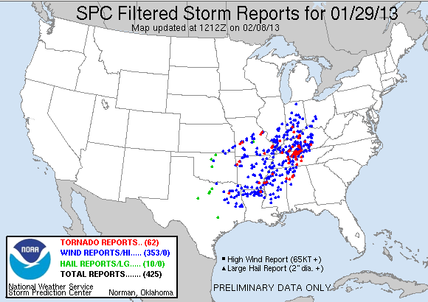
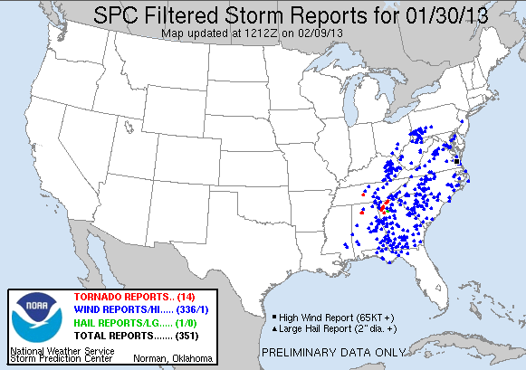
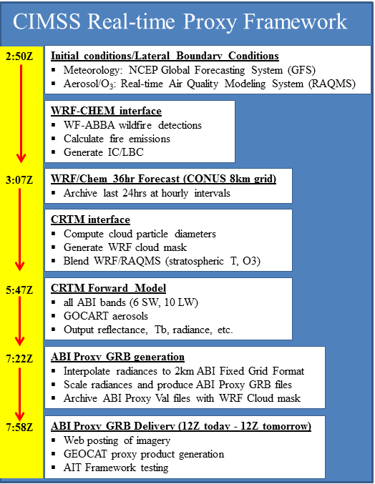
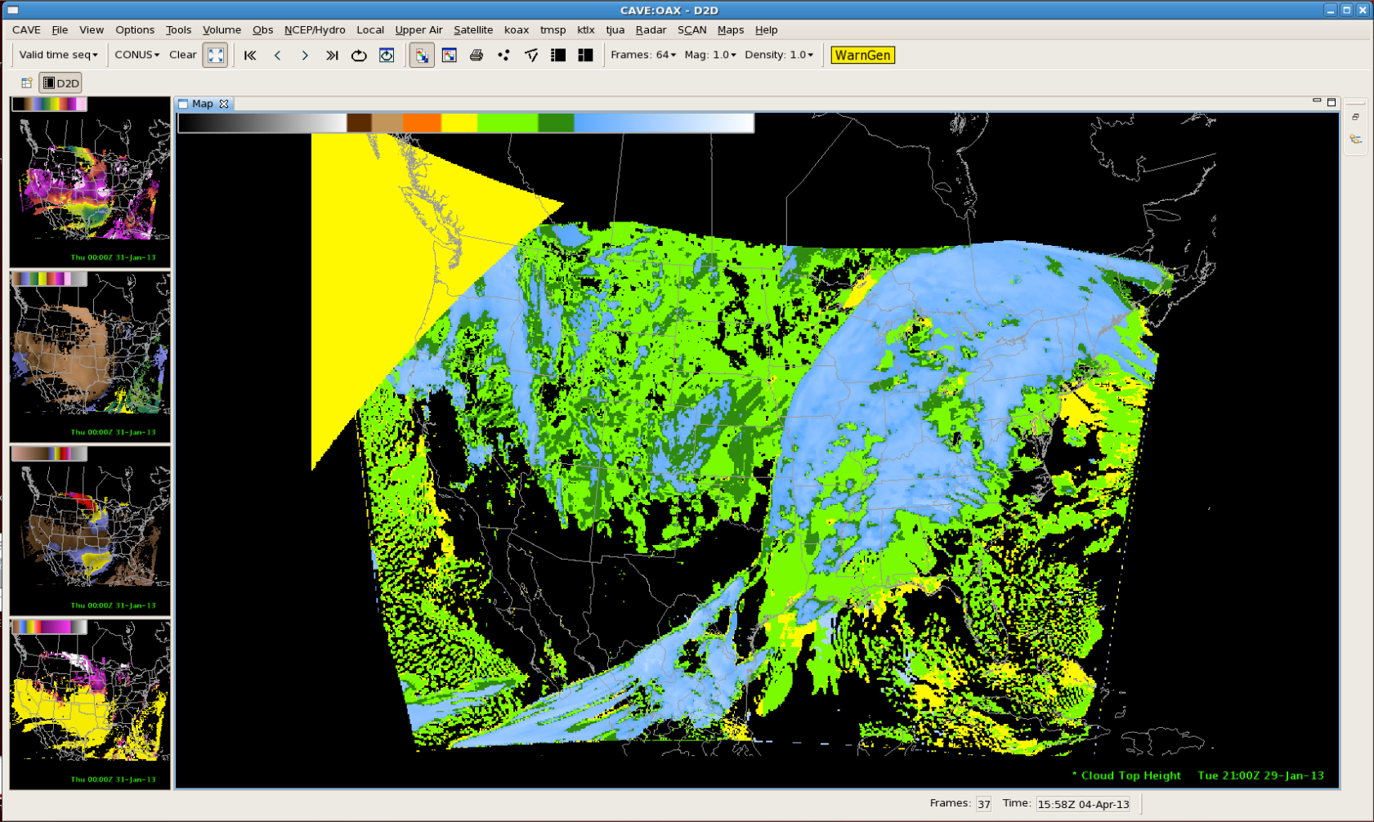
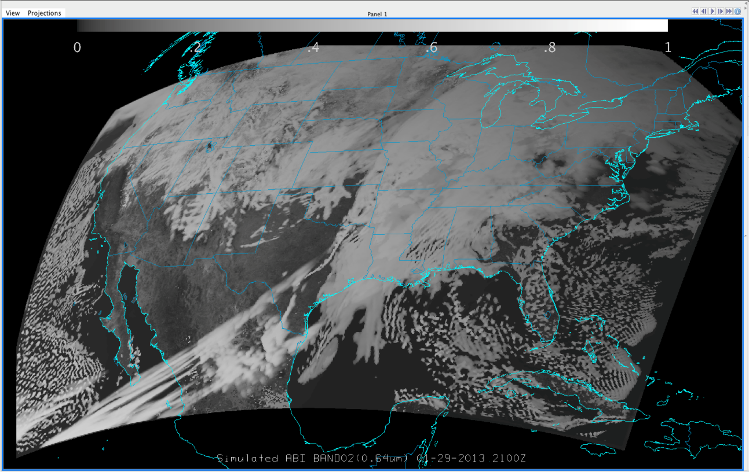
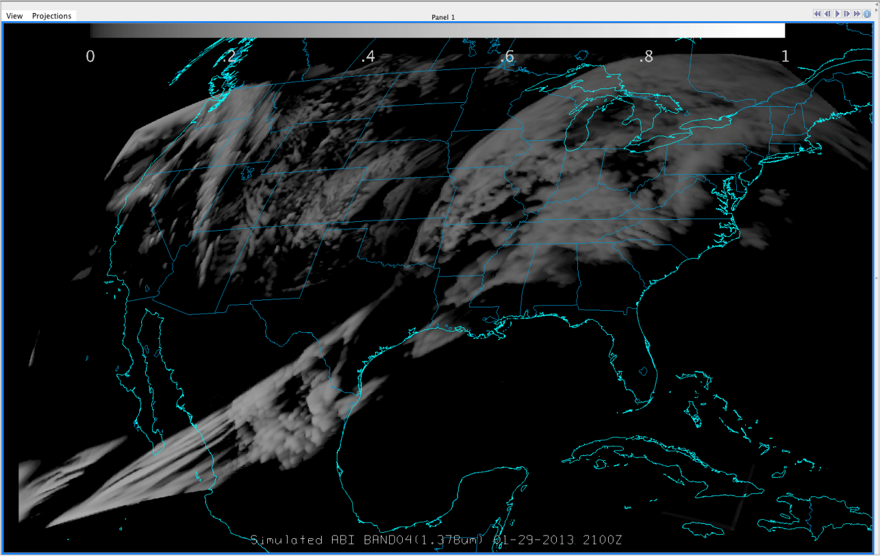
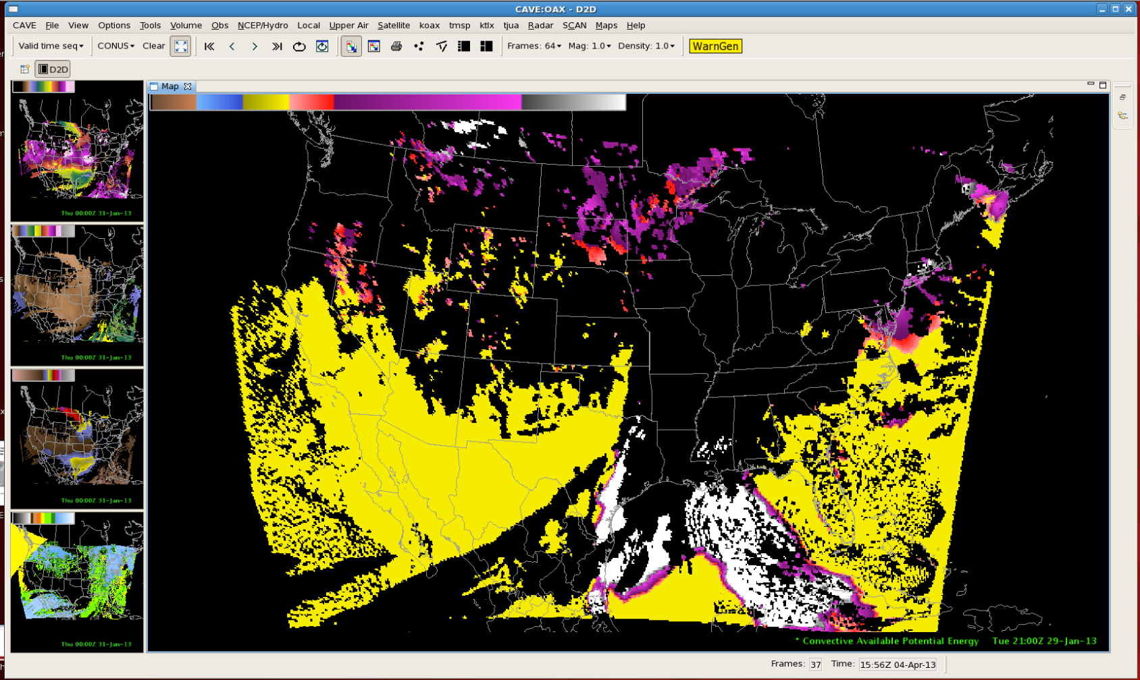
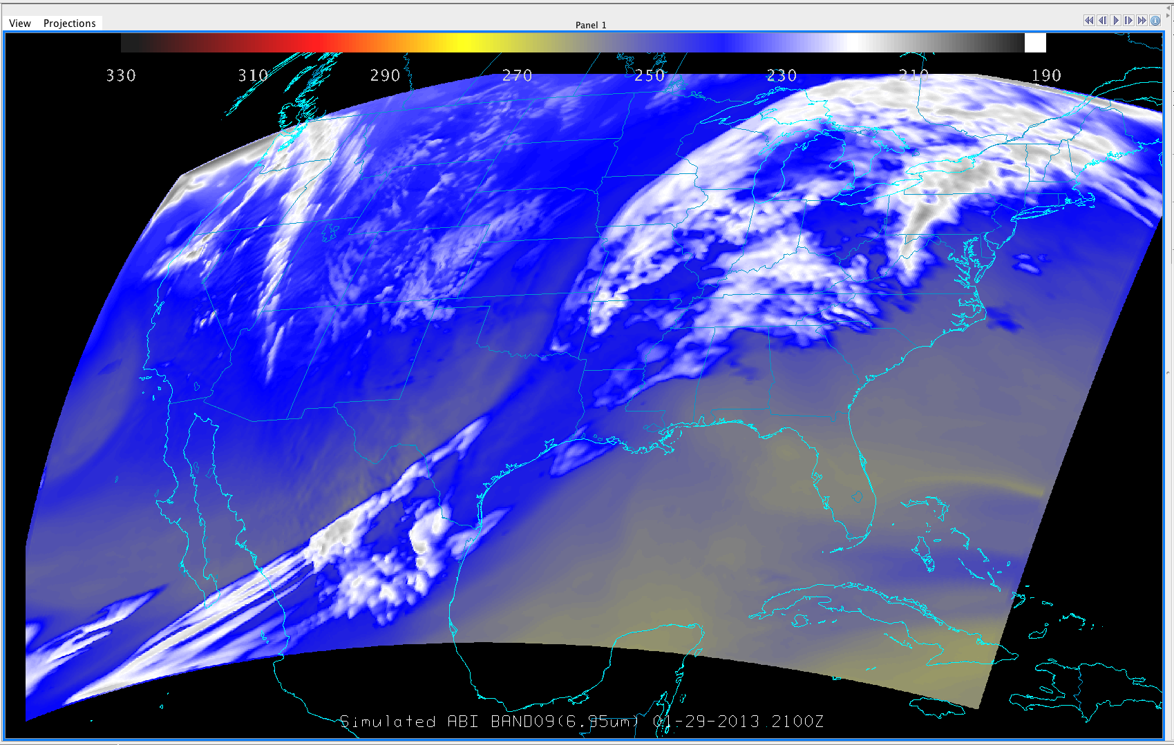
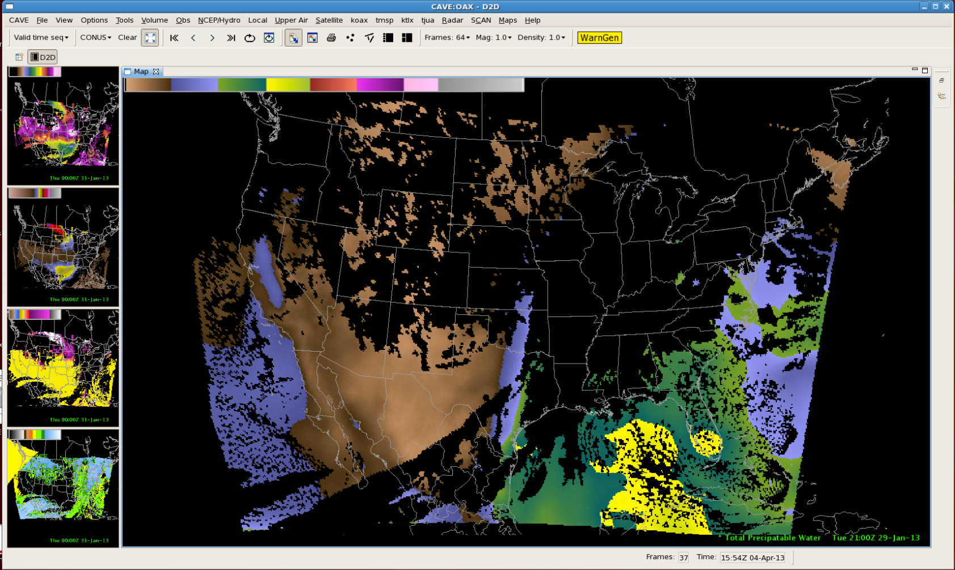
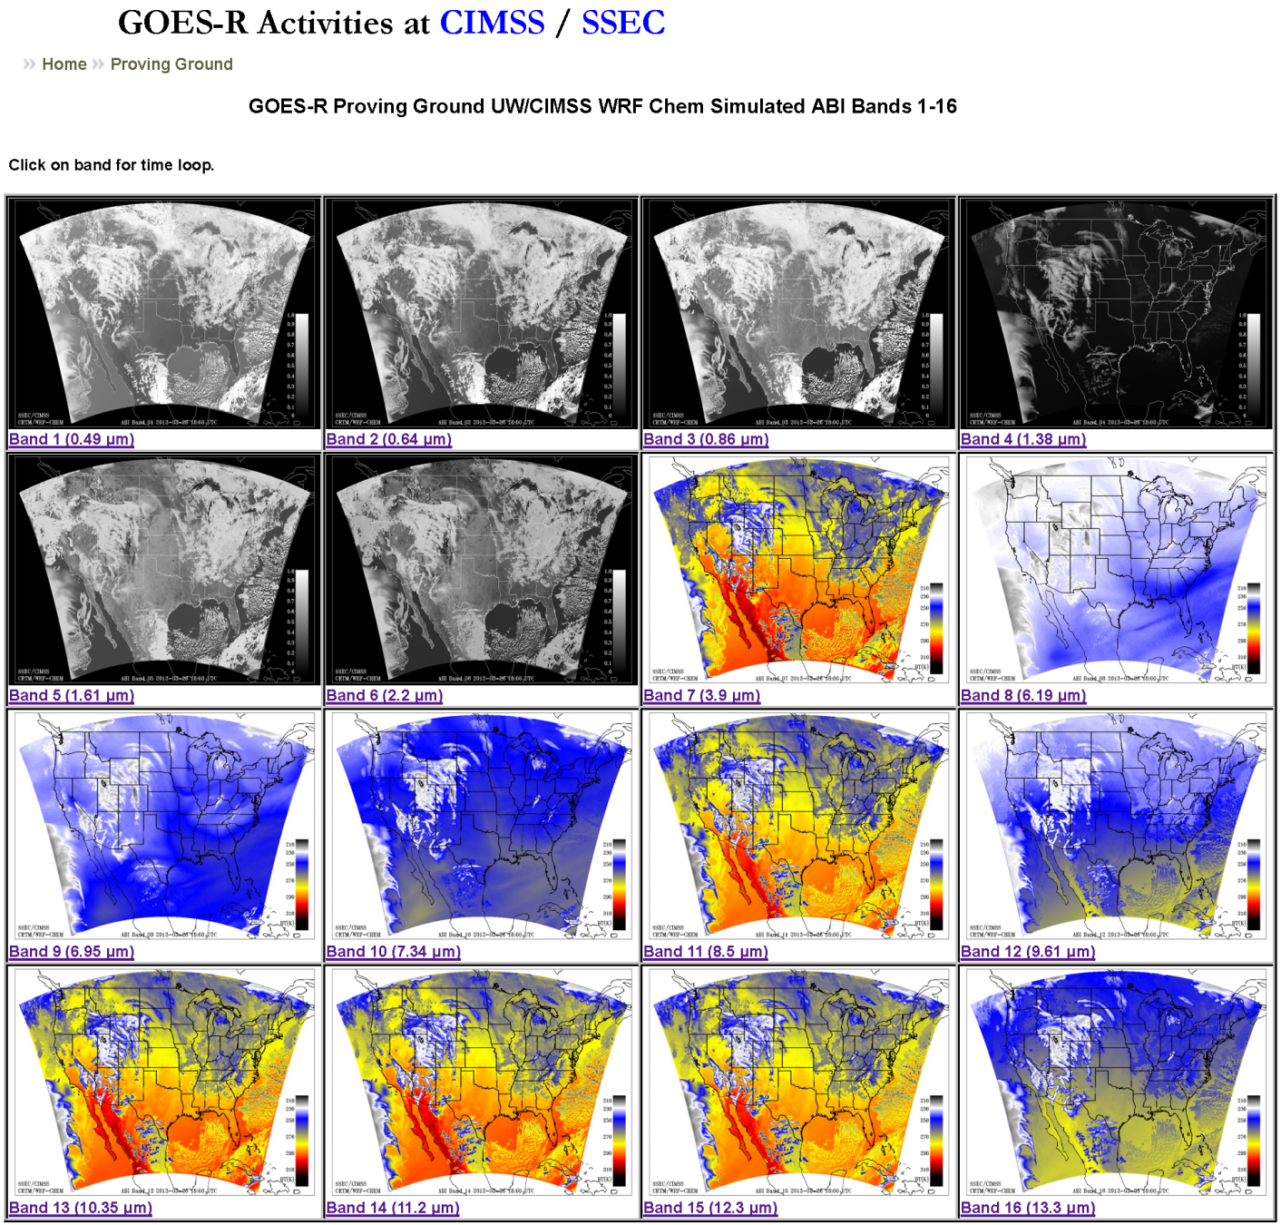
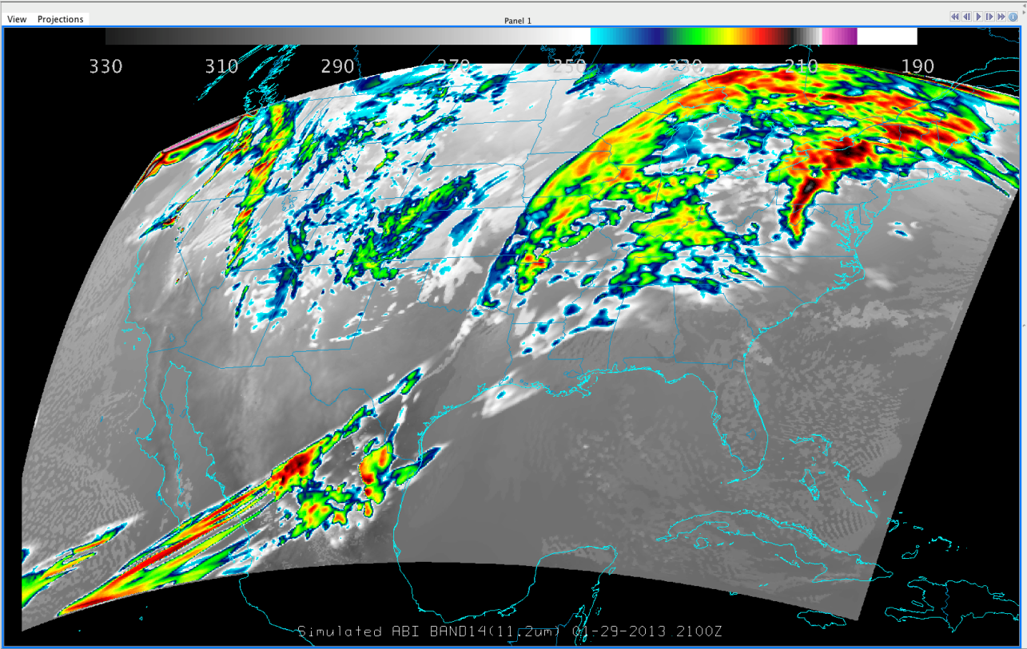
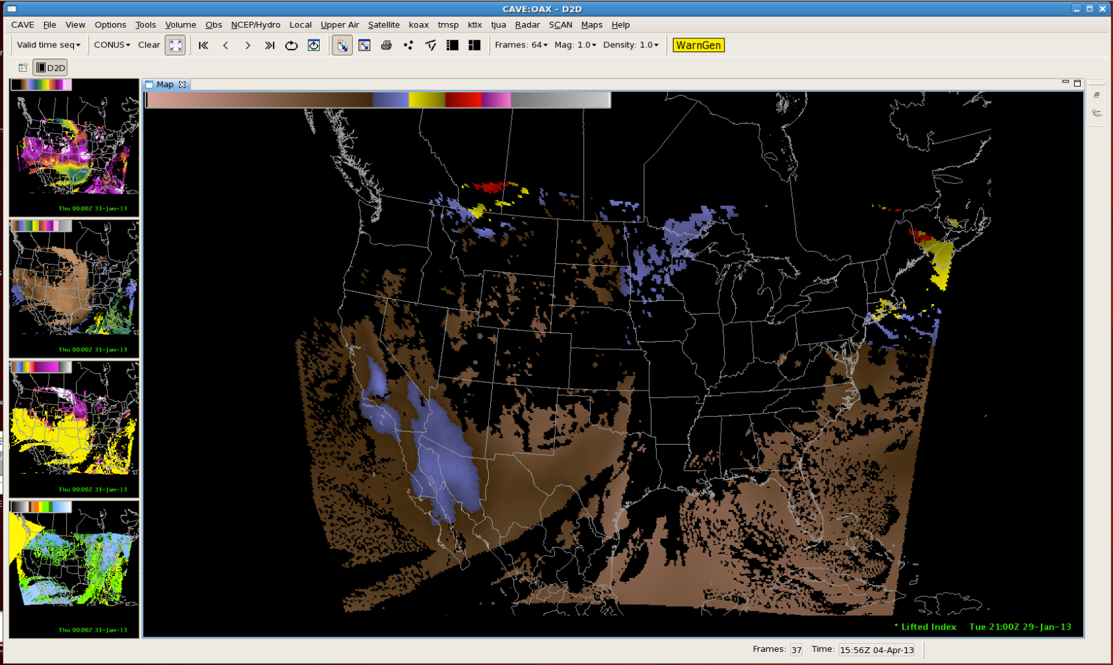
Near-Real-Time Proxy ABI Products for GOES-R User Readiness
Tom Greenwald, Brad Pierce*, Todd Schaack, Jason Otkin, Kaba Bah, Jim Davies, Justin Sieglaff, Allen Lenzen, Jim Nelson, Marek Rogal, and Hung-Lung (Allen) Huang
Cooperative Institute for Meteorological Satellite Studies (CIMSS), University of Wisconsin-Madison
* NOAA/NESDIS ORA ASPB
Objectives
Tornado Outbreak of January 29-30, 2013
Introduce users to Advanced Baseline Imager (ABI) imagery and products in near-real-time but at reduced time and space resolution using simulated data derived from a regional forecast model with chemistry coupled to global chemical/aerosol analyses
Make selected simulated ABI data products available within AWIPS to support Proving Ground activities
One of the largest outbreaks ever recorded in January
Total of 83 reported tornados; 57 confirmed
Produced one EF3 tornado with one fatality
Production of Simulated ABI Data
Sample Proxy ABI Products
Weather Research & Forecasting with Chemistry (WRF-CHEM) model is run for CONUS (as defined in GOES-R Product Users’ Guide (PUG)) on 8 km grid with hourly output
CRTM v2.1 used to compute radiances from WRF-CHEM model output for all ABI bands
Radiances remapped to 2 km Fixed Grid Format according to PUG conventions, rescaled, then output to CF compliant NetCDF-4 data files
Data files are run through GEOCAT (GEOstationary Cloud Algorithm Testbed) to generate baseline products (HDF5 output)
McIDAS-X is used to convert these HDF files to the type of NetCDF files needed by AWIPS II
Imagery in McIDAS-V
0
15000 m
Baseline products in AWIPS II
Cloud Top Height
0
5000 J/kg
Baseline products currently available in GEOCAT:
Cloud mask
Cloud top height
Cloud top phase
Cloud top pressure/temperature
Daytime cloud optical depth/effective radius
Legacy temperature/moisture profiles
Total precipitable water
Derived stability indices: CAPE, lifted index, K-Index, Total Totals index, Showalter Index
Derived motion winds
Fire/hot spot characterization
Volcanic ash: detection and height
Cloud and moisture imagery
Radiances
0
100 mm
Near-Real-Time Website:
CAPE
Total Precipitable Water
-10
40 K
Remaining work: streamline the conversion of GEOCAT HDF files into AWIPS II-compatible NetCDF files, address color table issues, and include additional ABI baseline products.
Lifted Index
http://cimss.ssec.wisc.edu/goes_r/proving-ground/wrf_chem_abi/wrf_chem_abi.html
Support provided by the GOES-R Program, NOAA Cooperative Agreement #NA10NES4400013.

