Slide 1
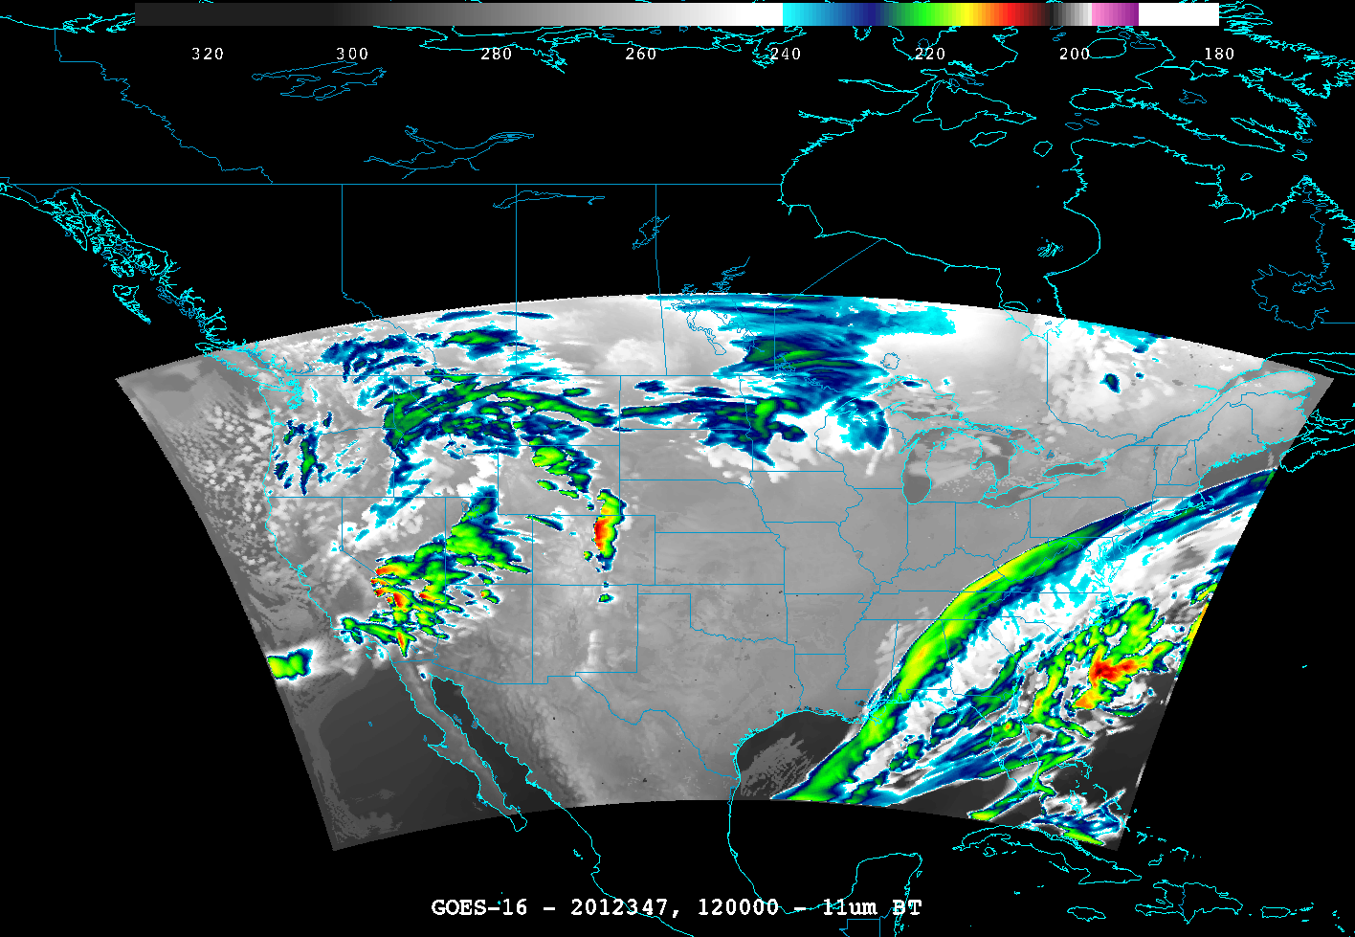
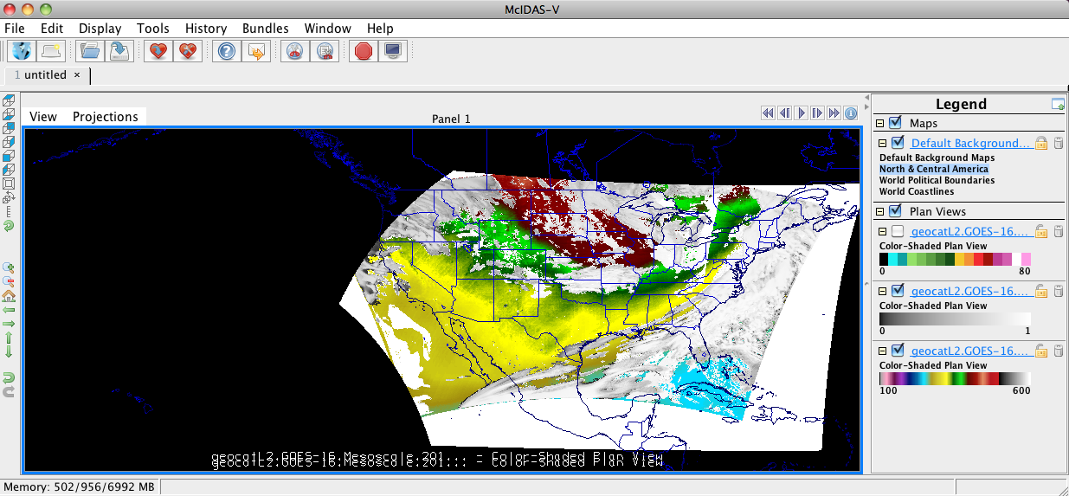
Near-Real-Time Proxy ABI Products for GOES-R User Readiness
T. Greenwald, B. Pierce*, T. Schaack, J. Otkin, K. Bah, J. Davies, J. Sieglaff, A. Lenzen, J. Nelson, M. Rogal, A. Huang
CIMSS, University of Wisconsin-Madison, WI; *NOAA/NESDIS ORA ASPB
CIMSS is producing simulated ABI products in near-real-time over CONUS from WRF-Chem model forecasts and the CRTM to support Proving Ground activities by making these products available within AWIPS
Data File Features:
CF compliant NetCDF
PUG Fixed Grid Format conventions
Current Products:
ABI 16-band imagery
Cloud mask
Temperature/moisture profiles
Total precipitable water
Total column ozone
And more …
Simulated ABI band 14 (11.2 µm)
Simulated
Total Column Ozone

