Slide 1
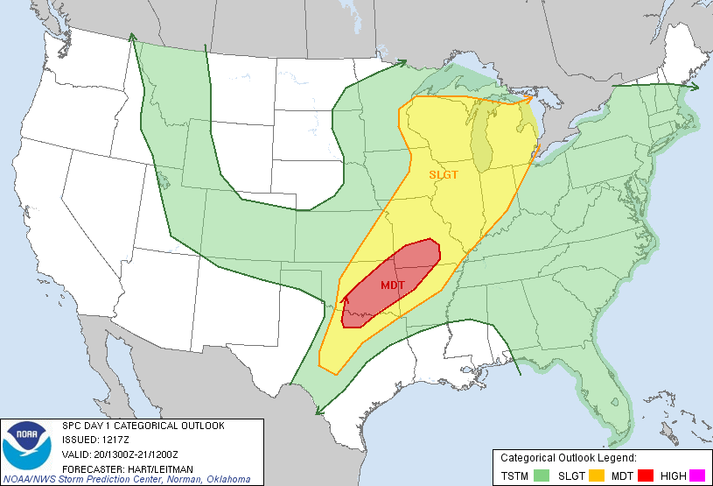
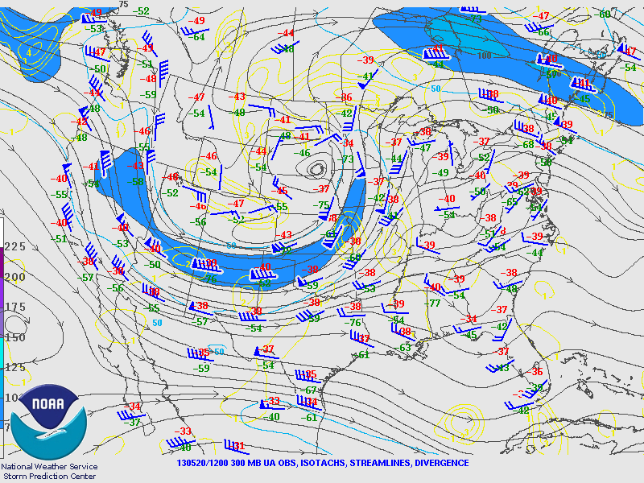
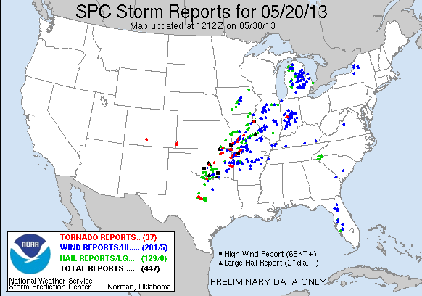
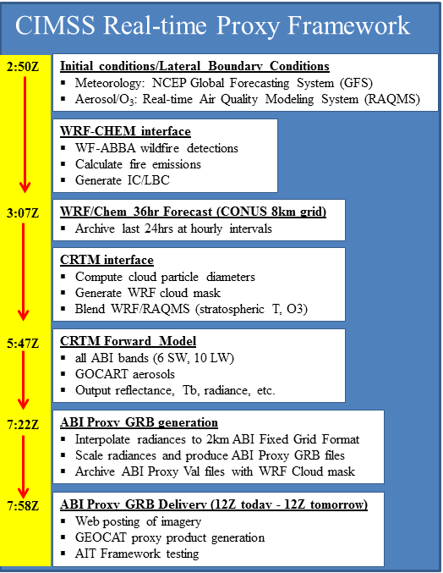
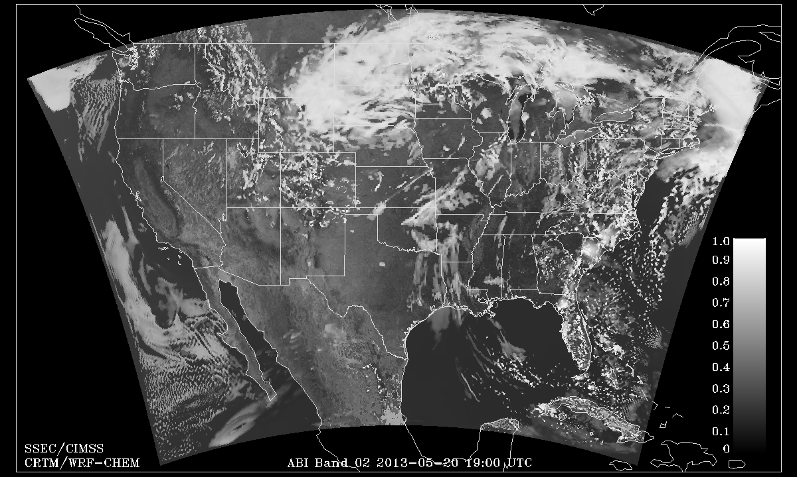
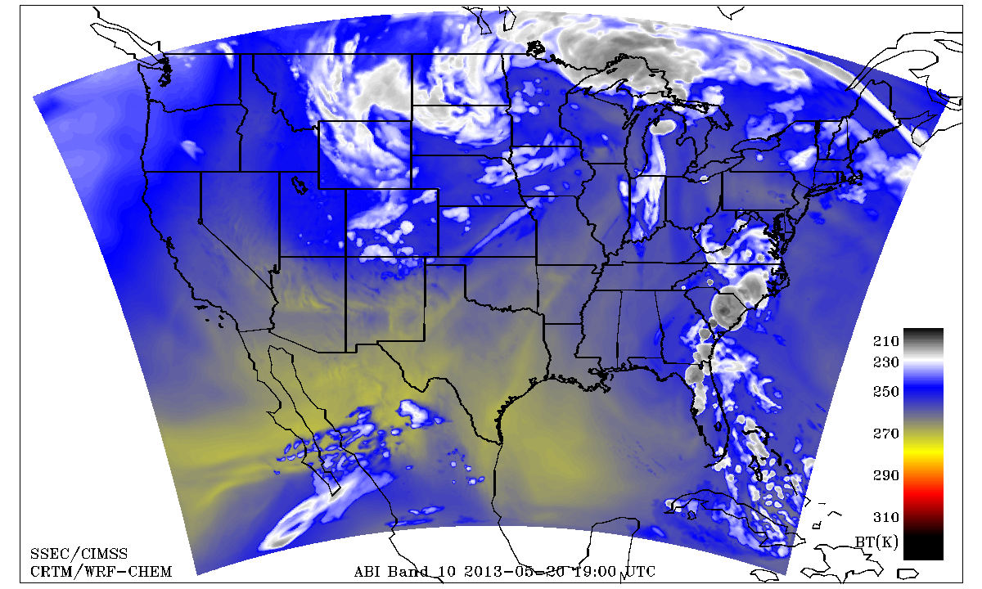
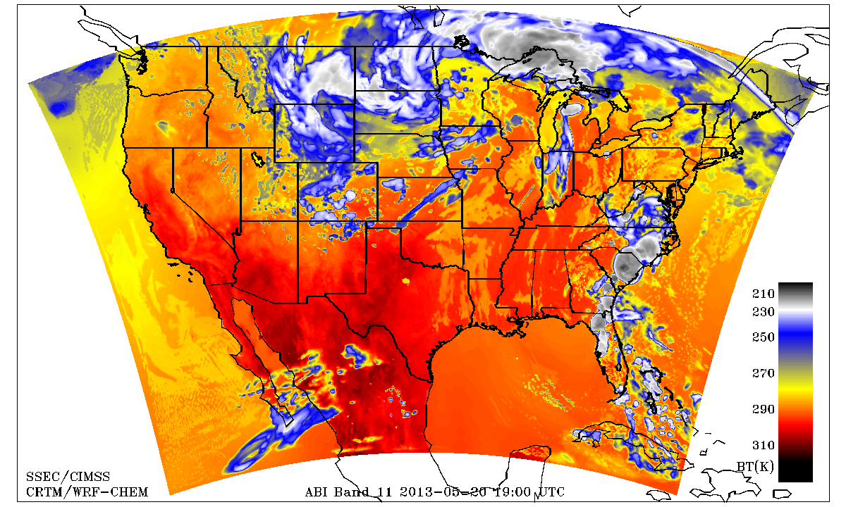
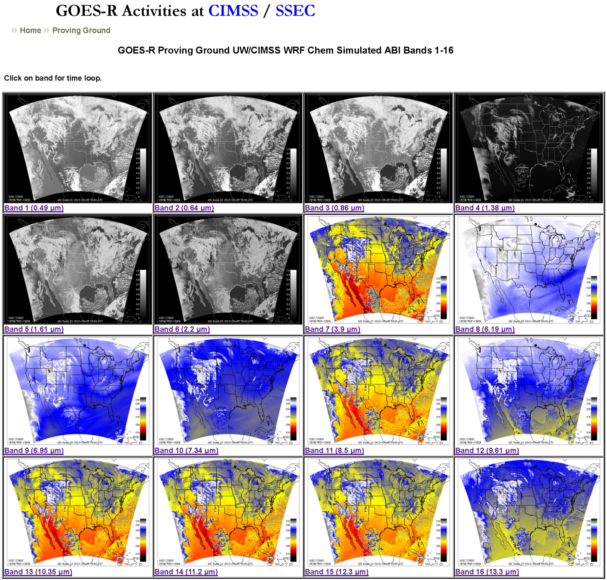
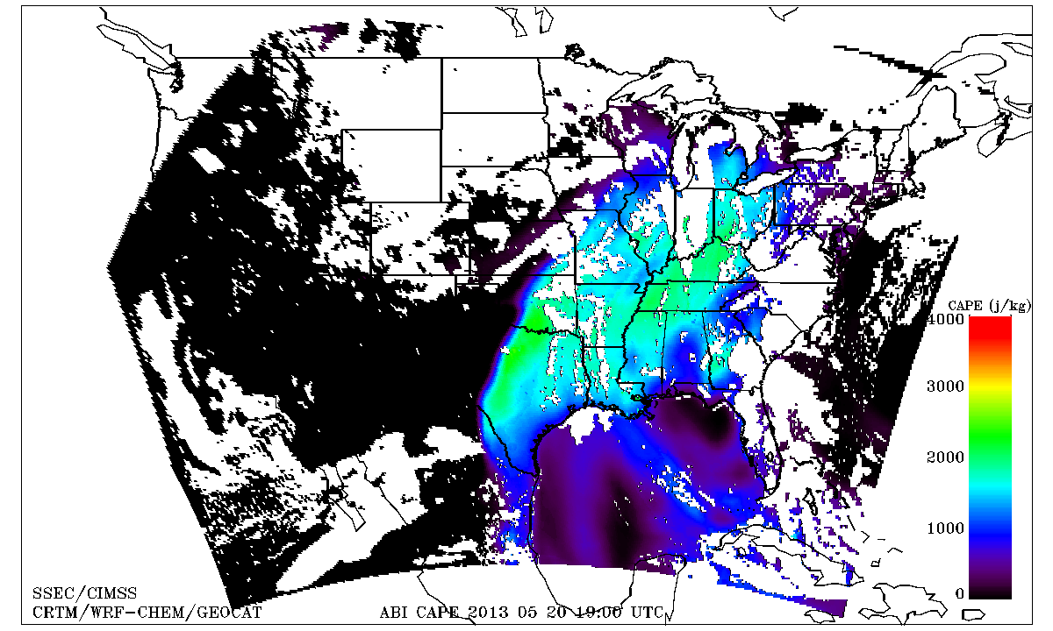
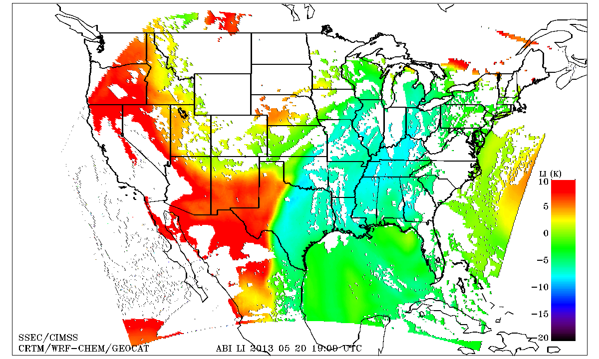
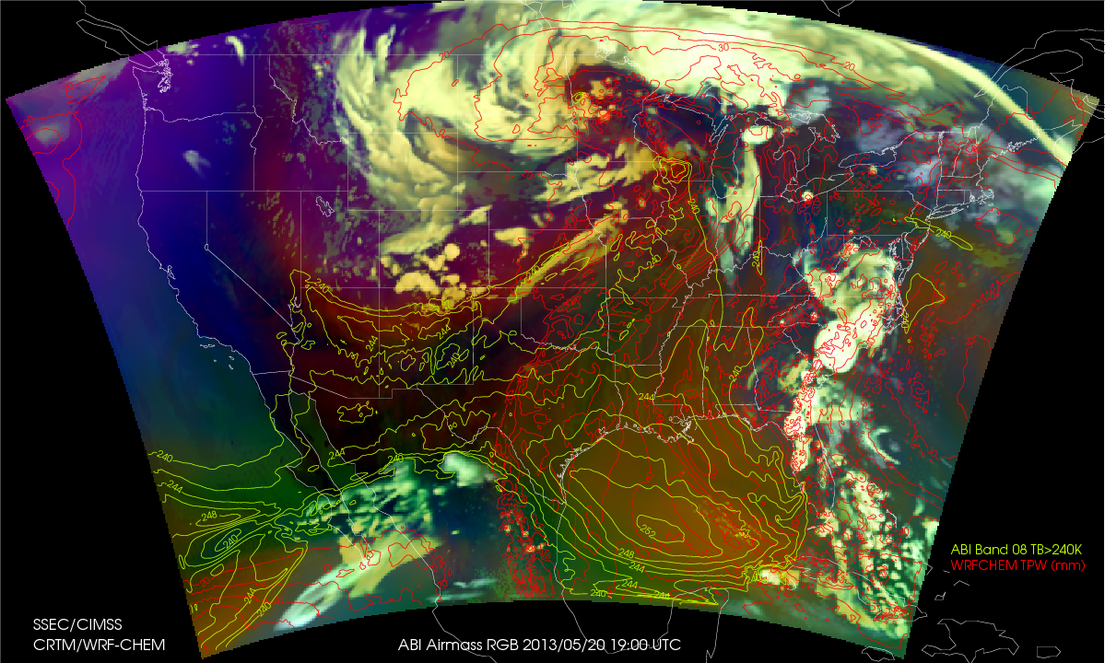
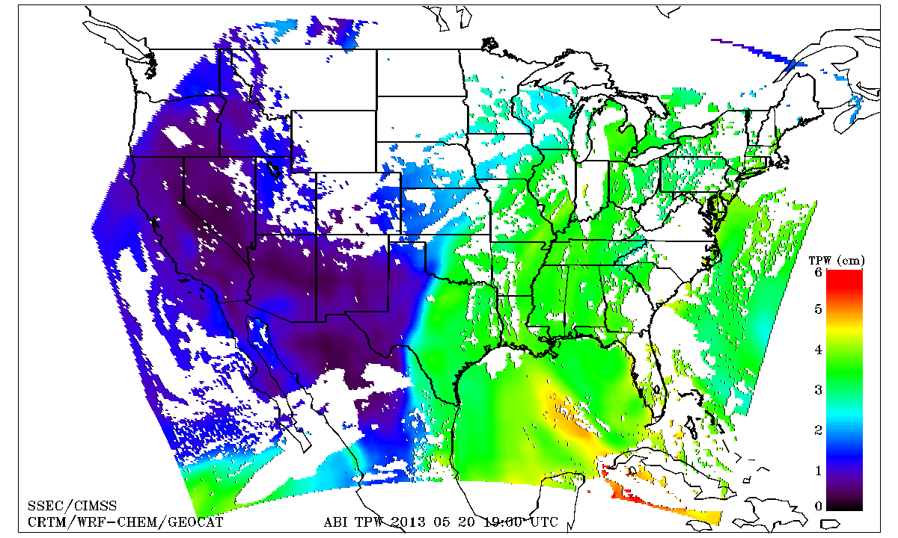
Improving severe weather monitoring and forecasting capabilities using real time ABI proxy and derived products.
Kaba Bah, Brad Pierce*, Tom Greenwald, Marek Rogal, Todd Schaack, Allen Lenzen, Jim Nelson, Jason Otkin, and Hung-Lung (Allen) Huang
Cooperative Institute for Meteorological Satellite Studies (CIMSS), University of Wisconsin-Madison
* NOAA/NESDIS ORA ASPB
Objectives
WES Case: May 20, 2013 Oklahoma Tornado Outbreak
Introduce users to Advanced Baseline Imager (ABI) imagery and products in near-real-time but at reduced time and space resolution using simulated data derived from a regional forecast model with chemistry coupled to global chemical/aerosol analyses.
Make selected simulated ABI data products available within AWIPS through WES cases to support Proving Ground activities.
Rated:EF-5, Fatalities:25, Injuries:390, Damage:~$3B, Path length:17miles, Path Width:1.3 miles.
SPC monitors and alerts public about the development of a possible sever weather event.
Production of Simulated ABI Data
12:17Z , SPC issues a moderate risk of severe thunderstorm.
19:40Z (2:40pm) Tornado warning issued.
24hr CIMSS WRFCHEM Proxy simulations and derived products captures onset of severe Wx that led to Tornado outbreak.
12:00Z , SPC analysis shows wind-shear and high dew points associated with upper-level trough.
Weather Research & Forecasting with Chemistry (WRF-CHEM) model is run for CONUS (as defined in GOES-R Product Users’ Guide (PUG)) on 8 km grid with hourly output
CRTM v2.1 used to compute radiances from WRF-CHEM model output for all ABI bands
Radiances remapped to 2 km Fixed Grid Format according to PUG conventions, rescaled, then output to CF compliant NetCDF-4 data files
Data files are run through GEOCAT (GEOstationary Cloud Algorithm Testbed) to generate baseline products (HDF5 output)
McIDAS-X is used to convert these HDF files to the type of NetCDF files needed by AWIPS II
0
15000 m
GOES-R ABI LI and CAPE retrievals are in reasonable agreement with 18Z Dallas/Fort Worth, TX sounding prior to May 20, tornado outbreak.
Corresponding Simulated GOES-R ABI Imagery
0
5000 J/kg
Baseline products currently available in GEOCAT:
Cloud mask
Cloud top height
Cloud top phase
Cloud top pressure/temperature
Daytime cloud optical depth/effective radius
Legacy temperature/moisture profiles
Total precipitable water
Derived stability indices: CAPE, lifted index, K-Index, Total Totals index, Showalter Index
Derived motion winds
Fire/hot spot characterization
Volcanic ash: detection and height
Cloud and moisture imagery
Radiances
0
100 mm
Near-Real-Time Website:
Matching proxy derived ABI products
CAPE
LI
-10
40 K
Airmass RGB
TPW
For more information visit:
http://cimss.ssec.wisc.edu/goes_r/proving-ground/wrf_chem_abi/ABI-PRODUCTS/wrf_chem_abi_prod.html
Email: kbah@ssec.wisc.edu
Phone: 608-262-4462
Lifted Index
http://cimss.ssec.wisc.edu/goes_r/proving-ground/wrf_chem_abi/wrf_chem_abi.html
Support provided by the GOES-R Program, NOAA Cooperative Agreement #NA10NES4400013.

