Slide 1
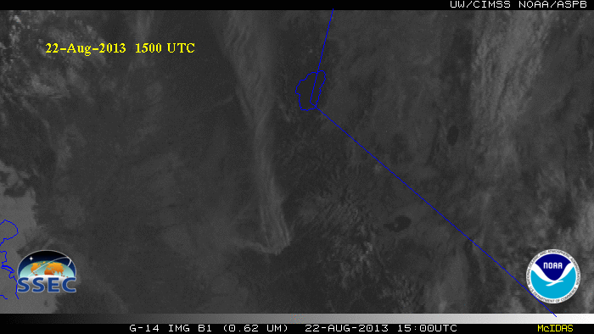
GOES-14: Special Rapid Scanning offers glimpse of the ABI
SRSOR (Super Rapid Scan Operations for GOES-R) from GOES-14 imager
Data between mid-August and September 24th and late October 2012; and two days in June and 12 days in mid-August, 2013.
http://cimss.ssec.wisc.edu/goes/srsor/GOES-14_SRSOR.html and http://cimss.ssec.wisc.edu/goes/srsor2013/GOES-14_SRSOR.html
Many phenomena were observed: convection, hurricanes, fires, smoke, ...
Data to many groups HPC, OPC, AWC, SPC, SAB, several regions, etc.
Animation from GOES-14 Imager visible image at 1-min time resolution.
GOES-14 provided very unique information and offers a glimpse into the possibilities that will be provided by the ABI on GOES-R.
Notes:
mp4

