Slide 1
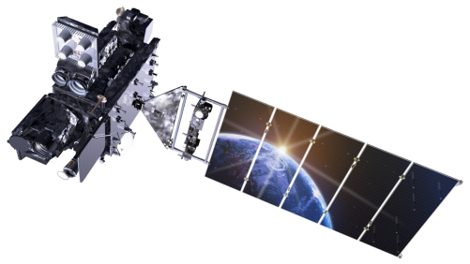
GOES-R Advanced Baseline Imager (ABI) Outline.
Polar vs Geo.
Current GOES Imager and Sounder
GOES-14/15
Futures: ABI
Spectral
Spatial
Temporal
Summary
More information
Questions
Lockheed Martin

Slide 2
The Advanced Baseline Imager:
ABI Current
Spectral Coverage
16 bands 5 bands
Spatial resolution
0.64 μm Visible 0.5 km Approx. 1 km
Other Visible/near-IR 1.0 km n/a
Bands (>2 μm) 2 km Approx. 4 km
Coverage
Full disk 4 per hour Scheduled (3 hourly)
CONUS 12 per hour ~4 per hour
Mesoscale Every 30 sec n/a

Slide 3
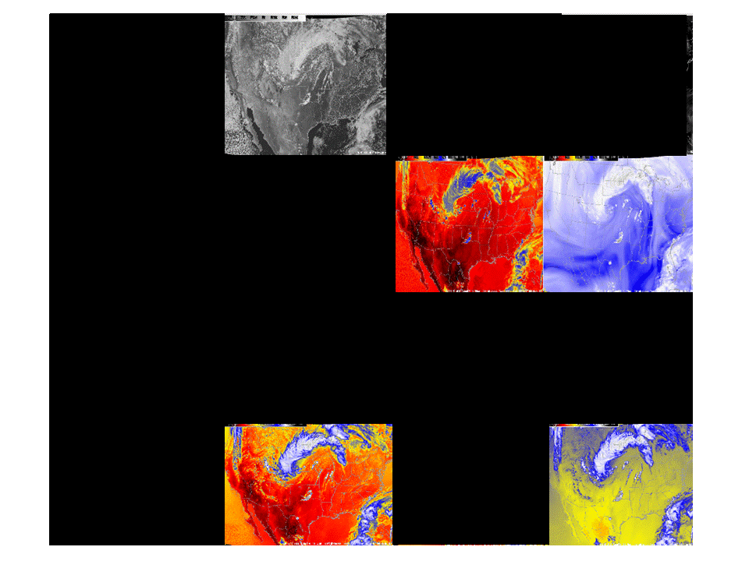
Current GOES band selection

Slide 4
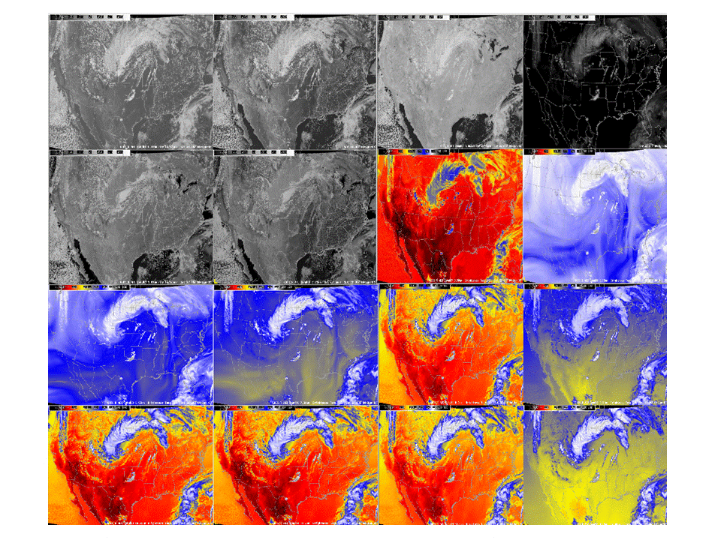
Near Future: ABI band selection
0.47 μm
0.64 μm
0.86 μm
1.38 μm
1.61 μm
2.26 μm
3.9 μm
6.19 μm
6.95 μm
7.34 μm
8.5 μm
9.61 μm
10.35 μm
11.2 μm
12.3 μm
13.3 μm

Slide 5
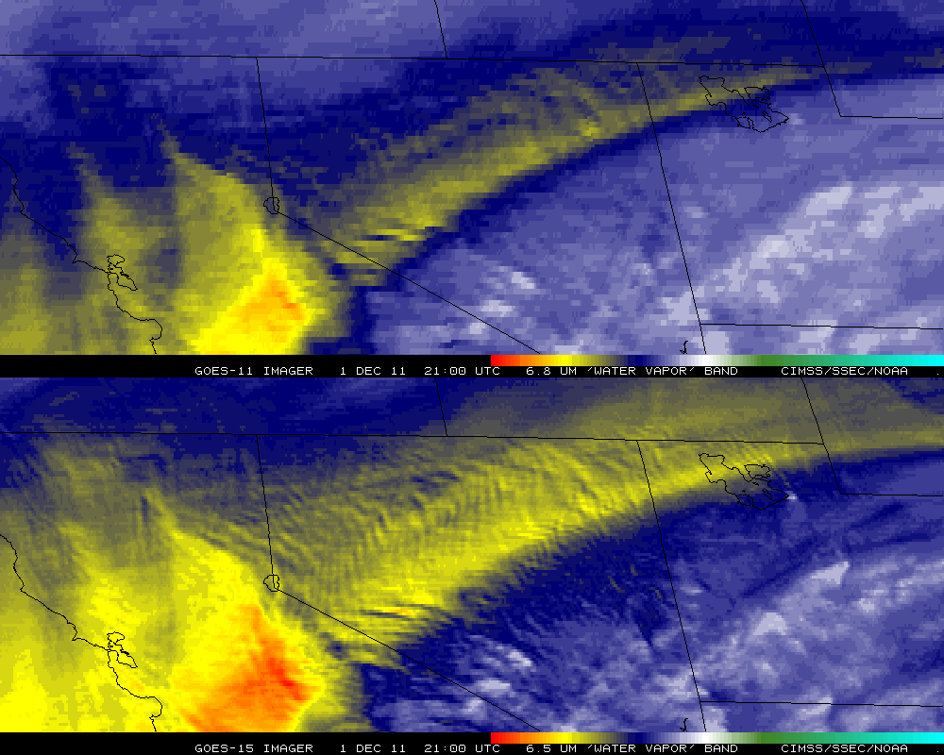
Improved GOES-15 WV imagery
GOES-11
GOES-15

Slide 6
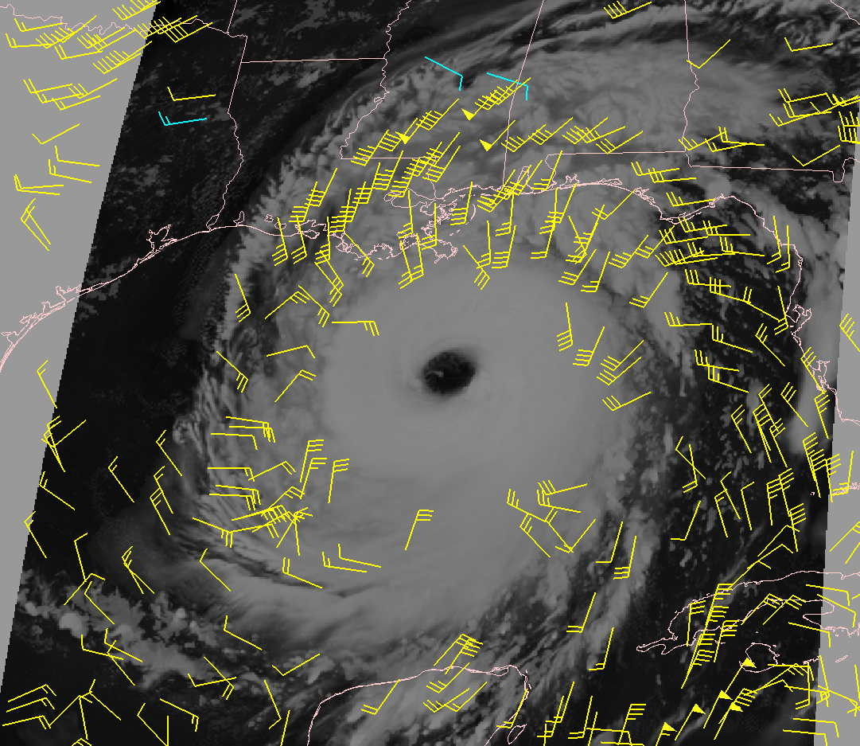
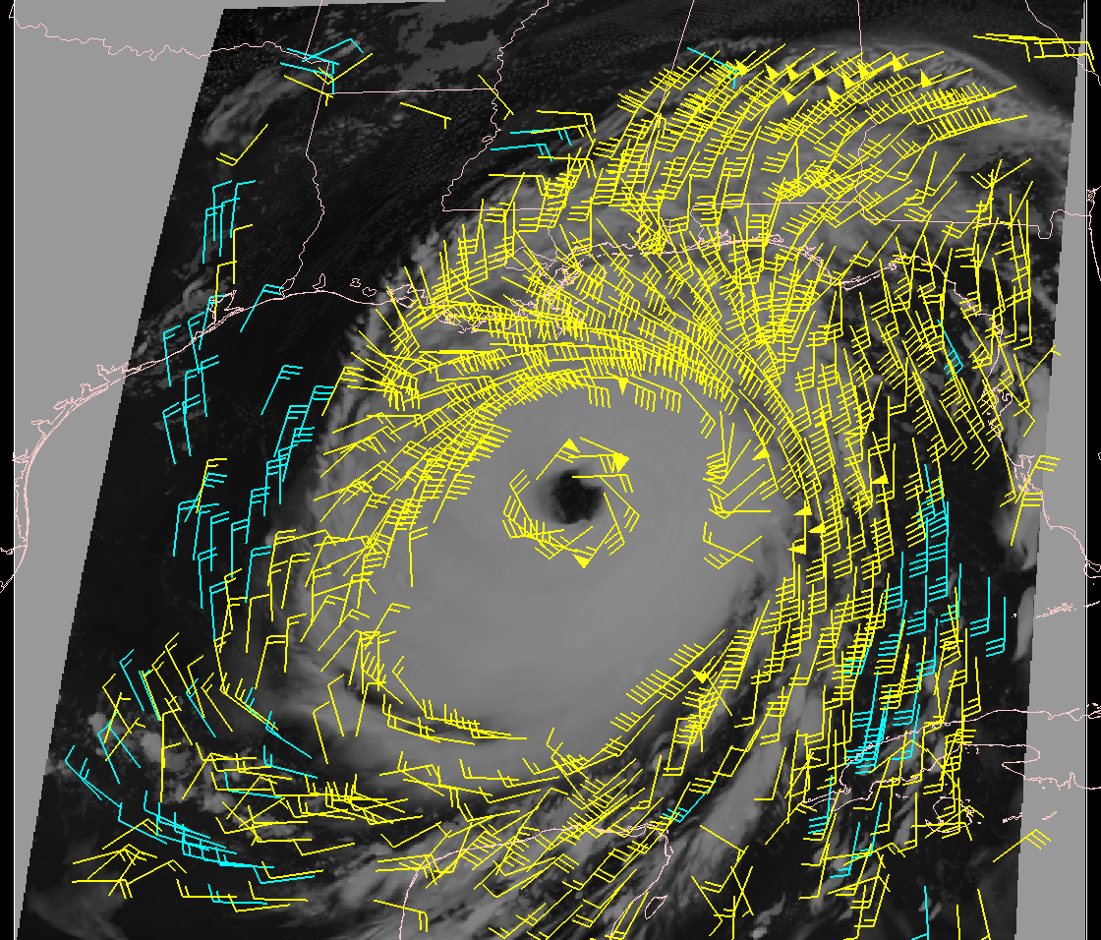
MESO, GOES-R Atmospheric Motion Vectors
Product Example: Hurricane Katrina
Low-mid level vectors- cyan Upper-level vectors - yellow
IR AMVs derived from WRF model images
using simulated future GOES-R radiances
2 km resolution; 5-minute time step
IR AMVs derived from current GOES-12
4km resolution; 15-minute time step
Courtesy C. Velden: UWisc-CIMSS/NOAA-STAR
Notes:
Will provide automated hurricane intensity estimates for tropical cyclone analysts over the GOES-R observation domain using infrared geostationary infrared window (IRW) imagery
Significant Heritage to draw from:
Based on Subjective Dvorak “Enhanced Infrared” (EIR) Technique (SDT) developed in the 1970’s and 1980’s by NOAA/NESDIS scientist Vern Dvorak.
Provides estimated hurricane intensity in oceanic regions where direct aircraft reconnaissance measurements of intensity are not available.
Satellite-based technique that employs image pattern recognition techniques and empirically based rules to derive an estimate of Tropical Cyclone (TC) intensity in “T numbers” which ultimately relate to surface wind speeds.
The increased higher density winds derived from the higher resolution GOES-R ABI allows forecasters to more accurately determine the extent of the eye and gale force winds (upper winds, not ground), and improve the model forecasts of track and intensity. Example compares the winds GOES-R ABI can produce with its 2-km IR spatial resolution and 5-min refresh rate as simulated using the Weather Research and Forecast (WRF) Model compared to the current GOES-R imager with 4-km IR resolution and 15 min or longer refresh rate.
GOES-R improves spatial and temporal resolution thereby increasing the accuracy of storm height assigment. GOES-R will also detect and more define eye helping to more accurately predict forward track.
The higher density winds derived from the GOES-R ABI allows forecasters to more accurately determine the extent of the eye and gale force winds, and will improve the model forecasts of track and intensity.

Slide 7
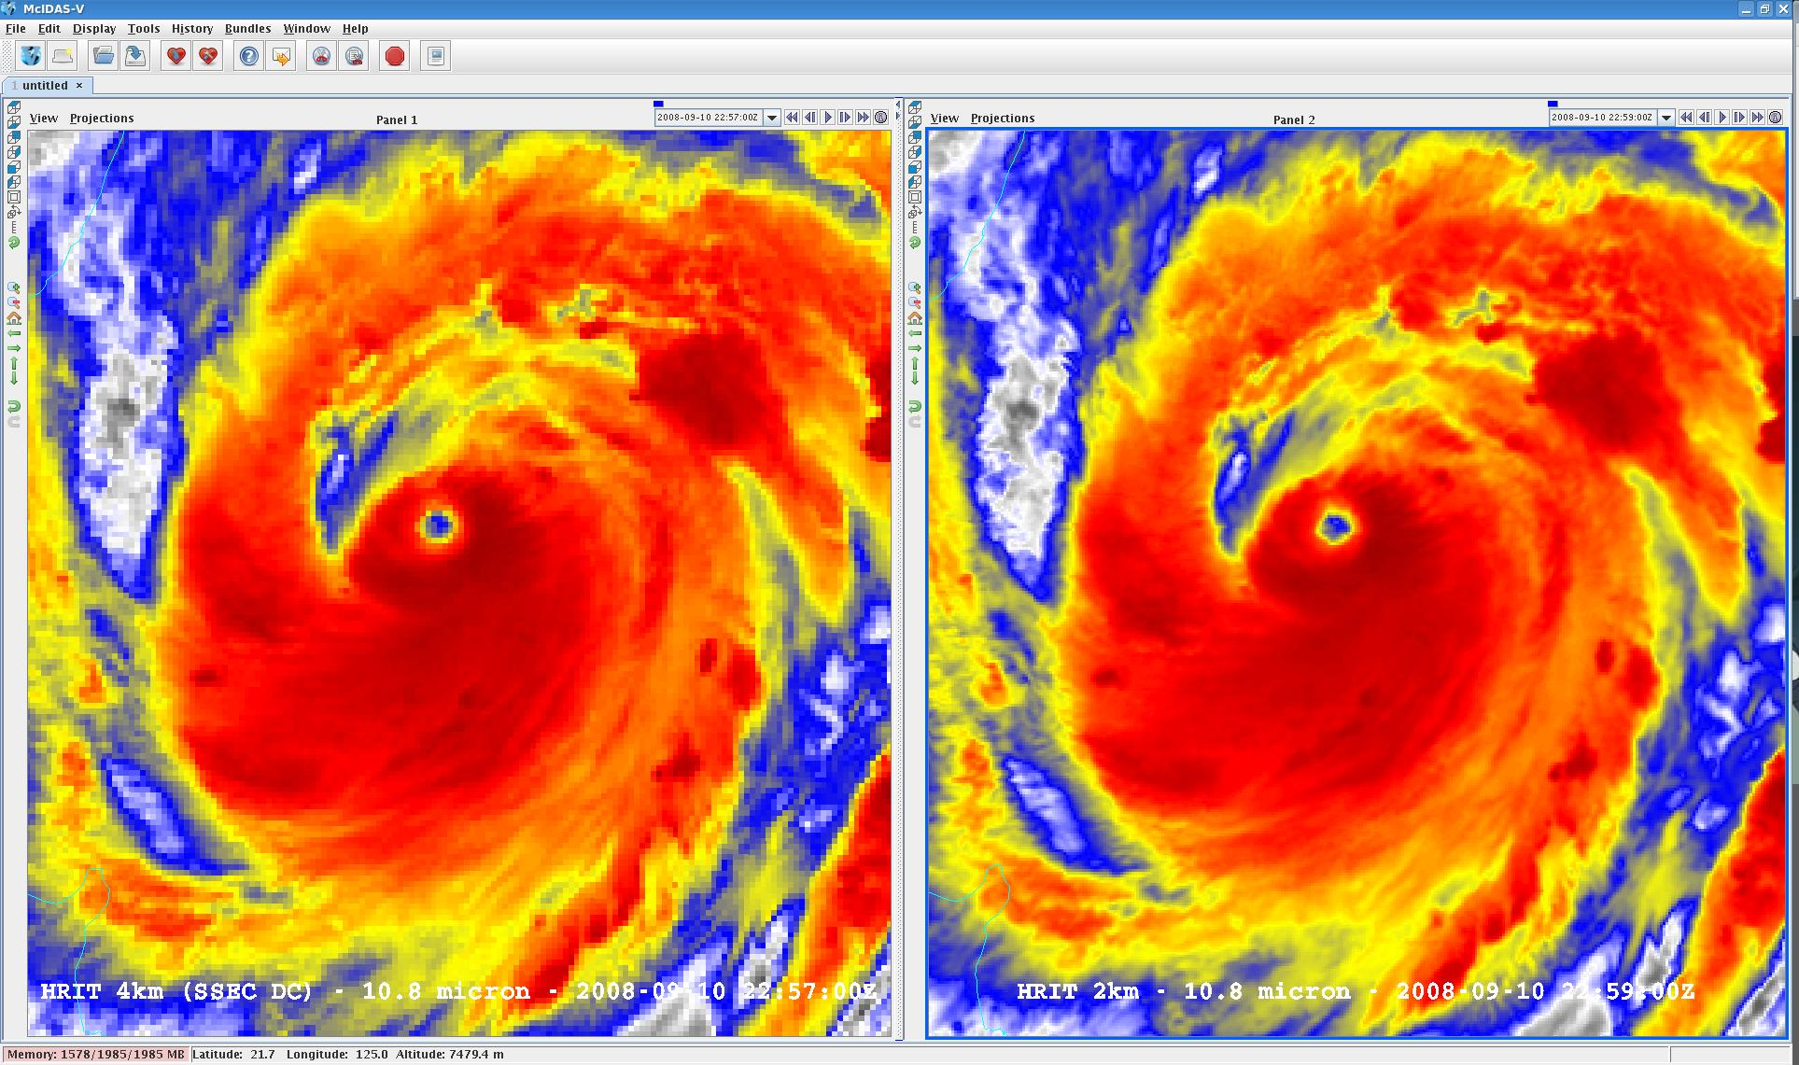
Visualization (2 km MTSAT; data from JMA)
SSEC

Slide 8
1-min imagery
Operational (GOES-13)
1-min mode (SRSOR from GOES-14)

Slide 9
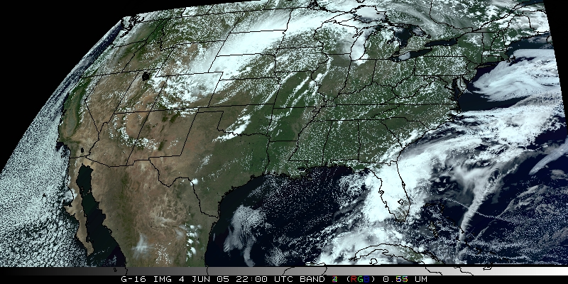
CONUS Visualization (“true color” as a decision aid”)
“True Color” with “synthetic” green from ABI simulated data (from CIMSS); image from Don Hillger, RAMMB.
Courtesy Don Hillier: CIRA/NOAA/NESDIS

Slide 10
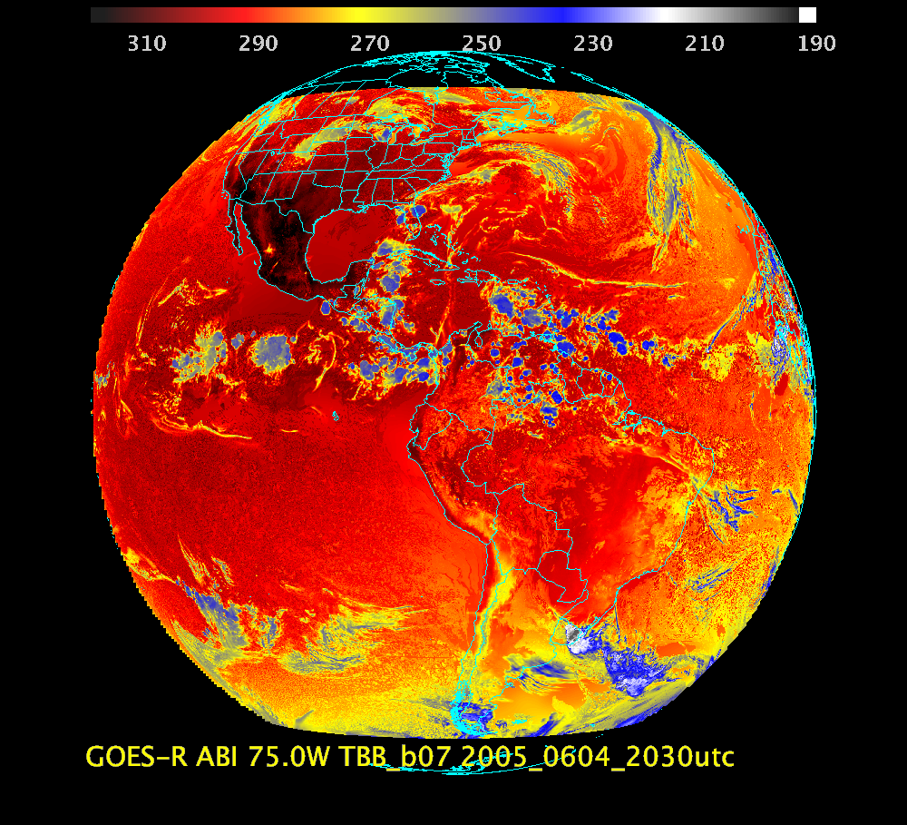
FULL DISK Band 7: Shortwave IR window band - fog, fires, etc.

Slide 11
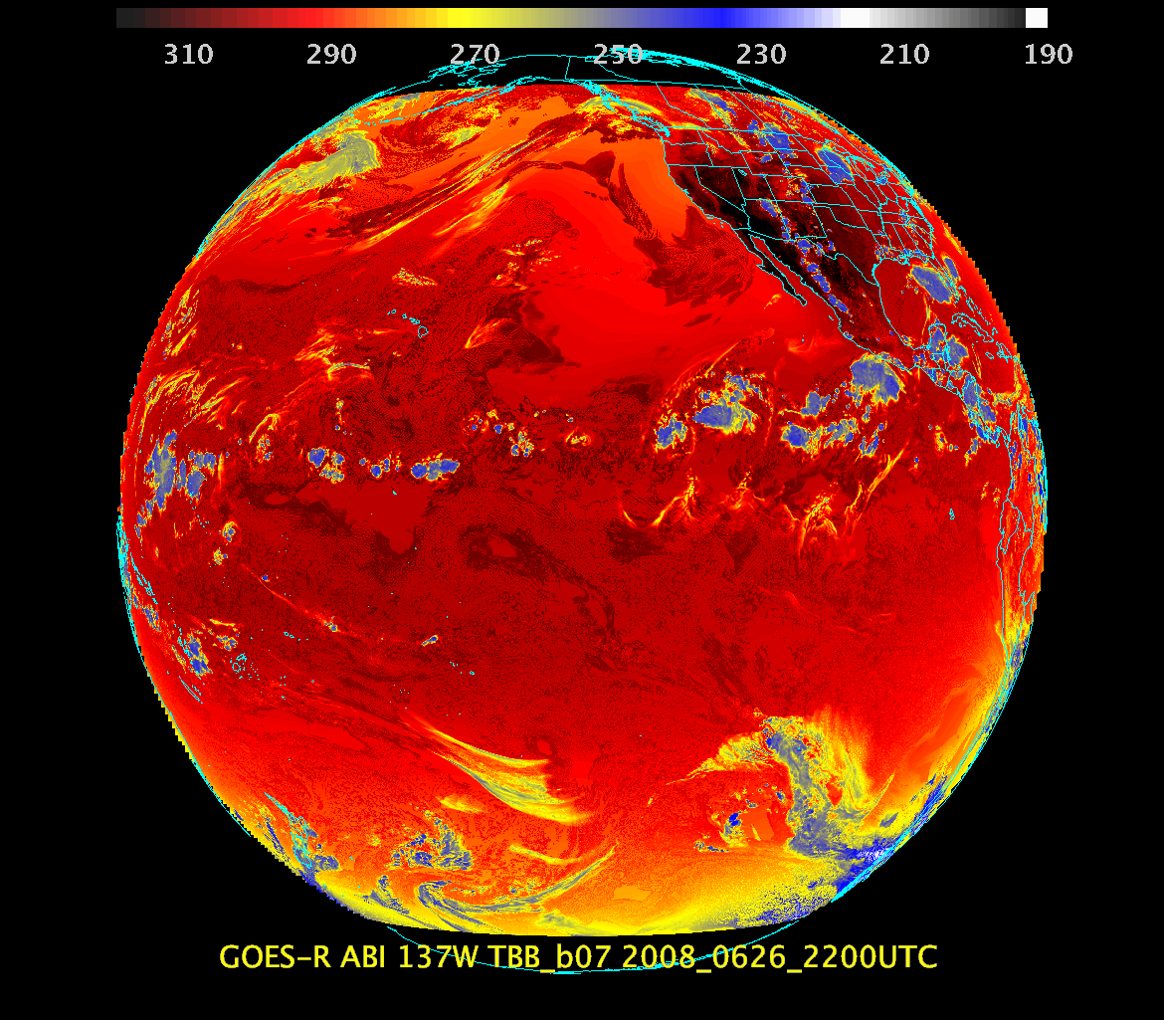
FULL DISK Band 7: Shortwave IR window band - fog, fires, etc.

Slide 12
McIDAS-V on hands
Sample Data:
ftp://ftp.ssec.wisc.edu/ABI/kaba/sim-abi/fgf/GRB/
ftp://ftp.ssec.wisc.edu/ABI/kaba/sim-abi/fgf/VAL/
Sample images:
ftp://ftp.ssec.wisc.edu/ABI/kaba/sim-abi/fgf/images/

Slide 13
END

