Slide 1
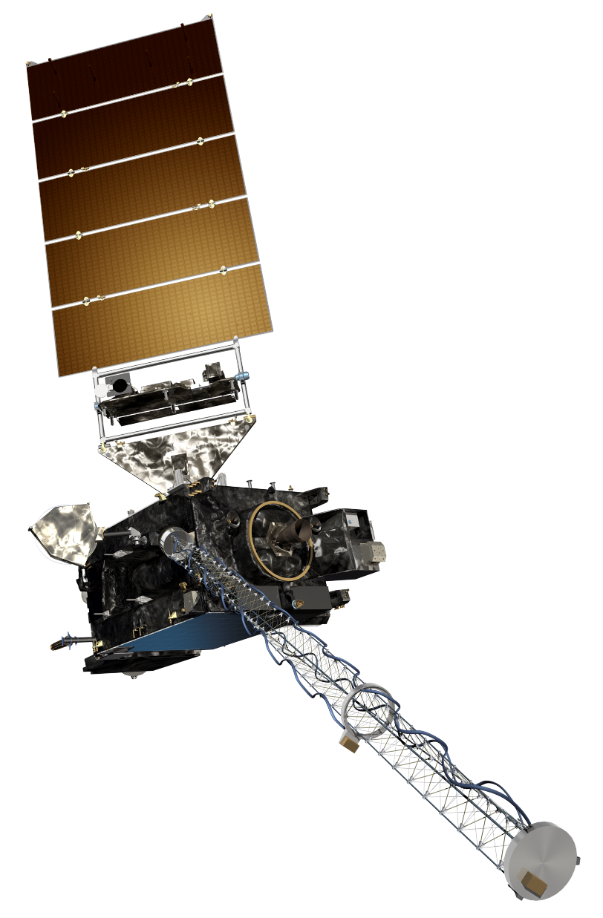
The GOES-R Series:
Welcome to GOES-R:
The 2.24 μm “Cloud particle size”
Scott Lindstrom
UW Madison CIMSS
with Kaba Bah, Margaret Mooney, Kathy Strabala, Scott Bachmeier, and more!
SHyMet Introductory Course
Notes:
This is the SHyMet course on the Advanced Baseline Imager (the ABI), one of two sensors on GOES-R that measures the Earth's atmosphere (the Geostationary Lightning Mapper is the second). This course has been created with funding from the GOES-R Program and it should show you uses for the 16 channels on ABI. Contributors to this training are listed on this slide.

Slide 2
ABI: Bands 1-6 (Visible / NearIR)
ABI Band | Wavelength (µm) | Wavelength range (µm) | Sub-point pixel spacing (km) | Descriptive Name
1 | 0.47 | 0.45 - 0.49 | 1 | “Blue”
2 | 0.64 | 0.60 - 0.68 | 0.5 | “Red”
3 | 0.864 | 0.847 - 0.882 | 1 | “Veggie”
4 | 1.373 | 1.366 - 1.380 | 2 | “Cirrus”
5 | 1.61 | 1.59 - 1.63 | 1 | “Snow/Ice”
6 | 2.24 | 2.22 -2.27 | 2 | “Cloud Particle Size”
Six visible or near visible bands on ABI
(there was only one on heritage imager)
Notes:
This table is based on Schmit et al, 2017. (References are listed at the end of this training) Band numbers are shown (you can also call them channels), as well as the central wavelength, the wavelength range, the pixel resolution at the satellite sub-point (That is, nadir), and the nickname. The green circles are around bands5 1, 3 and 5, which bands have 1-km resolution at the sub-satellite point. The highest-resolution band, band 2, the 0.64 micrometer band (the so-called “Red Visible”) has half-kilometer resolution at the sub-satellite point. This is also the band that was on earlier GOES instruments.
You might be asking: WHY are these wavelengths chosen for band placement? Are they random? No! As you'll see next, there's a reason.

Slide 3
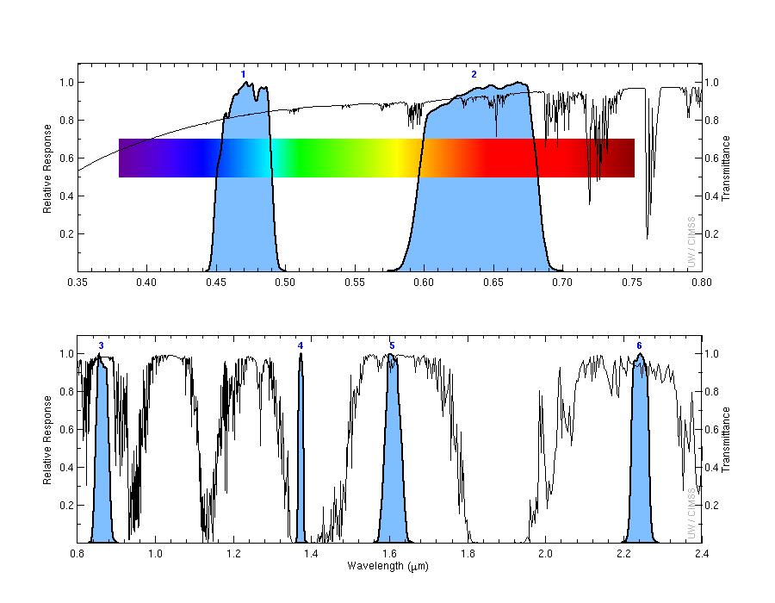
Plays key roles in cloud particle size .
1
2
Transmittance
0.47 μm
0.64 μm
3
4
5
6
Transmittance
0.86 μm
1.38 μm
1.61 μm
2.2 μm
Notes:
Visible and near-infrared imagery relies on reflected solar radiation to create a signal. This chart shows similar information to the previous slide. Band number is shown across the top. The Roy G Biv visible spectrum is shown too - do you see why they're nicknames the blue and red bands? The blue regions - the spectral response function - shows where information is detected for each channel. The black line is transmittance through the atmosphere - note how it decreases across the 'blue band', band 1, because atmospheric scattering increases. Band 4, at 1.38 micrometers, is special among these 6 bands because it occupies a region with strong absorption (by water vapor). As you'll see, that means it has a much different look than the other bands in the visible and near-infrared part of the spectrum.

Slide 4
Why use the “Cloud particle size” Band
Excellent for studying futures relating to:
Cloud particle growth for cloud development and intensity..
Aerosol particle size estimation.
Cloud screening.
Hot spot detection
Snow ice detection.
Information from 2.24 μm can be very helpful in deriving products relating to cloud particle size distribution, aerosol detection, aerosol and cloud optical depths, as well as snow cover.
Notes:
The 2.24 μm band (a near-infrared band), is well known for enabling cloud particle size estimations. This is very important for understanding cloud growth and intensity of that development. When used in conjunction with other bands, it can significantly enhance cloud screening, hot-sport and snow detection.

Slide 5
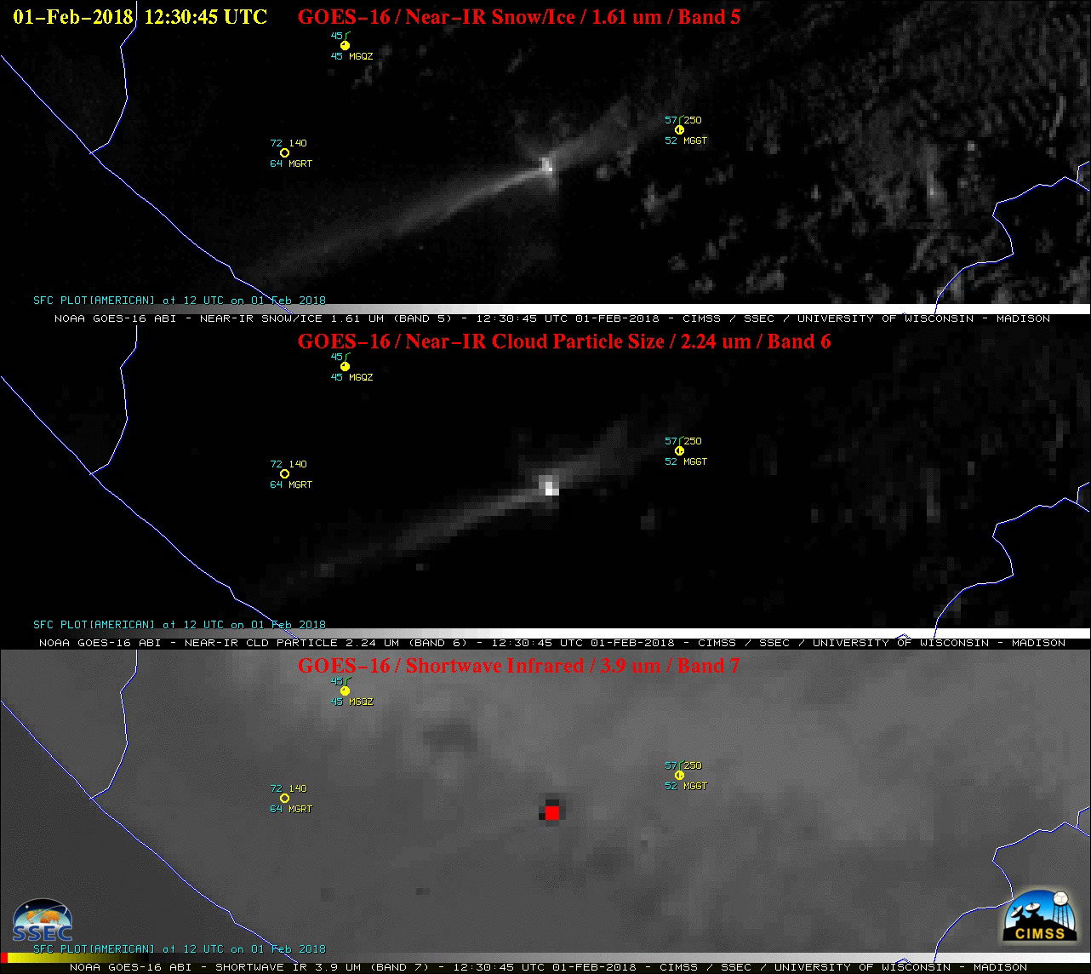
The 2.24 μm can be used to identify thermal signature.
Notes:
This example shows GOES-16 bands 05 (1.61µm) , 06 (2.24µm) and 08 (3.90µm) for February- 01st,2018 at 12:30 UTC being used for identifying thermal signatures.
The thermal anomaly or “hot spot” could be seen in all the above images but it easily stands out in band 06 (2.24µm) because it is located closer to the peak emitted radiance of very hot features such as active volcanoes or large fires compared to the other bands. In this case, the hottest 3.9 mm brightness temperature is 393 K (vs a background value around 285-290K); the largest albedo at 2.24 µm is 37% (vs, a background value between 1 and 3, generally; the largest albedo at 1.61 µm is 20 (vs a background value of 2-5%)

Slide 6
Why use the cloud particle size Band
Very useful for monitoring cloud genesis.
Excellent for identifying thermal signatures .
Information from 2.24 μm is critical for multiple level 2 products including cloud particle size distribution, aerosol detection, cloud optical depth, snow cover and reflected shortwave radiation TOA.
Notes:
A summary of what you’ve just learned.

Slide 7
Thank you
For more information visit www.goes-r.gov --
or find your favorite social media link below
www.facebook.com/GOESRsatellite
www.youtube.com/user/NOAASatellites
twitter.com/NOAASatellites
www.flickr.com/photos/noaasatellites
Notes:
There are places online that you can find. Here as some Social Media contacts as of 2018.

