Slide 1
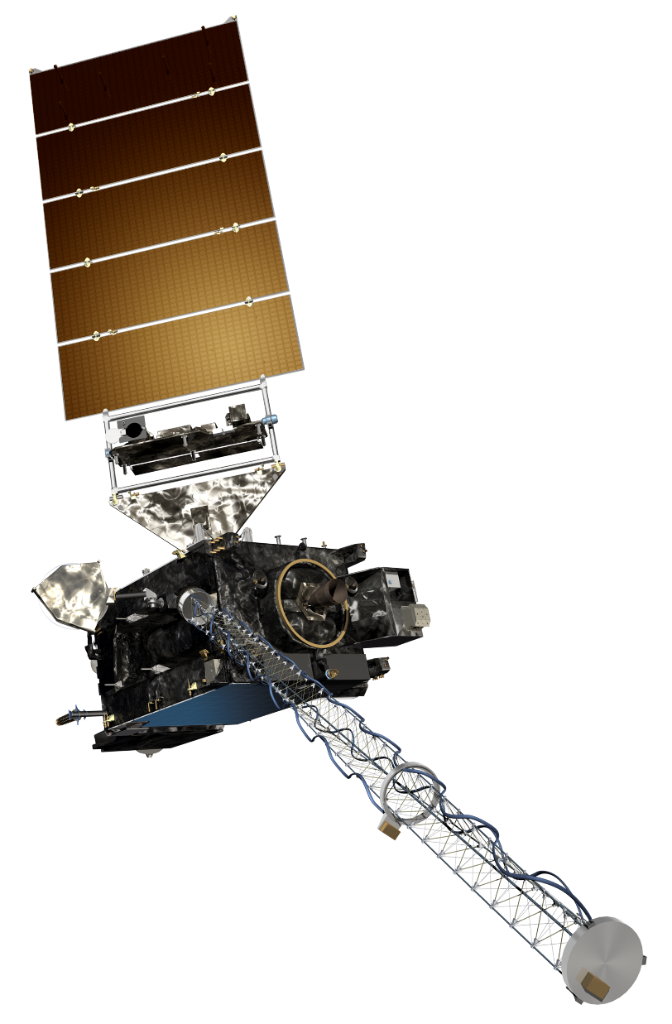
The GOES-R Series:
Welcome to GOES-R:
The 1.61 μm “Snow/Ice” Band
Scott Lindstrom
UW Madison CIMSS
with Kaba Bah, Margaret Mooney, Kathy Strabala, Scott Bachmeier, and more!
SHyMet Introductory Course
Notes:
This is the SHyMet course on the Advanced Baseline Imager (the ABI), one of two sensors on GOES-R that measures the Earth's atmosphere (the Geostationary Lightning Mapper is the second). This course has been created with funding from the GOES-R Program and it should show you uses for the 16 channels on ABI. Contributors to this training are listed on this slide.

Slide 2
ABI: Bands 1-6 (Visible / NearIR)
ABI Band | Wavelength (µm) | Wavelength range (µm) | Sub-point pixel spacing (km) | Descriptive Name
1 | 0.47 | 0.45 - 0.49 | 1 | “Blue”
2 | 0.64 | 0.60 - 0.68 | 0.5 | “Red”
3 | 0.864 | 0.847 - 0.882 | 1 | “Veggie”
4 | 1.373 | 1.366 - 1.380 | 2 | “Cirrus”
5 | 1.61 | 1.59 - 1.63 | 1 | “Snow/Ice”
6 | 2.24 | 2.22 -2.27 | 2 | “Cloud Particle Size”
Six visible or near visible bands on ABI
(there was only one on heritage imager)
Notes:
This table is based on Schmit et al, 2017. (References are listed at the end of this training) Band numbers are shown (you can also call them channels), as well as the central wavelength, the wavelength range, the pixel resolution at the satellite sub-point (That is, nadir), and the nickname. The green circles are around bands5 1, 3 and 5, which bands have 1-km resolution at the sub-satellite point. The highest-resolution band, band 2, the 0.64 micrometer band (the so-called “Red Visible”) has half-kilometer resolution at the sub-satellite point. This is also the band that was on earlier GOES instruments.
You might be asking: WHY are these wavelengths chosen for band placement? Are they random? No! As you'll see next, there's a reason.

Slide 3
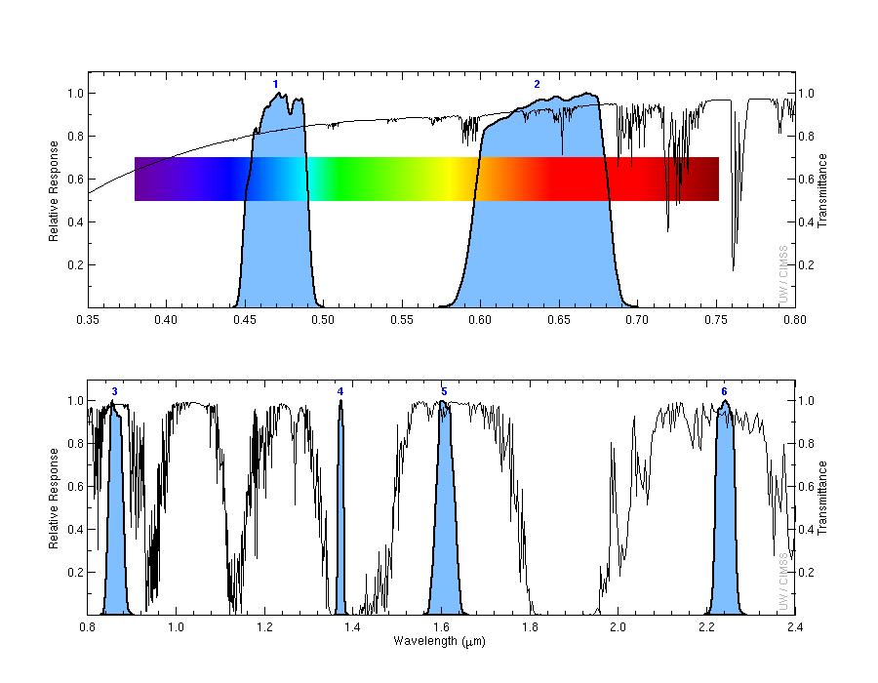
Shows very large difference between how ice and water droplets absorbs energy with a wavelength of 1.61um .
1
2
Transmittance
0.47 μm
0.64 μm
3
4
5
6
Transmittance
0.86 μm
1.38 μm
1.61 μm
2.2 μm
Notes:
Visible and near-infrared imagery relies on reflected solar radiation to create a signal. This chart shows similar information to the previous slide. Band number is shown across the top. The Roy G Biv visible spectrum is shown too - do you see why they're nicknames the blue and red bands? The blue regions - the spectral response function - shows where information is detected for each channel. The black line is transmittance through the atmosphere - note how it decreases across the 'blue band', band 1, because atmospheric scattering increases. Band 4, at 1.38 micrometers, is special among these 6 bands because it occupies a region with strong absorption (by water vapor). As you'll see, that means it has a much different look than the other bands in the visible and near-infrared part of the spectrum.

Slide 4
Why use the “Snow/Ice” Band
1.0-km, spatial resolution.
Excellent for revealing daytime features such as:
Discrimination between cloud, snow and ice (useful for aircraft routing) .
Water droplets, which are highly reflective at 1.61um (appears bright).
Ice, which absorbs radiation at 1.61um (appears dark).
Above anvil cirrus plumes
Detecting night time fires.
Can be used to infer cloud phase as well as land/water contrast.
Information from 1.61 μm can be very helpful in deriving products relating to snow & cloud cover, aerosol detection, aerosol optical depth, smoke detection and clear sky masks.
Notes:
The 1.61μm band (a near-infrared band), occupies a region in the electromagnetic spectrum where water droplets reflects such energy while ice absorbs the energy. This results in liquid water clouds appearing bright while ice clouds appear dark. This relatively large difference between the reflection components of water and ice clouds, makes it possible to discern the two which can be very useful for aircraft routing, inferring cloud phase, land water contrast and even fire signals for very hot fires.

Slide 5
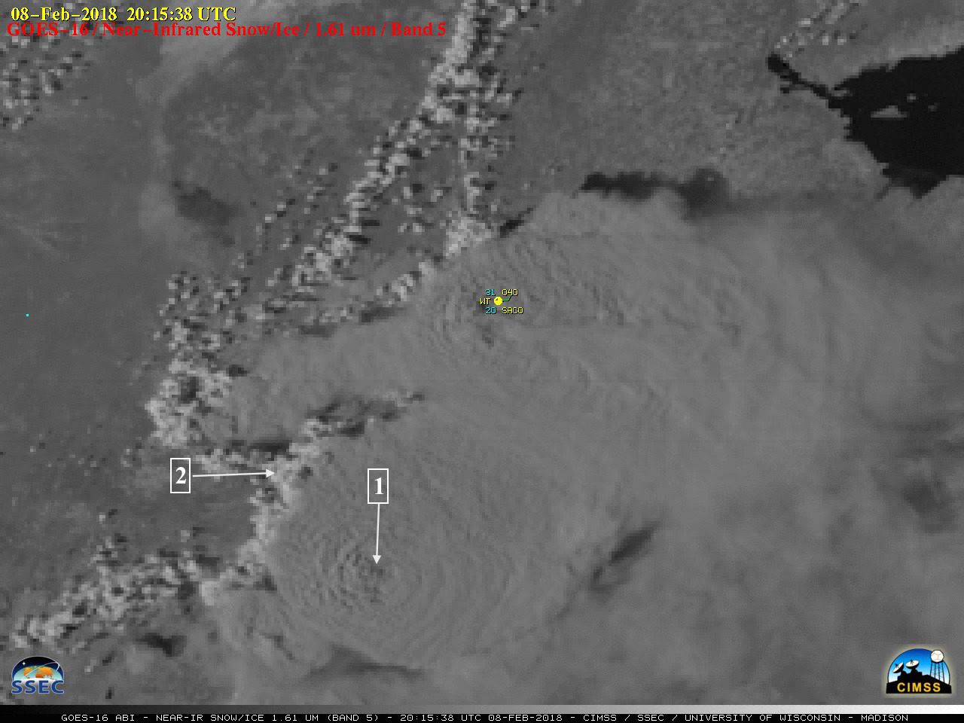
The 1.61 μm can be used to identify Above-anvil cirrus plumes.
Notes:
This example shows the GOES-16 near Infrared snow/Ice (1.61µm) band for February- 08th,2018 at 20:58UTC. Ice clouds, liquid water and land/water boundaries are visually identifiable.
1: Liquid water clouds reflect energy and appear bright at 1.61µm
2: Ice clouds absorb energy and appear darker at 1.61µm

Slide 6
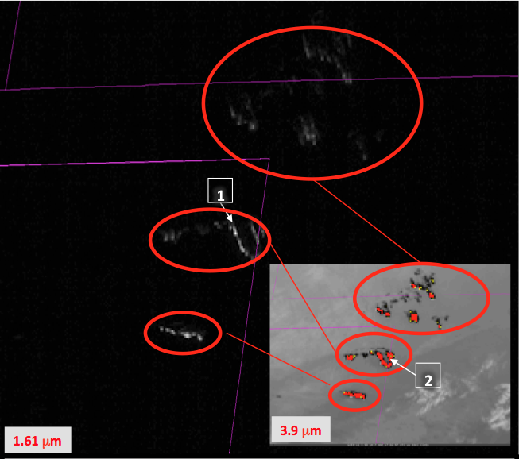
The 1.61 μm can be used to detecting fires at night.
Notes:
This example shows the GOES-16 near Infrared snow/Ice (1.61µm) band for March- 07th,2018 at 20:58UTC with an Inset from the 3.9 µm and color-enhanced to show Hot Spots.
Care must be taken however to monitor clouds: cloud motion or development can block the night-time view of the fire.
1: Hot fires emit 1.61µm radiation that shows up well against the black background of night.
2: Inset shows the 3.9µm image for the same time.

Slide 7
Why use the Snow/Ice Band
1.0-km spatial resolution.
Very efficient for cloud, snow and Ice discrimination.
Excellent land/ water boundary contrast.
Can be used to identify the following:
Above-anvil snow plumes
Detecting night time fires
Sand
Haze
Dust
Information from 1.61 μm is critical for multiple level 2 products including aerosol detection, snow cover and reflected shortwave radiation TOA.
Notes:
A summary of what you’ve just learned.

Slide 8
Thank you
For more information visit www.goes-r.gov --
or find your favorite social media link below
www.facebook.com/GOESRsatellite
www.youtube.com/user/NOAASatellites
twitter.com/NOAASatellites
www.flickr.com/photos/noaasatellites
Notes:
There are places online that you can find. Here as some Social Media contacts as of 2018.

