Slide 1
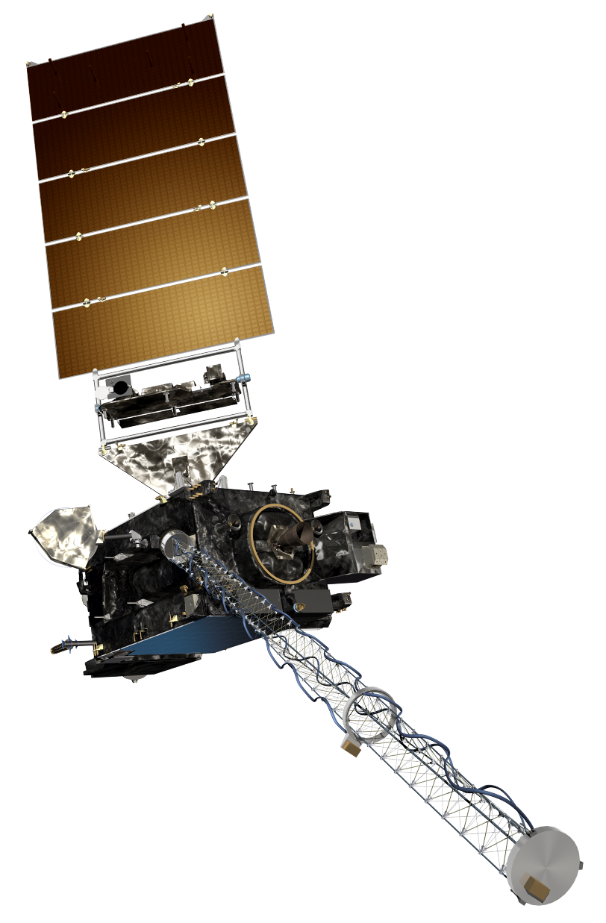
The GOES-R Series:
Welcome to GOES-R:
The 1.37 μm “Cirrus” Band
Scott Lindstrom
UW Madison CIMSS
with Kaba Bah, Margaret Mooney, Kathy Strabala, Scott Bachmeier, and more!
SHyMet Introductory Course
Notes:
This is the SHyMet course on the Advanced Baseline Imager (the ABI), one of two sensors on GOES-R that measures the Earth's atmosphere (the Geostationary Lightning Mapper is the second). This course has been created with funding from the GOES-R Program and it should show you uses for the 16 channels on ABI. Contributors to this training are listed on this slide.

Slide 2
ABI: Bands 1-6 (Visible / NearIR)
ABI Band | Wavelength (µm) | Wavelength range (µm) | Sub-point pixel spacing (km) | Descriptive Name
1 | 0.47 | 0.45 - 0.49 | 1 | “Blue”
2 | 0.64 | 0.60 - 0.68 | 0.5 | “Red”
3 | 0.864 | 0.847 - 0.882 | 1 | “Veggie”
4 | 1.373 | 1.366 - 1.380 | 2 | “Cirrus”
5 | 1.61 | 1.59 - 1.63 | 1 | “Snow/Ice”
6 | 2.24 | 2.22 -2.27 | 2 | “Cloud Particle Size”
Six visible or near visible bands on ABI
(there was only one on heritage imager)
Notes:
This table is based on Schmit et al, 2017. (References are listed at the end of this training) Band numbers are shown (you can also call them channels), as well as the central wavelength, the wavelength range, the pixel resolution at the satellite sub-point (That is, nadir), and the nickname. The green circles are around bands5 1, 3 and 5, which bands have 1-km resolution at the sub-satellite point. The highest-resolution band, band 2, the 0.64 micrometer band (the so-called “Red Visible”) has half-kilometer resolution at the sub-satellite point. This is also the band that was on earlier GOES instruments.
You might be asking: WHY are these wavelengths chosen for band placement? Are they random? No! As you'll see next, there's a reason.

Slide 3
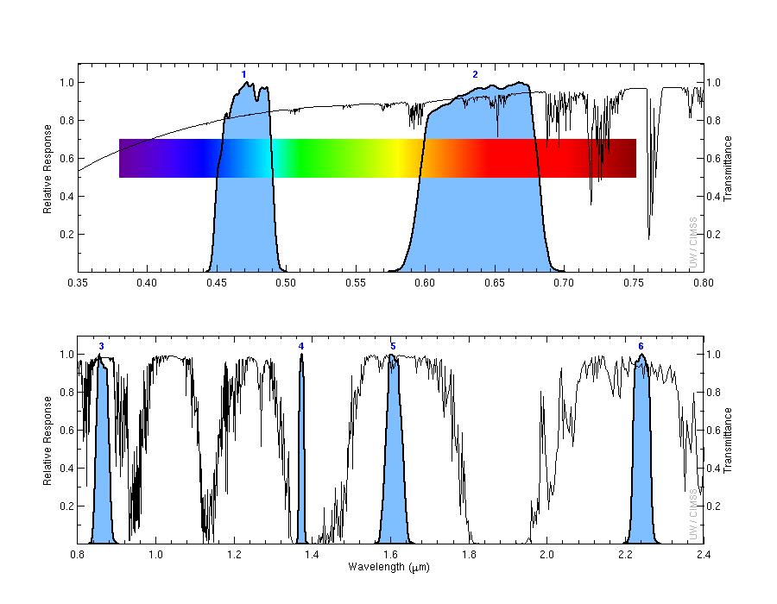
Very strong absorption by water vapor in the “cirrus” band with a very narrow spectral width compared to other visible bands.
1
2
Transmittance
0.47 μm
0.64 μm
3
4
5
6
Transmittance
0.86 μm
1.38 μm
1.61 μm
2.2 μm
Notes:
Visible and near-infrared imagery relies on reflected solar radiation to create a signal. This chart shows similar information to the previous slide. Band number is shown across the top. The Roy G Biv visible spectrum is shown too - do you see why they're nicknames the blue and red bands? The blue regions - the spectral response function - shows where information is detected for each channel. The black line is transmittance through the atmosphere - note how it decreases across the 'blue band', band 1, because atmospheric scattering increases. Band 4, at 1.38 micrometers, is special among these 6 bands because it occupies a region with strong absorption (by water vapor). As you'll see, that means it has a much different look than the other bands in the visible and near-infrared part of the spectrum.

Slide 4
Why use the “Cirrus” Band
2.0-km, spatial resolution.
Excellent for revealing features such as:
Daytime high, thin cirrus under most circumstances.
Highly reflecting blowing dust.
Can be used in concert with visible imagery to distinguish between low and high clouds.
Information from 1.37 μm can be very helpful in derived products that assess aerosols, clear sky masks, upper level smoke and ash plumes.
Notes:
The 1.37μm band (a near-infrared or “reflective” band), occupies a region in the electromagnetic spectrum where very strong absorption of water vapor occurs. This often leads to excellent daytime sensitivity to high, very thin cirrus specially in warm and moist atmospheres, but does not routinely sense lower troposphere as a result. Besides being used as a stand alone band for major critical decision making in areas relating to tin cirrus and blowing dust, the “cirrus” band is often used in concert with visible imagery to distinguish low clouds from high clods as well.

Slide 5
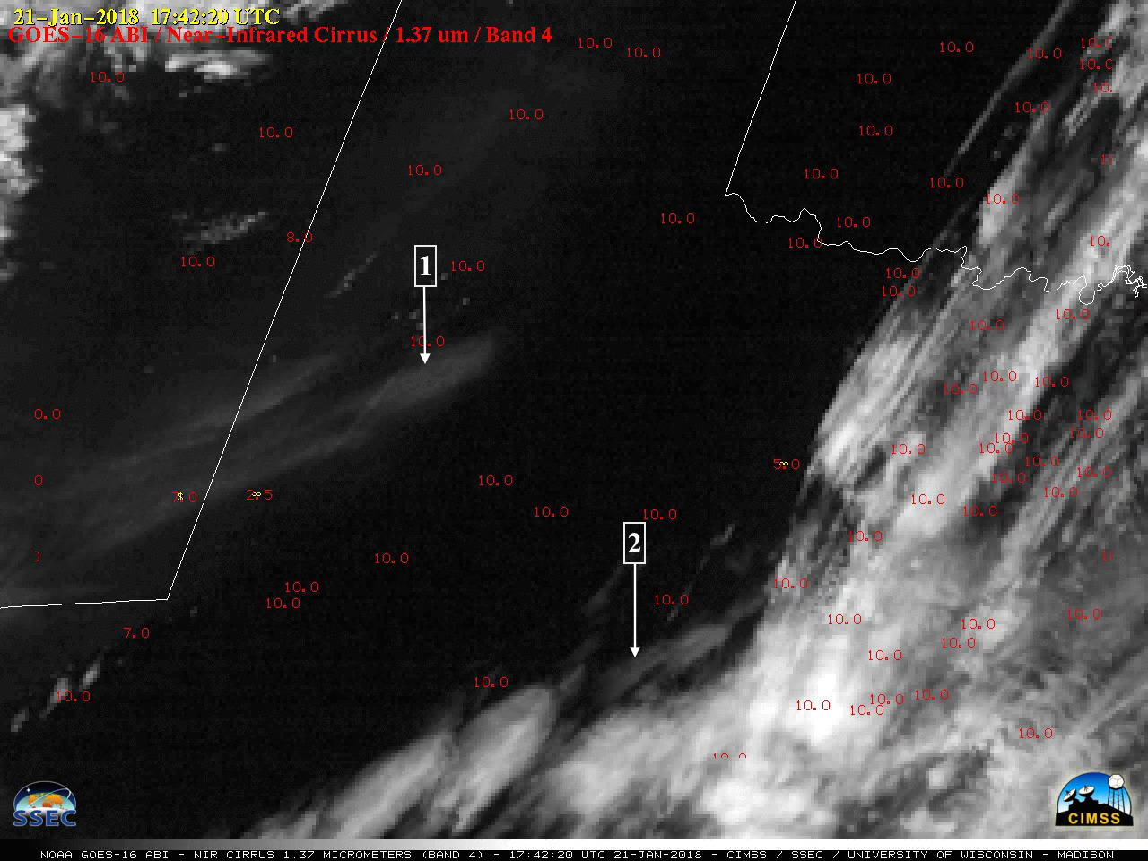
The 1.37 μm can be used to detect airborne dust.
Notes:
This example shows the Texas and Oklahoma airborne dust that occurred on January- 21st,2018 at 17:42UTC as seen on the GOES-16 1.37µm “cirrus” band.
Airborne particles that are effective scatters of light such as cirrus ice crystals, volcanic ash, sand, haze or dust under most circumstances can easily be apparent in the “cirrus” band.
1: Airborne dust, easily identifiable due to effective scattering of light at 1.37µm.
2: Thin cirrus, easily identifiable due to high absorption of water vapor in the lower troposphere.

Slide 6
Why use the Cirrus Band
2.0-km spatial resolution.
Most sensitive to high, very thin cirrus amongst all the ABI bands.
Can easily identify light scattering airborne particles such as:
High cirrus ice crystals
Volcanic ash
Sand
Haze
Dust
Information from 1.37 μm is critical for multiple aerosols, clear sky mask and cloud type products.
Notes:
A summary of what you’ve just learned.

Slide 7
Thank you
For more information visit www.goes-r.gov --
or find your favorite social media link below
www.facebook.com/GOESRsatellite
www.youtube.com/user/NOAASatellites
twitter.com/NOAASatellites
www.flickr.com/photos/noaasatellites
Notes:
There are places online that you can find. Here as some Social Media contacts as of 2018.

