Slide 1
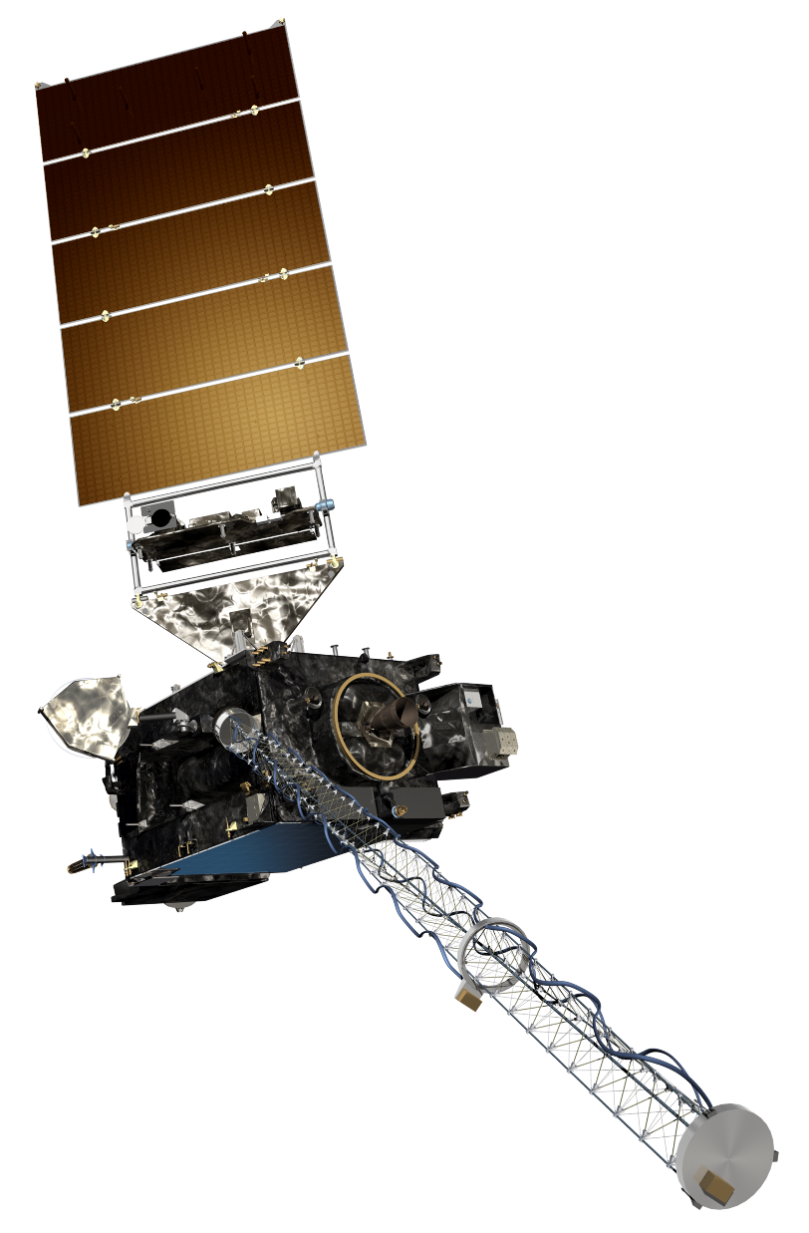
The GOES-R Series:
Welcome to GOES-R:
The 0.86 μm “Veggie” Band
Scott Lindstrom
UW Madison CIMSS
with Kaba Bah, Margaret Mooney, Kathy Strabala, Scott Bachmeier, and more!
SHyMet Introductory Course
Notes:
This is the SHyMet course on the Advanced Baseline Imager (the ABI), one of two sensors on GOES-R that measures the Earth's atmosphere (the Geostationary Lightning Mapper is the second). This course has been created with funding from the GOES-R Program and it should show you uses for the 16 channels on ABI. Contributors to this training are listed on this slide.

Slide 2
ABI: Bands 1-6 (Visible / NearIR)
ABI Band | Wavelength (µm) | Wavelength range (µm) | Sub-point pixel spacing (km) | Descriptive Name
1 | 0.47 | 0.45 - 0.49 | 1 | “Blue”
2 | 0.64 | 0.60 - 0.68 | 0.5 | “Red”
3 | 0.864 | 0.847 - 0.882 | 1 | “Veggie”
4 | 1.373 | 1.366 - 1.380 | 2 | “Cirrus”
5 | 1.61 | 1.59 - 1.63 | 1 | “Snow/Ice”
6 | 2.24 | 2.22 -2.27 | 2 | “Cloud Particle Size”
Six visible or near visible bands on ABI
(there was only one on heritage imager)
Notes:
This table is based on Schmit et al, 2017. (References are listed at the end of this training) Band numbers are shown (you can also call them channels), as well as the central wavelength, the wavelength range, the pixel resolution at the satellite sub-point (That is, nadir), and the nickname. The green circles are around bands5 1, 3 and 5, which bands have 1-km resolution at the sub-satellite point. The highest-resolution band, band 2, the 0.64 micrometer band (the so-called “Red Visible”) has half-kilometer resolution at the sub-satellite point. This is also the band that was on earlier GOES instruments.
You might be asking: WHY are these wavelengths chosen for band placement? Are they random? No! As you'll see next, there's a reason.

Slide 3
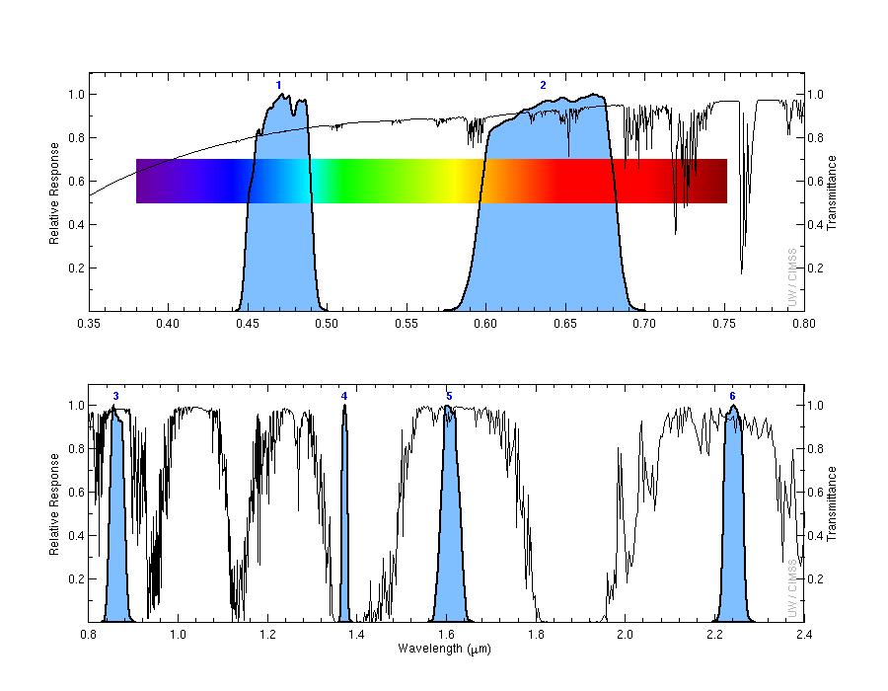
Transmittance is very strong in the “veggie” Band with a very narrow spectral width compared to the Red band.
1
2
Transmittance
0.47 μm
0.64 μm
3
4
5
6
Transmittance
0.86 μm
1.38 μm
1.61 μm
2.2 μm
Notes:
Visible and near-infrared imagery relies on reflected solar radiation to create a signal. This chart shows similar information to the previous slide. Band number is shown across the top. The Roy G Biv visible spectrum is shown too - do you see why they're nicknames the blue and red bands? The blue regions - the spectral response function - shows where information is detected for each channel. The black line is transmittance through the atmosphere - note how it decreases across the 'blue band', band 1, because atmospheric scattering increases. Band 4, at 1.38 micrometers, is special among these 6 bands because it occupies a region with strong absorption (by water vapor). As you'll see, that means it has a much different look than the other bands in the visible and near-infrared part of the spectrum.

Slide 4
Why use the “Veggie” Band
1.0-km, spatial resolution.
Can be used to identify day time burn scars, flash floods, mud slides, clouds, fog and aerosols and even forest regrowth patterns.
Excellent for revealing features such as:
Analyzing areal extent of flooding.
Detecting wildfire burn scars.
Information from 0.86 μm can be very helpful in derived products that assess land characteristics relating to fire, flood and vegetation patterns.
0.86 μm data are used in ‘True Color’ imagery for generating the “green” band.
Notes:
The 0.86μm band (a near-infrared or “reflective” band), highly reflects vegetated surfaces. This leads to a huge reflectance contrast between vegetated and non-vegetated surfaces. This contrast can then be leveraged to identify daytime surface features such as burn scars, flash floods and mudslides. Besides being used as a stand along band for major critical decision making, the “veggie” band is also critical in simulating the “green” band in ABI “True color” imagery for both the natural and enhanced versions.

Slide 5
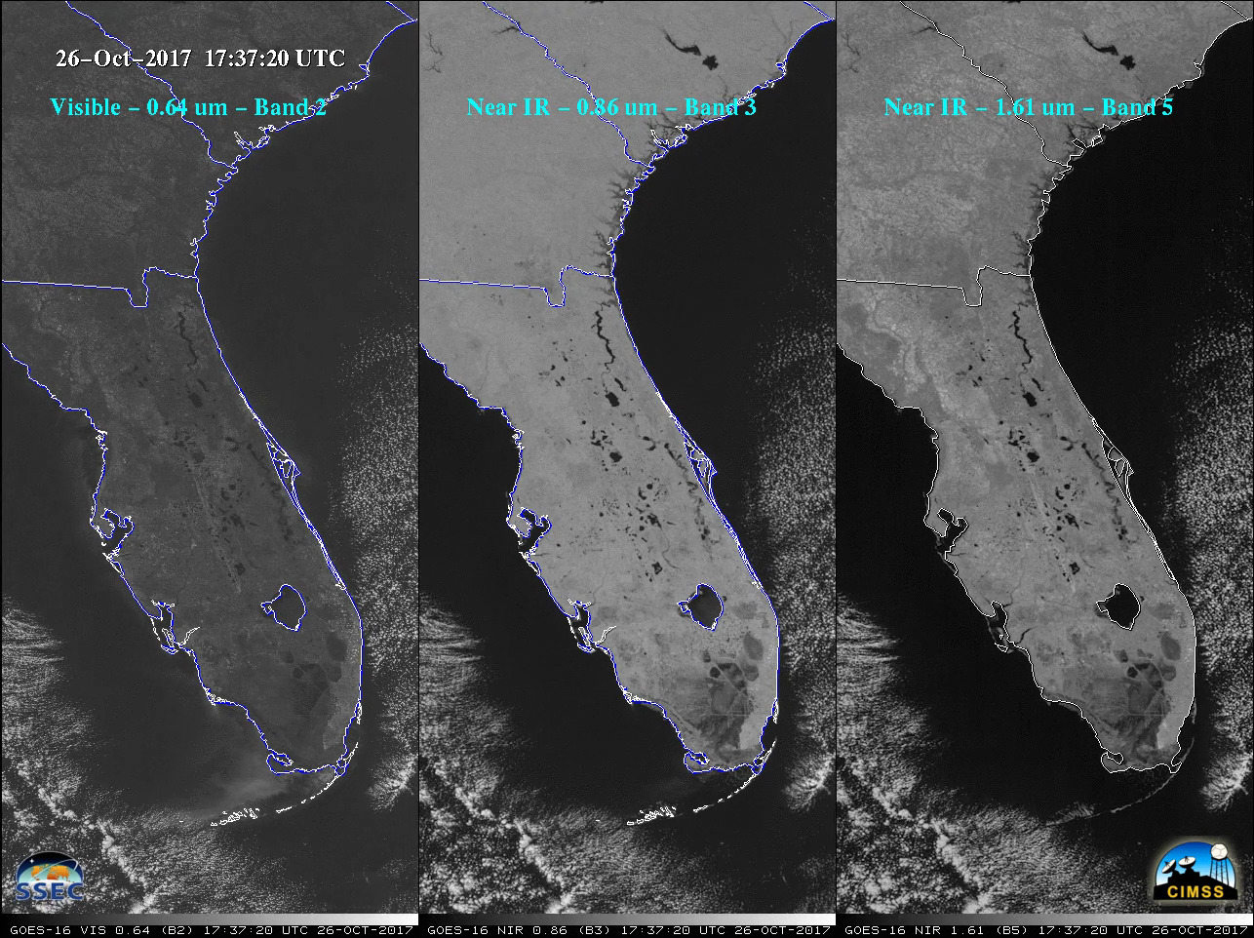
The 0.86 μm can be used to detect areal extent of flooding.
Notes:
This example shows comparison between GOES-16 “Red” Visible (0.64 µm), Near-Infrared “Vegetation” (0.86 µm) and Near-Infrared “Snow/Ice” (1.61 µm) images. Wet ground, rivers, lakes and the oceans appears dark at 0.86 µm and 1.61 µm. This is because water is a strong absorber of radiation at there wavelength. Hence, this makes those two GOES-16 ABI spectral bands useful for identifying areas of flooding.

Slide 6
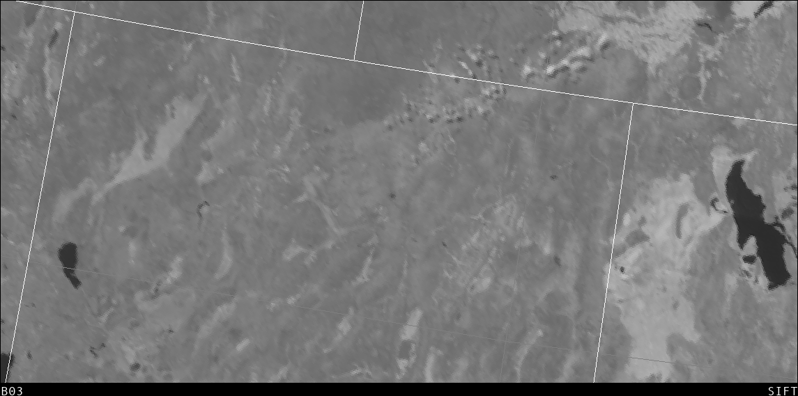
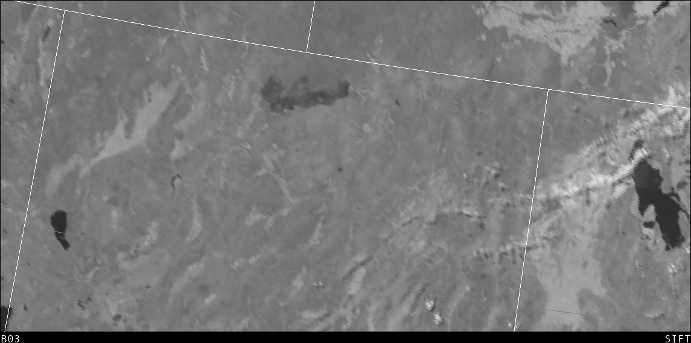
Wild fire burnt scars apparent at 0.86 μm
4th July 2018
11th July 2018
Notes:
This example shows the development of a pronounced burn scar (circled) across northern Nevada during a 7-day period observed on the same “veggie” band (0.86 µm). The top image is from 4th July 2018 at 18:47UTC while the bottom image is from 11th July 2018 at 18:47UTC.

Slide 7
“Veggie” Band is critical for ABI True Color
Notes:
AWIPS includes simulated True Color imagery, and the ‘Veggie Band’ is a critical component in simulating the green, along with the ‘blue Band’ – at 0.47 µm, and the “Red Band” at 0.64 µm’.

Slide 8
Why use the Veggie Band
1.0-km spatial resolution.
Most sensitive to vegetation amongst all the ABI bands.
Can better reveal land characters such as”
Areal extent of flooding
Burnt scars
Forest regrowth patterns.
Information from 0.86 μm is critical for multiple aerosols and surface Baseline Products.
The 0.86 μm is also very critical for calculating ABI Normalized Difference Vegetation Index (NDVI) and for simulating the “green” band for “True color” imagery.
Notes:
A summary of what you’ve just learned.

Slide 9
Thank you
For more information visit www.goes-r.gov --
or find your favorite social media link below
www.facebook.com/GOESRsatellite
www.youtube.com/user/NOAASatellites
twitter.com/NOAASatellites
www.flickr.com/photos/noaasatellites
Notes:
There are places online that you can find. Here as some Social Media contacts as of 2018.

