Slide 1

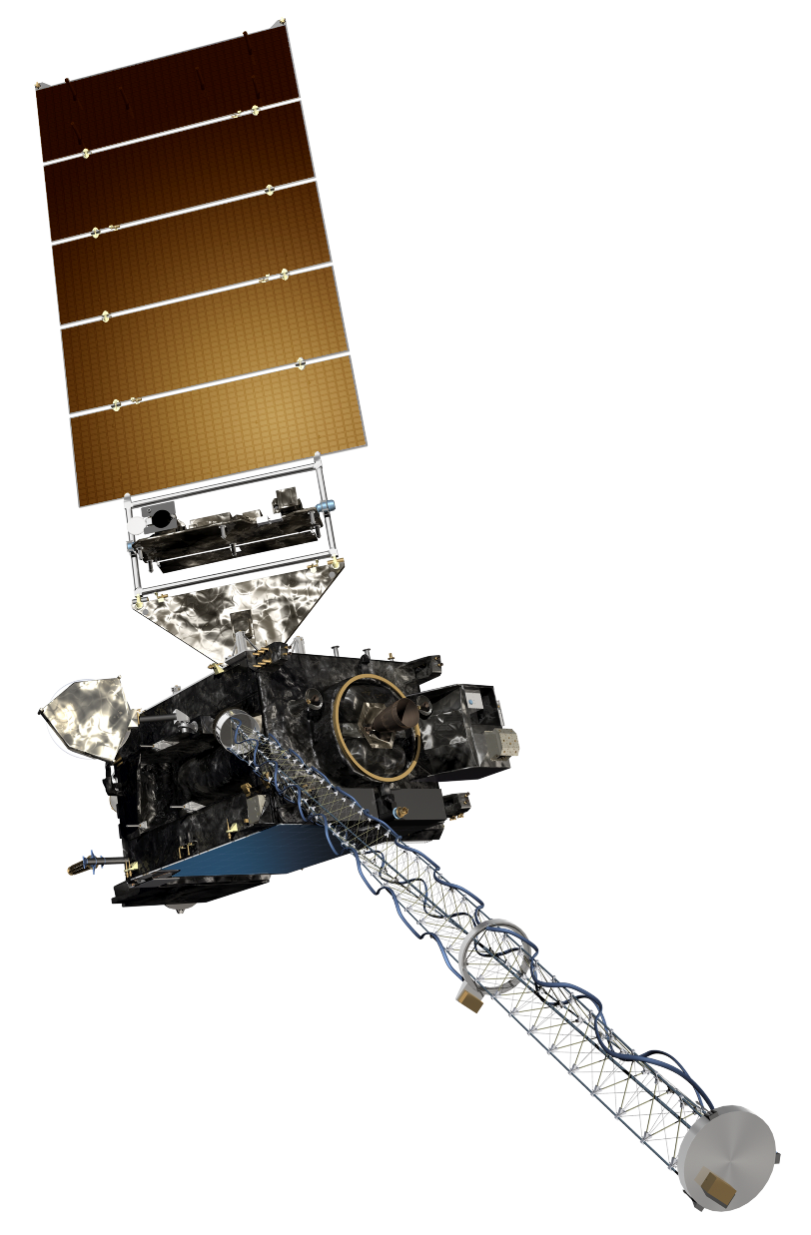
The GOES-R Series:
Welcome to GOES-R:
The 0.47 μm Blue Band
Scott Lindstrom
UW Madison CIMSS
with Kaba Bah, Margaret Mooney, Kathy Strabala, Scott Bachmeier, and more!
SHyMet Introductory Course
Notes:
This is the SHyMet course on the Advanced Baseline Imager (the ABI), one of two sensors on GOES-R that measures the Earth's atmosphere (the Geostationary Lightning Mapper is the second). This course has been created with funding from the GOES-R Program and it should show you uses for the 16 channels on ABI. Contributors to this training are listed oin this slide.

Slide 2
ABI: Bands 1-6 (Visible / NearIR)
ABI Band | Wavelength (µm) | Wavelength range (µm) | Sub-point pixel spacing (km) | Descriptive Name
1 | 0.47 | 0.45 - 0.49 | 1 | “Blue”
2 | 0.64 | 0.60 - 0.68 | 0.5 | “Red”
3 | 0.864 | 0.847 - 0.882 | 1 | “Veggie”
4 | 1.373 | 1.366 - 1.380 | 2 | “Cirrus”
5 | 1.61 | 1.59 - 1.63 | 1 | “Snow/Ice”
6 | 2.24 | 2.22 -2.27 | 2 | “Cloud Particle Size”
Six visible or near visible bands on ABI
(there was only one on heritage imager)
Notes:
This table is based on Schmit et al, 2017. (References are listed at the end of this training) Band numbers are shown (you can also call them channels), as well as the central wavelength, the wavelength range, the pixel resolution at the satellite sub-point (That is, nadir), and the nickname. The green circles are around bands5 1, 3 and 5, which bands have 1-km resolution at the sub-satellite point. The highest-resolution band, band 2, the 0.64 micrometer band (the so-called “Red Visible”) has half-kilometer resolution at the sub-satellite point. This is also the band that was on earlier GOES instruments.
You might be asking: WHY are these wavelengths chosen for band placement? Are they random? No! As you'll see next, there's a reason.

Slide 3
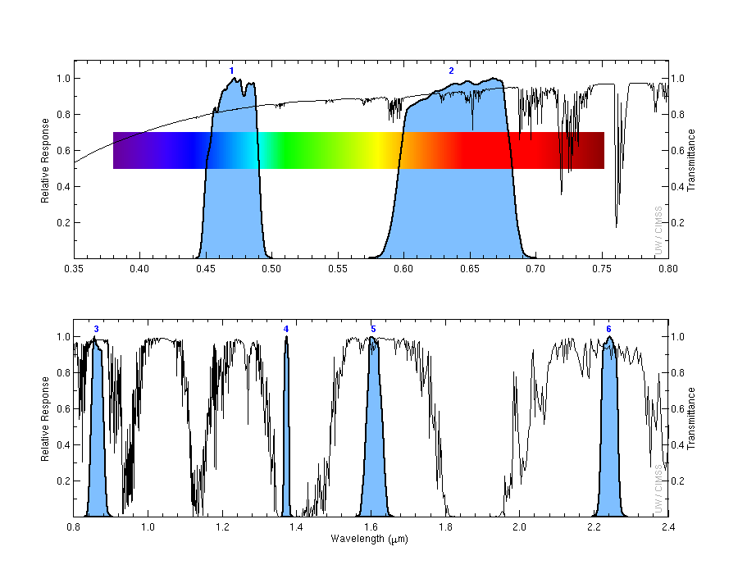
Transmittance is fairly strong in the Blue Band but not as strong as in the Red Band
1
2
Transmittance
0.47 μm
0.64 μm
3
4
5
6
Transmittance
0.86 μm
1.38 μm
1.61 μm
2.2 μm
Notes:
Visible and near-infrared imagery relies on reflected solar radiation to create a signal. This chart shows similar information to the previous slide. Band number is shown across the top. The Roy G Biv visible spectrum is shown too - do you see why they're nicknames the blue and red bands? The blue regions - the spectral response function - shows where information is detected for each channel. The black line is transmittance through the atmosphere - note how it decreases across the 'blue band', band 1, because atmospheric scattering increases. Band 4, at 1.38 micrometers, is special among these 6 bands because it occupies a region with strong absorption (by water vapor). As you'll see, that means it has a much different look than the other bands in the visible and near-infrared part of the spectrum.

Slide 4
Why use the Blue Band
1-km Resolution
Can better reveal features for which scattering is important
  Smoke
  Aerosols/Haze
Information from 0.47 μm is used in Baseline Aerosol Products
0.47 μm data are used in ‘True Color’ imagery.
Notes:
The 0.47 µm, or “Blue” visible band, senses radiation in a part of the electromagnetic spectrum where scattering is important. This channel is therefore useful for monitoring aerosols. The 0.47 µm band provides continuous daytime observations of dust, haze, smoke and clouds and it is a key component of GOES-R Baseline Aerosol Products. It will be part of the Baseline Snow Products as well when they are produced.
Users of the ‘Blue Band’ who are interested in detecting aerosols should be mindful that the scattering angle affects dust and smoke signals: smoke and dust are more effective forward scatterers than backward scatterers. Thus, smoke and dust signals are more apparent when the sun is low in the sky vs. high in the sky.
The Blue band in combination with a “Green” band simulated from the “Vegetation” band (0.86 µm) and the “Red” band (0.64 µm), provides approximate “natural true color” imagery of the Earth.

Slide 5
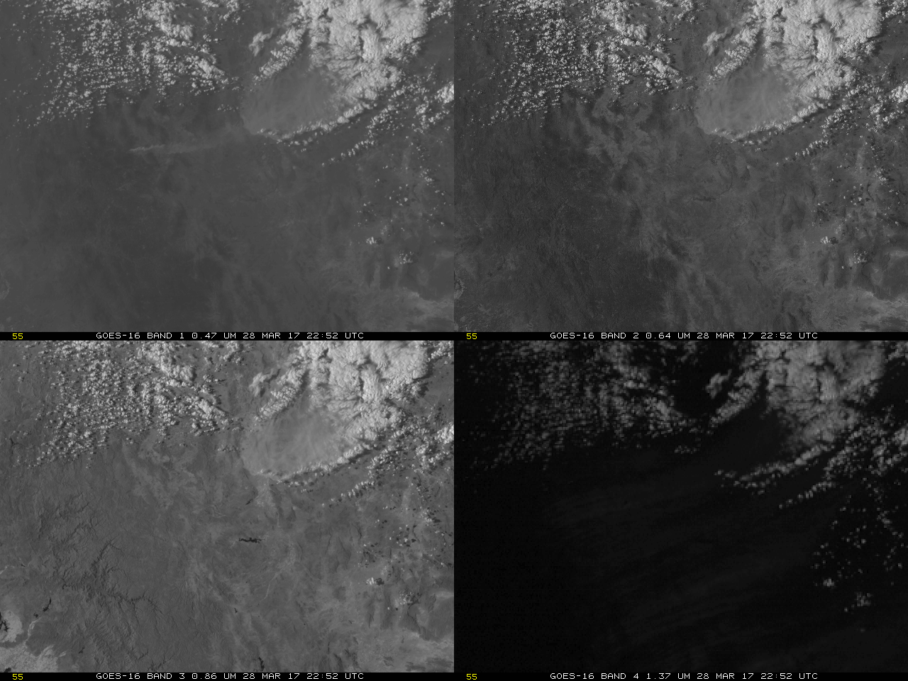
Smoke can be more apparent at 0.47 μm – because of scattering
0.47 μm
0.64 μm
0.86 μm
1.38 μm
1.38 μm
Notes:
This example shows smoke more apparent in the blue band over northern Mexico than in the higher-resolution red band or in the ‘Veggie Band’. The ‘Cirrus Channel’ is also shown.

Slide 6
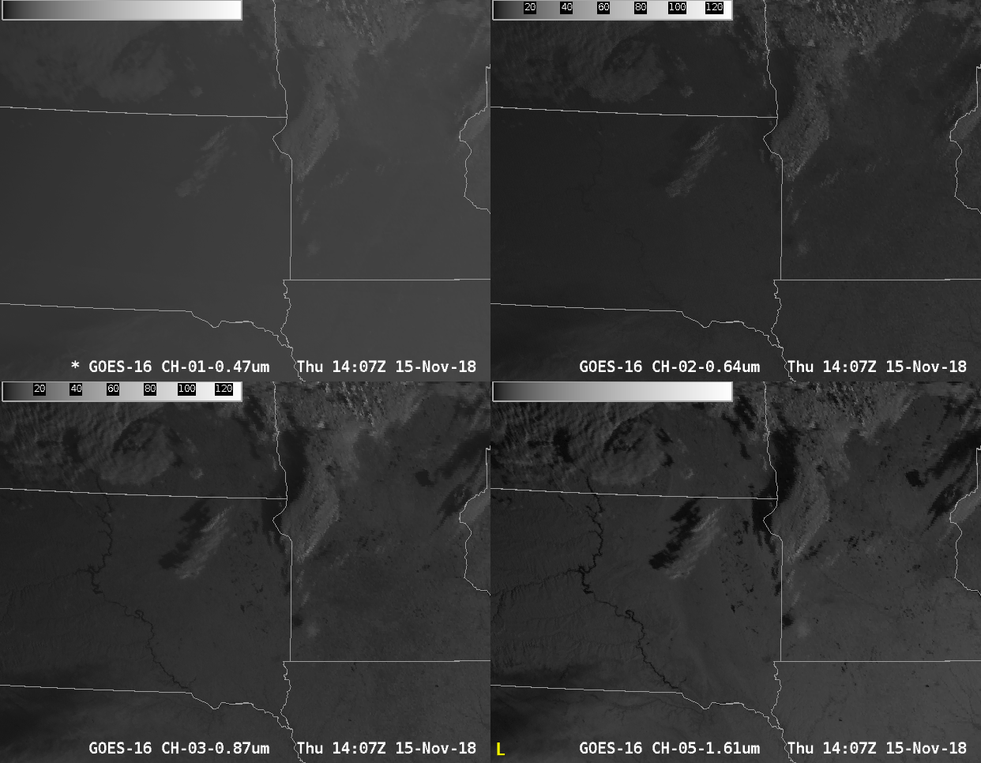
More scattering is apparent in 0.47 compared to other bands
Notes:
The blue band has a hazy and diffuse look to it compared to other bands, because of increased scattering. Increased scattering also means that shadows are less distinct. Consider this early morning shot over the northern Plains. The 1.6 micrometer imagery includes a very distinct shadow next to a high cloud – but that shadow becomes more and more nebulous at shorter and shorter wavelengths: 0.86, 0.64 and 0.47 micrometers. Why? Because scattering at shorter wavelengths is adding light to the region in shadow.

Slide 7
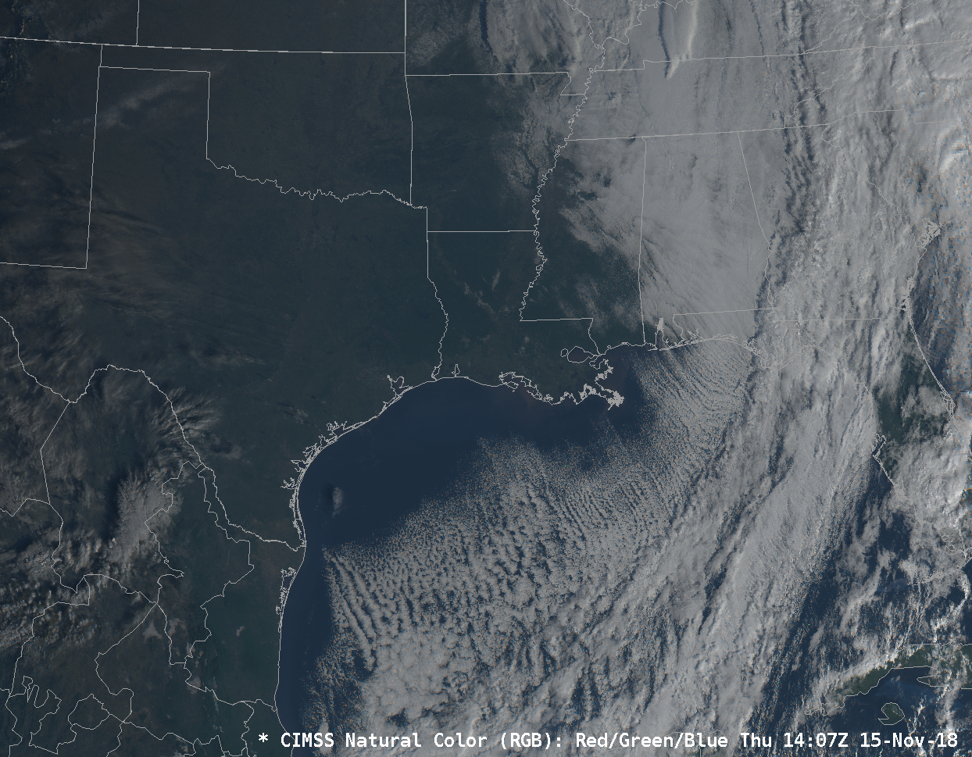
Blue Band is necessary for True Color
Notes:
AWIPS includes simulated True Color imagery, and the ‘Blue Band’ is a necessary component of that, along with the ‘Red Band’ – at 0.64 micrometers, and a simulated green band that considers output from the ‘Veggie Band’. This RGB product does not have very sharp colors because Rayleigh Scattering that is naturally present in the atmosphere reduces the lucidity of the image.

Slide 8
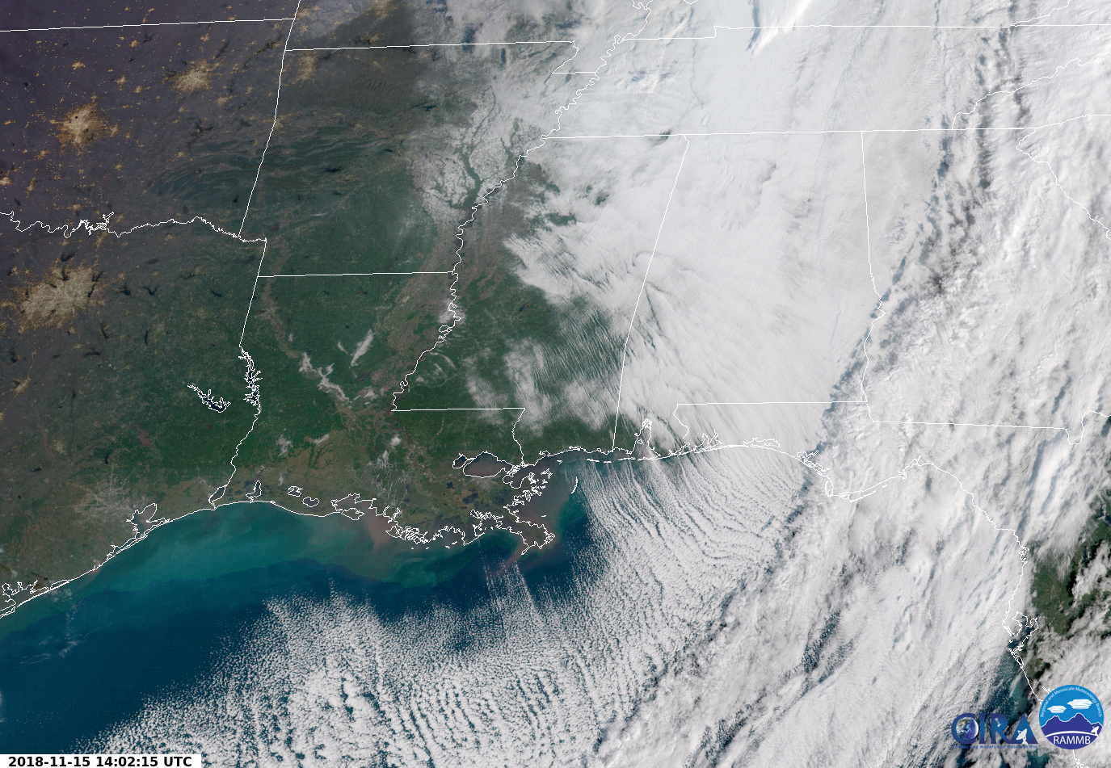
Blue Band is necessary for True Color
Notes:
There are products that correct for the effects of Rayleigh scattering to produce more vivid imagery, such as this GeoColor image. The Blue Band is a vital piece of this product.

Slide 9
Why use the Blue Band
1-km Resolution
Can better reveal features for which scattering is important
  Smoke
  Aerosols/Haze
Information from 0.47 μm is used in Baseline Aerosol Products
Scattering causes the imagery to look hazy and diffuse compared to other Bands.
0.47 μm data are used in ‘True Color’ imagery.
Notes:
A summary of what you’ve just learned.

Slide 10

Thank you
For more information visit www.goes-r.gov --
or find your favorite social media link below
www.facebook.com/GOESRsatellite
www.youtube.com/user/NOAASatellites
twitter.com/NOAASatellites
www.flickr.com/photos/noaasatellites
Notes:
There are places online that you can find. Here as some Social Media contacts as of 2018.

