Slide 1
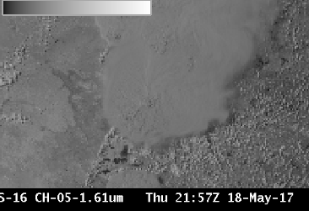
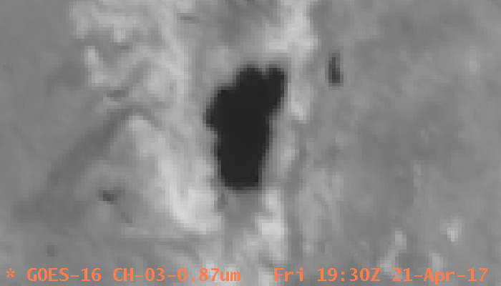
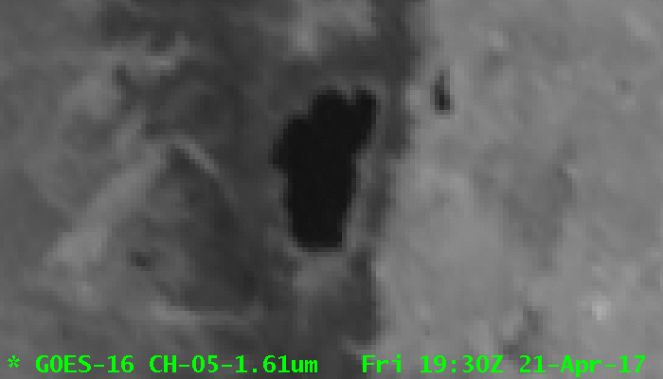
ABI Band 5 (1.61 μm)
Quick Guide
Why is the Snow/Ice Band Important?
The Snow/Ice band takes advantage of the difference between the refraction components of water and ice at 1.61 μm. Liquid water clouds are bright in this channel; ice clouds are darker because ice absorbs (rather than reflects) radiation at 1.61 μm. Thus you can infer cloud phase: compare at right the darker region of the cirrus anvil to the more reflective water-based cumulus clouds to the right of the storm. Land/water contrast is great at 1.61 μm (lakes are readily apparent in the image) and shadows can be particularly striking. Fires can also be detected at night using this band
ABI Snow/Ice Channel uses
ABI Band | Central Wavelength (µm) | Use | Phenomena : Brightness | Resolution
5 | 1.61 µm | Phase Discrimination | Water Clouds: Bright | 1 km
 |  |  | Ice Clouds: Dark
5 | 1.61 µm | Night time Fire Detection | Night Fires : Bright | 1 km
Impact on Operations
Limitations
Primary Application: This band identifies regions of ice/ snow, as at right (centered on Lake Tahoe (A)): snow (B, for example) is bright in the Veggie Band (0.86 μm) but dark in the Snow/Ice Band (1.61 μm).
0.86 μm
Daytime application: The 1.61 µm band detects reflected visible solar radiation.
B
A
1.61 μm
B
A
Nighttime application: Fires can be detected using the 1.61 µm channel at night. This is especially true of very hot fires. The default enhancement in AWIPS must be changed to view fires at night. Care must also be taken to monitor clouds: cloud motion or development can block the night-time view of the fire.
Application: Fires emit radiation with a wavelength of 1.61 µm, so this band is useful to detect very hot fires at night, especially because spatial resolution is 1 km. The Snow/Ice Band is a component of some nighttime fire detection RGBs.
Application: The Snow/Ice Channel can be used to discriminate water-based clouds from a snow-covered surface.
Contributors: Scott Lindstrom, Tim Schmit, Jordan Gerth, UW-Madison CIMSS/NOAA August 2017

Slide 2
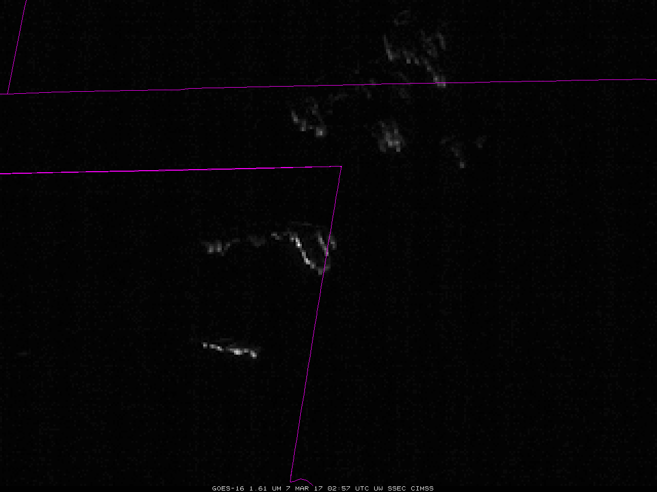
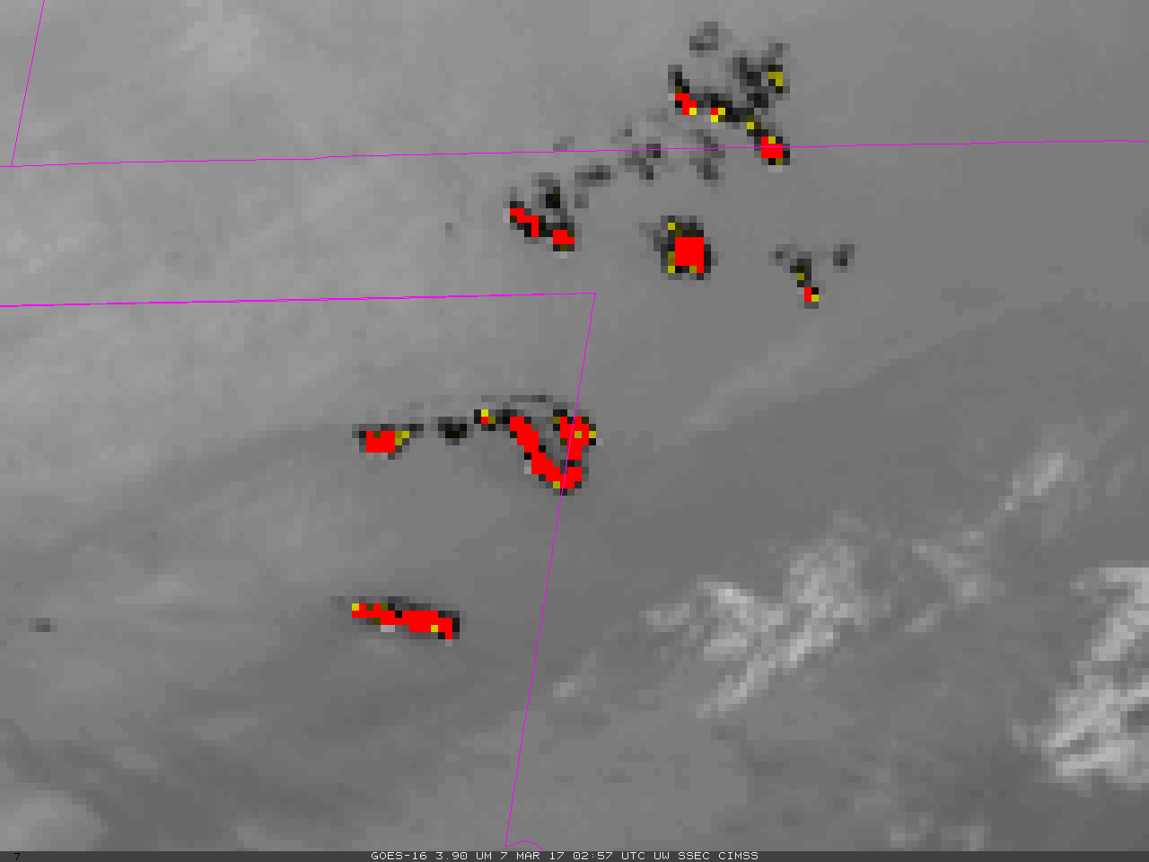
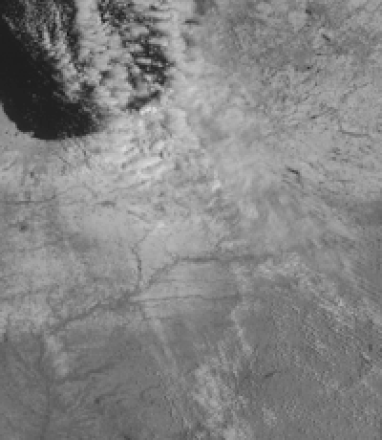
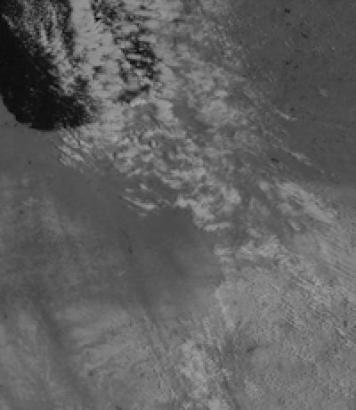
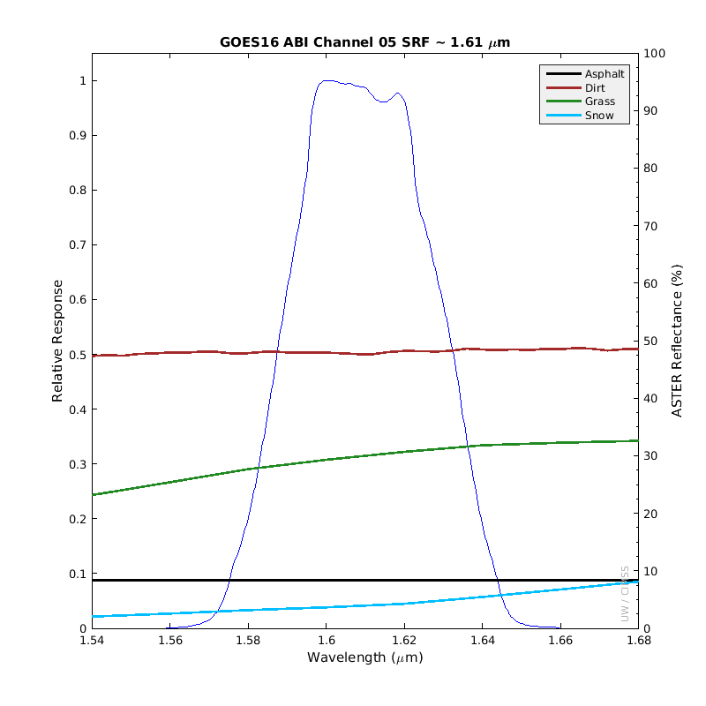
ABI Band 5 (1.61 μm)
Snow/Ice Band
Image Interpretation
Hot fires emit 1.61 µm radiation that shows up well against the black background of night
Inset shows the 3.9 µm image for the same time
Use the 1.61 μm to distinguish clouds made of water from underlying snow
1
2
1
3
0.64 μm
1
3
2
3
Moist Airmass
over Southeast
1.61 μm
1.61 μm
3.9 μm
GOES-16 ‘Snow/Ice Channel’ (1.61 μm) at 02:57 UTC, 07 March 2017 (Inset: 3.9 μm color-enhanced to show Hot Spots). The default 1.61 μm enhancement usually does not show fires – it must be changed.
3
Resources
BAMS Article
Schmit et al. 2017
GOES-R.GOV
Band 5 Fact Sheet
CIMSS Blog Entries on GOES-16 Snow/Ice Channel
Hyperlinks do not work in AWIPS but they do in VLab
The Spectral Response Function (SRF) for the Snow/Ice Channel is shown in blue at right. The colored lines show reflectance of different surfaces: Asphalt (black), Grass (green) Dirt (red) and Snow (cyan). Note in particular the low reflectance of snow. Water clouds are highly reflective in this wavelength range (not shown).

