Slide 1
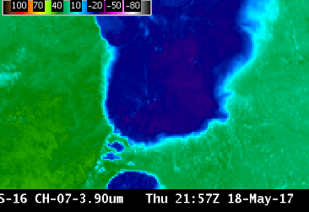
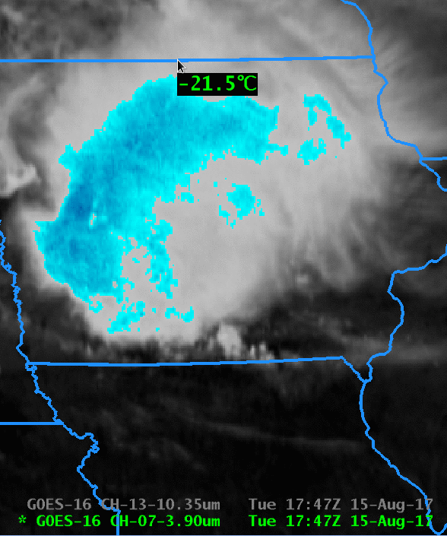
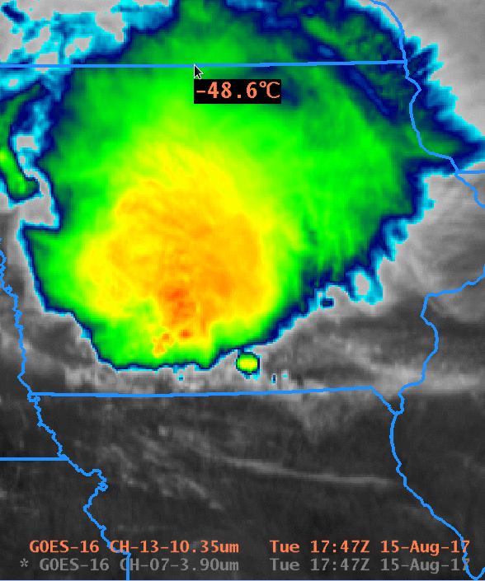
ABI Band 7 (3.9 μm)
Quick Guide
Why is the Shortwave Infrared Band Important?
The 3.9 μm band can be used to identify fog and low clouds at night, identify fire hot spots, detect volcanic ash, estimate sea-surface temperatures, and discriminate between ice crystal sizes during the day. Low-level atmospheric vector winds can be estimated with this band, and the band can be used to study urban heat islands. The 3.9 μm is unique among ABI bands because it senses both emitted terrestrial radiation as well as significant reflected solar radiation during the day.
The daytime imagery at left shows the warming at 3.9 μm that results from solar reflection. The same color enhancement is used for the 3.9 μm and 10.3 μm GOES-16 imagery.
3.9 μm
10.3 μm
Impact on Operations
Limitations
Primary Application: This infrared channel is used for fire detection; its short wavelength is more sensitive than longer wavelength infrared channels to the hottest part of the pixel.
Daytime: Solar reflectance adds to the detected 3.9 μm radiation. Compare 3.9 μm (above left) and 10.3 μm (above right) brightness temperatures at right: The 3.9 is much warmer.
Application: Small ice crystals reflect more solar 3.9 μm radiation than large crystals during daytime.
Application: Stratus clouds do not emit 3.9 µm radiation as a blackbody so the inferred temperature is colder than the temperature inferred from the 10.3 µm radiation (Stratus clouds emit 10.3 µm radiation as a blackbody). Thus, at night, stratus clouds are apparent in the brightness temperature difference.
Fire application: 2-km resolution means that very small fires can be overlooked.
Contributor: Scott Lindstrom, Tim Schmit, Jordan Gerth, UW-Madison CIMSS/NOAA September 2017

Slide 2
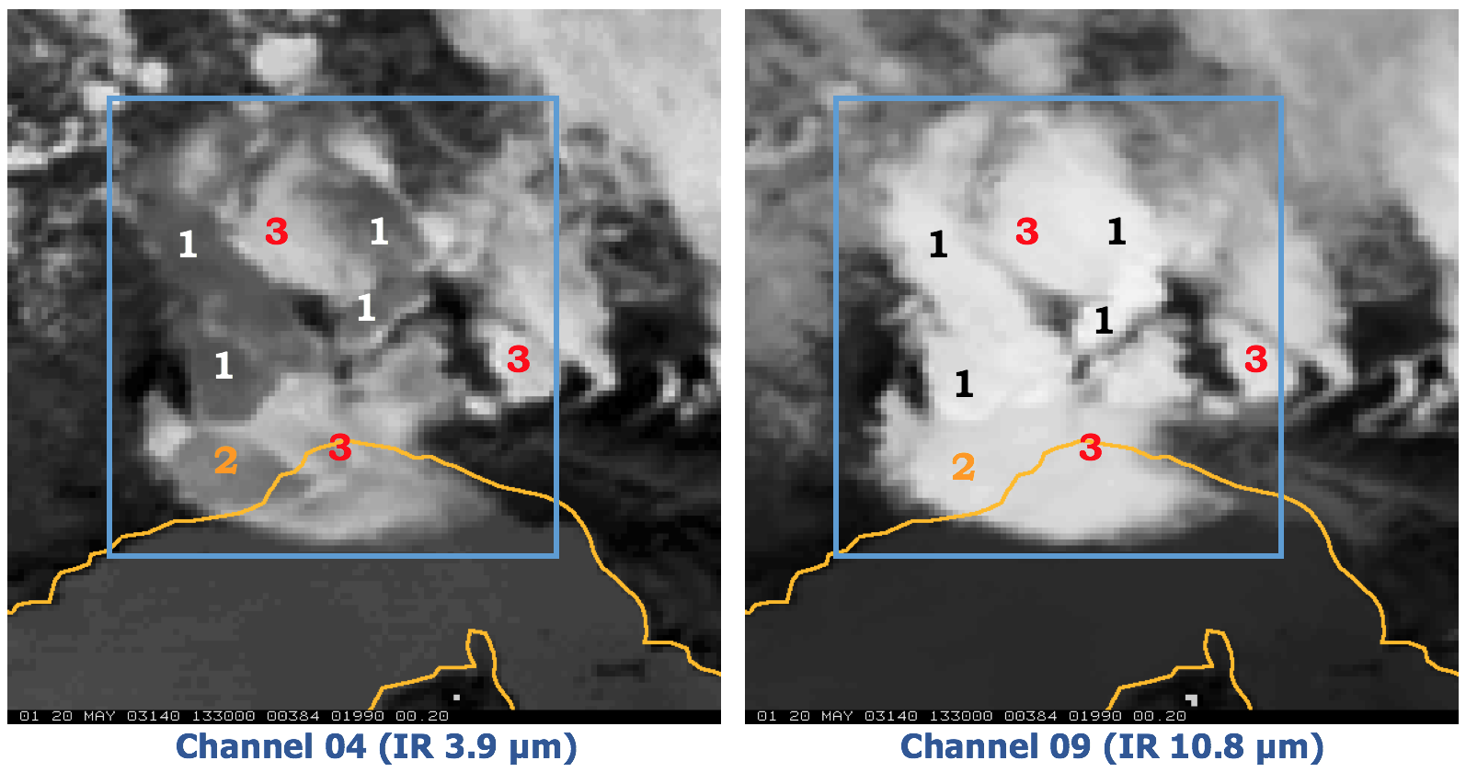
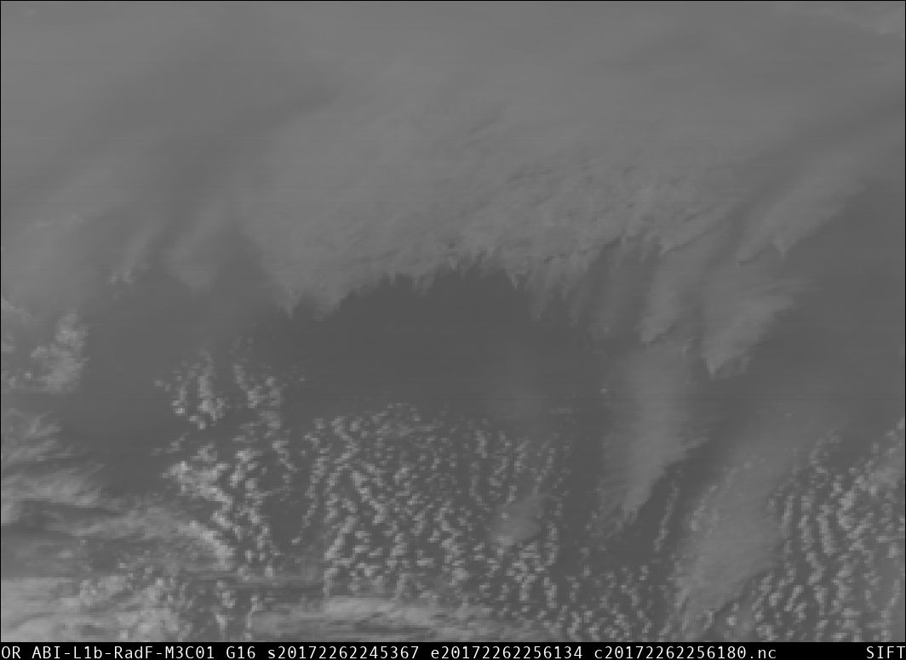
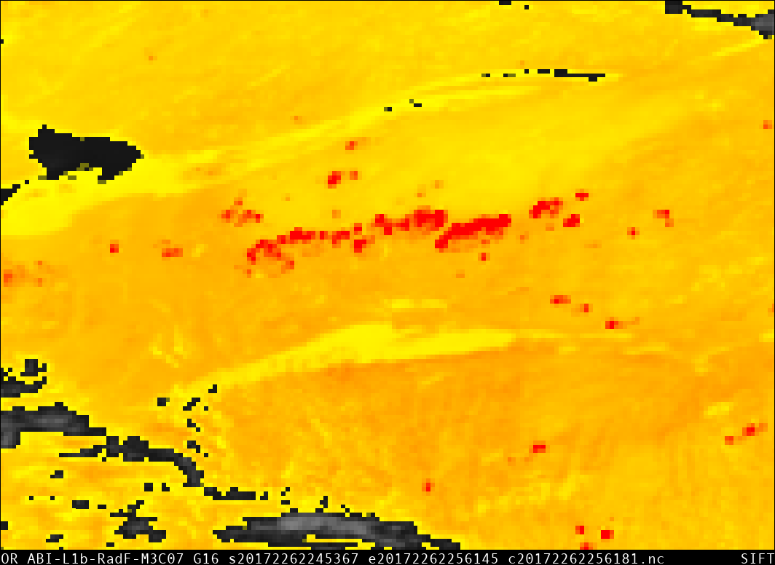
ABI Band 7 (3.9 μm)
Shortwave Infrared Band
Satellite Image Interpretation
Very small ice crystals reflect 3.9 μm solar radiation very effectively and are warmest in the 3.9 μm imagery
Small ice crystals also reflect 3.9 μm solar radiation, but not as well, and aren’t as warm
Large ice crystals do not reflect 3.9 μm solar radiation, and are cold.
1
2
3.9 μm
10.7 μm
GOES-12 3.9μm Brightness Temperatures (BTs) (Left) and 10.7 μm BTs. Ice Crystal Size at anvil top affects the amount of reflected solar radiation at 3.9 μm and consequently the BT, displayed as a greyscale, with whites cold and blacks hot. 10.7 μm BTs are less affected by Ice Particle Size. (Credit: Chad Gravelle, CIMSS/OPG)
3
GOES-16 3.9 μm imagery, bottom left, enhanced so that the black/ yellow transition occurs at 12 C and the yellow/red transition occurs at 30 C, shows numerous hot spots (in red) associated with fires. The ‘Blue Band’ (0.47 μm), at left, shows the plumes of smoke produced by the fires. (2245 UTC, 14 August 2017). The 3.9 μm band has the most bit depth of any ABI band, containing 14 bits. The range of Brightness Temperatures detected is -75 C to 140 C.
0.47 μm
Resources
BAMS Article
Schmit et al. 2017
GOES-R.GOV
Band 7 Fact Sheet
Animation of Fire Case at left
Blog Post on Fire Detection
Hyperlinks do not work in AWIPS but they do in VLab
3.9 μm

