Slide 1
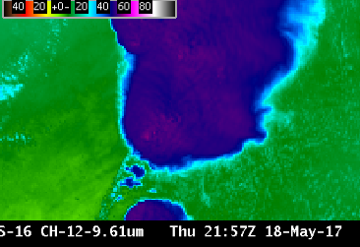
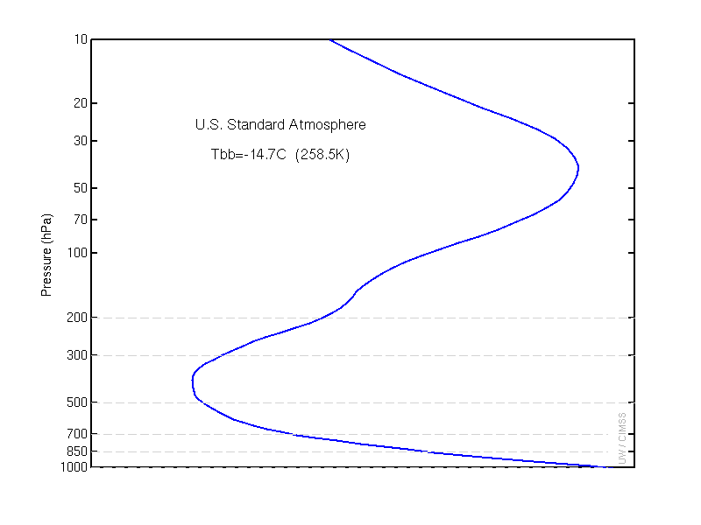
ABI Band 12 (9.6 μm)
Quick Guide
Why is the Ozone Band Important?
The 9.6 μm band gives information both day and night about the dynamics of the atmosphere near the tropopause. This band shows cooler temperatures than the clean window band because both ozone and water vapor absorb 9.6 μm atmospheric energy. The cooling effect is especially apparent at large zenith angles. This band alone cannot diagnose total column ozone: product generation using other bands will be necessary for that.
The clear-sky Weighting Function for this band, shown in right as the blue line, has peaks at the surface (a typical characteristic of bands that can view the surface) and in the stratosphere (where ozone is most common). Surface ozone cannot be detected by this channel because water vapor also absorbs atmospheric energy at 9.6 μm.
Impact on Operations
Limitations
Primary Application: The Ozone Band is used in RGBs (it is a component of the Airmass RGB Product, for example) and in derived products (such as Legacy Atmospheric Profiles).
Water vapor absorption occurs in this band, complicating the use of Band 12 (9.6 μm) because the horizontal distribution of ozone and water vapor varies across the globe. Brightness temperature will generally increase with less water vapor, less ozone, or with an increase in air temperature in the layer where water vapor or ozone occurs.
Contributors: Scott Lindstrom, Tim Schmit, Jordan Gerth, UW-Madison CIMSS/NOAA August 2017

Slide 2
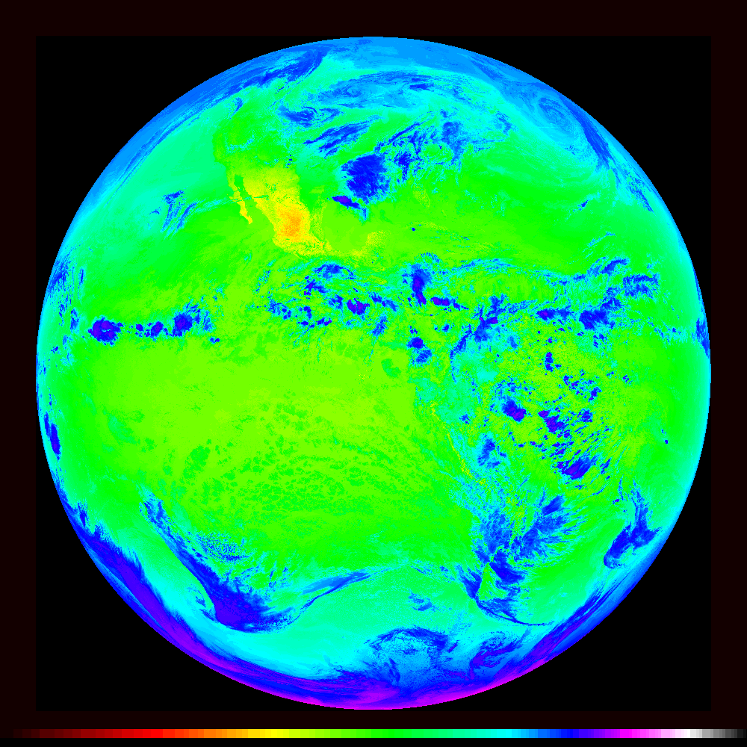
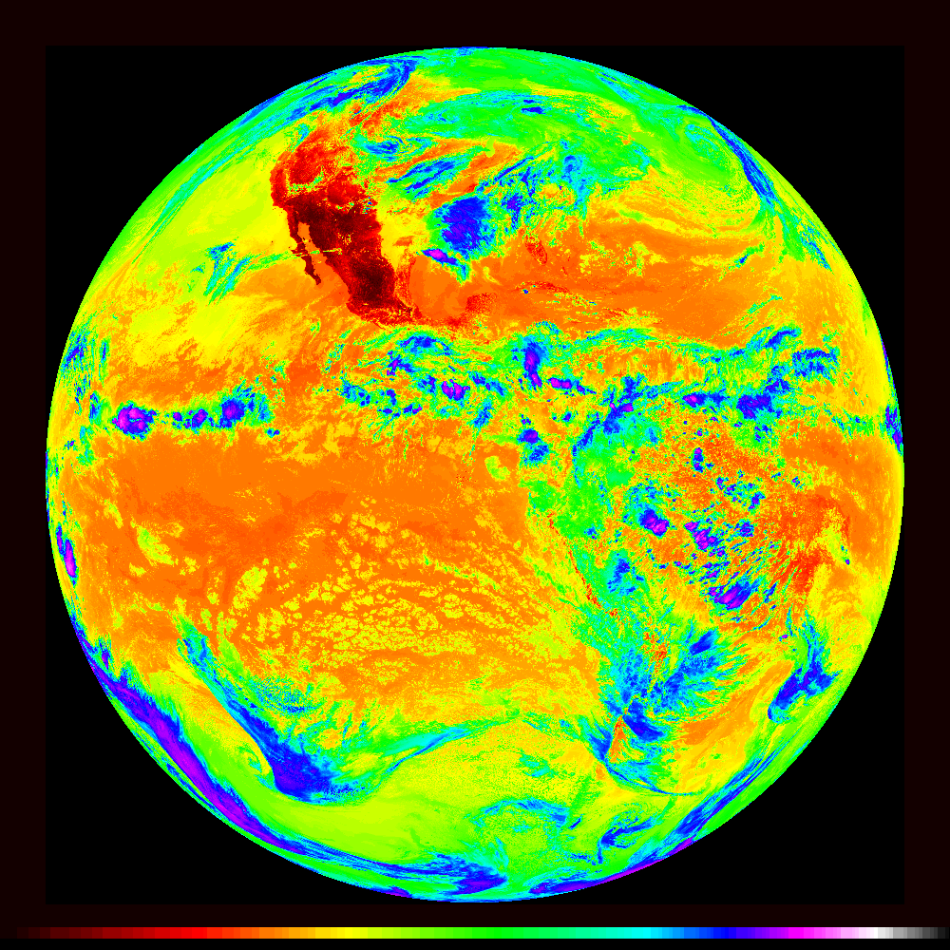
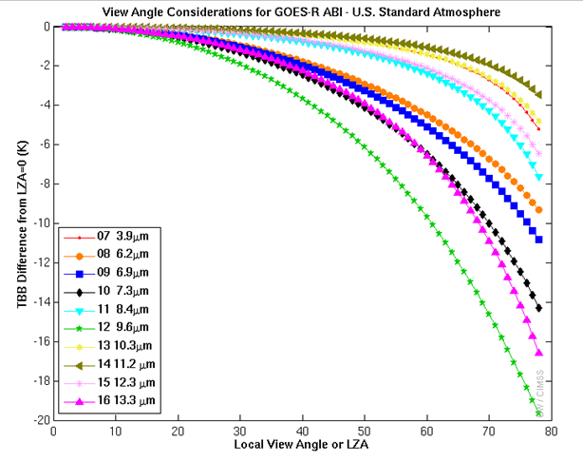
ABI Band 12 (9.6 μm)
Ozone Band
Satellite Image Interpretation
The Full-Disk Ozone shows cooling all around the edges.
Brightness Temperatures over deep convection are warmer (blue enhancement) than in the window channel (purple enhancement) because of absorption by ozone in the warmer stratosphere
Band 12 Brightness Temperatures outside of deep convection are cooler (green enhancement) than in the window channel (yellow/orange enhancement) because of absorption by tropospheric water vapor and by stratospheric ozone
Surface features can be discerned. The Ozone Channel is a Window Channel
9.6 μm
1
4
2
1
2
1
3
10.33 μm
4
2
1
1
3
3
4
Resources
BAMS Article
Schmit et al. 2017
GOES-R.GOV
Band 12 Fact Sheet
Quick Guide on Airmass RGB
Hyperlinks do not work in AWIPS but they do in VLab
The 9.6 μm Band (the green line at right) shows the most cooling as you move farther from the sub-satellite point (relative to nadir views) for any ABI IR band.

