Slide 1
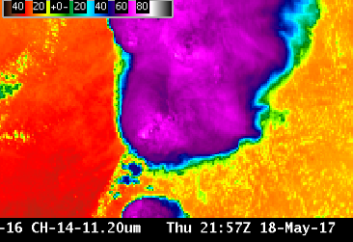
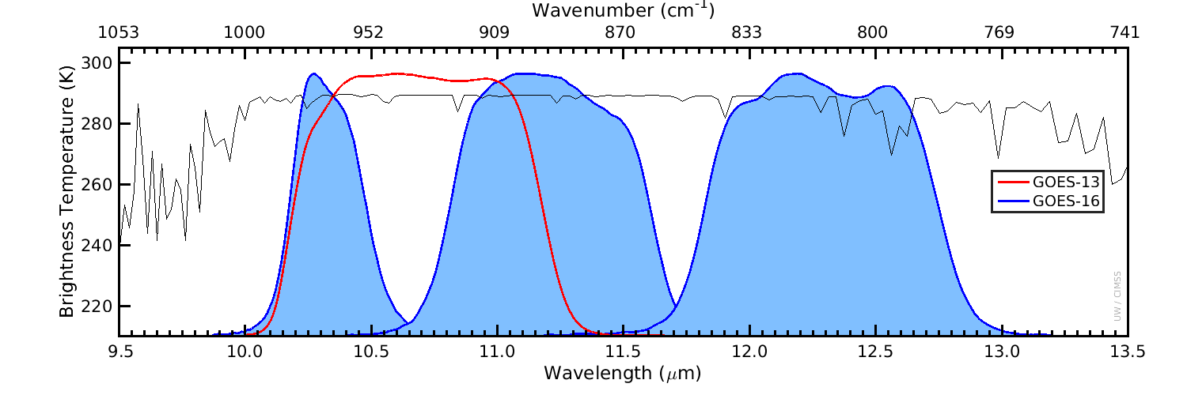
ABI Band 14 (11.2 μm)
Quick Guide
Why is the Infrared Longwave Window Band Important?
The infrared 11.2 μm band is a window channel; however, there is absorption of energy by water vapor at this wavelength. Brightness Temperatures (BTs) are affected by this absorption, and 11.2 μm BTs will be cooler than clean window (10.3 μm) BTs – by an amount that is a function of the amount of moisture in the atmosphere. This band has similarities to the legacy infrared channel at 10.7 μm.
Left: U.S. Standard Atmosphere Earth-emitted temperatures and spectral responses for ABI and GOES-13 Window Channels. The Legacy channel (10.7 μm) covers parts of the 10.3 μm and 11.2 μm bands on ABI (Figure: Mat Gunshor, CIMSS)
10.7 μm
10.3 μm
11.2 μm
12.3 μm
Impact on Operations
Limitations
Primary Application: The 11.2 μm channel is used in ways that are similar to the clean window (10.3 μm). However, there is more absorption of 11.2 μm energy – than of 10.3 μm energy – by water vapor; thus clear-sky brightness temperatures are more affected by water vapor in this channel than in the Clean Window Channel at 10.3 μm. Data from the 11.2 μm channel is used in many Baseline Products, such as Fire Detection, Volcanic Ash Detection, Derived Motion Wind Vectors, Legacy Atmospheric Profiles including Precipitable Water, Cloud Top Properties, Aerosol Detection and Land Surface Temperature.
This is not a “clean” window: Water vapor absorbs atmospheric energy at 11.2 μm; that energy is subsequently re-emitted from higher, cooler temperatures. Thus, surface or near-surface clear-sky brightness temperatures will be cooler than observed by an amount that is a function of the amount of moisture in the atmosphere. The amount of absorption (and cooling) is greater at 11.2 μm than at 10.3 μm, but less than that at 12.3 μm, the “Dirty” Longwave Window.
The 11.2 μm window has a similar spectral width to the Legacy GOES 10.7 μm window channel, but it is shifted to longer wavelengths as shown above.
Contributor: Scott Lindstrom, Tim Schmit, Jordan Gerth, UW-Madison CIMSS/NOAA August 2017

Slide 2
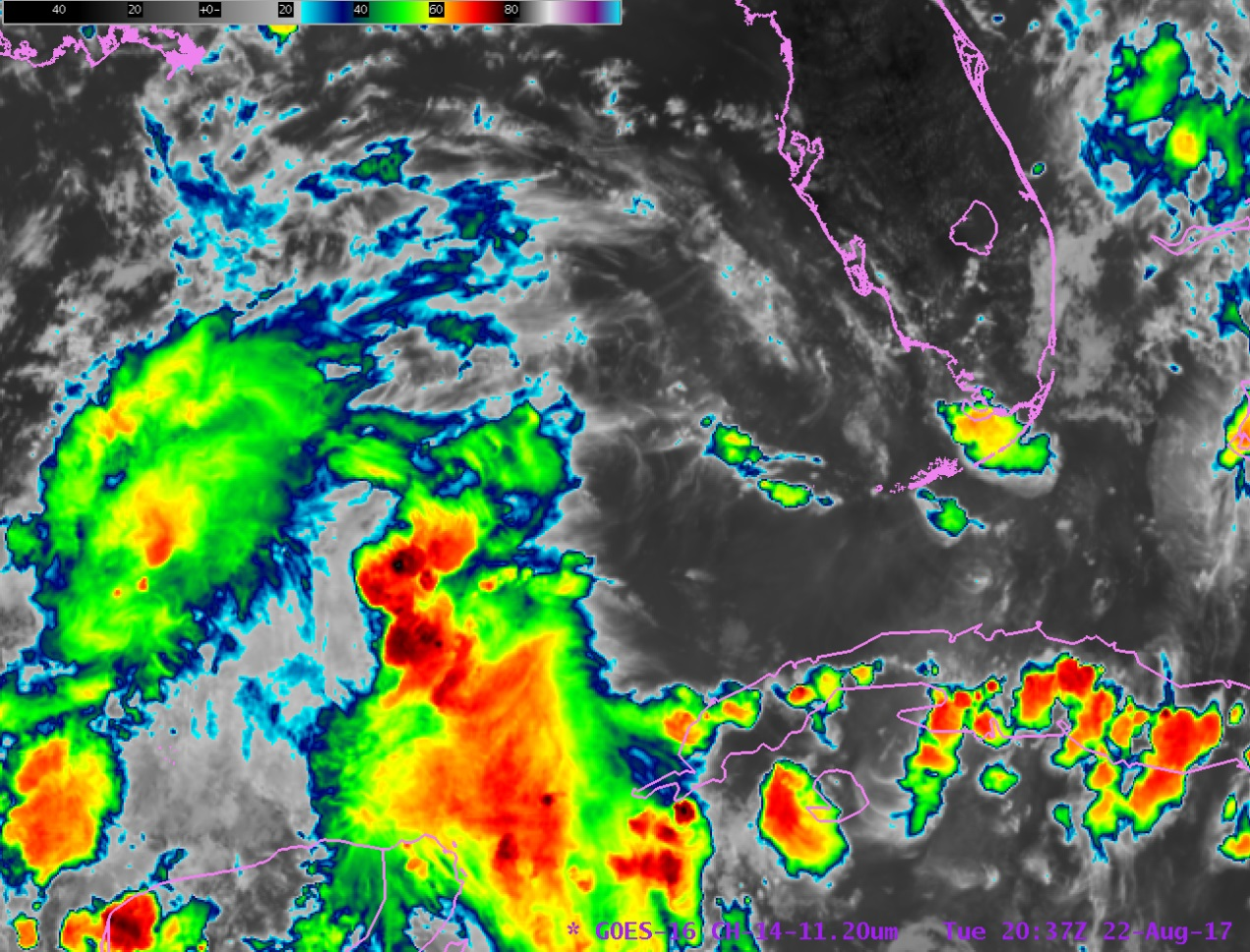
ABI Band 14 (11.2 μm)
IR Longwave Window
Satellite Image Interpretation
2
11.2 μm Brightness Temperatures (BTs) over cold cloud tops, such as overshooting tops, will be very similar to 10.3 μm Clean Window BTs because there is little water vapor above the overshoot to absorb energy.
In clear air over land or water, the 11.2 μm channel BT will be cooler than the clean window BT because of energy absorption by water vapor.
2
1
1
2
2
1
GOES-16 11.2 μm Infrared Imagery, 2027 UTC on 22 August 2017 showing a tropical wave over the southeastern Gulf of Mexico
3
There is more water vapor absorption (designated by the red spikes in the plot at right) in the 12.3 μm band than in the 11.2 μm or 10.3 μm channels. The 10.3 μm channel is the cleanest window – that is, it has the smallest amount of cooling due to water vapor absorption.
Resources
BAMS Article
Schmit et al. 2017
GOES-R.GOV
Band 14 Fact Sheet
Hyperlinks do not work in AWIPS but they do in VLab
10.3 μm
12.3 μm
11.2 μm
Wavelength (μm)

