Slide 1
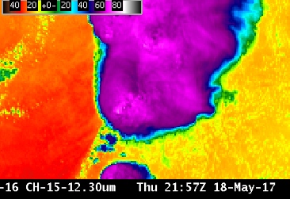
ABI Band 15 (12.3 μm)
Quick Guide
Why is the Dirty Window Band Important?
Absorption and re-emission of water vapor, particularly in the lower troposphere, slightly cools most non-cloud brightness temperatures (BTs) in the 12.3 μm band compared to the other infrared window channels: the more water vapor, the greater the BT difference. The 12.3 μm band and the 10.3 μm are used to compute the ‘split window difference’.
The 10.3 μm “Clean Window” channel is a better choice than the “Dirty Window” (12.3 μm) for the monitoring of simple atmospheric phenomena.
Left: U.S. Standard Atmosphere Earth-emitted temperatures and spectral responses for ABI and GOES-13 Window Channels. The Legacy channel (10.7 μm) covers parts of the 10.3 μm and 11.2 μm bands on ABI (Figure: Mat Gunshor, CIMSS)
10.7 μm
10.3 μm
11.2 μm
12.3 μm
Impact on Operations
Limitations
Primary Application: The Split Window Difference (SWD) (10.3 μm – 12.3 μm) can detect both moisture and dust, so the 12.3 μm channel is part of many Baseline Products, including Clear Sky Mask, Cloud Top Properties, Legacy Atmospheric Profiles, Volcanic Ash and Fire Hot Spot Characterization.
The SWD can distinguish volcanic ash and dust silicates from cloud water and ice. The emissivity of silicates is lower at 10.3 μm than at 12.3 μm, so 10.3 μm BTs are cooler than 12.3 μm BTs for dust and volcanic ash scenes. Airborne dust (including Saharan Air Layers that suppress tropical cyclogenesis) can also be detected by the SWD.
This is a “dirty” window: Water vapor absorbs atmospheric energy at 12.3 μm; that energy is subsequently re-emitted from higher, cooler temperatures. Thus, surface or near-surface BTs will be cooler than observed by near-surface shelter thermometers by an amount that is a function of the amount of moisture in the atmosphere. The amount of absorption (and cooling) is greater at 12.3 μm than at 11.2 μm and 10.3 μm, two other window channels on the ABI.
The 10.3 μm “Clean Window” channel is preferred to the “Dirty Window” (12.3 μm) for the monitoring of simple atmospheric phenomena.
Contributor: Scott Lindstrom, Tim Schmit, Jordan Gerth, UW-Madison CIMSS/NOAA August 2017

Slide 2
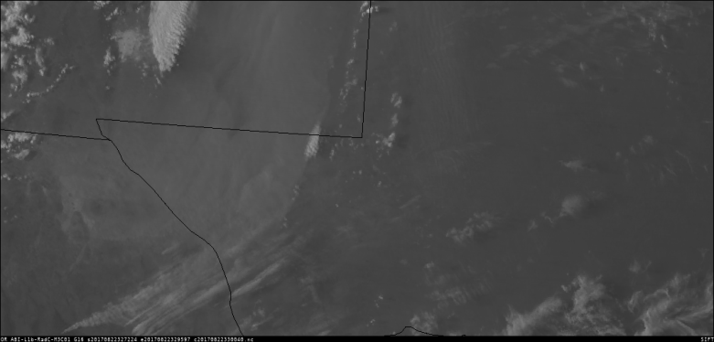
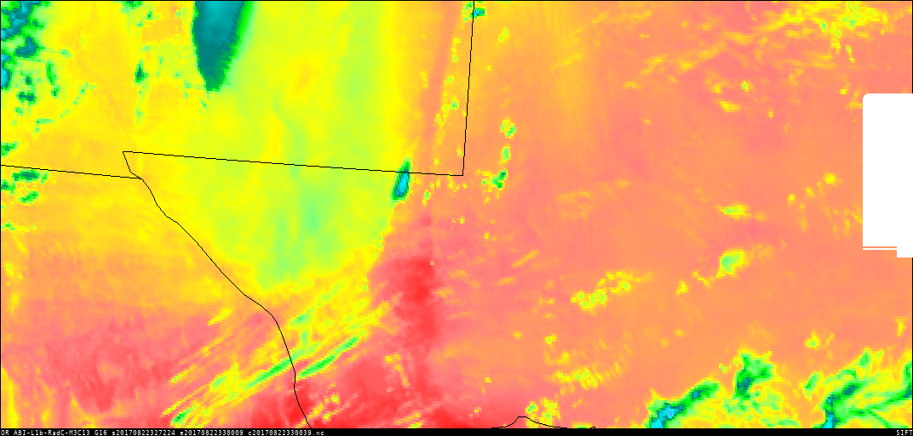
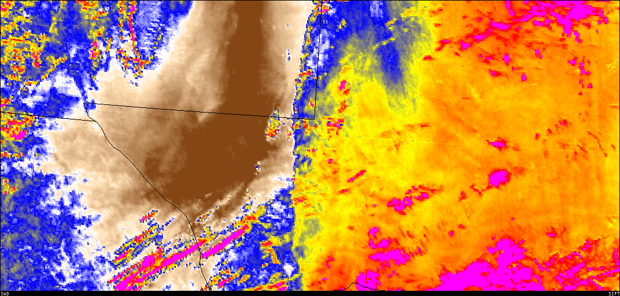
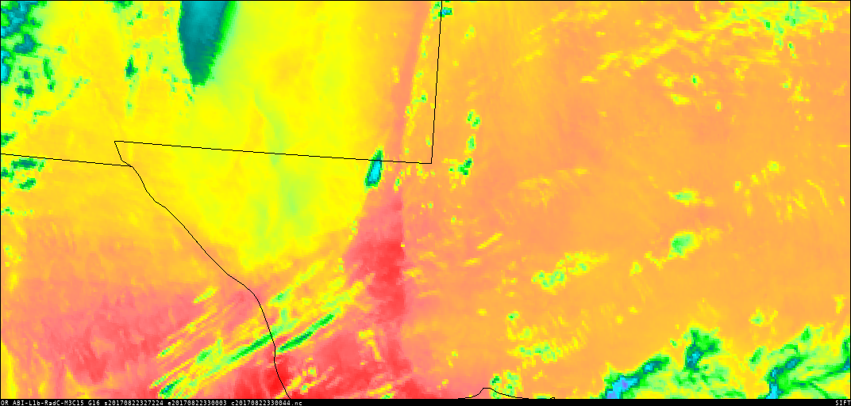
ABI Band 15 (12.3 μm)
Dirty Window
Satellite Image Interpretation
Over Big Bend Country, the 12.3 μm image is warmer (mostly yellow, a little green in the enhancement) than the 10.3 μm (and the Split Window Difference is negative) because of the blowing dust that is present.
Over the more humid High Plains of west Texas, the 12.3 μm image is colder (pink in the enhancement) than the 10.3 μm because of absorption by water vapor and the Split Window Difference is positive.
2
1
1
0.47 μm
Split Window Difference
1
2
1
2
10.3 μm
-7
0
+7
2
2
1
12.3 μm
GOES-16 Imagery, 2327 UTC on 23 March 2017: Visible (0.47 μm), top left; Clean Window (10.3 μm), middle left; Dirty Window (12.3 μm), bottom left; Split Window Difference (10.3 μm – 12.3 μm), middle right, color enhancement of -7 º C to +7 º C
There is more water vapor absorption in the 12.3 μm band than in the 11.2 μm or 10.3 μm channels. In the plot at right, absorption by gases as a function of wavelength is shown by the spiky red line representing the perceived temperature based on Earth-emitted radiance (cooler values at towards the top). The 10.3 μm channel is the cleanest longwave window: it has the smallest amount of cooling due to water vapor absorption.
Resources
BAMS Article
Schmit et al. 2017
GOES-R.GOV
Band 15 Fact Sheet
RAMMB Loop of Dust RGB over Texas on 23 March 2017
Hyperlinks do not work in AWIPS but they do in VLab
10.3 μm
11.2 μm
12.3 μm

