Slide 1
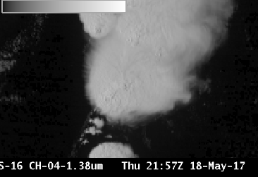
ABI Band 4 (1.37 μm)
Quick Guide
Why is the Cirrus Band Important?
The Cirrus Band (1.37 μm) is unique among the reflective bands on the ABI in that it occupies a region of very strong absorption by water vapor in the electromagnetic spectrum. It will detect very thin cirrus clouds during the day. In the image at right of a Supercell thunderstorm over Oklahoma, low-level cumulus clouds east of the system are only faintly visible because energy at 1.37 μm has been absorbed as it moves through the moist atmosphere.
ABI Channels in the near Infrared
ABI Band | Central Wavelength (µm) | Band Nickname | Type | Resolution
4 | 1.37 µm | Cirrus | Near-Infrared | 2 km
5 | 1.61 µm | Snow/Ice | Near-Infrared | 1km
6 | 2.24 µm | Cloud phase | Near-Infrared | 2 km
Impact on Operations
Limitations
Primary Application: This channel detects high clouds during the day time. Very thin cirrus can be discerned.
0.64 μm
Daytime only application: The 1.37 µm band detects reflected visible solar radiation.
1.38 μm
Application: In a dry atmosphere, this band will detect highly reflective features, such as dust, or clouds, if there is limited water vapor above those features.
Application: The Cirrus Channel is an important part of the Daytime Cloud Mask computation because of its ability at detecting very thin cirrus.
Limitation: Theory suggests that about 12 mm of Total Precipitable Water is sufficient to absorb most of the solar radiation at 1.37 µm. Variable amounts of moisture in the atmosphere (and where in the vertical that moisture exists) influence how far down the satellite can see at this wavelength.
The Cirrus Channel is one of two near-infrared channels on ABI with 2-km resolution.
Contributors: Scott Lindstrom, Tim Schmit, Jordan Gerth, UW-Madison CIMSS/NOAA August 2017

Slide 2
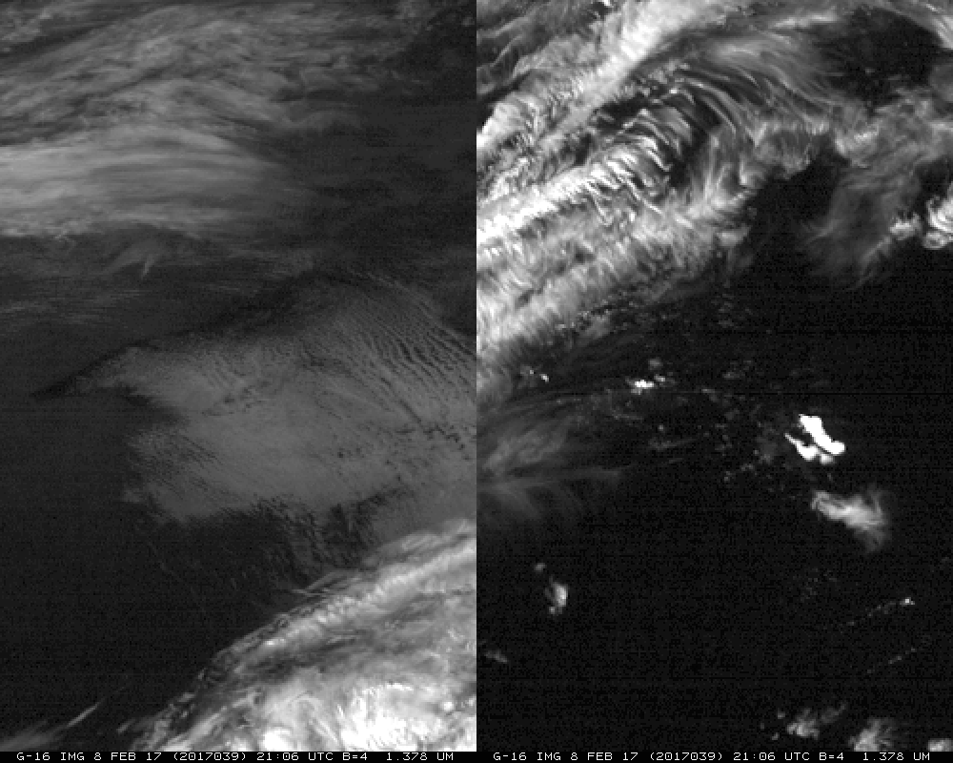
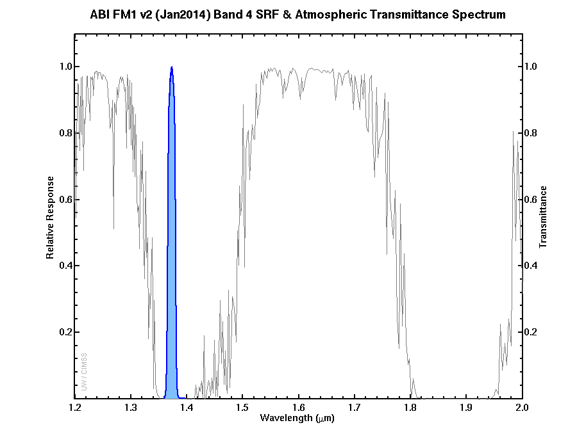
ABI Band 4 (1.37 μm)
Cirrus Band
Image Interpretation
Thin cirrus easily detectable
Thick cirrus shows up easily
Low Clouds are not detected in a moist atmosphere
Low clouds visible in dry atmosphere
Coastlines visible in dry air
1
2
2
3
5
4
Dry, cold Airmass
over Midwest
5
4
1
3
Moist Airmass
over Southeast
GOES-16 ‘Cirrus Channel’ (1.37 μm) at 21:06 UTC, 08 February 2017
The Spectral Response Function for the Cirrus Channel is shown in blue at left. The grey line shows transmittance through the atmosphere. The Cirrus Channel is in a region where strong absorption (by water vapor) occurs. (Figure courtesy Mat Gunshor, CIMSS)
Resources
BAMS Article
Schmit et al. 2017
GOES-R.GOV
Band 4 Fact Sheet
Hyperlinks do not work in AWIPS but they do in VLab

