Slide 1
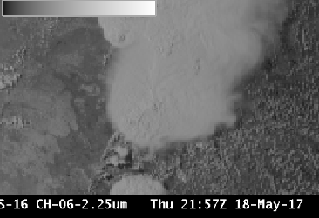
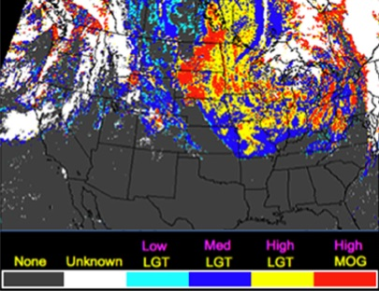
ABI Band 6 (2.24 μm)
Quick Guide
Why is the Cloud Particle Size Band Important?
The 2.24 μm band, in conjunction with other bands, enables cloud particle size estimation. Cloud particle size changes can indicate cloud development. The 2.24 μm band is also used with other bands to estimate aerosol particle size (by characterizing the aerosol-free background over land), to create cloud masking and to detect hot spots.
ABI Snow/Ice and Cloud Particle Size bands
ABI Band | Central Wavelength (µm) | Band Nickname | Phenomena/Brightness | Resolution
5 | 1.61 µm | Snow/Ice | Water Clouds : Bright | 1 km
 |  |  | Snow/Ice/Cirrus : Dark
6 | 2.24 µm | Cloud Particle Size | Small Particles : Bright | 2 km
 |  |  | Large Particles : Dark
Impact on Operations
Limitations
Primary Application: This band is used as input into derived products such as Cloud Mask, Aerosol Optical Depth and Cloud Phase. Cloud phase as shown in the figure can be used to predict icing threat
Daytime application: The 2.24 µm band detects reflected visible solar radiation.
Nighttime application: The default enhancement in AWIPS must be changed to show hot fires at night; care must be taken to monitor clouds: cloud motion or development can block the view of the fire.
Application: Hot fires emit radiation with a wavelength of 2.24 µm. GOES-16 can detect that emitted energy in the absence of clouds. This band is used as a component in some fire detection RGBs.
Application: Cloud Particle Size discrimination is a key use of this band.
Resolution: The 2.24 µm channel exhibits less liquid water-ice contrast than the 1.61 µm channel, and it has poorer spatial resolution as well. For many daytime uses, the 1.61 µm channel is a better choice.
Contributors: Scott Lindstrom, Tim Schmit, Jordan Gerth, UW-Madison CIMSS/NOAA August 2017

Slide 2
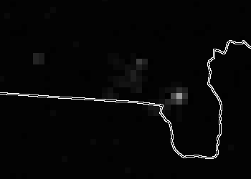
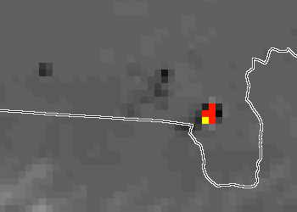
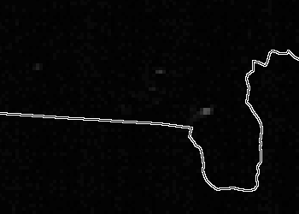
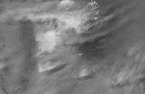
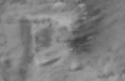
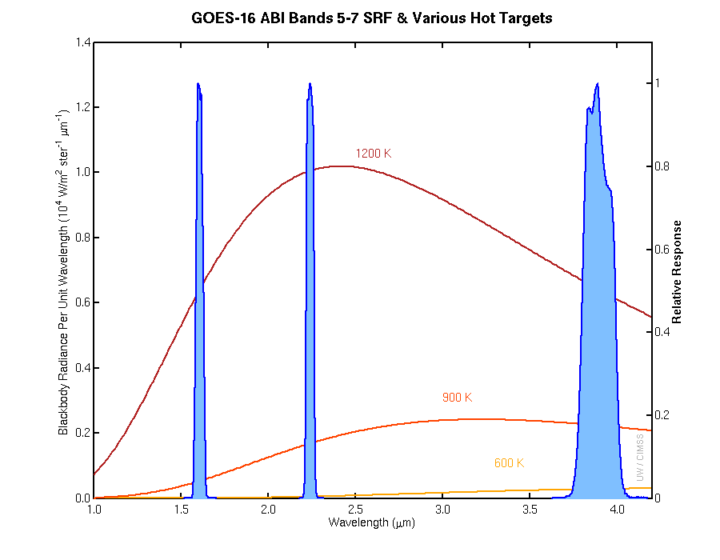
ABI Band 6 (2.24 μm)
Cloud Particle Size
Image Interpretation
Hot fires emit 2.24 µm radiation that shows up well against the black background of night
Fire not as distinct at 1.61 µm
Color-Enhanced 3.9 µm shows pixel temperatures as hot as 370 K
1
2
1
2.24 μm
3
3
5
3.9 μm
4
0.64 μm
2
5
1.61 μm
4
1.61 μm
GOES-16 ‘Cloud Particle Size Channel’ (2.24 μm) (Upper Left) and ‘Snow/Ice Channel’ (1.61 μm) (Lower Left) and, at 00:37 UTC, 26 April 2017 showing night-time fire emissions. At right: 3.9 μm for the same time, color-enhanced to show Fire Hot Spots.
5
Resources
BAMS Article
Schmit et al. 2017
GOES-R.GOV
Band 6 Fact Sheet
Aircraft Icing Threat Product
4
1200 K
2.24 μm
White Sands National Monument in New Mexico, circled above near the , shows different reflectance at 0.64, 1.61 and 2.24 μm because of the soil type; cirrus clouds northeast of White Sands (near the ) also show different reflectances.
4
1.61 μm
2.24 μm
3.9 μm
900 K
5
600 K
Spectral Response Functions for three GOES-16 channels; Very hot fires emit more energy at shorter wavelengths and the Cloud Particle Size band can detect that energy. Figure from Mat Gunshor, CIMSS.

