Slide 1
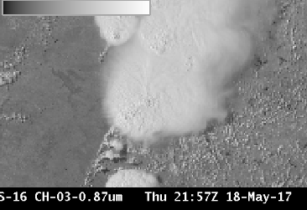
ABI Band 3 (0.86 μm)
Quick Guide
Why is the “Veggie” band Important?
The 0.86 μm band (a reflective band) detects daytime clouds, fog, and aerosols and is used to compute the normalized difference vegetation index (NDVI). Its nickname is the “veggie” or “vegetation” band. The 0.86 μm band can detect burn scars and thereby show land characteristics to determine fire and run-off potential. Vegetated land, in general, shows up brighter in this band than in visible bands. Land-water contrast is also large in this band. This band is essential to simulate a “green” band needed for a true color image from the ABI.
ABI Channels with strong land/water contrast
ABI Band | Central Wavelength (µm) | Band Nickname | Type | Pixel Resolution at sub-satellite point
3 | 0.86 | Vegetation/Veggie | Near-Infrared | 1 km
4 | 1.37 | Cirrus | Near-Infrared | 2 km
5 | 1.61 | Snow/Ice | Near-Infrared | 1 km
6 | 2.24 | Cloud Phase | Near-Infrared | 2 km
Impact on Operations
Limitations
Primary Application: The Veggie band can detect burn scars, allowing for early identification of potential run-off issues.
Daytime only application: The “Veggie” Band detects reflected solar energy and is therefore a daytime only band
Burn Scars
Lake
Application: Land is more reflective at 0.86 than in the visible bands, so the Vegetation band is very useful for detecting islands, lakes, flooded regions and land/sea boundaries.
Application: The Vegetation band is used in the simulation of the “Green” band for simulated true color imagery.
Limitation: The Veggie band can be used as a stand-in for the “Green” band (for example, 0.51 µm from Himawari-8’s AHI) in RGB composites, but reflectance over vegetation at 0.86 µm is much greater than for Green Light and that must be accounted for. An example of this True Color imagery is shown on the next page.
Contributors: Scott Lindstrom, Tim Schmit, Jordan Gerth, UW-Madison CIMSS/NOAA May 2017

Slide 2
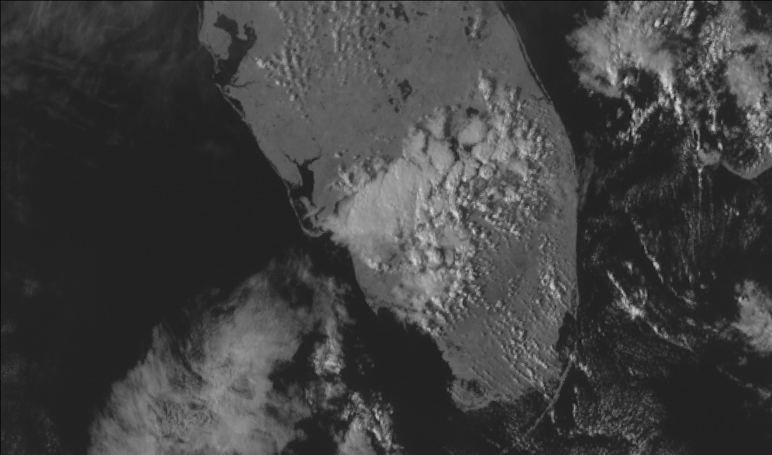
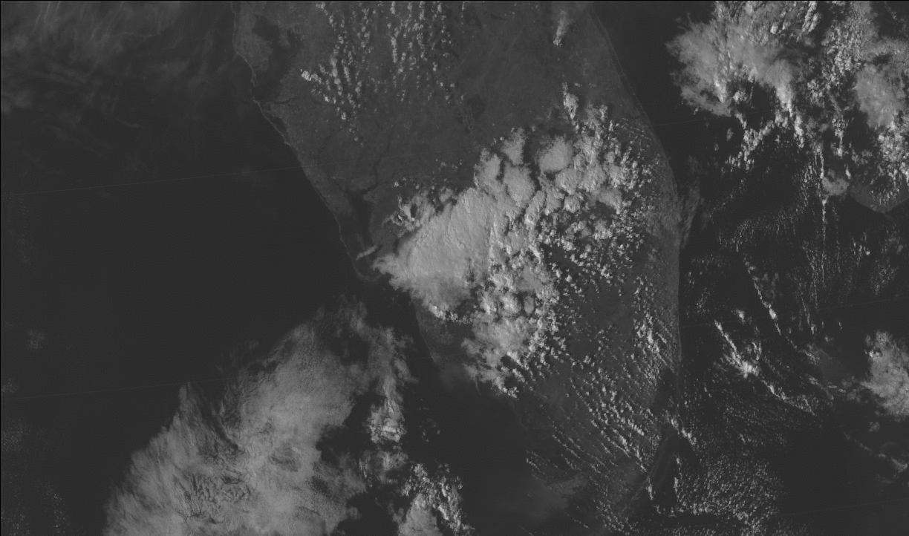
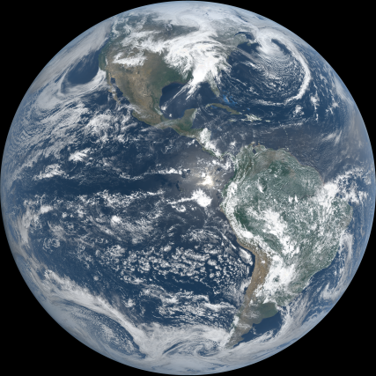
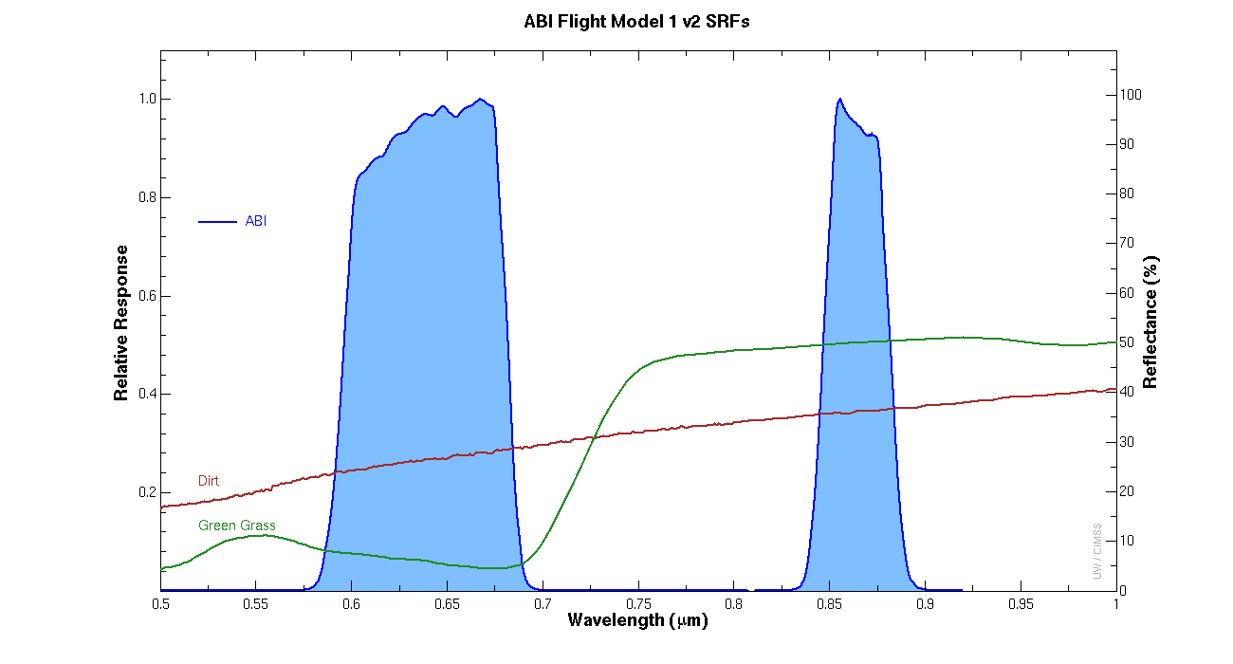
ABI Band 3 (0.86 μm)
Vegetation Band
Image Interpretation
Land-water contrast is high: coastlines stand out
Cloud-Water contrast means clouds are distinct over water
Clouds over land are less distinct because land and clouds are both reflective in the 0.86 μm imagery
The Vegetation band is vital for the creation of True Color Imagery, below
1
2
3
3
2
1
Veggie band 0.86 μm (Inset: Red Visible, 0.64 μm) from GOES-16 ABI at 2111 UTC, 01 March 2017.
Resources
BAMS Article
Schmit et al.(2017).
GOES-R.gov Band 3 Fact Sheet
Hyperlinks do not work in AWIPS but they do in VLab
0.64 µm
0.86 µm
This True Color image, from CIMSS, was made using Blue, Red and Veggie bands. The image was not corrected for Rayleigh Scattering that is present in the Blue band.
Reflectance of grass is much larger at 0.86 μm
Above: ABI red visible and vegetation spectral bands (blue solid shaded area). Reflectance for grass (green) and dirt (red) are also plotted. (Credit: CIMSS and ASTER spectral library and Mat Gunshor)

