Slide 1
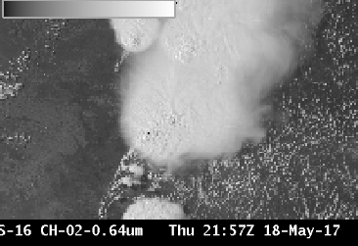
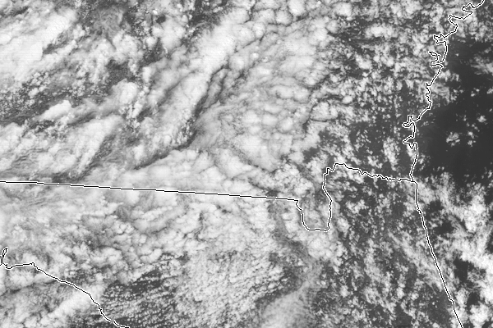
ABI Band 2 (0.64 μm)
Quick Guide
Why is the Red Visible Band Important?
The ‘Red’ Visible band – 0.64 μm – has the finest spatial resolution (0.5 km at the sub-satellite point) of all ABI bands. Thus it is ideal to identify small-scale features such as river fogs and fog/clear air boundaries, or overshooting tops or cumulus clouds. It has also been used to document daytime snow and ice cover, diagnose low-level cloud-drift winds, assist with detection of volcanic ash and analysis of hurricanes and winter storms. The ‘Red’ Visible band is also essential for creation of “true color” imagery.
Comparison of ABI Visible Bands
ABI Band | Central Wavelength (µm) | Band Nickname | Type | Pixel Resolution at sub-satellite point
1 | 0.47 | Blue | Visible | 1 km
2 | 0.64 | Red | Visible | 0.5 km
Benefits to Operations
Limitations
Primary Application: Detection / analysis of clouds and weather systems during daytime. Half-kilometer resolution allows detection of boundaries and small clouds , especially useful in
Daytime-only application: The 0.64 µm band detects reflected visible solar radiation.
Limitation: Very large Data Volume: Excellent spatial resolution in the “Red” band means that the data volume from this one ABI band is comparable to that from all the infrared bands on the ABI.
Limitation: Pixel reflectance in this band can exceed 100% over thick clouds for a large solar zenith angle because of contributions to reflectance from scattering within the cloud.
mesoscale sectors for rapidly changing phenomena. Application: Land absorbs energy at 0.64 µm; at longer near-infrared wavelengths, more energy is reflected. Thus, contrast between land and highly reflective clouds is greater over land in the “Red” Visible than in the “Veggie” or “Snow/Ice” bands.
Application: Input into RGB imagery: The “Red” visible band is used when creating “true color” imagery.
Contributors: Scott Lindstrom, Tim Schmit, Jordan Gerth, UW-Madison/CIMSS May 2017

Slide 2
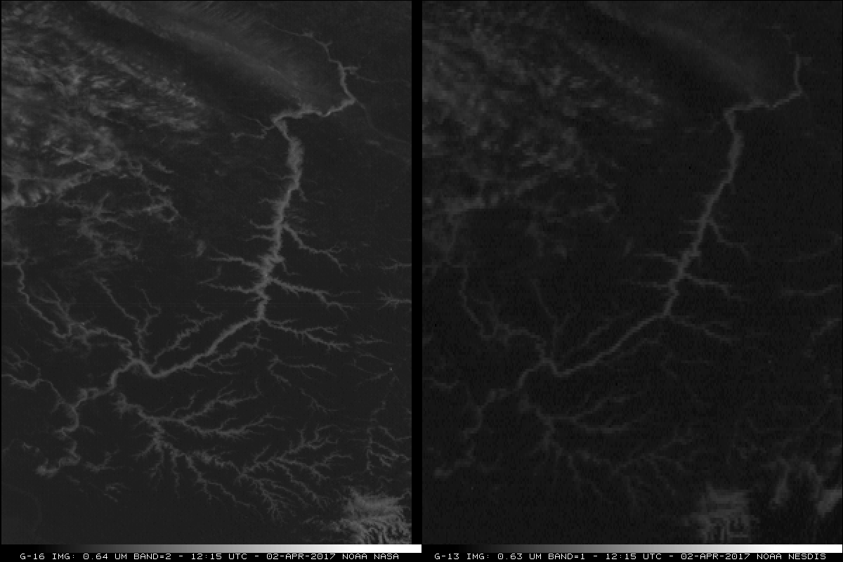
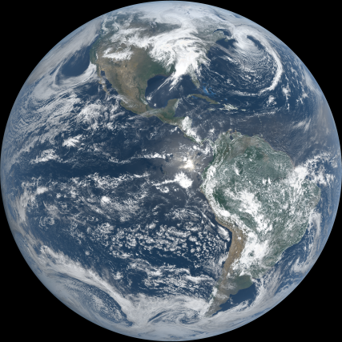
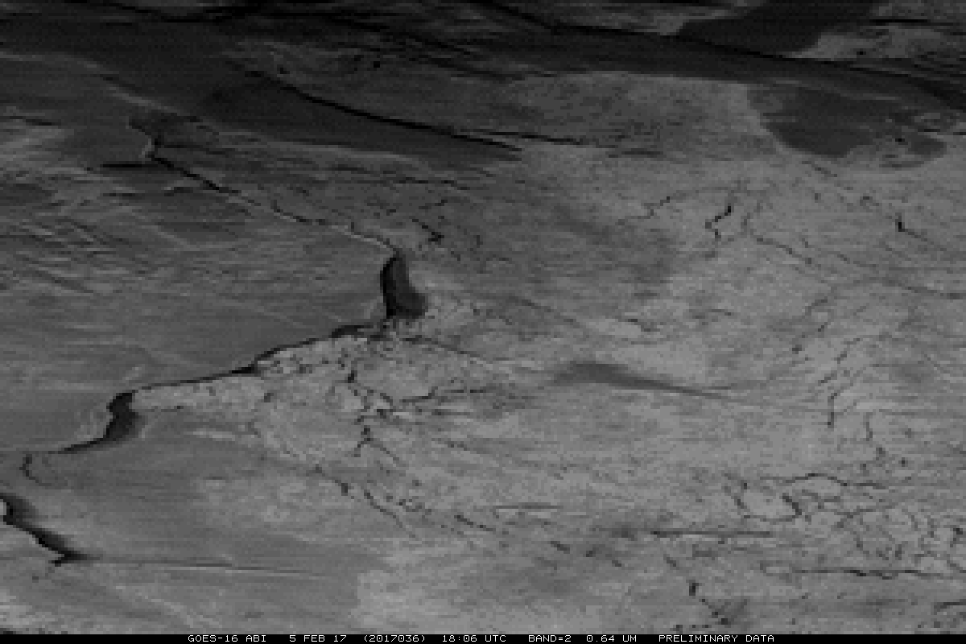
ABI Band 2 (0.64 μm)
Red Band
Band Interpretation
GOES-16 has on-board visible calibration so that bright whites will not fade as the spacecraft ages as has happened with Legacy GOES
Half-kilometer resolution allows identification of small features such as narrow river valleys full of fog and stratus
Land features stand out well because atmospheric scattering is not large at 0.64 μm
1
1
1
2
Cloud-free Land
2
“Red Visible band” (0.64 μm) GOES-16 ABI (Left) and GOES-13 Imager (Right) at 1215 UTC, 02 April 2017.
GOES-16’s Red band has excellent resolution to enable identification of small features at High Latitudes, such as ice leads in Hudson Bay near 66 N Latitude, below
Resources
BAMS Paper Schmit et al.(2017).
Wx and Forecasting
Line et al. (2016).
GOES-R.gov Band 2 Fact Sheet
Hyperlinks do not work in AWIPS but they work in VLab
The “natural” True Color image above, from CIMSS, was created using Blue, Red and “Veggie” bands. This was not corrected for the Rayleigh Scattering that is present in the Blue band.

