Slide 1
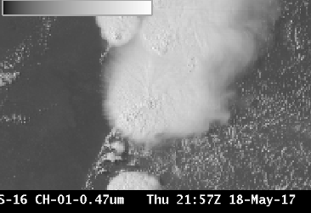
ABI Band 1 (0.47 μm)
Quick Guide
Why is Blue Visible Band Imagery Important?
The 0.47 µm, or “Blue” visible band, is one of two visible bands on the ABI, and provides data for monitoring aerosols. Included on NASA’s MODIS and Suomi NPP VIIRS instruments, this band provides well-established benefits. The geostationary ABI 0.47 µm band will provide nearly continuous daytime observations of dust, haze, smoke and clouds. The 0.47 µm band is more sensitive to aerosols / dust / smoke because it samples a part of the electromagnetic spectrum where clear-sky atmospheric scattering is important.
Comparison of ABI Visible Bands
ABI Band | Central Wavelength (µm) | Band Nickname | Type | Pixel Resolution at sub-satellite point
1 | 0.47 | Blue | Visible | 1 km
2 | 0.64 | Red | Visible | 0.5 km
Impact on Operations
Limitations
Primary Application Smoke and Aerosol: Highlight regions where visibility is reduced because of particulate matter. Faint smoke plumes at right are not visible in the “Red” band.
Daytime Only: The 0.47 µm band detects reflected visible solar radiation.
Smoke Plumes
Scattering Angle Affects Dust/Smoke Signal: Smoke and dust are more effective forward scatterers than backward scatterers. Thus, the smoke and dust signals will be much more apparent when the Sun is low in the sky vs. high in the sky.
Input into Baseline Products: The 0.47 µm Blue band is a key component of the GOES-R Baseline Aerosol Products and Baseline Snow Products.
Input into RGB imagery: The Blue band, combined with a “Green” band simulated from the “Vegetation” band (0.86 µm) and the “Red” band (0.64 µm), will provide “natural color” imagery of the Earth.
Scattering and the Blue Sky: Clear-sky Rayleigh Scattering is greater in the “Blue” Visible band part of the electromagnetic spectrum than in the “Red” Visible band part. This Rayleigh scattering causes the sky on Earth to be blue.
Contributors: Scott Lindstrom, Tim Schmit, Jordan Gerth UW-Madison/CIMSS August 2017

Slide 2
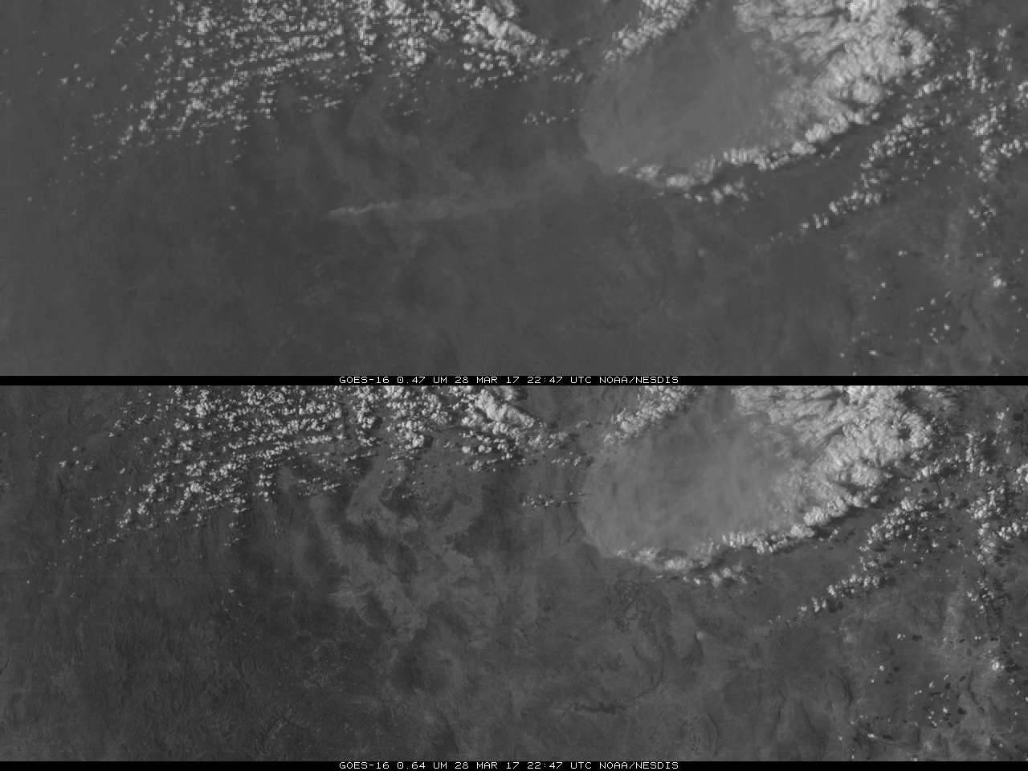
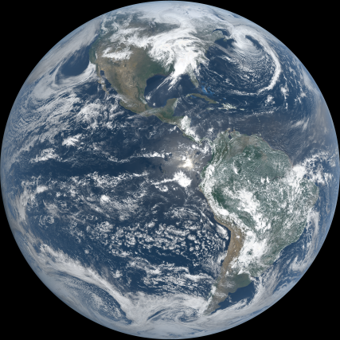
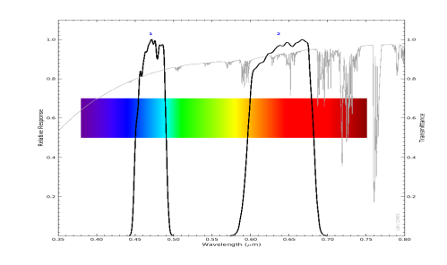
ABI Band 1 (0.47 μm)
Blue Band
Image Interpretation
Smoke is very apparent in the Blue band, but not in the Red
Thick dust is apparent in both bands
Surface Features show more distinctly in the Red band because of better spatial resolution in the Red and enhanced Rayleigh scattering in the Blue band
Clouds look similar in both Blue and Red bands.
Mexico
4
1
1
2
2
3
3
0.47 μm
Mexico
4
1
2
4
3
0.64 μm
Blue Band (0.47 μm, top) and Red Band (0.64 μm, bottom) at 22:47 UTC on 28 March 2017
Resources
BAMS Papers Schmit et al.(2017).
Miller et al. (2016).
GOES-R.gov Band 1 Fact Sheet
GOES-R Aerosol Products
These links do not work in AWIPS but they do in VLab
The “natural” True Color image above, from CIMSS, was created using Blue, Red and Veggie bands. This image was not corrected for the Rayleigh Scattering that is present in the “Blue” band.
Above: ABI visible spectral bands (black solid lines) and atmospheric transmittance (grey line). There is decreased transmittance (increased scattering) at shorter wavelengths. (Credit: CIMSS and ASTER spectral library and Mat Gunshor)

