Slide 1
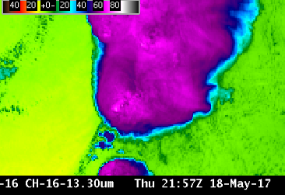
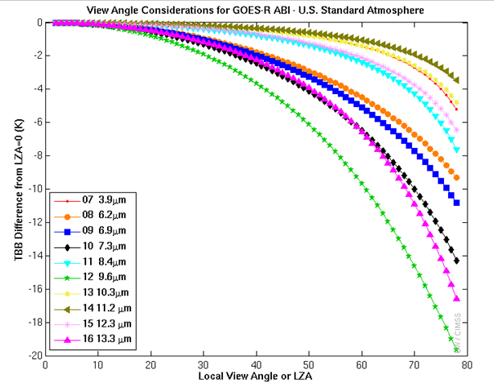
ABI Band 16 (13.3 μm)
Quick Guide
Why is the CO₂ Band Important?
Products derived using the infrared 13.3 μm “Carbon Dioxide” band can be used to delineate the tropopause, to estimate cloud-top heights, to discern the level of Derived Motion Winds, to supplement Automated Surface Observing System (ASOS) sky observations and to identify Volcanic Ash. The 13.3 μm band is vital for Baseline Products; that is demonstrated by its presence on heritage GOES Imagers and Sounders. Despite its importance in products, the CO₂ channel is typically not used for visual interpretation of weather events.
Impact on Operations
Limitations
Primary Application: The 13.3 μm band on the ABI is used in many GOES-16 Baseline Products. These products include cloud mask, cloud-top height, pressure, and temperature. This band is an input to the legacy moisture and temperature profiles, and hence is used for the products derived from the profiles, such as total precipitable water and stability indices. This band is also used in the quantitative volcanic ash detection and height algorithm
Because the CO₂ band has a muted view of surface features, it can be used to create RGBs that highlight features at upper levels.
This is a “dirty” window: Cooling in this band is associated with the ubiquitous nature of carbon dioxide (CO₂) in the atmosphere. That cooling is especially noticeable near the limb, moreso than almost any other ABI channel (see below). Earth’s surface is apparent in clear skies, but strong cooling from CO₂ means 13.3 μm brightness temperatures are much cooler than in other window channels at the limb.
The figure at right shows cooling as a function of zenith angle for clear skies. Cooling effects are strongest for the Ozone Band (9.6 μm, green stars), just a bit stronger than those for the CO₂ band (13.3 μm, magenta triangles)
Contributor: Scott Lindstrom, Tim Schmit, Jordan Gerth, UW-Madison CIMSS/NOAA September 2017

Slide 2
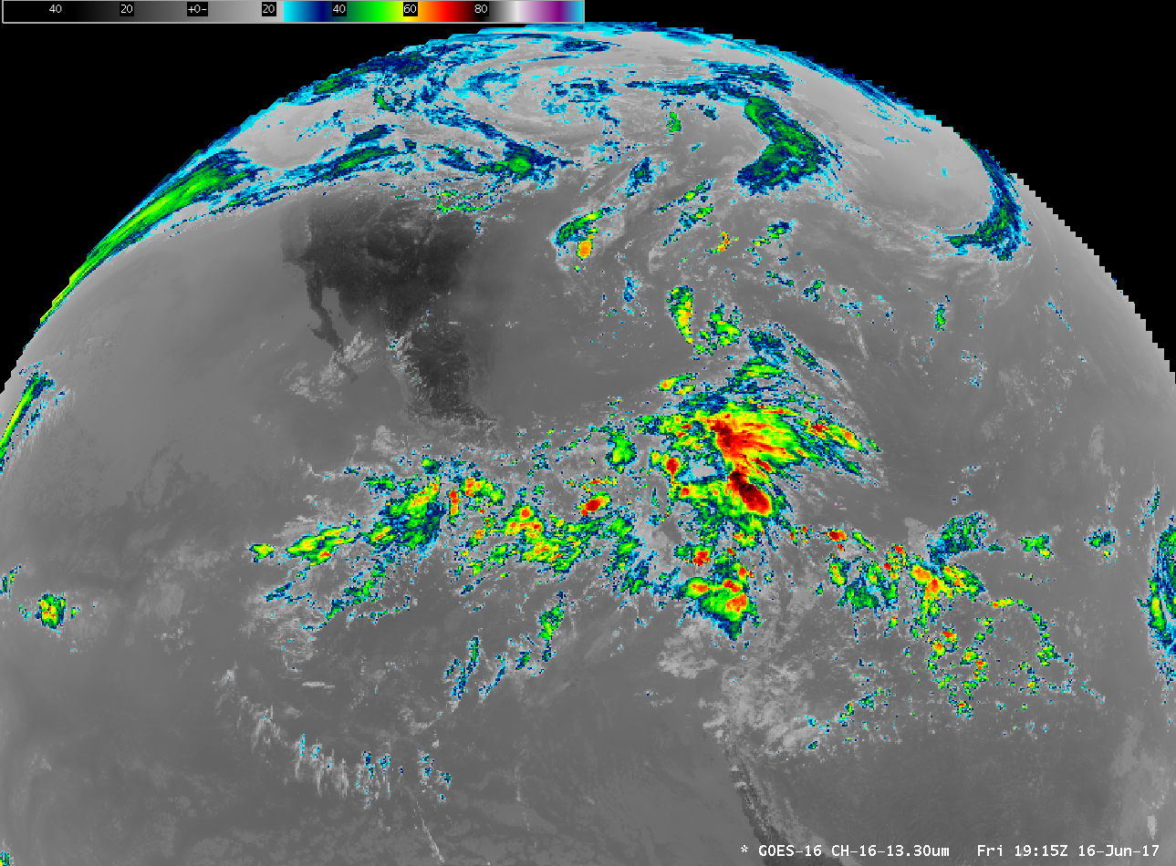
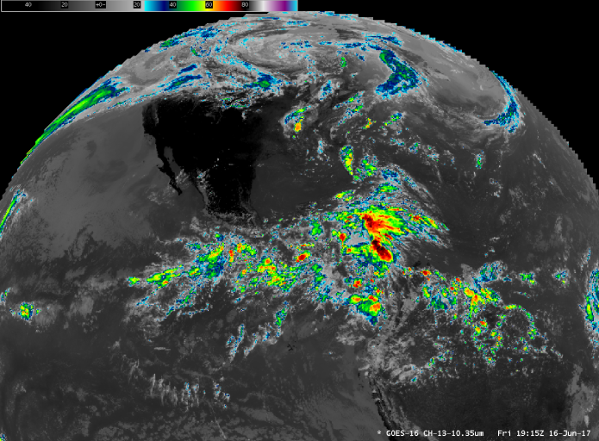
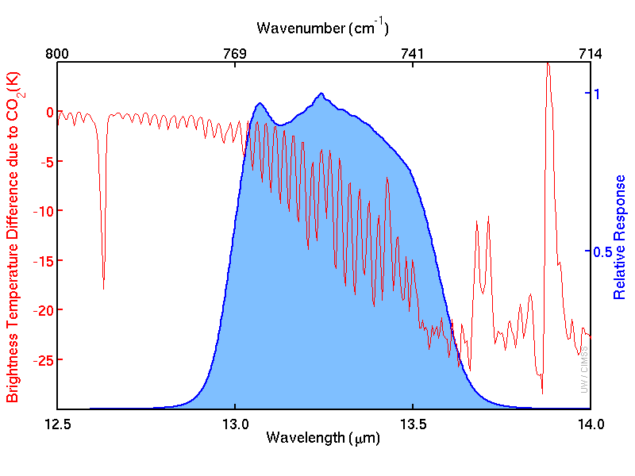
ABI Band 16 (13.3 μm)
CO₂ Band
Satellite Image Interpretation
The CO₂ channel is a window channel, meaning surface features can be apparent in clear air. Features over the ocean can also be apparent.
However, Brightness Temperatures in clear air from the CO₂ channel are uniformly cooler than temperatures in the window channel (10.3 μm) because of cooling due to absorption (and re-emission) of atmospheric energy with a wavelength of 13.3 μm by CO₂ molecules.
1
1
2
2
1
2
10.3 μm
13.3 μm
GOES-16 13.3 μm (CO₂), 16 June 2017 at 1915 UTC. Inset: 10.3 μm imagery for the same time
Resources
BAMS Article
Schmit et al. 2017
GOES-R.GOV
Band 16 Fact Sheet
Hyperlinks do not work in AWIPS but they do in VLab
The spectral response function for the 13.3 μm CO₂ channel, in blue at right, occupies the “shoulder” of a CO₂ absorption band between 13 μm and 14 μm. The cooling effect of CO₂ absorption is shown with the red line.
3

