Slide 1
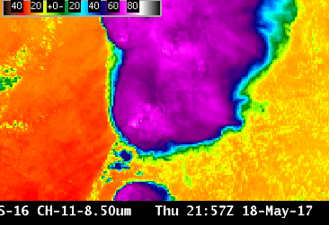
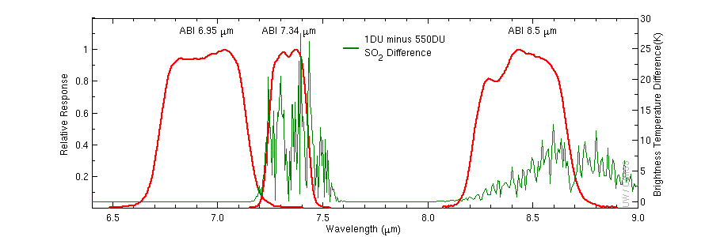
ABI Band 11 (8.5 μm)
Quick Guide
Why is the Infrared Cloud Phase Band Important?
The infrared 8.5 μm band is a window channel; there is little atmospheric absorption of energy in clear skies at this wavelength (unless SO₂ from a volcanic eruption is present). However, knowledge of emissivity is important in the interpretation of this Band: Differences in surface emissivity at 8.5 μm occur over different soil types, affecting the perceived brightness temperature. Water droplets also have different emissivity properties for 8.5 μm radiation compared to other wavelengths. The 8.5 μm band was not available on either the Legacy GOES Imager or GOES Sounder.
The figure at right shows Spectral Response Functions in red for 3 ABI Channels and the large effect of SO₂ on the detected temperature (green line) at 7.3 μm (where there is also water vapor absorption) and at 8.5 μm. Both channels are thus useful for detecting volcanic ash.
6.9 μm
7.3 μm
8.5 μm
Impact on Operations
Limitations
Primary Application: This is an important channel to monitor volcanic activity; also cloud Phase can be determined using the brightness temperature difference between the 8.5 μm and 11.2 μm Window Channels that is driven by emissivity differences.
This is a “dirty” window: There is more water vapor absorption in this 8.5 μm channel than in the Clean Window Channel at 10.3 μm. Brightness Temperatures will be modulated by water vapor. For most purposes in tracking meteorological features, it makes more sense to use the cleaner 10.3 μm window channel.
Contributor: Scott Lindstrom, Tim Schmit, Jordan Gerth, UW-Madison CIMSS/NOAA May 2017

Slide 2
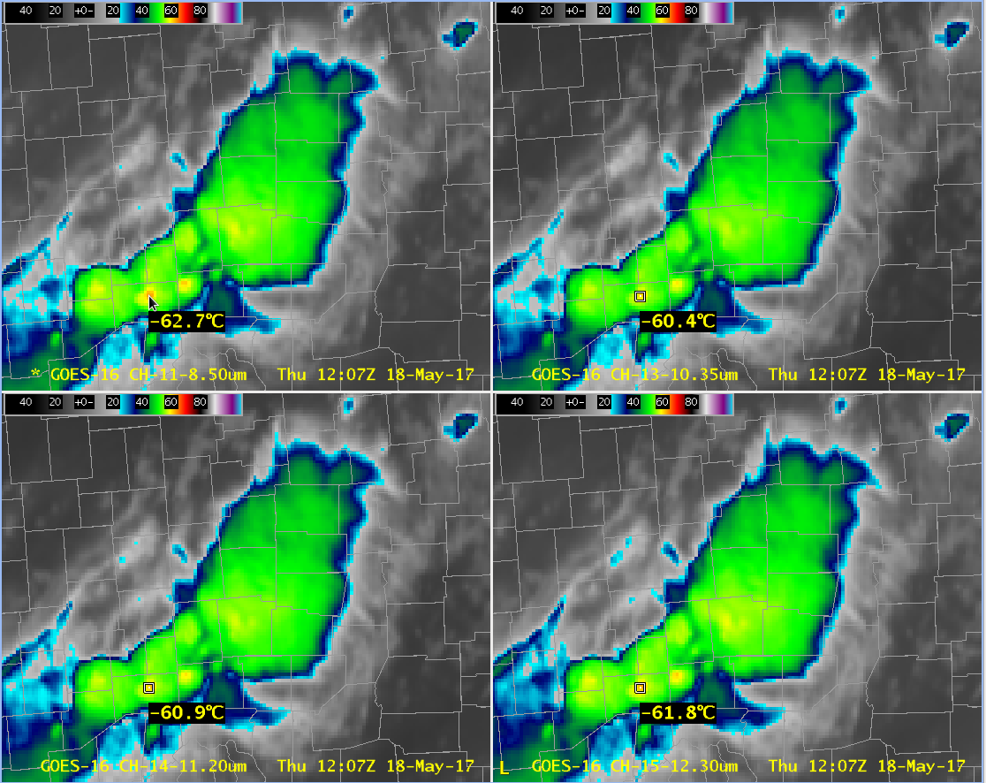
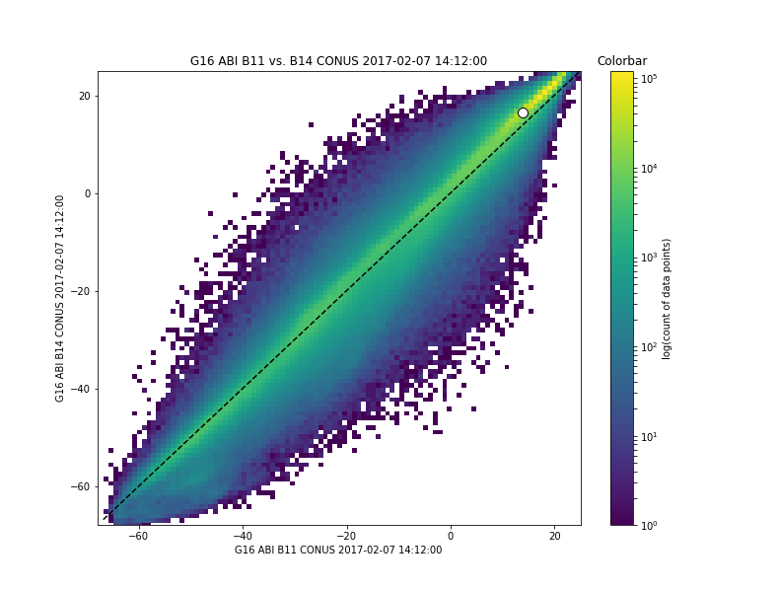
ABI Band 11 (8.5 μm)
IR Cloud Phase
Satellite Image Interpretation
In the 4-panel at right with all four window channels displays, note how the cold overshoot has a different brightness temperature in each band – this is important if you use a threshold temperature for any purpose.
Thin Cirrus also shows different brightness temperatures because the cold part of the pixel is better detected by longer wavelengths
2
2
1
1
1
2
2
1
1
2
GOES-16 Window Channels, 18 May 2017 at 1207 UTC. Upper Left: 8.5 μm ; Upper Right: 10.3 μm ; Lower Left: 11.2 μm ; Lower Right 12.3 μm
8.5 μm vs. 11.2 μm Brightness Temperature
for one CONUS scene using ABI data
There is a wide spread in the scatterplot at right of 8.5 μm (x-axis) vs. 11.2 μm (y-axis) brightness temperatures over the entire CONUS. Brightness temperature difference between these two channels are a function of emissivity differences, absorption of energy by water vapor, and cloud thickness, and it is a useful indicator of cloud top phase. Different regions of the scatterplot are associated with different cloud types.
Resources
BAMS Article
Schmit et al. 2017
GOES-R.GOV
Band 11 Fact Sheet
COMET MetEd Training on ABI Band 11
Hyperlinks do not work in AWIPS but they do in VLab
3
11.2 μm Brightness Temperature
8.5 μm Brightness Temperature

