Slide 1
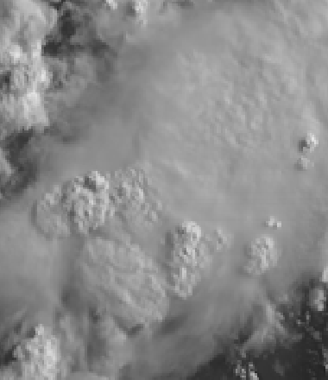
AHI Band 2 (0.51 μm)
Quick Guide
Why is Green Visible Band Imagery Important?
The 0.51 µm, or “Green” visible band, is one of three visible bands on the AHI aboard Himawari-8 and Himawari-9. It provides data for monitoring cloud development as well as dust, smoke and haze. It allows for an easy creation of RGB True Color imagery when combined with the “Blue” (0.47 µm) and “Red” (0.64 µm) bands.
Comparison of AHI Visible Bands
AHI Band | Central Wavelength (µm) | Band Nickname | Type | Pixel Resolution at sub-satellite point
1 | 0.47 | Blue | Visible | 1 km
2 | 0.51 | Green | Visible | 1 km
3 | 0.64 | Red | Visible | 0.5 km
Impact on Operations
Limitations
Primary Application: Visible Imagery detection / analysis of clouds and weather systems during daytime.
Daytime only application: The 0.51 µm band detects reflected visible solar radiation.
Input into Products: The 0.51 µm Green band can be helpful in Aerosol detection because of increased scattering at that wavelength relative to 0.64 µm.
Input into RGB imagery: The Green band, ‘boosted’ with information from the “Vegetation” band (0.86 µm), combines with information from the and the “Red” band (0.64 µm) and “Blue” band (0.47 µm) to provide “natural color” imagery of the Earth.
Scattering angle affects dust/smoke/cirrus signals: Smoke, dust and cirrus are more effective forward scatterers than backward scatterers. Thus, the smoke, dust and cirrus signals will be much more apparent when the Sun is low in the sky vs. high in the sky. (This is true for the Blue and Red Visible bands as well.)
Contributors: Scott Lindstrom, Tim Schmit, Jordan Gerth UW-Madison/CIMSS June 2017

Slide 2
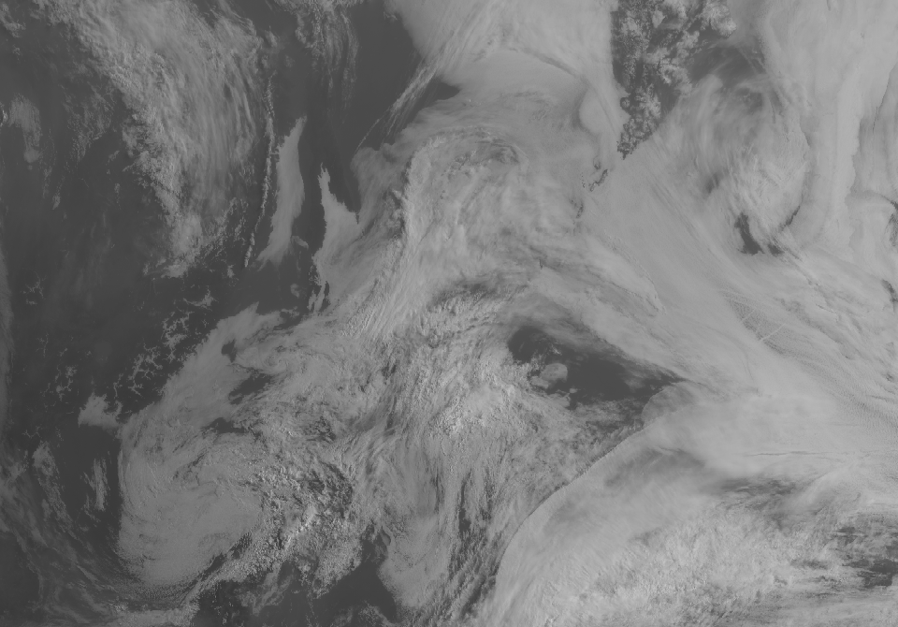
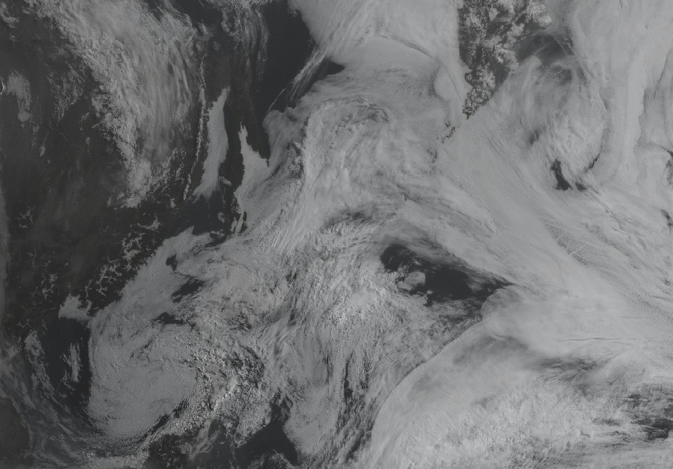
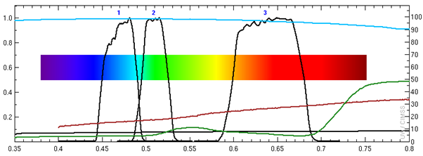
AHI Band 2 (0.51 μm)
Green Band
Image Interpretation
Effects of atmospheric scattering increase as the wavelength shortens from 0.64 (Red Band) to 0.51 (Green Band) to 0.47 (Red Band).
In general, the better spatial resolution in the Red Band makes it an obvious choice for monitoring features in the visible. Smoke and aerosols will be more apparent in the Blue Band.
The Green Band is important for aerosol product generation and for RGB products
Mexico
4
1
2
0.47 μm
3
0.47 μm
0.51 μm
Mexico
4
1
2
0.64 μm
3
Blue Band (0.47 μm, top), Green Band (0.51 μm, middle) and
Red Band (0.64 μm, bottom) at 22:47 UTC on 15 June 2017
Resources
BAMS Papers Schmit et al.(2017).
GOES-R.gov AHI Band 2 Fact Sheet
Hyperlinks do not work in AWIPS but they do in VLab
Above: AHI visible spectral bands (black solid lines) and reflectance properties of snow (cyan line), dirt (red line), grass (green line) and asphalt (black line). A significant portion of the visible spectrum (green and yellow) is not sensed by AHI.(Credit: CIMSS and ASTER spectral library and Mat Gunshor)

